Slide 1
Servo1
(base)
Servo2
(elbow1)
Servo3
(elbow2)
Servo4
(top)
Servo5
(wrist)
Servo6
(claw)
O2
O1
MICROPROCESSOR
O6
O5
O4
O3
I5
I4
I4
I3
I2
I1
Joystick
R(front, back)
Accelerometer 2
R(front, back)
Accelerometer 2
R(front, back)
Accelerometer 1
R(up, down)
Accelerometer 1
R(left ,right)
Flex 1

Slide 2
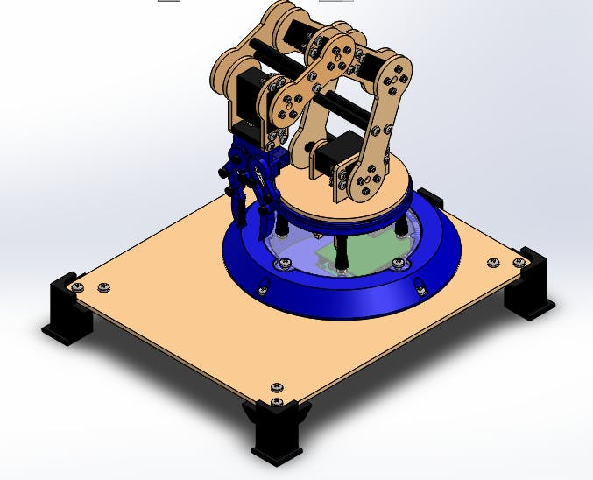

Slide 3
ARM -Budget
S.no | component | quantity | Model/range | link | Est .price
1 | Digital Servomotors | 4 | mg996r | https://cutt.ly/mvrn2RW | Rs 200/- x4
2 | Micro Servomotors | 2 | SG90 | https://cutt.ly/7vrQADo | Rs 100/- x2
3 | ARM(Hardware ) | 1 | Acrylic |  | Rs 1500 x1
4 | jump wire | 4 set |  | https://cutt.ly/rvrEKme | Rs 65/- x4
5 | Miscellaneous Feviquick Gluesticks etc | - | - | - | Rs 200/-
 |  |  |  | Total | 3000

Slide 4
Controller-Budget
S.no | component | quantity | Model/range | link | Est .price
1 | Glove | 1 | Woolen | - | 150/-
2 | Flex sensors | 2 | Flex Sensor 2.2 | https://cutt.ly/svrOMl9 | Rs 345
3 | String Potentiometer | 2 | 10kOhms |  | Rs 100
4 | Accelerometer | 2 | ADXL345 |  | Rs 150/-
5 | Joystick | 2 | PS2 RC-A-040 | - | Rs 50/-
6 | Touch sensor | 2 | REDTTP223 |  | Rs 150/-
7 | Vibration motor | 2 | Cellphone Micro Vibrator Motor | https://www.hnhcart.com/products/cellphone-micro-vibrator-motor?variant=33191667794008&currency=INR&utm_medium=product_sync&utm_source=google&utm_content=sag_organic&utm_campaign=sag_organic&utm_campaign=gs-2020-11-23&utm_source=google&utm_medium=smart_campaign | Rs 50/-

