Slide 1
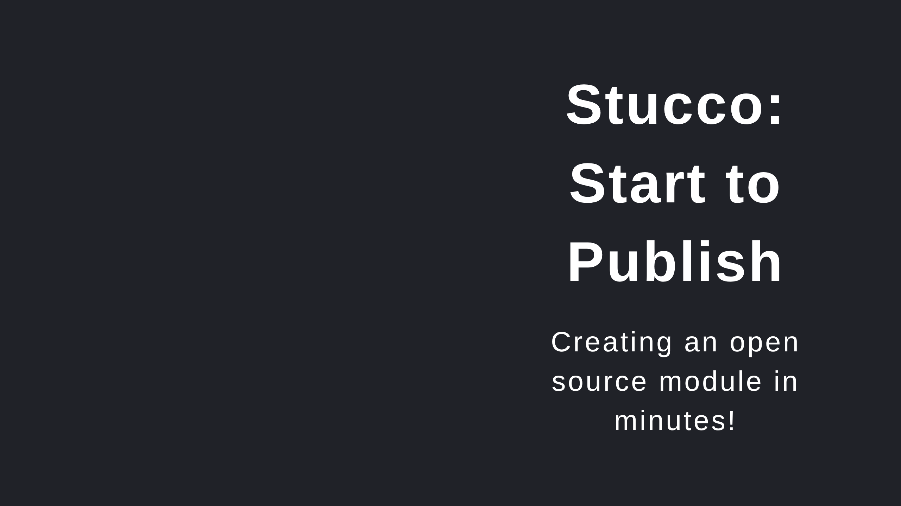
Notes:
For Demo I pre-logged into PSGallery & Github Basic VM with the following configured - Windows Terminal Preview - Git - VS Code w/ following Extensions -- PowerShell Preview -- markdownlint -- Marp for VS Code

Slide 2


Slide 3
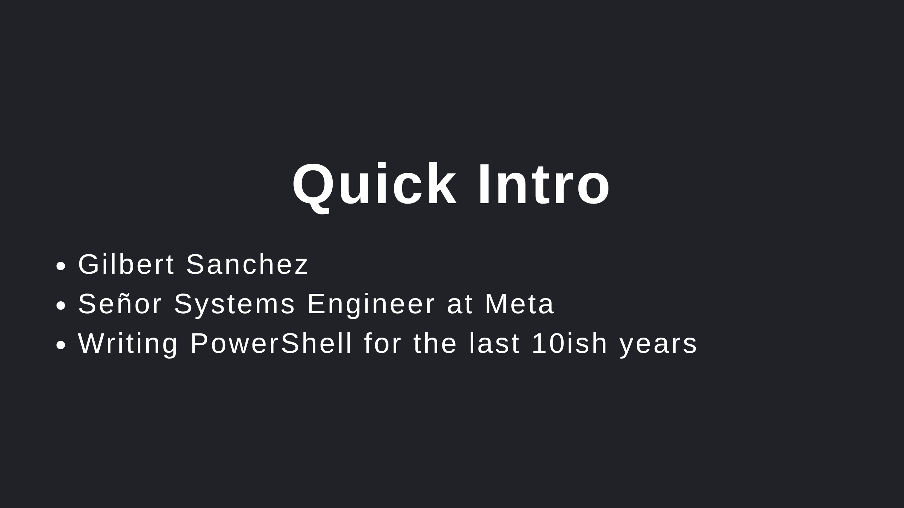

Slide 4
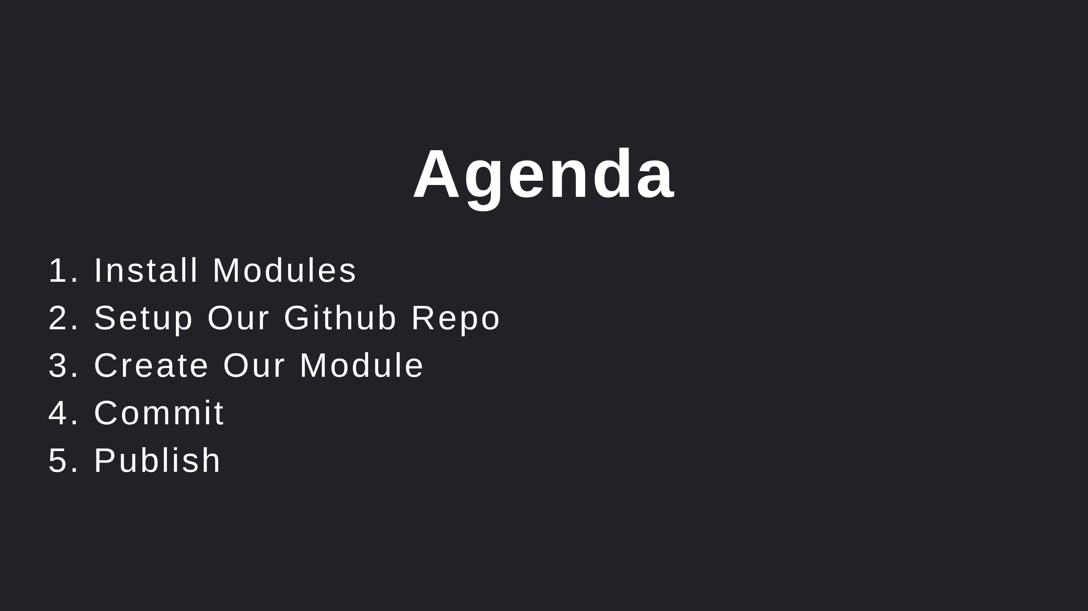

Slide 5
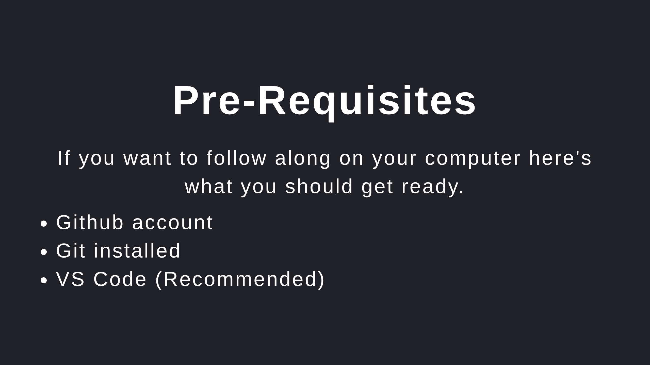

Slide 6
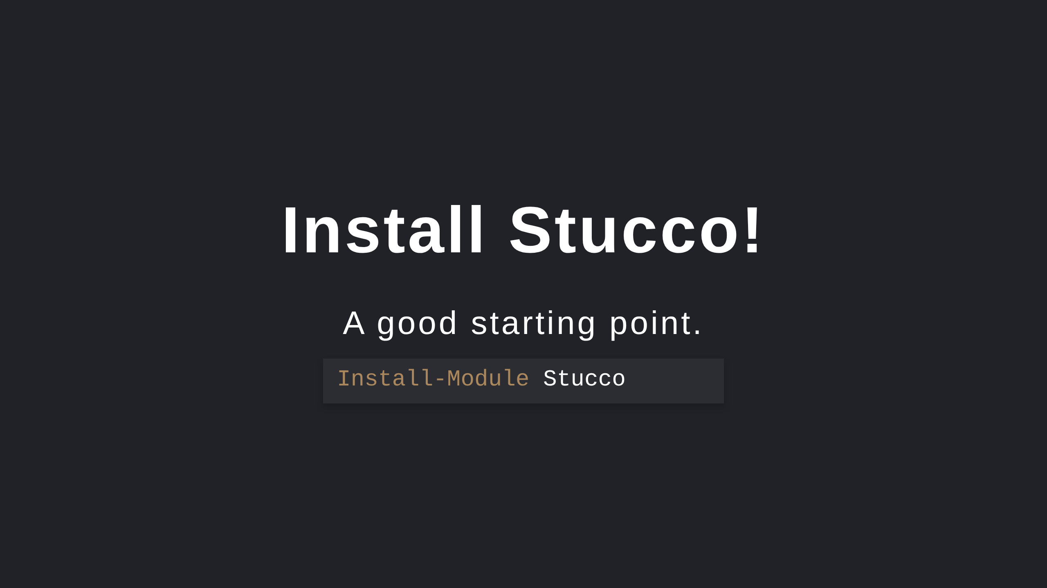
Notes:
Note that it installs it's pre-requisites. Pester included (which you may need to ) Install-Module Pester -RequiredVersion 5.3.3 -SkipPublisherCheck

Slide 7
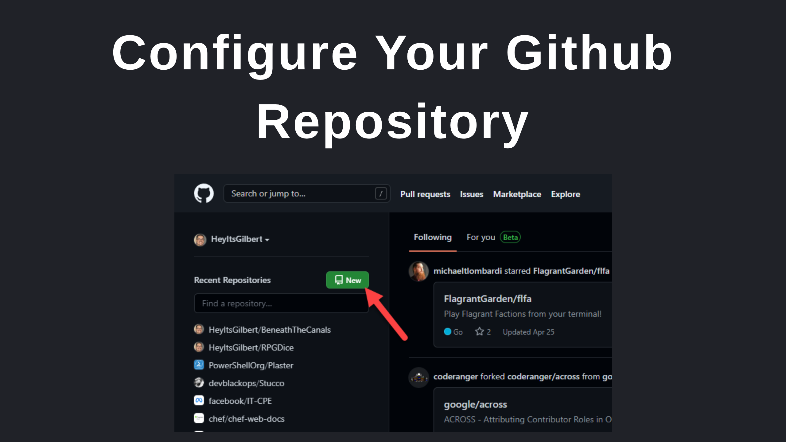

Slide 8
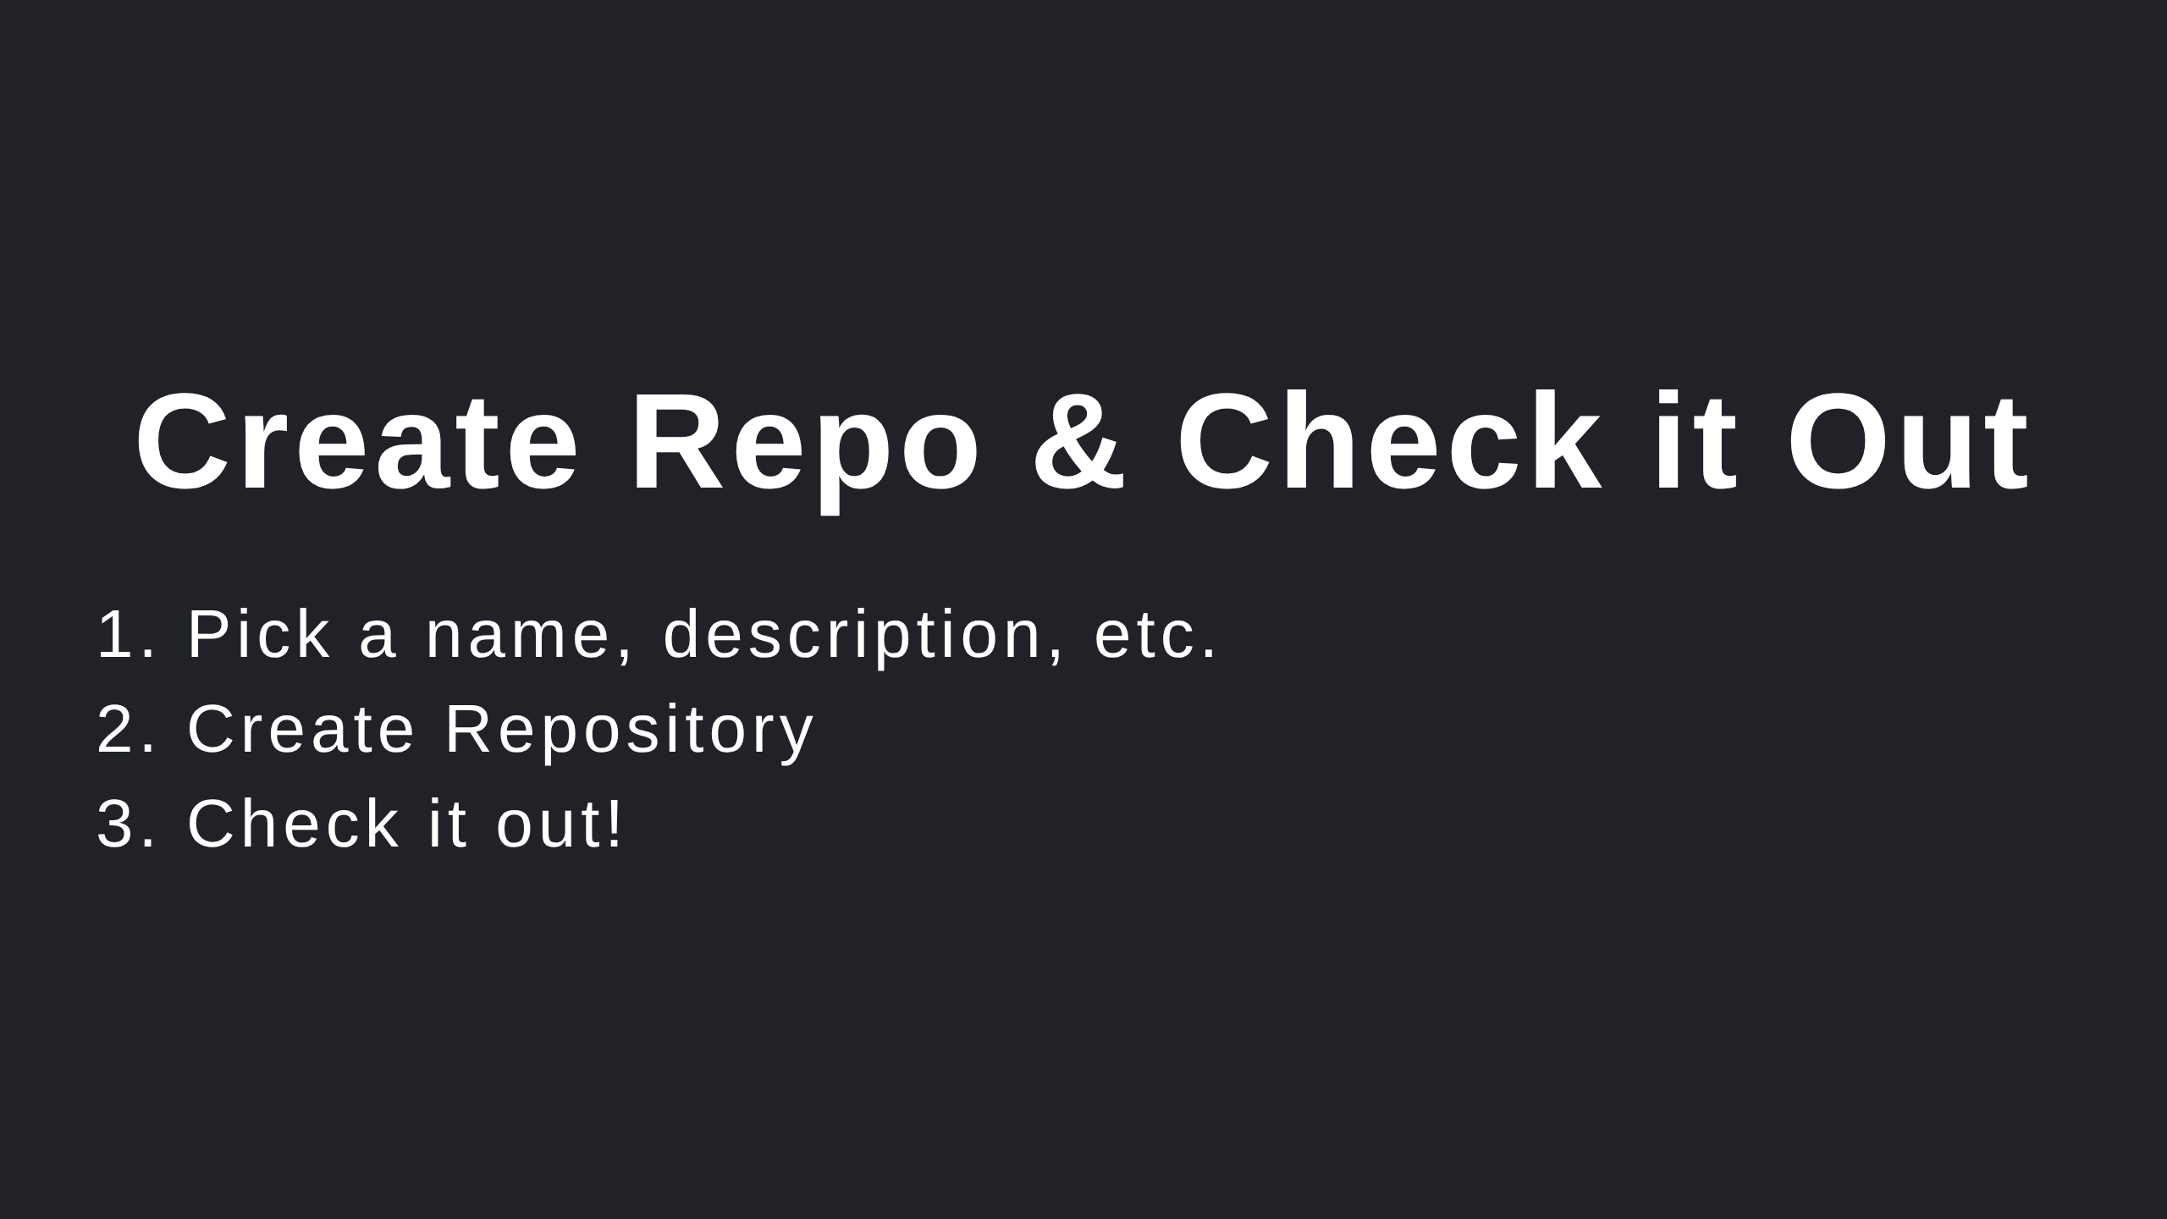
Notes:
A few options... git clone ... Github's tool

Slide 9
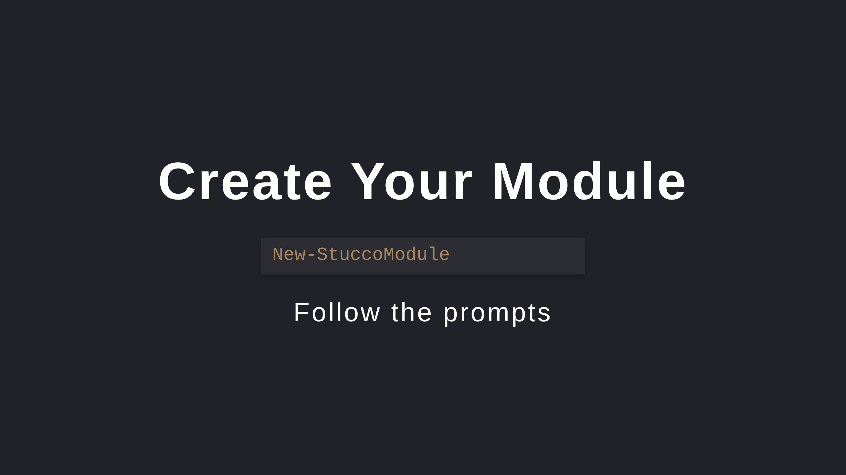

Slide 10
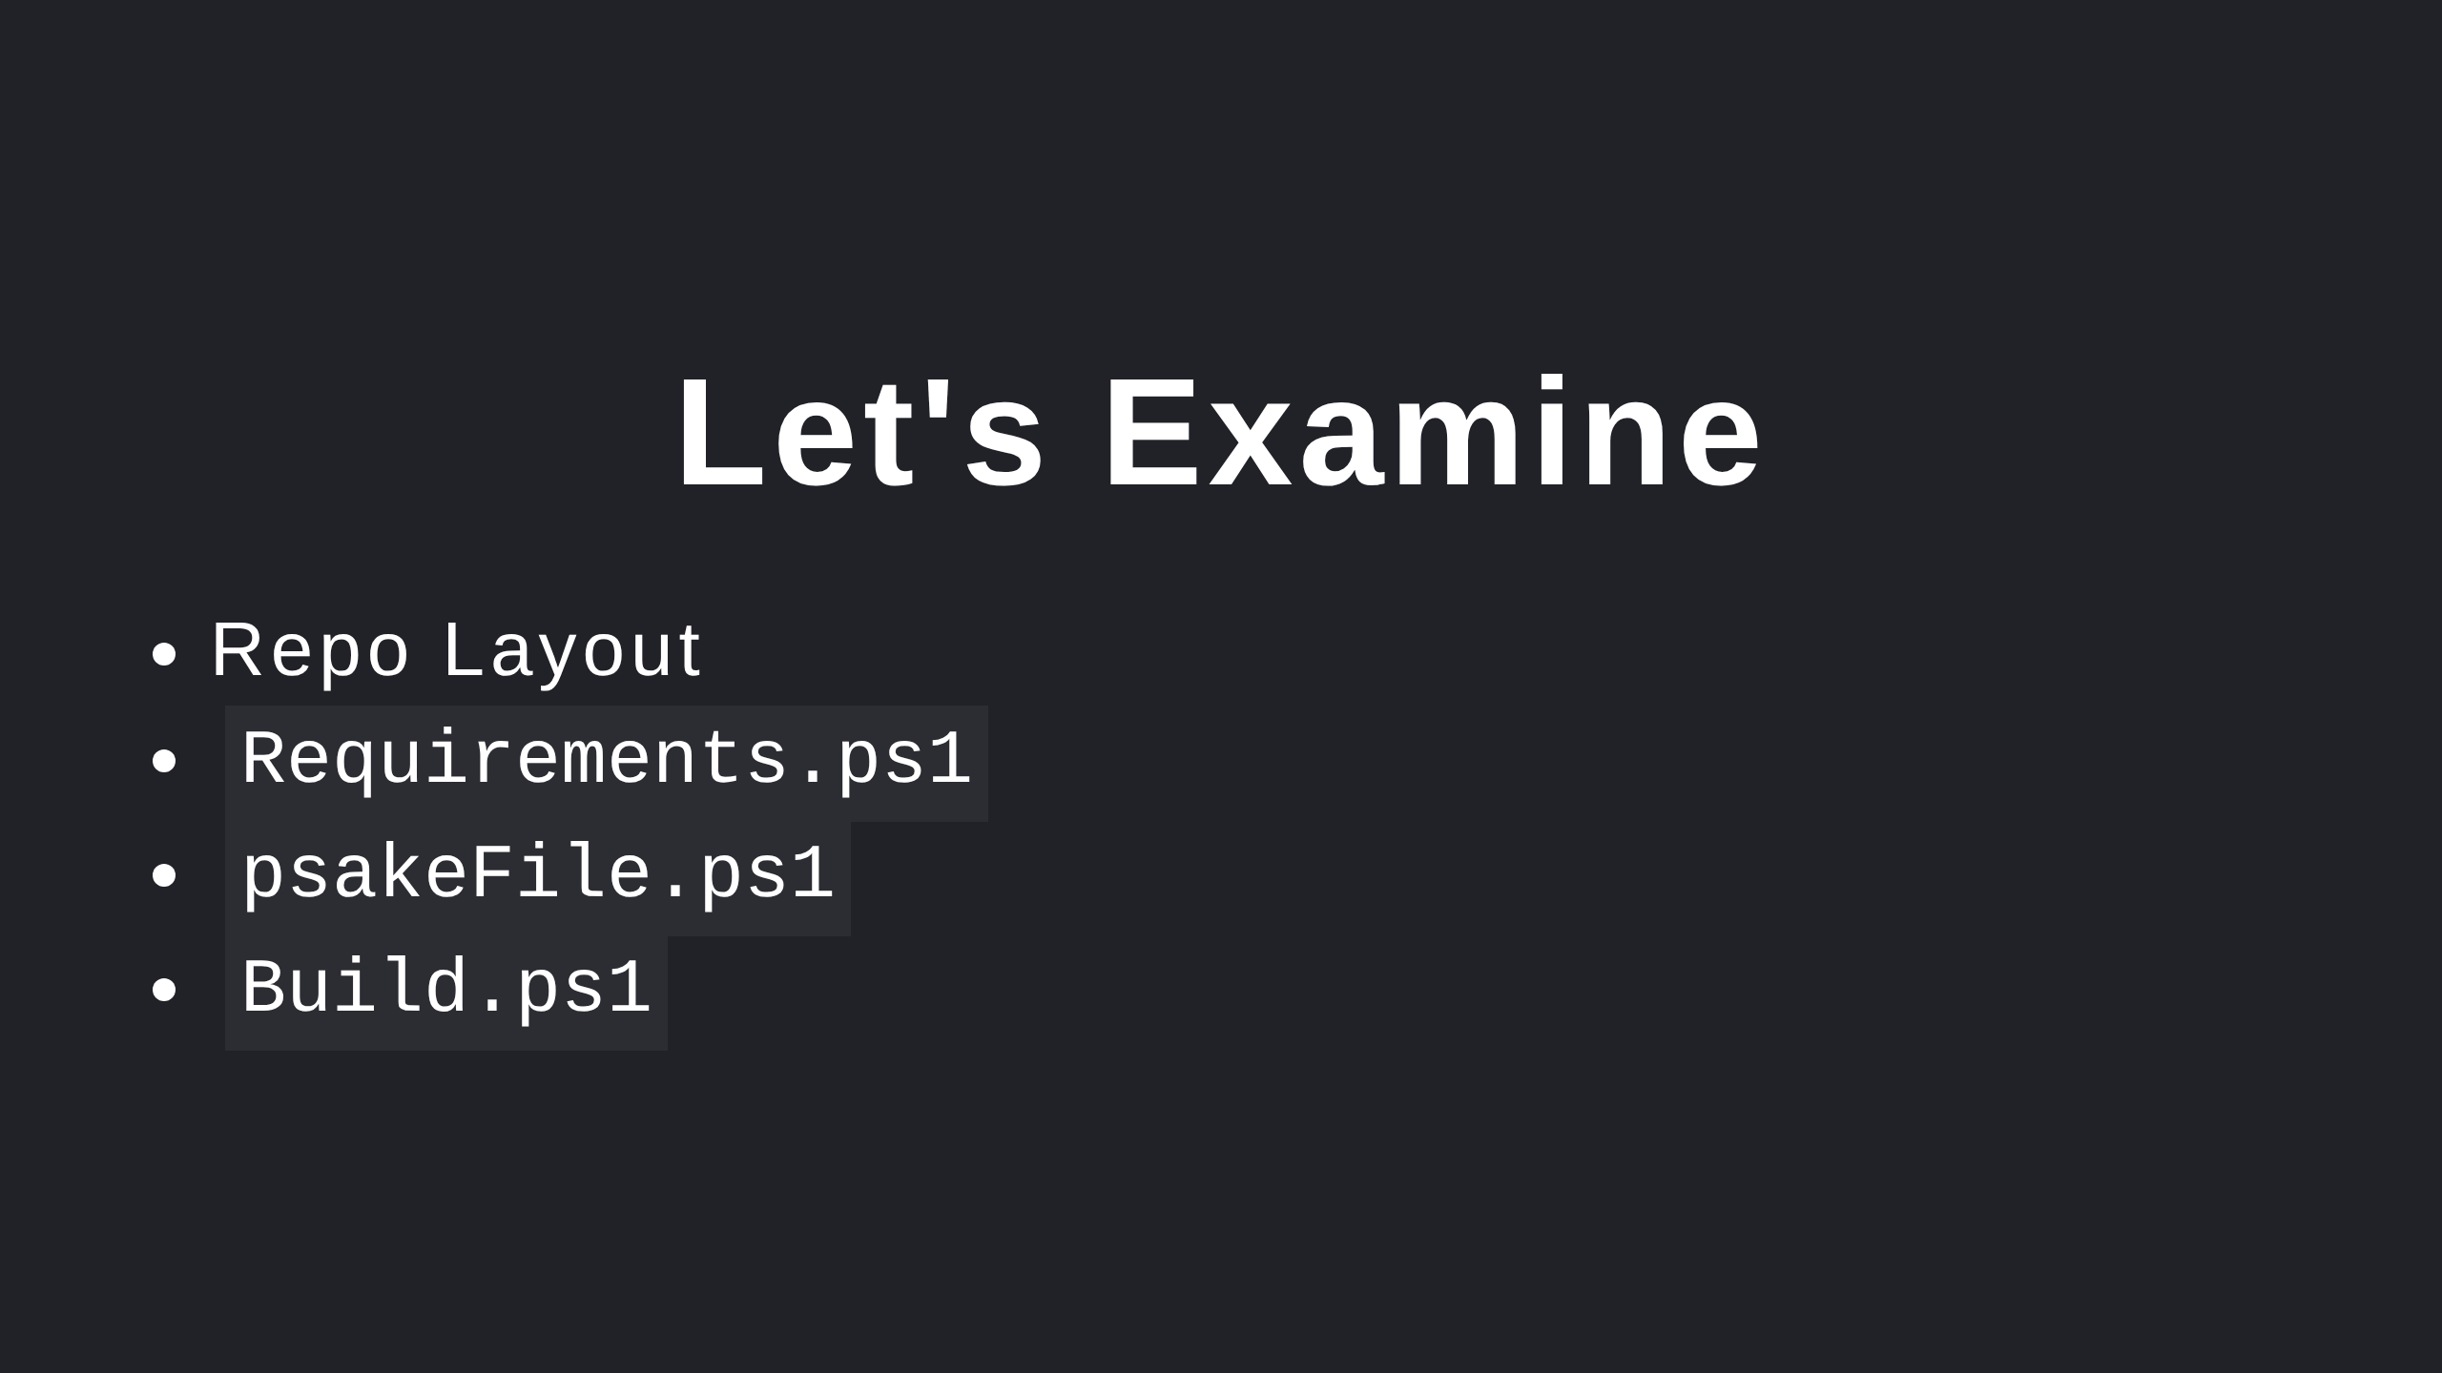

Slide 11
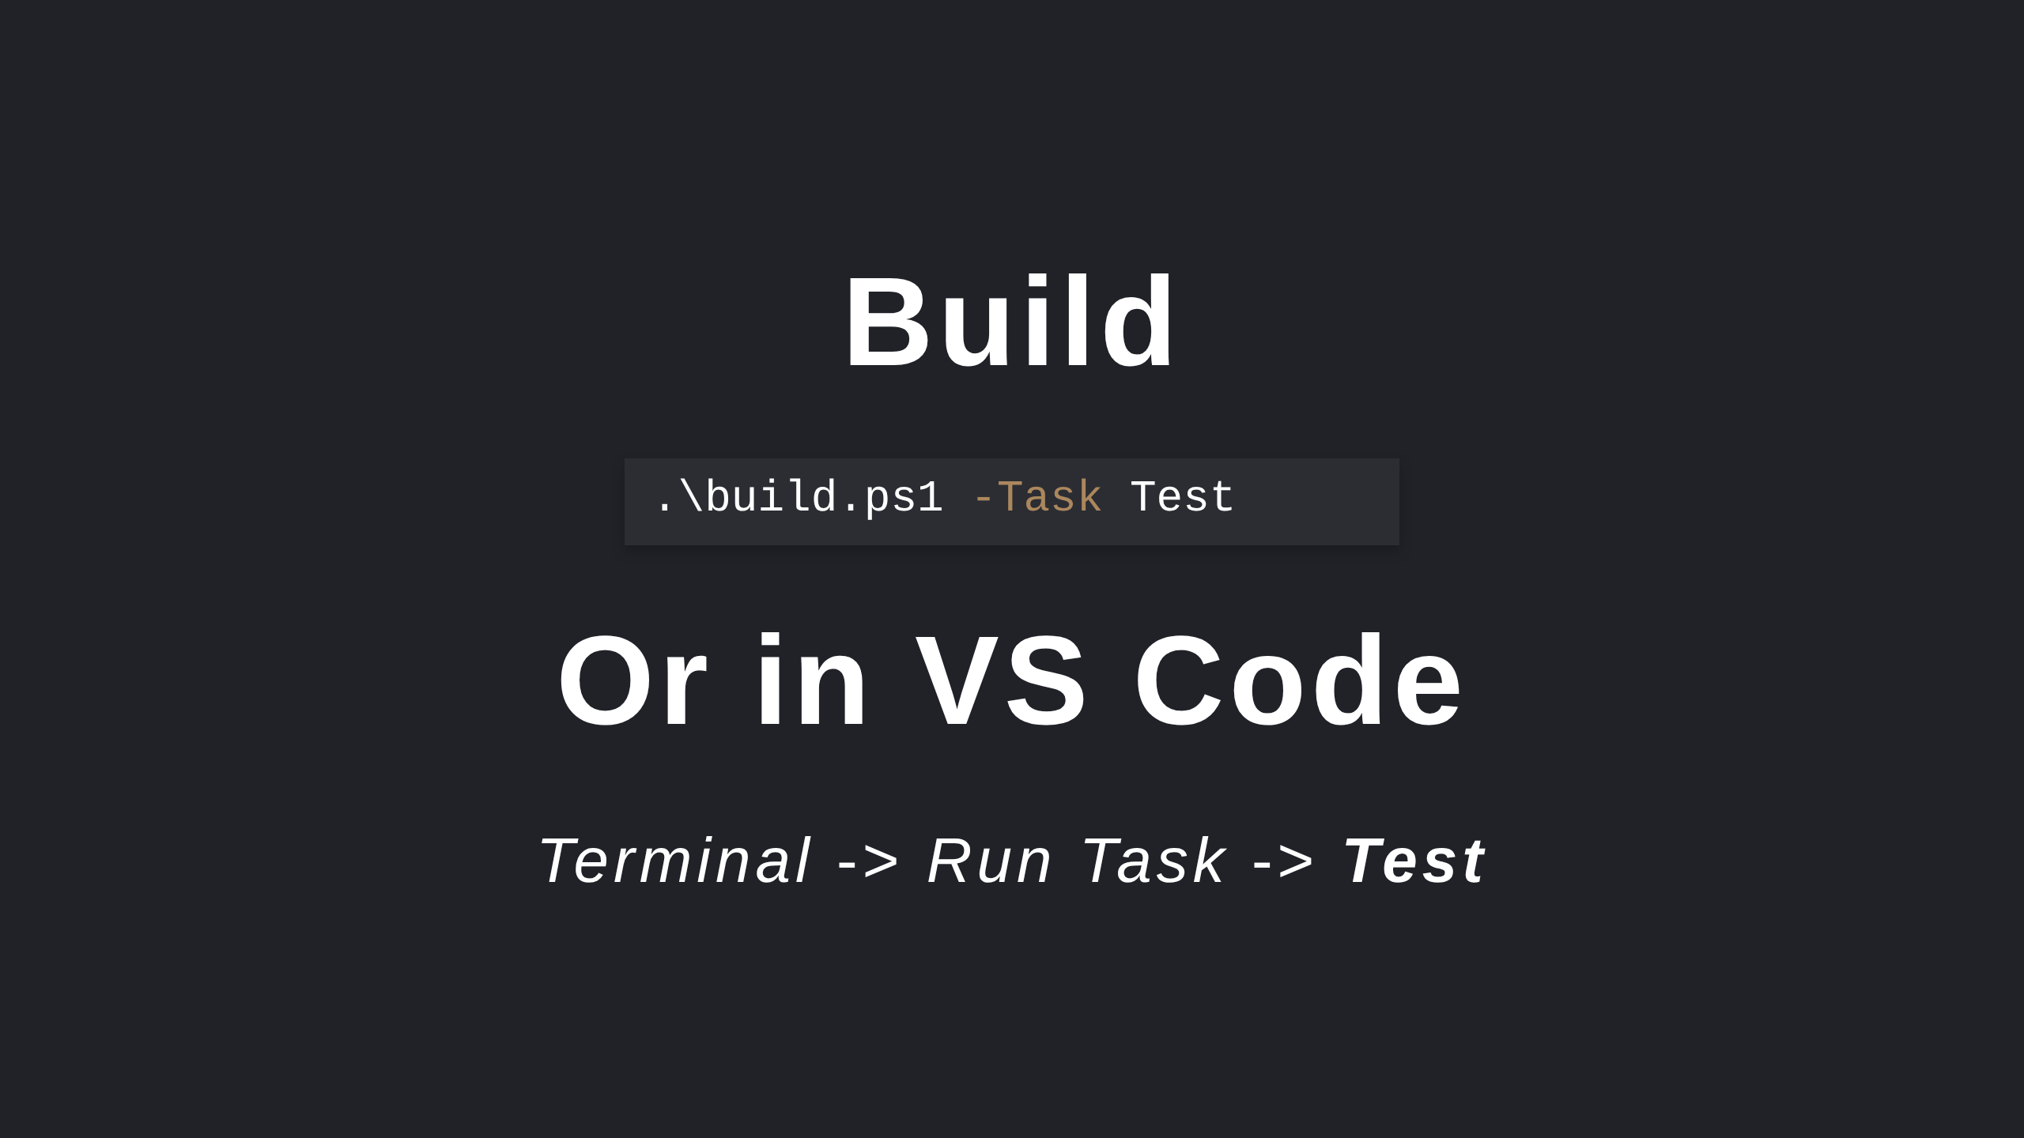
Notes:
Known issue with Windows PowerShell https://github.com/psake/PowerShellBuild/pull/60

Slide 12
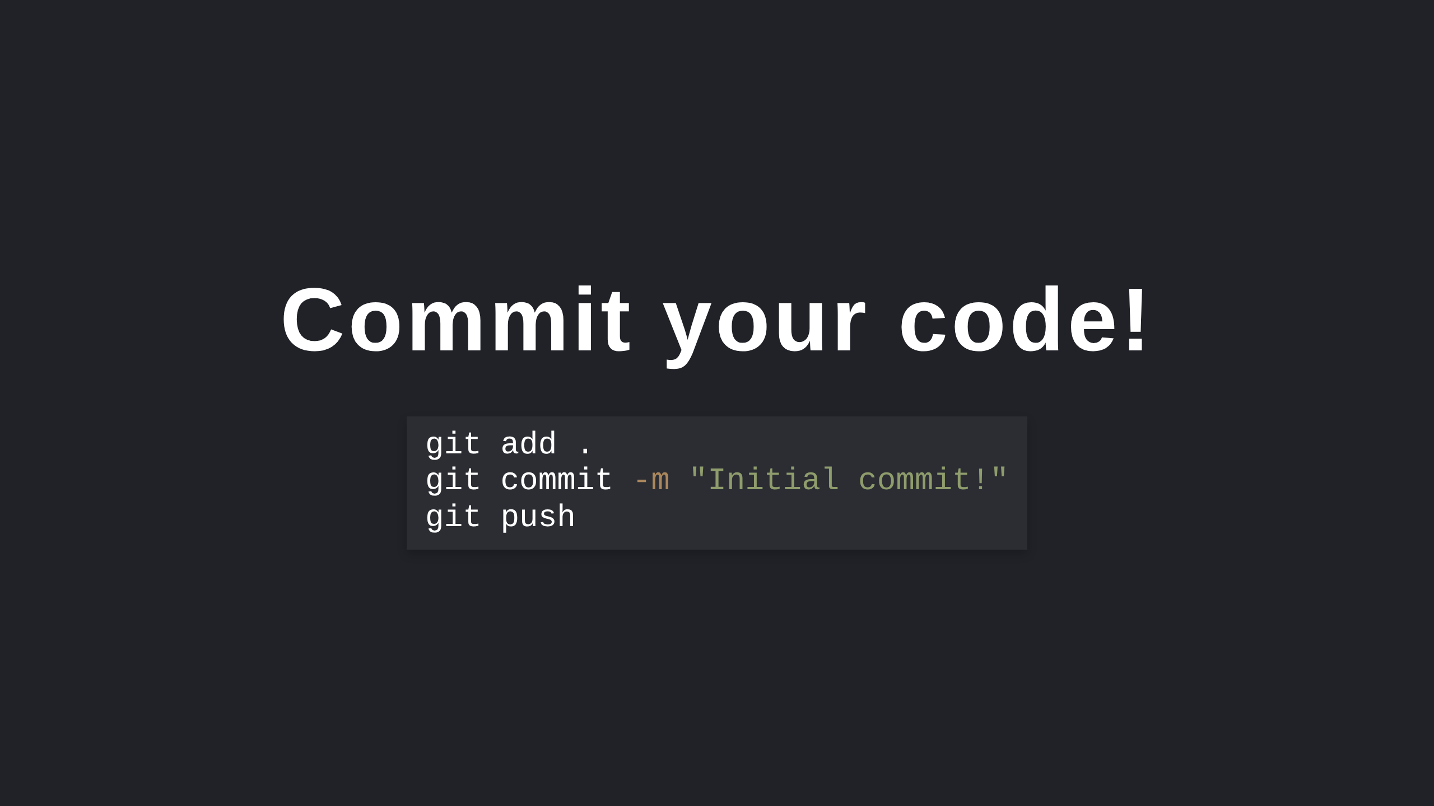

Slide 13
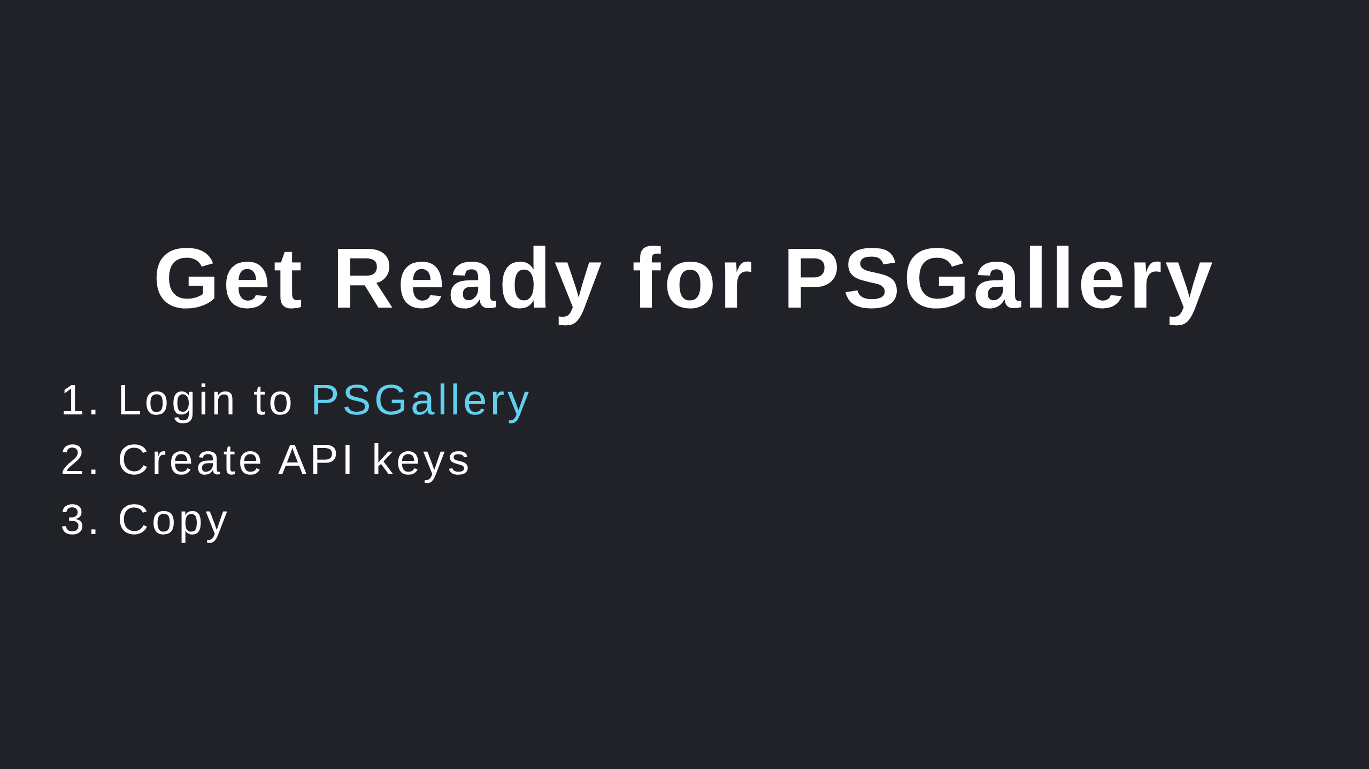

Slide 14
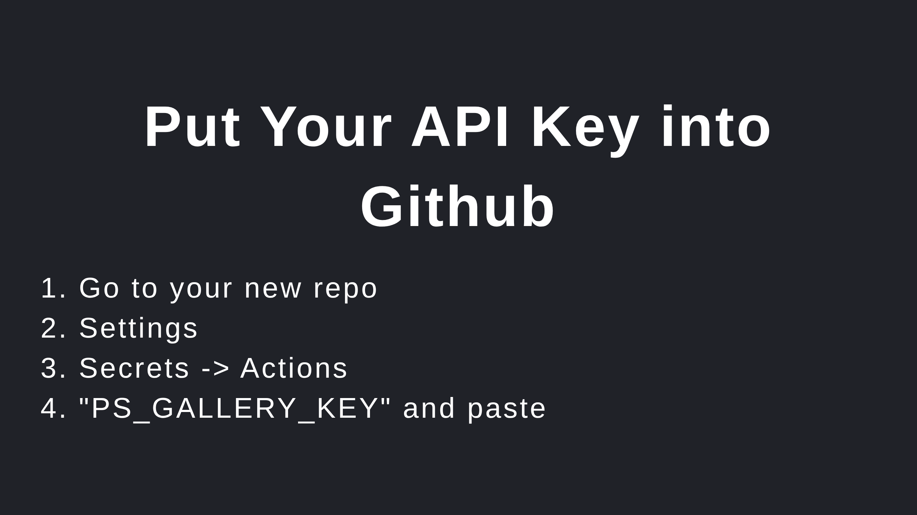
Notes:
Look into branch protection rules

Slide 15
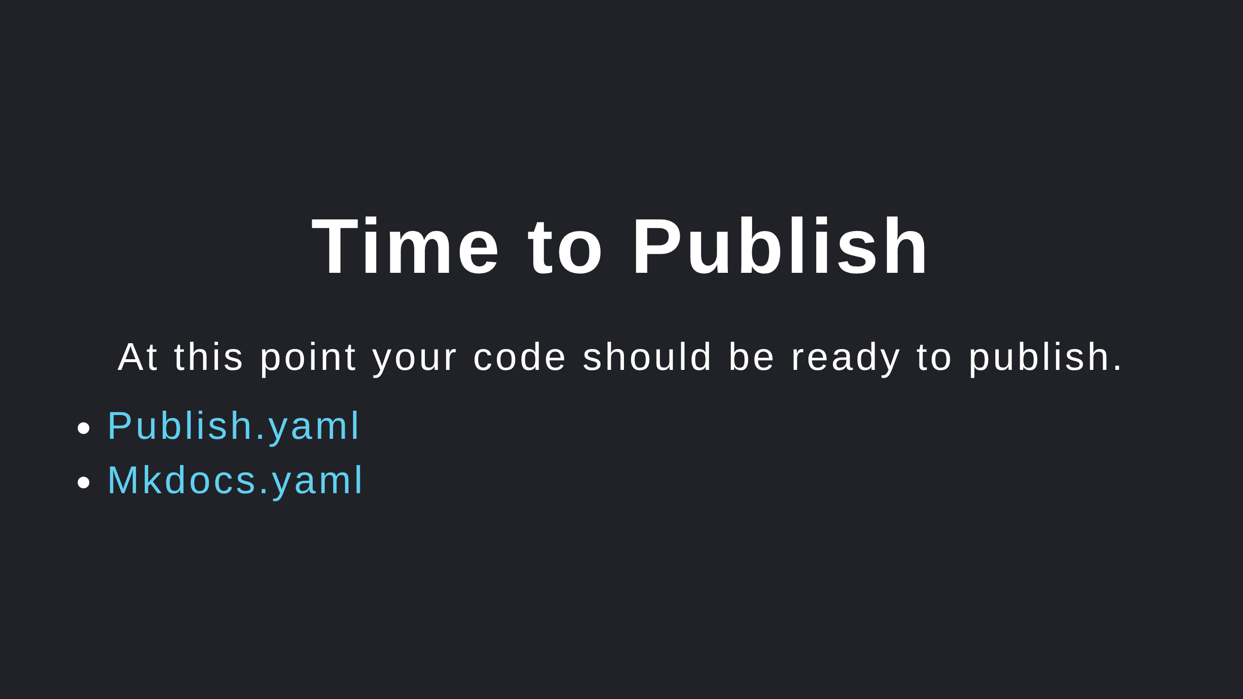

Slide 16
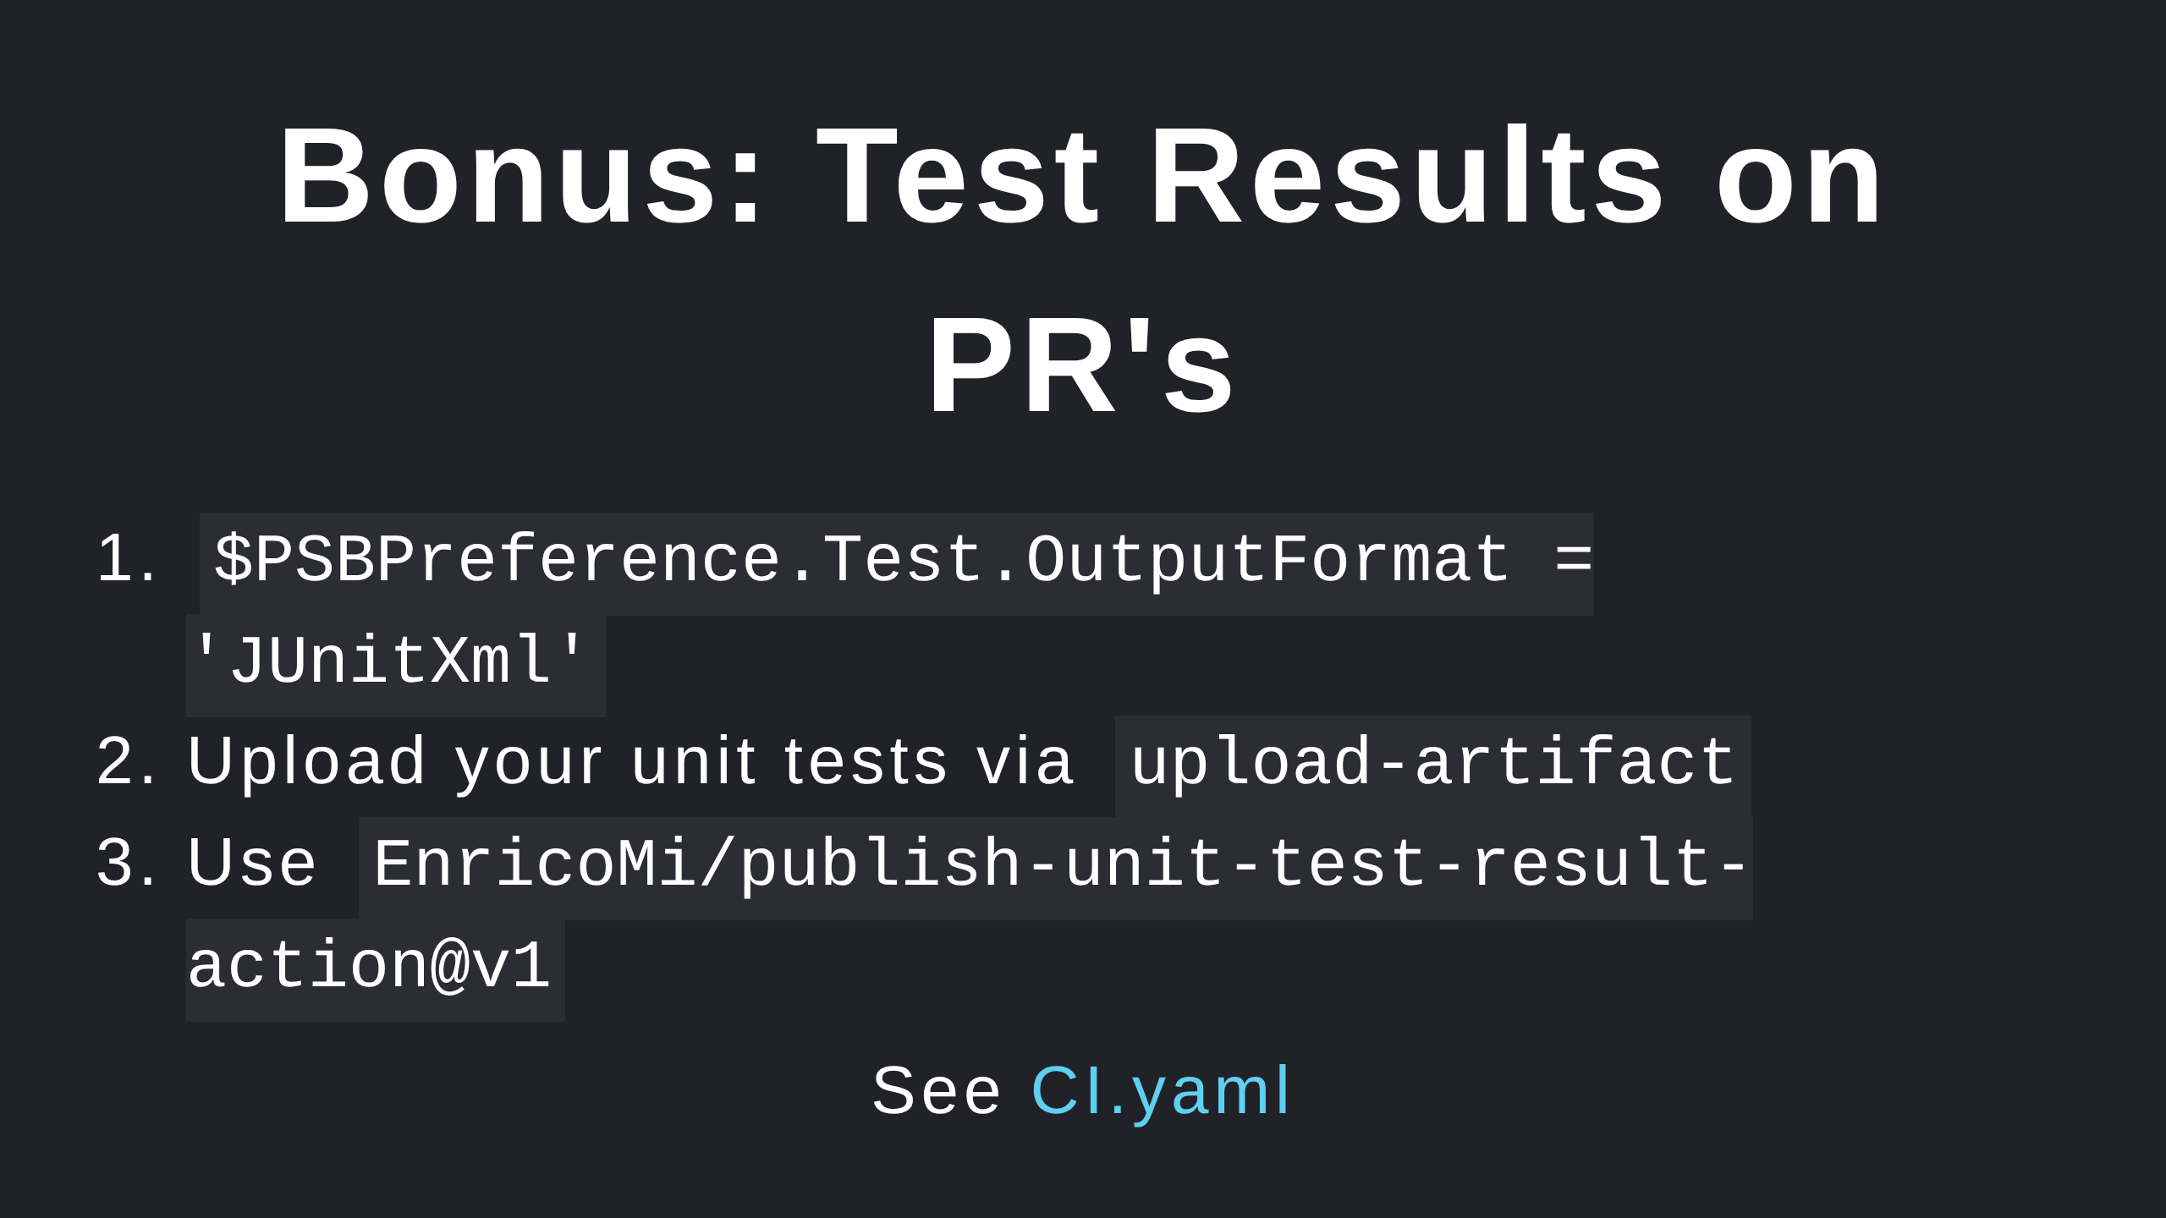

Slide 17


