Slide 2

Original Img

Slide 3
Image process

Slide 4
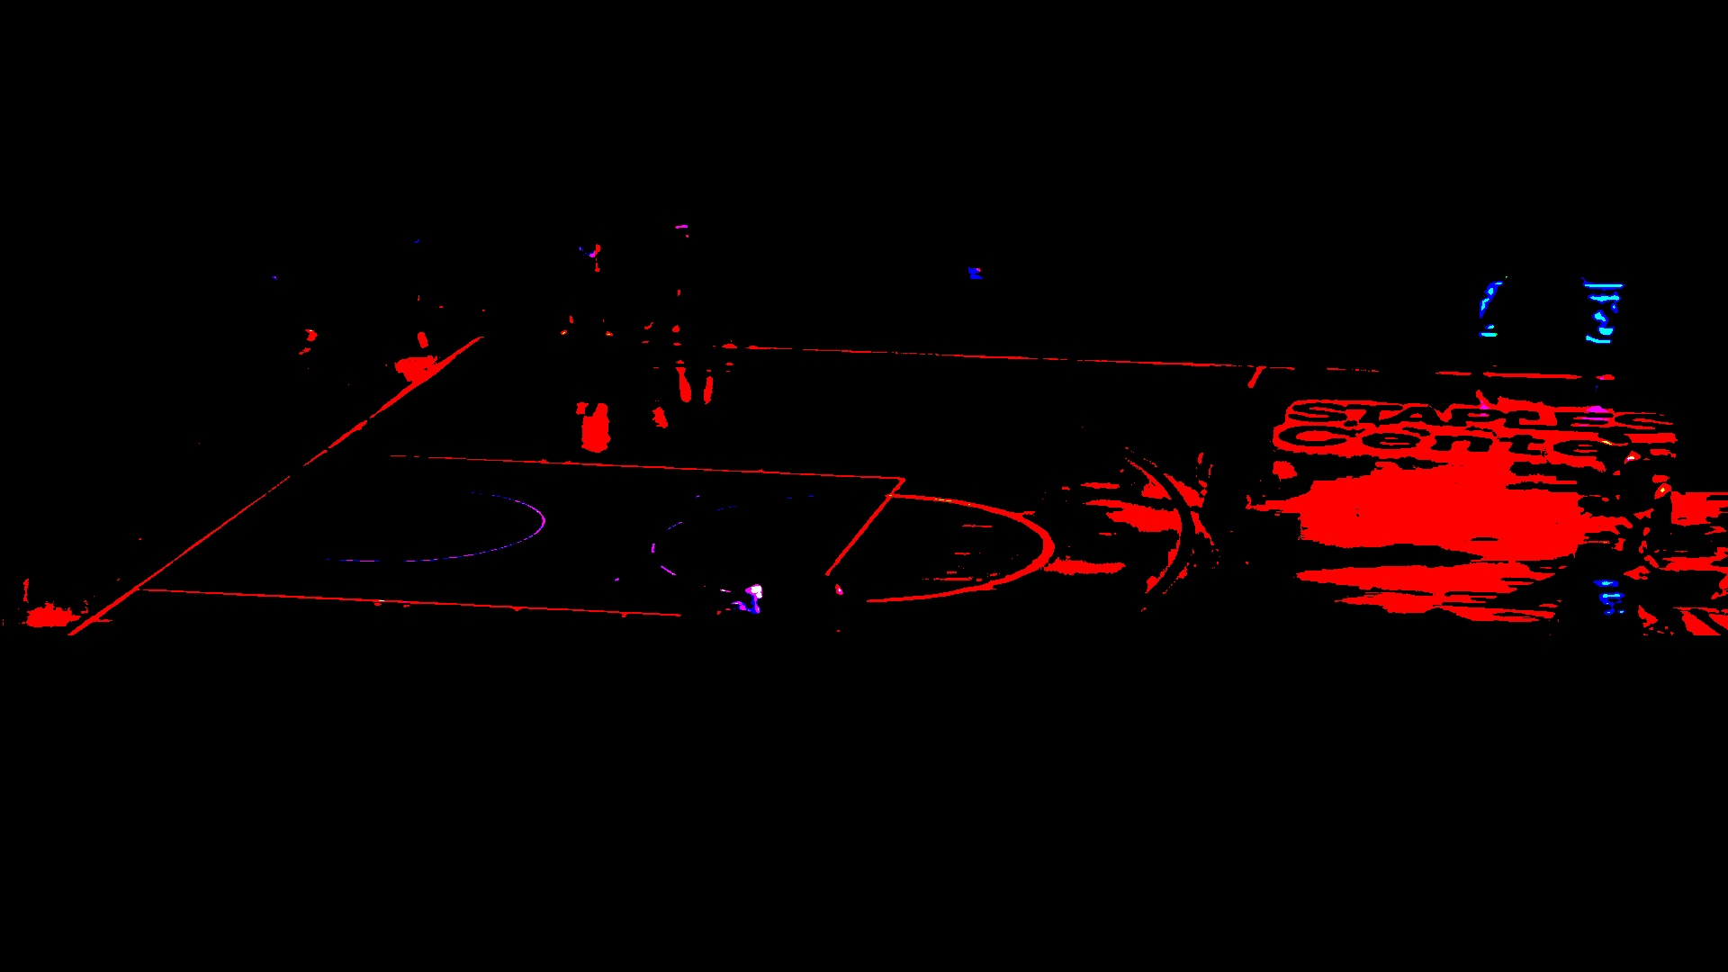
Picture Binarization(二值化)
cv2.threshold(img,241,255,cv2.THRESH_BINARY)
Threshold 241, if bigger than 241, then turn into 255(white) , similarly, values smaller than 241, turns into 0(black).

Slide 5
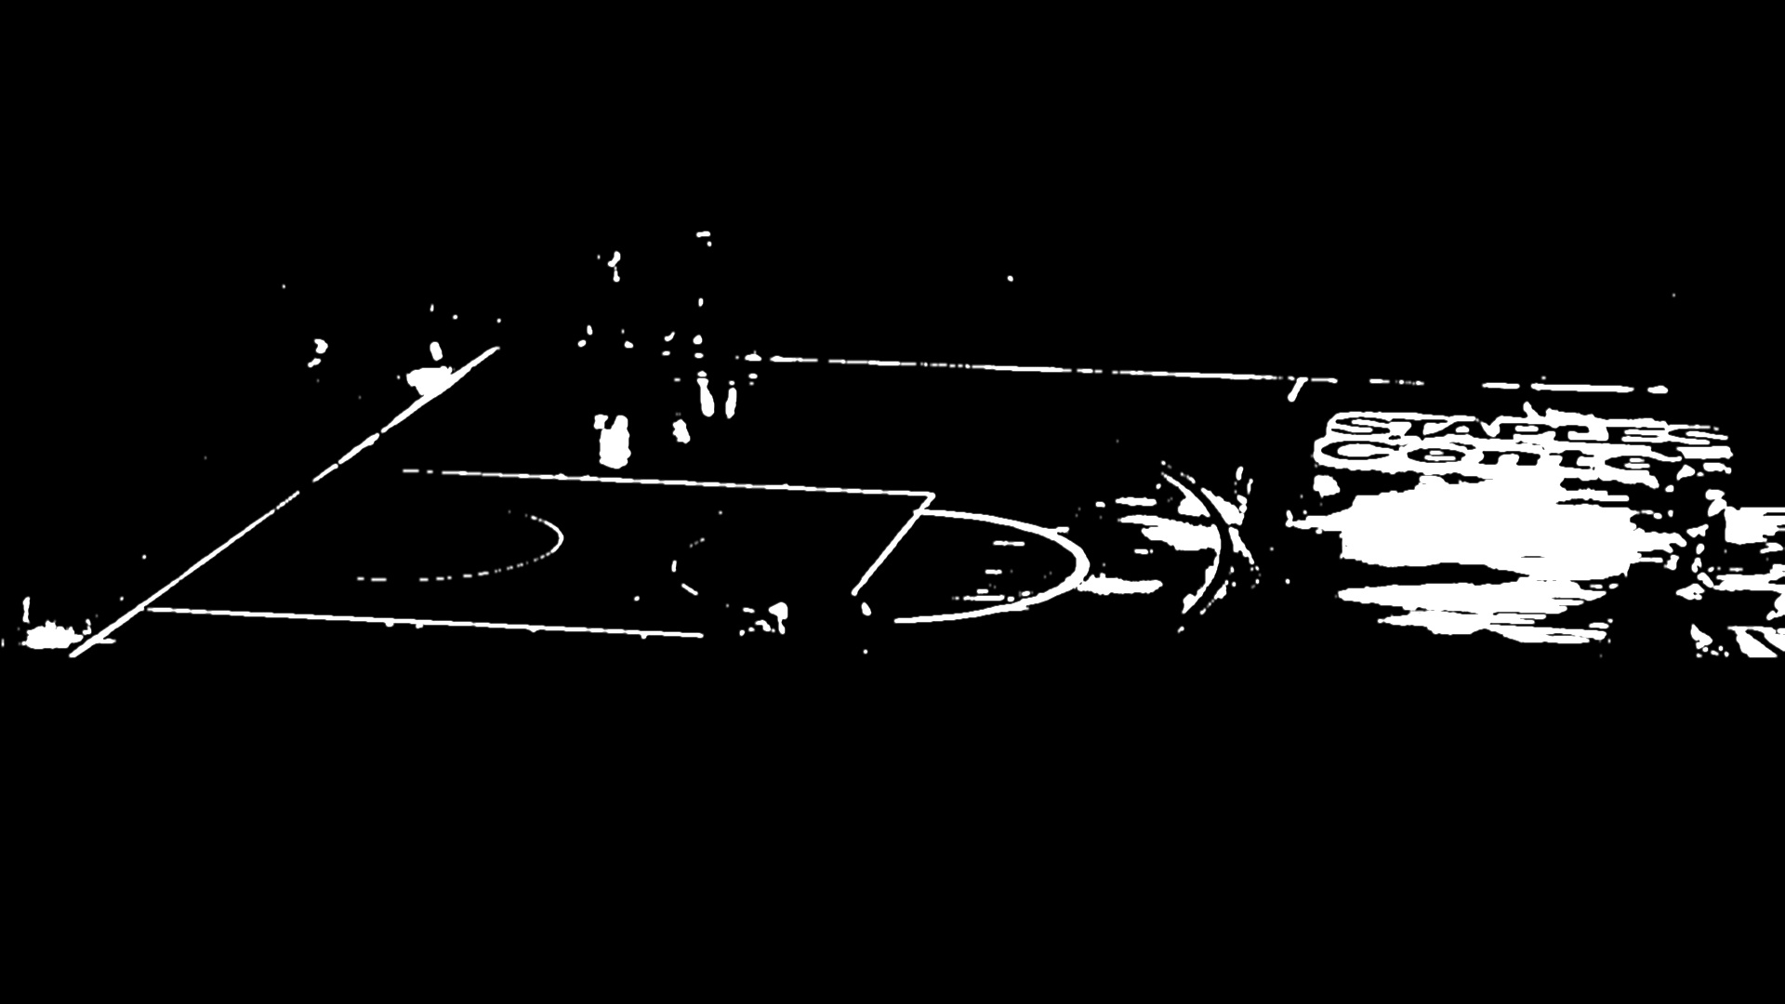
Get RGB R Layer
img_bi_gray=img_bi[:,:,2]
Instead of converting to Gray(cv2.cvtColor(img,cv2.COLOR_RGB2GRAY)), after binarization, values are mostly concentrated in Red Layer, thus extracting Red layer gets a explicit value.

Slide 6
Gaussian Blurrized
img_bi_gray = cv2.GaussianBlur(img_bi_gray, (5,7), 0)
Kernel 5*7

Slide 7
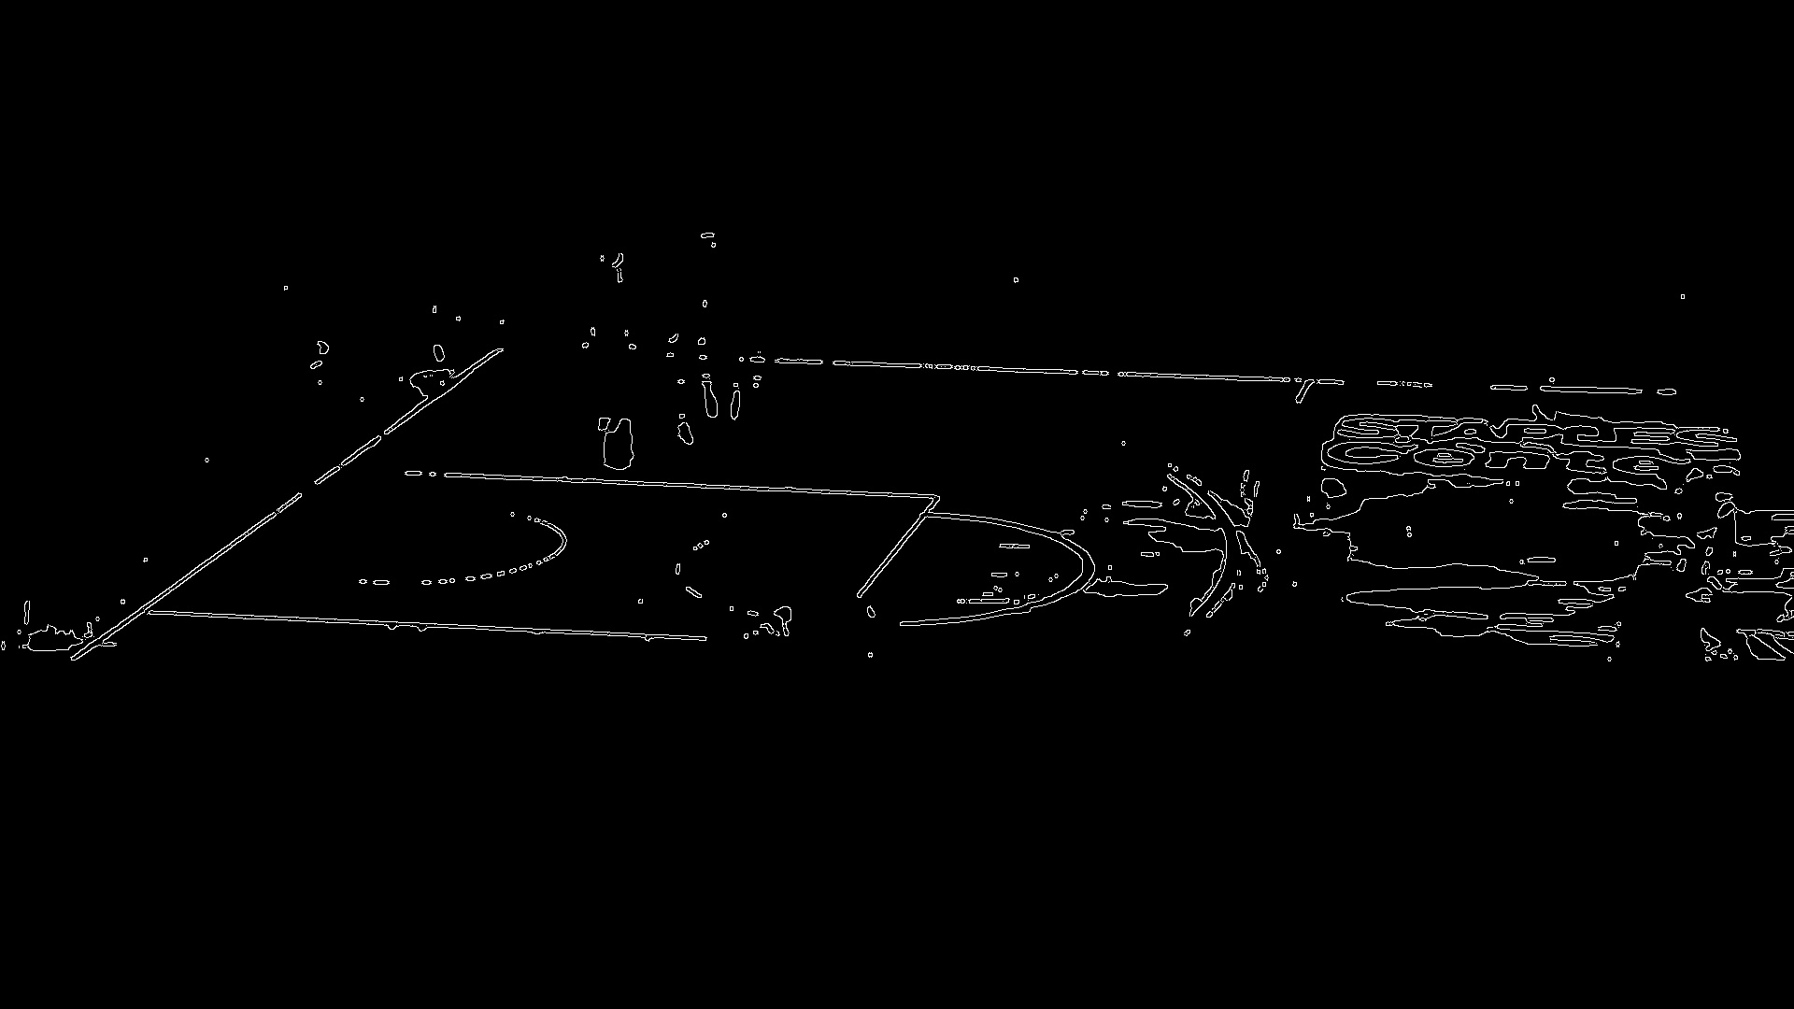
Canny
cv2.Canny(img_bi_gray,150 ,200,apertureSize = 7)
150-> the threshold of canny

Slide 8
HoughLinesP
cv2.HoughLinesP(canny,1,np.pi/180,1,0.1,350,65)
# HoughLinesP(image, rho, theta, threshold, lines=None, minLineLength=None, maxLineGap=None)
# image： 必须是二值图像，推荐使用canny边缘检测的结果图像；
# rho: 线段以像素为单位的距离精度，double类型的，推荐用1.0
# theta： 线段以弧度为单位的角度精度，推荐用numpy.pi/180
# threshold: The minimum number of intersecting points to detect a line.
# threshod: 累加平面的阈值参数，int类型，超过设定阈值才被检测出线段，值越大，基本上意味着检出的线段越长，检出的线段个数越少。根据情况推荐先用100试试
# lines：这个参数的意义未知，发现不同的lines对结果没影响，但是不要忽略了它的存在
# minLineLength：线段以像素为单位的最小长度，根据应用场景设置
# maxLineGap：同一方向上两条线段判定为一条线段的最大允许间隔（断裂），超过了设定值，则把两条线段当成一条线段，值越大，允许线段上的断裂越大，越有可能检出潜在的直线段

Slide 9
HoughLines (endless lines)
HoughLinesP(lines with end point)

Slide 10
