Slide 1


Project Report
Personal Finance Tracker Project Report
Presented by：Lu Yifeng/Huang Danlin/Gong Zhe/Tang Ranran/Ye Xinran/Chen Junzhi

Slide 2


1
Project Background & Objectives
2
System Design & Technical Architecture
Contents
3
Team Responsibilities & Work Overview
4
Project Deliverables & Demonstration
5
Project Value & Impact

Slide 3
1
Project Background & Objectives
Introduces the motivation behind the project, the real-world problem it aims to solve, and the key objectives that guide the system design.

Slide 4

Background
Hard to track daily spending clearly
Students often lack financial awareness
Existing apps are too complex or not visual enough
Privacy concerns with cloud-based finance tools
Objectives
Build a cross-platform Personal Finance Tracker
Enable easy recording of income & expenses
Provide clear financial insights through charts and analysis
Support local data storage to ensure privacy and offline usage
See Your Money Clearly → Make Smarter Decisions
Easy • Visual • Secure • Offline • Practical

Slide 5
2
System Design & Technical Architecture
Describes the overall architecture, technology stack, module structure, and data flow of the application.

Slide 6

Database Schema Design
Database Schema Design
The structure is simple and incurs low query overhead, making it well-suited for standalone financial applications. Additionally, “accounts.balance” is automatically updated via triggers on insert, update, or delete operations, eliminating the need for costly join-based aggregations on every query.
Design 1
Design 2
Design 3
Utilizes embedded SQLite with a fixed storage path in the local FinanceTracker application directory, facilitating offline operation and quick startup on desktop devices.
The core consists of three tables: users, accounts, and transactions, establishing a hierarchical relationship from user → account → transaction, which facilitates aggregated statistics.
During the initialization phase, a default user and a primary account are automatically inserted to ensure that usable data is available upon the first load of the interface.

Slide 7
API Endpoint Documentation
- GET /api/transactions: Returns all transactions, sorted by date desc, created_at desc.
- GET /api/transactions/{id}: Returns details of a single transaction.
- POST /api/transactions: Creates a new transaction (request body: CreateTransaction), returns { id } on success.
- PUT /api/transactions/{id}: Partial update — allows modifying amount, type, category, description, and date; automatically recalculates account balance.
- DELETE /api/transactions/{id}: Deletes the transaction and rolls back the account balance.
- GET /api/accounts: Lists all accounts.
- POST /api/accounts: Creates a new account (requires user_id, name, account_type, balance).
- GET /api/stats?start_date&end_date: Returns income, expenses, net amount, and categorized aggregations (defaults to full range).
- GET /api/trends?months=6: Returns monthly aggregated income/expense/net trends, defaulting to the last 6 months.

Slide 8
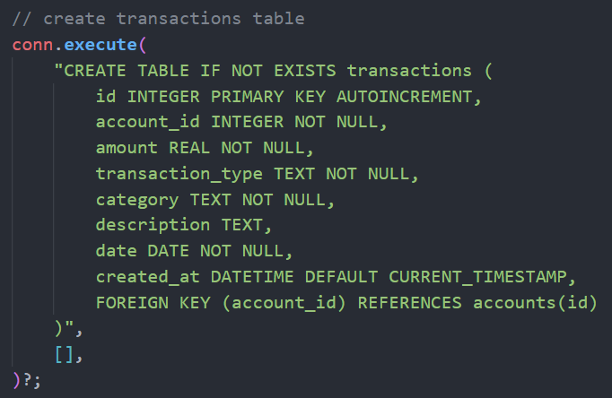
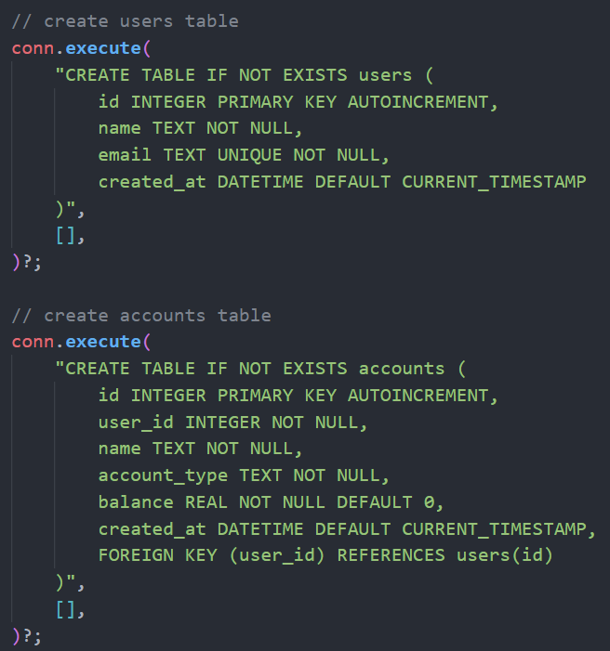
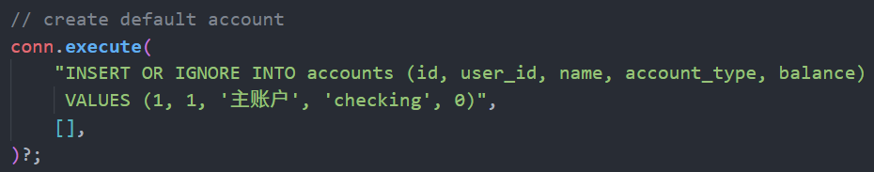
Database Schema Design

Slide 9
Reasonableness of Web Framework
Tauri Sheall: Provides a cross-platform desktop container with a built-in command system that exposes Rust backend capabilities to the frontend via invoke. It also allows direct access to local files and SQLite, delivering an optimal user experience for offline use cases such as offline expense tracking.
Actix-web + Tokio: Launch an Actix HTTP server in the background within lib.rs, sharing the same Arc<Mutex<Connection>>. This setup allows serving Tauri frontend commands while simultaneously exposing a REST API externally for other clients or mobile applications.
Actix provides mature routing, middleware, and CORS management; the Tauri command layer reuses the same logic to avoid redundant implementation.
PPT模板 http://www.1ppt.com/moban/

Slide 10
Challenges in Frontend-Backend Data Binding
Robust Chart Management
Charts are explicitly destroyed before reinitialization, preventing canvas overlap and memory leaks.
Encapsulated invoke Calls
Consistent Data Refresh Flow
Every database operation (CRUD, stats, trends) is routed through Tauri’s invoke—no direct REST calls—improving security and maintainability.
After any create/update/delete action, the system refreshes data in a fixed sequence:
loadData → updateDashboard → renderLists → updateAnalytics,
ensuring all UI elements reflect the same up-to-date state.
Single Source of Truth for State
The frontend consolidates transactions, accounts, filter results, and chart instances into a unified state object. All UI rendering functions read from this single source, resolving inconsistencies caused by scattered state management.
Smart Form Handling
Forms validate inputs (e.g., amount, account ID) before submission and auto-fill sensible defaults (e.g., current date), reducing invalid requests and backend errors.

Slide 11
3
Team Responsibilities & Work Overview
Presents the roles of each team member, their assigned modules, and contributions, highlighting collaboration and workflow structure.

Slide 12
Task 1
Database design and initialization module
Owner: Chen Junzhi

Slide 13

1
Task Description
Responsible for database initialization
table schema design
database connection management
default data creation
Responsible File:
src-tauri/src/database.rs (part: init_database() and related helper functions)
Ensure database creation runs during first app startup
Design foreign key relationships (users → accounts → transactions)
Implement thread-safe connection handling with Arc<Mutex<Connection>>
Handle SQLite errors and fallbacks during initialization
Additional Technical Responsibilities

Slide 14
1
Detailed Work Items
1.Database Path Management
2.Database Initialization
3.Table Schema Design
4.Default Data Initialization
Create users table (user information)
Create accounts table (linked to users via foreign key)
Create transactions table (linked to accounts via foreign key)
Ensure correct setup of all foreign key constraints
Create default user (id=1, name="Default User")
Create default account (id=1, name="Main Account", type="checking")
Implement get_db_path() to obtain the user data directory
Create the application data directory FinanceTracker
Return the full path of the SQLite database file
Implement init_database()
Create SQLite database connection
Wrap the connection inside Arc<Mutex> for thread-safe access

Slide 15
Task 2
Data Model and Serialization Module
Owner: Lu Yifeng

Slide 16

2
Data Model and Serialization Module
Core objective
Three Major Model Systems
Person in charge and documents
The core goal of this project is to define type-safe data contracts, enabling seamless front-end and back-end interaction through serialization technology, and providing solid support for CRUD operations, API calls, and the Tauri framework.
A core entity model has been built, covering three-level associations of User, Account, and Transaction, including the audit field created_at to ensure data traceability; interaction DTO models, such as mandatory fields in CreateXXX to guarantee data integrity, and full Option fields in UpdateTransaction to support partial updates; analytical models, which pre-calculate core indicators such as category proportions and monthly trends to reduce front-end computation costs.
This module is responsible by Lu Yifeng, and the relevant code files are located in src-tauri/src/models.rs. Ensure code quality and functional implementation.

Slide 17
2
Technical Implementation and Value Highlights
Technical Implementation
Use the serde framework in the Rust language as the core serialization tool, which supports compatibility with multiple data formats. Globally adopt the snake_case naming convention to adapt to JavaScript variable habits. Generate serialization code at compile time to achieve zero runtime overhead.
Core Value 1
Type Safety: Validate data structures during the compilation phase to effectively prevent type errors at runtime and enhance system stability; Unified Contracts: Share data models between front-end and back-end to eliminate inconsistencies in interface documentation and reduce communication costs.
Core Value 2
Efficiency Optimization: The serialization logic is free of redundancy, adapted to Tauri cross-platform communication scenarios to improve communication efficiency; Strong Scalability: The model adopts a decoupled design, supporting flexible addition of new fields and entities in the future to adapt to business development
Core Acceptance
Ensure that the entire structure implements Serialize/Deserialize functionality, all fields of UpdateTransaction are of Option type, there are no exceptions during the JSON serialization process between front-end and back-end, and guarantee high-quality delivery of the module.

Slide 18
Task 3
Database CRUD operation module
Owner: Gong Zhe

Slide 19
3
Detailed Work Items
01
02
03
04
Transaction CRUD
Account Management
Statistical Features
Balance Auto-update Logic
create_transaction()
get_all_transactions()
get_transaction_by_id()
update_transaction()
delete_transaction()
get_all_accounts()
create_account()
delete_account()
get_transaction_stats()
get_monthly_trends()
On creation
On update
On deletion

Slide 20
3
Acceptance Criteria
01
CRUD Operations
03
Dependency Check
05
Error Handling
Full CRUD functionality is implemented.
Checks for transaction dependencies before deleting accounts.
Proper error handling mechanisms are in place.
Account balances are updated correctly.
Statistical queries support date-range filtering.
Use parameterized queries to prevent SQL injection attacks.
02
Balance Sync
04
Date Filtering
06
Security

Slide 21
Task 4
RESTful API service module
Owner: Tang Ranran

Slide 22

4
RESTful API Service Module
Core Problems to Solve
1. Build a Web Server: Enable the frontend to call backend functions over the network
2. Define Data Interfaces: Provide standardized data access methods for the frontend
3. Handle Frontend-Backend Communication: Ensure data can be correctly transmitted between frontend and backend
4. Error Handling: Provide a unified error response mechanism
Specific Tasks to Complete
1. Establish API Routing System
2. Implement Handler Functions for Each Endpoint
3. Data Serialization/Deserialization
4. Error Handling Mechanism
5. CORS Configuration (Cross-Origin Resource Sharing)
6. Database Connection Sharing

Slide 23
4
Team Coliaboration
01
02
03
With Database Developer (Task 3):
With Frontend Developer:
With Chart/Visualization Developer:
· Understand the interfaces of database operation functions
· Determine function signatures and return types
· Coordinate consistency of data models
· Determine API response formats
· Negotiate error handling methods
· Define parameter formats for pagination, sorting, etc.
· Provide statistical and trend data interfaces
· Determine data aggregation methods

Slide 24
Task 5
Tauri Cmd Interface & Frontend Comm Module
Owner: Ye Xinran

Slide 25
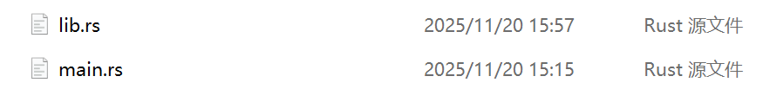
5
Tauri Command Interface & Frontend Communication Module
Task Description：
Implement Tauri commands to connect Rust backend and JavaScript frontend, manage app lifecycle, and handle shared database state.
src-tauri/src/lib.rs (entire file)
src-tauri/src/main.rs (verification)
1. Overall Architecture and Dependencies
Core Framework: Tauri (a cross-platform desktop/mobile application framework that combines a Rust backend with a web frontend).
Core Capabilities: Database operations (encapsulated in the database module), data models (models module), API services (api module), command interfaces for frontend calls (tauri::command).
Key Features: Asynchronous operations, global management of database connections (tauri::State), API services running on background threads.

Slide 26
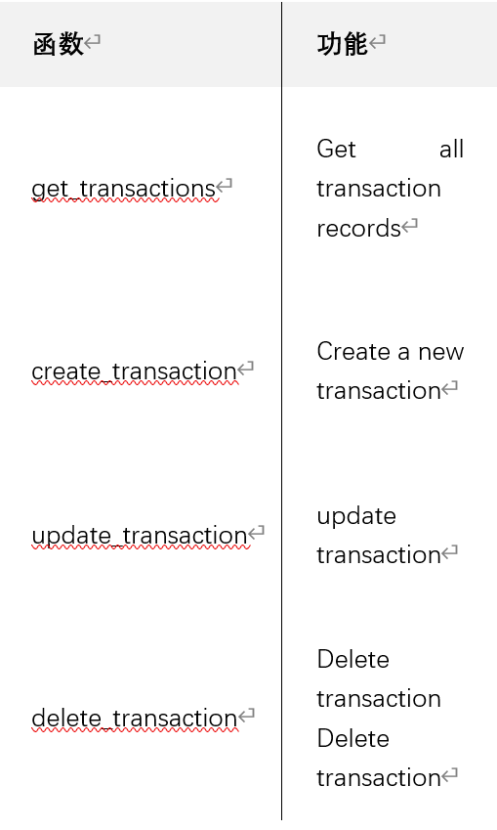
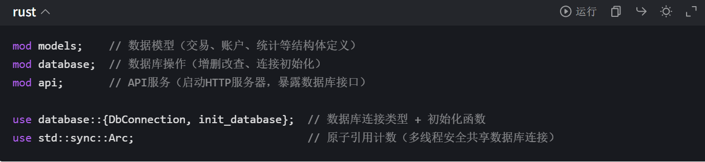
5
Tauri Command Interface & Frontend Communication Module
2. Code Section Display
（1）. Module Import
（2）.Tauri Commands: Interfaces Exposed to the Frontend
All asynchronous functions marked with #[tauri::command] are Rust backend interfaces for the frontend (HTML/JS) to call, and their core logic is 'calling database module methods and handling errors'.

Slide 27
5
Tauri Command Interface & Frontend Communication Module
Model layer (models)
Database layer (database)
Interface layer (tauri::command)
Service layer (api)
Multithreading safety:
Use Arc to share database connections, ensuring safe access for the main thread (Tauri) and background threads (API services);
Tauri's State mechanism ensures thread-safe access to global state.
Why split main.rs and tauri_app_lib?
The entry file is only responsible for 'starting up', while the core logic is encapsulated in separate modules for easier maintenance and testing;
If further expansion is needed later (such as adding CLI commands or multiple entry points), main.rs only needs to call different modules without modifying the core logic.
03
Core Design Concept
04
Additional Explanation

Slide 28
Task 6
Frontend UI & Data Visualization Module
Owner: Huang Danlin

Slide 29
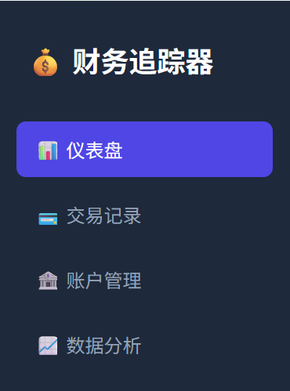
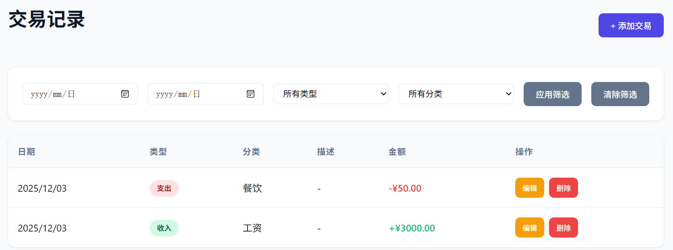
6
UI Structure & Frontend Logic
UI Structure
Transactions, Accounts, Recent list
Dashboard updates
Dynamic dropdowns
Sidebar: Dashboard / Transactions / Accounts / Analytics
Dashboard: stats + recent list
Transactions: table + filters + add
Accounts: account cards
Analytics: charts + date selector
Modals: add/edit transaction, add account
Rendering
⚙️ Frontend Logic
Global state
loadData()
switchView()
Form handling
Filters: date / type / category
CRUD via Tauri.invoke()

Slide 30

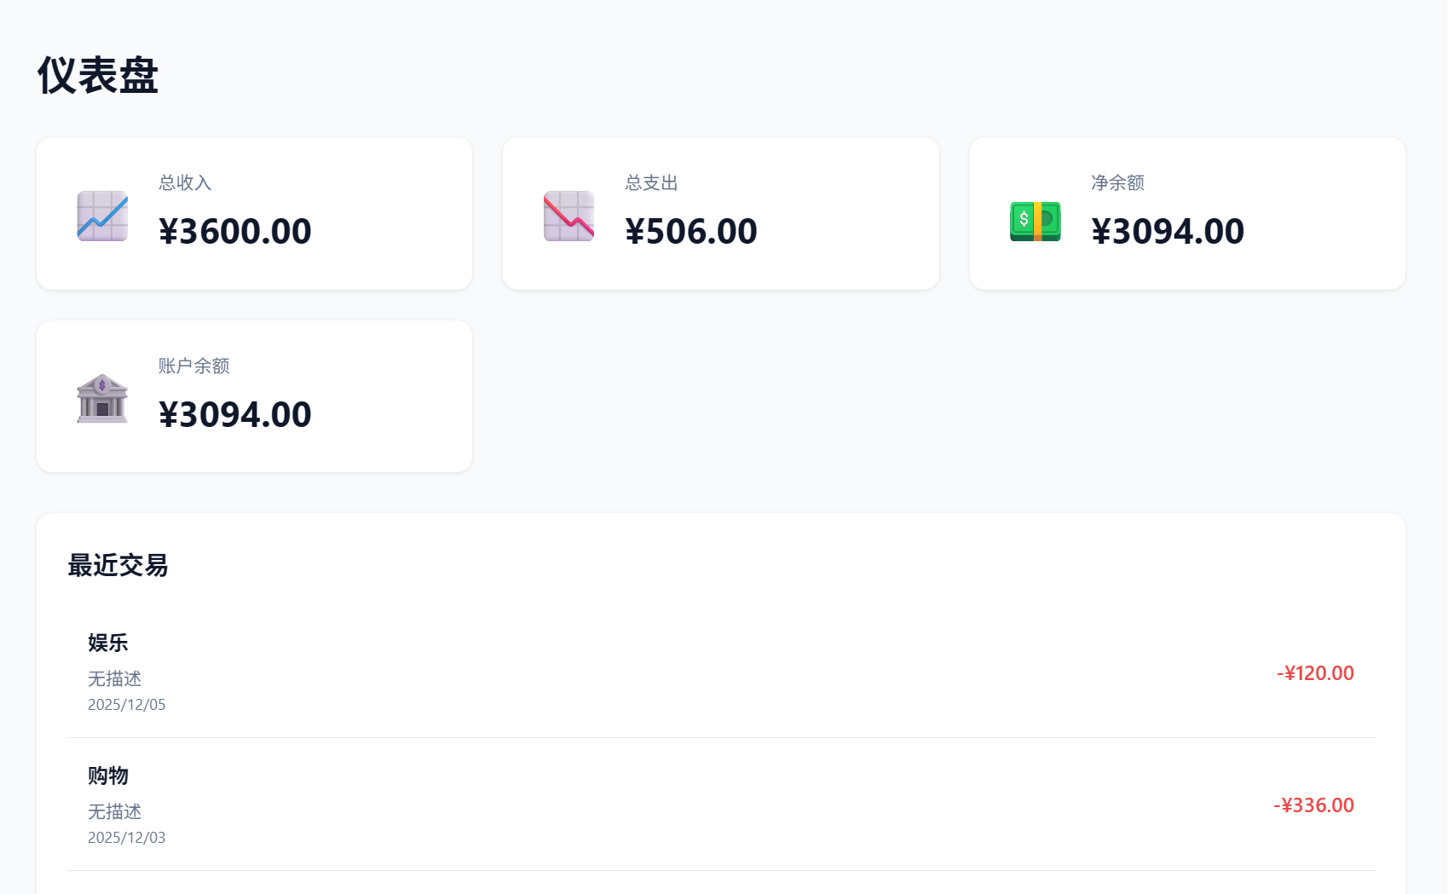
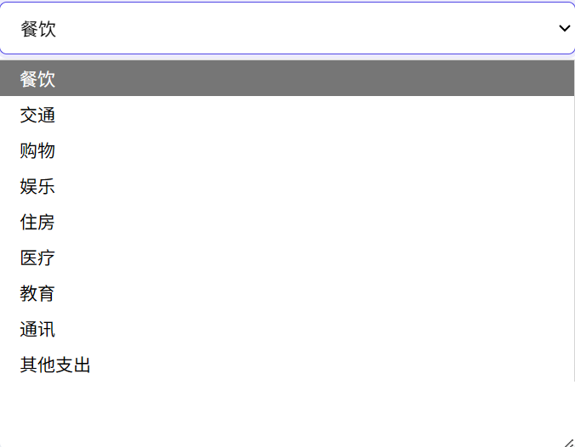
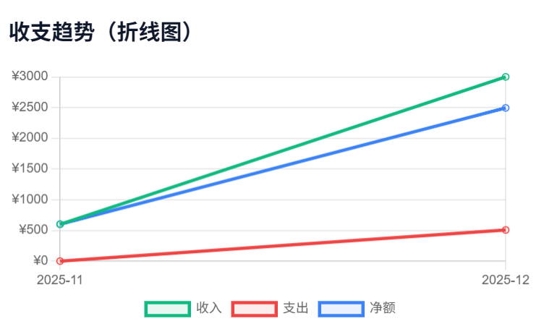
6
Visualization & Styling
Charts (Chart.js)
🎨 Styling (CSS)
Pie: expense categories
Line: income-expense trends
Destroy/recreate lifecycle
Dynamic updates
Responsive layout (Flex / Grid)
Modern UI: rounded, shadow, color palette
Buttons, cards, modals
Adaptive chart sizing

Slide 31




6
Acceptance Criteria
Code Quality
Clear modules Single-responsibility logic
Functionality
Filters work Charts render + update
Modals smooth Responsive layout
UI & Interaction
Clean, consistent UI Smooth navigation
Forms trigger backend properly Auto-refresh lists

Slide 32
4
Project Deliverables & Demonstration
Demonstrates the core features, workflows, and visual analytics of the system through a realistic user scenario.

Slide 33
5
Project Value & Impact
Summarizes the real-world value, user benefits, and future potential of the project, addressing the key question: “Why does this matter?”

Slide 34

Understand spending patterns clearly
Build better budgeting habits
Reduce time spent on manual tracking
Visualized data makes finance easy to grasp
User Value
Practical Impact
Provides clear trends and monthly insights
Supports smarter financial decisions
Fully offline → privacy protected
Lightweight and fast for daily use
Personal finance should be simple, visual, and stress-free.
Our tool helps users gain financial clarity with minimal effort.
Why It Matters
Future Potential
AI-powered expense categorization
Multi-device synchronization
Savings & investment modules
Personalized financial analytics

Slide 35
Thank you
Personal Finance Tracker Project Report

