Slide 1
Research Summary
Zhejiang University
Yunchao Zhang

Slide 2
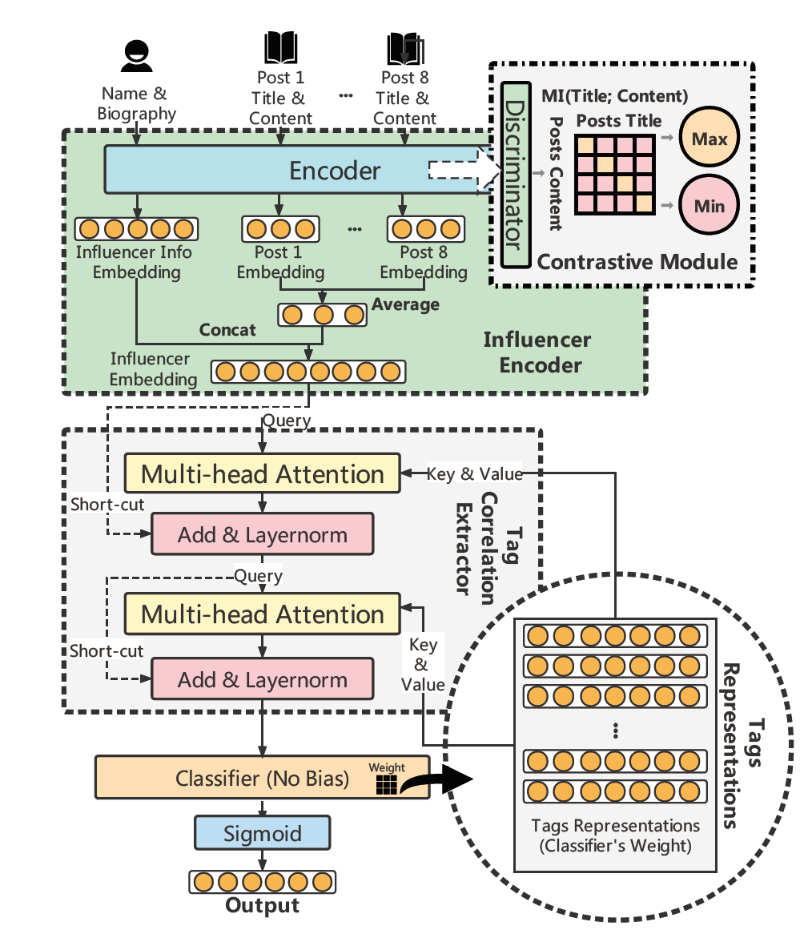
Social Media Influencer Recommendation for Brand Promotion
I Have been admitted to join the AI Lab in ZJU directed by associate professor Yang Yang, who is serving as dean of Artificial Intelligence. I am now participating the program which explores the influencer recommendation system for brand promoting. For a particular brand party, the system can select the influencer who is the most appropriate one to promote its products.
I have been in charge of the Influencer Encoder(See right side) which includes the contrastive learning in NLP.
I am now focusing on multi-modal fusion and representation learning for this system.
Our paper has been submitted to WWW'2022(reject) and SIGIR'2022 (I am the third author).

Slide 3

AGMI: Attention-Guided Multi-omics Integration for Drug Response Prediction with Graph Neural Networks
I’m now also a member of Queshi Technology.
There are great individual differences in the sensitivity of different patients with tumor to different drugs. Focusing on the demand of clinical anti-tumor precise drug use, Queshi Technology proposed a clinically real and available intelligent decision-making system for precise drug use based on patient genome panoramic information and artificial intelligence algorithm model.
I am now in charge of the model construction to predict the appropriate medicine from gene sequencing.
Cancer Cell
Lines
Multilateral heterogeneous graph
$×$8
Basic Layer
Basic Layer
Basic Layer
…
…
…
gGRU
gGRU
gGRU

