Slide 1
Healthcare Deserts in the DMV
Ms Emily Reynolds
Mr. Richie Pherson
Mr. Mike Marshall
Mr. Vibhanshu Shekhar

Slide 2
Motivation & Summary Slide
We are interested in how economic conditions in specific geographic areas affect access to healthcare in the Washington, DC area.
What is the likelihood that more doctors are located in more populated areas?
Would hospital facilities be located more within higher income or lower income areas?
Is the unemployment rate higher in lower income areas?
Does per capita income influence the percentage of individuals possess healthcare insurance?
We found that

Slide 3
Questions & Data
Question #1: What is the likelihood that more doctors would be located in higher populated areas?
Number of doctors by zip code: Google Places API
Population by zip code: US Census Bureau, American Fact Finder
Question #2: Would hospital facilities be located more within higher income or lower income areas?
Number of hospitals by zip code: Google Places API
Income by zip code: US Census Bureau, American Fact Finder
Question #3: Is the unemployment rate higher in lower income areas?
Unemployment and Per Capita Income by zip code: US Census Bureau, American Fact Finder
Question 4: Does per capita income influence the percentage of individuals possess healthcare insurance?
Per Capita Income and Percent of pop. Insured: US Census Bureau, American Fact Finder

Slide 4
Data Cleanup & Exploration
Exploration and Cleanup
Selected desired data and downloaded into multiple CSVs from factfinder.census.gov
Cleaned it in Pandas with DataFrames – eliminated, renamed, and merged DataFrame from multiple CSVs.
Google Places API??
Turned the Google Places data into a DataFrame, which was merged with the economic indicators
Unexpected Insights
??
Problems
Problem we discovered on thursday
New Tools
Describe API mapping process

Slide 5
Data Analysis
Discuss the steps you took to analyze the data and answer each question you asked in your proposal
Present and discuss interesting figures developed during analysis, ideally with the help of Jupyter Notebook

Slide 6
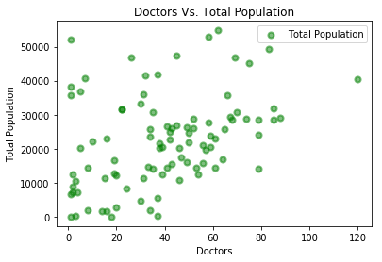
Discussion – Question 1
We did not find a relationship between the income of a zip code and the number of doctors practicing there.

Slide 7
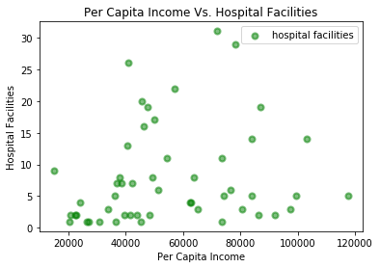
Question #2: Are there more hospitals in lower- or higher-income zip codes?
More hospitals at either the higher or lower end and not as much within areas with medium income per capita
Possibly due to lower property costs

Slide 9
Post Mortem

Slide 10
Questions

