Slide 1
Digital Marketing Campaign Conversion Prediction

Slide 2
Project Objective
to enhance campaign effectiveness in the digital marketing sector with accurate customer conversions prediction by developing a machine learning model.
to identify potential converters and optimize marketing strategies based on various demographic and engagement factors.
enabling the improved campaign targeting to increase conversion rates, and to maximize return on advertising spend (ROAS)

Slide 3
Process
Problem Definition
Data Collection
Data Preprocessing
Exploratory Data Analysis (EDA)
Model Selection
Model Training
Model Evaluation and Validation
Model Deployment

Slide 4
Problem Definition
Develop a robust machine learning model to accurately predict customer conversions based on various demographic and engagement factors. By utilizing this model, the company aims to improve campaign targeting, increase conversion rates, and maximize return on advertising spend (ROAS).

Slide 5
Data Collection
Data Acquisition:
Load the dataset-
Import Essential Libraries
Available dataset: “digital_marketing_campaign_dataset.csv” load using “pd.read_csv”
Gather the Information about records and dataset structure

Slide 6
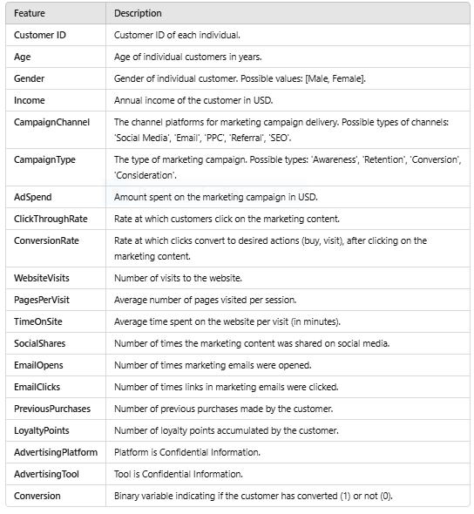
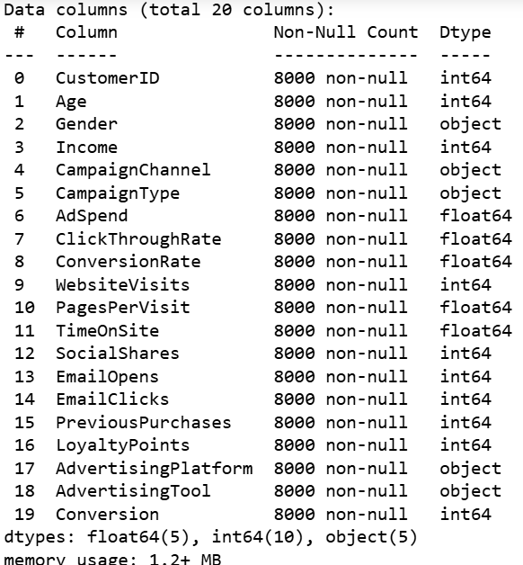
Data Information and structure of data

Slide 7
Data description
Get know the Numeric Features
['CustomerID', 'Age', 'Income', 'AdSpend', 'ClickThroughRate', 'ConversionRate', 'WebsiteVisits', 'PagesPerVisit', 'TimeOnSite', 'SocialShares', 'EmailOpens', 'EmailClicks', 'PreviousPurchases', 'LoyaltyPoints’]
Get know the Catagorical features
['Gender', 'CampaignChannel', 'CampaignType', 'AdvertisingPlatform','AdvertisingTool']

Slide 8
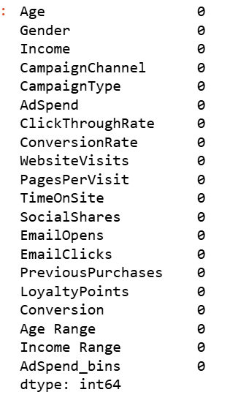
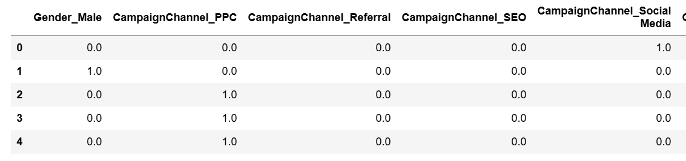
Data Preprocessing
handling missing data- df.isnull().sum()
handling duplicate values-
df.duplicated().sum() -->0
handling categorical values-
Using onehot encoding

Slide 9
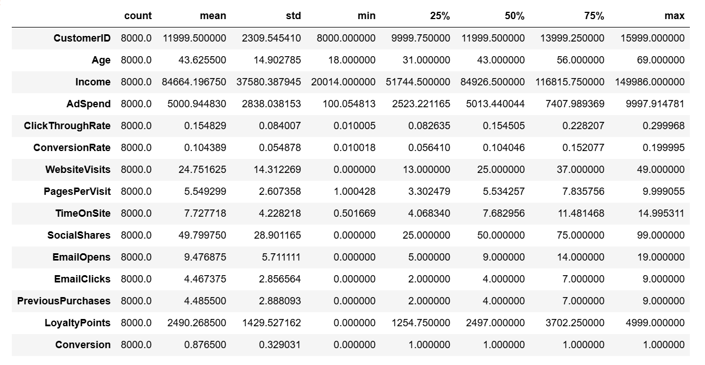
Exploratory data analysis
Get know the statistical description of data

Slide 10
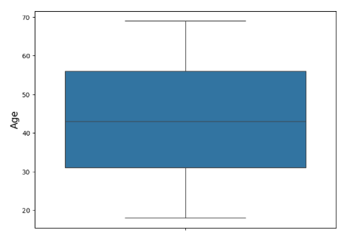
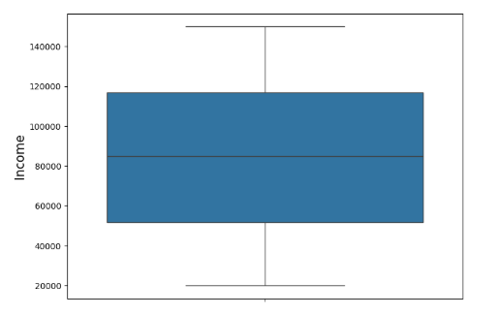
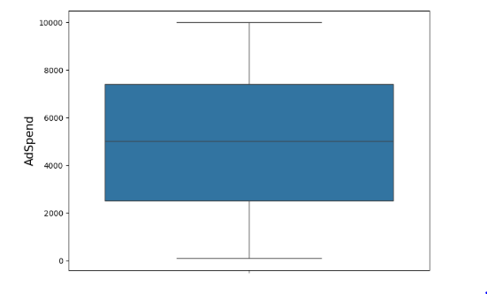
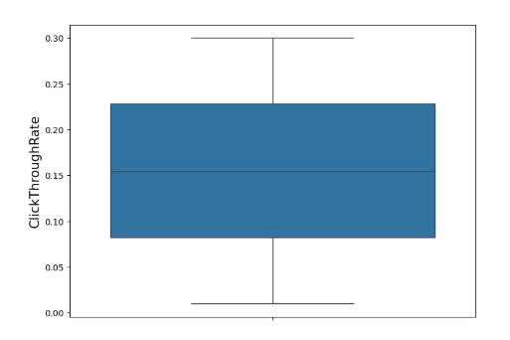
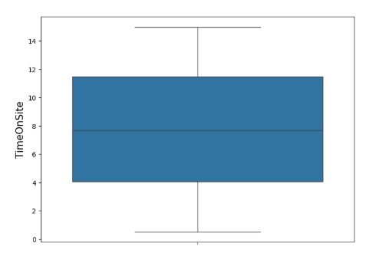
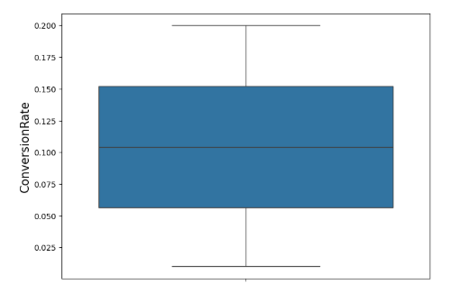
EDA – Univarient analysis of features

Slide 11
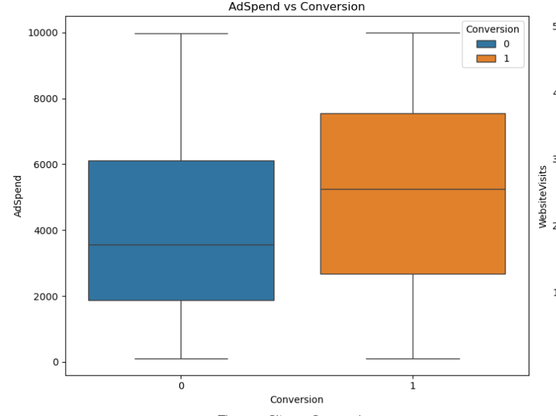
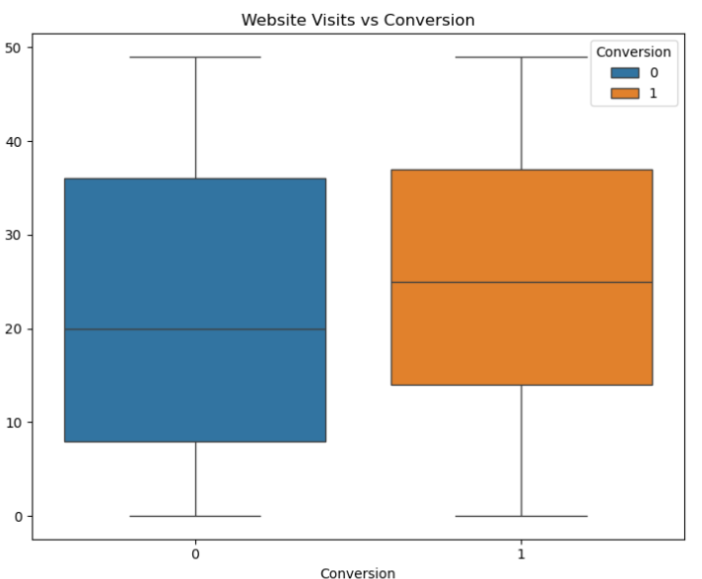
EDA- BiVariate Analysis

Slide 12
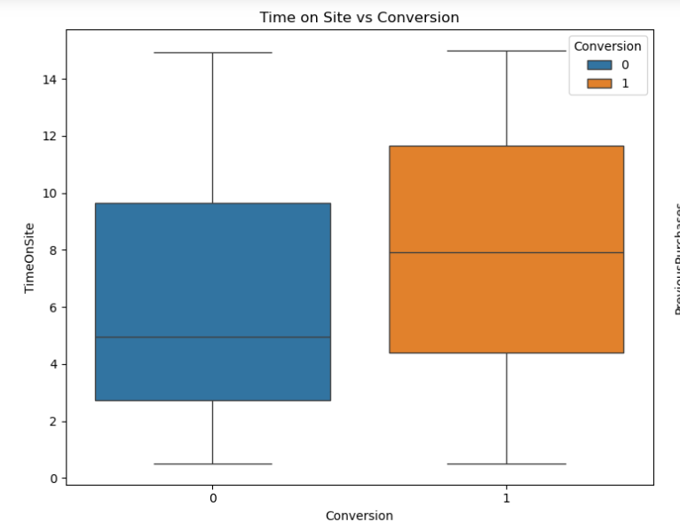
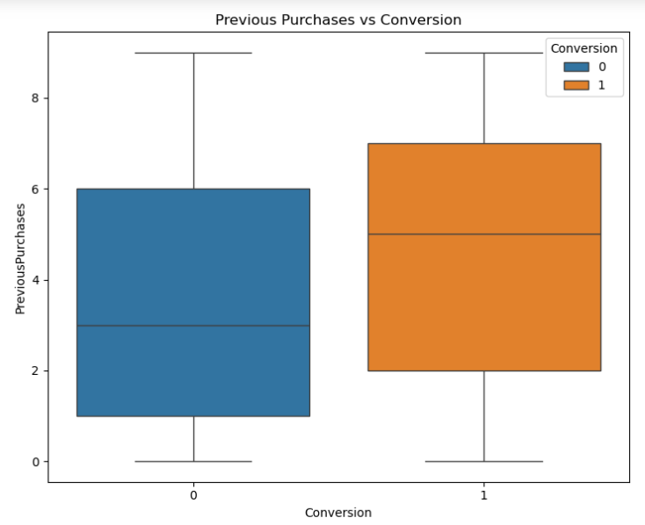
EDA- Bivariate

Slide 13
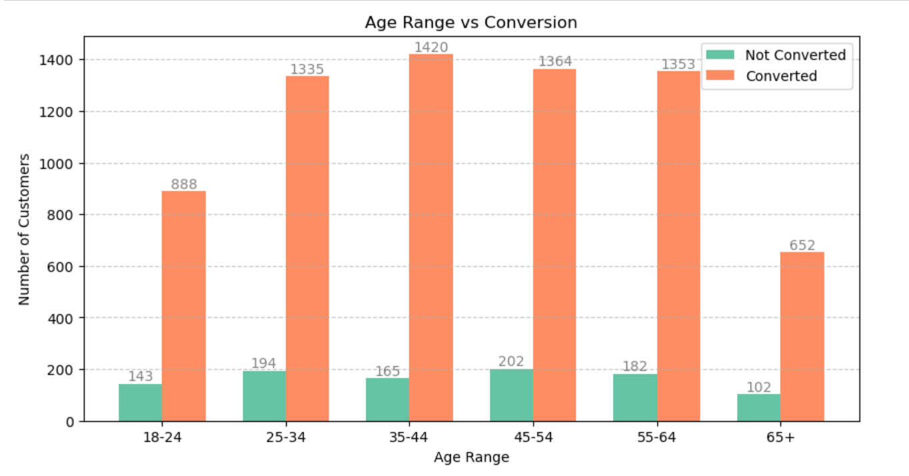
Age vs conversion
Insights from Age Vs Conversion
35–44 years: Highest conversions
25–34 years: Second highest
45–54 years: Third highest
55–64 years: Fourth highest
18–24 years: Lower conversions but significant
65+ years: Lowest conversions

Slide 14
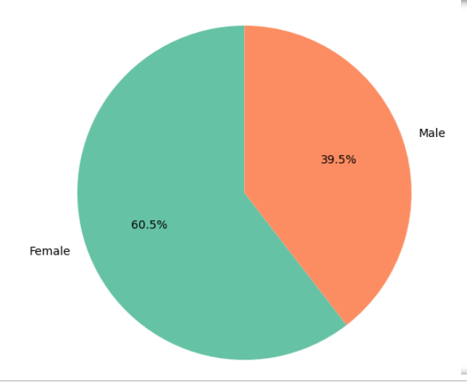
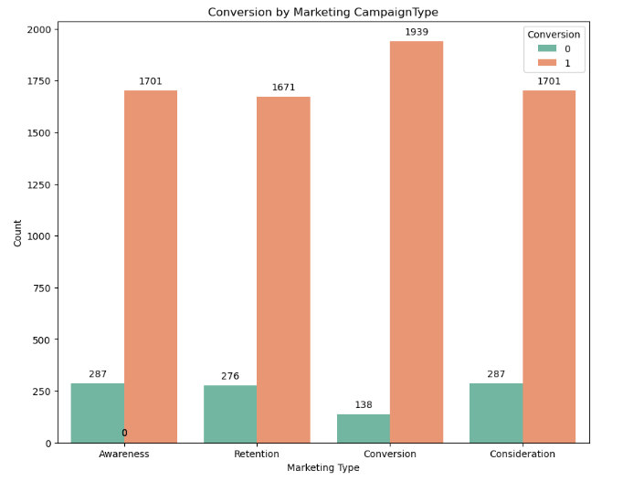
Gender Vs Conversion Camp.Type Vs Conversion
Insights from Gender Vs Conversion
Female: Represents 60.5% of the converting audience
Male: Represents 39.53% of the converting audience
Insights from Number of Website visit by campaign type Vs Conversion
almost each campaign type contributes equal amount of share for website visit
Where as Conversion Marketing Type has Highest rate for Conversion of customers

Slide 15
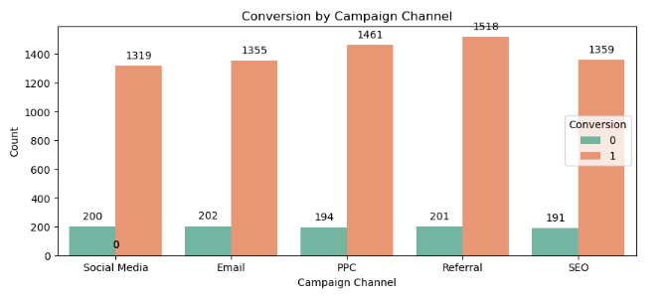
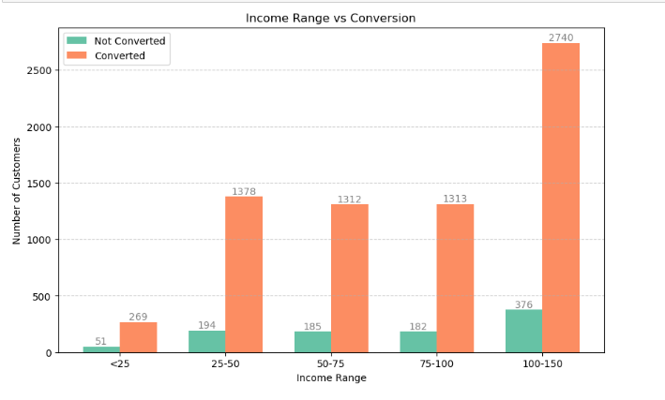
Camp. Channel vs Conversion income vs conversion
Insights from conversion by campaign Channel
almost each campaign channel contributes equal ammount of share for website visit
whereas Social Media, Email, SEO Marketing Channel has bit lower rate of Customer Conversion
Insights from Income Vs Conversion :
100-150: Highest conversions, 25-30: Second highest
75-100: Third highest, 50-75: Fourth highest, 25: Lowest conversions

Slide 16
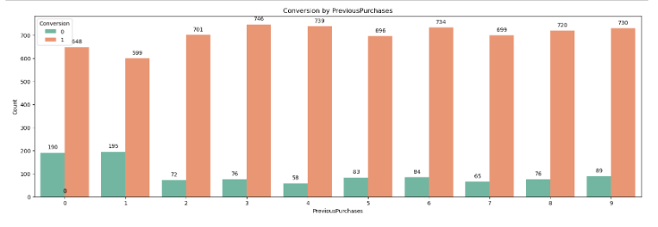
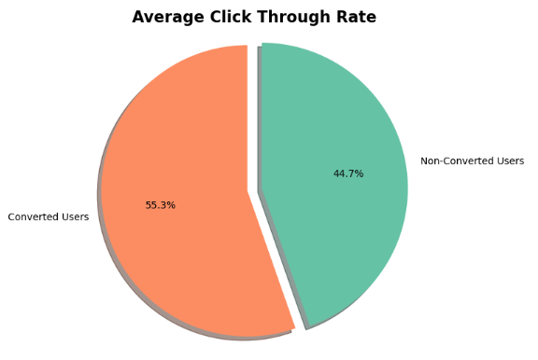
PreviousPurchase vs conv. Avg ctr vs Conversion
Insights from Number of Previous Purchases Vs Conversion
Previous Purchases more than 2 has more chance Of Customer Conversion
Insights from Average CTR Vs Conversion
Average CTR converts more user than non-converts, 55.3% to 44.7% respectively.

Slide 17
Cost Per Aquisation
total_cost = df['AdSpend'].sum()= 40007558.64339962
total_customers = len(df[df['Conversion'] == 1])= 7012
cpa = total_cost / total_customer= $5705.58
Average_Sales_Conversion= len(df[df['Conversion'] == 1])/ len(df) = 0.88
Insignts from Adspent Cost Aquisition Analysis
Money spend on Ads for each customer is 5705.58 USD
Money spend on an vaerage is 5000.94 USD

Slide 18
Return On Investment
total_revenue = 100000000
total_cost = df['AdSpend'].sum()
roi_alternative = ((avg_revenue_per_conversion - total_cost) / total_cost )* 100
avg_revenue_per_conversion = round((total_revenue / total_conversions), (2))
Insights from ROI
spent 14261.27 USD per converted customer
total_cost= 40007558.64339962USD
Alternative ROI (Avg. Revenue per Conversion): -99.96%
That means, for every dollar spent on marketing, the campaign is losing 0.9 USD( or 9cents).

Slide 19
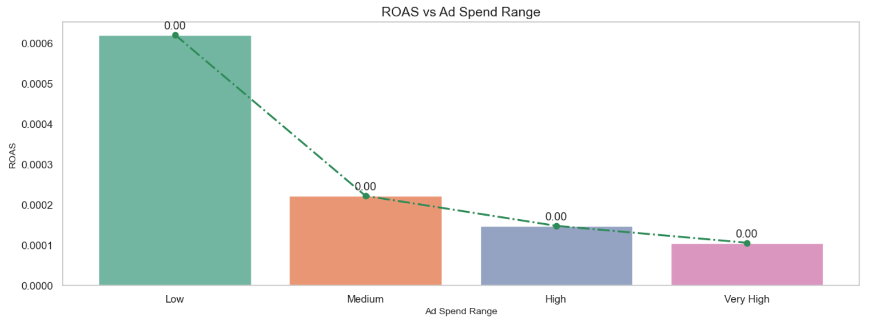
Return On AdSpend ROAS
ROAS by AdSpend bin: AdSpend_bins : Low 0.000621
Medium 0.000222
High 0.000148
Very High 0.000106

Slide 20
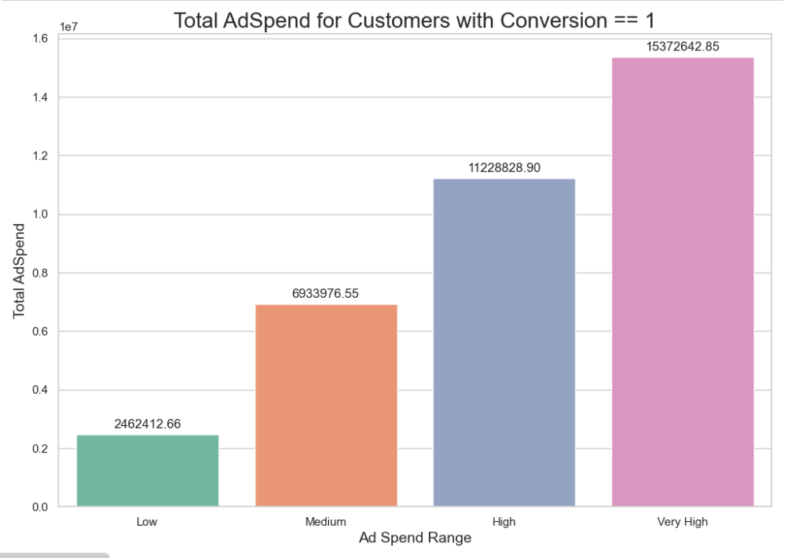
INSIGHTS FROM ROAS
Insights from Return on Advertisement Spent (ROAS)
Calculate the ROAS by comparing the Ad comaign Cost (e.g., from conversions) to the converted Customer Ad Spent cost.
As the Advertisment spend increase the ROAS decreases.
Hence,we can conclude spending more on advertisement does not help to increase the ROAS

Slide 21
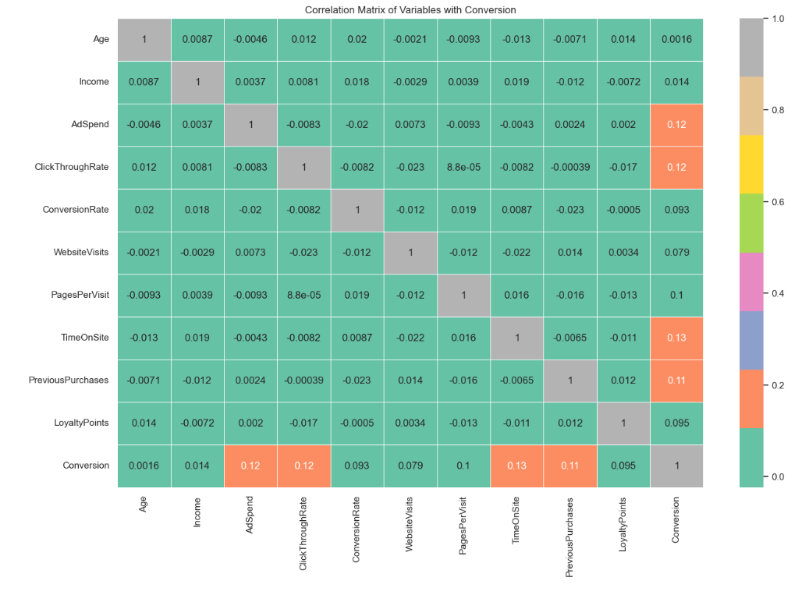
Multivariate Analysis
Insights from Heatmap Correlation with respect to Conversion:
Positive Corelation:
AdSpend (0.12)
ClickThroughRate (0.12):
TimeOnSite (0.13)
PagesPerVisit (0.10)
ConversionRate (0.093)
LoyaltyPoints (0.095)

Slide 22
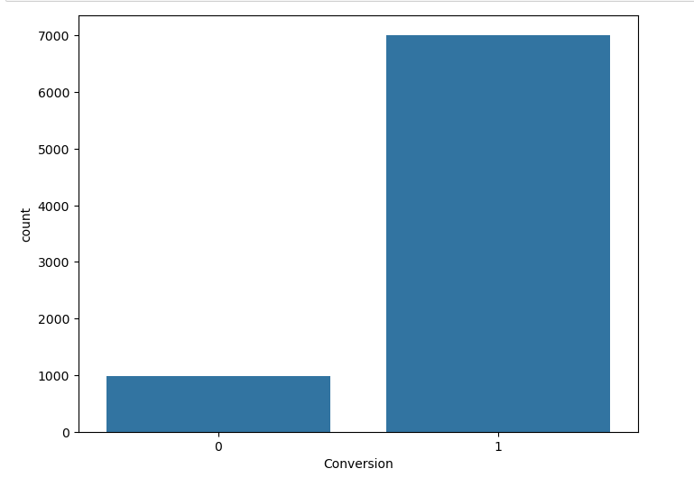
Pre- Model Selection
Before model selection need to divide data into X independent and y dependent set.
Balance the Data Using SMOTE (Synthetic Minority Over-sampling Technique) Library
# ideally the ratio of NonConvererstion:
Conversion should be 1:3
988: 2968but it’s 988:7018
print(988*3) but here it is 1:7.
then data splited in 80:20 for train test
sets

Slide 23
find best k value for cross validation while modeling the data
Given dataset considered a medium-to-large dataset. And the larger dataset generally requires a slightly higher k value to smooth out noise and prevent overfitting.
With 21 features, it may encounter the curse of dimensionality. Higher dimensions tend to require slightly higher k values to counteract noise. Hence, consider testing k = 1 to 60 for better coverage.
Insights from Finding Best K value for models
The best K-Value for the Cross Validation K-fold must be 1
Got k=1 with score:0.89

Slide 24
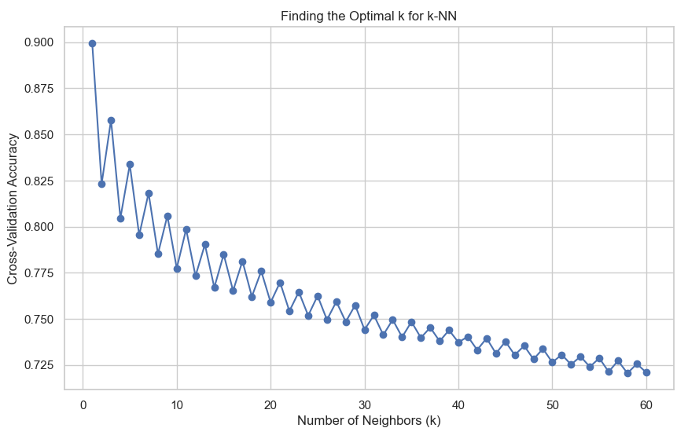
Finding K-value

Slide 25
Model Selection
Decision Tree: A model that uses a tree structure to represent hierarchical decision rules
Random Forest: An ensemble learning technique that combines multiple decision trees to improve model accuracy and robustness
AdaBoost: Another ensemble learning algorithm that iteratively adjusts the weights of observations to focus on the most challenging cases.
Gradient Boosting: An ensemble learning technique that builds decision trees sequentially, optimizing a specific loss criterion.
XGBoost: An efficient implementation of gradient boosting, known for its speed and superior performance.
SVM: SVM tries to find the optimal hyperplane that maximizes the margin between different classes. For non-linear problems, it uses kernel tricks to transform data into higher dimensions.
KNeighborsClassifier: Classifies a data point based on the majority class of its K nearest neighbors (using distance metrics like Euclidean distance).

Slide 26
Model Building and Trining
Model | Training Accuracy | Testing Accuracy
4 | XGBClassifier | 0.999020 | 0.957576
1 | RandomForestClassifier | 1.000000 | 0.948307
2 | GradientBoostingClassifier | 0.922275 | 0.906239
5 | SVC | 0.918085 | 0.880214
0 | DecisionTreeClassifier | 1.000000 | 0.861319
3 | AdaBoostClassifier | 0.823603 | 0.813547
6 | KNeighborsClassifier | 0.827346 | 0.795009
Models are called and build.
This chart shows training and testing accuracy at very initial level of model creation

Slide 27
Model training- feature Importance
Why is Feature Importance Important? to determine the relevance or contribution of each feature (input variable) in making predictions.
identify which features have the most influence on the target variable, guiding feature selection, model optimization, and interpretability.
Key Insights: 'AdSpend', 'WebsiteVisits', 'TimeOnSite’, ‘previous purchase’,’ emailclicks,’—some of most imprtnat
Feature importance differences across models provided insights into model behavior and feature dependencies.

Slide 28
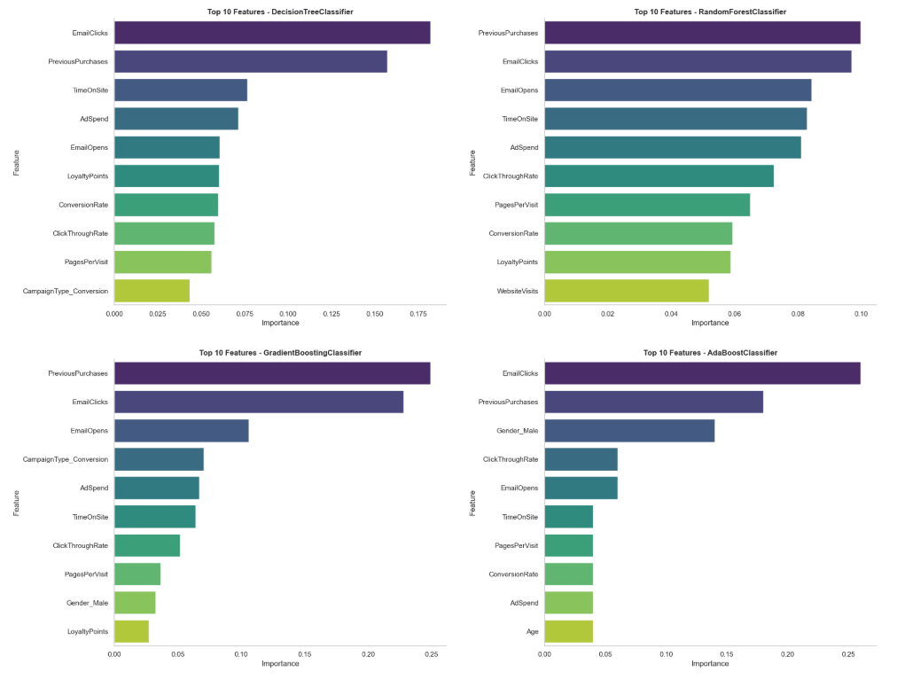
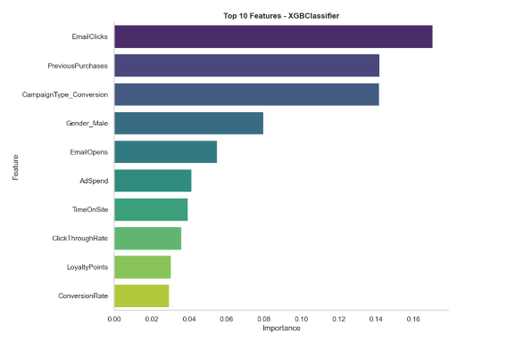
Feature Importance

Slide 29
Hyper parameter tuning
Hyperparameter tuning with cross-validation is vital because it provides an objective evaluation of model performance.
It avoids the pitfalls of overfitting or underfitting and ensures that the chose
model is generalizable to unseen data.
Key Observations: Ensemble Models (XGBoost, Random Forest, and Gradient Boosting) consistently outperform other models due to their ability to handle non-linear relationships, high-dimensional data, and ensemble learning techniques.
XGBClassifier emerges as the best model for deployment, offering both high accuracy and balanced precision-recall metrics. Simpler models like DecisionTree and KNeighborsClassifier are less effective, indicating the need for more complex algorithms to handle this datasetn model is generalizable to unseen data.

Slide 30
Model Evaluation- using different Matrices
Precisison= Precision measures how many of the predicted positive instances are actually positive.
Recall=Recall measures how many actual positive instances are correctly predicted by the model.
F1 Score= harmonic mean of Precision and Recall and provides a balance between the two metrics.
Classification Report- it has all evaluation metrices shown in single report
Accuracy- training
testing
Confusion matrix= A confusion matrix is a table that summarizes the performance of a classification model by comparing actual and predicted values.

Slide 31
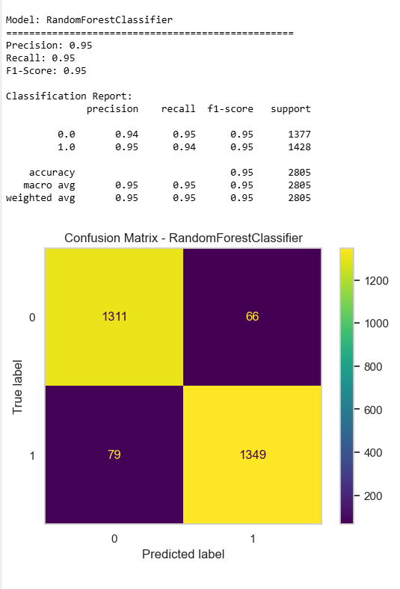

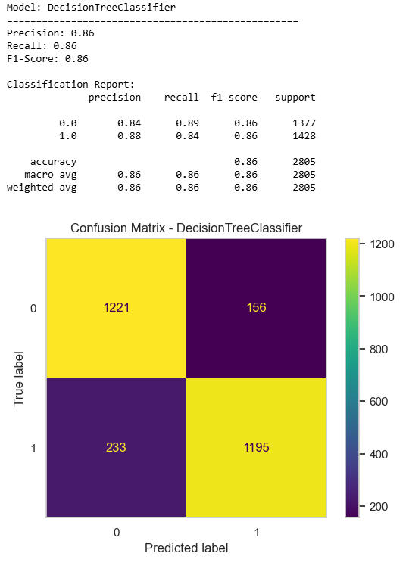
Confusion matrices of models

Slide 32
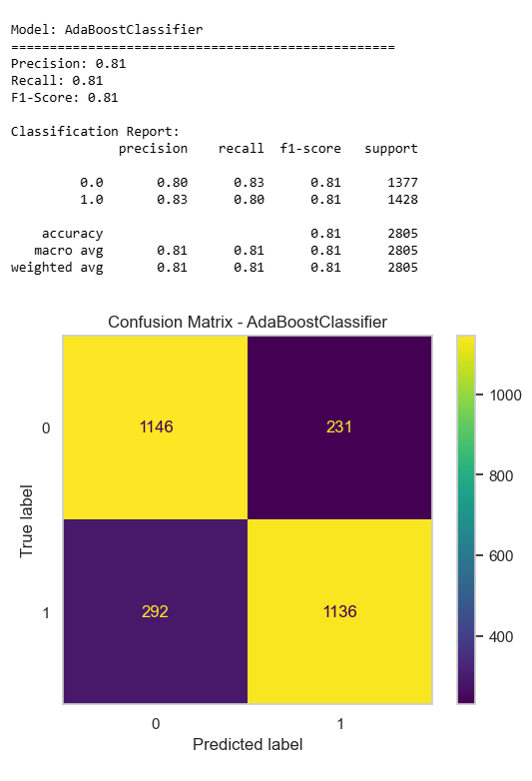
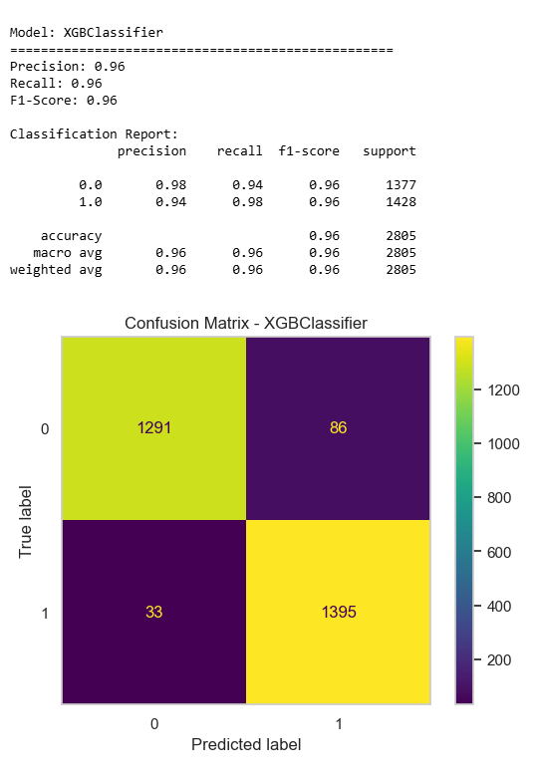
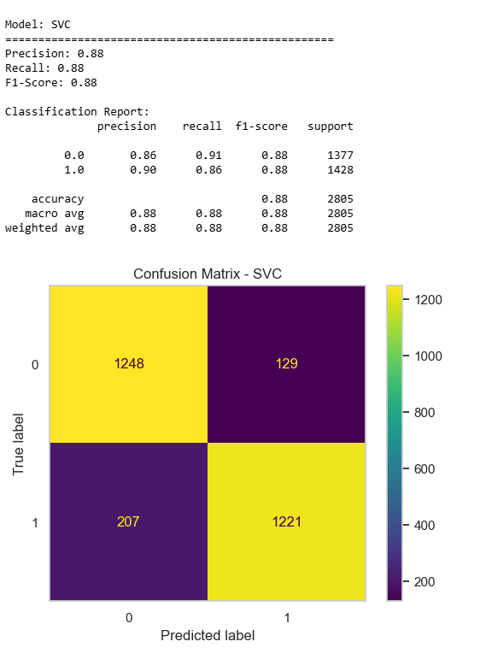

Slide 33
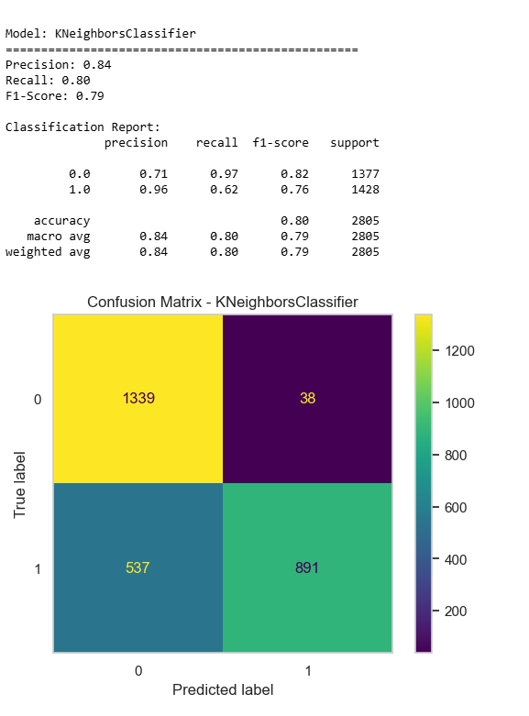
Confusion matrices of models

Slide 34
ROC- AUC Curve
essential tool for evaluating classification models
a key evaluation metric for classification models, especially in scenarios involving imbalanced datasets.
ROC Shows the model's ability to distinguish between classes across thresholds.
AUC score Provides a single value summarizing performance—higher values indicate better performance.
Diagonal Line (Random Guess) Helps visually compare how far the model performs above chance-level classification.

Slide 35
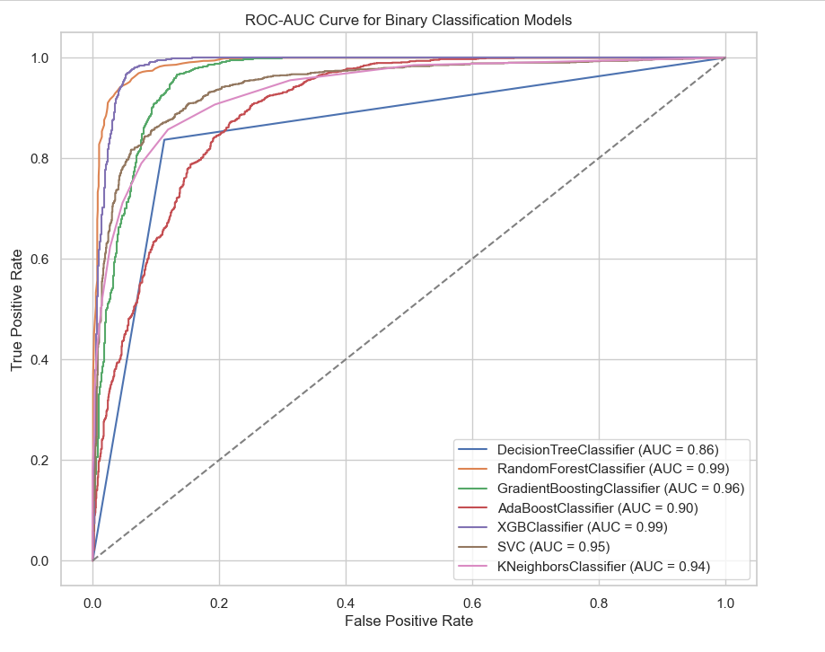
ROC- AUC Curve
Top Performers: If high accuracy and balanced performance across classes are required,
XGBClassifier and RandomForestClassifier are the top choices, both exhibiting robust and consistent performance.
GradientBoostingClassifier is a good alternative, though slightly less effective compared to the top two.

Slide 36
Comparative analysis of all models
 | Model | Accuracy | Precision | Recall | F1 Score
4 | XGBClassifier | 95.76% | 94.19% | 97.69% | 95.91%
1 | RandomForestClassifier | 94.83% | 95.34% | 94.47% | 94.90%
2 | GradientBoostingClassifier | 90.62% | 90.20% | 91.53% | 90.86%
5 | SVC | 88.02% | 90.44% | 85.50% | 87.90%
0 | DecisionTreeClassifier | 86.13% | 88.45% | 83.68% | 86.00%
3 | AdaBoostClassifier | 81.35% | 83.10% | 79.55% | 81.29%
6 | KNeighborsClassifier | 79.50% | 95.91% | 62.39% | 75.60%
Final Verdict: While the XGBClassifier and RandomForestClassifier models stand out as the best-performing models based on their accuracy, precision, recall, and F1-score,
the GradientBoostingClassifier and SVC also offer solid alternatives, each with their own strengths.
XGBClassifier being the best choice in this comparison.

Slide 37
Deploy The Model
To deploy the best-performing machine learning model (e.g., XGBClassifier) and ensure it's ready for use in production, we'll use the joblib library to save the model.
Then
Load the Saved Model
And Create Streamlit application- CostmerConversionApp.py

Slide 38
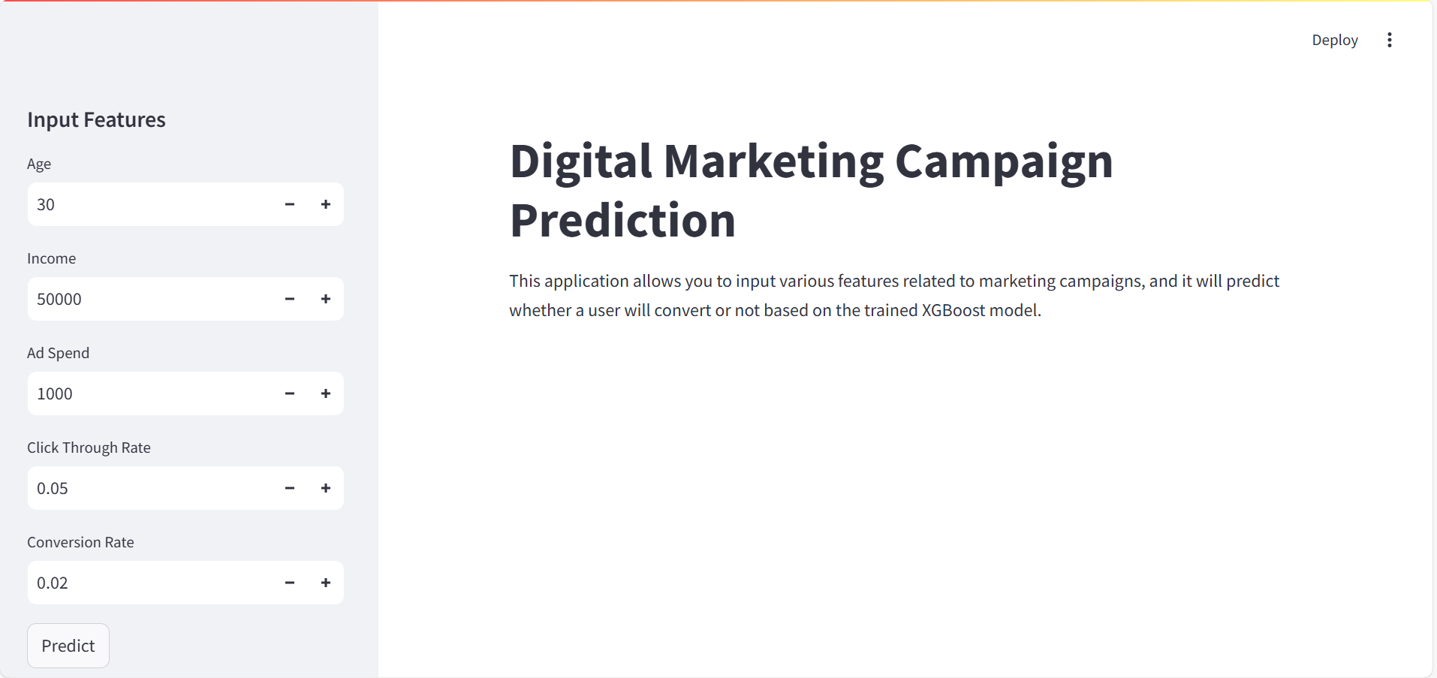
Streamlit App User View
The streamlit window is the display of prediction work done at the background.
User can fill the value In blanks and get to know the prediction of Customer Conversion accordingly.

Slide 39
Questions ?

Slide 40
Thank You!

