Slide 1
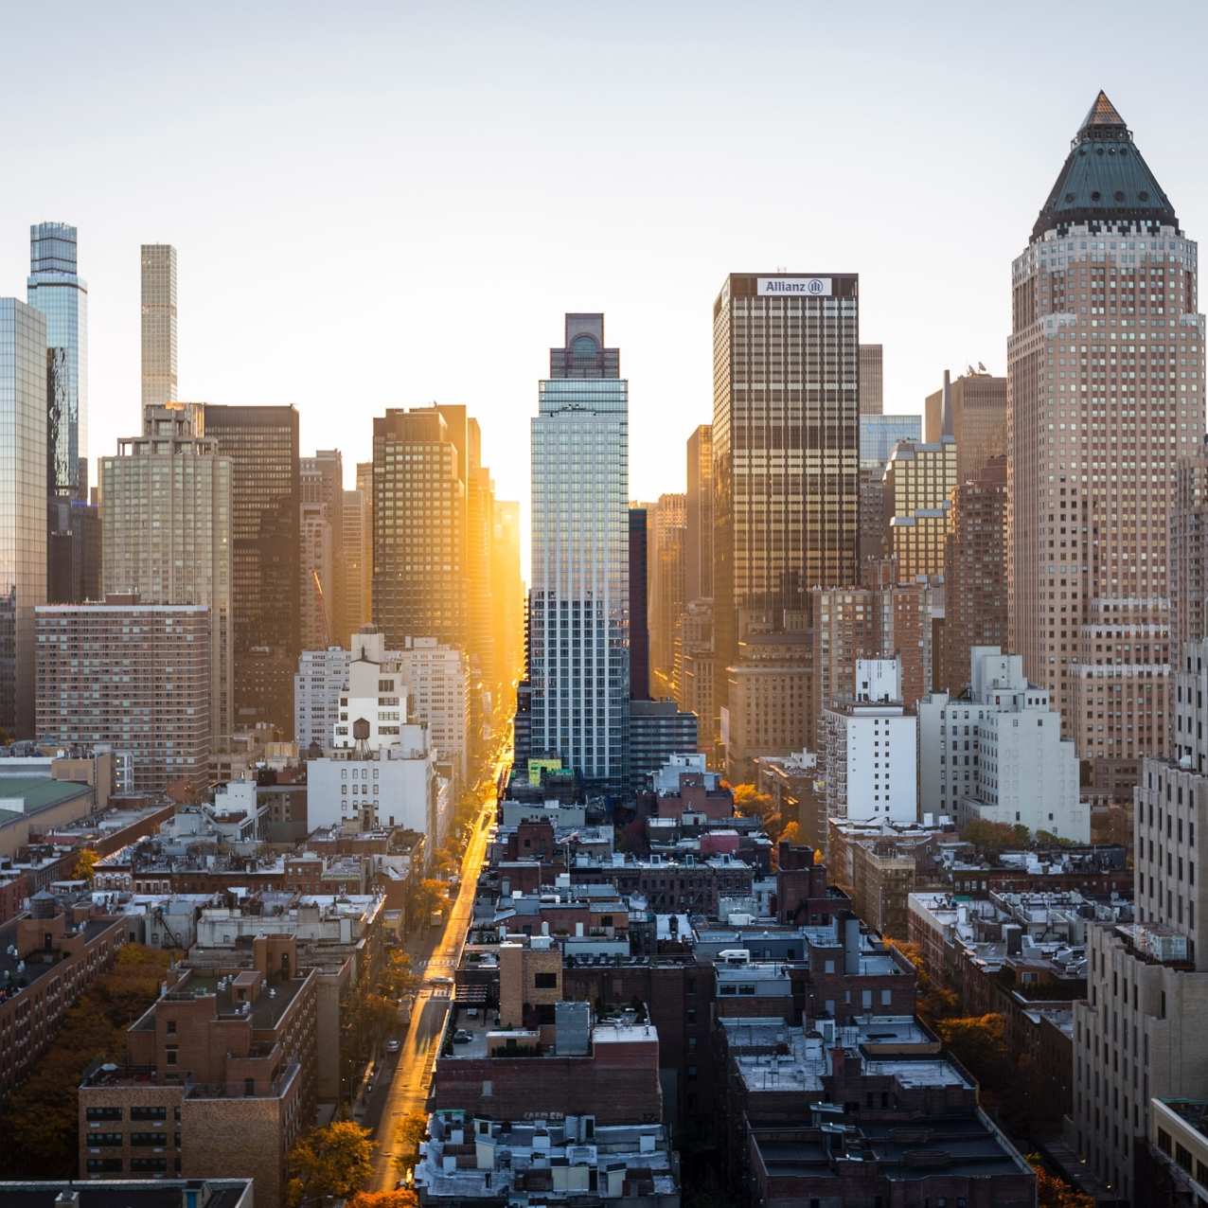
INVESTING IN AIRBNB
A SAN FRANCISCO PERSPECTIVE
BY ALEXANDRIA THOMPSON

Slide 2
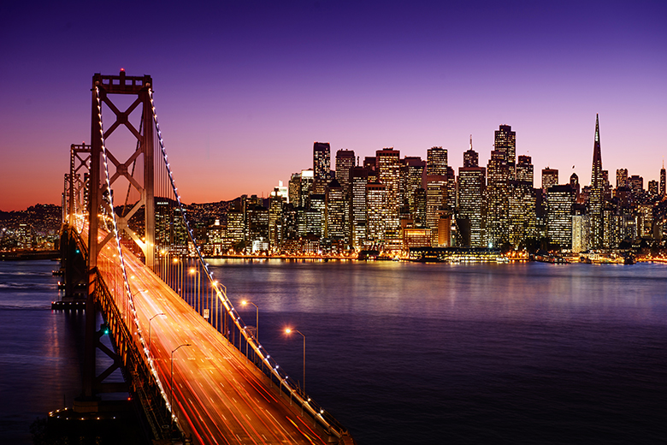
AIRBNB’S PROPERTY INVESTMENT SUCCESS
Airbnb offers great opportunities for anyone looking to make money in real estate. With over 150 million guests making trips to 65,000 cities around the world, investing in Airbnb rentals is quickly becoming the optimal real estate investment strategy for savvy property investors. Let’s take a look at the San Francisco market and which neighborhood is best for you!

Slide 3
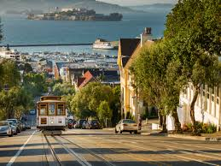
Sf Airbnb setting
With over 35 neighborhoods throughout the city, San Francisco offers dozens of options when entering into the market.
A high entry cost keeps many investors out, however, in the right neighborhood, an investor can create a great revenue stream in this highly visited tourist destination.

Slide 4
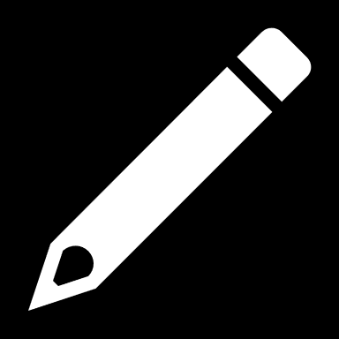
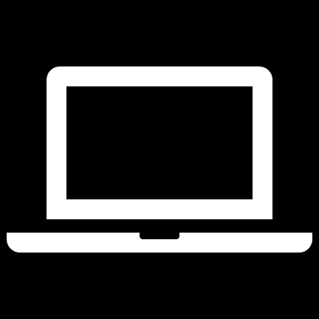
DATA CLEANING STEPS
CREATED ROI COLUMN WITH AVERAGE HOUSING PRICES AND TOTAL REVENUE
DELETED LISTINGS WITH BLANK ZIPCODES, 0 NUMBER OF STAYS AND PRICED AT $0
CLEANED UP REVIEW RATING COLUMN. CREATED NEW COLUMN WITH PERCENTAGE IN DECIMAL FORMAT
DATA CLEANING
REMOVED DUPLICATES AND BLANKS FROM ID COLUMN
REMOVED COLUMNS/ FIELDS THAT WILL NOT BE USED IN ANALYSIS
ADDED PRICE PER NIGHT, PER STAY, AND TOTAL REVENUE COLUMNS
CLEANED UP ZIPCODES AND ADDED MEDIAN HOUSING PRICES COLUMN WITH INFO FROM Redfin_median_home_price_2019
ORGANIZING AND EDITING

Slide 5
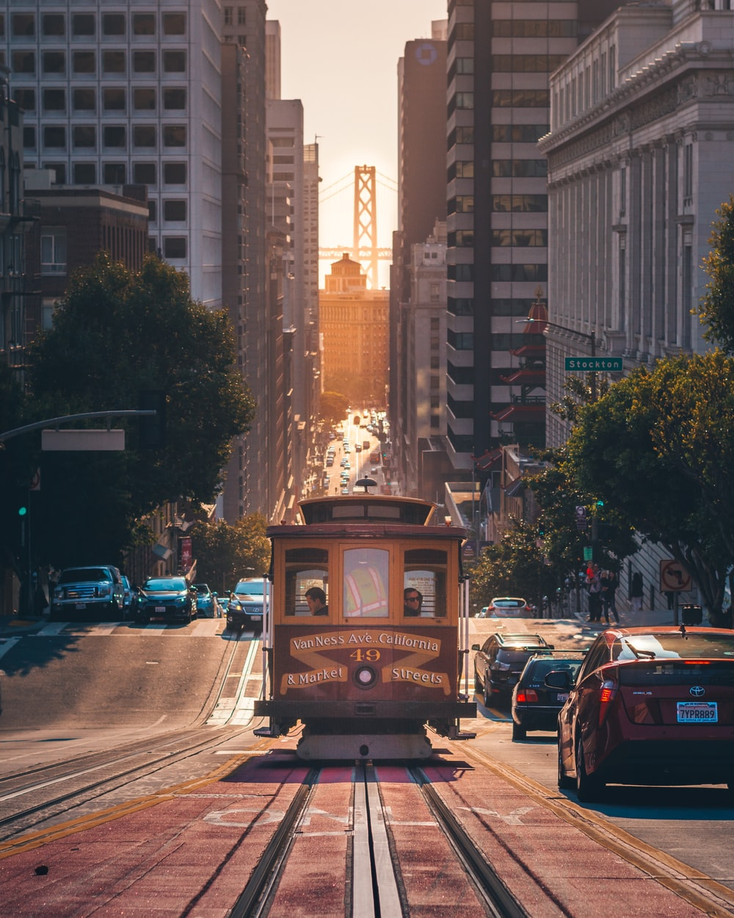
Airbnb in the city
Number of Listings in the city:
6165 throughout the city, after cleaning
Number of visitors to all listings:
699532
Total Market Revenue
$1,293,863,192
Average Listing Revenue
$209,874

Slide 6
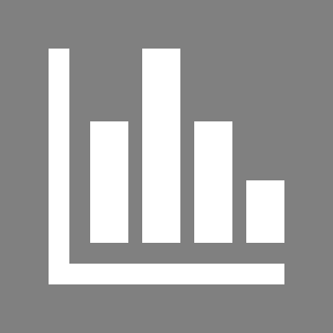
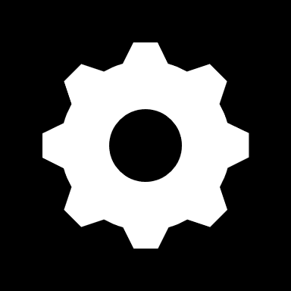
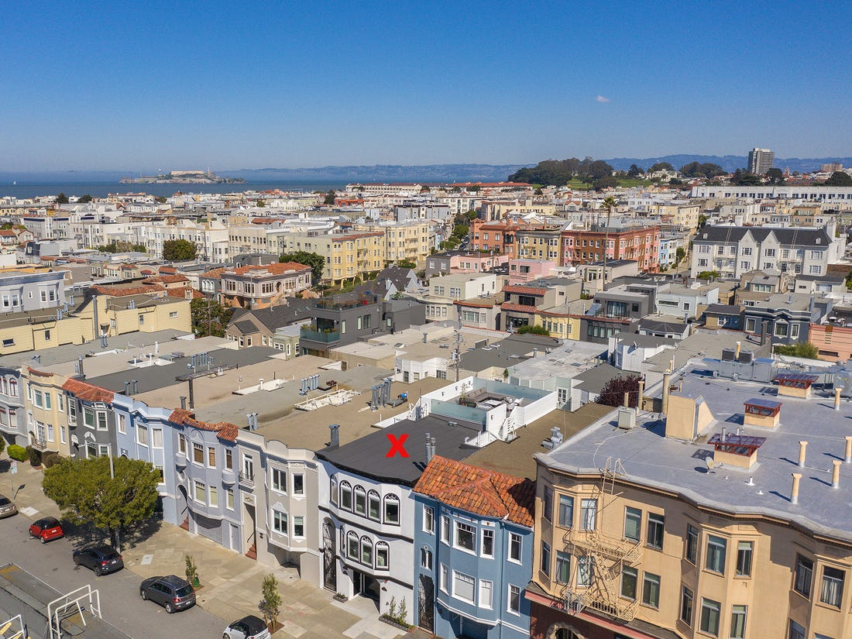
What neighborhood offers the highest revenue??
Investing in city property
What neighborhood offers the best return?
San Francisco offers tourists options for eat, sleep and play all over the city. Choosing a neighborhood that intinces the most visitors is essential for a successful listing.
Several neighborhoods are highly visited and the success is in the revenue, but is a neighborhood that has high number of stays the best one to invest in?
Let’s look at some of the most popular areas in the city.

Slide 7
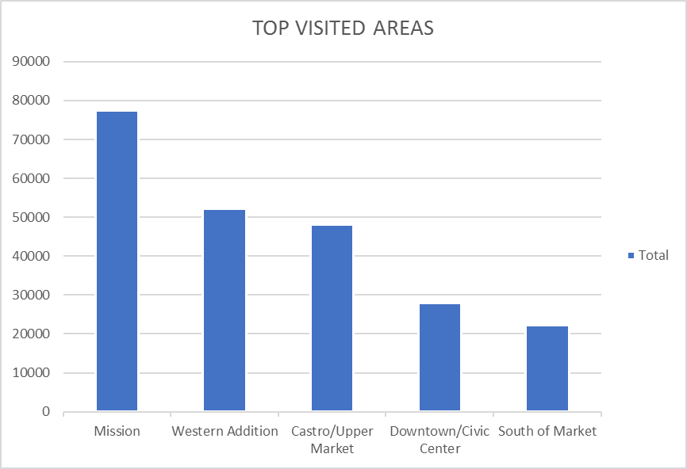
High-performing neighborhoods
Visitors love these areas
THESE NEIGHBORHOODS HAVE THE HIGHEST VISITOR TRAFFIC IN THE CITY:
MISSION
WESTERN ADDITION
CASTRO
DOWNTOWN/ CIIVIC CENTER
SOUTH OF MARKET (SOMA)
Most popular for tourists

Slide 8
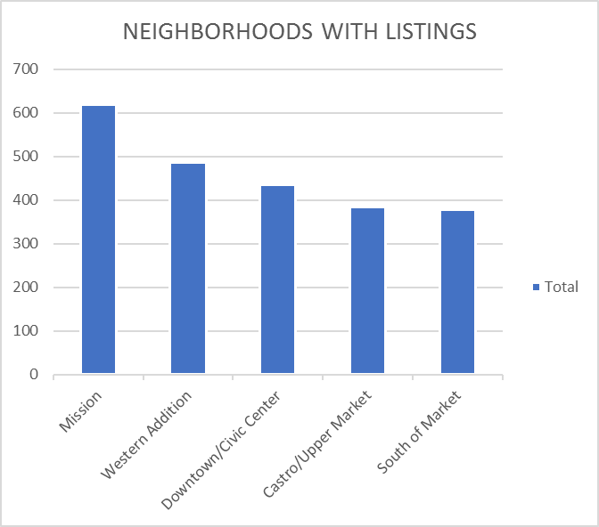
High-performing neighborhoods
THESE NEIGHBORHOODS HAVE THE MOST LISTINGS IN THE CITY:
MISSION
WESTERN ADDITION
DOWNTOWN/ CIVIC CENTER
CASTRO
SOMA
Competitive neighborhoods
These areas have a larger listing density

Slide 9
Taking a look into SAN FRANCISCO’S revenue…

Slide 10
Taking a look into SAN FRANCISCO’S revenue…
Mean not close to median
Standard Error very high
Such a high range between listings
High Standard Deviation

Slide 11
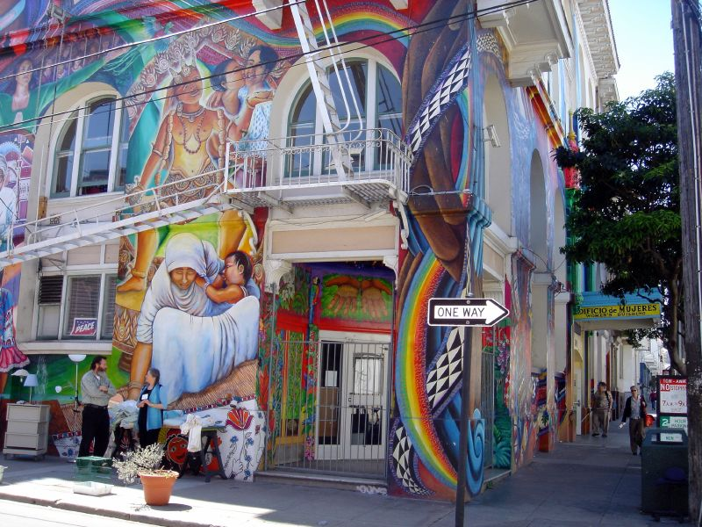
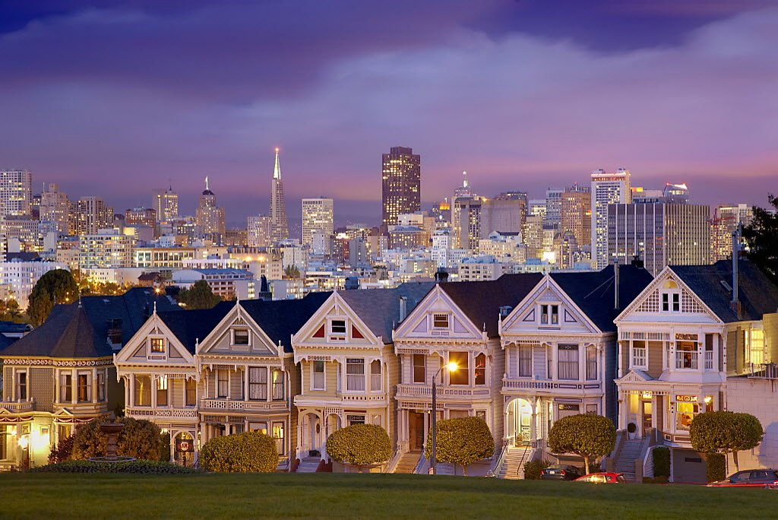
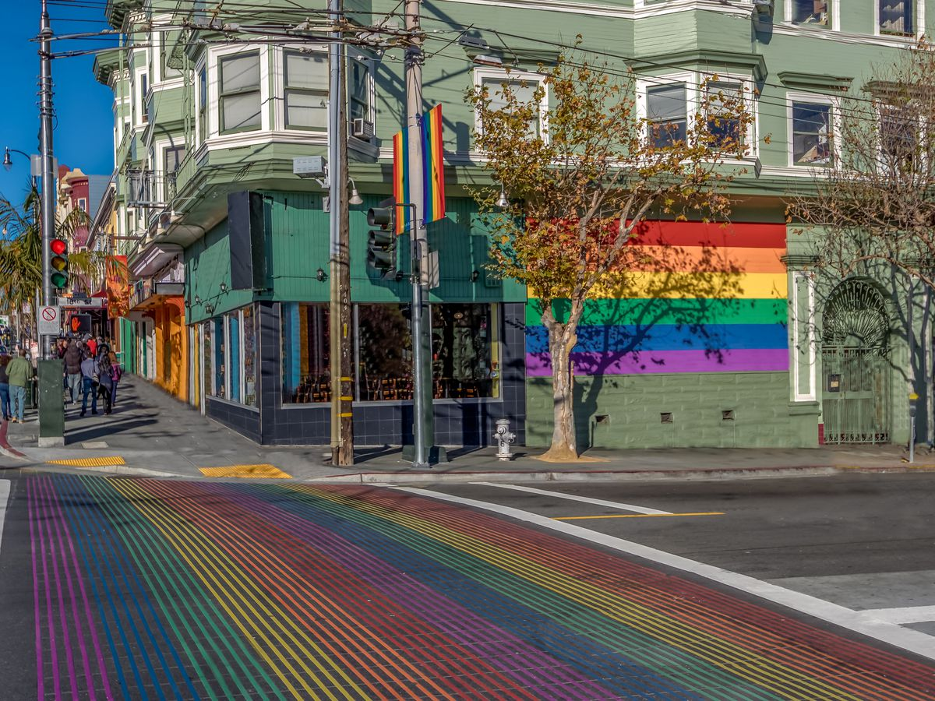
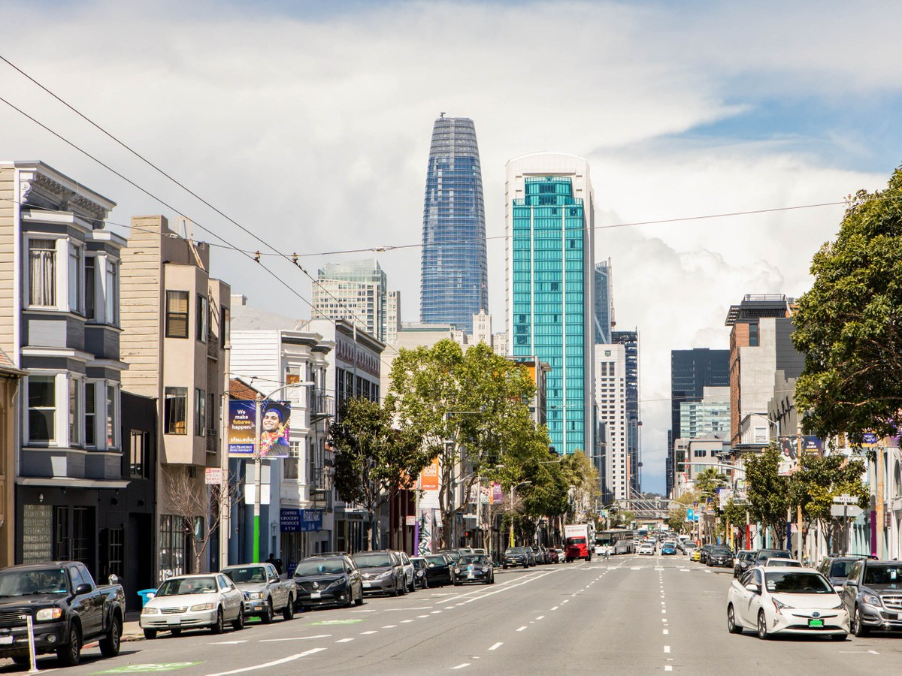
RECOMMENDED NEIGHBORHOODS
mission
Western addition
castro
SOMA
Number of Listings: 378
Avg Revenue: $259,396
Number of stays: 22,230
Avg Review Rating: 82%
Number of Listings: 618
Avg Revenue: $236,382
Number of stays: 77,434
Avg Review Rating: 87%
Number of Listings: 486
Avg Revenue: $266,745
Number of stays: 52,270
Avg Review Rating: 88%
Number of Listings: 384
Avg Revenue: $216,416
Number of stays: 48,062
Avg Review Rating: 87%

Slide 12
TOP CHOICE!
CASTRO DISTRICT!
THIRD HIGHEST REVENUE
HIGH NUMBER OF STAYS
NOT AS DENSE AS OTHER NEIGHBORHOODS
87% AVERAGE REVIEW RATING

Slide 13
Castro’s stats

Slide 14

Questions? Comments?

