Slide 1
Affective Computing in Healthcare: A Strategic Analysis
Presented by: Jaishnoor Kaur

Slide 2
AGENDA
Introduction: AI in Healthcare
Market Trends
Threats & Opportunities
POC Demo
Cotiviti Special

Slide 3
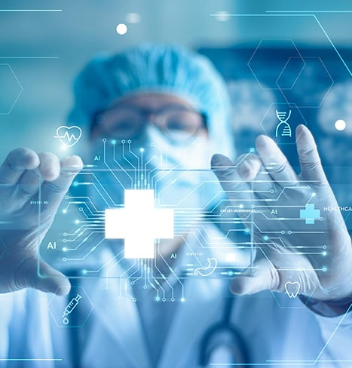
AI IN HEALTHCARE
Notes:
Image credit: https://www.google.com/url?sa=i&url=https%3A%2F%2Fwww.intertek.com%2Fblog%2F2024%2F04-16-the-future-of-healthcare%2F&psig=AOvVaw3NYZQD1FOE-TyRcHVaQo1V&ust=1724025707450000&source=images&cd=vfe&opi=89978449&ved=0CBQQjRxqFwoTCIjR-bqe_YcDFQAAAAAdAAAAABAE

Slide 4
APPLICATIONS:
DRUG DISCOVERY AND DEVELOPMENT
MACHINE VISION AND MEDICAL IMAGE RECOGNITION FOR DIAGNOSTICS
PRECISION MEDICINE
ADMINISTRATIVE TASKS

Slide 5
https://www.vspvision.com/dam/jcr:a1969a94-892a-4c31-8462-815255bdde43/Future%20of%20Generative%20AI%20in%20Healthcare_1%20(1).pdf.

Slide 6

MARKET TRENDS
Notes:
Image credit: https://www.adhesivesmag.com/ext/resources/Default_Images/responsive/market-trends-900x550.jpg?1522690932

Slide 7
DEAL Activity growth AI in healthcare twice as fast Tech industry overall
GEN AI INVESTMENTS:
USD 1.7B in 2022 -> USD 14B in 2023
USD 109B projected by 2030
EMOTION AI INVESTMENT PROJECTION:
USD 13B by 2032
Notes:
Sources:
VSP Vision. The Future of Generative AI in Healthcare. 2024. VSP Vision. Accessed 16 Aug. 2024, https://www.vspvision.com/dam/jcr:a1969a94-892a-4c31-8462-815255bdde43/Future%20of%20Generative%20AI%20in%20Healthcare_1%20(1).pdf.
“Emotion AI Market." Allied Market Research, 2023, www.alliedmarketresearch.com/emotion-ai-market-A231628.
"AI Investments Dominate Healthcare: Silicon Valley Bank Releases New AI Patient Journey Report." Silicon Valley Bank, 2023, www.svb.com/news/company-news/ai-investments-dominate-healthcare--silicon-valley-bank-releases-new-ai-patient-journey-report/.

Slide 8
Threats & OPPORTunities

Slide 9
opportunities
THREATS & CHALLENGES
Data Privacy & Security
Biased Data
Trust Deficit
Mental Health
Patient Monitoring
Customer Service

Slide 10
PROOF OF CONCEPT DEMO

Slide 11
* DEMO REMOVED FROM SLIDE DECK due to github size limitations

Slide 12
COTIVIti SPECIFIC OPPORTUNITY

Slide 13
INTEGRATION WITH ELIZA
The Perfect Marriage
Empathy rooted in Behavioral Science
Population Insights
Emotion Analysis
The Result
Improved Customer Engagement
Improved Clinical Outcomes

Slide 14
THANK YOU
Jaishnoor Kaur
jkaur122@horizon.csueastbay.edu

