Slide 1
Computers Against Developers
A game for sad tech nerds

Slide 2
Inspiration
Inspired by Cards Against Humanity, I wanted to throw my own spin on an interactive terminal version of the game.
Having been coding for the past 3 weeks, additional inspiration came from my very extensive knowledge of problems developers face.

Slide 3
Who can play?
The target audience is any tech nerd, developer, and computer alike.
Some mildly offensive language, so probably best to keep your laptop away from kids if you choose to play this at home!

Slide 4
App Structure
The app opens with a display screen and menu, through which you can choose which area of the app you want to navigate to
I created the menu using the ruby tty-prompt gem to generate the menu, and then pass through the methods I wanted to display.
This looks like…

Slide 5


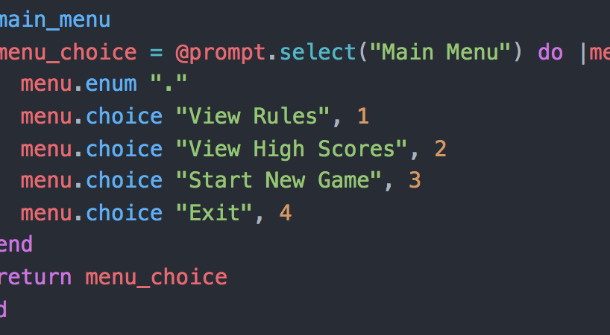
This:

Slide 6
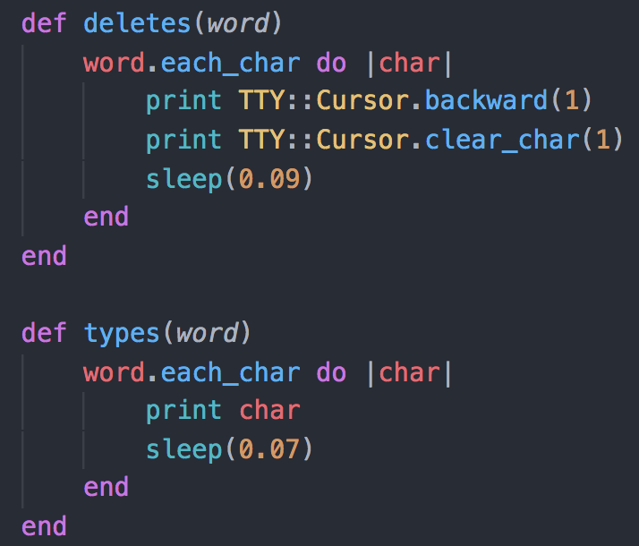
Other Gems used
The tty-cursor gem was
used to delete a word,
And type to replace said
word

Slide 7
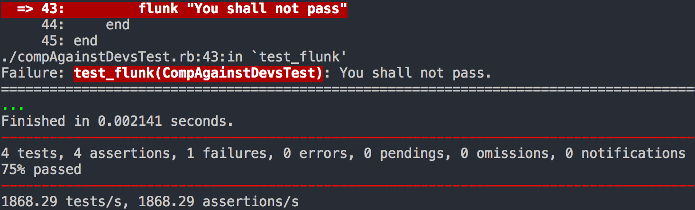
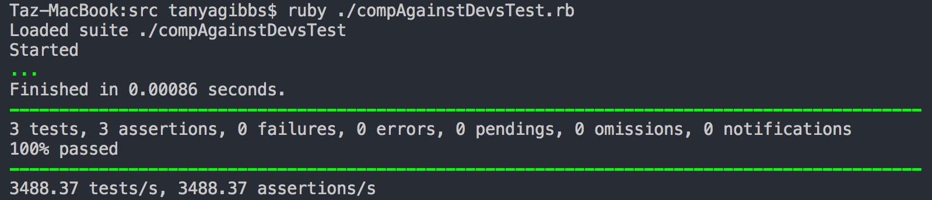
Testing
With the help of the unit-test Gem, I built 4 tests, to ensure the app ran correctly.

Slide 8
Anyway…
The app allows you to View Rules, View High Scores, Start a New Game, and Exit.
Each option has different features, which I have tried to make as interactive as I could within the time-frame for this project, as well as my scope.

Slide 9
The Game!
The current version of this app allows a Human Player to play against 3 computer opponents.
The computer is also the Code Master (The leader of the game).
Some of the features include:
Dealing cards to each player, showing the players hand, and allowing player to choose which card to submit… among a few other sprinkles

Slide 10
Possible features
If I had more time, I would have liked to add some more features including, but not limited to:
Connecting multiple terminals together so that friends can play against each other
Rotating players between being the Code Master and a player
‘corrupting’ users files if they lose the game.

Slide 11
Take away
I feel as though I have definitely challenged myself, but am incredibly proud of how much I’ve learned in such a short amount of time.
I hope you enjoy this app as much as I do!

