Slide 1
Project Presentation of CO-OP Project at Industry (Module-2) (22CS421)
On
Impact of Artificial Intelligence on Education
Krishna Raj Mitra Rishant Singh Summit Singla Ocean Kajal
2210991816 2210992158 2210992420 2210992006
Supervised By
Dr. Simarjeet Kaur
Department of Computer Science and Engineering,
Chitkara University, Punjab

Slide 2
Introduction
AI is transforming traditional education into a personalized system.
Artificial Intelligence (AI) is rapidly transforming modern education by introducing intelligence that can adapt to individual learning needs.
Traditional education follows a “one-size-fits-all” method, which often fails to address differences in student learning speed and understanding.
AI enables personalized, adaptive, data-driven learning, allowing students to learn at their own pace.
It also supports teachers by automating repetitive tasks and improving decision-making through data insights.
2

Slide 3
Problem Statement
Traditional education lacks flexibility and fails to address individual learning needs.
Uniform teaching methods ignore individual learning differences
Students learn at different speeds, leading to gaps in understanding
Teachers face high workload due to grading, tracking, and administration
Lack of personalization feedback reduces learning efficiency
These challenges highlight the need for an intelligent system that can adapt to diverse learning outcomes.
3

Slide 4
Objectives
This study evaluates how AI improves learning and teaching.
To analyze impact of AI on student learning and teaching efficiency
To compare the performance of different AI tools in education
To evaluate both quantitative and qualitative learning outcomes
To identify benefits, limitations, and real-world implications of AI
4

Slide 5
Literature Review
Previous studies highlight both benefits and limitations of AI in education.
Recent studies show that AI significantly improves personalized learning by adapting content based on student performance.
Generative AI tools like ChatGPT enhance engagement and support independent learning.
Research also indicates that AI reduces task completion time and increase productivity in academic activities
However, most studies lack long-term validation and are limited to small-scale experiments, indicating the need for deeper analysis.
5

Slide 6
Research Gap
Existing research lacks large-scale and long-term validation.
Limited real-world experimental validation
Lack of long-term impact analysis
No standardized evaluation framework for AI tools
Insufficient focus on ethical and accessible issues
The study aims to address these gaps by providing a structured and multi-dimensional evaluation.
6

Slide 7
AI Tools Consideration
Different AI tools contribute uniquely to modern education.
ChatGPT – Provides instant explanation, flexible responses, and supports multiple academic tasks
Intelligent Tutoring System (ITS) – Offers structured, step-by-step learning with adaptive feedback
AI Learning Platforms – Provide organized courses, progress tracking, and scalability
Automated Assessment Tools – Enable fast and consistent grading
Each tool contributes differently to the learning ecosystem.
7

Slide 8
Methodology
The study follows a dataset-driven experimental approach:
The same academic tasks were given to all AI tools
Tasks included concept explanation, problem-solving, content generation, and revision
Controlled environment ensures fairness in evaluation
Multiple iterations were performed and results were averaged
The goal was to simulate real academic usage while maintaining consistency.
8

Slide 9
Evaluation Parameters
Both numerical and qualitative metrics were used for analysis.
Quantitative
Response time
Accuracy
Task completion rate
Qualitative:
Engagement
Usability
Personalization
Clarity of explanation
A weighted scoring system was used to ensure balanced evaluation.
9

Slide 10
Result
AI shows measurable improvement in key learning metrics.
Improvement in understanding: +26%
Task completion rate: + 28%
Reduction in study time: -38%
Increase in engagement: +50%
These results clearly demonstrate the effectiveness of AI over traditional learning methods
10

Slide 11
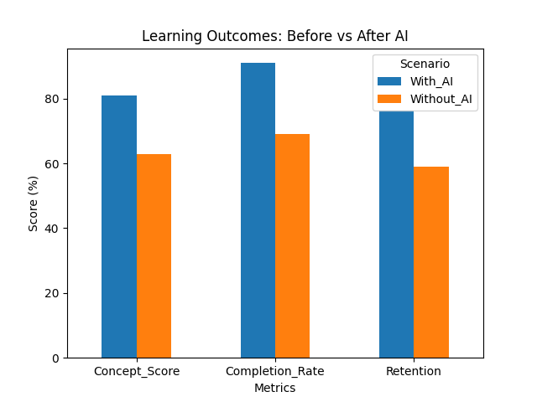
Impact of AI on Student Learning
AI enhances the way students understand and learn concepts.
Personalized learning experience based on individual needs
Improves conceptual understanding and long-term retention
Allows students to learn at their own
pace without pressure
Provides instant explanation and
doubt resolution
Encourages independent and self-
directed learning
11

Slide 12
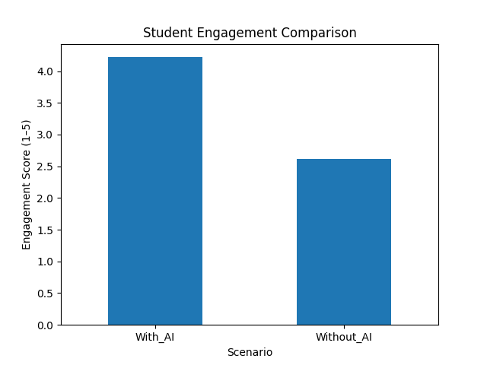
Student Engagement
AI increases student interest and participation in learning.
Higher engagement through interactive learning methods
Faster task completion improves learning efficiency
Increased motivation by providing instant
feedback
Encourages continuous learning without
waiting for teachers
Makes learning more interesting and less
monotonous
12

Slide 13
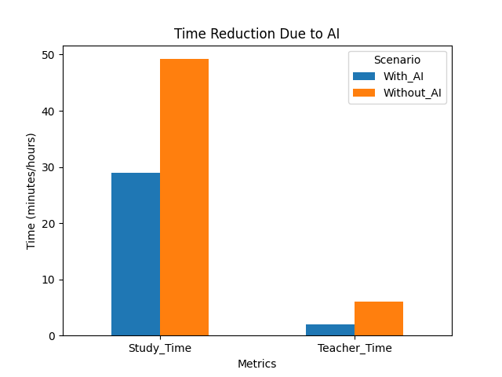
Impact of AI on Teaching Efficiency
Reduces grading and lesson planning time
Automates repetitive administrative tasks
Provides instant feedback to students
Helps teachers identify weak students
quickly
Allows teachers to focus more on
mentoring and interaction
13

Slide 14
AI Impact on Educational Institutions
AI enables institutes to:
Make data-driven decisions
Improve curriculum design
Identify weak students early
Scale education to larger audiences
It transforms education into a more efficient and intelligent system.
14

Slide 15
Key Advantages of AI in Education
Personalized learning tailored to individual needs
Increased efficiency in academic tasks
Improved accessibility for diverse learners
Continuous support and instant feedback
Scalability (can support large number of students)
15

Slide 16
Challenges & Limitations
Despite benefits, AI also introduces several challenges.
Data privacy and security concerns
Algorithm bias and fairness issues
Digital divide and accessibility limitations
Risk of over-reliance of AI tools
These challenges must be addressed for responsible implementation.
16

Slide 17
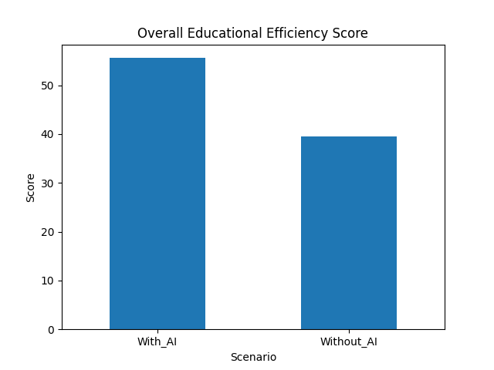
Overall Impact of AI in education
AI creates a balanced and efficient learning ecosystem.
Improves overall learning efficiency and outcomes
Enhances both student engagement and performance
Supports teachers and reduces workload
Enables data-driven decision-making in
institutions
Best results achieved with AI + human
collaboration
17

Slide 18
Conclusion
AI significantly enhances learning outcomes, teaching efficiency, and institutional performance.
It enables personalized, efficient, and scalable education system.
However, responsible usage and ethical consideration are crucial.
The future of education lies in a hybrid model of AI + human intelligence.
AI is not replacing teachers — it is enhancing human intelligence.
18

Slide 19
Future Scope
Explore advanced AI tools like Gemini and Copilot
Conduct long-term studies on learning outcomes
Integrate AI with technologies like VR and AR
Improve ethical frameworks and data security
19

Slide 20
Thank You
We welcome your questions and feedback
20

