Slide 1

SAMSUNG PRISM
Generative AI
Hackathon
3rd Edition 2026 – 27
Theme ID -Agentic Code Intelligence
Team Name - 4bidden
College Name -SRM Institute of Science and Technology
Member Name & Email 1- Mithun Reddy my6506@srmist.edu.in
Member Name & Email 2- Podili Ayusana Durga Vashiti ap8121@srmist.edu.in
Member Name & Email 3- Nived Krishna K nk2347@srmist.edu.in
Member Name & Email 4- Heytish V hs4676@srmist.edu.in
Submission Github link - https://github.com/Heytish-V/Samsung_Agentic_Code_Workflow

Slide 2
Theme
Modern software repositories have numerous functions, classes, and interrelated modules. Manually searching for the particular part of code in question is quite a lengthy process.
Objective of our project
Construct a retrieval mechanism which will take as input the description of the required function and rank the top related code snippets from an available repository.
Challenges involved
Semantic understanding may be different from keyword naming.
The required code can be present in several files.
Similar functions may appear in the search result misleadingly.
Updating of the indexes because of code changes between versions.
Running LLM on the whole codebase for every request would be inefficient.
Goal: Precise and fast code retrieval with minimum use of GPU

Slide 3
Existing Solutions & Gaps
Keyword Search:- Matches exact words and identifiers but may miss semantically related code with different naming.
Dense Semantic Search:- Returns conceptually close functions but might give results that are semantically close yet structurally unconnected to the desired functionality.
LLM-Only Code Analysis :- Sending a whole repository to the LLM might be inefficient because of the time taken and limited context window size.
Our target:Creating a retrieval system which integrates lexical match, semantic match, and structural context to return relevant code snippets.

Slide 4
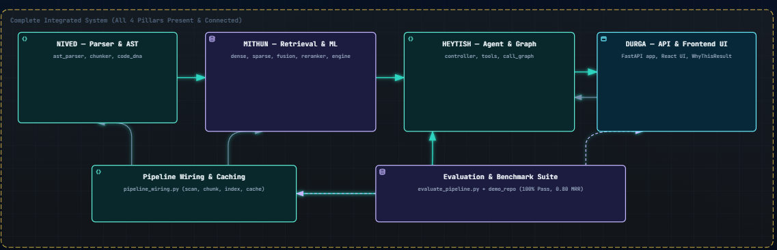
Our Solutions & Architecture Diagram
Explanation for the Diagram
Parsing and chunking using AST preserve code structure.
Semantic similarity can be achieved by dense retrieval.
BM25 will find lexical and identifier matches.
Hybrid ranking will integrate complementary search features.
Structural analysis will provide call-graph information to help explore code.

Slide 5
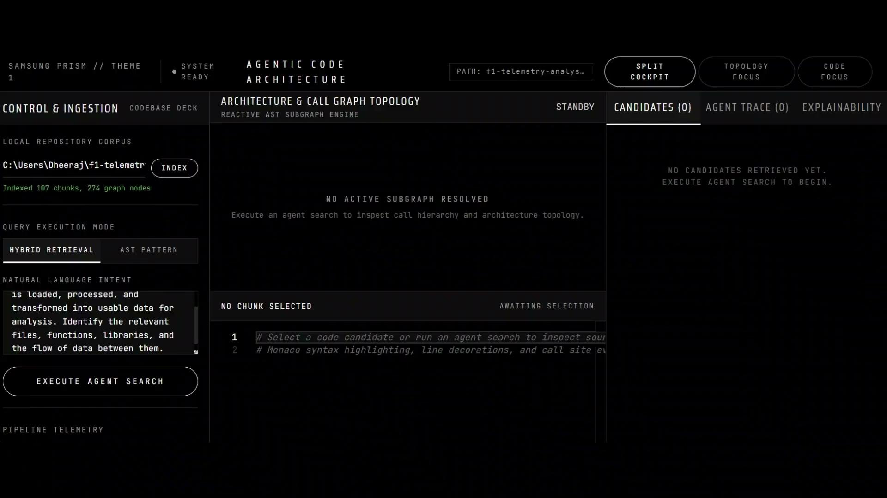
Demo & Product Walkthrough

Slide 6
Tools and tech stack used
Layer | Technology
Programming language | Python,JavaScript
Parsing | Tree-sitter / AST parsing
Embeddings | Sentence Transformers, BGE-small-en-v1.5
Vector search | FAISS
Lexical search | BM25Okapi, rank-bm25
Structural analysis | NetworkX
Backend API | FastAPI
Frontend | React, Vite
Code viewer | Monaco Code Viewer
Version control | Git, Github
Evaluation | MTEB, CoIR AppsRetrieval

Slide 7
Impact & Use case
Real-world applications
Bug Debugging
Identify functions and modules corresponding to the observed behavior.
Dependency Analysis
Analyze relations between functions and modules.
Developer Onboarding
Learn where crucial functionality lies.
Code Maintenance
Find implementation details of interest as the codebase evolves.
Target users:-
Software developers dealing with unknown codebases.
Engineers debugging issues that occur within several modules.
Groups of people maintaining large and constantly evolving codebases.
New contributors to existing software projects.

Slide 8
Innovation highlights, results and limitations
Innovation summary
Hybrid retrieval: Fusion of dense semantic retrieval with sparse lexical retrieval.
Structure awareness: Leverages parsed code structure and call graph dependencies for result exploration.
Repository-level retrieval: Queries indexed code chunks instead of submitting the whole codebase to the LLM.
Interactive exploration: Binds ranked results with source code inspection and architecture visualization.
CPU-friendly retrieval: Utilizes efficient embedding and retrieval components according to the theme’s resource requirements.
Limitations to recognize
Retrieval quality is dependent on parsing, chunking, embedding quality, and ranking.
Similar functionalities might be hard to differentiate.
Structural analysis may not be complete in case of dynamic call or language complexities.
A version-based retrieval should be validated using different repository versions.
Accuracy and performance of retrieval need formal benchmark measurements.

Slide 9
Results
Performance Summary
Median Query Latency 44 ms
Initial Indexing Time 1.8 s
Code Chunks Indexed 51
P95 Query Latency 77 ms
Retrieval evaluation
Pipeline MRR@5 · 10 representative queries 0.800
BGE-small published NDCG@10 benchmark 0.5842

Slide 10
What’s next
Current:-Core Retrieval
Code parsing, chunking, dense and sparse indexing, hybrid search, and interactive results exploration.
Next:-Optimizing Retrieval
Fine-tune chunking, query preprocessing, candidate merging, reranking, and benchmark performance.
Future:-Version-Aware Code Intelligence
Enhance index updates, retrieve relevant code from version history, and differentiate between similar fragments that change over commits.

Slide 11
Brownie points
Multiple Retrieval Triggers
Highly dense semantic similarity and BM25 lexical relevance work well together.
Awareness of the Code Structure
The call-graph context will aid developers in navigating away from the first retrieval snippet.
Modular Retrieval Workflow
Parsing, indexing, retrieval, ranking, back-end APIs, and the UI can all be independently developed and tested.
Measurable Performance
Use NDCG@10 and MRR to measure retrieval performance and separately report latency and indexing overheads.

Slide 12
Thank you
Organised by the Language AI Team and the PRISM Team, Samsung R&D Institute India
Notes:
Closing slide. Add the Google Form URL and a contact email before sharing. Edition 2 organising team for reference: Language AI - Sourabh Tiwari, Gaurav, Sanjeeth Pothireddy, Gorang Maniar; PRISM - Binny Lakra, Prakhar Chandrakar, Vishu Kumar; Kick-off and mentors - Giridhar Jakki, Deepraj Prabhakar Patkar (Language AI), Srimanu Prasad Nagaraju, Ashish Kumar (Tech Strategy).

