Slide 1
Multiserver-job (MSJ) Scheduling with Continuous Requirement Distribution
Heyuan Yao, Willow Kowalik, Izzy Grosof
Department of Industrial Engineering and Management Sciences
Northwestern University
2025 INFORMS Annual Meeting
Atlanta, GA

Slide 2









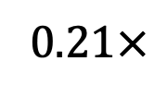

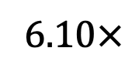






Multiserver-job (MSJ) and Multiresource-job (MRJ) Systems
Resource capacity
Server
$$2.60×$$
$$1.91×$$
$$3.33×$$
$$1.22×$$
$$1.74×$$
$$2.55×$$
Jobs with resource requirements being served
$$7.73×$$
$$1.97×$$
Job Arrivals
6.$10×$
0.2$1×$

Slide 3


Prior Work: Discrete Resource Requirement Distribution
 | Stability Analysis | Throughput-optimality Analysis | Mean Response Time Analysis | Continuous Resource Setting
FCFS [BG’84] [RM’27] [GSHS’23]
MaxWeight [MSY’12]
Randomized multi-resource scheduling (RMS) [PG’18]
ServerFilling-SRPT [GHHS’22]
Markovian Service Rate (MSR) [CGB’24]
Most Servers First with Quickswap (MSFQ) [CAOM’25]
No previous research studied the continuous resource setting.

Slide 4
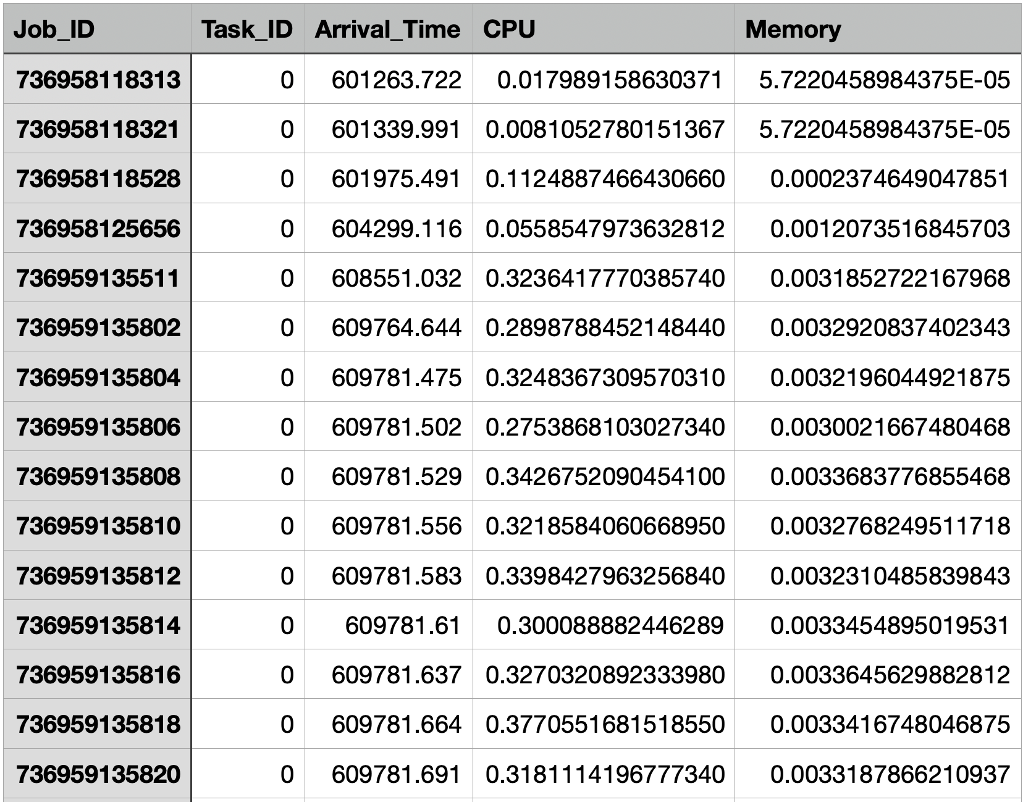
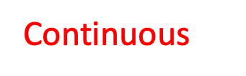
Examples of user requests for cloud resources in Google Borg clusters
Continuous

Slide 5
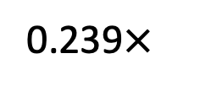
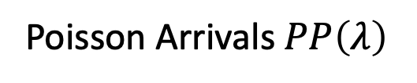



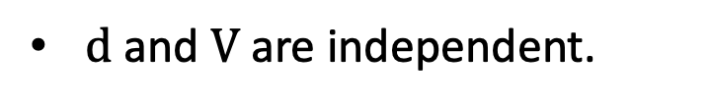

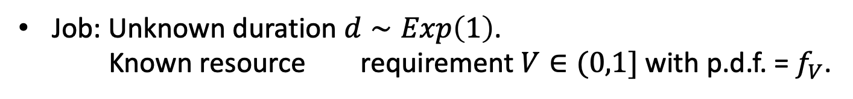
MSJ/MRJ with Continuous Resource Requirement
This talk: Single-resource (MSJ). Our working paper: Multi-resource (MRJ)
$$0.325×$$
$$0.417×$$
0.239$×$
Poisson Arrivals $PP\left(λ\right)$
$$0.967×$$
$$0.246×$$
Server: Normalized resource capacity = 1.
Job: Unknown duration $d∼Exp\left(1\right)$.
Known resource requirement $V∈(0,1]$with p.d.f. = $f_{V}$.
$d \text{and} V$ are independent.
We found the first throughput-optimal family of policies.

Slide 6
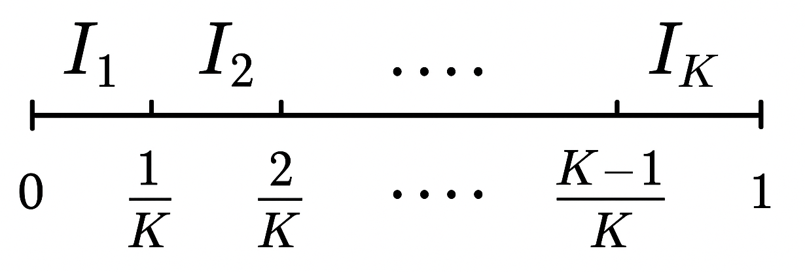
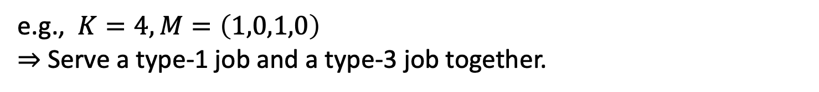
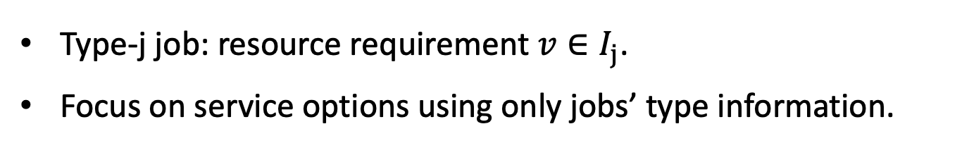
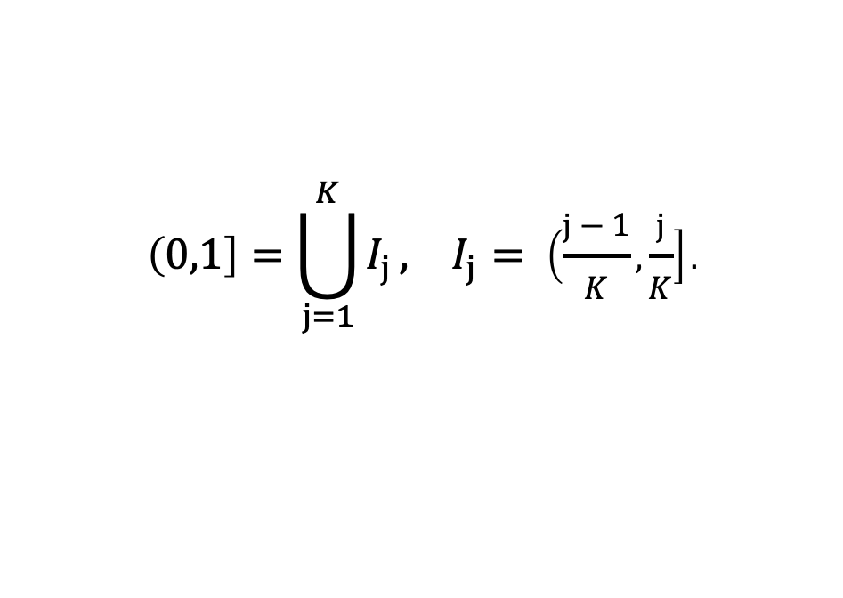
K-Discretization and the Discretized Service Options
Prior work: Exact discrete distribution.
Now: Choose how finely to discretize the resource range.
Equal partition of resource range (0,1] to $K$buckets:
$$\left(0,1\right]=\bigcup_{j=1}^{K}{I_{j}},{ I}_{j} = \left(\frac{j−1}{K},\frac{j}{K}\right].$$
Type-j job: resource requirement ${v∈I}_{j}$.
Focus on service options using only jobs’ type information.
Admissible discretized options:
$$C_{K}≔\{M∈\{0,1,…,K\}^{K}:\left\langle M,\left(1/K,2/K,…,1\right)\right\rangle ≤1\}.$$
e.g., $K=4, M=\left(1,0,1,0\right)$
$⇒$ Serve a type-1 job and a type-3 job together.

Slide 7
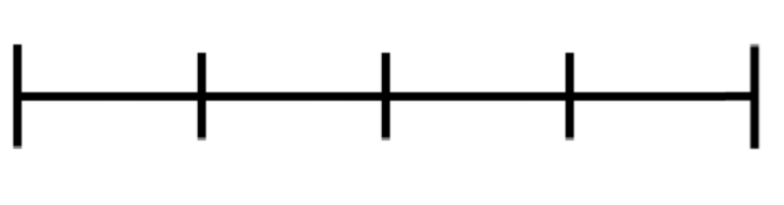

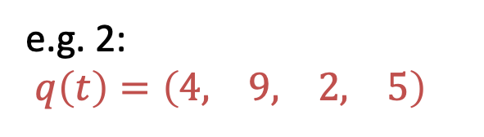



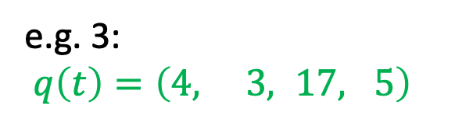
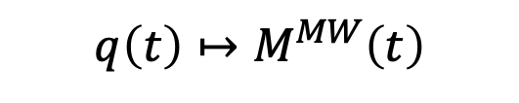



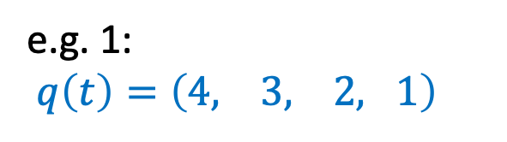
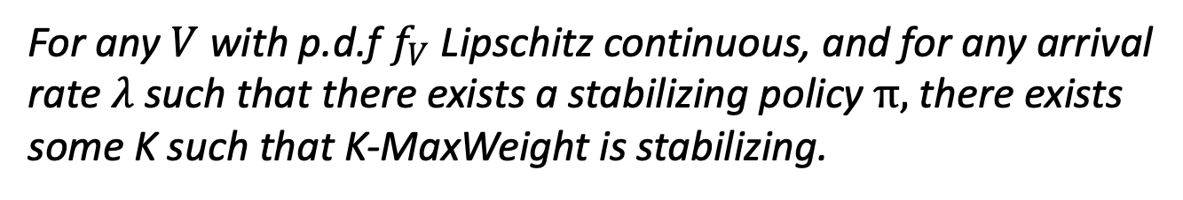
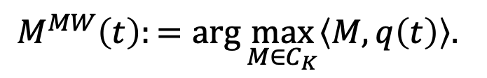


K-Discretized MaxWeight: Throughput-Optimality
Discretized service options $⇒$ Countable state space:
$$q\left(t\right)=( q_{1}\left(t\right),…,q_{j}\left(t\right),…,q_{K}\left(t\right) )∈{\text{ℕ}}^{K}$$
# type-j jobs
The K-Discretized MaxWeight Policy (K-MaxWeight):
$$M^{MW}\left(t\right):=\arg{\max_{M∈C_{K}}\left\langle M,q\left(t\right)\right\rangle .}$$
e.g. 2:
$q\left(t\right)=\left(4, 9, 2, 5\right)$
e.g. 3:
$q\left(t\right)=\left(4, 3, 17, 5\right)$
e.g. 1:
$q\left(t\right)=\left(4, 3, 2, 1\right)$
$$q\left(t\right)↦M^{MW}\left(t\right)$$
$$M^{MW}\left(t\right)=(0, 2,0,0)$$
$$M^{MW}\left(t\right)=(1, 0,1,0)$$
$$M^{MW}\left(t\right)=(4, 0,0,0)$$
$$\left(4,3,2,1\right)↦\left(4,0,0,0\right)$$
$$I_{1 }$$
$$I_{2 }$$
$$I_{3}$$
$$I_{4}$$
$$\left(4,9,2,5\right)↦\left(0,2,0,0\right)$$
Result: Theorem [Throughput-optimality of K-MaxWeight]
For any $V$ with p.d.f $f_{V}$Lipschitz continuous, and for any arrival rate $λ$such that there exists a stabilizing policy $π,$there exists some K such that K-MaxWeight is stabilizing.

Slide 8
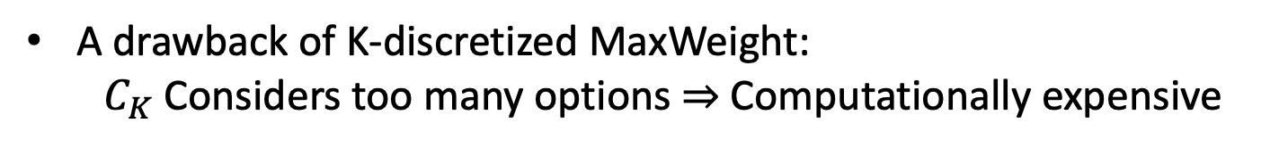
The K-Efficient MaxWeight (K-EMaxWeight) Policy
A drawback of K-discretized MaxWeight:
$C_{K}$Considers too many options $⇒$ Computationally expensive
Improvement:
A smaller service option subset still guarantees stability.
Efficient Set
Some candidate set choices:
2-Jobs K-efficient set: $⌈\frac{K}{2}⌉$service options.
2-Buckets K-efficient set: $K$ service options$.$

Slide 9
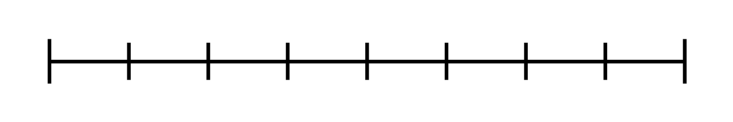
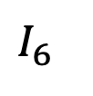
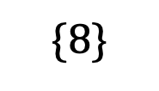

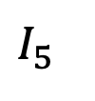
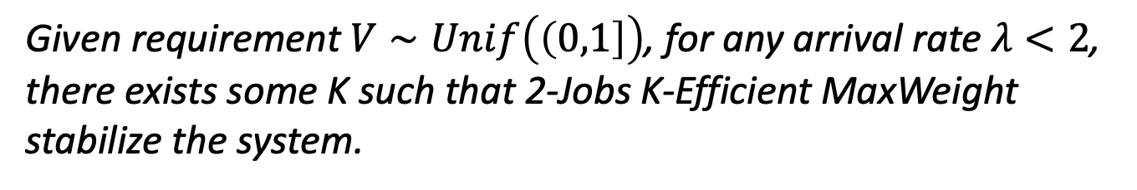
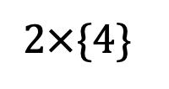
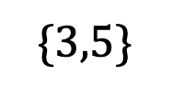
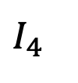
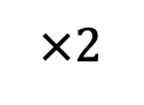
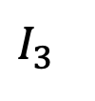
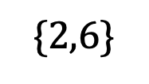
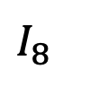
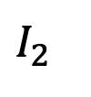
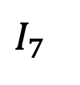
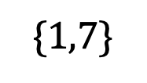
2-Jobs K-Efficient MaxWeight: Unif((0,1])
Serve one type-j job and one type-(K-j) job together, or just one type-K job.
$$\{8\}$$
$$\{1,7\}$$
$$I_{1}$$
$$I_{2}$$
$$I_{3}$$
$$I_{4}$$
$$I_{5}$$
$$I_{6}$$
$$I_{7}$$
$$I_{8}$$
$$\{2,6\}$$
$$\{3,5\}$$
$$2×\{4\}$$
$$×2$$
Throughput-optimal
Theorem [2-Jobs K-Efficient MaxWeight]
Given requirement $V∼Unif\left(\left(0,1\right]\right)$, for any arrival rate $λ<2$, there exists some K such that 2-Jobs K-Efficient MaxWeight stabilize the system.

Slide 10
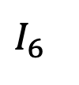
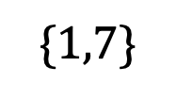
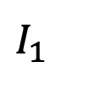
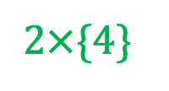
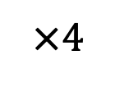
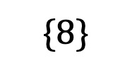
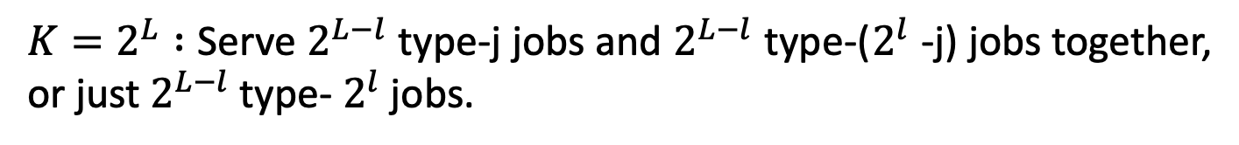
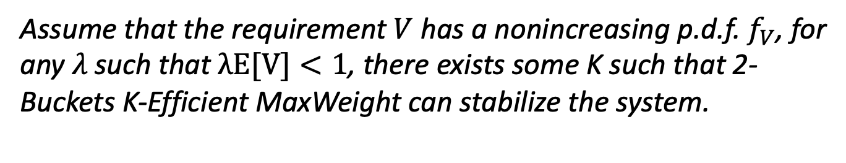
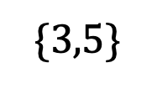
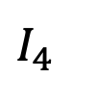
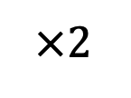
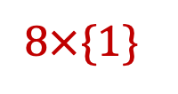
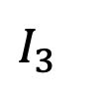
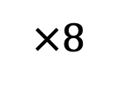
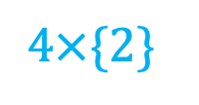






2-Buckets K-Efficient MaxWeight: Nonincreasing requirement p.d.f.
$K=2^{L} :$Serve $2^{L−l}$ type-j jobs and $2^{L−l}$ type-($2^{l}$ -j) jobs together, or just $2^{L−l}$ type- $2^{l}$ jobs.
$$I_{1}$$
$$I_{2}$$
$$I_{3}$$
$$I_{4}$$
$$I_{5}$$
$$I_{6}$$
$$I_{7}$$
$$I_{8}$$
$$2×\{4\}$$
$$\{8\}$$
$$2×\{1,3\}$$
$$\{1,7\}$$
$$4×\{2\}$$
$$\{2,6\}$$
$$8×\{1\}$$
$$\{3,5\}$$
$$×8$$
Throughput-optimal
$$×2$$
$$×4$$
$$×2$$
$$×2$$
Theorem [2-Buckets K-Efficient MaxWeight]
Assume that the requirement $V$has a nonincreasing p.d.f. $f_{V}$, for any $λ$such that $λE[V]<1$, there exists some K such that 2-Buckets K-Efficient MaxWeight can stabilize the system.

Slide 11



Results: The Talk & The Working Paper
MSJ with Continuous Resource Requirement
Preemptive
K-MaxWeight:
Throughput-optimal for Lipschitz p.d.f. $f_{V}$.
Work also for MRJ
2-Jobs K-EMaxWeight
Throughput-optimal for $V∼\text{Uniform}\text{((0,1])}.$
2-Buckets K-EMaxWeight
Throughput-optimal for $V$ with nonincreasing density.
Non-preemptive Throughput-optimal policies for MSJ/MRJ:
K-discretized Non-preemptive Markovian Service Rate (K-nMSR)
2-Jobs K-Efficient nMSR
2-Buckets K-Efficient nMSR

Slide 12








Conclusion
This talk: Single-resource (MSJ). Our workingpaper: Multi-resource (MRJ)
$$0.325×$$
$$0.417×$$
0.239$×$
Poisson Arrivals $PP\left(λ\right)$
$$0.967×$$
$$0.246×$$
K-MaxWeight: $M^{MW}\left(t\right):=\arg{\max_{M∈C_{K}}\left\langle M,q\left(t\right)\right\rangle .}$
Core Result: Theorem [Throughput-optimality of K-MaxWeight]
For any $V$, with p.d.f $f_{V}$Lipschitz continuous, and for any arrival rate $λ$such that there exists is a stabilizing policy $π,$there exists some K such that K-MaxWeight is stable.

Slide 13
Thank You

