Slide 1


Multiserver-job (MSJ) System with Varying Resource Requirement
Heyuan Yao*, Chutong Gao*#, Izzy Grosof*
* Northwestern University
# MIT & Purdue University
2026 INFORMS Annual Meeting, San Franscico

Slide 2
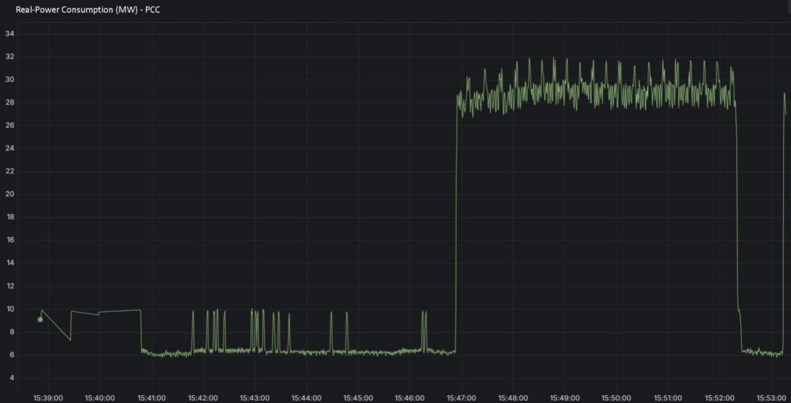
Motivation from the Real-world Resource Profiles
Datacenter jobs use various amount of resource requirements
Requirements are often heterogeneous, real-valued and time-varying.
AI Training Power Consumption (EdgeTunePower, Inc) [GridLab ’25]
Power Consumption $≈$GPU/CPU Requirement

Slide 3





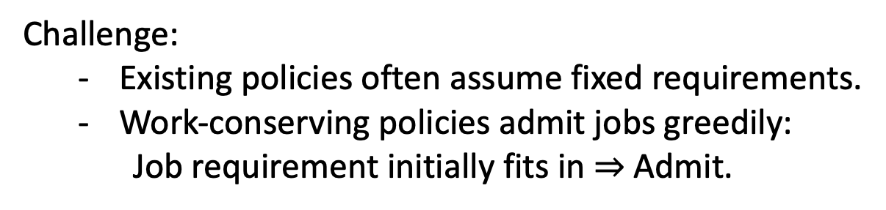
New Challenge to Current Multiserver-Job Batching Rule
Challenge:
  Existing policies often assume fixed requirements.
  Work-conserving policies admit jobs greedily:
  Job requirement initially fits in $⇒$ Admit.
Usage function: Instantaneous resource requirement as a function of attained service time (age).
Usage
2
Server
Capacity = 6
1
$$⋯⋯$$
t = 0:
Empty state
age
0
1
2

Slide 4






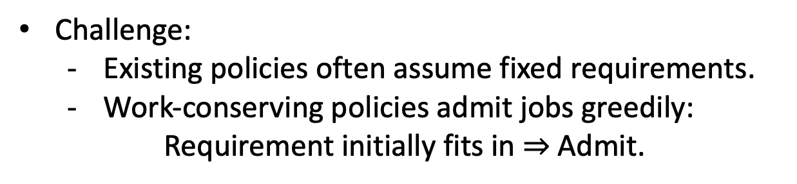
New Challenge to Current Multiserver-Job Batching Rule
Challenge:
  Existing policies often assume fixed requirements.
  Work-conserving policies admit jobs greedily:
  Requirement initially fits in $⇒$ Admit.
Usage
2
Server
Capacity = 6
1
$$⋯⋯$$
t = 0:
Admit 6 jobs
age
0
1
2

Slide 5
New Challenge to Current Multiserver-Job Batching Rule
Challenge:
  Existing policies often assume fixed requirements.
  Work-conserving policies admit jobs greedily:
  Requirement initially fits in $⇒$ Admit.
Usage
2
Server
Capacity = 6
1
$$⋯⋯$$
t = 1:
Exceedance!!!
Preempt 3 jobs
age
0
1
2

Slide 6
New Challenge to Current Multiserver-Job Batching Rule
Challenge:
  Existing policies often assume fixed requirements.
  Work-conserving policies admit jobs greedily:
  Requirement initially fits in $⇒$ Admit.
Total resource usage: 100%
Wasted resource usage: 25%
Usage
2
Server
Capacity = 6
1
$$⋯⋯$$
t = 2:
Complete 3 jobs
age
0
1
2

Slide 7
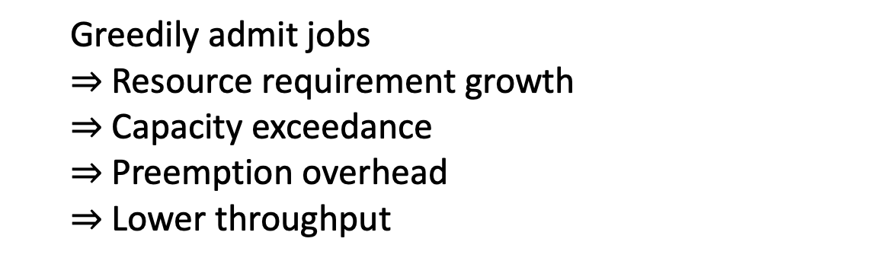
Why Greedy Policy Fails?
  Greedily admit jobs
  $⇒$ Resource requirement growth
  $⇒$ Capacity exceedance
  $⇒$Preemption overhead
  $⇒$ Lower throughput
Key Question: When should we admit the next job?
Admit jobs as frequently as possible
Avoid preemption or service waste

Slide 8


Prior Work
 | Varying Usage Function? | Continuous requirement? | General Random Usage Function Setting?
Stability Analysis: [NSZ ’26]
Scheduling Policies: [CYZ ’25] [ALSW ’26] [JJMM ’26]
Admission Policies: [ADLS ’26]
Scheduling Policies: [HXW ’23]
Caching Policies: [YGLG ’26] [ZLMP ’26]
Scheduling Policies: [S 04’] [SSS ’04][AKRS’04]
Scheduling Policies: [YKG 26’]
Linear
Linear
Linear
Piecewise-constant
Piecewise-constant
Varying capacity
We focus on a general time-varying, real-valued random usage function.

Slide 9

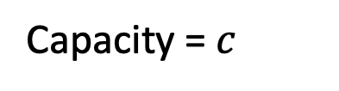
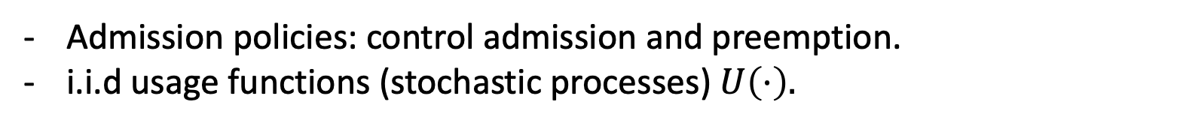
Model: Real-valued & Time-Varying Usage Function
Saturated system
Server
Capacity = $c$
$$∞⋯$$
usage
usage
usage
age
age
age
Admission policies: control admission and preemption.
i.i.d usage functions (stochastic processes) $U\left(⋅\right).$

Slide 10
Model: Real-valued & Time-Varying Usage Function
Saturated system
Server
Capacity = $c$
$$∞⋯$$
usage
usage
usage
age
age
age
Admission policies: control admission and preemption.
i.i.d usage functions (stochastic processes) $U\left(⋅\right).$

Slide 11
Model: Real-valued & Time-Varying Usage Function
Saturated system
Server
Capacity = $c$
$$∞⋯$$
usage
usage
usage
age
age
age
Admission policies: control admission and preemption.
i.i.d usage functions (stochastic processes) $U\left(⋅\right).$

Slide 12
Model: Real-valued & Time-Varying Usage Function
Saturated system
Server
Capacity = $c$
$$∞⋯$$
usage
usage
usage
Good case
age
age
age
Admission policies: control admission and preemption.
i.i.d usage functions (stochastic processes) $U\left(⋅\right).$

Slide 13
Model: Real-valued & Time-Varying Usage Function
Saturated system
Server
Capacity = $c$
$$∞⋯$$
usage
usage
usage
Bad case
age
age
age
Admission policies: control admission and preemption.
i.i.d usage functions (stochastic processes) $U\left(⋅\right).$

Slide 14
Model: Real-valued & Time-Varying Usage Function
Saturated system
Server
Capacity = $c$
$$∞⋯$$
usage
usage
usage
Bad case
age
age
age
Admission policies: control admission and preemption.
i.i.d usage functions (stochastic processes) $U\left(⋅\right).$

Slide 15
Model: Real-valued & Time-Varying Usage Function
Saturated system
Server
Capacity = $c$
$$∞⋯$$
usage
usage
usage
Bad case
age
age
age
Admission policies: control admission and preemption.
i.i.d usage functions (stochastic processes) $U\left(⋅\right).$

Slide 16
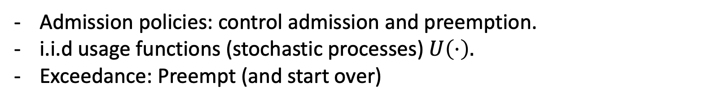
Model: Real-valued & Time-Varying Random Usage Function
Saturated system
Server
Capacity = $c$
$$∞⋯$$
usage
usage
usage
Bad case
age
age
age
Admission policies: control admission and preemption.
i.i.d usage functions (stochastic processes) $U\left(⋅\right).$
Exceedance: Preempt (and start over)
Goal: Find an asymptotically throughput-optimal admission policy

Slide 17
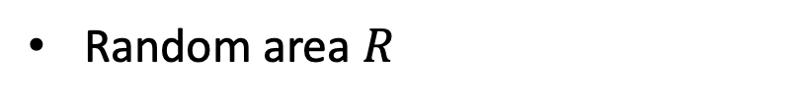
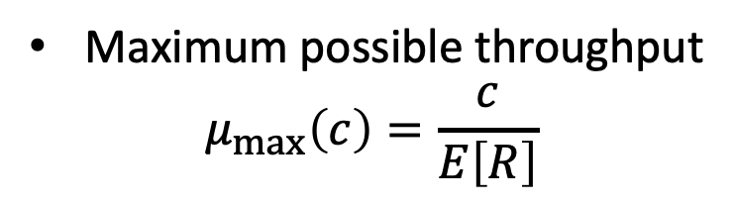
Asymptotically Throughput-optimal Admission Policy
Saturated system
Server
$$∞⋯$$
usage
Random area $R$
Maximum possible throughput
$$μ_{max}\left(c\right)=\frac{c}{E\left[R\right]}$$
age
Goal: Find a policy $π$, with throughput $μ^{π}\left(c\right),$ such that
for a fixed usage function distribution $\left\{U\left(⋅\right)\right\}$, $\lim_{c↑∞}{\frac{μ^{π}\left(c\right)}{μ_{max}\left(c\right)}}=1$.

Slide 18
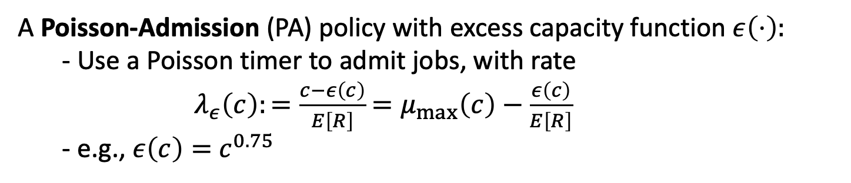
Our Solution: The Family of Poisson-Admission policies
A Poisson-Admission (PA) policy with excess capacity function $ε\left(⋅\right):$
- Use a Poisson timer to admit jobs, with rate
$λ_{ε}\left(c\right):=\frac{c−ε\left(c\right)}{E\left[R\right]}$ $=μ_{max}\left(c\right)−\frac{ε\left(c\right)}{E\left[R\right]}$
- e.g., $ε\left(c\right)=$ $c^{0.75}$
Key idea: Desynchronize usage fluctuations and make preemptions rare.
Theorem (Informal)
The PA policy is asymptotically throughput-optimal.
Proof sketch:
Construct a stationary system driven by PA (marked PRM).
Capacity exceedance/preemption frequency exponentially unlikely.
Job admission rate near the maximum throughput.

Slide 19
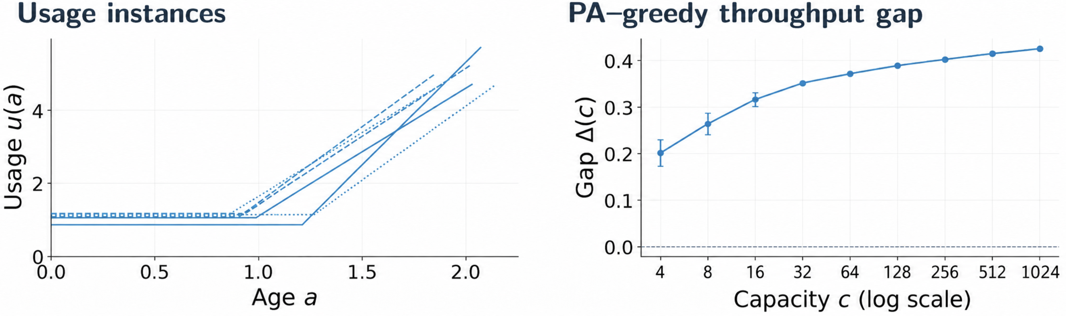
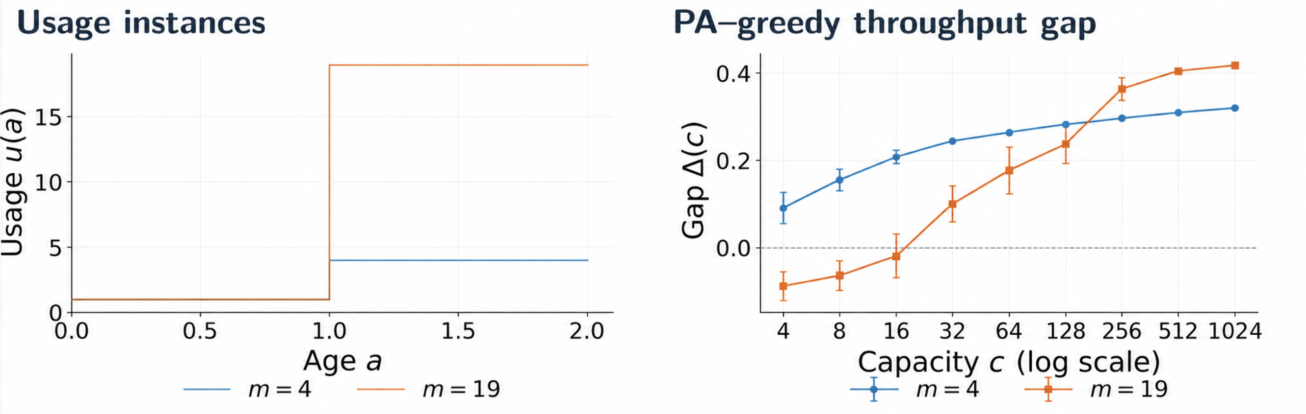
Simulation Results: PA versus Greedy
$ε\left(c\right)=c^{0.75}$, Gap: $Δ\left(c\right)=\frac{{\overset{ˆ}{μ}}^{PA}\left(c\right)−{\overset{ˆ}{μ}}^{Greedy}\left(c\right)}{μ_{max}\left(c\right)}$
Constant-linear usage:
Deterministic usage:
Large capacity regime & smaller usage variation: better PA throughput

Slide 20
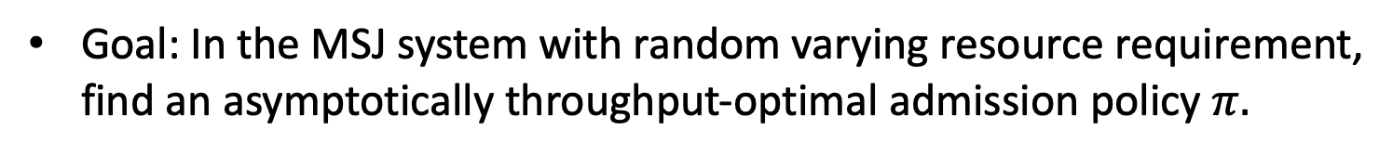

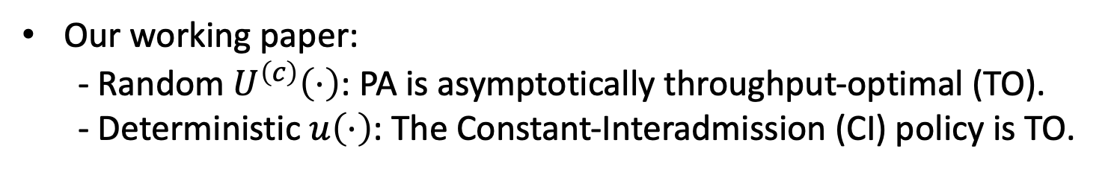
Conclusion
Saturated MSJ System
usage
Server
$$∞⋯$$
age
Goal: In the MSJ system with random varying resource requirement, find an asymptotically throughput-optimal admission policy $π.$
Our solution: The Poisson-Admission Policy
Key idea: Desynchronize usage variations & Bound the preemption frequency.
Our working paper:
- Random $U^{\left(c\right)}\left(⋅\right)$: PA is asymptotically throughput-optimal (TO).
- Deterministic $u\left(⋅\right)$: The Constant-Interadmission (CI) policy is TO.

Slide 21
Thank You

Slide 22
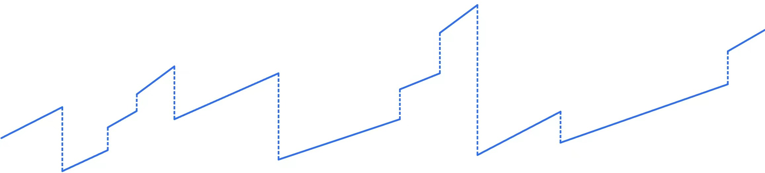


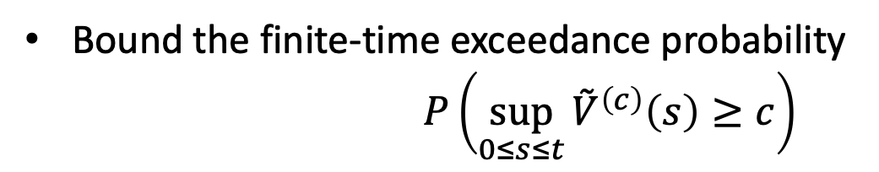
Frequency of Exceedance Happens (Weakly Increasing $U\left(⋅\right)$)
Bound the finite-time exceedance probability
$P\left(\sup_{0≤s≤t}{{\overset{˜}{V}}^{\left(c\right)}\left(s\right)}≥c\right)$
Local maximum always lies at a completion time
Bound the usage at each ${\overset{˜}{V}}^{\left(c\right)}\left(\text{job} \text{completion} \text{time}\right)$
$P\left(\sup_{0≤s≤t}{{\overset{˜}{V}}^{\left(c\right)}\left(s\right)}≥c\right)≲ct\exp\left(−\frac{ε^{2}\left(c\right)}{c}\right)$
$${\overset{˜}{V}}^{\left(c\right)}\left(s\right)$$
Important time set
$$s$$

Slide 23
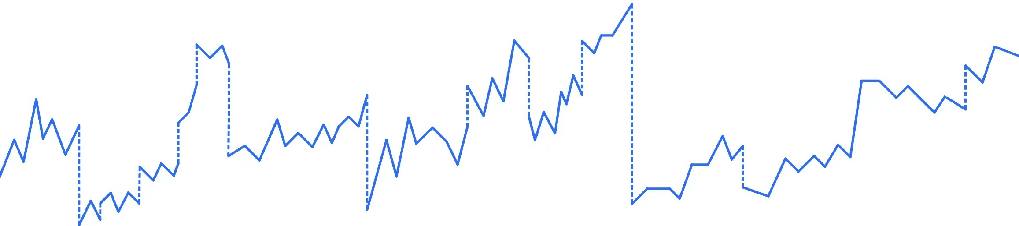

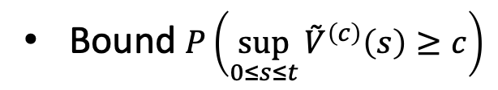


Frequency of Exceedance Happens (One-sided Lipschitz $U\left(⋅\right)$)
One-sided Lipchitz: $U\left(t_{1}\right)−U\left(t_{2}\right)≥ –L\left(t_{1}−t_{2}\right),∀t_{1}>t_{2}$
Bound $P\left(\sup_{0≤s≤t}{{\overset{˜}{V}}^{\left(c\right)}\left(s\right)}≥c\right)$
Important time set
checking points via equal partition
& completion times
$$O\left(\frac{cLt}{ε\left(c\right)}\right)$$
$$O\left(ct\right)$$
$P\left(\sup_{0≤s≤t}{{\overset{˜}{V}}^{\left(c\right)}\left(s\right)}≥c\right)≲\left(\frac{cL}{ε\left(c\right)}t+ct \right)\exp\left(−\frac{ε^{2}\left(c\right)}{c}\right)$
Maximal possible total usage
$${\overset{˜}{V}}^{\left(c\right)}\left(s\right)$$
$$O\left(\frac{ε\left(c\right)}{cL}\right)$$
$$s$$

Slide 24




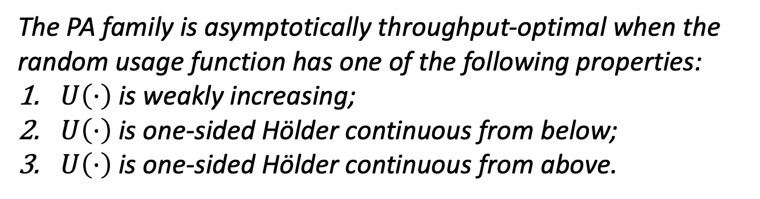


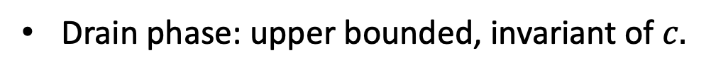

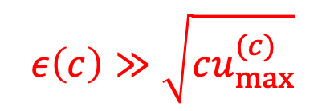
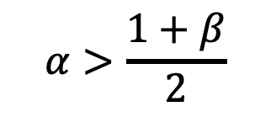



Asymptotical Throughput-optimality
Goal: Find a policy $π$, with throughput $μ^{π}\left(c\right),$ such that
- For a fixed random usage function $\left\{U\left(⋅\right)\right\}$, $\lim_{c↑∞}{\frac{μ^{π}\left(c\right)}{μ_{max}\left(c\right)}}=1$.
$$ε\left(c\right)≫\sqrt{c}$$
- For a sequence of random usage functions $\left\{U^{\left(c\right)}\left(⋅\right)\right\}$, $\lim_{c↑∞}{\frac{μ^{π}\left(c\right)}{μ_{max}\left(c\right)}}=1.$
Admission phase: expectation duration grows exponentially when $c$ grows.
$$ε\left(c\right)≫\sqrt{cu_{max}^{(c)}}$$
Drain phase: upper bounded, invariant of $c.$
$$β$$
Theorem (Informal)
[Asymptotical Throughput-optimality of the PA family]
$$1$$
$$u_{max}^{\left(c\right)}∼c^{β}$$
The PA family is asymptotically throughput-optimal when the random usage function has one of the following properties:
$U\left(⋅\right)$ is weakly increasing;
$U\left(⋅\right)$ is one-sided Hölder continuous from below;
$U\left(⋅\right)$ is one-sided Hölder continuous from above.
$$ε\left(c\right)∼c^{α}$$
$$α>\frac{1+β}{2}$$
$$α$$
$$0$$
$$1/2$$
$$1$$

