Slide 1


Slide 2

What is a convolution
Effectively a local weighted sum.
A main tool in DSP: linear filters

Slide 3
The origin story
Multiple perspectives
  Neuroscience
  Image processing
  Learning theory

Slide 4
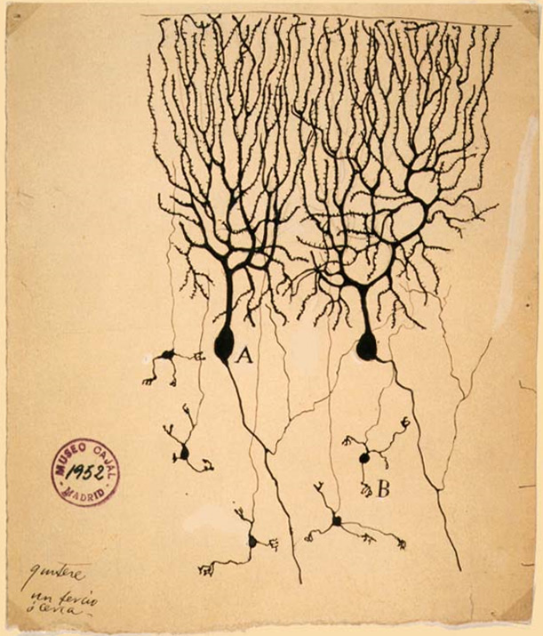
From Neuron to the Brain
Ramón y Cajal (1888-ish): the brain is built up of modular units.

Slide 5
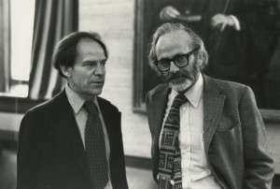
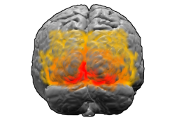
From Neuron to the Brain
Fast forward to the late '50s..
David Hubel & Torsten Wiesel are experimenting with the primary visual cortex or anesthetized cats.
They find a differential “activation” of neurons in response to edges in various locations and orientations.
Is the primary visual cortex convolving the retinal input with Gabor filters?

Slide 6
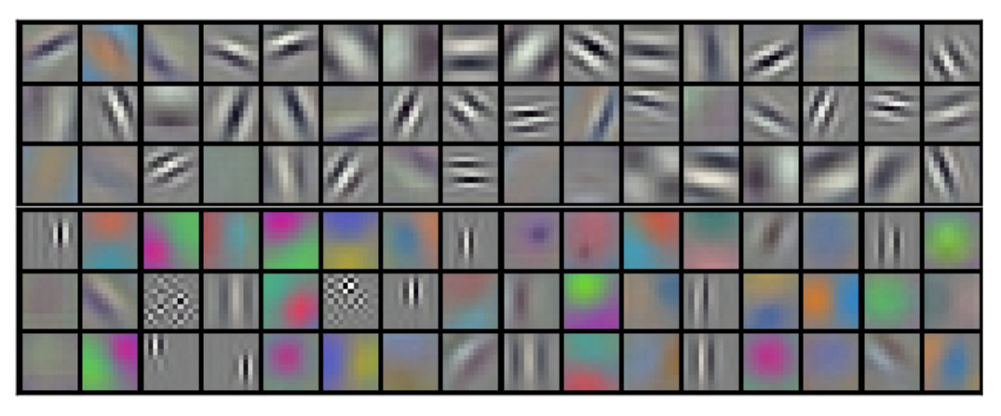
Filters learned by AlexNet
Krizhevsky, A., Sutskever, I., & Hinton, G. E. (2012). Imagenet classification with deep convolutional neural networks. In Advances in neural information processing systems (pp. 1097-1105).

Slide 7
Image processing
Traditional approach:
  Engineer (hand-tailor) many features
  Compute each one in many (or all) locations on the image
CNN
  Learn many features
  Compute each one in many (or all) locations on the image

Slide 8
Learning Theory
Deep (actually even shallow) NN are universal function approximators
Good: the net can approximate any function we want
Bad: learnability
Solution: regularization
In this view, CNN architectures act as a regularization by limiting\directing the search in the function space. This is related to the previously discussed image processing view, by inserting domain knowledge regarding the family of functions we are searching over.

Slide 9
CNN Layers
CNNs are defined using a layered structure (usually linear, and always a directed graph).
There are many types of layers used, but in practice a few stand out as universal elements in CNNs.
Convolutional layer
Pooling layer
Dropout layer
Fully connected layer

Slide 10
Convolutional Layer
A convolutional layer preforms a convolution of a predefined size of its input with a learned kernel
Following the convolution, a pointwise non-linear (so-called “activation function”) is applied.
Ex. sigmoid, relu, tanh
Without the non-linearity there is no point in subsequent convolutional layers.

Slide 11
Pooling Layer
A pooling layer is used to reduce the size of the data by means of a spatial aggregating function (mean\max of local regions).

Slide 12
Dropout Layer
A dropout layer “hides” the values in a predefined percent of the data during training. This serves as a regularization mechanism, preventing the net from learning a specific representation that applies only to the training-set.

Slide 13
Fully connected Layer
A fully connected layer, as the name suggests if a layer with output “fully connected” to the input, with a set of learned weights.
(with a dimension which is the multiplication of the in and out dims)
Output = W * input
Fully connected layers are typically used after the convolutoinal layers and before the final output.

Slide 14
Common Architectures and the ImageNet Challenge
The annual ImageNet Large Scale Visual Recognition Challenge (ILSVRC) is a contest where research groups compete by submitting models for the visual object recognition task (1000 categories).
The history of CNNs is tightly coupled with this competition, with the winners over the last few years becoming the models of choice throughout the field of computer vision.

Slide 15
AlexNet

Slide 16
VGG

Slide 17
ResNet

