Slide 1

The Alire package manager for Ada and SPARK
https://alire.ada.dev/
Alejandro R. Mosteo
Fabien Chouteau
June 14th, 2022

Slide 2
TOOLCHAIN INSTALLATION
Alire indexes GNAT FSF for:
Windows
Linux
macOS
Including cross-compilers for:
ARM Cortex-M
AVR
RISC-V
Pre-built with public scripts at GitHub::
https://github.com/alire-project/GNAT-FSF-builds

Slide 3
USE CASE: TOOLCHAIN INSTALLATION
$ alr toolchain --select gnat gprbuild
$ alr toolchain --select
Please select the gnat version for use with this configuration
1. gnat_native=11.2.4
2. None
3. gnat_external=9.4.0 [Detected at /usr/bin/gnat]
4. gnat_arm_elf=11.2.4
5. gnat_avr_elf=11.2.4
6. gnat_riscv64_elf=11.2.4
a. (See more choices...)
$ alr toolchain
CRATE VERSION STATUS NOTES
gprbuild 22.0.1 Default
gprbuild 2019.0.0 Available Detected at /usr/bin/gprbuild
gnat_arm_elf 11.2.3 Available
gnat_native 10.3.2 Available
gnat_native 11.2.4 Default
gnat_external 9.4.0 Available Detected at /usr/bin/gnat
Users just wanna have fun

Slide 4
CONTENTS
Introduction
Use cases
Ecosystem

Slide 5

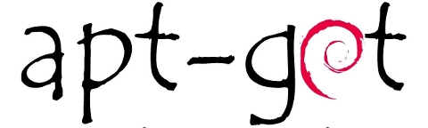


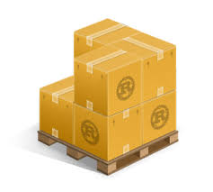





PACKAGE MANAGERS
Ada world
AURA

Slide 6
TIMELINE
Jun 2017: first repository & discussions (with seeds at A-E 2017)
Feb 2018: presentation at Ada-Europe 2018
Apr 2019: AdaCore sponsorship
Aug 2019: Website goes live
Nov 2019: internal beta
Feb 2021: v1.0
Sep 2021: v1.1
May 2022: v1.2
Jun 2022: first tutorial

Slide 7
KINDS OF PMs
SYSTEM vs USER
PLATFORM vs LANGUAGE
BINARY vs SOURCES
OFFICIAL vs COMMUNITY

Slide 8
OVERVIEW
Alire
Project as a whole
Community index
Available packages
Packages ⇒ “crates”
https://github.com/alire-project
alr
Command-line tool
Dependency solver
Source downloading
Building
Ada Library Repository

Slide 9
USE CASE: OBTAIN AND RUN AN EXECUTABLE
$ alr get hangman
$ ls
hangman_1.0.0_a5790492
$ cd hangman_1.0.0_a5790492
$ alr run
***** W E L C O M E T O H A N G M A N *****
By: Jon Hollan, Mark Hoffman, & Brandon Ball
$ alr run --list
Project hangman builds these executables:
hangmain (found at ./bin/hangmain)

Slide 10
USE CASES: LIBRARY REUSE / DEPENDENCIES
┌───────────────────────────────────────────────────────────────────────────────────────────────────────────────────────────────────────────┐
│ │
│ │
│ ┌──────────────────────────────────────────────────┐ │
│ │ v v
┌─────────────────────────┐ ┌───────────────────────────┐ ┌───────────────────┐ ┌──────────────────┐ ┌────────────────┐ ┌───────────┐
│ pygamer_simulator=1.0.0 │ <── │ │ ──> │ pygamer_bsp=1.0.0 │ ──> │ samd51_hal=0.1.0 │ ──> │ cortex_m=0.1.0 │ ──> │ hal=0.1.0 │
└─────────────────────────┘ │ │ └───────────────────┘ └──────────────────┘ └────────────────┘ └───────────┘
│ │ │ │ ∧
│ │ shoot_n_loot=1.0.0 │ └───────────────────────────────────────────────┘
v │ │
┌─────────────────────────┐ │ │ ┌───────────────────┐
│ asfml=2.5.1 │ ┌─ │ │ ──> │ geste=1.1.0 │
└─────────────────────────┘ │ └───────────────────────────┘ └───────────────────┘
│ │ │
│ │ │
v │ v
┌─────────────────────────┐ │ ┌───────────────────────────┐
│ libcsfml=2.5.0 │ │ │ gnat=10.3.2 (gnat_native) │
└─────────────────────────┘ │ └───────────────────────────┘
│ ┌───────────────────────────┐
└> │ virtapu=0.2.0 │
└───────────────────────────┘
Dependency reuse
Simply reuse code from other projects
Finding a valid dependency solution
Updates
Notes:
generated with: debtree libxmlezout5-dev --no-recommends --no-alternatives --condense --no-conflicts --max-depth=3 | dot -T png

Slide 11
SEMANTIC VERSIONING
version 1.2.3-prerelease+anything
major . minor . patch
Major changes that break compatibility
Minor changes that add functionality
Patch that fix bugs preserving the API w.o. changes
Minor/patch updates are theoretically “safe”
Special operators:
^1.0 (>=1.0 & <2.0) -- Excludes e.g. 2.0-rc1
~2.3 (>=2.3 & <2.4)

Slide 12
USE CASES: DEPENDENCIES, SEARCHING
$ alr search --crates
ada_lua An Ada binding for Lua
adacurses Wrapper on different packagings of NcursesAda
adayaml Experimental YAML 1.3 implementation in Ada
adayaml_server Experimental YAML 1.3 server component
agpl Ada General Purpose Library with a robotics flavor
ajunitgen Generator of JUnit-compatible XML reports
alire Alire project catalog and support files
alr Command-line tool from the Alire project
apq APQ Ada95 Database Library (core)
aunit Ada unit test framework
$ alr search toml
NAME STATUS VERSION DESCRIPTION
ada_toml 0.3.0 TOML parser for Ada
toml_slicer 0.1.0 Edit TOML files directly without parsing
Users just wanna have fun

Slide 13
USE CASES: BOOTSTRAP A PROJECT
$ alr init --bin my_project
$ cd my_project
$ alr build
$ alr run
$ alr edit

Slide 14
USE CASES: DEPENDENCIES, USAGE
$ alr with hello
Changes to dependency solution:
+ hello 1.0.1 (new)
+ libhello 1.0.0 (new,indirect)
$ alr with --tree
my_project=0.1.0-dev
└── hello=1.0.1 (^1.0.1)
└── libhello=1.0.0 (^1.0)
$ alr with --graph
┌──────────────────────┐ ┌─────────────┐ ┌────────────────┐
│ my_project=0.1.0-dev │ ──> │ hello=1.0.1 │ ──> │ libhello=1.0.0 │
└──────────────────────┘ └─────────────┘ └────────────────┘
Users just wanna have fun

Slide 15
ON-DISK FILE TREE
$ tree my_project
my_project/
├── alire
│ ├── alire.lock
│ └── cache
│ └── dependencies
│ ├── hello_1.0.1_dcc36a2f
│ └── libhello_1.0.0_7bc7dcfd
├── alire.toml
├── config
│ └── my_project_config.gpr
├── my_project.gpr
└── src
└── my_project.adb
Dependencies
Manifest

Slide 16
MANIFEST alire.toml
$ alr init --bin my_project && cd my_project && cat alire.toml
name = "my_project"
description = "Shiny new project"
version = "0.1.0-dev"
authors = ["Alejandro R. Mosteo"]
maintainers = ["Alejandro R. Mosteo <alejandro@mosteo.com>"]
maintainers-logins = ["mosteo"]
project-files = [“my_project.gpr”]
executables = ["my_project"]
[[depends-on]]
hello = "^1.0.1"

Slide 17
USE CASES: PUBLISHING
Publishing assistant: alr publish‌
Local validation
Metadata
Compilation
Manifest generation
Open pull-request on the community index
Remote validation based on GitHub Actions
alr index --update-all
Private indexes can also be used
Several indexes can be used simultaneously

Slide 18
PUBLISHING EXAMPLE
$ alr publish
✓ Local repository is clean
✓ Revision exists in local repository (4550aa3)
Publishing assistant: step 1 of 6: Verify origin URL
✓ Origin is of supported kind: GIT
✓ Origin is hosted on trusted site: github.com
Publishing assistant: step 2 of 6: Verify GitHub infrastructure
✓ User has a GitHub account: mosteo
✓ User has forked the community repository
✓ User's fork contains base branch: stable-1.1
Publishing assistant: step 3 of 6: Deploy sources
Publishing assistant: step 4 of 6: Build release
✓ Sources built successfull
Publishing assistant: step 5 of 6: User review
minirest=0.2.0-dev: Minimalist Ada REST client library
Origin: commit 4550aa3 from https://github.com/mosteo/minirest.git
Properties:
Description: Minimalist Ada REST client library
License: MIT
Maintainer: alejandro@mosteo.com
Name: minirest
Version: 0.2-dev
Publishing assistant: step 6 of 6: Generate index manifest
✓ Manifest generated at ./alire/releases/minirest-0.2.0-dev.toml
ⓘ Please upload this file to https://github.com/mosteo/alire-index/upload/stable-1.1/index/mi/minirest

Slide 19
USE CASE: STATIC CONFIGURATION
Neither Ada nor GPRbuild have a pre-processor
Difficults non-trivial build processes
(But for good reasons)
Alire has pre-build step
Exploited to generate a static file prior to compilation
Useable by all dependencies.
Configuration section in the manifest

Slide 20
CONFIGURATIONS
# In crate “my_crate” [configuration.variables] Device_Name = {type = "String", default = "no device name"} Print_Debug = {type = "Boolean", default = false} Debug_Level = {type = "Enum", values = ["Debug", "Warn", "Error"], default = "Warn"} Buffer_Size = {type = "Integer", first = 0, last = 1024, default = 256} Max_Power = {type = "Real", first = 0.0, last = 100.0, default = 50.0}
# In another crate, depending on “my_crate” [configuration.values] my_crate.Device_Name = "Custom device name" my_crate.Print_Debug = true my_crate.Debug_Level = "Error" my_crate.Buffer_Size = 42 my_crate.Max_Power = 42.0
-- Generated by Alire (*.ads, *.h, *.gpr) package my_crate_Config is Buffer_Size_First : constant := 0; Buffer_Size_Last : constant := 1024; Buffer_Size : constant := 42; type Debug_Level_Kind is (Debug, Warn, Error); Debug_Level : constant Debug_Level_Kind := Error; Print_Debug : constant Boolean := True; Max_Power_First : constant := 0.0; Max_Power_Last : constant := 100.0; Max_Power : constant := 42.0; Device_Name : constant String := "Custom device name"; end my_crate_Config;

Slide 21
USE CASES: MULTI-CRATE DEVELOPMENT
[[pins]]
foo = { version = "1.3.2+bugfix" } # Specific version override
bar = { path = "../my/bar" } # Local folder used to fulfill a dependency
baz = { url = "https://github.com/baz.git" } # Use default branch, updated on `alr update`
wip = { url = "https://gitrepo.com/wip.git" branch="feature" } # Use given branch, updated on `alr update`
gru = { url = "https://gitlab.com/gru.git" commit="..." } # Use given commit, never updated
Pins always satisfy the corresponding dependency, no matter the version found at the pin location

Slide 22
USE CASES: TESTS, DEMOS
my_project
├── alire.toml
│
├── examples
│ └── alire.toml
│
├── src
│
└── tests
└── alire.toml
To submit to the community index
executables = [“demo1”, “demo2”]
# Demo binaries, normally not needed
# by dependencies so out of lib build.
[[pins]]
my_crate = { path=”..” }
[[pins]]
my_crate = { path=”..” }
[[depends-on]]
# Extra dependencies, for testing only
aunit = “*”

Slide 23
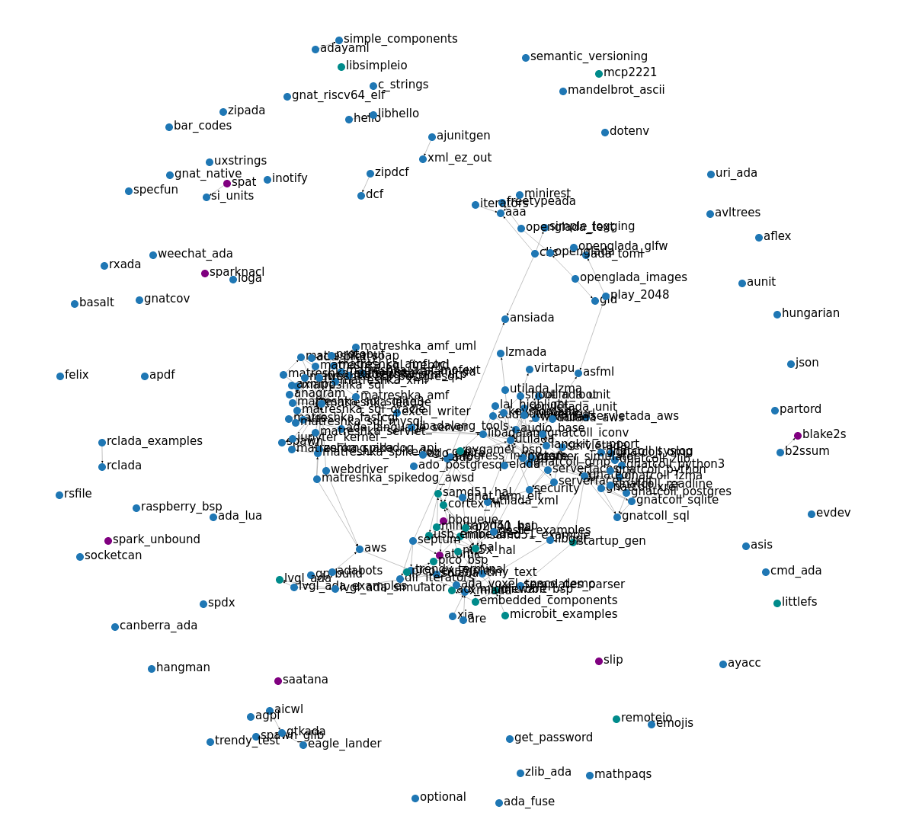
ECOSYSTEM
243 Crates
35 Embedded
14 SPARK
Top 10 tags
embedded(32) nostd(26) gnatcoll(14) web(12) spark(10) database(10) rp2040(9) bindings(9) sql(8) game(8)
22500+ downloads of “alr”
https://hanadigital.github.io/grev/?user=alire-project&repo=alire
https://alire.ada.dev/network

Slide 24
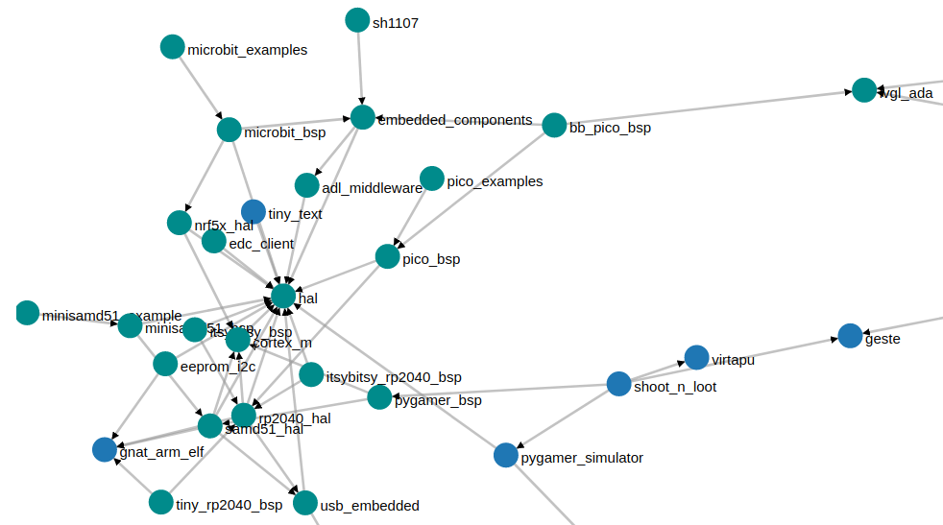
EMBEDDED

Slide 25
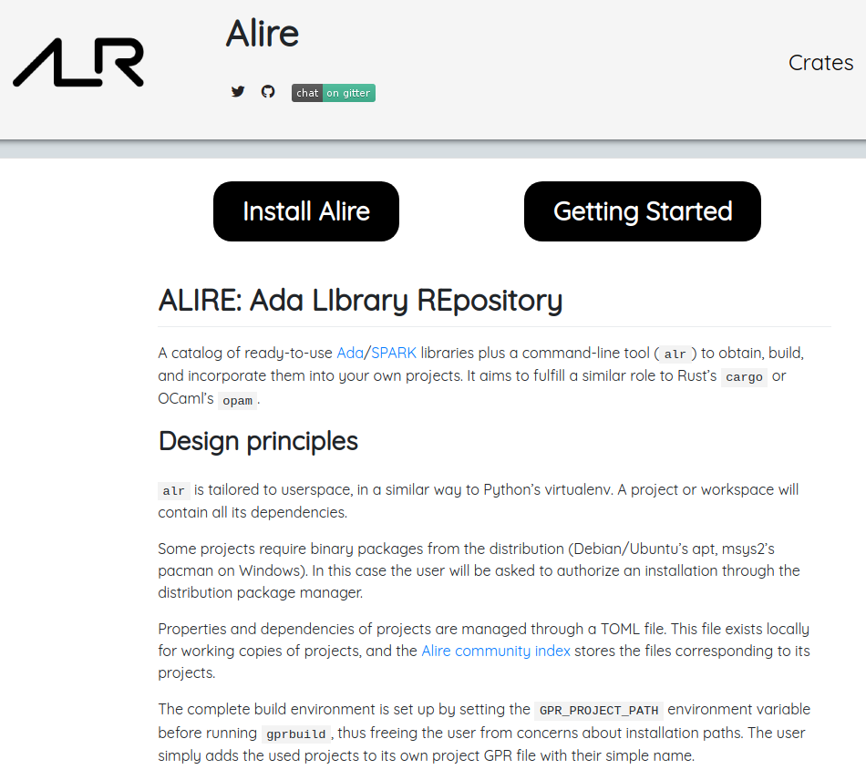
WEBSITE
https://alire.ada.dev

Slide 26
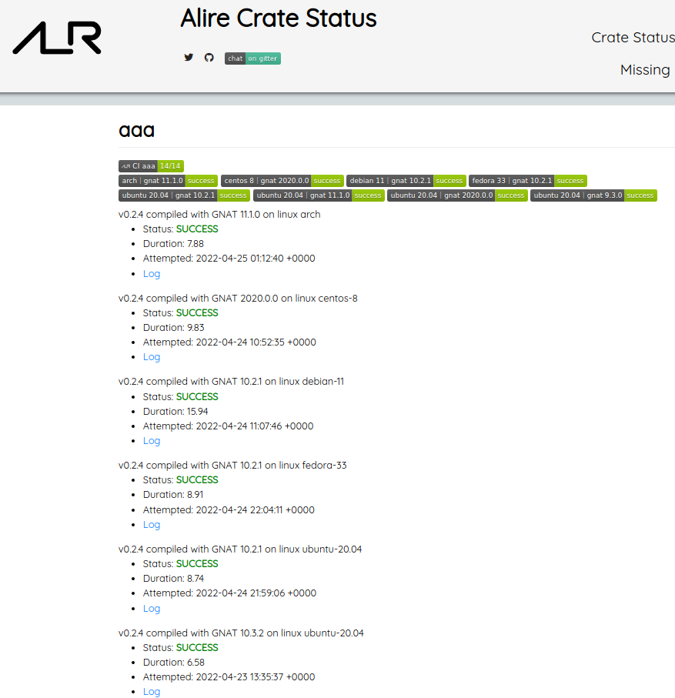
CRATE STATUS
https://alire-crates-ci.mosteo.com

Slide 27
CONCLUSIONS
User-level package manager for Ada/SPARK
Complete solver
Will find a solution if there is one
Support for several use cases:
Toolchain installation
User interested only on final executables
Developer interested on library reuse
With support for multi-crate development
Embedded developer
Cross-compilers
Static configuration
Open Source contributor
Publishing assistant
Rich and growing ecosystem
Public repository oriented
Chat at Gitter

Slide 28

THANKS FOR YOUR ATTENTION
🔗 https://github.com/alire-project
https://alire.ada.dev
https://gitter.im/ada-lang/Alire
https://www.reddit.com/r/ada/
✉ amosteo@unizar.es
🐦 @mosteobotic (Alejandro R. Mosteo)
@DesChips (Fabien Chouteau)

