Slide 1

Alire 2.0: a Quality-of-Life Update
https://alire.ada.dev/
Alejandro R. Mosteo
June 14, 2024

Slide 2
CONTENTS
Context
Ecosystem
Use cases
Novelties

Slide 3


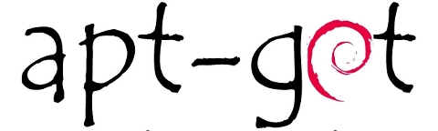

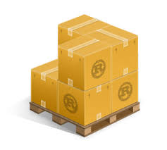





PACKAGE MANAGERS

Slide 4
TAXONOMY
SYSTEM vs USER
PLATFORM vs LANGUAGE
BINARY vs SOURCE
OFFICIAL vs COMMUNITY

Slide 5

CONTEXTS
https://github.com/alire-project
Alire
Project as a whole
Community index
https://…/alire-index
Project = “crate”
alr
Command-line tool
https://…/alire
Source download
Dependency mngmnt
Build
Ada Library Repository

Slide 6
TIMELINE
Feb 2016: 1st repo created (early ideas)
Jun 2018: AEiC 2018 paper & current org+repo creation
Aug 2019: Website online
Feb 2021: 1.0
Sep 2021: 1.1
May 2022: 1.2
Mar 2024: 2.0

Slide 7
ECOSYSTEM

Slide 8
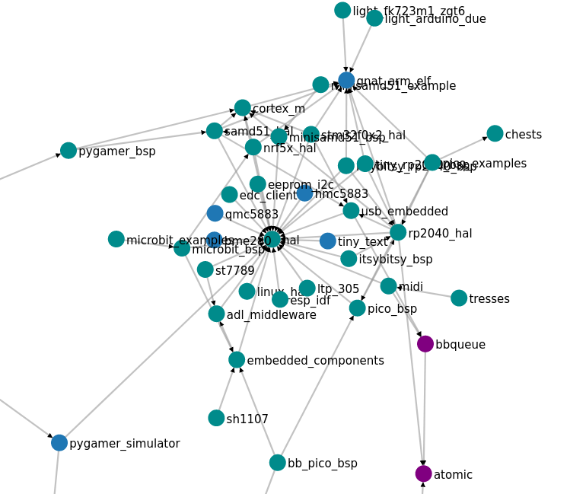
CRATES
https://alire.ada.dev/network
407 crates (1064 releases)
56 Embedded
16 SPARK
Top 10 tags
#embedded(56) #nostd(33) #web(26) #linux(18) #database(17) #spark(16) #game(15) #orka(14) #gnatcoll(14) #bindings(14)

Slide 9
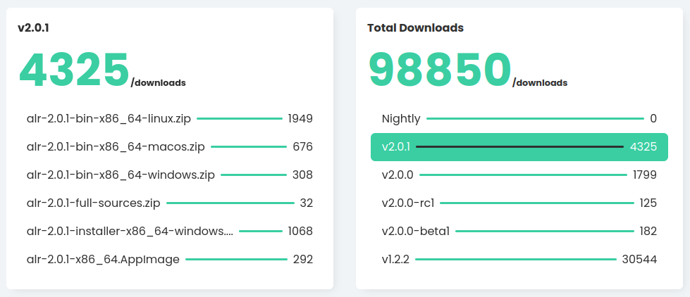
DOWNLOADS
Almost 100k downloads
https://hanadigital.github.io/grev/?user=alire-project&repo=alire

Slide 10
NEW PLATFORMS
Tested
Homebrew/MacPorts on macOS (Simon Wright)
x86_64 arch
Untested (no GH workflow runs)
SUSE/openSUSE/zypper (John Serock)
Docker image needed
FreeBSD (Stephane Carrez)

Slide 11
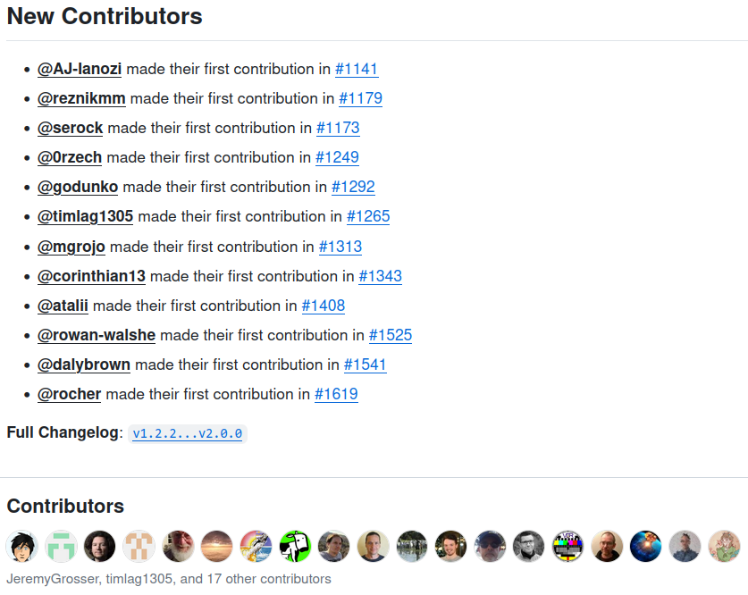
COMMUNITY
257 pull requests

Slide 12
GENERAL USE CASES

Slide 13
CRATE RETRIEVAL
# Retrieve crate for learning/testing
# NEW: nested report
$ alr get umwi
umwi=0.1.0 successfully retrieved.
ⓘ Found 2 nested crates in ./umwi_0.1.0_34abe384:
demo/demo=1.0.0: Demo of default and corner cases
generator/generator=1.0.0: Generate the proper
bodies based on Unicode spec
# Also works for `alr with`

Slide 14
CRATE INSPECTION
# NEW: describe projects under current location
$ alr show --nested
ⓘ Found 80 nested crates in /home/user/prog:
...
wordle_ada/wordle=0.1.0: Wordle for the terminal
wordlist_ada/wordlist=0.1.3: An English word list
wordlist_ada/demo/demo=0.1.0-dev: Demo project
yeison/yeison=0.1.0-dev: A JSON-like data
structure using Ada 2022 features

Slide 15
INITIALIZATION
# NEW: interactive initialization (optional)
$ alr init --bin myproject
Enter a short description of the crate:
> Cool program
Select a software license for the crate?
1. MIT OR Apache-2.0 WITH LLVM-exception
9. Other...
Enter a comma (',') separated list of tags:
> cool,executable
✓ myprogram initialized successfully.

Slide 16
EDITION
# NEW: lets you pick editor the 1st time
$ alr init --bin myprogram
$ cd myprogram
$ alr run
$ alr edit
ⓘ Please select your prefered editor
1. VS Code
2. GNAT studio
3. Other

Slide 17
INSTALLATION
$ alr install wordle # new command to build + gprinstall
$ tree ~/.alire/
$HOME/.alire/ # default location
├── bin/
│ └── wordle
└── share/
└── wordlist/
├── large.toml
├── small.toml
└── wordle.txt
$ alr install gnatprove # binary crates too
$ alr install # installs current workspace crate
$ alr test # tests current workspace crate
“Resources”

Slide 18
PUBLISHING

Slide 19
PUBLISHING
# Complete command-line workflow (--> automatable)
$ export GH_TOKEN=... # GitHub Personal Access Token
$ alr publish
...
✓ Pull request created successfully
ⓘ Visit https://.../alire-index/pull/4 for details
⚠ The submission is in draft mode.
Please request a review once automated checks
have succeeded.

Slide 20
PUBLISHING
$ alr publish --status
PR REFERENCE STATUS URL
8 mosteo:release/umwi-2.0.0 Checks_Ongoing https://…
5 mosteo:release/dashera-0.15.1 Checks_Failed https://…
2 mosteo:release/rxada-0.1.2 Checks_Passed https://…
$ alr publish --request-review=2
$ alr publish --cancel=5 --reason=”Obsolete”

Slide 21
DEPENDENCY-related

Slide 22
FINDING LIBRARIES
# Enhanced default search with match identification
$ alr search emoji
NAME VERSION DESCRIPTION MATCHES
emojis 1.0.1 A library to replace names between colons with emojis Description, Name, Tag, Website
keypadder 0.3.0 Programmable virtual keypad for your Linux desktop Long_Description
umwi 0.1.0 Unicode Monospace Width Information Tag

Slide 23
FINDING DEPENDENTS
$ alr show ada_toml --dependents[=direct]
# Direct dependents
CRATE VERSION DEPENDENCY
clic 0.2.1 ~0.2.0|~0.3.0
wordlist 0.1.3 ~0.3.0
$ alr show ada_toml --dependents=shortest
# Shortest dependency path for every dependent
CRATE VERSION DEPENDENCY CHAIN
clic 0.2.1 ~0.2.0|~0.3.0 clic=0.2.1»ada_toml=0.3.0
wordle 0.1.1 ~0.3.0 wordle=0.1.1»wordlist=0.1.3»ada_toml=0.3.0
wordlist 0.1.3 ~0.3.0 wordlist=0.1.3»ada_toml=0.3.0
$ alr show ada_toml --dependents=all
# Every dependency path for every dependent
Users just wanna have fun

Slide 24
SHARED BUILDS

Slide 25
OLD BEHAVIOR
$ alr init --bin myprogram && cd myprogram
$ alr settings --set dependencies.shared false
$ alr with hello # hello depends on libhello
$ tree .
myprogram/
├── alire
│ ├── alire.lock
│ └── cache
│ └── dependencies
│ ├── hello_1.0.1_dcc36a2f
│ └── libhello_1.0.0_7bc7dcfd
├── alire.toml
├── myprogram.gpr
└── src
└── myprogram.adb

Slide 26
NEW DEFAULT BEHAVIOR
$ alr init --bin myprogram && cd myprogram
$ alr with hello
$ tree .
myprogram/
├── alire
│ └── alire.lock
├── alire.toml
├── myprogram.gpr
└── src
└── myprogram.adb

Slide 27
NEW DEFAULT BEHAVIOR
$ tree $HOME/.local/share/alire/
$HOME/.local/share/alire/
├── builds
│ ├── hello_1.0.2_5715870b # For each release in VAULT,
│ │ ├── f049a4cc2ce09 # SHARED build locations
│ │ └── 64359f1082c9d # having unique config.
│ └── libhello_1.0.1_3c15bc7f
│ ├── 4ec0aaac3c670
│ └── 6a8aaea7927c8
└── releases # “VAULT” of r/o releases
├── hello_1.0.2_5715870b # downloaded just once,
└── libhello_1.0.1_3c15bc7 # kept pristine.

Slide 28
UNIQUE BUILD HASH (.ali for builds)
$ cat …/builds/hello…/f049a4cc2ce09/alire/build_hash_inputs
dependency:libhello=1.0.1=5075676debf3
external:HELLO_LIBRARY_TYPE=default
external:LIBRARY_TYPE=default
profile:hello=VALIDATION
switches:hello=-O3,-fdata-sections,-ffunction-sections,-g,
-gnatVa,-gnatW8,-gnata,-gnatn,-gnato,-gnatw.X,-gnatwa,
-gnatwe,-gnaty-d,-gnaty3,-gnatyA,-gnatyB,-gnatyI,-gnatyO,
-gnatyS,-gnatya,-gnatyb,-gnatyc,-gnatye,-gnatyf,-gnatyh,
-gnatyi,-gnatyk,-gnatyl,-gnatym,-gnatyn,-gnatyp,-gnatyr,
-gnatyt,-gnatyu,-gnatyx
version:gnat_native=14.1.3

Slide 29
SHARED BUILDS ENVIRONMENT
$ alr printenv
export GPR_PROJECT_PATH="$HOME/.local/share/alire/builds/hello_1.0.2_5715870b/830a733e5eab:$HOME/.local/share/alire/builds/libhello_1.0.1_3c15bc7f/eb3958dc41730:/tmp/a/myprogram
# IMPLICATION: the hash cannot be computed unless all inputs (configuration values, environment variables, compiler to be used) are known.
# IMPLEMENTATION:
# - VAULT → BUILD sync is delayed until build time
# - post-fetch is run only once after sync, not on fetch

Slide 30
SHARED BUILDS PATHS
$ alr version
CONFIGURATION
settings folder: ~/.config/alire
cache folder: ~/.local/share/alire
vault folder: ~/.local/share/alire/releases
build folder: ~/.local/share/alire/builds
toolchain folder: ~/.local/share/alire/toolchains
# cache and toolchain folders can be relocated with settings
# cache.dir
# toolchain.dir

Slide 31
MISCELLANEA

Slide 32
INDEX IMPROVEMENTS
Indexes are loaded on demand and piecemeal
Decreased latency for many commands
Community index is refreshed once a day
Asks for permission on first refresh
Indexes can be accessed over ssh+git
Contributors: Daly Brown/Rowal Walshe

Slide 33
BREAKING CHANGES
Unicode enabled by default (-gnatW8)
UTF-8-encoded sources created and expected
No significant trouble to date
Cache locations
Manual cleanup needed of ~/.config/alire/
Toolchain export through `alr toolchain`
Removed `--install/--uninstall/--install-dir`
Use `alr install` (or `alr get` for the old behavior)

Slide 34
PLANS for 2024

Slide 35
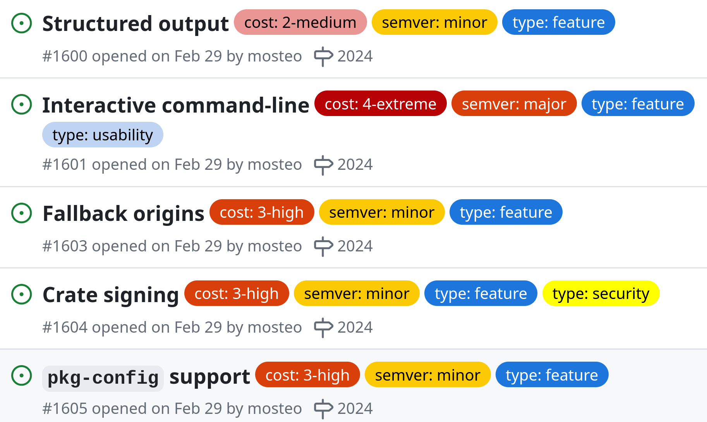

Slide 36

THANKS FOR YOUR INTEREST
🔗 https://github.com/alire-project
https://alire.ada.dev
https://gitter.im/ada-lang/Alire
GH @mosteo (Alejandro R. Mosteo)
@Fabien-Chouteau (Fabien Chouteau)

