Slide 1
Term Project
Courses Registration System
MET CS 655
Haifeng Zhang

Slide 2
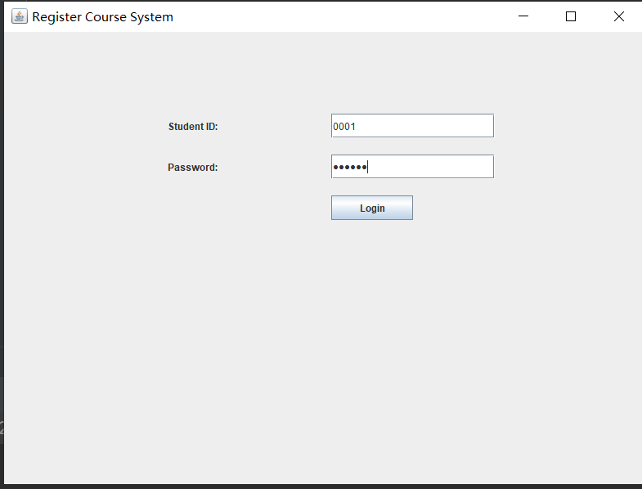
Login in

Slide 3
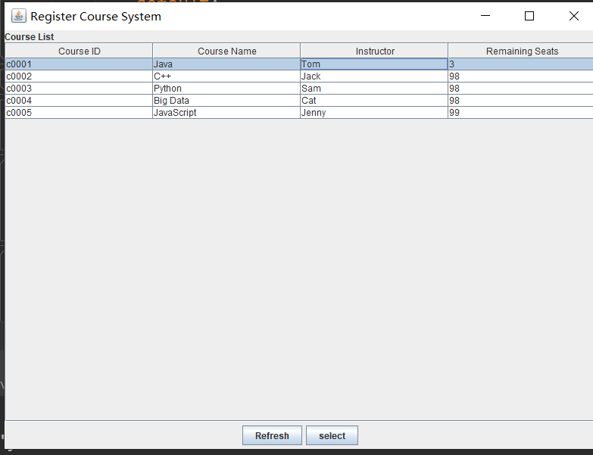
Get the course list and register in

Slide 4
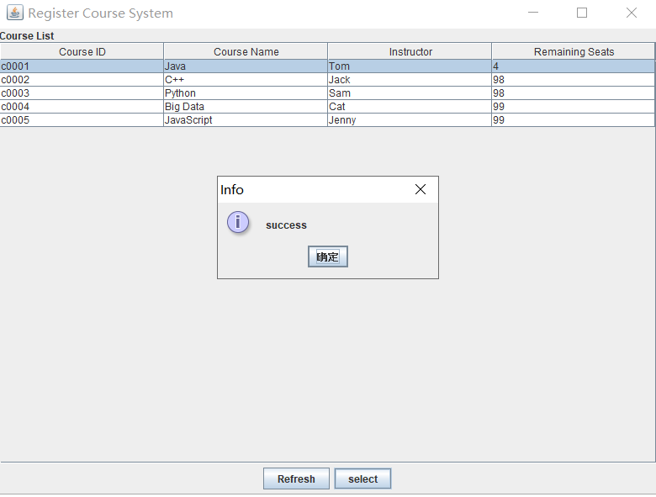
enroll in successfully

Slide 5
MVC pattern
Strategy Pattern
Data Access Object pattern

Slide 6
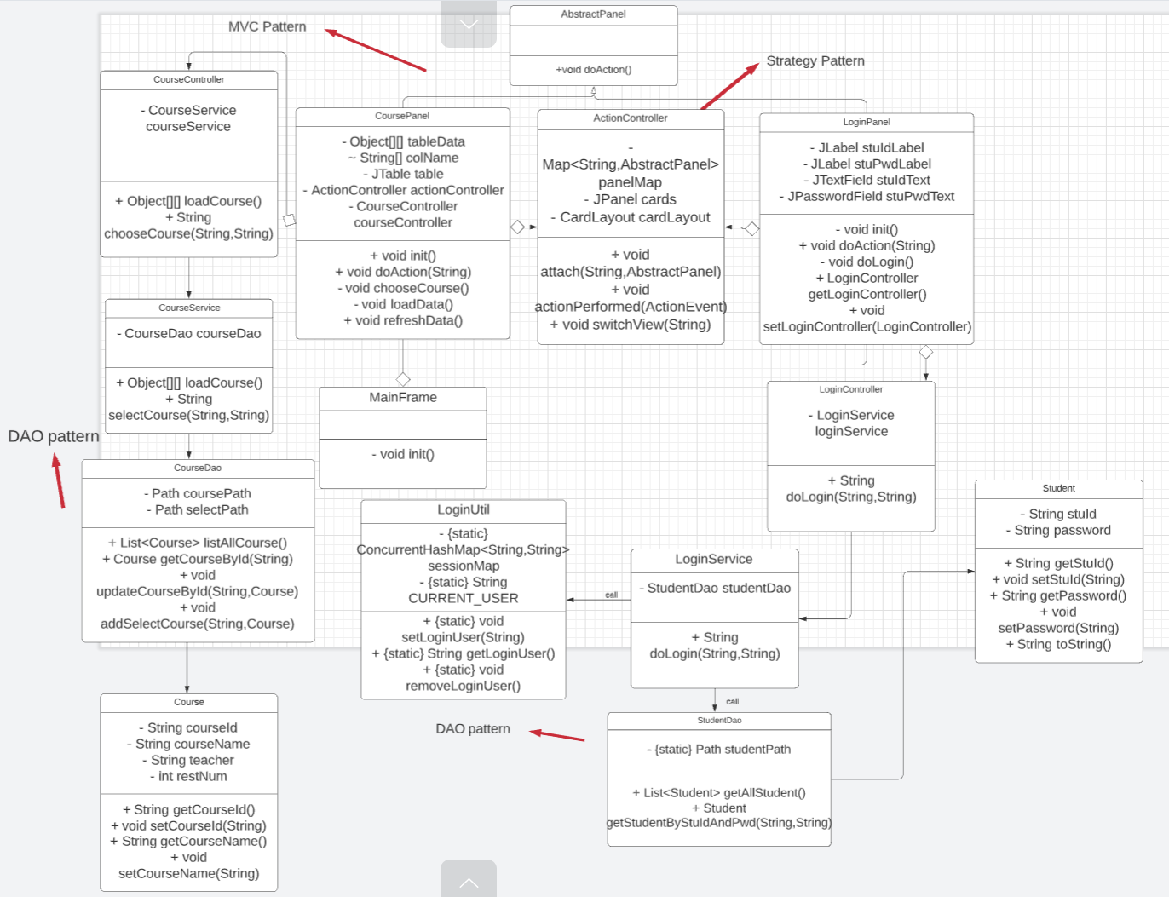

Slide 7
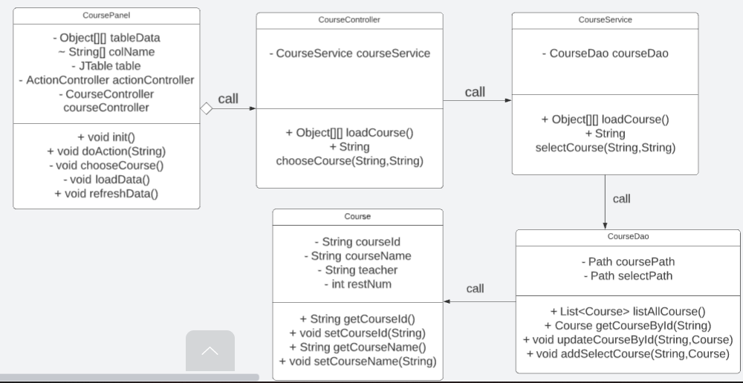
MVC Pattern

Slide 8
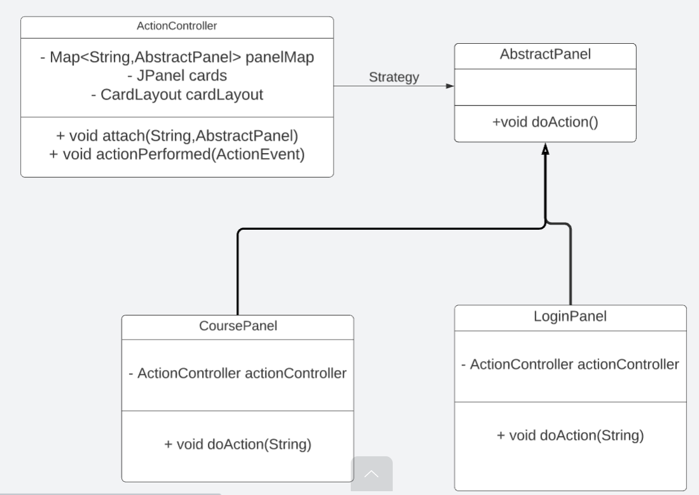
Strategy Pattern

Slide 9
Data Access Object Pattern

Slide 10
What is Data Access Objetct Pattern(DAO)?
Data Access Object Pattern or DAO pattern is used to separate low level data accessing API or operations from high level business services.

Slide 11
The participants in the Data Access Pattern
Data Access Object Interface - This interface defines the standard operations to be performed on a model object(s).
Data Access Object concrete class - This class implements above interface. This class is responsible to get data from a data source which can be database / xml or any other storage mechanism.
Model Object or Value Object - This object is simple POJO containing get/set methods to store data retrieved using DAO class.

Slide 12
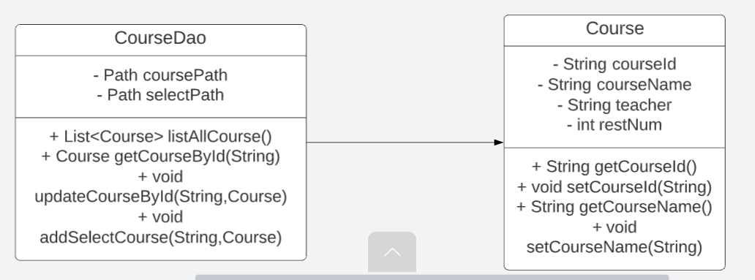
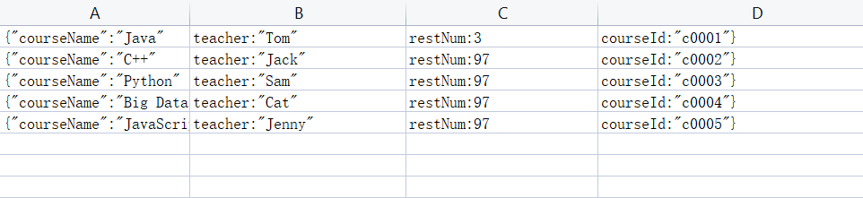

Slide 13
Thank you!!!!

