Slide 1
My Proccess Of the Analysis
Hazem Gamal

Slide 2
Excel Proccess
First I view the excel sheet and the I Created the new sheet and copy the id of the product and the get all data related to this product using xlookup function.

Slide 3
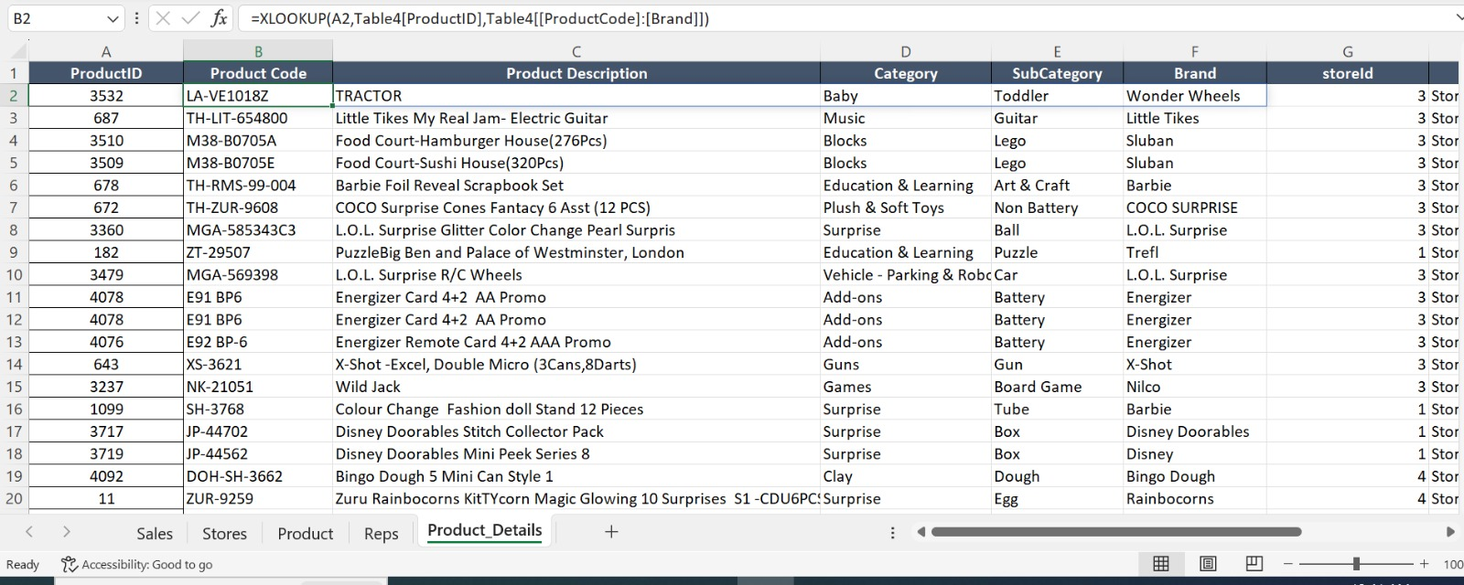
The Xlookup function

Slide 4
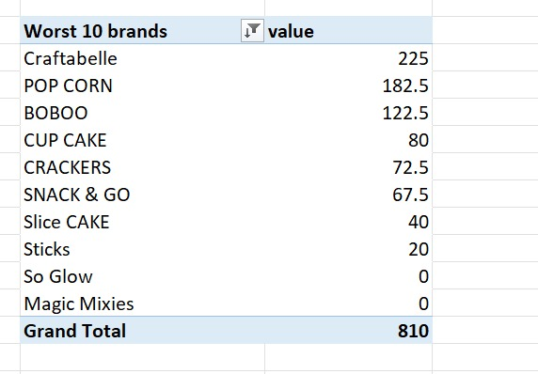
The pivot table
I Created the pivot tables as requested using excel and get some calculus using Pivot Tables and the image explain on of the pivot tables I created

Slide 5
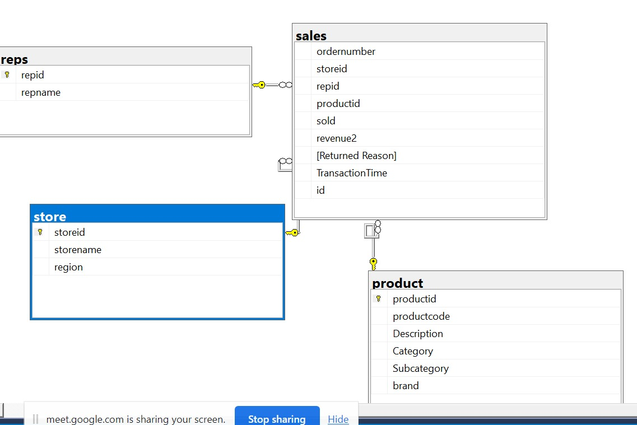
SQL SERVER
I Create database called Bingo and create tables that exists in excel sheet after that I created the realationship and DWH

Slide 6
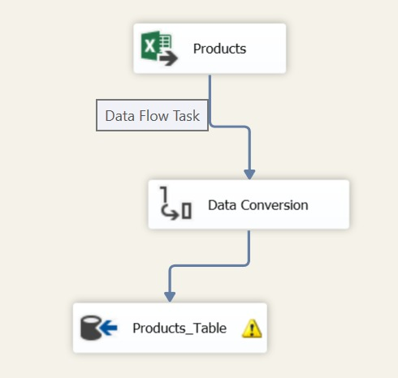
SSIS Tools
Created the SSIS Tools to integrate excel sheet with database that I created it and get the data from excel to ssis

Slide 7
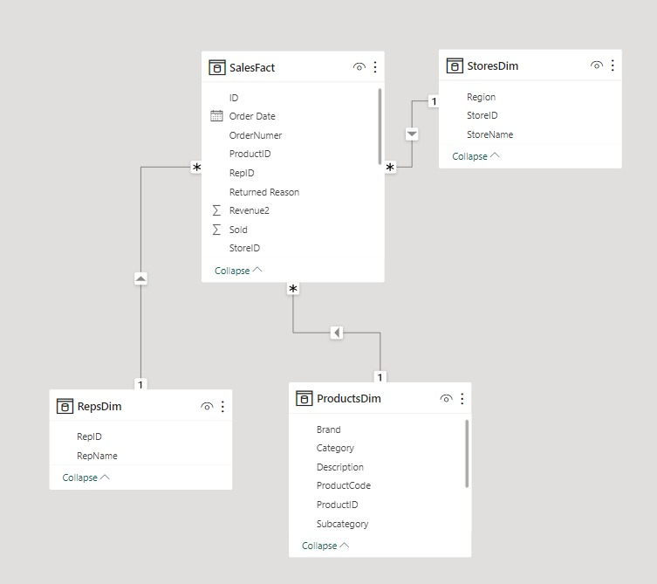
Tranfom And Modeling Data Using PowerBi
I used PowerBi to transform the data and specify the fact and Dimentions table and create Star Schema and the fact table is Sales Table

Slide 8
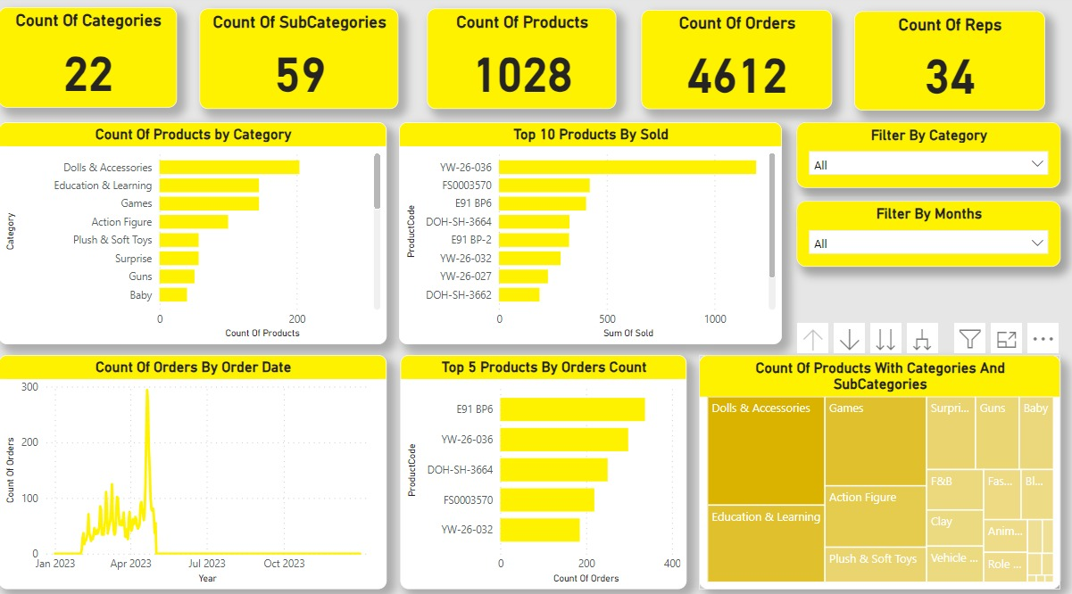
Reports Of The Data Using PowerBi
Reporting and made a dashboard using PowerBi to get information from the data Like Count Orders By Order Date and top 10 product by sold.

Slide 9
Thank You

