Slide 1
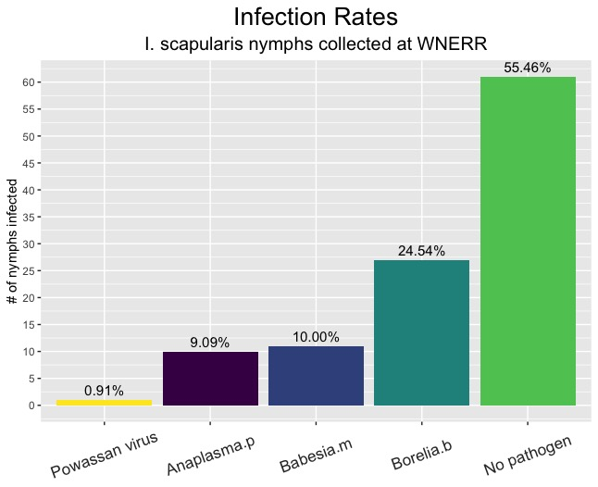
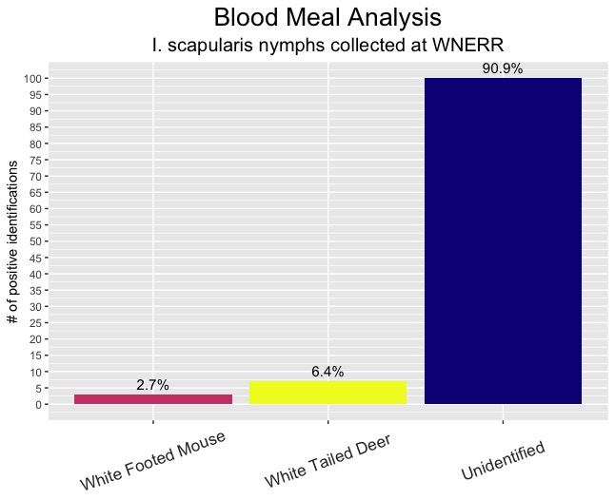

Blood Meal Analysis and Infection Rates of I. Scapularis Nymphs Collected From Wells, Maine
Henry Becker, Rebecca Robich, Libby Schneider, Danielle Cosenza, Chuck Lubelczyk, Susan Elias, Robert Smith
Larva attaches to first host and feeds
Adult female lays eggs in WNERR
Nymph tested for pathogens
Egg hatches to larva
Larva quests for host
Larva molts into nymph
Nymph quests for host
Nymph collected at Wells Reserve
Blood meal remnant analysis performed to test for mouse or deer blood
Larva acquires pathogen from host blood
On what animals are nymphal deer ticks feeding at the WNERR?
From what animals are nymphal deer ticks acquiring the pathogens they carry at the WNERR?
110 nymphs collected and tested
91% of nymphs negative for mice and deer blood
2/31 infected nymphs positive for deer blood
0/31 infected nymphs positive for mouse blood
Fig 1. (Above): Bar graph showing the infection prevalence of each pathogen in the 110 nymphal deer ticks collected and sampled.
Fig 2. (Above): Bar graph showing the number and percentage of nymphs that tested positive for mice or deer blood based on blood meal remnant analysis.
Rodino, Kyle G, Elitza S Theel, and Bobbi S Pritt. “Tick-Borne Diseases in the United States.” Clinical Chemistry 66, no. 4 (April 1, 2020): 537–48. https://doi.org/10.1093/clinchem/hvaa040.
Goethert HK, Mather TN, Buchthal J, Telford SR, III. 2021. Retrotransposon-based blood meal analysis of nymphal deer ticks demonstrates spatiotemporal diversity of Borrelia burgdorferi and Babesia microti reservoirs. Appl Environ Microbiol 87:e02370-20. https://doi.org/ 10.1128/AEM.02370-20.
Thank you to the vector borne disease lab! - Dr. Rob Smith, Dr. Rebecca Robich, Dr. Chuck Lubelczyk, Dr. Susan Elias, Libby Schnieder, and Danielle Cosenza. Thank you to the SSRP coordinators Liz Bergst, Christine Ellis, Dr. Rob Koza, and Dr. Lucy Liaw for making this program possible!

