Slide 1

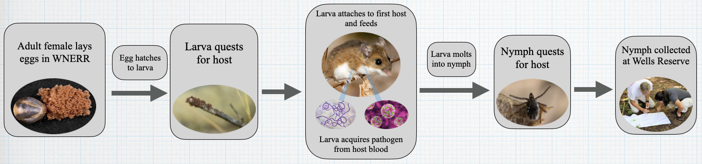
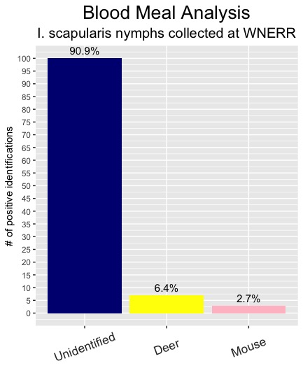
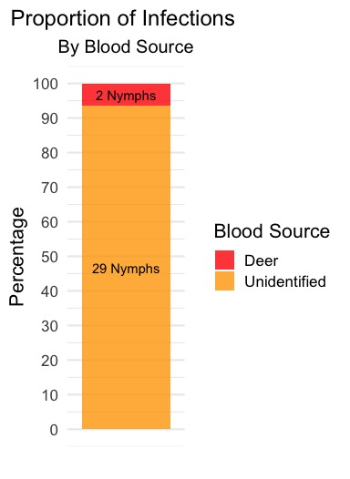
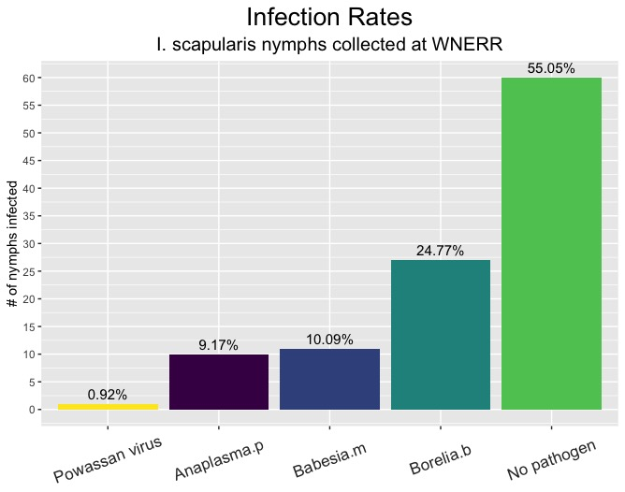
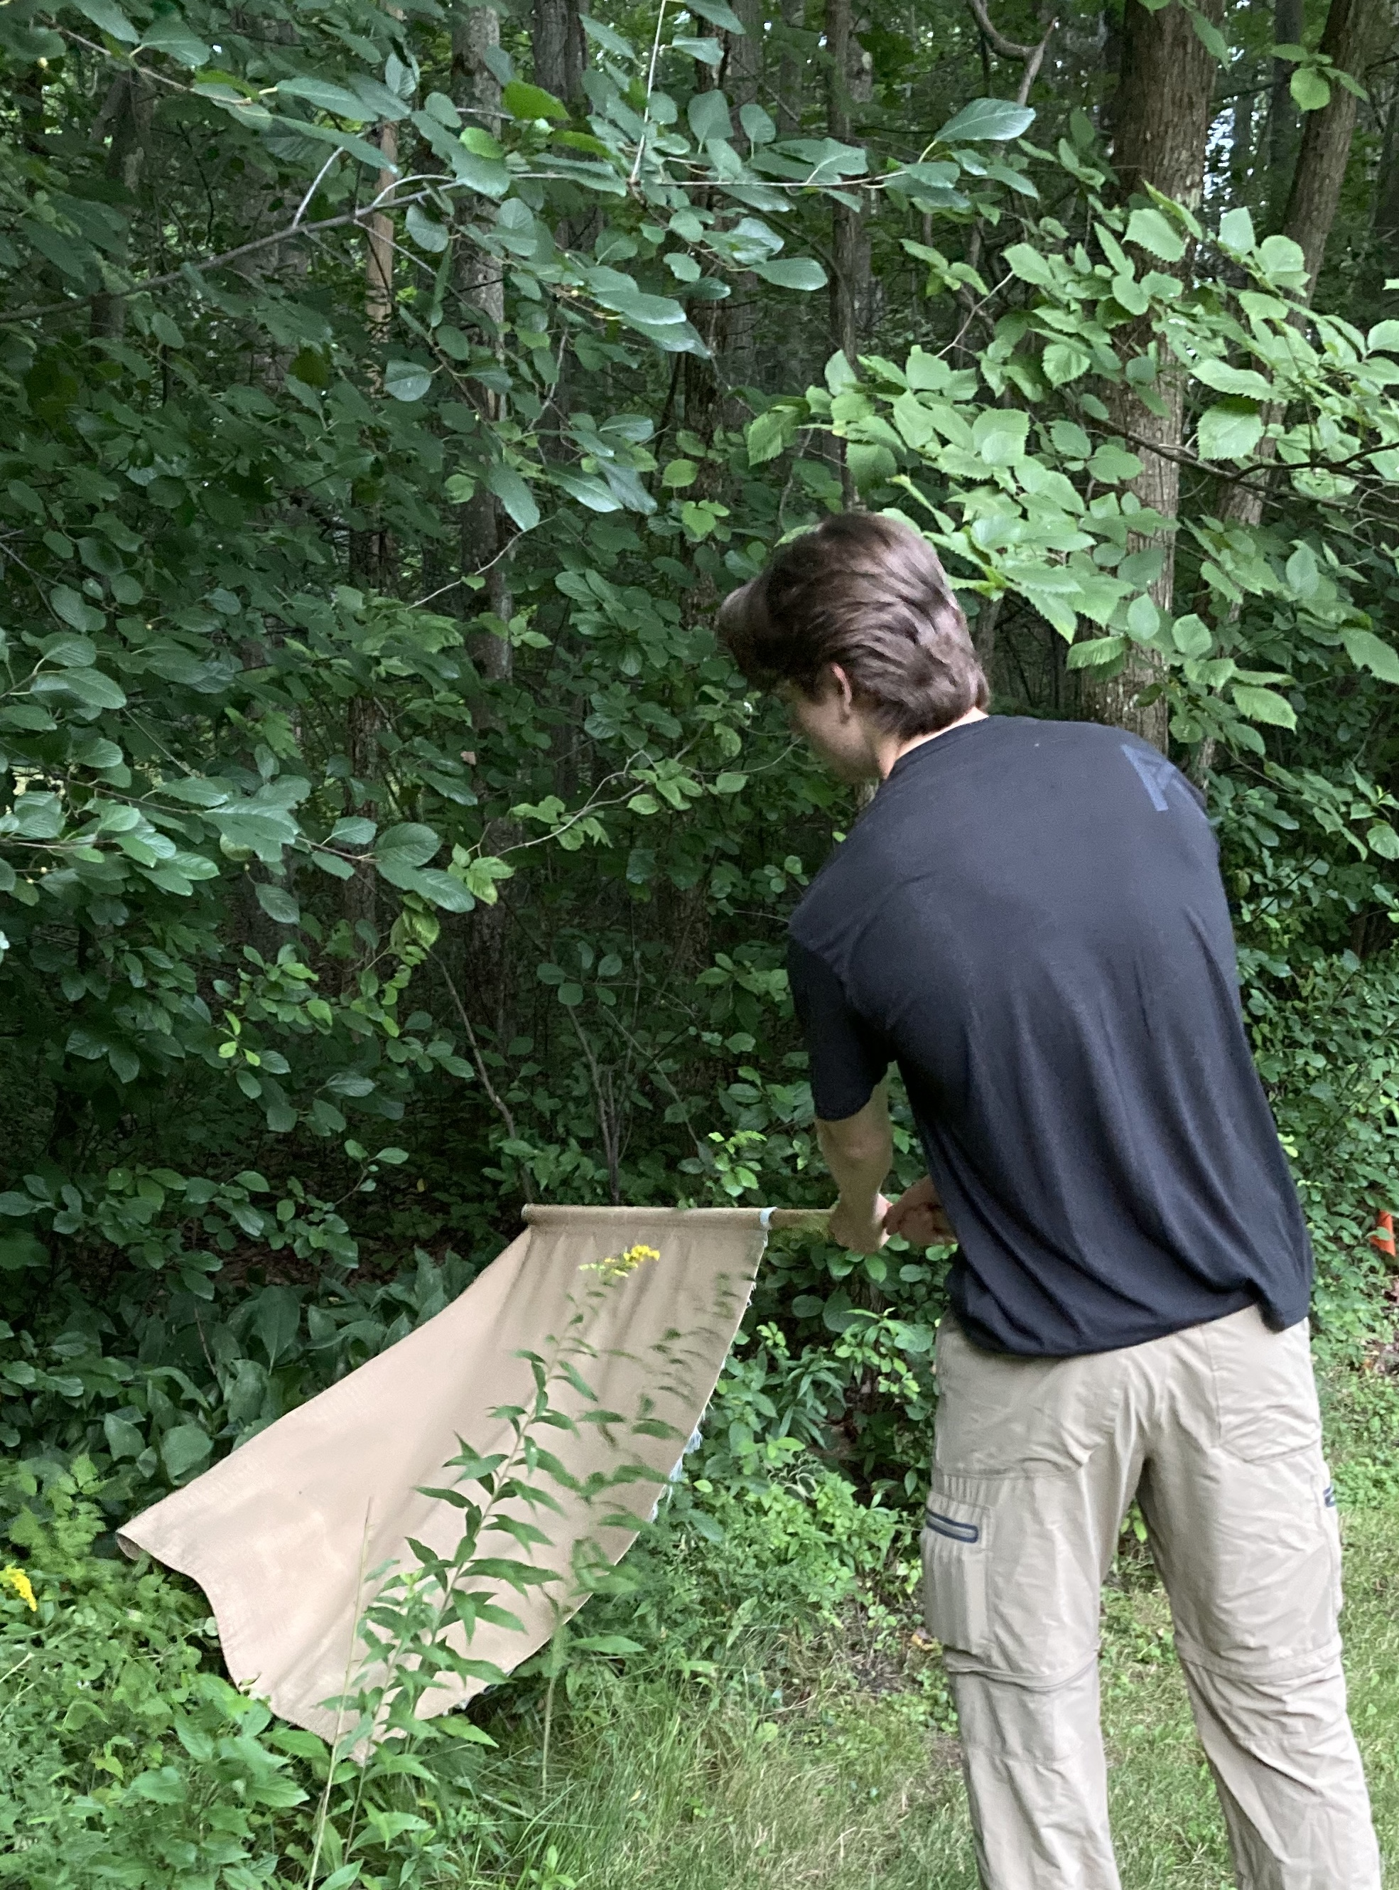


Blood Meal Analysis and Infection Rates of I. Scapularis Nymphs Collected From Wells, Maine
Henry Becker^{1,2}, Rebecca Robich¹, Elisabeth Schneider¹, Danielle Cosenza¹, Chuck Lubelczyk¹, Susan Elias¹, Robert Smith¹
¹Vector Borne Disease Lab, Maine Medical Center Research Institute, Scarborough, ME 04074
²George Washington University, Washington, DC 20052
Background
Fig 2. Below: Flow chart showing the progression of the tick life cycle up to sample collection.
Aims
Ticks are the primary disease vector in the United States, accounting for over 75% of the annual reported vector-borne disease cases². Tick borne illness cases are increasing across the US and in Maine. The deer tick, also known as the black legged tick (Ixodes scapularis) is the most dangerous tick species endemic to Maine and transmits more than 5 different agents of human disease including:
Borrelia burgdorferi (the agent of Lyme disease)
Babesia microti (the agent of human babesiosis)
Anaplasma phagocytophylum (the agent of human granulocytic anaplasmosis)
Powassan virus (the agent of Powassan encephalitis)
Previous research has implicated white footed mice (Peromyscus leucopus) and white tailed deer (Odocoileus virginianus) as the principle hosts of deer ticks.¹ Additionally, white footed mice have been implicated as a principle reservoir of B. burgdorferi, B. microti, A. phagocytophylum and Powassan virus. To make the best tick management decisions, it is essential to understand what animals deer ticks feed on and from what animals deer ticks acquire the pathogens they carry. Tick blood meal analysis has the potential to provide this information, but until recently, tick blood meal analysis strategies have been inefficient or inaccurate.
The goal of this study was to pair the newly developed blood meal analysis assays with pathogen testing to answer the following questions:
What proportion of nymphal deer ticks feed on mice and deer in the WNERR?
What proportion of the pathogens of interest originate from mice and deer in the WNERR?
Discussion
Results
Throughout the course of this study 110 nymphal deer ticks were collected and tested for pathogens and for remnants of mouse and deer blood. Our results contradict the notions that 1. White footed mice and white tailed deer contribute the majority of blood meals to deer ticks in Maine and 2. White footed mice are the principle reservoirs for the pathogens tested.
91% of nymphs tested negative for mice and deer blood, suggesting they fed on other woodland animals (chipmunks, voles, shrews, etc).
0/31 infected nymphs positive for mouse blood and 2/31 infected nymphs positive for deer blood suggesting 29/31 infected ticks acquired their infections from woodland animals other than mice and deer (chipmunks, voles, shrews, etc).
2 nymphs positive for deer blood were both positive for Borrelia burgdorferi. Deer are thought to be dead end hosts for B. burgdorferi but this result suggests otherwise and may be the result of cofeeding as proposed by Goethert et al.
Goethert et al tested the mouse and deer blood meal analysis assays on nymphal deer ticks from island and mainland sites in Massachusetts in 2018 and 2019. Mainland sites had at the lowest 19% mice and deer contribution to blood meals which corroborates our finding that mice and deer are not necessarily the principle blood source for deer ticks.
The DNA samples collected in this study are being sent to Tufts University to be retested. Though retesting will help rule out erroneous results, it will be difficult to rule out false negatives until a sample tests positive for DNA of another woodland animal.
These results provide support for significant spatiotemporal diversity in woodland mammal blood meal and pathogen contributions to deer ticks in Maine.
Blood Meal Analysis
Deer ticks digest and metabolize their blood meal in order to molt to the next life stage. Blood meal analysis strategies attempt to detect remnants of host DNA leftover from the blood meal after the tick has molted. This allows researchers to determine the previous host of a deer tick. Because only small amounts of blood DNA remain after the molt, blood meal analysis strategies are often limited by their lack of sensitivity. Researchers at Tufts university recently pioneered a retrotransposon based qPCR approach for tick blood meal analysis. In this approach, specific retrotransposon sequences are targeted for amplification through qPCR. Retrotransposons are self replicating DNA elements found in high concentrations in mammalian genomes. Retrotransposons make up 30% of some mammalian genomes.¹ Targeting a sequence that takes up such a high percentage of the mammalian genome maximizes the assay’s sensitivity. Assays for mice and deer DNA have been developed and assays for several other woodland animals are under active development. Though blood meal analysis techniques have been developed before, this retrotransposon based technique is more cost effective and more accurate than previous strategies. This project marks the first application of this new technique to the study of ticks in Maine.
Fig 3. Above: Bar graph showing the number of nymphs testing positive for mouse or deer blood.
Fig 4. Above: Stacked bar graph showing the proportion of infected nymphs that also tested positive for mouse or deer blood (0 infected nymphs tested positive for mouse blood).
Future directions
Researchers at Tufts University are developing more assays to identify blood remnants of other woodland mammals. With more assays available:
The percentage of unidentified blood meals will likely decrease.
Potential false negatives can be confirmed as true negatives.
A more accurate picture of the enzootic transmission cycle of each pathogen will come into focus.
Methods
Field Collection: 110 questing (host-seeking) nymphal I. scapularis ticks were collected in June and July of 2021 by dragging a 1 meter square corduroy cloth over vegetation at the Wells National Estuarine Reserve in York County, Southern Maine.
RNA extraction and pathogen testing:
Individually extracted RNA samples were pooled in groups of ten. The Powassan target region was amplified using bench top PCR. Samples were then run on agarose gel to determine the presence/absence of Powassan virus RNA. Samples from positive pools were then tested individually.
DNA extraction and pathogen testing:
Individually extracted DNA was used to test for evidence of infection with Borrelia burgdorferi, Anaplasma phagocytophylum and Babesia microti using primers and probes in accordance with the latest CDC molecular algorithm.
Blood meal Assay:
Individual DNA samples were tested for remnants of white footed mouse and white tailed deer DNA using the retrotransposon-based qPCR assays described by Goethert et al.¹
Literature Cited
Goethert HK, Mather TN, Buchthal J, Telford SR, III. 2021. Retrotransposon-based blood meal analysis of nymphal deer ticks demonstrates spatiotemporal diversity of Borrelia burgdorferi and Babesia microti reservoirs. Appl Environ Microbiol 87:e02370-20. https://doi.org/ 10.1128/AEM.02370-20.
Rodino, Kyle G, Elitza S Theel, and Bobbi S Pritt. “Tick-Borne Diseases in the United States.” Clinical Chemistry 66, no. 4 (April 1, 2020): 537–48. https://doi.org/10.1093/clinchem/hvaa040.
Smith, Robert P. MD MPH; McCarthy, Carol A. MD; and Elias, Susan P. PhD (2019) "Increasing Actual and Perceived Burden of
Tick-Borne Disease in Maine," Journal of Maine Medical Center: Vol. 1 : Iss. 1 , Article 13.
Available at: https://knowledgeconnection.mainehealth.org/jmmc/vol1/iss1/13
Acknowledgments
Fig 1. Above: field collection by flagging at the WNERR (Wells National Estuarine Research Reserve).
Thank you to the Twombly family. Thank you to the vector borne disease lab - Dr. Rob Smith, Dr. Rebecca Robich, Dr. Chuck Lubelczyk, Dr. Susan Elias, Libby Schnieder, and Danielle Cosenza - for giving me the opportunity to work with you all and for supporting me along the way. Thank you to the SSRP coordinators Liz Bergst, Christine Ellis, Dr. Rob Koza, Dr. Lucy Liaw for making this program possible!
Fig 5. Above: Bar graph showing the number of nymphs testing positive for each pathogen. Co-infections occurred and are not reflected in this bar graph.

