Slide 1
Embeddings
Xavier Evans

Slide 2
Why?
Words intractable for machine learning models
Convert natural language → numeric representation
Many ways to do this numeric representation
One-hot encoding
Each word ⇔ unique index
Word embeddings

Slide 3
One-hot encoding
Consider: “The dog wore the sparkly bowtie.”
Let the encoding work as follows.
the ⇔ [1, 0, 0, 0, 0]
dog ⇔ [0, 1, 0, 0, 0]
wore ⇔ [0, 0, 1, 0, 0]
sparkly ⇔ [0, 0, 0, 1, 0]
bowtie ⇔ [0, 0, 0, 0, 1]

Slide 4
One-hot encoding
Consider: “The dog wore the sparkly bowtie.”
The encoding is, then, as follows.
[1, 0, 0, 0, 0]
[0, 1, 0, 0, 0]
[0, 0, 1, 0, 0]
[1, 0, 0, 0, 0]
[0, 0, 0, 1, 0]
[0, 0, 0, 0, 1]

Slide 5
One-hot encoding
Consider: “The dog wore the sparkly bowtie.”
The encoding is, then, as follows.
S = [
[1, 0, 0, 0, 0],
[0, 1, 0, 0, 0],
[0, 0, 1, 0, 0],
[1, 0, 0, 0, 0],
[0, 0, 0, 1, 0],
[0, 0, 0, 0, 1]]

Slide 6
One-hot encoding
This is very inefficient! Why?
Mostly zeroes, wasted space
Particularly inefficient for large vocabulary sizes
How do we fix this?

Slide 7
Each word gets a unique index
Consider: “The dog wore the sparkly bowtie.”
Let the encoding work as follows.
the ⇔ 1
dog ⇔ 2
wore ⇔ 3
sparkly ⇔ 4
bowtie ⇔ 5

Slide 8
Each word gets a unique index
Consider: “The dog wore the sparkly bowtie.”
The encoding is, then, as follows.
1
2
3
1
4
5

Slide 9
Each word gets a unique index
Consider: “The dog wore the sparkly bowtie.”
The encoding is, then, as follows.
S = [1, 2, 3, 1, 4, 5]

Slide 10
Each word gets a unique index
Still not optimal. Why?
The encoding is completely arbitrary
Does not express any relationship between the words
How do we fix this?

Slide 11
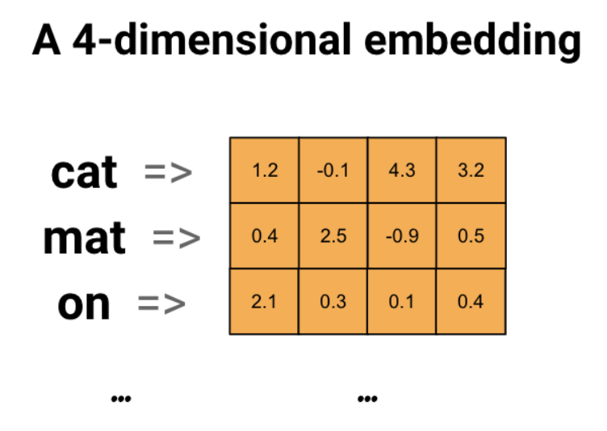
Word embeddings
Per TensorFlow, “Word embeddings give us a way to use an efficient, dense representation in which similar words have a similar encoding.”
Dense floating-point vectors
More dimensions for larger (more diverse) datasets
More dimensions → more expressivity (larger state space)
Polar opposites are further apart with more dimensions
Unit square → √2
Unit cube → √3
General → √n
Notes:
But can they be arbitrarily large? No because of time concerns now.

Slide 12
Word embeddings
We don’t have to choose them
Trainable parameters
Use tf.keras.layers.Embedding
Input vocabulary size and dimension of the embedding vectors

Slide 13
Word embeddings
model = Sequential()
model.add(Embedding(MAX_NB_WORDS, EMBEDDING_DIM, input_length=X.shape[1]))
model.add(SpatialDropout1D(0.2))
model.add(LSTM(100, dropout=0.2, recurrent_dropout=0.2))
model.add(Dense(13, activation='softmax’))
model.compile(loss='categorical_crossentropy', optimizer='adam', metrics=['accuracy’])
epochs = 5
batch_size = 64
history = model.fit(X_train, Y_train, epochs=epochs, batch_size=batch_size, validation_split=0.1, callbacks=[EarlyStopping(monitor='val_loss', patience=3, min_delta=0.0001)])
Notes:
Input_length is length of longest sentence (unless using a ragged tensor)

Slide 14
Graph embeddings
Just like natural language, graphs intractable for ML
Convert graph → numeric representation
Transform nodes to vectors, preserve as much info as possible
Similar nodes are embedded close together
For example, two nodes that are close to each other
What else? Linked? Share neighbors? Similar structural roles?
Similarity in original graph ≈ dot product of vector representations
But how?

Slide 15
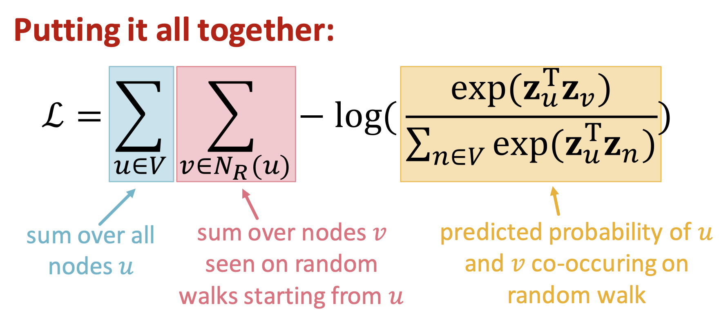
Graph embeddings
Random walks
Run short fixed-length random walks starting at each node in the graph
For each node u collect N_R(u), all the nodes visited on the walk from u
Minimize L

Slide 16
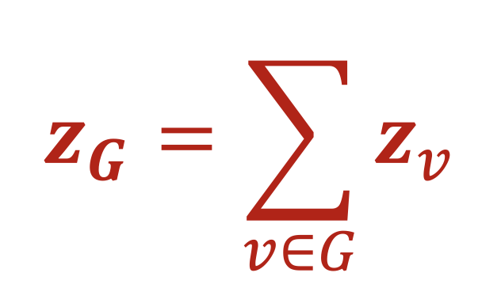
Graph embeddings
Can embed entire graph
Run standard technique
Then, sum all embedding vectors

Slide 17
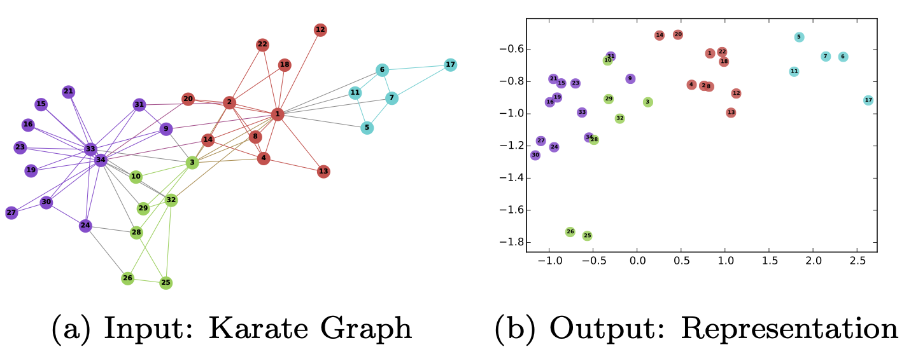
Graph embeddings

Slide 18
Application
Crawling
Predicting keywords, a simple classification task (if necessary)
Vectorize the articles somehow?
Indexing
Create a database of this numeric information
Ranking
Compare query to titles and keywords
Use distance metrics (just comparing vectors)
How would we make a graph? Citations?
Get similar nodes

Slide 19
Application
Additional consideration: meaning of the query
Spelling mistakes, synonyms

