Slide 1
Research and Development of Joint Language and Graph Embeddings for GES-DISC Search Engine
Xavier Evans

Slide 2
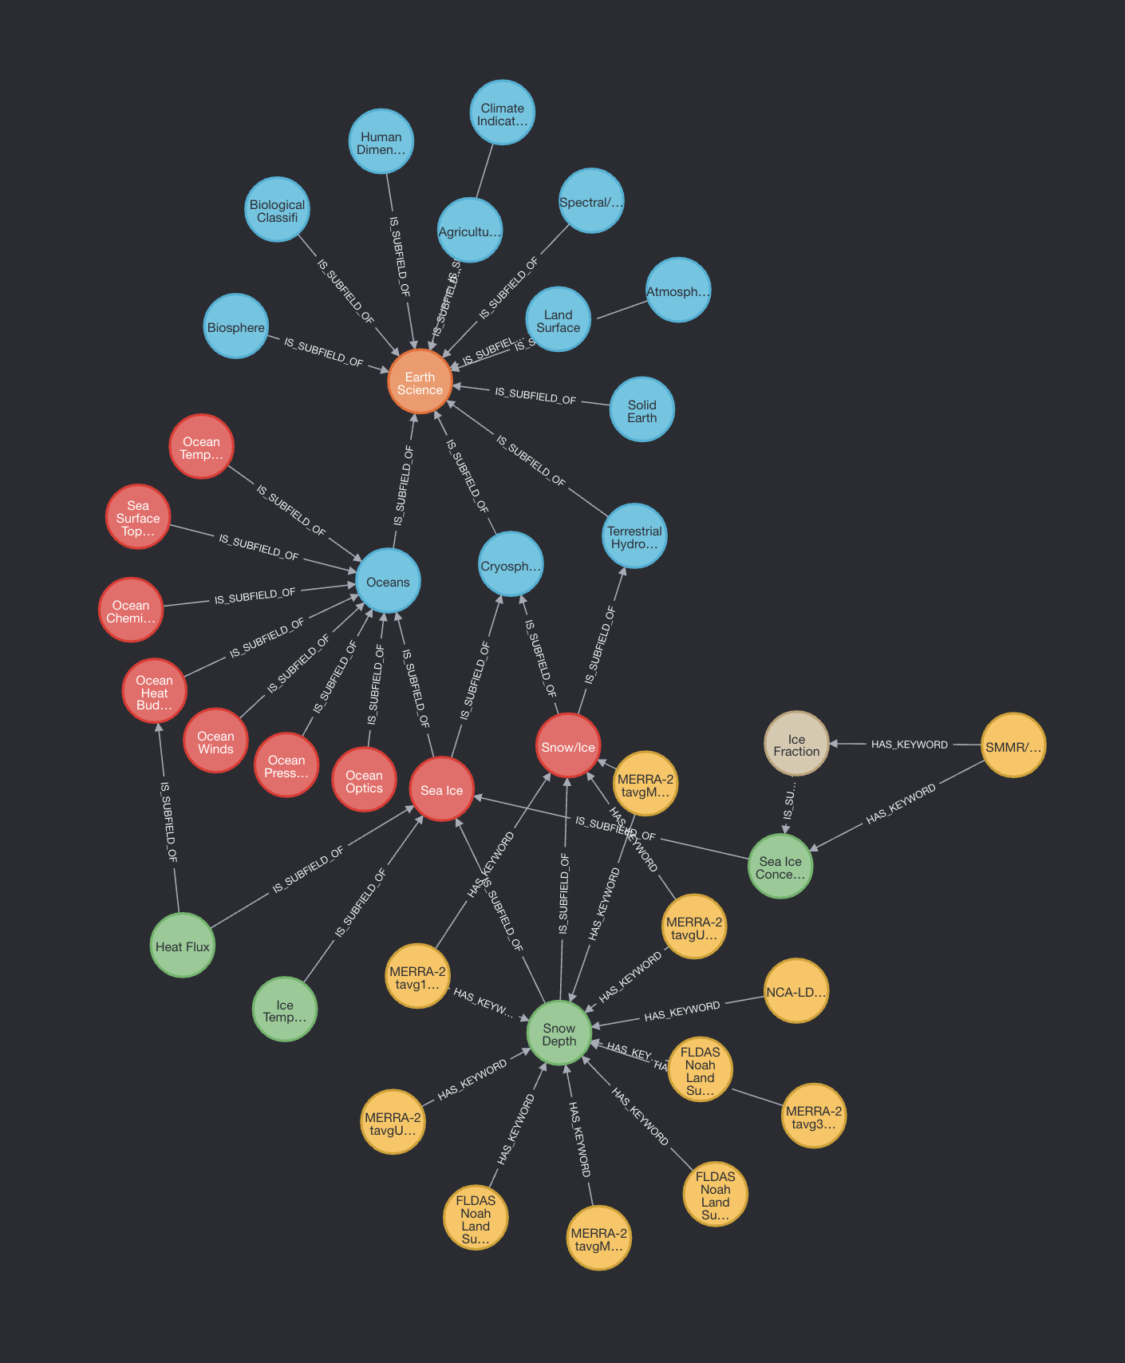
Introduction
Embeddings
Natural language and graph
GES-DISC search engine
Only natural language now
What about keywords?
Goal: graph embeddings

Slide 3
Method
0
x₀ = 1
Graph machine learning
Node features
Graph structure
PyG (PyTorch Geometric)
Built on PyTorch, for training GNNs
What do we need?
Vector to represent every node’s info
Edge index (e.g. [[0, 1, 1, 2], [1, 0, 2, 1]])
1
2
x₁ = 100
x₂ = -4

Slide 4
Heterogeneous graph
0
Learn interactions between node types
Different info available
Can we standardize this a bit?
1
2

Slide 5
Solution
One type of keyword
No Category, Topic…
Keywords average of dataset nodes

Slide 6
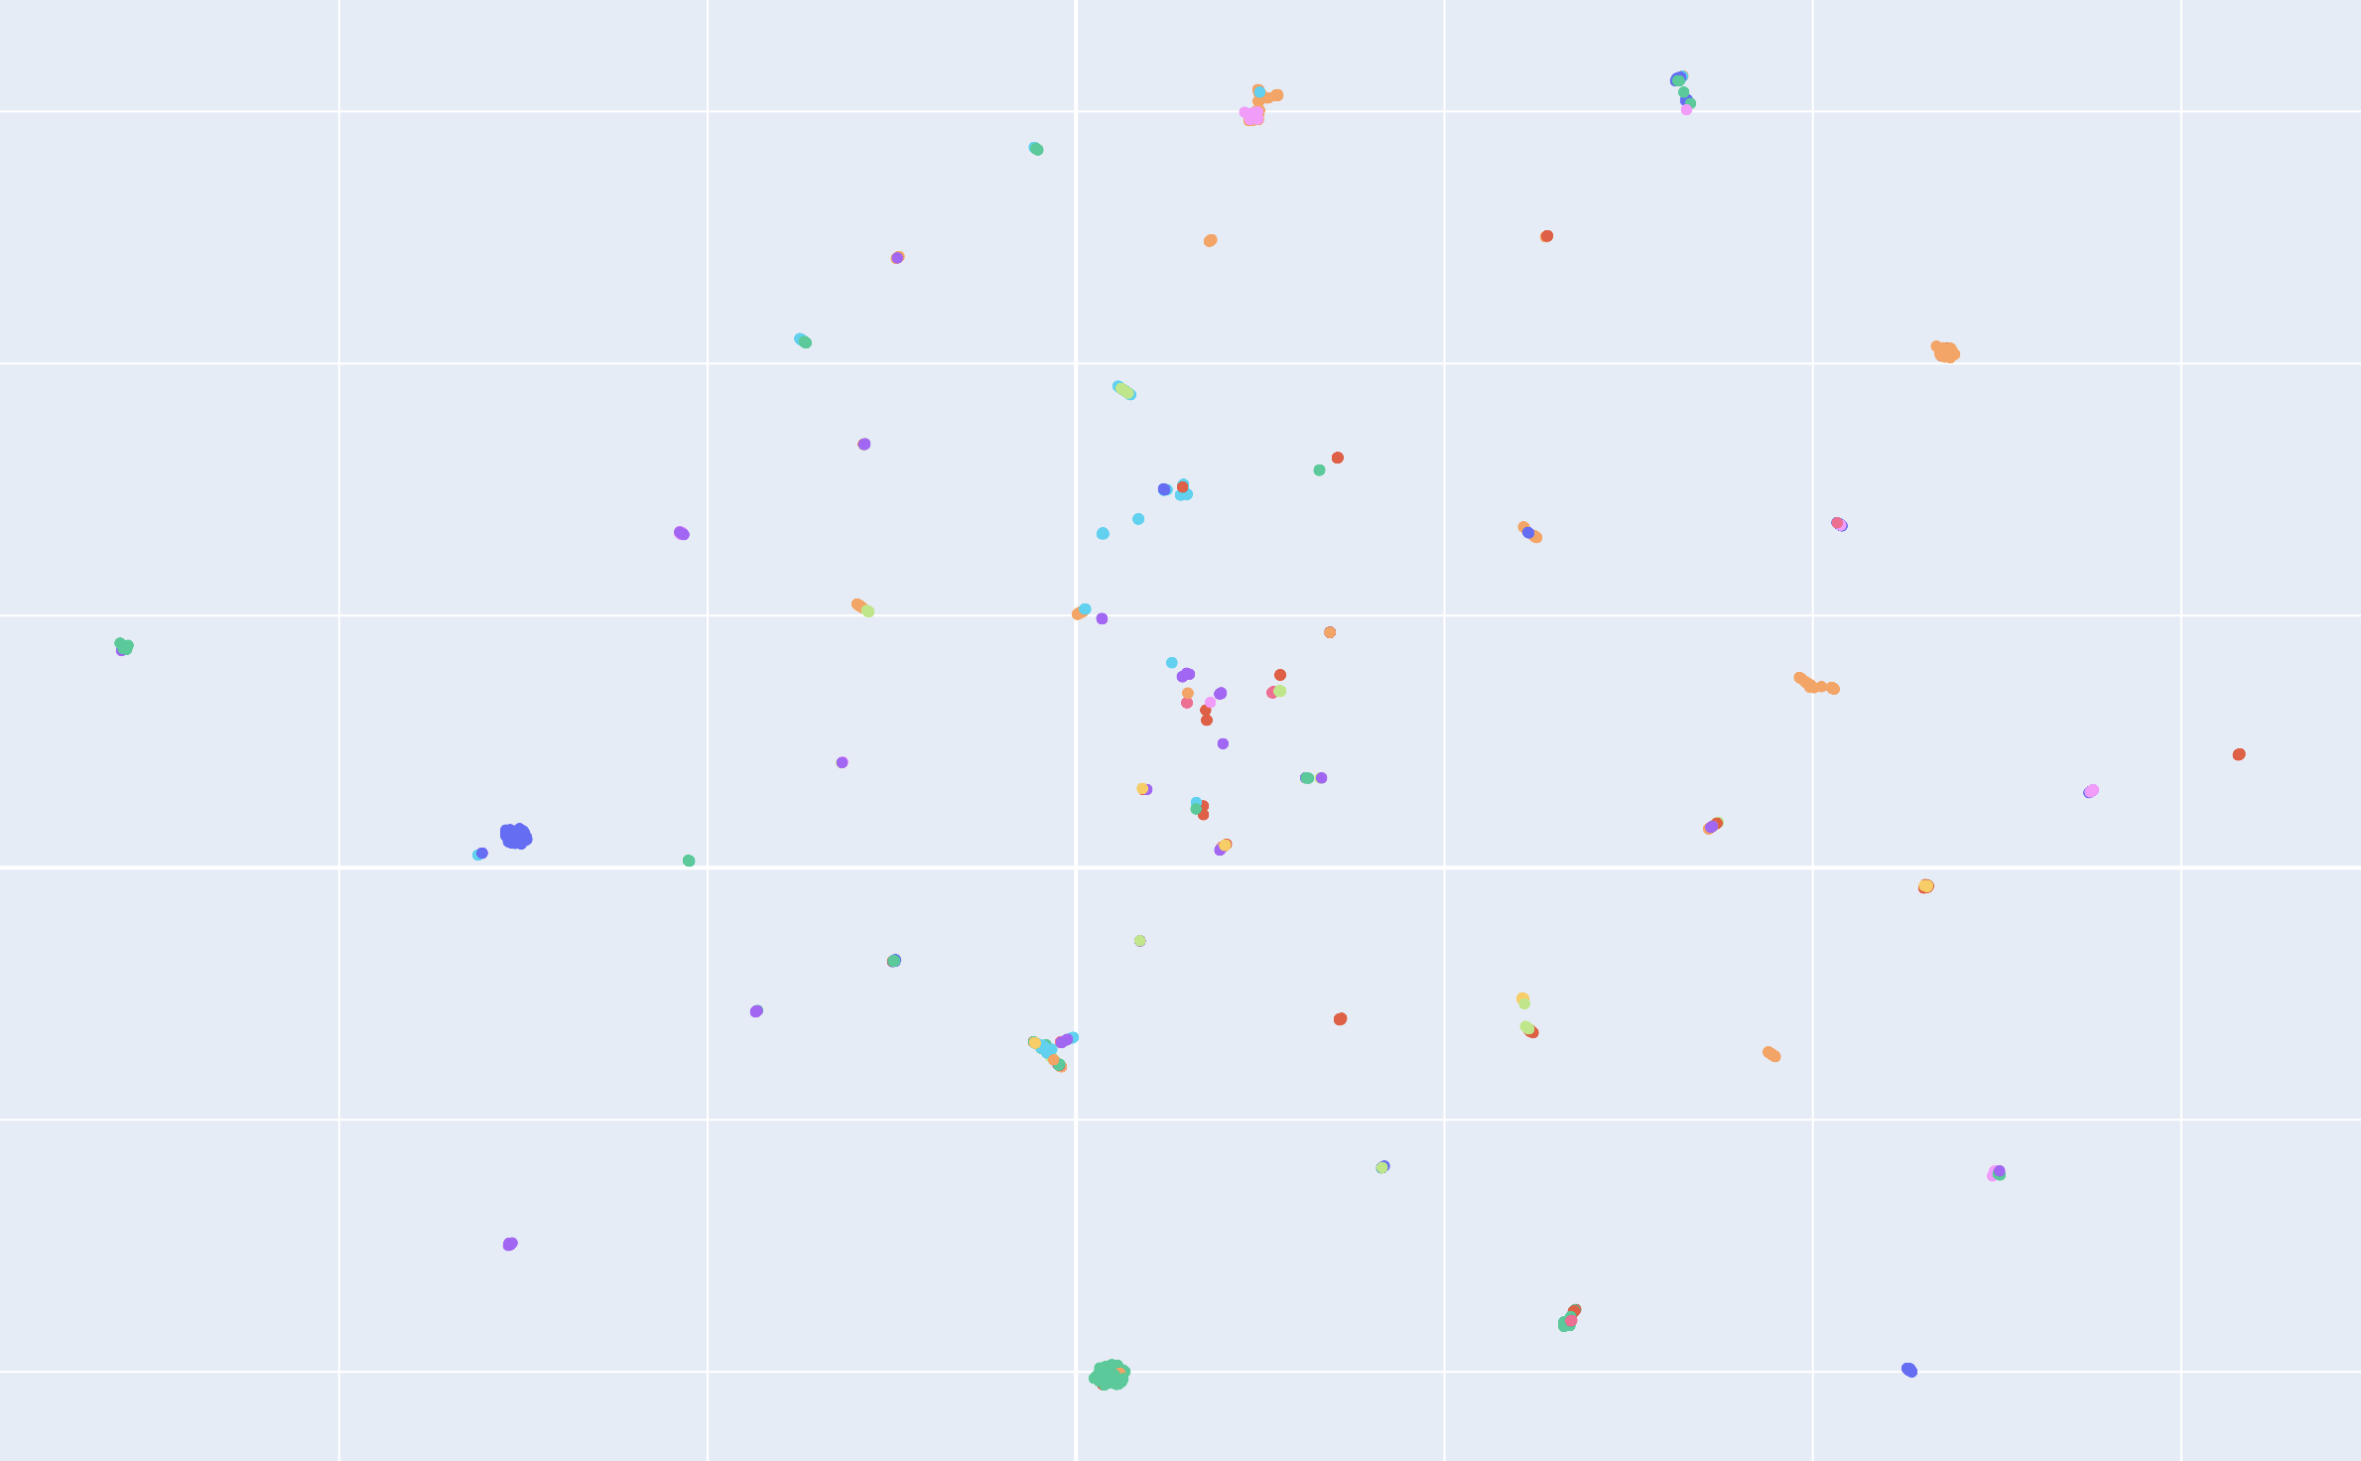
Embeddings
Stanford’s GraphSAGE
UMAP
Notes:
Projection — the process or technique of reproducing a spatial object upon a plane, a curved surface, or a line by projecting its points. You can also think of it as a mapping of an object from high-dimensional to low-dimensional space.
Approximation — the algorithm assumes that we only have a finite set of data samples (points), not the entire set that makes up the manifold. Hence, we need to approximate the manifold based on the data available.
Manifold — a manifold is a topological space that locally resembles Euclidean space near each point. One-dimensional manifolds include lines and circles, but not figure eights. Two-dimensional manifolds (a.k.a. surfaces) include planes, spheres, torus, and more.
Uniform — the uniformity assumption tells us that our data samples are uniformly (evenly) distributed across the manifold. In the real world, however, this is rarely the case. Hence, this assumption leads to the notion that the distance varies across the manifold. i.e., the space itself is warping: stretching or shrinking according to where the data appear sparser or denser.
Low-dimensional embeddings of nodes in large graphs have proved extremely useful in a variety of prediction tasks, from content recommendation to identifying protein functions. However, most existing approaches require that all nodes in the graph are present during training of the embeddings; these previous approaches are inherently transductive and do not naturally generalize to unseen nodes. Here we present GraphSAGE, a general inductive framework that leverages node feature information (e.g., text attributes) to efficiently generate node embeddings for previously unseen data. Instead of training individual embeddings for each node, we learn a function that generates embeddings by sampling and aggregating features from a node’s local neighborhood. Our algorithm outperforms strong baselines on three inductive node-classification benchmarks: we classify the category of unseen nodes in evolving information graphs based on citation and Reddit post data, and we show that our algorithm generalizes to completely unseen graphs using a multi-graph dataset of protein-protein interactions.

Slide 7
Findings
Expected clustering
Efficient way to find similar datasets
More like this
Combine it, two relevance metrics

Slide 8
References
Hamilton, W., Ying, R. & Leskovec, J. Inductive Representation Learning on Large Graphs. CoRR. abs/1706.02216 (2017), http://arxiv.org/abs/1706.02216
https://pytorch-geometric.readthedocs.io/en/latest/

