Slide 1
Databases − Introduction to SQL Woong-Kee Loh Dept. of Software, Gachon University

Slide 2
Overview
History
IBM Sequel language developed as part of System R project at the IBM San Jose Research Laboratory
Renamed Structured Query Language (SQL)
ANSI and ISO standard SQL:
SQL-86, SQL-89, SQL-92
SQL:1999, SQL:2003
Commercial systems offer most of SQL-92 features
Plus varying feature sets from later standards and special proprietary features
NOTE: Some examples here may not work on your particular system

Slide 3
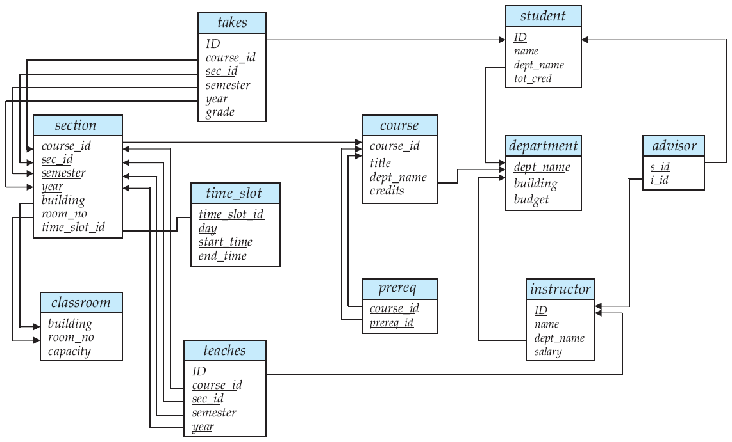
Sample Database
University database

Slide 4
University database cont’d

Slide 5
University database cont’d

Slide 6
University database cont’d

Slide 7


MySQL
MySQL
A free open-source database management system (DBMS)
Pronounced "My S-Q-L" or "My Sequel"
A popular choice as the database system for use with web applications (a component of LAMP)
Widely used in various web sites
Facebook, Google, Wikipedia, Twitter, Flickr, and YouTube

Slide 8
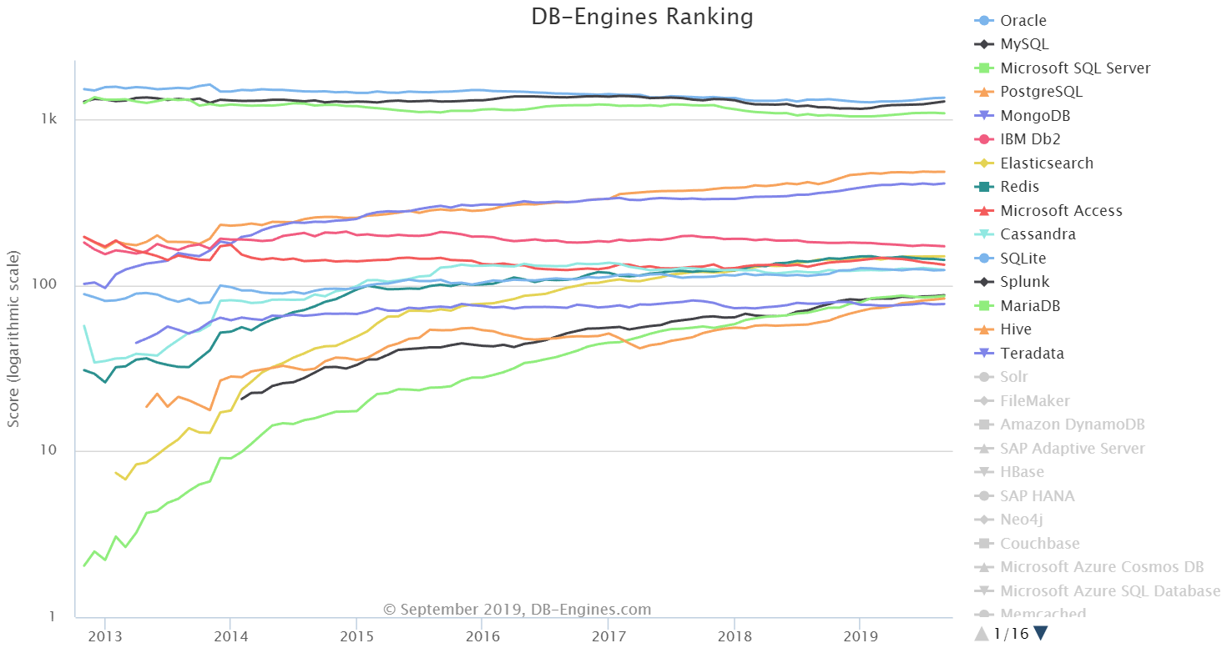
MySQL usage
Ranked second after Oracle; first among open source databases (as of Sept. 2019)
http://db-engines.com/en/ranking

Slide 9
MySQL database hierarchy

Slide 10
Using MySQL
Connect to MySQL server
C:\> mysql -u root -p mysql
C:\> mysql -u root -p mydb
C:\> mysql -u root -p
Enter password: 12345
Create a database
mysql> CREATE DATABASE MYDB;
mysql> COMMIT;
mysql> USE MYDB;
(Note: MySQL commands and SQL database/table/attribute names are case-insensitive!)

Slide 11
Manage databases
mysql> SHOW DATABASES;
mysql> DELETE DATABASE MYDB;
mysql> COMMIT;
Update root password
mysql> USE MYSQL;
mysql> UPDATE USER SET PASSWORD=PASSWORD('12345') WHERE USER='root';
mysql> FLUSH PRIVILEGES;

Slide 12
SQL Data Definition
Data definition language (DDL)
Allows the specification of information about relations
Schema for each relation
Domain of values associated with each attribute
Integrity constraints
Also other information such as:
Set of indices to be maintained for each relations
Security and authorization information for each relation
Physical storage structure of each relation on disk

Slide 13
Domain types in SQL
char(n) − fixed length character string, with user-specified length n
varchar(n) − variable length character strings, with user-specified maximum length n
int − integer (a finite machine-dependent subset of integers)
numeric(p,d) − fixed point number, with user-specified precision of p digits, with d digits to the right of decimal point
E.g., numeric(3,1) allows 44.5, but not 444.5 or 0.32
real, double precision − floating point and double-precision floating point numbers, with machine-dependent precision
float(n) − floating point number, with user-specified precision of at least n digits
and more

Slide 14
Create table construct
An SQL relation is defined using the create table command:
create table r (A₁ D₁, A₂ D₂, ... , A_{n} D_{n}, <integrity-constraint₁>, ... , <integrity-constraint_{k}>);
r is the name of the relation
Each A_{i} is an attribute name in the schema of relation r
D_{i} is the data type of values in the domain of attribute A_{i}
Example:
create table department ( dept_name varchar (20), building varchar (15), budget numeric (12,2), primary key (dept_name));

Slide 15
Integrity constraints in create table
not null
primary key (A₁, ... , A_{n})
foreign key (A_{m}, ... , A_{n}) references r
Example:
create table instructor ( ID varchar (5), name varchar (20) not null, dept_name varchar (20), salary numeric (8,2), primary key (ID), foreign key (dept_name) references department (dept_name));
primary key declaration automatically ensures not null

Slide 16
More relation definitions
create table student ( ID varchar(5) primary key, name varchar(20) not null, dept_name varchar(20) references department (dept_name), tot_cred numeric(3,0));
create table course ( course_id varchar (7) primary key, title varchar (50), dept_name varchar (20) references department (dept_name), credits numeric (2,0));

Slide 17
More relation definitions cont’d
create table takes ( ID varchar(5), course_id varchar(8), sec_id varchar(8), semester varchar(6), year numeric(4,0), grade varchar(2), primary key (ID, course_id, sec_id, semester, year), foreign key (ID) references student (ID), foreign key (course_id, sec_id, semester, year) references section (course_id, sec_id, semester, year));
Note: sec_id can be dropped from primary key above, to ensure a student cannot be registered for two sections of the same course in the same semester

Slide 18
Updates to tables
Drop table
drop table r;
Delete
delete from student;
Remove all tuples from the student relation
Alter table
alter table r add A D;
A is the name of the attribute to be added to relation r, and D is the domain of A
All exiting tuples in the relation are assigned null as the value for the new attribute
alter table r drop A;
A is the name of an attribute of relation r
Dropping of attributes not supported by many databases

Slide 19
Basic Structure of SQL Queries
Basic query structure
A typical SQL query has the form:
select A₁, A₂, ... , A_{n} from r₁, r₂, ... , r_{m} where P;
A_{i} represents an attribute
R_{i} represents a relation
P is a predicate
NOTE: the result of an SQL query is a relation

Slide 20
Select clause
Lists the attributes desired in the result of a query
Corresponds to the relational projection operation
E.g., Find the names of all instructors:
select name from instructor;
NOTE: SQL names are case insensitive
Some people use upper case wherever we use bold font

Slide 21
Select clause cont’d
SQL allows duplicates in relations as well as query results
For elimination of duplicates, insert the keyword distinct after select
E.g., Find the department names of all instructors, and remove duplicates
select distinct dept_name from instructor;
all specifies that duplicates should not be removed
select all dept_name from instructor;

Slide 22
Select clause cont’d
An asterisk in the select clause denotes "all attributes"
select * from instructor;
An attribute can be a literal without from clause
select '437';
Results in a table with one column and a single row with value "437"
Can give the column a name
select '437' as FOO;
An attribute can be a literal with from clause
select 'A' from instructor;
Results in a table with one column and N rows (number of tuples in the instructor table), each row with value "A"

Slide 23
Select clause cont’d
Can contain arithmetic expressions involving the operations +, –, *, and / on constants or tuple attributes
Example:
select ID, name, salary/12 from instructor;
Returns a relation that is the same as the instructor relation, except that the value of the attribute salary is divided by 12
Can rename "salary/12" using as clause:
select ID, name, salary/12 as monthly_salary from instructor;

Slide 24
Where clause
Specifies the conditions that the result must satisfy
Corresponds to the selection predicate of the relational algebra
E.g., Find all instructors in Comp. Sci. department
select name from instructor where dept_name = "Comp. Sci.";
Comparison results can be combined using the logical connectives and, or, and not
E.g., Find all instructors in Comp. Sci. dept with salary > 80000
select name from instructor where dept_name = 'Comp. Sci.' and salary > 80000;
Comparisons can be applied to results of arithmetic expressions

Slide 25
From clause
Lists the relations involved in the query
Corresponds to the Cartesian product operation of the relational algebra
E.g., Find the Cartesian product instructor × teaches
select * from instructor, teaches;
Generates every possible (instructor, teaches) pair, with all attributes from both relations
For common attributes (e.g., ID), the attributes in the resulting table are renamed using the relation name (e.g., instructor.ID)
Cartesian product is not very useful directly, but useful combined with where-clause condition

Slide 26
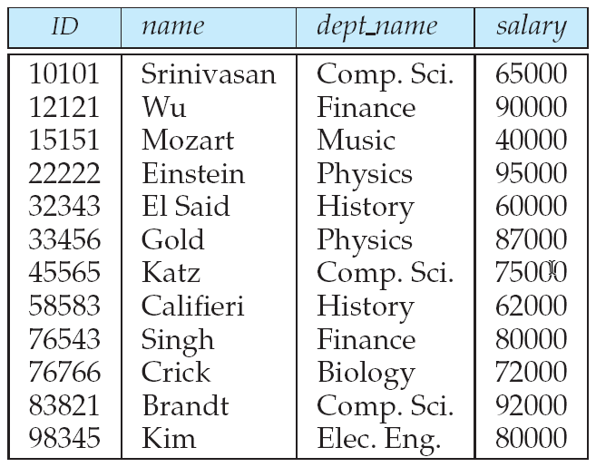
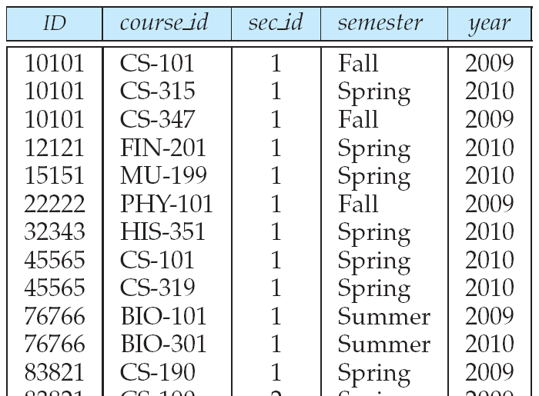
Joins
For all instructors who have taught some course, find their names and the course ID of the courses they taught.
select name, course_id from instructor, teaches where instructor.ID = teaches.ID;
instructor
teaches

Slide 27
Natural join
Natural join matches tuples with the same values for all common attributes, and retains only one copy of each common column
select * from instructor natural join teaches;
List the names of instructors along with the course ID of the courses that they taught.
select name, course_id from instructor, teaches where instructor.ID = teaches.ID;
select name, course_id from instructor natural join teaches;

Slide 28
Additional Basic Operations
Rename operation
SQL allows renaming relations and attributes using as clause:
old-name as new-name
E.g., Find the names of all instructors who have a higher salary than some instructor in 'Comp. Sci.'
select distinct T.name from instructor as T, instructor as S where T.salary > S.salary and S.dept_name = 'Comp. Sci.';
T and S can be thought of as copies of the relation instructor; they are declared as aliases, that is as alternative names, for the relation instructor

Slide 29
String operations
SQL includes a string-matching operator like for comparisons on character strings
It uses patterns that are described using two special characters.
percent (%) − matches any substring
underscore (_) − matches any single character
E.g., Find the names of all instructors whose name includes the substring "dar".
select name from instructor where name like '%dar%';
E.g., Match the string "100%"
… like '100\%' escape '\';
We use backslash (\) as the escape character

Slide 30
String operations cont’d
Patterns are case sensitive
'Intro%' matches any string beginning with 'Intro'
'%Comp%' matches any string containing 'Comp' as a substring
'___' matches any string of exactly three characters
'___%' matches any string of at least three characters
SQL supports a variety of string operations such as:
Concatenation (using '||' in Oracle)
Converting from upper to lower case (and vice versa)
Finding string length, extracting substrings, etc.

Slide 31
Ordering the display of tuples
List the names of all instructors in an alphabetic order
select distinct name from instructor order by name;
We may specify desc or asc for descending or ascending order, for each attribute
Ascending order is the default
E.g., … order by name desc;
Can sort on multiple attributes
E.g., … order by name asc, dept_name desc;

Slide 32
Where clause predicates
SQL includes between comparison operator
E.g., Find the names of all instructors with the salary between $90,000 and $100,000 (i.e., ≥ $90,000 and ≤ $100,000)
select name from instructor where salary between 90000 and 100000;
Tuple comparison
select name, course_id from instructor, teaches where (instructor.ID, dept_name) = (teaches.ID, 'Biology');

Slide 33
Set Operations
Set operations
Find courses that ran in Fall 2009 or in Spring 2010
(select course_id from section where sem = 'Fall' and year = 2009) union (select course_id from section where sem = 'Spring' and year = 2010);
Find courses that ran in Fall 2009 and in Spring 2010
(select course_id from section where sem = 'Fall' and year = 2009) intersect (select course_id from section where sem = 'Spring' and year = 2010);
Find courses that ran in Fall 2009 but not in Spring 2010
(select course_id from section where sem = 'Fall' and year = 2009) except (select course_id from section where sem = 'Spring' and year = 2010);

Slide 34
Set operations cont’d
Find the salaries of all instructors that are less than the largest salary
select distinct T.salary # first query from instructor as T, instructor as S where T.salary < S.salary;
Find all the salaries of all instructors
select distinct salary # second query from instructor;
Find the largest salary of all instructors
(select … /* second query */) except (select … / * first query */);

Slide 35
Set operations cont’d
Set operations union, intersect, except
Each of the above operations automatically eliminates duplicates
To retain all duplicates, use the corresponding multiset versions: union all, intersect all, except all

Slide 36
Null Values
Null values
It is possible for tuples to have a null value, denoted by null, for some of their attributes
null signifies an unknown value or a value does not exist
Any arithmetic expression involving null returns null
E.g., 5 + null returns null
The predicate is null can be used to check for null values
E.g., Find all instructors whose salary is unknown
select name from instructor where salary is null;

Slide 37
Null values and three valued logic
Three values: true, false, unknown
Any comparison with null returns unknown
E.g., 5 < null, null <> null, null = null
Three-valued logic using the value unknown:
OR: (unknown or true) = true (unknown or false) = unknown (unknown or unknown) = unknown
AND: (true and unknown) = unknown (false and unknown) = false (unknown and unknown) = unknown
NOT: (not unknown) = unknown
"P is unknown" evaluates to true if predicate P evaluates to unknown
Result of where clause predicate is treated as false if it evaluates to unknown

Slide 38
Exercise 3.1
Run SQL statements on MySQL
Setup MySQL 5.5 on your computer
Run MYDB.SQL script to create the university database
mysql> source c:/work/mydb.sql;
Re-run the script to initialize the database
Enter SQL statements and check the result

Slide 39
Aggregate Functions
Aggregate functions
Operate on the multiset of values of a column of a relation, and return a value
avg − average value
min − minimum value
max − maximum value
sum − sum of values
count − number of values

Slide 40
Aggregate functions cont’d
Find the average salary of instructors in the Computer Science department
select avg(salary) from instructor where dept_name = 'Comp. Sci.';
Find the total number of instructors who teach a course in the Spring 2010 semester
select count(distinct ID) from teaches where semester = 'Spring' and year = 2010;
Find the number of tuples in the course relation
select count(*) from course;

Slide 41
Aggregate functions – Group By
Find the average salary of instructors in each department
select dept_name, avg(salary) as avg_salary from instructor group by dept_name;

Slide 42
Aggregation cont’d
Attributes in select clause outside of aggregate functions must appear in group by list
# Incorrect statement select dept_name, ID, avg(salary) from instructor group by dept_name;

Slide 43
Aggregate functions – Having clause
Find the names and average salaries of all departments whose average salary is greater than 42,000
select dept_name, avg(salary) from instructor group by dept_name having avg(salary) > 42000;
Note: predicates in the having clause are applied after the formation of groups, whereas predicates in the where clause are applied before forming groups

Slide 44
Null values and aggregates
Total all salaries
select sum(salary) from instructor;
Above statement ignores null amounts
Result is null if there is no non-null amount
All aggregate operations except count(*) ignore tuples with null values on the aggregated attributes
What if collection has only null values?
count(salary) returns 0; count(*) return null count
All other aggregates return null

Slide 45
Nested Subqueries
Set membership
Find courses offered in Fall 2009 and in Spring 2010
select distinct course_id from section where semester = 'Fall' and year= 2009 and course_id in (select course_id from section where semester = 'Spring' and year= 2010);
Find courses offered in Fall 2009 but not in Spring 2010
select distinct course_id from section where semester = 'Fall' and year= 2009 and course_id not in (select course_id from section where semester = 'Spring' and year= 2010);

Slide 46
Set membership cont’d
Find the number of (distinct) students who have taken course sections taught by the instructor with ID 10101
select count (distinct ID) from takes where (course_id, sec_id, semester, year) in (select course_id, sec_id, semester, year from teaches where teaches.ID= 10101);
Above query can be written in a much simpler manner.

Slide 47
Set comparison – "some" clause
Find names of instructors with salary greater than that of some (at least one) instructor in the Biology department
select distinct T.name from instructor as T, instructor as S where T.salary > S.salary and S.dept_name = 'Biology';
select name from instructor where salary > some (select salary from instructor where dept_name = 'Biology');

Slide 48
Set comparison – "all" clause
Find the names of all instructors whose salary is greater than the salary of all instructors in the Biology department
select name from instructor where salary > all (select salary from instructor where dept_name = 'Biology');

Slide 49
Use of "exists" clause
Yet another way of specifying the query "Find all courses taught in both the Fall 2009 semester and in the Spring 2010 semester"
select course_id from section as S where semester = 'Fall' and year = 2009 and exists (select * from section as T where semester = 'Spring' and year= 2010 and S.course_id = T.course_id);
Correlation name: variable S in the outer query
Correlated subquery: the inner query

Slide 50
Use of "not exists" clause
Find all students who have taken all courses offered in the Biology department
select distinct S.ID, S.name from student as S where not exists ((select course_id from course where dept_name = 'Biology') except (select T.course_id from takes as T where S.ID = T.ID));
First nested query lists all courses offered in Biology
Second nested query lists all courses a particular student took

Slide 51
Test for absence of duplicate tuples
The unique construct tests whether a subquery has any duplicate tuples in its result
Evaluates to "true" if a given subquery contains no duplicates
Find all courses that were offered at most once in 2009
select T.course_id from course as T where unique (select R.course_id from section as R where T.course_id= R.course_id and R.year = 2009);

Slide 52
Subqueries in the from clause
SQL allows a subquery expression to be used in the from clause
E.g., Find the average instructors' salaries of those departments where the average salary is greater than $42,000.
select dept_name, avg_salary from (select dept_name, avg (salary) as avg_salary from instructor group by dept_name) where avg_salary > 42000;
Note that we do not need to use the having clause
Another way to write above query
select dept_name, avg_salary from (select dept_name, avg (salary) from instructor group by dept_name) as dept_avg (dept_name, avg_salary) where avg_salary > 42000;

Slide 53
Scalar subquery
Scalar subquery is one which is used where a single value is expected
E.g., List all departments along with the number of instructors in each department
select dept_name, (select count(*) from instructor where department.dept_name = instructor.dept_name) as num_instructors from department;
Runtime error if subquery returns more than one result

Slide 54
Modification of the Database
Deletion
Delete all instructors
delete from instructor;
Delete all instructors from the Finance department
delete from instructor where dept_name= 'Finance';
Delete all instructors associated with a department located in the Watson building
delete from instructor where dept_name in (select dept_name from department where building = 'Watson');

Slide 55
Insertion
Add a new tuple to course
insert into course values ('CS-437', 'Database Systems', 'Comp. Sci.', 4);
insert into course (course_id, title, dept_name, credits) values ('CS-437', 'Database Systems', 'Comp. Sci.', 4);
Add a new tuple to student with tot_creds set to null
insert into student values ('3003', 'Green', 'Finance', null);

Slide 56
Insertion cont’d
Add all instructors to the student relation with tot_creds set to 0
insert into student select ID, name, dept_name, 0 from instructor;
The select statement is evaluated fully before any of its results are inserted into the relation

Slide 57
Updates
Increase salaries of instructors whose salary is over $100,000 by 3%
update instructor set salary = salary * 1.03 where salary > 100000;

Slide 58
Homework
Do Practice Exercises (p.105):
3.1, 3.3, 3.9, 3.10
Do Exercises (p.108):
3.11, 3.12, 3.15, 3.16, 3.17
Due: one day before next class

