Slide 1
Introduction to Big Data Systems
Lecture 3. MPI Programming
Wenguang CHEN
Tsinghua University

Slide 2
1. Message Passing Paradigm

Slide 3
We have talked a lot on single machine
OpenMP (or other threading ) is good for a single machine
Shared memory space
Incremental parallelization
Flexible scheduling policy
There are more to optimize for a single machine,
Vector / locality optimization
Accelerators
I/O optimizations
But one machine is not sufficient for many big data tasks
Let’s try to use multiple machines now

Slide 4
Task/Channel Model
Parallel computation = set of tasks
Task
Program, local memory, collection of I/O ports
Tasks interact by sending messages through channels
Task
Channel

Slide 5
The message passing paradigm
Parallel PROCESSES
Separate memory spaces
Communication through explicit message send/recv
Need rewrite code, incremental annotation is not sufficient
Private memory
s: 12
s: 14
s: 11
receive Pn,s
y = ..s ...
i: 2
i: 3
i: 1
P0
P1
send P1,s
Pn
Network

Slide 6
Install, compile and run MPI programs
Installation
Download one of the MPI implementation
OpenMPI, MPICH, IntelMPI etc.
http://www.open-mpi.org/
Install it by reading the documents, set paths etc.
Compile
Use “mpicc” instead of “gcc”
Run
Use “mpirun”

Slide 7
2. MPI programming
2.1 Hello World

Slide 8
A Minimal MPI Program (C)
#include "mpi.h"
#include <stdio.h>
int main( int argc, char *argv[] )
{
MPI_Init( &argc, &argv );
printf( "Hello, world!\n" );
MPI_Finalize();
return 0;
}
Use mpicc to compile code, and mpirun to run the code
$mpicc –o mpi_helloworld mpi_helloworld.c
$mpirun –np 4 ./mpi_helloworld

Slide 9
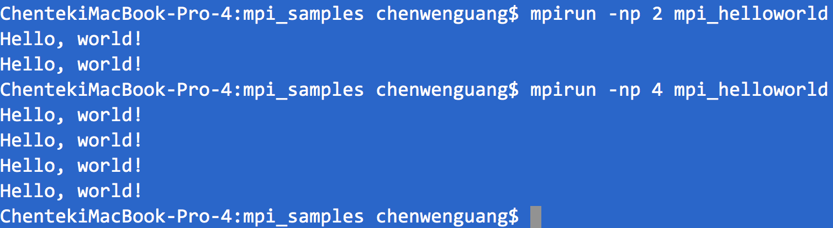

Slide 10
Check the pthread array_sum
volatile long global_sum = 0; /* global */
void *sum_thread(void *vargp)
{
long sum;
int myid = (long) vargp;
int start = myid * sample_num / 4;
int end = (myid+1) * sample_num / 4 - 1;
sum = 0;
for (int i=start; i<=end; i++)
sum += x[i];
sem_wait(&num_mutex);
global_sum += sum;
sem_post(&num_mutex);
return NULL;
}
To do something useful, each process needs to know something about the world and itself

Slide 11
Finding Out About the Environment
Two important questions that arise early in a parallel program are:
How many processes are participating in this computation?
Who am I?
MPI provides functions to answer these questions:
MPI_Comm_size reports the number of processes.
MPI_Comm_rank reports the rank, a number between 0 and size-1, identifying the calling process

Slide 12
Better Hello (C)
#include "mpi.h"
#include <stdio.h>
int main( int argc, char *argv[] )
{
int rank, size;
MPI_Init( &argc, &argv );
MPI_Comm_rank( MPI_COMM_WORLD, &rank );
MPI_Comm_size( MPI_COMM_WORLD, &size );
printf( "I am %d of %d\n", rank, size );
MPI_Finalize();
return 0;
}
Notes:
Run the code and show the results

Slide 13
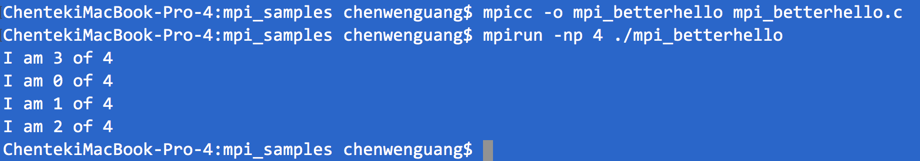

Slide 14
2. MPI programming
2.2 Point-to-Point operations

Slide 15
MPI Basic Send/Receive
We need to fill in the details in
Things that need specifying:
Data description
Process naming
Recognize/screen messages?
Completion of operation/return of function call
Process 0
Process 1
Send(data)
Receive(data)

Slide 16
What is message passing?
Data transfer plus synchronization
Process 0
Data
May I Send?
Data
Data
Data
Data
Data
Data
Data
Data
Process 1
Yes
Time
Requires cooperation of sender and receiver
Cooperation not always apparent in code

Slide 17
MPI Basic (Blocking) Send/Receive
MPI_SEND (start, count, datatype, dest, tag, comm)
MPI_RECV(start, count, datatype, source, tag, comm, status)
start, count, datatype, dest seems trivial. What are tag and comm ?
Notes:
This is particularly important.

Slide 18
MPI Tags
Messages are sent with an accompanying user-defined integer tag, to assist the receiving process in identifying the message.
Messages can be screened at the receiving end by specifying a specific tag, or not screened by specifying MPI_ANY_TAG as the tag in a receive.

Slide 19
Tags can possibly used as message types
Tags can also serves as “message type”, although we should not confuse it with MPI data types

Slide 20
Communicator
Processes can be collected into groups.
Each message is sent in a context, and must be received in the same context.
A group and context together form a communicator.
A process is identified by its rank in the group associated with a communicator.
There is a default communicator whose group contains all initial processes, called MPI_COMM_WORLD.

Slide 21
MPI Datatypes
The data in a message to sent or received is described by a triple (address, count, datatype), where
An MPI datatype is recursively defined as:
predefined, corresponding to a data type from the language (e.g., MPI_INT, MPI_DOUBLE_PRECISION)
a contiguous array of MPI datatypes
a strided block of datatypes
an indexed array of blocks of datatypes
an arbitrary structure of datatypes
There are MPI functions to construct custom datatypes, such an array of (int, float) pairs, or a row of a matrix stored columnwise.

Slide 22
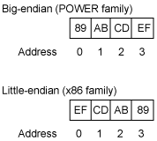
Why Datatypes?
Support communication between processes on machines with different memory representations
Big endian vs little endian
Data structure alignment
Specifying application-oriented layout of data in memory
reduces memory-to-memory copies in the implementation
allows the use of special hardware (scatter/gather) when available
struct S1 {
char c;
int i[2];
double v;
} *p;
c
i[0]
i[1]
v
p+0
p+4
p+8
p+16
p+24
Multiple of 4
Multiple of 8
Multiple of 8
Multiple of 8
Notes:
Get examples for big/little endian

Slide 23
MPI Basic (Blocking) Send
MPI_SEND (start, count, datatype, dest, tag, comm)
The message buffer is described by (start, count, datatype).
The target process is specified by dest, which is the rank of the target process in the communicator specified by comm.
When this function returns, the data has been delivered to the system and the buffer can be reused. The message may not have been received by the target process.
Notes:
This is particularly important.

Slide 24
MPI Basic (Blocking) Receive
MPI_RECV(start, count, datatype, source, tag, comm, status)
Waits until a matching (on source and tag) message is received from the system, and the buffer can be used.
source is rank in communicator specified by comm, or MPI_ANY_SOURCE.
status contains further information
Receiving fewer than count occurrences of datatype is OK, but receiving more is an error.

Slide 25
Send_recv samples
MPI_Init(&argc,&argv);
MPI_Comm_size(MPI_COMM_WORLD,&numprocs);
MPI_Comm_rank(MPI_COMM_WORLD,&myid);
tag=1234;source=0;destination=1;count=1;
if(myid == source){
buffer=5678;
MPI_Send(&buffer,count,MPI_INT,destination,tag,MPI_COMM_WORLD);
printf("processor %d sent %d\n",myid,buffer);
}
if(myid == destination){ MPI_Recv(&buffer,count,MPI_INT,source,tag,MPI_COMM_WORLD,&status);
printf("processor %d got %d\n",myid,buffer);
}
MPI_Finalize();
Notes:
Conditional statement is used to distinguish the operations on different processes, this is called SPMD model

Slide 26
Quiz
Write a pingpong program
One process send a message to the other, the other send it back
This is useful to measure the bandwidth/latency of network
Can we just send the local time to remote machine for this purpose? Why?
Notes:
Use console to show code

Slide 27
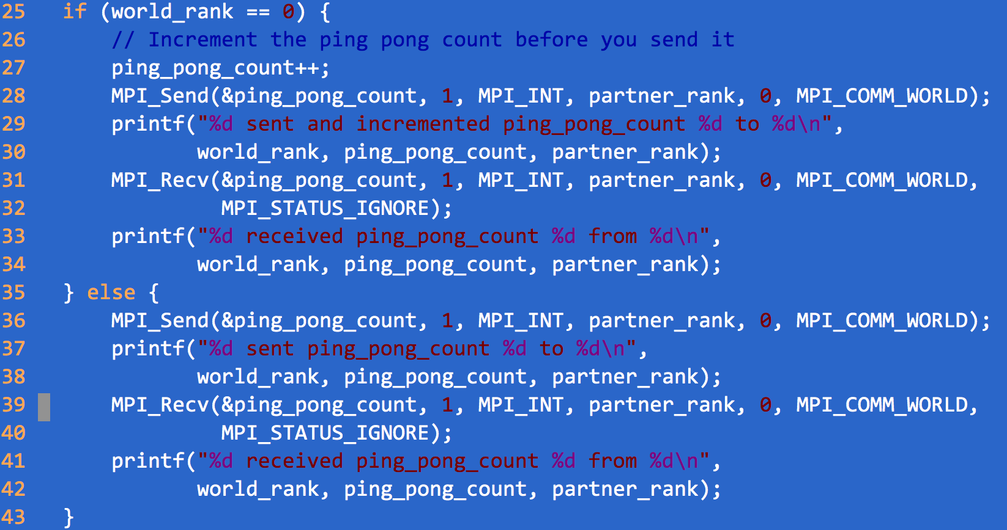

Slide 28
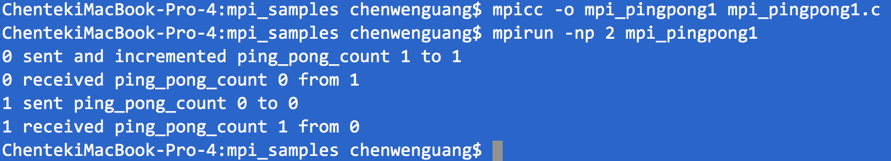

Slide 29

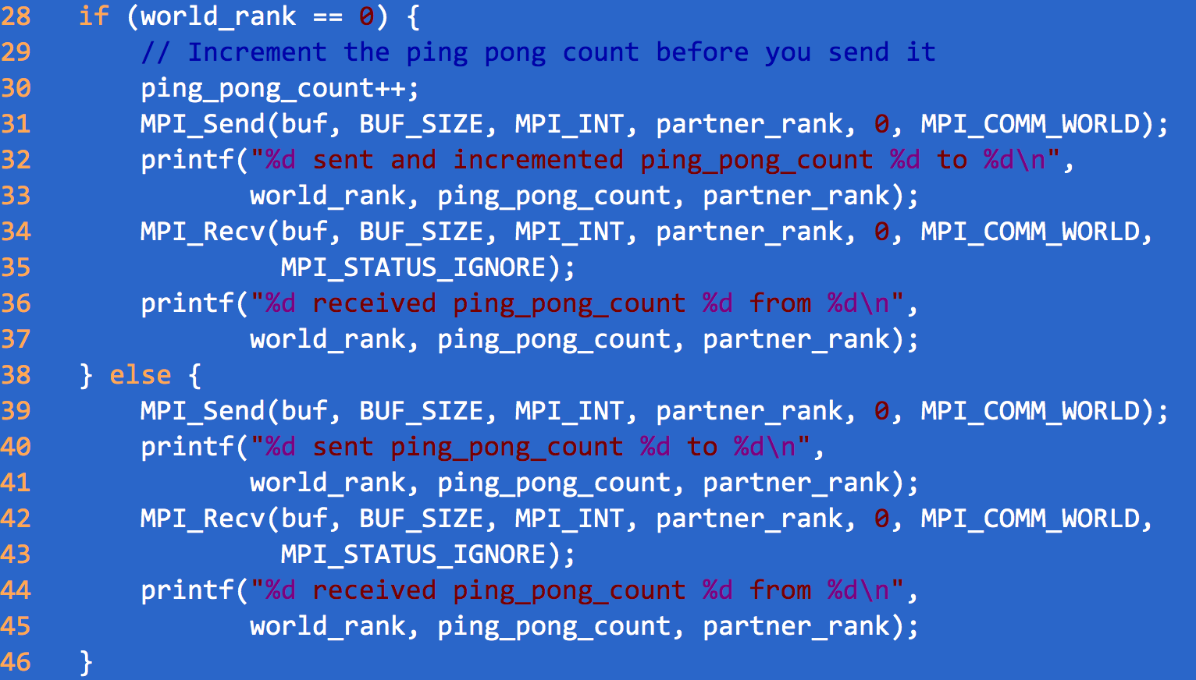

Slide 30
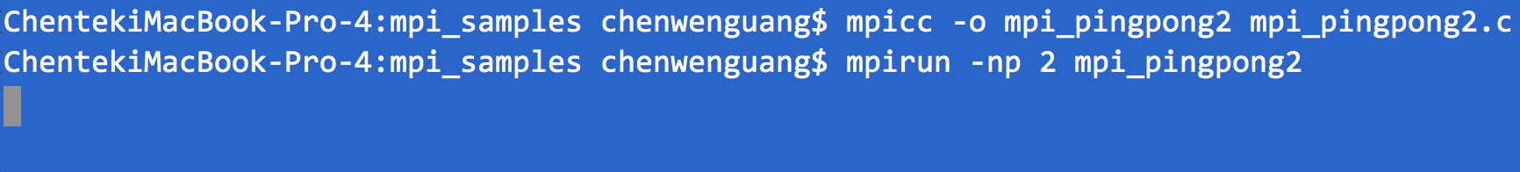
Notes:
Deadlock happens

Slide 31
Q&A & break 1

Slide 32
2. MPI programming
2.3 Eager/Rendezvous mode and Non-blocking message passing

Slide 33
Sources of Deadlocks
Send a large message from process 0 to process 1
If there is insufficient storage at the destination, the send must wait for the user to provide the memory space (through a receive)
What happens with
Process 0
Send(1)
Recv(1)
Process 1
Send(0)
Recv(0)
This is called “unsafe” because it depends on the availability of system buffers

Slide 34
Some Solutions to the “unsafe” Problem
Order the operations more carefully:
Process 0
Send(1)
Recv(1)
Process 1
Recv(0)
Send(0)
Use non-blocking operations:
Process 0
Isend(1)
Irecv(1)
Waitall
Process 1
Isend(0)
Irecv(0)
Waitall

Slide 35
if (rank == 0) {
MPI_Isend(..., 1, tag, MPI_COMM_WORLD, &req);
MPI_Recv(..., 1, tag, MPI_COMM_WORLD, &status);
MPI_Wait(&req, &status);
} else if (rank == 1) {
MPI_Recv(..., 0, tag, MPI_COMM_WORLD, &status);
MPI_Send(..., 0, tag, MPI_COMM_WORLD);
}

Slide 36
Retrieving Further Information
Status is a data structure allocated in the user’s program.
In C:
int recvd_tag, recvd_from, recvd_count;
MPI_Status status;
MPI_Recv(..., MPI_ANY_SOURCE, MPI_ANY_TAG, ..., &status )
recvd_tag = status.MPI_TAG;
recvd_from = status.MPI_SOURCE;
MPI_Get_count( &status, datatype, &recvd_count );

Slide 37
MPI is Simple
Many parallel programs can be written using just these six functions, only two of which are non-trivial:
MPI_INIT
MPI_FINALIZE
MPI_COMM_SIZE
MPI_COMM_RANK
MPI_SEND
MPI_RECV
Point-to-point (send/recv) isn’t the only way...

Slide 38
2. MPI programming
2.4 Collective Communications

Slide 39
The pi example
4.0
1
∫
4.0
dx = π
(1+x²)
0
2.0
static long num_steps = 100000;
double step;
void main ()
{int I;
double x, pi, sum = 0.0;
step = 1.0/(double) num_steps;
for (i=0; i< num_steps; i++){
x = (i+0.5)*step;
sum = sum + 4.0/(1.0+x*x);
}
pi = step * sum;
}
F(x) = 4.0/(1+x²)
0.0
1.0
X

Slide 40
The OpenMP version
x=0;
sum = 0.0;
step = 1.0/(double) num_steps;
#pragma omp for reduction(+:sum) private(x)
for (i=0; i < num_steps; i=i+1){
x=(i+0.5)*step;
sum = sum + 4.0/(1.0+x*x);
}
pi=step*sum;
What are needed in MPI if we wish each process do part of the calculation?
First, each process need to know num_steps, also there should be support of reduction.
Notes:
First, each process need to know num_steps, also there should be support of reduction.

Slide 41
Example: PI in C -1
#include "mpi.h"
#include <math.h>
int main(int argc, char *argv[])
{ int done = 0, n, myid, numprocs, i, rc; double PI25DT = 3.141592653589793238462643; double mypi, pi, h, sum, x, a; MPI_Init(&argc,&argv); MPI_Comm_size(MPI_COMM_WORLD,&numprocs); MPI_Comm_rank(MPI_COMM_WORLD,&myid); while (!done) { if (myid == 0) { printf("Enter the number of intervals: (0 quits) "); scanf("%d",&n); } // let each process know the n, how? if (n == 0) break;

Slide 42
Example: PI in C -1
#include "mpi.h"
#include <math.h>
int main(int argc, char *argv[])
{ int done = 0, n, myid, numprocs, i, rc; double PI25DT = 3.141592653589793238462643; double mypi, pi, h, sum, x, a; MPI_Init(&argc,&argv); MPI_Comm_size(MPI_COMM_WORLD,&numprocs); MPI_Comm_rank(MPI_COMM_WORLD,&myid); while (!done) { if (myid == 0) { printf("Enter the number of intervals: (0 quits) "); scanf("%d",&n); } // let each process know the n, how?
// This can be done with a loop of send/receive, but… if (n == 0) break;

Slide 43
Introduction to Collective Operations in MPI
Collective operations are called by all processes in a communicator.
MPI_BCAST distributes data from one process (the root) to all others in a communicator.
MPI_REDUCE combines data from all processes in communicator and returns it to one process.
In many numerical algorithms, SEND/RECEIVE can be replaced by BCAST/REDUCE, improving both simplicity and efficiency.

Slide 44
Pi
#include "mpi.h"
#include <math.h>
int main(int argc, char *argv[])
{ int done = 0, n, myid, numprocs, i, rc; double PI25DT = 3.141592653589793238462643; double mypi, pi, h, sum, x, a; MPI_Init(&argc,&argv); MPI_Comm_size(MPI_COMM_WORLD,&numprocs); MPI_Comm_rank(MPI_COMM_WORLD,&myid); while (!done) { if (myid == 0) { printf("Enter the number of intervals: (0 quits) "); scanf("%d",&n); } MPI_Bcast(&n, 1, MPI_INT, 0, MPI_COMM_WORLD); if (n == 0) break;

Slide 45
Example: PI in C - 2
h = 1.0 / (double) n; sum = 0.0; for (i = myid + 1; i <= n; i += numprocs) { x = h * ((double)i - 0.5); sum += 4.0 / (1.0 + x*x); } mypi = h * sum; MPI_Reduce(&mypi, &pi, 1, MPI_DOUBLE, MPI_SUM, 0, MPI_COMM_WORLD); if (myid == 0) printf("pi is approximately %.16f, Error is %.16f\n", pi, fabs(pi - PI25DT)); } MPI_Finalize();
return 0;
}

Slide 46
Alternative set of 6 Functions for Simplified MPI
MPI_INIT
MPI_FINALIZE
MPI_COMM_SIZE
MPI_COMM_RANK
MPI_BCAST
MPI_REDUCE
What else are needed (and why)?

Slide 47
2. Parallelization Methodogy

Slide 48
Use Reduction as an example
Given associative operator ⊕
a₀ ⊕ a₁ ⊕ a₂ ⊕ … ⊕ a_{n-1}
Examples
Add
Multiply
And, Or
Maximum, Minimum
Notes:
This operation is O(N) with sequential execution

Slide 49
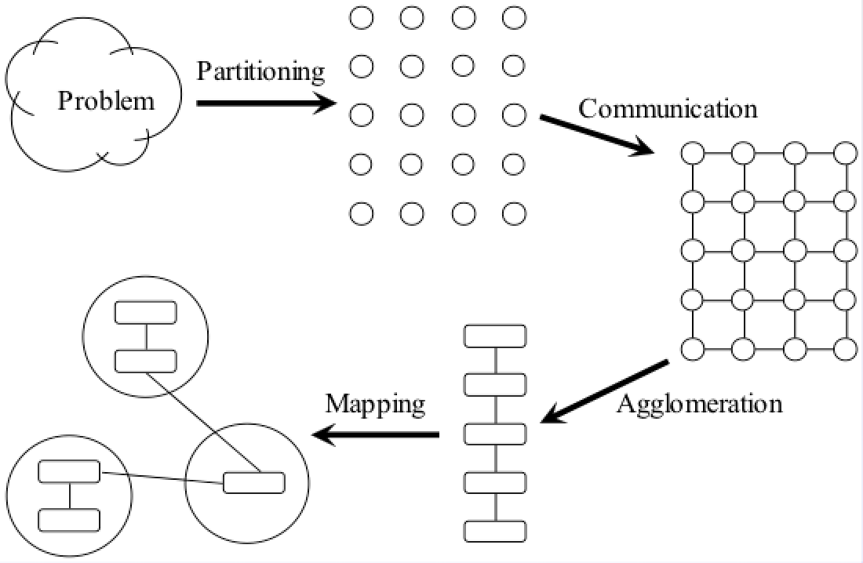
Foster’s Design Methodology for parallelization*
*Sourcebook of Parallel Computing
https://www.academia.edu/371614/Sourcebook_of_Parallel_Computing

Slide 50
Partitioning
Dividing computation and data into pieces
Domain decomposition
Divide data into pieces
Determine how to associate computations with the data
Functional decomposition
Divide computation into pieces
Determine how to associate data with the computations

Slide 51
Example Domain Decompositions

Slide 52
Example Functional Decomposition

Slide 53
Partitioning Checklist
At least 10x more primitive tasks than processors in target computer
Minimize redundant computations and redundant data storage
Primitive tasks roughly the same size
Number of tasks an increasing function of problem size

Slide 54
Communication
Determine values passed among tasks
Local communication
Task needs values from a small number of other tasks
Create channels illustrating data flow
Global communication
Significant number of tasks contribute data to perform a computation

Slide 55
Communication Checklist
Communication operations balanced among tasks
Each task communicates with only small group of neighbors
Tasks can perform communications concurrently
Task can perform computations concurrently

Slide 56
Agglomeration
Grouping tasks into larger tasks
Goals
Improve performance
Maintain scalability of program
In MPI programming, goal often to create one agglomerated task per processor

Slide 57
Agglomeration Checklist
Locality of parallel algorithm has increased
Replicated computations take less time than communications they replace
Data replication doesn’t affect scalability
Agglomerated tasks have similar computational and communications costs
Number of tasks increases with problem size
Number of tasks suitable for likely target systems
Tradeoff between agglomeration and code modifications costs is reasonable

Slide 58
Mapping
Process of assigning tasks to processors
Centralized multiprocessor: mapping done by operating system
Distributed memory system: mapping done by user

Slide 59
Mapping Example
Goals of mapping
Maximize processor utilization(load balance)
Minimize interprocessor communication

Slide 60
Optimal Mapping
Finding optimal mapping is NP-hard
Must rely on heuristics
Check my two papers if you are interested in this direction:
Chen, Hu, et al. “MPIPP: an automatic profile-guided parallel process placement toolset for SMP clusters and multiclusters.” Proceedings of the 20th annual international conference on Supercomputing. ACM, 2006.
Zhang, Jin, et al. "Process mapping for mpi collective communications." European Conference on Parallel Processing. Springer Berlin Heidelberg, 2009.

Slide 61
Mapping Decision Tree
Static number of tasks
Structured communication
Constant computation time per task
Agglomerate tasks to minimize comm
Create one task per processor
Variable computation time per task
Cyclically map tasks to processors
Unstructured communication
Use a static load balancing algorithm

Slide 62
Mapping Strategy
Dynamic number of tasks
Frequent communications between tasks
Use a dynamic load balancing algorithm
Many short-lived tasks
Use a run-time task-scheduling algorithm

Slide 63
Mapping Checklist
Considered designs based on one task per processor and multiple tasks per processor
Evaluated static and dynamic task allocation
If dynamic task allocation chosen, task allocator is not a bottleneck to performance
If static task allocation chosen, ratio of tasks to processors is at least 10:1

Slide 64
Case Studies
Finding the maximum/global sum
This is a reduction operation
Also we show a potential parallel implementation of MPI_Reduction

Slide 65
Reduction
Given associative operator ⊕
a₀ ⊕ a₁ ⊕ a₂ ⊕ … ⊕ a_{n-1}
Examples
Add
Multiply
And, Or
Maximum, Minimum
Notes:
This operation is O(N) with sequential execution

Slide 66
Parallel Reduction Evolution

Slide 67
Finding Global Sum
4
2
0
7
-3
5
-6
-3
8
1
2
3
-4
4
6
-1

Slide 68
Finding Global Sum
1
7
-6
4
4
5
8
2

Slide 69
Finding Global Sum
8
-2
9
10

Slide 70
Finding Global Sum
17
8

Slide 71
Finding Global Sum
Binomial Tree
25

Slide 72
Agglomeration

Slide 73
Agglomeration
sum
sum
sum
sum

Slide 74
When to use MPI
Portability and Performance
Irregular Data Structures
Building Tools for Others
Libraries
Need to Manage memory on a per processor basis

Slide 75
Summary
The parallel computing community has cooperated on the development of a standard for message-passing libraries.
There are many implementations, on nearly all platforms.
MPI subsets are easy to learn and use.
Lots of MPI material is available.

Slide 76
Reference
https://computing.llnl.gov/tutorials/mpi/
Skip LLNL MPI Implementations and Compilers Section

Slide 77
Why mpi is inadequate for big data processing

Slide 78
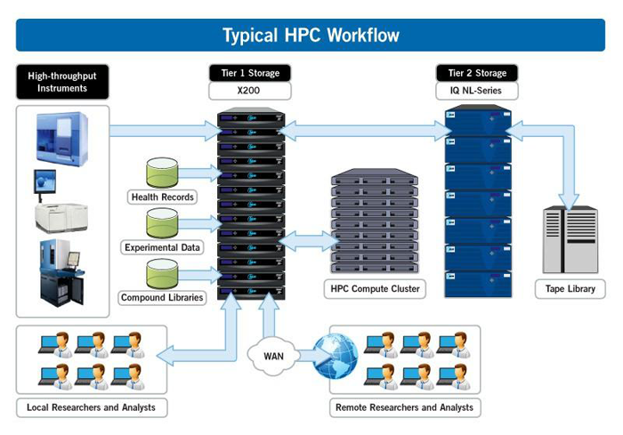
MPI and HPC cluster architecture
Notes:
-Separated compute and storage
-Homogeneous machines

Slide 79
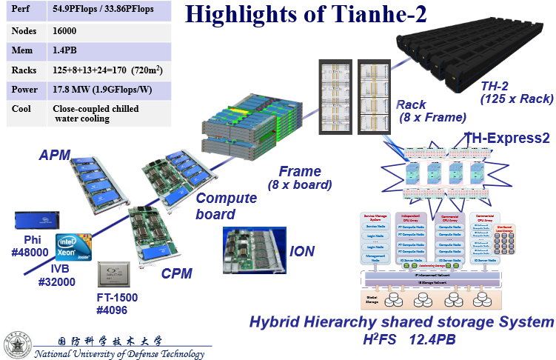
Tianhe - 2

Slide 80
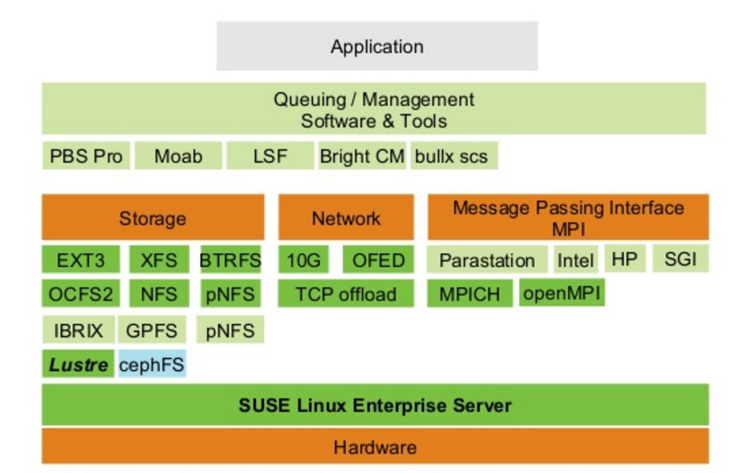
Typical Software Stack of HPC
Notes:
Hardware
Hundreds to thousands cores, homogeneous
Connected with high speed network, such as Infiniband
Software
MPI applications
MPI Libraries( Intel MPI, OpenMPI etc. )
OpenPBS or LSF as scheduler
NFS or Lustre
TotalView, gdb, or printf…
Fastest machine today
5Pflops ( 10¹⁵)

Slide 81
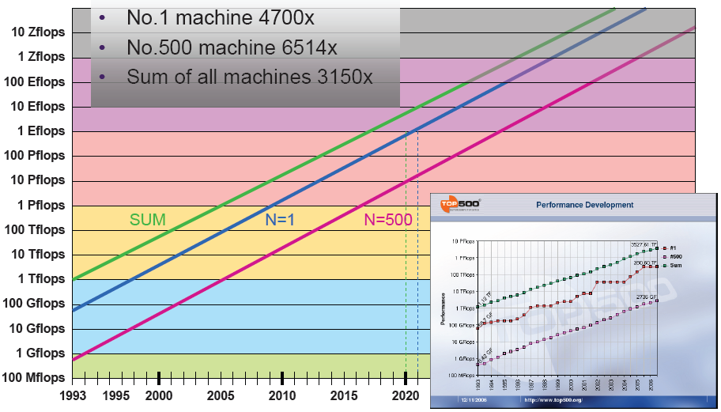
10 Year for 1000X Performance
1998(Tflops) →2008(Pflops) →2021? (Eflops)
What are the challenges to build Eflops computers and beyond?

Slide 82
Availability
MPI_Init(&argc,&argv);
MPI_Comm_size(MPI_COMM_WORLD,&numprocs);
MPI_Comm_rank(MPI_COMM_WORLD,&myid);
tag=1234;source=0;destination=1;count=1;
if(myid == source){
buffer=5678;
MPI_Send(&buffer,count,MPI_INT,destination,tag,MPI_COMM_WORLD);
printf("processor %d sent %d\n",myid,buffer);
}
if(myid == destination){ MPI_Recv(&buffer,count,MPI_INT,source,tag,MPI_COMM_WORLD,&status);
printf("processor %d got %d\n",myid,buffer);
}
MPI_Finalize();
What happens if process 1 crashes?

Slide 83
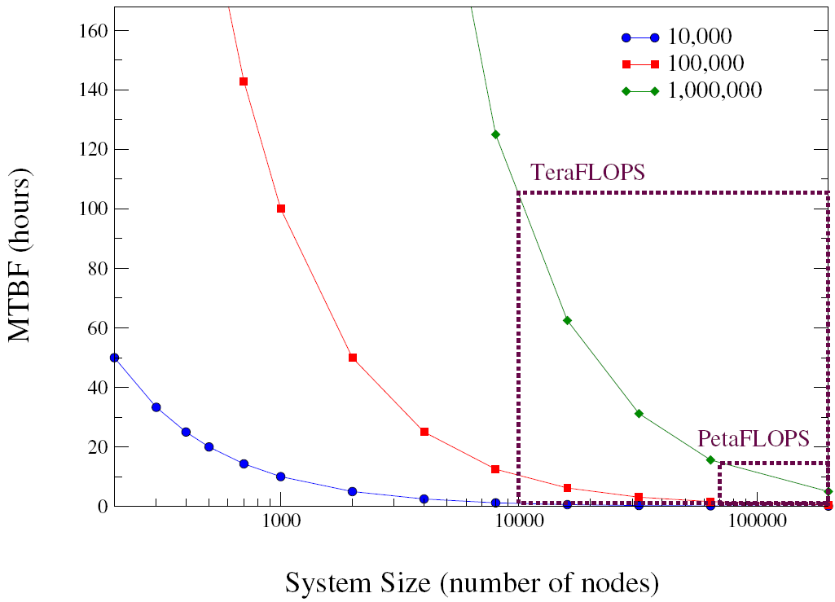
Availability
MTBF of Petaflops machine is likely just a few hours*
What if an application runs 20 days or even longer?
Restart from the beginning does not help
Classic fault tolerance mechanisms do not fit well
Lockstep, n-version programming…
Checkpoint and Restart
* Fabrizio Petrini and Kei Davis and José Carlos Sancho. System-Level Fault-Tolerance in Large-Scale Parallel Machines with Buffered Coscheduling. FTPDS04, 2004.
Notes:
Source: Fabrizio Petrini and Kei Davis and José Carlos Sancho. System-Level Fault-Tolerance in Large-Scale Parallel Machines with Buffered Coscheduling. In In 9th IEEE Workshop on Fault-Tolerant Parallel, Distributed and Network-Centric Systems (FTPDS04), Santa Fe, NM, April 2004.
显示当节点数增加后整个系统MTBF的下降。不同的曲线表示节点不同的MTBF。
04年的预测数据可能比较老，尤其是对系统规模。

Slide 84
What’s in checkpoint?
Applications can write its own checkpoint
Compact, only save necessary state variables
Not trivial, especially when multiple people are involved to write software
Save the memory state automatically
Heavy I/O overhead on checkpointing
Sunway TaihuLight
500GB/s IO, 1.3PB memory, what is the time for a checkpoint?
MTBF of this machine is a few hours only

Slide 85
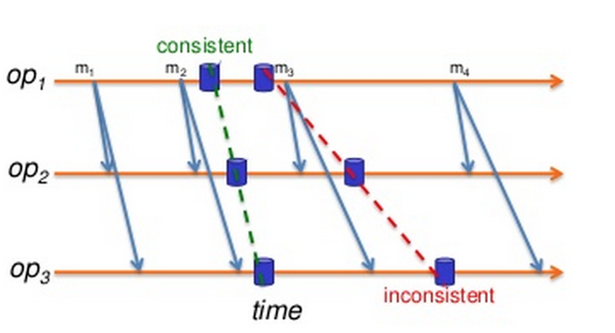
When to save checkpoints
Checkpoints can not be saved at any points.
Coordination is necessary
How frequent should we write checkpoint?
Too long? Too short?
Given a MTTF and the time for a checkpoint writing, what is the optimal checkpoint interval?

Slide 86
File Checkpointing?
We propose a way to solve the file system consistency problem by leveraging a user-level file system*
Buffer file changes until the next checkpoint
CKPT
crash
read(buf, “foo”)
File Not Found!
unlink(“foo”)
*Ruini Xue, Wenguang Chen, Weimin Zheng: CprFS: A User-Level File System to Support Consistent File States for Checkpoint and Restart. ICS 2008: 114-123

Slide 87
Revisit HPC cluster architecture
Separated storage and compute nodes
Homogeneous compute nodes
Batch scheduler
All or none scheduling policy
Fault-tolerance with checkpoints( high overhead)
Notes:
-Separated compute and storage
-Homogeneous machines

Slide 88
Challenges to Big data systems
More cost sensitive
Tend to use cheap computers whose MTBF may not as high as in HPC systems
Fault tolerance becomes more important
Elastic demand
Can not fix the number of computers used
Adding/updating new machines all years long, heterogeneous nodes

Slide 89
Challenges to Big data systems(cont’d)
Production workload and analysis workload co-exist in the same cluster for better utilization
The required resources may not be fully available
May kill some tasks for jobs with higher priority
Strong demands on fault tolerance and the support of heterogeneous nodes

