Slide 1
Introduction to Big Data Systems
Lecture 3. Parallel/Distributed I/O systems
Wenguang CHEN
Tsinghua University

Slide 2
Demand for Parallel I/O Systems
Performance
Fill the gap between memory and I/O devices
Memory: 10-100GB/s
Single Disk: 100MB/s, use multiple disks would be good
Fault-tolerance
Disk failure
Node failure
failure
crash
CKPT

Slide 3
Parallel I/O Systems
Disk level
RAID
Node level
Google File Systems and HDFS

Slide 4
Problem Statement
Given a large file of M bytes file, and N disks
Find a way to distribute the file into disks.
Objective: Read a long sequential part of the file as fast as possible
M
File
Disk 0
Disk 1
Disk 2
Disk N-1
• • •

Slide 5
Solution 1: Chunk
M/N
M/N
• • •
M/N
M
File
Disk 0
Disk 1
Disk 2
Disk N-1
• • •

Slide 6
Solution 2: Stripe
Stripe the data across an array of disks
many alternative striping strategies possible
Example: consider a big file striped across N disks
stripe width is S bytes
hence each stripe unit is S/N bytes
sequential read of S bytes at a time
S
S
S
s_{0,0}
s_{0,1}
s_{0,2}
• • •
s_{0,N-1}
s_{1,0}
s_{1,1}
s_{1,2}
• • •
s_{1,N-1}
s_{2,0}
s_{2,1}
s_{2,2}
• • •
s_{2,N-1}
• • • • •
Disk 0
Disk 1
Disk 2
Disk N-1
S_{0,0}
S_{0,1}
S_{0,2}
• • •
S_{0,N-1}
S_{1,0}
S_{1,1}
S_{1,2}
• • •
S_{1,N-1}
S_{2,0}
S_{2,1}
S_{2,2}
• • •
S_{2,N-1}
• • •
• • •
• • •
• • •

Slide 7
Performance Benefit
Sequential read or write of large file
application (or I/O buffer cache) reads in multiples of S bytes
controller performs parallel access of N disks
aggregate bandwidth is N times individual disk bandwidth
(assumes that disk is the bottleneck)
Disk 0
Disk 1
Disk 2
Disk N-1
• • •
x MB/s
x MB/s
x MB/s
x MB/s
S _{k,0}
S _{k,1}
S _{k,2}
S _{k,N-1}
Array Controller
Nx MB/s
S_{k}

Slide 8
It also benefits small read/writes,but…
N concurrent small read or write requests
randomly distributed across N drives (we hope!)
common in database and Web server environments
Disk 0
Disk 1
Disk 2
Disk N-1
• • •
x MB/s
x MB/s
x MB/s
x MB/s
req 1
req 2
req 0
req N-1
Array Controller
Nx MB/s
N independent requests
Notes:
Looks great, but what is the problem of this solution?

Slide 9
Reliability of Disk Arrays
As number of disks grows, chances of at least one failing increases
Reliability of N disks = (reliability of 1 disk) / N
suppose each disk has MTTF of 50,000 hours
(roughly 6 years before any given disk fails)
then some disk in a 70-disk array will fail in (50,000 / 70) hours
(roughly once a month!)

Slide 10
RAID
Large arrays without redundancy too unreliable to be useful
“Redundant Arrays of Independent(Inexpensive) Disks”
However, Redundancy means cost…
Many alternative approaches to achieving this redundancy
Metrics to evaluate alternatives？
Wasted space due to redundancy, and more?

Slide 11
RAID Level 1
D₁
B₁
D₂
B₂
D₃
B₃
Also known as “mirroring”
To read a block:
read from either data disk or backup
To write a block:
write both data and backup disks
How many failure can tolerate? What is the cost for redundancy?

Slide 12
RAID Levels 2 & 3
D₁
D₂
D₃
P
• • •
These are bit-interleaved schemes
In Raid Level 2, P contains memory-style ECC
In Raid Level 3, P contains simple parity
Rarely used today
Good for large data read/write, poor for small data transfer

Slide 13
RAID Level 4
D_{0,0}
D_{0,1}
D_{0,2}
P₀
D_{1,0}
D_{1,1}
D_{1,2}
P₁
D_{2,0}
D_{2,1}
D_{2,2}
P₂
D_{3,0}
D_{3,1}
D_{3,2}
P₃
D_{0,0} ⊕ D_{0,1} ⊕ D_{0,2} = P₀
Block-interleaved parity
Wasted storage is small: one parity block for N data blocks
Key problem:
parity disk becomes a hot spot
write access to parity disk on every write to any block

Slide 14
RAID Level 5
D_{0,0}
D_{0,1}
D_{0,2}
P₀
D_{1,0}
D_{1,1}
P₁
D_{1,3}
D_{2,0}
P₂
D_{2,2}
D_{2,3}
P₃
D_{3,1}
D_{3,2}
D_{3,3}
D_{0,0} ⊕ D_{0,1} ⊕ D_{0,2} = P₀
Rotated parity
Wastage is small: same as in Raid 4
Parity update traffic is distributed across disks

Slide 15
RAID 5 Actions
Fault-free Read
Fault-free Write
⊕
2
4
1
3
D
D
D
P
D
D
D
P
Degraded Read
Degraded Write
⊕
⊕
D
D
D
P
D
D
D
P

Slide 16
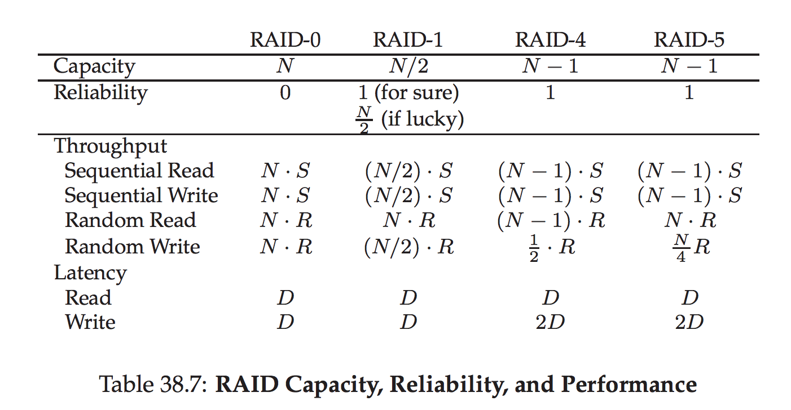
Comparing RAID
http://pages.cs.wisc.edu/~remzi/OSTEP/file-raid.pdf

Slide 17
Is RAID5 good enough?
Large number of disks in a server, e.g. 24
→High failure rate:
50000 hours/24 = ~2000 hours
Disks are larger, e.g. 8TB
→Long recovery times :
8TB / 20MB/s = 400,000s (~100 hours)
100hours is close to 2000 hours：
The probability to have two disk failure at the same time is not very small

Slide 18
RAID Level 6
D₀
D₁
P₀
P₁
D₂
P₂
P₃
D₃
P₄
P₅
D₄
D₅
P₆
D₆
D₇
P7
Tolerate 2 disk failures
Read performance is good, while write performance is a little slower
Parity update traffic is distributed across disks

Slide 19
Software based RAID
Software implementations are provided by many Operating Systems.
A software layer sits above the disk device drivers and provides an abstraction layer between the logical drives(RAIDs) and physical drives.
Server's processor is used to run the RAID software.
Used for simpler configurations like RAID0 and RAID1.
Notes:
What are the potential problems of software raid?

Slide 20
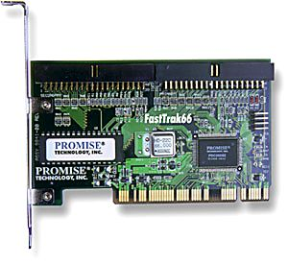
Hardware based RAID
A hardware implementation of RAID requires at least a special-purpose RAID controller.
On a desktop system this may be built into the motherboard.
Processor is not used for RAID calculations as a separate controller present.
A PCI-bus-based, IDE/ATA hard disk RAID controller, supporting levels 0, 1, and 01.

Slide 21
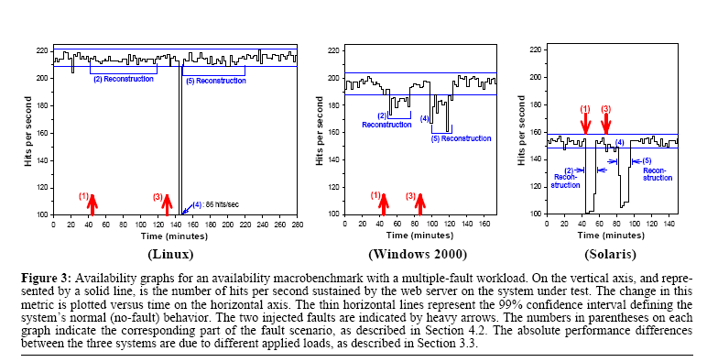
About Recovery / with service
Notes:
Recovery time is a problem, reconstructing RAID while

Slide 22
Is RAID sufficient for big data storage?
RAID provide good reliability for storage in a single node
but it can not tolerate node/network failure
We need a way to distributed file/strips across nodes
c1
node1
node2
node3
Notes:
What are the potential problems of software raid?

Slide 23
Break, Q&A

Slide 24
Parallel I/O Systems
Disk level
RAID
RAID is good but it can not tolerate node failure
Node level
Google File Systems and HDFS

Slide 25
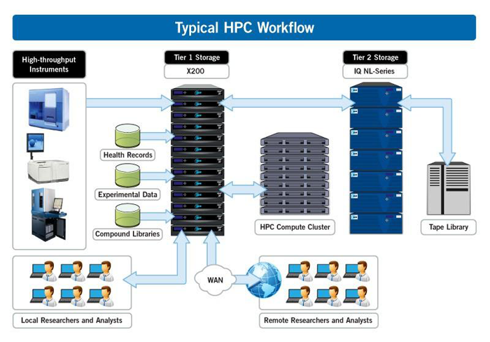
Review: MPI and HPC cluster architecture
Notes:
-Separated compute and storage
-Homogeneous machines

Slide 26

Data Center Architecture
Merge compute and storage nodes
Connected with Networks
Node – Rack – Datacenter layers
Oversubscripted high level network
…
Google Cloud Infrastructure
Node
Node
…
…
Node
Node
The Google file system, Sanjay Ghemawat, Howard Gobioff, Shun-Tak Leung，SOSP 2003

Slide 27
Problem Statement
Given a set of large files and N machine nodes
Find a way to distribute the file into nodes.
Objective:
Tolerate node failure
Read a long sequential part of the file as fast as possible
Write are mostly large append mode write
File1
File2
File3
node 0
node 1
node 2
node N-1
• • •

Slide 28
Duplicate Whole Files to Nodes
A node include all content of file.
A file is duplicated in multiple nodes. (In this example:2)
Pros and cons of this strategy?
File1
File2
File3
node 0
node 1
node 2
node N-1
• • •

Slide 29
Duplicate chunks of files
A file is divided into fixed size chunks
Each chunk is distributed and duplicated to a few nodes (usually 2-3)
Pros and cons of this strategy?
Number of node failure tolerated?
Wasted space?
Space required to know the position of the chunk?
File1
node 0
node 1
node 2
node N-1
• • •

Slide 30
How should duplicated chunks distributed?
Why 3 replica is usually used in data centers
Hint: Estimate the time for recover a node failure and the MTBF of a node (homework)
How to distributed 3 replicas on node/rack hierarchy?
One replica on local node
Second replica on a remote rack
Third replica on same remote rack
…
…

Slide 31
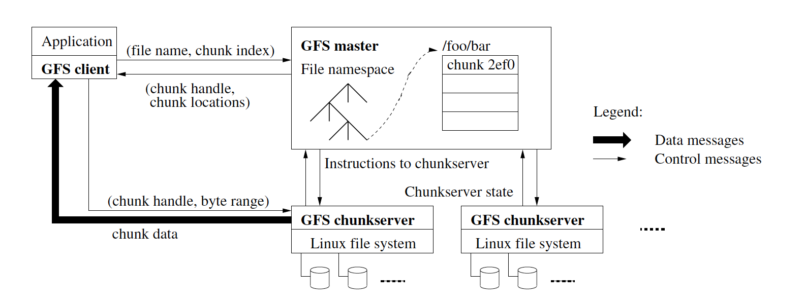
Where to find the block – meta data
Let’s assume the system contains modest number of HUGE files, and the chunk size is large(e.g. 64MB)
Meta data for the system is not large
They can be put in memory of a single server, this greatly reduce the complexity of the system and could get good meta data performance.
Single master design: Simple! With Availability and performance issues

Slide 32
Metadata in Master
Metadata in Memory
The entire metadata is in main memory
No demand paging of metadata
Types of metadata
List of files
List of Blocks for each file
List of chunk servers for each block
File attributes, e.g. creation time, replication factor
Metadata for a chunk is less than 64 bytes
What is the rough metadata size of a 1PB（1000TB) storage(assume each chunk is 64MB)?
Notes:
1000TB / 1M = 1GB

Slide 33
Google File System Architecture
Single master design
Performance issue
Separate data path with control path, no data need to pass chunk server
Chunk size selection
64MB – 128 MB , why?
Will discuss the single point of failure issue later
Notes:
Single master:
Reduce query to master - meta data in memory
Meta data in memory – reduce meta data size
Chunk size – large? Smaller meta data size, poor for small files. Good performance in disks
Number of replica ?

Slide 34
Key GFS design decisions
3 replicas of data for fault tolerance
Single master design for simplicity and performance
Master does not in data paths
Large chunk size for smaller meta data

Slide 35
Chunk server
A Block Server
Stores data in the local file system (e.g. ext3)
Each block of GFS data in a separate file in its local file system.
Stores metadata of a block (e.g. CRC)
Serves data and metadata to Clients

Slide 36
Data Correctness
Use Checksums to validate data
Use CRC32
File Creation
Client computes checksum per 512 bytes
Chunk server stores the checksum
File access
Client retrieves the data and checksum from chunk server
If Validation fails, Client tries other replicas

Slide 37
Get a chunk handle from master and read. Which one to read? Cache chunk handle and locations at client side. May ask for multiple chunks a time
Client - read
Notes:
Closest
First, using the fixed chunk size, the client translates the file name and byte offset specified by the application into a chunk index within the file.
Then, it sends the master a request containing the file name and chunk index. The master replies with the corresponding chunk handle and locations of the replicas. The client caches this information using the file name and chunk index as the key.
The client then sends a request to one of the replicas, most likely the closest one. The request specifies the chunk handle and a byte range within that chunk. Further reads of the same chunk require no more client-master interaction until the cached information expires or the file is reopened. In fact, the client typically asks for multiple chunks in the same request and the master can also include the informa- tion for chunks immediately following those requested. This extra information sidesteps several future client-master interactions at practically no extra cost.

Slide 38
3 replicas, which to write first?
Client - Write
Notes:
Also, the master should not be in the path

Slide 39
Replicas introduces consistency issue
Ideal consistency
Replicated files behaves like a non-replicated file
r1
c1
append(f, A)
append(f, A)
A
B
append(f, B)
c2
r2
append(f, B)
A
B

Slide 40
Reasons for consistency
Concurrency
Machine failures, temp or permanent
Network partitions, temp
r1
c1
append(f, A)
A
B
append(f, A)
append(f, B)
c2
r2
A
append(f, B)
B
B

Slide 41
Reasons for consistency
Concurrency ( consistent but not defined)
r1
c1
write(f, A)
write(f, A)
A1
B
A2
write(f, B)
c2
r2
write(f, B)
A1
B
A2

Slide 42
Ideal consistency is hard to get
Complex protocol
Hard to implement correctly
Poor performance
r1
c1
append(f, A)
append(f, A)
A
B
append(f, B)
c2
r2
append(f, B)
A
B

Slide 43
GFS design make an tradeoff
Trade ideal consistency for system simplicity
Clients may observe
Reading stale data
Duplicate append records
For applications such as search engine
This may be tolerable
Understanding GFS design as a tradeoff among
Consistency,fault-tolerance,performance simplicity of design

Slide 44
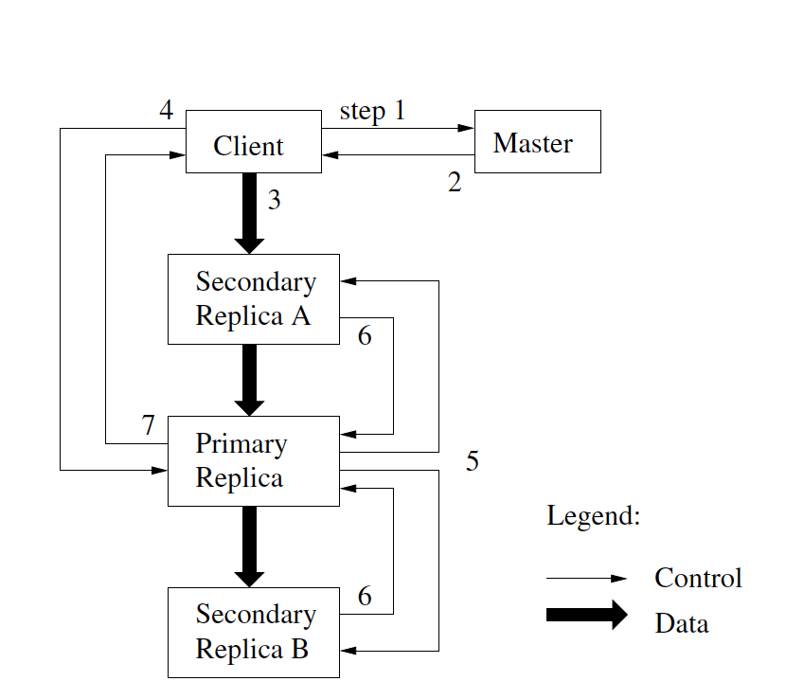
GFS Write
Notes:
1. The client asks the master which chunkserver holds
the current lease
2. The master replies with the identity of the primary and
the locations of the other (secondary) replicas
3. The client pushes the data to all the replicas. A client
can do so in any order.
4. Once all the replicas have acknowledged receiving the
data, the client sends a write request to the primary.
5. The primary forwards the write request to all secondary
replicas. Each secondary replica applies mutations
in the same serial number order assigned by
the primary.
6. The secondaries all reply to the primar
7. The primary replies to the client. Any errors encountered
at any of the replicas are reported to the client.

Slide 45
GFS Write
Why we need a primary?
Why we need a lease?
What happens if the primary fails?
What happens if a secondary fails?
What happens if the network fails between primary and secondary?
Notes:
1. The client asks the master which chunkserver holds
the current lease
2. The master replies with the identity of the primary and
the locations of the other (secondary) replicas
3. The client pushes the data to all the replicas. A client
can do so in any order.
4. Once all the replicas have acknowledged receiving the
data, the client sends a write request to the primary.
5. The primary forwards the write request to all secondary
replicas. Each secondary replica applies mutations
in the same serial number order assigned by
the primary.
6. The secondaries all reply to the primar
7. The primary replies to the client. Any errors encountered
at any of the replicas are reported to the client.

Slide 46
Why we need a primary?
r1
c1
append(f, A)
append(f, A)
A
B
append(f, B)
c2
r2
append(f, B)
A
B
A primary is need to control the order of the concurrent write

Slide 47
Why we need a lease?
master
primary
c1
secondary
secondary
c2
A lease for primary is to deal with primary failure or network failure

Slide 48
What happens if secondary fails
primary
Both secondary failure and network failure may cause write failure to client
Client will try the same write operations a few times(without go to master)
If it still fails, it will restart a new write operation by talking to master
This inconsistency between replicas are dealt with applications
Failure!
A
A
c1
secondary
A
secondary
A
A
Notes:
A lot of details

Slide 49
Fault tolerance and auto-maintenance
Detection
Move data?
New machines added?

Slide 50
Heartbeats
Master sends hearbeat to the chunkservers
Once every 3 seconds
No heartbeat does not necessarily indicate chunk server failure
May be network failure

Slide 51
Rebalancer
Goal: % disk full on chunk servers should be similar
Usually run when new chunk servers are added
Rebalancer is throttled to avoid network congestion

Slide 52
Replication Engine
Master detects chunk server failures
Chooses new chunk server for new replicas
Balances disk usage
Balances communication traffic to chunk servers

Slide 53

HDFS Architecture

Slide 54
User Interface
Commads for HDFS User:
hadoop dfs -mkdir /foodir
hadoop dfs -cat /foodir/myfile.txt
hadoop dfs -rm /foodir/myfile.txt
Commands for HDFS Administrator
hadoop dfsadmin -report
hadoop dfsadmin -decommision datanodename
Web Interface
http://host:port/dfshealth.jsp

Slide 55
Replica is good, but expensive
3X size !
How about using distributed RAID?
Overhead would be low(1.X)
RAID 5 is not sufficient
Other coding approaches are used
Some products
Hadoop EC
Huawei OceanStor UDS
Tsinghua storage ( 32 + 16 )

Slide 56
Discussion on the single master design
Why single master is simple but effective?
Capacity - Multiple server – Fault – Tolerance - Replication - Inconsistency – poor performance
But a single server does imply a limit on the capacity of the storage
Dynamo, a distributed key-value store with DHT addressed this issue for another scenario(shopping cart)

Slide 57
Thanks

