Slide 1
Introduction to Big Data Systems
Lecture 4. MapReduce
Wenguang CHEN
Tsinghua University

Slide 2
What we have learned so far in this course
Parallel programming
In a machine : threads, OpenMP
Distributed systems: MPI
Distributed file systems for fault tolerance
Google file system / HDFS
Are they good enough for distributed data processing?

Slide 3
Why MPI is hard to schedule flexibly and tolerant fault?
MPI_Init(&argc,&argv);
MPI_Comm_size(MPI_COMM_WORLD,&numprocs);
MPI_Comm_rank(MPI_COMM_WORLD,&myid);
tag=1234;source=0;destination=1;count=1;
if(myid == source){
buffer=5678;
MPI_Send(&buffer,count,MPI_INT,destination,tag,MPI_COMM_WORLD);
printf("processor %d sent %d\n",myid,buffer);
}
if(myid == destination){ MPI_Recv(&buffer,count,MPI_INT,source,tag,MPI_COMM_WORLD,&status);
printf("processor %d got %d\n",myid,buffer);
}
MPI_Finalize();
Notes:
Conditional statement is used to distinguish the operations on different processes, this is called SPMD model

Slide 4
Alternative set of 6 Functions for Simplified MPI
MPI_INIT
MPI_FINALIZE
MPI_COMM_SIZE
MPI_COMM_RANK
MPI_BCAST
MPI_REDUCE

Slide 5
Revisit the MPI with collective communications
#include "mpi.h"
#include <math.h>
int main(int argc, char *argv[])
{ int done = 0, n, myid, numprocs, i, rc; double PI25DT = 3.141592653589793238462643; double mypi, pi, h, sum, x, a; MPI_Init(&argc,&argv); MPI_Comm_size(MPI_COMM_WORLD,&numprocs); MPI_Comm_rank(MPI_COMM_WORLD,&myid); while (!done) { if (myid == 0) { printf("Enter the number of intervals: (0 quits) "); scanf("%d",&n); } MPI_Bcast(&n, 1, MPI_INT, 0, MPI_COMM_WORLD); if (n == 0) break;

Slide 6
h = 1.0 / (double) n; sum = 0.0; for (i = myid + 1; i <= n; i += numprocs) { x = h * ((double)i - 0.5); sum += 4.0 / (1.0 + x*x); } mypi = h * sum; MPI_Reduce(&mypi, &pi, 1, MPI_DOUBLE, MPI_SUM, 0, MPI_COMM_WORLD); if (myid == 0) printf("pi is approximately %.16f, Error is %.16f\n", pi, fabs(pi - PI25DT)); } MPI_Finalize();
return 0;
}

Slide 7
MPI model
What are the obstacles of supporting heterogeneous node and fault tolerance
Knowing N at the beginning
Static partition of the workload
Any idea to solve the problem?

Slide 8
The OpenMP version
x=0;
sum = 0.0;
step = 1.0/(double) num_steps;
#pragma omp for reduction(+:sum) private(x)
for (i=0; i < num_steps; i=i+1){
x=(i+0.5)*step;
sum = sum + 4.0/(1.0+x*x);
}
pi=step*sum;
This is similar to the MPI version we have
Notes:
First, each process need to know num_steps, also there should be support of reduction.

Slide 9
Revisit Static Scheduling
For N_{i} iterations and N_{t} threads, each thread gets one chunk of N_{i}/N_{t} loop iterations:
T0 T1 T2 T3 T4 T5
Thread #0: iterations 0 through N_{i}/N_{t}-1
Thread #1: iterations N_{i}/N_{t} through 2N_{i}/N_{t}-1
Thread #2: iterations 2N_{i}/N_{t} through 3N_{i}/N_{t}-1
…
Thread #N_{t}-1: iterations (N_{t}-1)N_{i}/N_{t} through N_{i}-1

Slide 10
The OpenMP version - Dynamic
x=0;
sum = 0.0;
step = 1.0/(double) num_steps;
#pragma omp for reduction(+:sum) private(x) schedule(dynamic,1)
for (i=0; i < num_steps; i=i+1){
x=(i+0.5)*step;
sum = sum + 4.0/(1.0+x*x);
}
pi=step*sum;
What are needed in MPI if we wish each process do part of the calculation?
Notes:
First, each process need to know num_steps, also there should be support of reduction.

Slide 11
Revisit Dynamic Scheduling
For N_{i} iterations and N_{t} threads, each thread gets a fixed-size chunk of k loop iterations:
T0 T1 T2 T3 T4 T5 T2 T3 T4 T0 T1 T5 T3 T2
When a particular thread finishes its chunk of iterations, it gets assigned a new chunk. So, the relationship between iterations and threads is nondeterministic.
Advantage: very flexible
Disadvantage: high overhead – lots of decision making about which thread gets each chunk

Slide 12
Dynamic scheduling on distributed systems
Doing a small piece of work, complete it and get the next piece
No N is required to know at the beginning
Need a reduce support similar to MPI_Reduce

Slide 13
Dynamic scheduling on distributed systems
Doing a small piece of work, complete it and get the next piece
Input from the global file system, similar to the MPI_Bcast
Write a map() function that transfers the input piece into partial output piece
No N is required to know at the beginning
Data specified by files in distributed file system
Need a reduce support similar to MPI_Reduce
Write a user defined reduce() file

Slide 14
The Google MapReduce Programming Model
Borrows from functional programming
Users implement interface of two functions
map (in_key, in_value) ->
(out_key, intermediate_value) list
reduce (out_key, intermediate_value list) ->
out_value list
MapReduce: Simplified Data Processing on Large Clusters ，Jeffrey Dean and Sanjay Ghemawat， OSDI 2004
14

Slide 15
Map in Scala
scala> val a = 1 to 9
a: scala.collection.immutable.Range.Inclusive = Range(1, 2, 3, 4, 5, 6, 7, 8, 9)
scala> val b = a.map(x=>x*2)
b: scala.collection.immutable.IndexedSeq[Int] = Vector(2, 4, 6, 8, 10, 12, 14, 16, 18)

Slide 16
reduce
Defines a function to combine two elements in a collection to one elements, and keep on applying it to elements in the collection
scala> val c = sc.parallelize(1 to 10)
scala> c.reduce((x, y) => x + y)
^{res4: Int = 55}

Slide 17
Example: Count word occurrences （pseudo code）
map(String input_key, String input_value):
// input_key: document name
// input_value: document contents
for each word w in input_value:
EmitIntermediate(w, "1");
reduce(String output_key, Iterator intermediate_values):
// output_key: a word
// output_values: a list of counts
int result = 0;
for each v in intermediate_values:
result += ParseInt(v);
Emit(AsString(result));
17

Slide 18
Example
Page 1: the weather is good
Page 2: today is good
Page 3: good weather is good.
18

Slide 19
Map output
Worker 1:
(the 1), (weather 1), (is 1), (good 1).
Worker 2:
(today 1), (is 1), (good 1).
Worker 3:
(good 1), (weather 1), (is 1), (good 1).
19

Slide 20
Reduce Input
Worker 1:
(the 1)
Worker 2:
(is 1), (is 1), (is 1)
Worker 3:
(weather 1), (weather 1)
Worker 4:
(today 1)
Worker 5:
(good 1), (good 1), (good 1), (good 1)
20

Slide 21
Reduce Output
Worker 1:
(the 1)
Worker 2:
(is 3)
Worker 3:
(weather 2)
Worker 4:
(today 1)
Worker 5:
(good 4)
21

Slide 22
Map in Google MapReduce
Records from the data source (lines out of files, rows of a database, etc) are fed into the map function as key*value pairs: e.g., (filename, line).
map() produces one or more intermediate values along with an output key from the input.
22

Slide 23
The concept of Key-value pair
Name – Value
int c = 5 ; c is the key, value is 5
<c,5>,<b,0>, <a,2>,<c,6>,<c,7>
What is the average of c?
Use c to retrieve data from the list

Slide 24
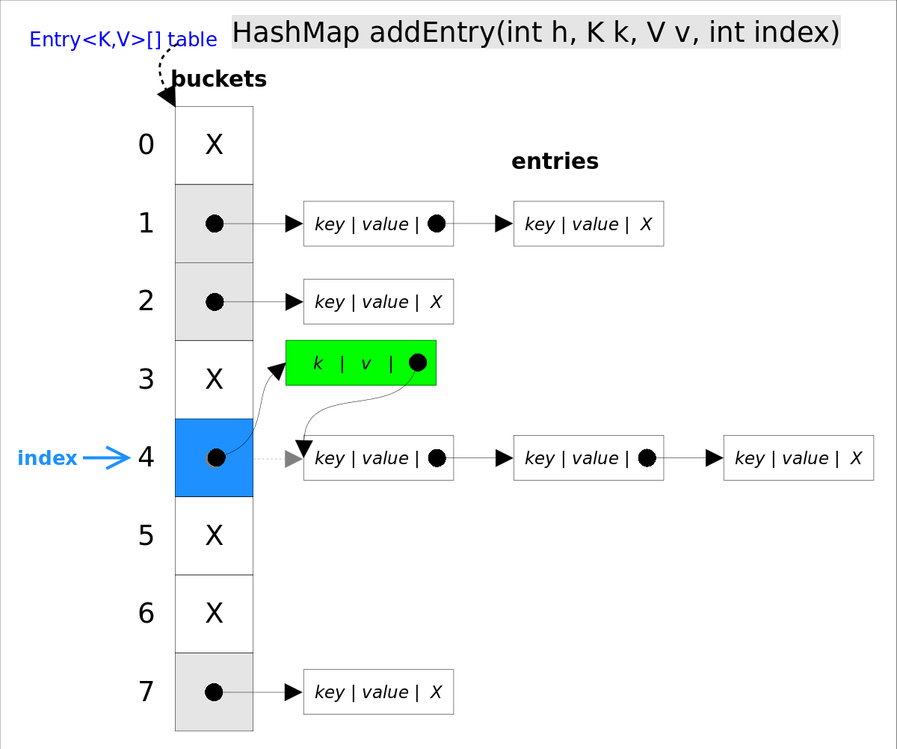
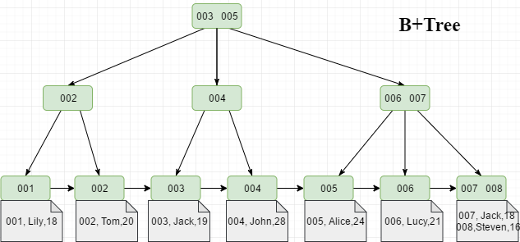
KV data structure
Data structure for KV
Hash map
Tree
Distributed KV

Slide 25
Reduce in Google MapReduce
After the map phase is over, all the intermediate values for a given output key are combined together into a list
reduce() combines those intermediate values into one or more final values for that same output key
For key value pairs, typically we do ReduceByKey
25

Slide 26
Architecture
26

Slide 27
Parallelism
map() functions run in parallel, creating different intermediate values from different input data sets
reduce() functions also run in parallel, each working on a different output key
All values are processed independently
Bottleneck: reduce phase can’t start until map phase is completely finished.
27

Slide 28
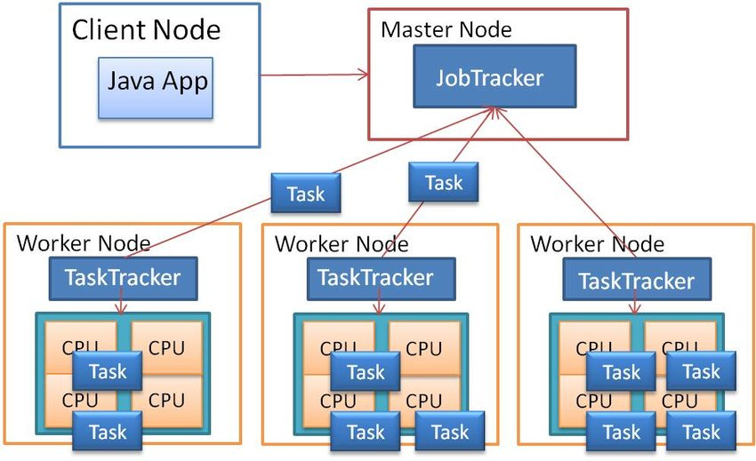
Master-worker style scheduling of MapReduce
Elastic scheduling and fault tolerance
Only need to re-execute failed tasks
Heterogeneous nodes? Jitter jobs? Change the number of worker nodes during execution?
At what cost?

Slide 29
What would need to be transferred by network from mappers to reducers
How to optimize the network traffic?
What happens if some machines are slow?
29

Slide 30
https://www.edureka.co/blog/mapreduce-tutorial/

Slide 31
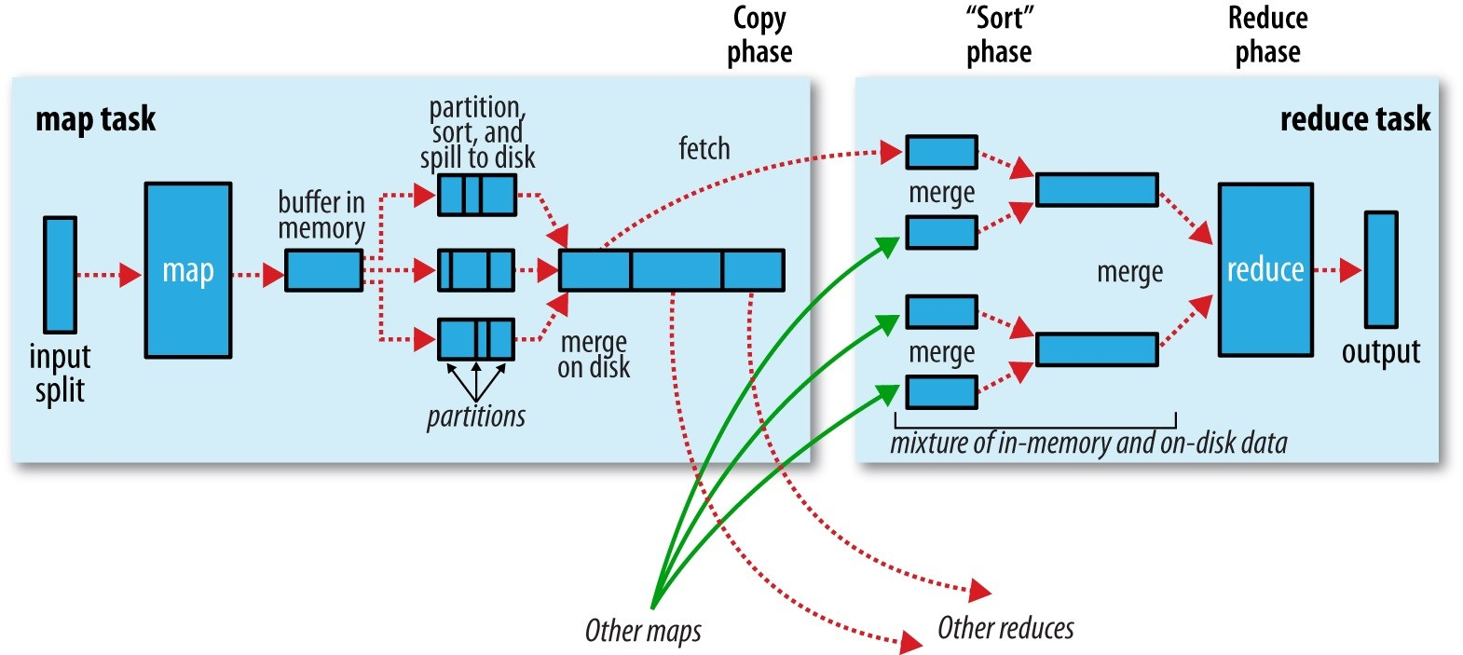
More on the shuffle phase*
*https://timepasstechies.com/mapreduce-shuffle-sort-phase/

Slide 32
Some Other Real Examples
Reverse web-link graph
Term frequencies through the whole Web repository
Count of URL access frequency
32

Slide 33
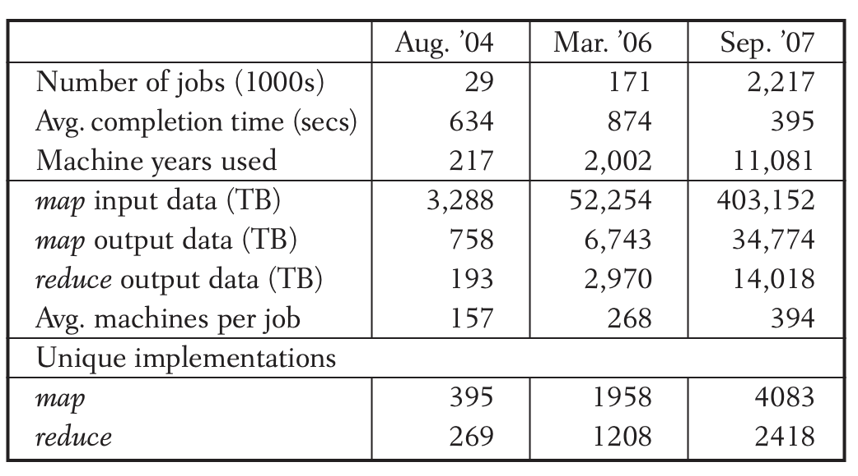
Summary
MapReduce has proven to be a useful abstraction
Greatly simplifies large-scale computations at Google
Fun to use: focus on problem, let library deal w/ messy details
Data center as a computer
MapReduce is the first instruction!
33

Slide 34
Map-Reduce Examples

Slide 35
Problem 1 Distributed Grep
Input
A key word and documents to be searched
Output
The line contains the keyword, with file name
[cwg@HPC-AMD phoenix_scheduler]$ grep main *
MapReduceScheduler.h:/* The main MapReduce engine. This is the function called by the application.
MapReduceScheduler.h: * also organizes and maintains the data which is passed from application to

Slide 36
MR Grep
Map
Emits the result of local grep
Reduce
Output what it get from Map

Slide 37
Problem 2 Inverted Index
Input
A few text documents
Output
(word, docIDList)

Slide 38
MR-II
Map
Parse document and emit (word, DocID)
Reduce
Emit ( word, DocIDList )

Slide 39
Problem 3 Common Friends*
Input:
A:B,C,D,F,E,O
B:A,C,E,K
C:F,A,D,I
D:A,E,F,L
E:B,C,D,M,L F:A,B,C,D,E,O,M
Output:
A-B: C E
A-C: D
…
*Examples from: https://blog.csdn.net/zhongqi2513/article/details/78344509

Slide 40
A:B,C,D,F,E,O
B:A,C,E,K
C:F,A,D,I
D:A,E,F,L
E:B,C,D,M,L F:A,B,C,D,E,O,M
A-B: C E
A-C: D
A-B: C
A-B: E
A-C: D
C : A
C : B
E : A
E : B
D : A
D : C

Slide 41
A:B,C,D,F,E,O
B:A,C,E,K
C:F,A,D,I
map
B : A
C : A
…
D : C
I : C
reduce
？
A ：F-I-O-K-G-D-C-H-B-
B ：E-J-F-A-
C ：B-E-K-A-H-G-F-
D ：H-C-G-F-E-A-K-L-
A-B: C E
A-C: D

Slide 42
Another pass of MapReduce
B ：E-J-F-A-
C : F,A,D,I
map
E-J : B
E-F : B
A-F : B
…
A-F : C
…
reduce
A-F : B C
…

Slide 43
Problem 4 Mutual Friends*
Input:
A:B,C,D,F,E,O
B:A,C,E,K
C:F,A,D,I
D:A,E,F,L
E:B,C,D,M,L F:A,B,C,D,E,O,M
Output:
A-B
A-C
A-D
…
*Examples from :https://blog.csdn.net/zhongqi2513/article/details/78344948

Slide 44
A:B,C,D,F,E,O
B:A,C,E,K
map
A-B:1
A-C:1
…
B-A → A-B:1
B-C:1
…
reduce
A-B:2 → A-B

Slide 45
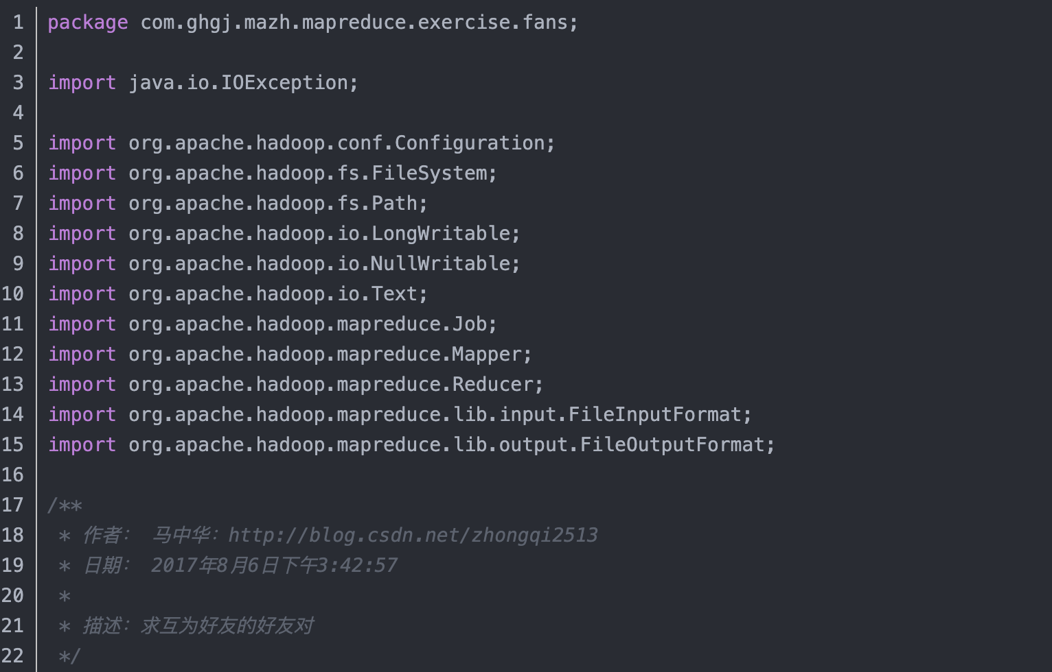

Slide 46
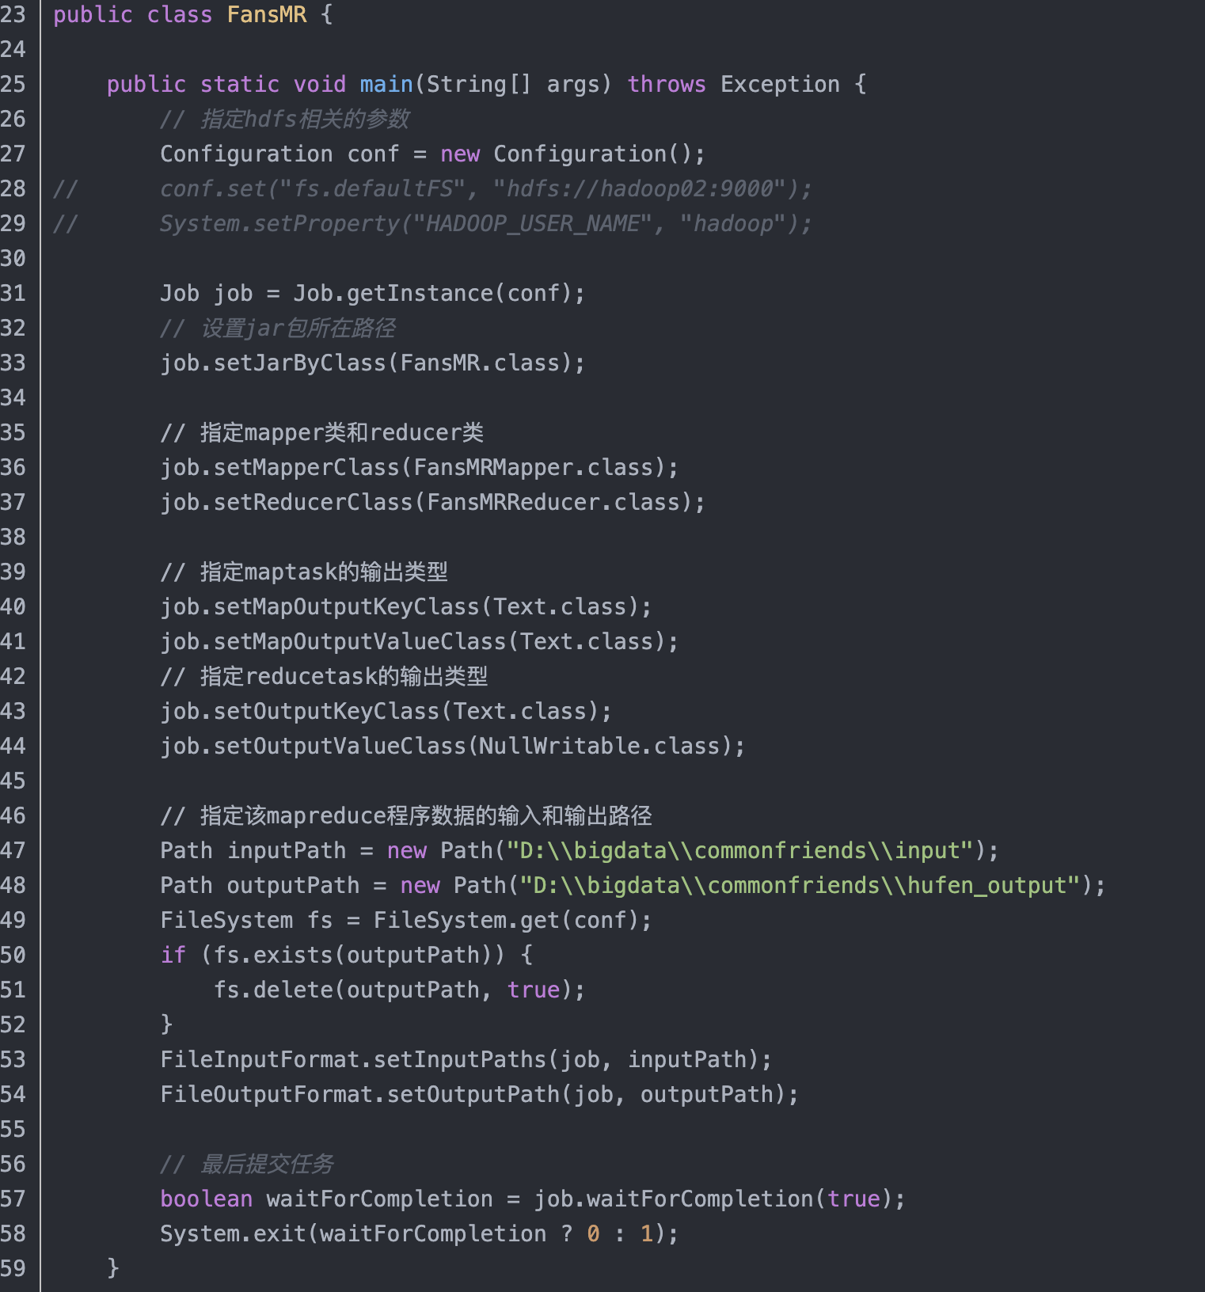

Slide 47
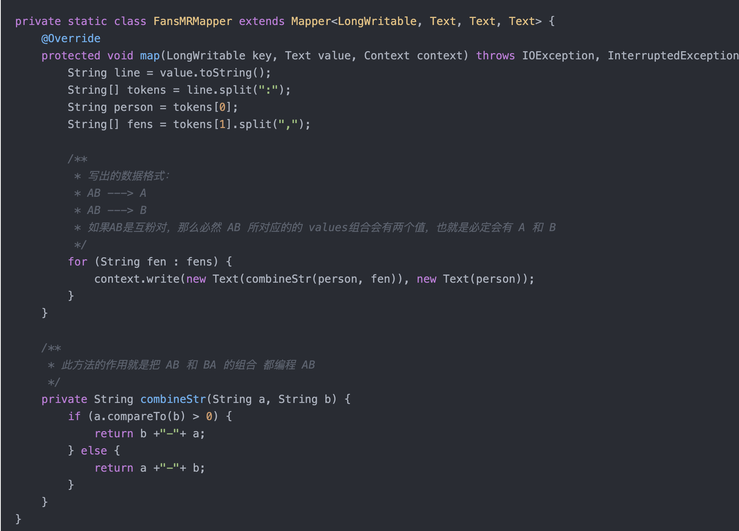

Slide 48
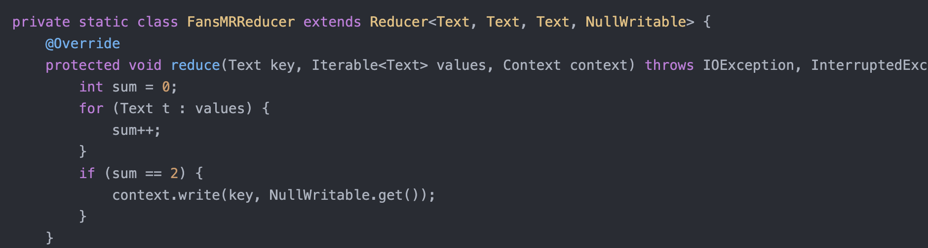

Slide 49

Discussion
What can not be done by Map-Reduce efficiently?
Can we do PageRank with MapReduce?
B
38.4
C
34.3
A
3.3
D
3.9
E
8.1
F
3.9
1.6
1.6
1.6
1.6
1.6

Slide 50
Iterative MapReduce: K-Means as an Example
Notes:
50

Slide 51
K-Means Algorithm
Input:
a set of P points in N-dimension space
Output:
distribute them into K clusters, so that points closer to each other is in the same cluster
This is an NP-hard problem
Even when K=2 or D=2
Notes:
51

Slide 52
K-Means Algorithm (cont.)
randomly generate K points as the means
do
for each point in the point set
find the closest mean I, assign the point to cluster I, forming K clusters
calculate new means for each cluster
until no changes are made to the clusters
Notes:
52

Slide 53
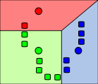
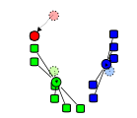
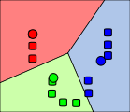
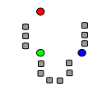
1) k initial "means" (in this case k=3) are randomly selected from the data set (shown in color).
2) k clusters are created by associating every observation with the nearest mean. The partitions here represent the Voronoi diagram generated by the means.
3) The centroid of each of the k clusters becomes the new means.
4) Steps 2 and 3 are repeated until convergence has been reached.

Slide 54
Expressing an Iteration in MapReduce
for each point in the point set
find the closest mean I, assign the point to cluster I, forming new K clusters
calculate new means for each cluster
can be done as a map task
reduce task
map(point p):
for each mean in K means
find the closet mean M to this point
emit_intermediate (index of M, p)
reduce(index of cluster i, list of points lp):
calculate the new mean M’ for points in lp
emit(M’)
Notes:
54

Slide 55
But it only completes one iteration
Can we express the whole K-Means algorithms with Map-Reduce
Yes, but we have to extend the basic Map-Reduce model
Connect output of a Map-Reduce iteration to the input of the next iteration
That what we called Iterative Map-Reduce

Slide 56
Transferring data with file system
HDFS read
HDFS write
HDFS read
HDFS write
iter. 1
iter. 2
. . .
Input
Iterative MapReduce is required when you need to “sum up” results more than 1 times
The MapReduce model is stateless, causing performance problems for iterative MapReduce programs
Notes:
Each iteration is, for example, a MapReduce job

Slide 57
Thanks
Notes:
57

