Slide 1
Introduction to Big Data Systems
Lecture 5. In Memory Computing
Wenguang CHEN
Tsinghua University

Slide 2
Agenda
Why in-memory computing is necessary
Understand different abstractions of distributed memory and the challenges they face
What is RDD and why does Spark use it?
Spark programming

Slide 3
Why MapReduce is successful?
Programmers only need to write serial code
Shared/private code in OpenMP
message orders in MPI
Automatically parallel and distributed computing
Automatic load-balancing and fault-tolerance

Slide 4
Users require more
More complex multi-stage applications
Iterative graph algorithms and machine learning, such as K-Means
Interactive query
Both multi-stage and interactive apps require faster data sharing across parallel jobs

Slide 5
Examples of an interactive query
>>> import graph
>>> weibo = graph.Graph('weibo')
Time: 1371.97
>>> import degree
>>> degree.count_degree_dist(weibo, graph.UNION)
Time: 5.68
((0, 128856),
(1, 33929926),
(2, 13015367),
(3, 8519516),
(4, 4755099),
(5, 3841489),
(6, 3296567),
(7, 3007741),
(8, 3328721),
(9, 3090643),
(10, 3306905),
...)
>>> import traversal
>>> traversal.count_bfs_length_dist(0, weibo, graph.UNION)
Time: 39.79
((1, 4),
(2, 3528554),
(3, 159265485),
…

Slide 6
Limitations of MapReduce
Only Map and Reduce
Iterative MapReduce
Intermediate result on disk
Many I/O operations , poor performance
Unable to support interactive query efficiently
No mechanism to share data in memory between MapReduce jobs

Slide 7
Read/Write data from/to disks
Not only slowdown the system with poor bandwidth of disks/SSDs
But also suffers the serialization overhead
Transform data into some standard, self-described format
Consider if there’s a pointer…
Parsed by readers which do reverse work of serializer
Comparable but more heavy than MPI message packaging
Notes:
Cost a lot of CPU time

Slide 8
Example of a serialization scheme*
http://www.happyponyland.net/cserialization/readme.html

Slide 9
MapReduce Use File to Transfer data
HDFS read
HDFS write
HDFS read
HDFS write
iter. 1
iter. 2
. . .
Input
HDFS read
query 1
result 1
query 2
result 2
query 3
result 3
Input
. . .
The copy, serialization and disk I/O makes it slow
Notes:
Each iteration is, for example, a MapReduce job

Slide 10
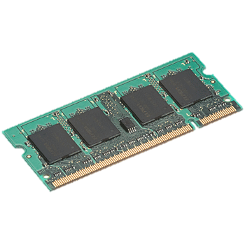
Use memory to store data
iter. 1
iter. 2
. . .
Input
query 1
one-time processing
query 2
query 3
Input
Distributed memory
. . .
10-100 times faster than the disk approach

Slide 11
Is memory computing feasible?

Slide 12
Issues
Is memory large enough to contain all the data?
How about the cost comparing to disks?
Fault-tolerance with memory?
How to represent the data in memory efficiently?
iter. 1
iter. 2
. . .
Input

Slide 13
Problem size with upper bound meet moore’s law
Problem size with upper bound
Social network
Number of human beings : 10 billion
The size of the social network topology is around 10TB
Recommendation systems
Number of users : 10 billion
Features of a user：1 million
Number of products：~100 million – 1 billion
Moore’s law is increasing the capacity of memory inside a machine exponentially
More and more problems can be fit in machine memory

Slide 14
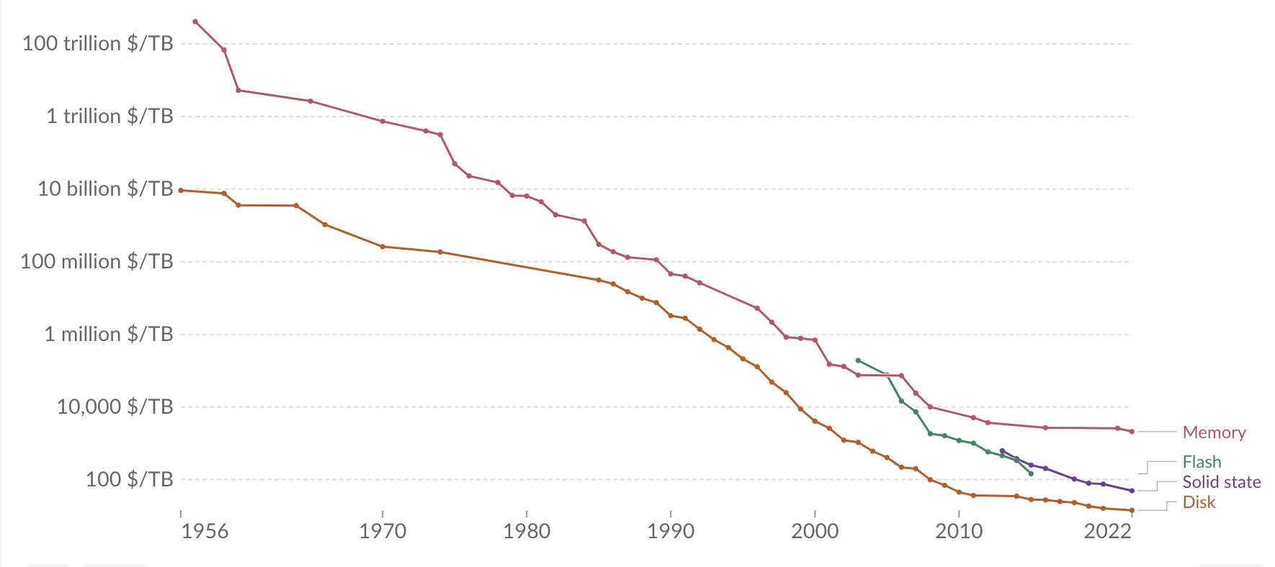
Moore’s law and memory cost
https://ourworldindata.org/grapher/historical-cost-of-computer-memory-and-storage
Notes:
DRAM costs are dropping about 32% every 12 months. Things are getting bigger, and costs are getting lower. If you looked at the price of a Dell server with a terabyte of memory three years ago, it was almost $100,000 on their internet site. Today, a server with more cores — sixteen instead of twelve — and a terabyte of DRAM, costs less than $40,000

Slide 15
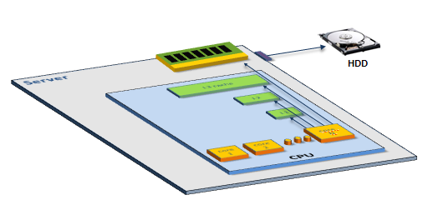
Memory latency / Bandwidth
CPU
Core
Core
L1 Cache
L1 Cache
0.5 NS
L2 Cache
L2 Cache
7.0 NS
Latency
DRAM is 100,000X faster than disks
but still is 6-200 times slower than on-chip caches
Bandwidth
1000X
L3 Cache
15.0 NS
Main Memory
100 NS, 100GB/s
Disk
SSD: 150K NS , 500 MB /s HD: 10M NS, 100MB/s
Always keep this memory hierarchy and its capacity in mind!
Source: SAP

Slide 16
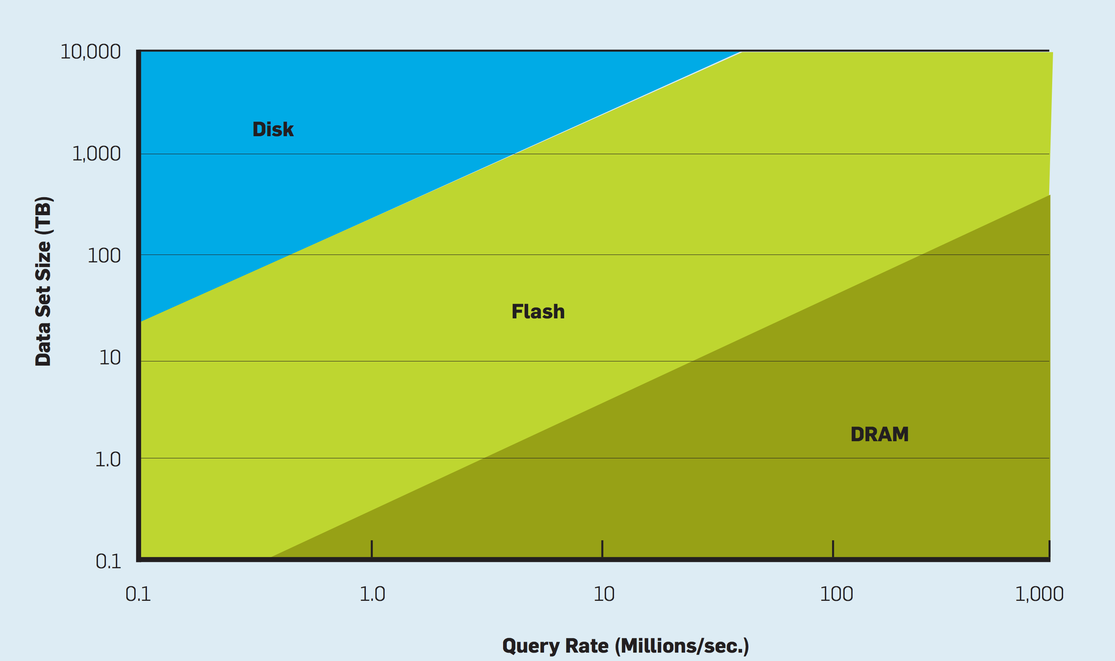
Performance/cost ratio with the data size and query rate
Notes:
3年TCO

Slide 17
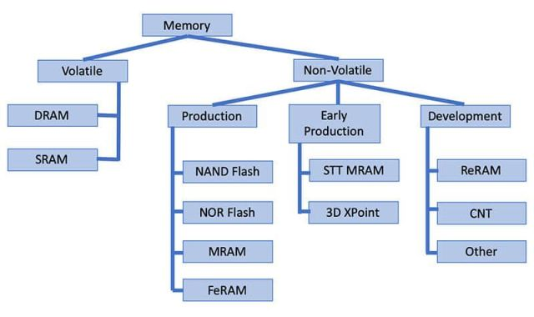
Emerging storage technologies
https://www.embedded.com/emerging-memory-technologies-ready-to-break-out/

Slide 18
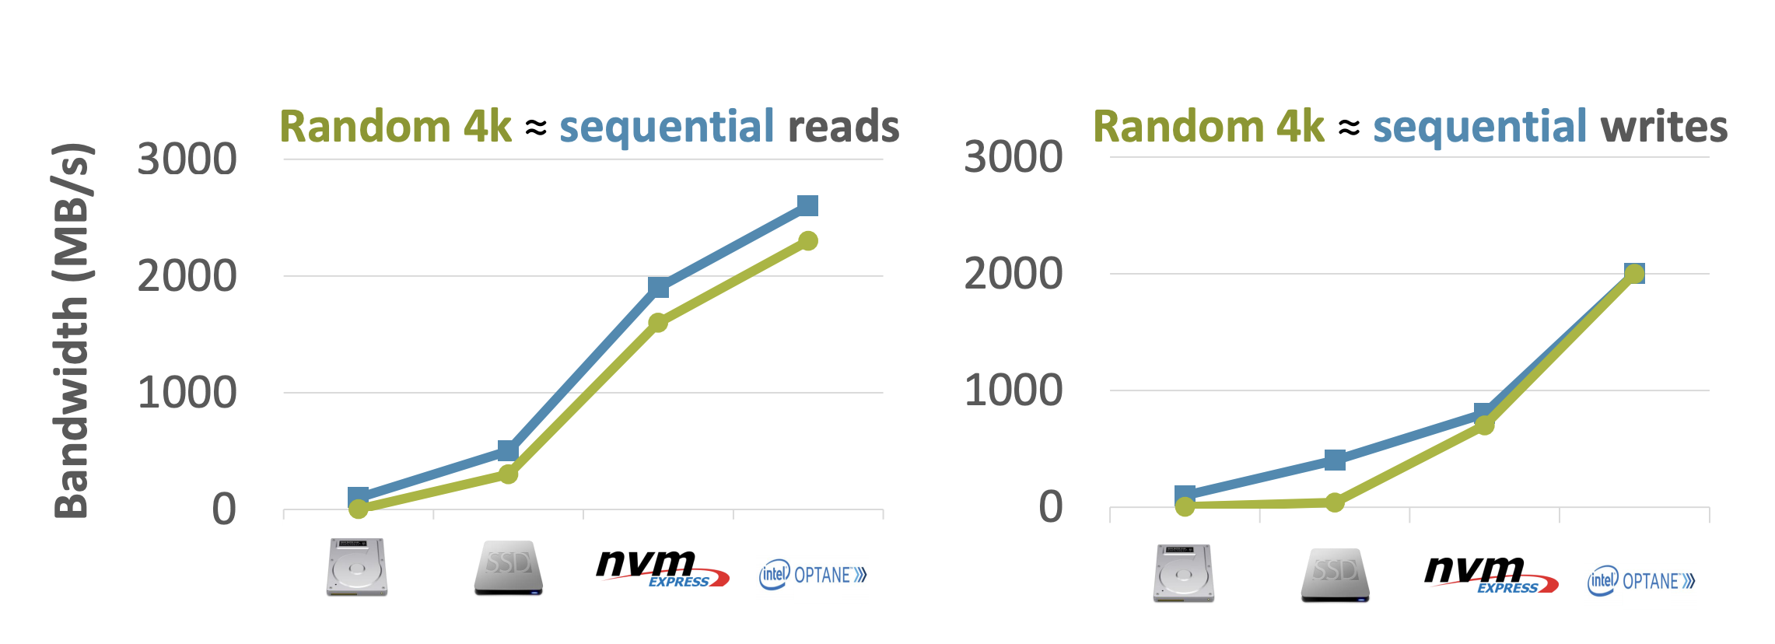
NVMe SSDs and Optane
Random Accesses are (almost) as fast as sequential accesses
https://sosp19.rcs.uwaterloo.ca/slides/lepers.pdf

Slide 19
Issues
Is memory large enough to contain all the data?
How about the cost comparing to disks?
Fault-tolerance with memory?
How to represent the data in memory efficiently?
iter. 1
iter. 2
. . .
Input

Slide 20
Dsm and distributed k-v stores

Slide 21
Two traditional abstractions
Distributed Shared Memory
Extend the virtual memory
read/write #address
Distributed KV stores
Value = Get(key)
Put(key, value)

Slide 22
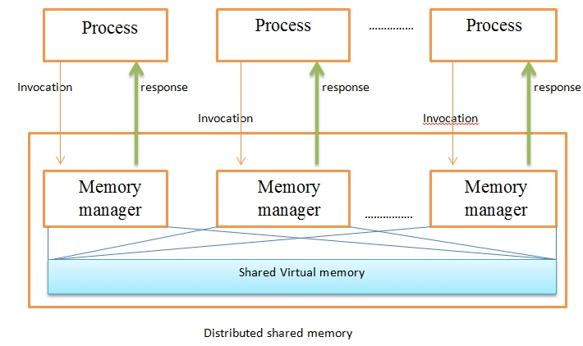
Abstractions on memory of multiple machines
Distributed Shared Memory
Unified memory space
Difficult for fault tolerance

Slide 23
Virtual Address

Slide 24
Virtual Address with page faults
4
Exception
Page fault exception handler
CPU chip
2
Cache/
memory
MMU
PTEA
Victim page
Disk
1
PTE
Processor
5
VA
3
7
New page
6
DSM can be implemented with the page fault handler: fetch data from remote machines

Slide 25
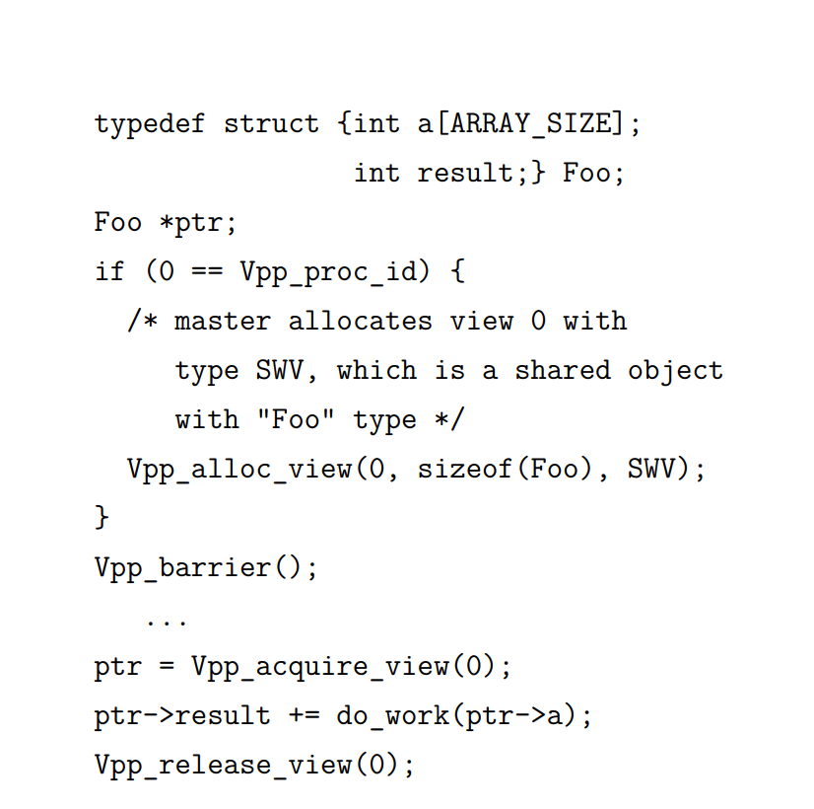
Example DSM program
How to tolerant fault in do_work
Checkpoint
More ideas?
https://ourarchive.otago.ac.nz/bitstream/10523/4065/1/LeungKaiCheung2013Ph.D.pdf
Notes:
What happens if there are fault in do_work?

Slide 26
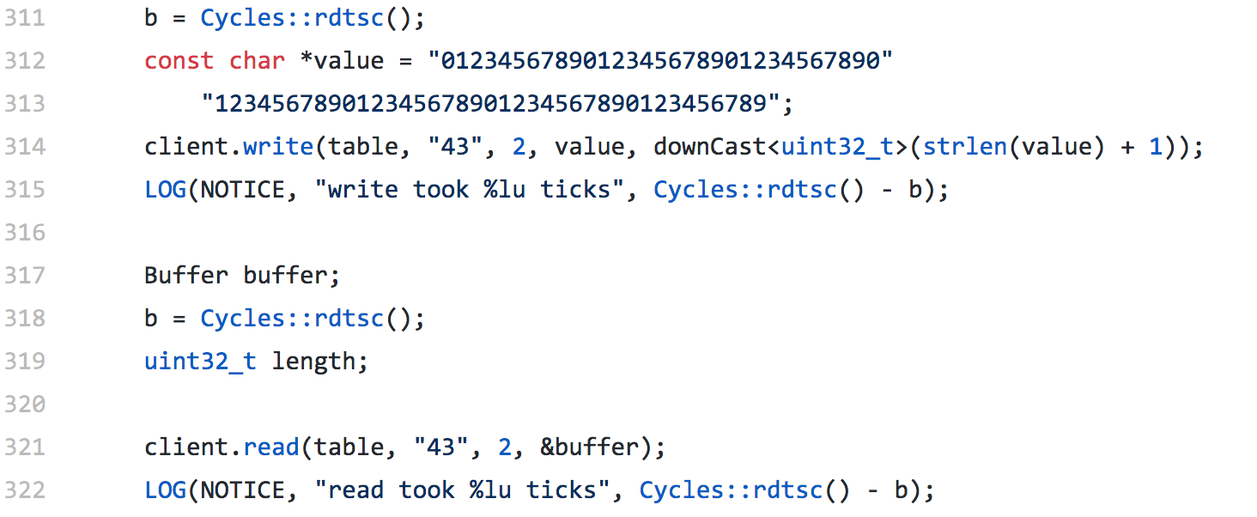
Distributed Key-Value store （Piccolo，RAMCloud)
How to tolerant fault in distributed k-v stores?
Checkpoint
Replica?
Erasure code?
https://github.com/PlatformLab/RAMCloud/blob/master/apps/ClientMain.cc

Slide 27
A Log Sample
+-------+------+--------+-------+------+--------+-------+
TID | T1 | T1 | T1 | T2 | T2 | T2 | T3 |
OLD | A=0 | B=0 | | A=100 | B=50 | | A=80 |
NEW | A=100 | B=50 | COMMIT | A=80 | B=70 | COMMIT | A=110 |
+-------+------+--------+-------+------+--------+-------+
begin // T1
A = 100
B = 50
commit // A=100; B=50
begin // T2
A = A - 20
B = B + 20
commit // A=80; B=70
begin // T3
A = A + 30 // A=110
--CRASH--

Slide 28
Five Operations Involved
Begin
Write variable
Read variable
Commit
Abort

Slide 29
Five Operations Involved
1. begin: allocate a new transaction ID
2. write variable: append an entry to the log
3. read variable: scan the log looking for last committed value
As an aside: how to see your own updates?
Read uncommitted values from your own TID

Slide 30
Read
+-------+------+--------+-------+------+--------+-------+
TID | T1 | T1 | T1 | T2 | T2 | T2 | T3 |
OLD | A=0 | B=0 | | A=100 | B=50 | | A=80 |
NEW | A=100 | B=50 | COMMIT | A=80 | B=70 | COMMIT | A=110 |
+-------+------+--------+-------+------+--------+-------+
read(log, var):
commits = {}
// scan backwards
for record r in log[len(log) - 1] .. log[0]:
// keep track of commits
if r.type == commit:
commits.add(r.tid)
// find var’s last committed value
if r.type == update and
r.tid in commits and
r.var == var:
return r.new_value
Notes:
Q: Which is a commit point?
Assumption: writing a single disk block is atomic. A partially written record is ignored.

Slide 31
Read
+-------+------+--------+-------+------+--------+-------+
TID | T1 | T1 | T1 | T2 | T2 | T2 | T3 |
OLD | A=0 | B=0 | | A=100 | B=50 | | A=80 |
NEW | A=100 | B=50 | COMMIT | A=80 | B=70 | COMMIT | A=110 |
+-------+------+--------+-------+------+--------+-------+
read(log, var):
commits = {}
// scan backwards
for record r in log[len(log) - 1] .. log[0]:
// keep track of commits
if r.type == commit:
commits.add(r.tid)
// find var’s last committed value
if r.type == update and
（r.tid in commits or r.tid == current_tid) and
r.var == var:
return r.new_value
Notes:
Q: Which is a commit point?
Assumption: writing a single disk block is atomic. A partially written record is ignored.

Slide 32
Five Operations Involved
4. Commit: write a commit record
Expectedly, writing a commit record is the "commit point" for action, because of the way read works (looks for commit record)
However, writing log records better be all-or-nothing
One approach, from last time: make each record fit within one sector
5. Abort: Do nothing or write a record?
Could write an abort record, but not strictly needed
Recover from a crash: do nothing

Slide 33
Performance Problem of Log-only Approach
Write performance is probably good
Sequential writes, instead of random
Need to write to disk twice instead of once
Read performance is terrible!
Scan the log for every read!
Recovery is instantaneous
Nothing to do

Slide 34
Performance Optimization
Keep both a log and cell storage
Log as before: authoritative, provides all-or-nothing atomicity
Cell storage: provides fast reads, but cannot provide all-or-nothing
Both are stored on disk
Terminology
"log" an update when it's written to the log
"install" an update when it's written to cell storage
Notes:
[ board: log, cell storage; updates going to both, read from cell storage ]

Slide 35
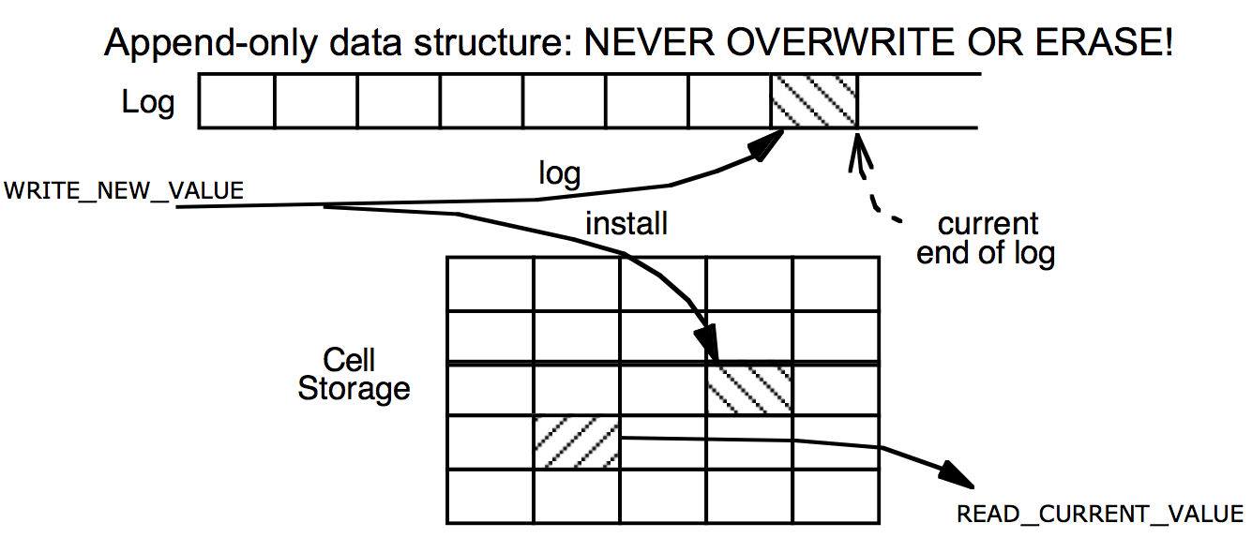
Use cell-storage

Slide 36
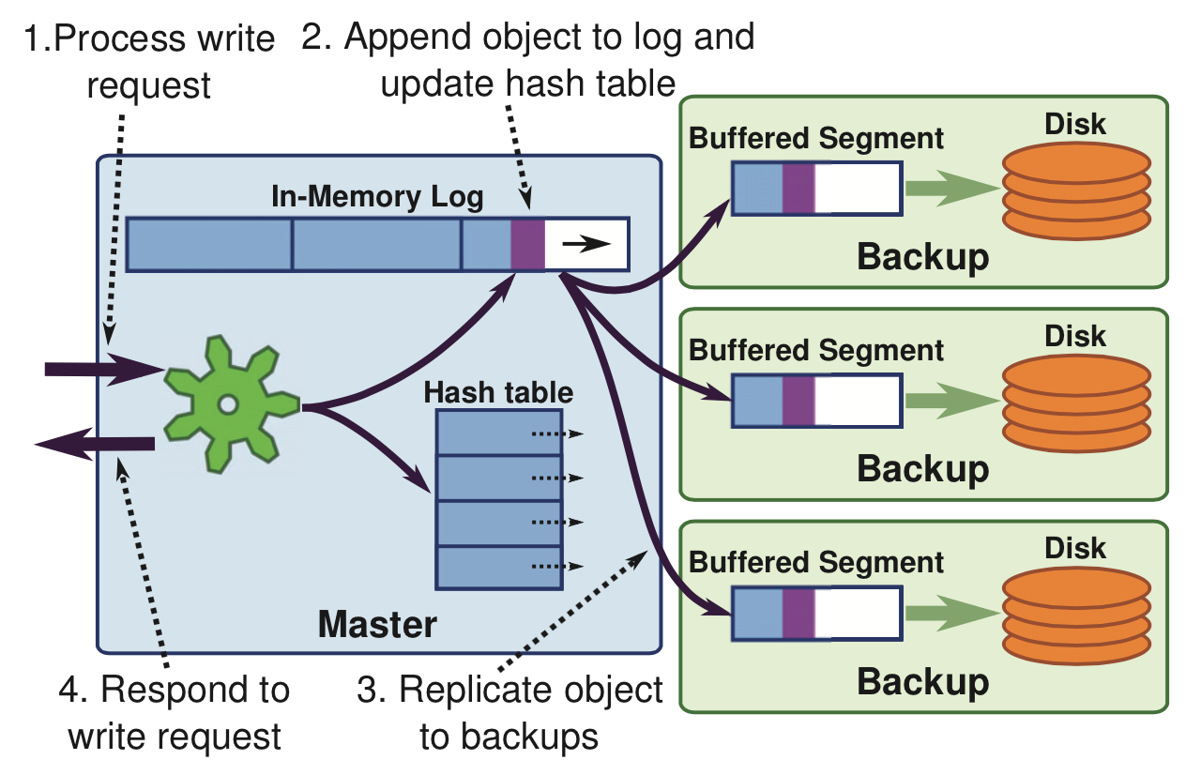
RAMCloud Approach: Buffered Logging
Notes:
Optimization: Log truncate and memory sharding

Slide 37
Fault tolerance mechanism of DSM or Key-value stores
Replica
High cost
Big time overhead
Log
Big time overhead
Remote memory access
10-100 times slower than local memory accesses
1-10us vs 100ns
A more lightweight fault tolerance mechanism for in-memory computing is desired

Slide 38
Abstraction of rdd

Slide 39
Solution
RDD（Resilient Distributed Datasets ）
Based on data sets, instead of single data
Generated with deterministic coarse grained operations（map，filter，join etc.）
Immutable
To modify data, create new datasets by transformation

Slide 40
Efficient Fault Tolerance
Once the data is generated deterministically, and immutable
Recover the data from “recompute”
Only need to log the sequences to generate rdd. small cost if there’s no fault happens
messages = textFile(...).filter(_.contains(“error”))
.map(_.split(‘\t’)(2))
HadoopRDD
path = hdfs://…
FilteredRDD
func = _.contains(...)
MappedRDD
func = _.split(…)
Notes:
只要记住rdd的生成过程就可以了，这样一次log可以用于很多数据，在不出错的时候几乎没有开销
2 means get the second column

Slide 41
Big data systems
Programming
Model
Fault
Tolerance
Performance/
Cost

Slide 42
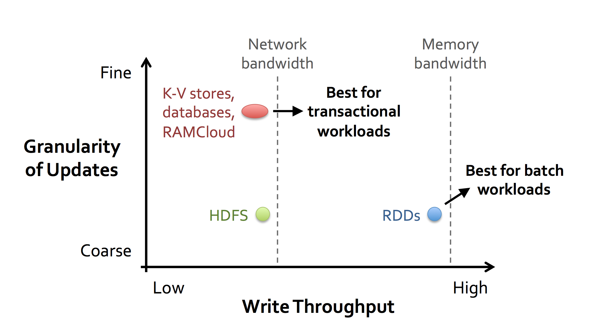
Spark Design Philosophy

Slide 43
Spark programming interface

Slide 44
Programming API
Based on Scala
A Java-like functional language
Can use spark in the Scala concole
Now support Java and Python
RDD operations
Transformation：generate new RDDs from existing RDDs
map, filter, groupBy, sort,distinct, sample…
Action: return a value from RDD
reduce，count, collect, first, foreach…，,

Slide 45
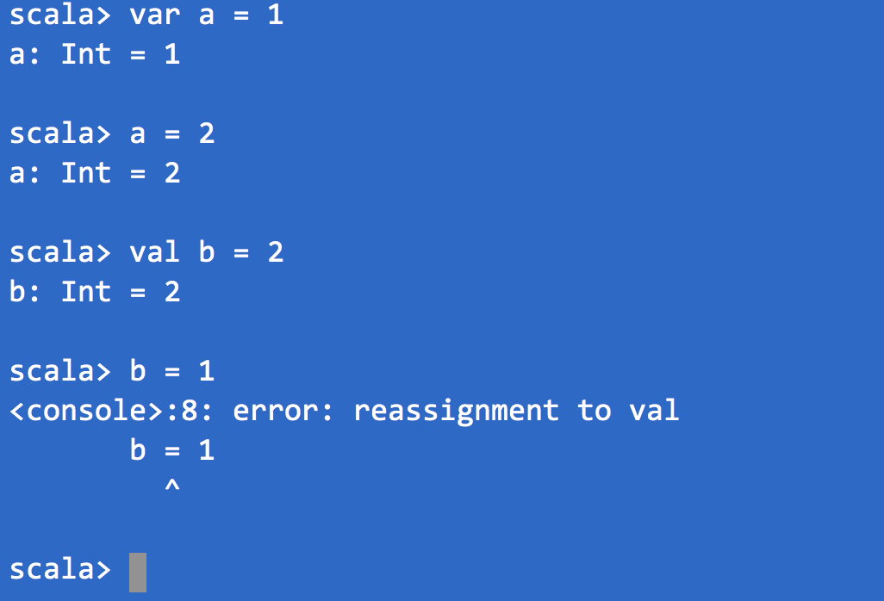
Scala Expressions
Expressions and values
var a = 1 //Mutable
val b = 2 // Immutable

Slide 46
Scala - Functions
def helloWord()={ println(“Hello World”)}
def addOne(x:Int) = {
x+1
}
def addOne(x:Int) = x+1
val addOne = (x:Int) => x + 1

Slide 47
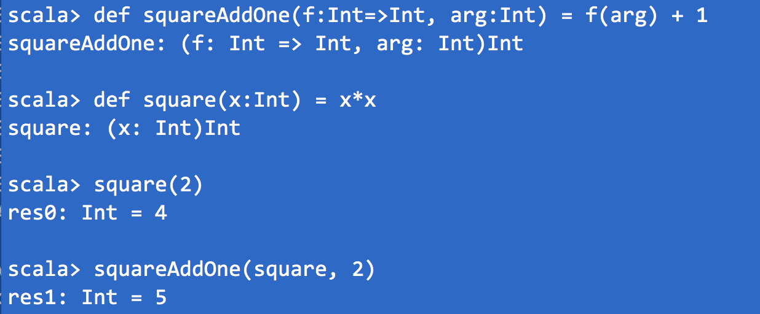
Scala Functions
Pass a function as a parameter

Slide 48
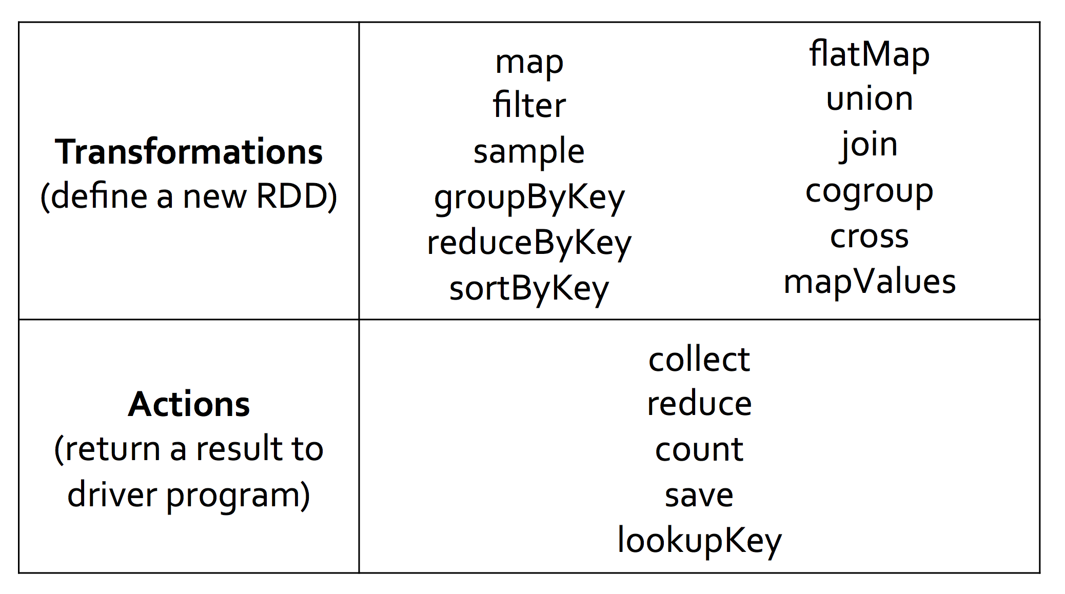
Spark Operators
http://spark.apache.org/docs/latest/programming-guide.html#rdd-operations
Notes:
FlatMap 即每一项可能返回多个同一类型的值

Slide 49
How to create RDDs
From Collection
val a = sc.parallelize(1 to 9, 3)
from File val b = sc.textFile(“/path/to/file”)
from other RDDs val c = b.map(line => line.split(“,”))
Notes:
Parallelize is a spark method to form a distributed dataset , 3 is the number of partitions

Slide 50
Map
Map each element in source RDD to ONE element in destination RDD
scala> val a = sc.parallelize(1 to 9, 3)
^{scala> val b = a.map(x => x*2)}
^{scala> a.collect}
res10: Array[Int] = Array(1, 2, 3, 4, 5, 6, 7, 8, 9)
^{scala> b.collect}
res11: Array[Int] = Array(2, 4, 6, 8, 10, 12, 14, 16, 18)

Slide 51
flatMap
One element in source rdd will be transformed to multiple elements(0..n) in destination rdd
scala> val a = sc.parallelize(1 to 4, 2)
scala> val b = a.flatMap(x => 1 to x)
^{scala> b.collect}
res0: Array[Int] = Array(1, 1, 2, 1, 2, 3, 1, 2, 3, 4)

Slide 52
reduce
Defines a function to combine two elements in a collection to one elements, and keep on applying it to elements in the collection
scala> val c = sc.parallelize(1 to 10)
scala> c.reduce((x, y) => x + y)
^{res4: Int = 55}

Slide 53
reduceByKey
Reduce for key-value list
Values with the same keys are reduced, and form a new key-value
scala> val a = sc.parallelize(List((1,2),(3,4),(3,6)))
scala> a.reduceByKey((x,y) => x + y).collect
res7: Array[(Int, Int)] = Array((1,2), (3,10))

Slide 54
Output
saveAsTextFile/saveAsSequenceFile/saveAsObjectFile
scala> val a = sc.parallelize(List((1,2),(3,4),(3,6)))
scala> a.reduceByKey((x,y) => x + y).saveAsTextFile(“test”)

Slide 55
Join
(k,v1) join (k, v2) ➔ (k, (v1, v2))
scala> val kv1=sc.parallelize(List((“A”,1),(“B”,2),(“C”,3)))
scala> val kv3=sc.parallelize(List((“A”,4), (“A”,5),(“B”,3),(”D”,30)))
^{scala> kv1.join(kv3).collect}
^{scala> kv1.union(kv3).collect}
Array[(String, (Int, Int))] = Array((A,(1,4)), (A,(1,5)),(B,(2,3)))
Array((A,1), (B,2), (C,3), (A,4), (A,5), (B,3), (D,30))

Slide 56
Use of _
^{val a = ( 1 to 9 )}
^{Val b = a.map( x => x*2 )}
is the same as val b = a.map( _ * 2)
val a = sc.parallelize(List((1,2),(3,4),(3,6))) a.reduceByKey((x,y) => x + y).collect is the same as a.reduceByKey(_+_).collect

Slide 57

Log Mining
Loading data from memory, than query the data interactively
Base RDD
Cache 1
lines = spark.textFile(“hdfs://...”)
errors = lines.filter(_.startsWith(“ERROR”))
messages = errors.map(_.split(‘\t’)(2))
cachedMsgs = messages.cache()
Transformed RDD
Worker
results
tasks
Block 1
Driver
Action
cachedMsgs.filter(_.contains(“foo”)).count
cachedMsgs.filter(_.contains(“bar”)).count
Cache 2
Worker
. . .
Cache 3
Performance: 1TB data with in 5-7 seconds
Disks: 170s
Worker
Block 2
Block 3
Notes:
Add “variables” to the “functions” in functional programming

Slide 58
Logistic Regression
val data = spark.textFile(...).map(readPoint).cache()
var w = Vector.random(D)
for (i <- 1 to ITERATIONS) {
val gradient = data.map(p =>
(1 / (1 + exp(-p.y*(w dot p.x))) - 1) * p.y * p.x
).reduce(_ + _)
w -= gradient
}
println("Final w: " + w)
Load data in memory once
Initial parameter vector
Repeated MapReduce steps to do gradient descent
Notes:
Key idea: add “variables” to the “functions” in functional programming

Slide 59
Logistic Regression Performance
127 s / iteration
first iteration 174 s
further iterations 6 s
Notes:
This is for a 29 GB dataset on 20 EC2 m1.xlarge machines (4 cores each)

Slide 60
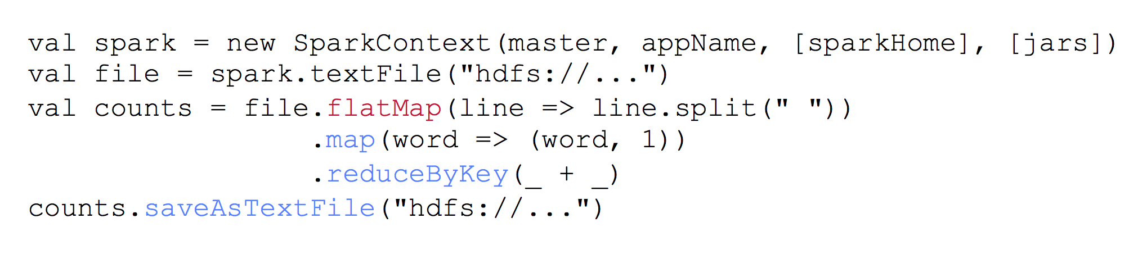
Example：WordCount
Notes:
flatMap，将一个成员映射为0个到多个成员
（word,1)是个键值对

Slide 61
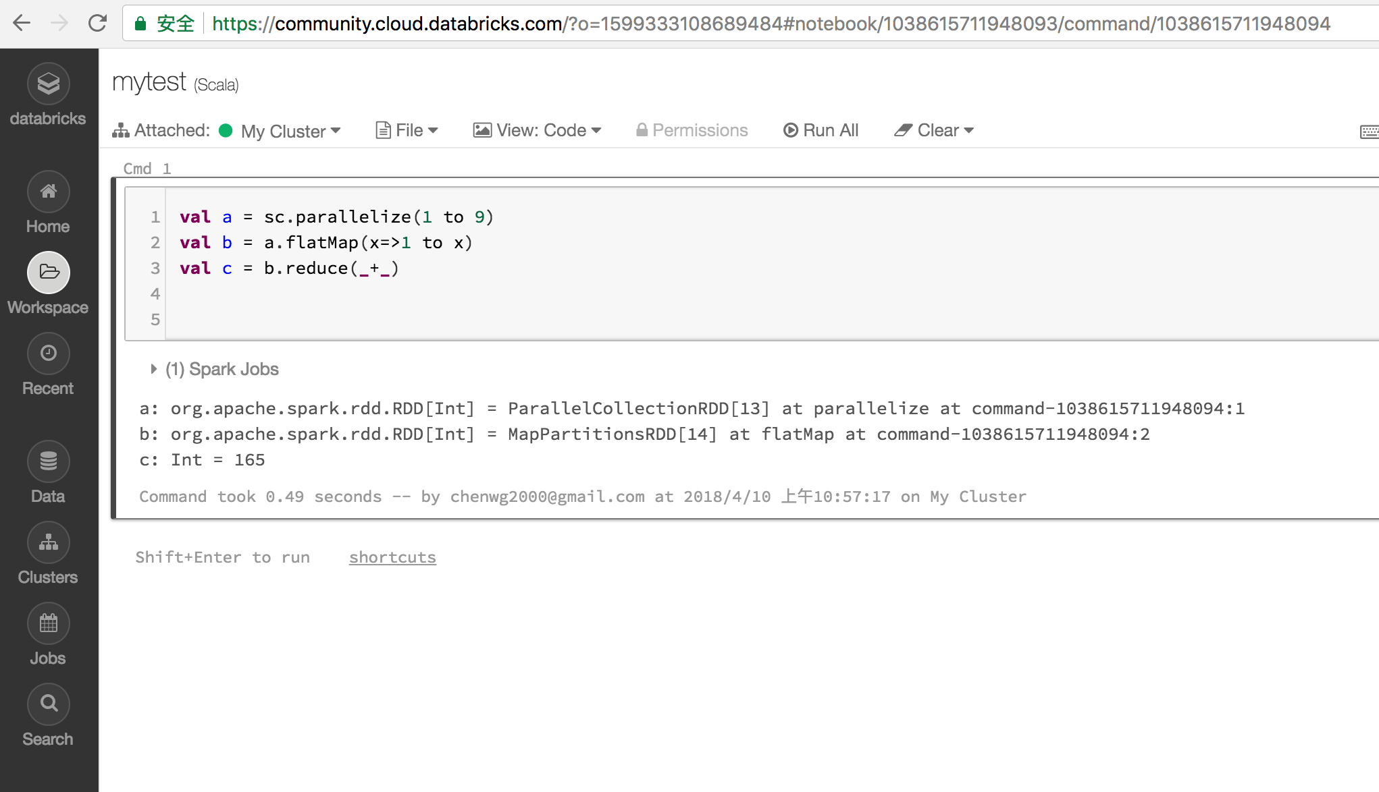
Learn Spark
https://community.cloud.databricks.com

Slide 62
Conclusion
In-memory computing for high performance
But fault-tolerance is a big issue
Replica, checkpointing and logging are all expensive
RDD is a model for low-overhead fault-tolerance
Deterministic transformation on datasets
Recompute in addition to state storage

Slide 63
Thanks!

