Slide 1

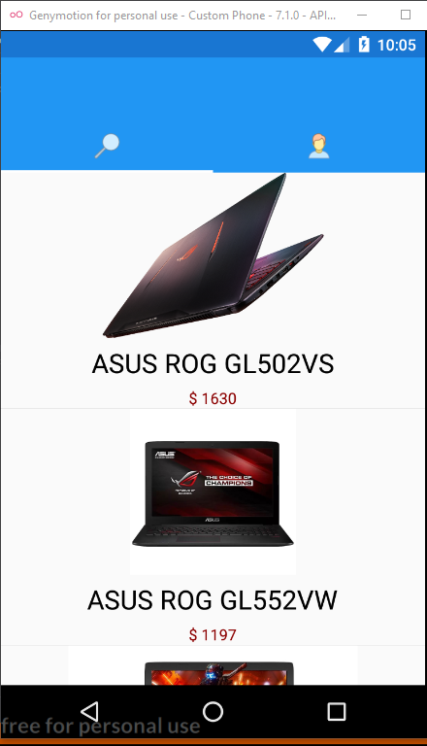
tekVan
Need new laptop? We’re here

Slide 2
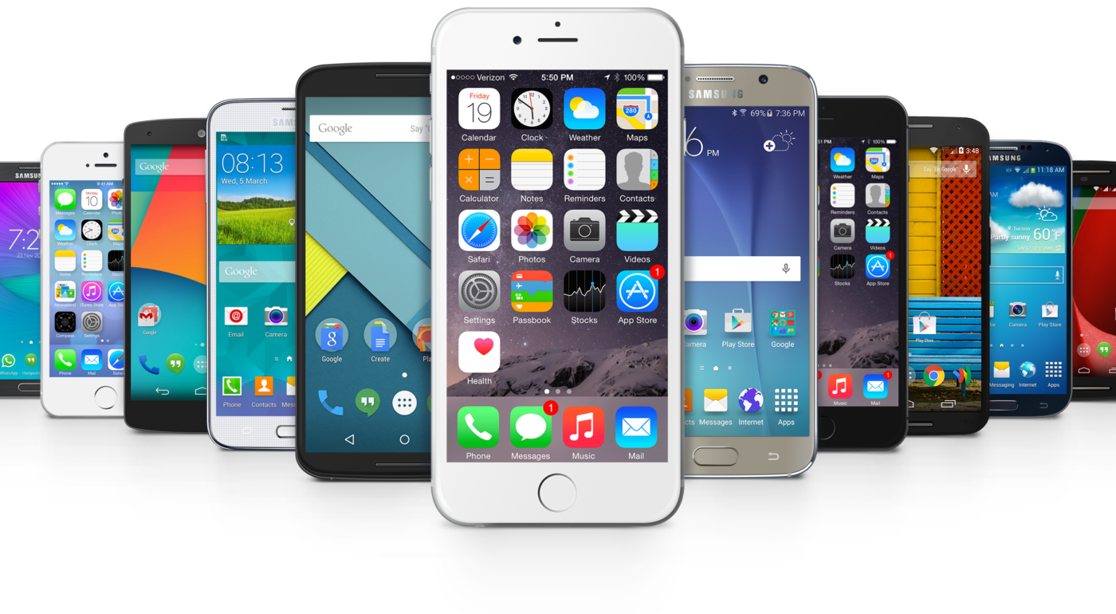


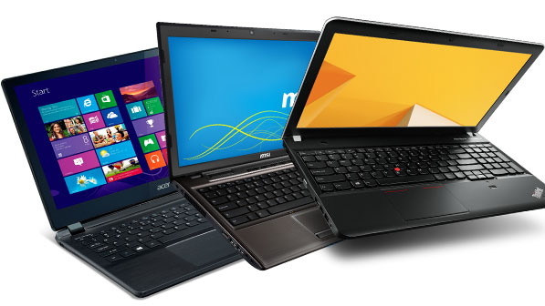
What is tekVan?
Notes:
tekVan is an application sells and delivers laptops in both iOS and Android platforms.
tekVan stands for Technology Van (Truck). Our application itself is a truck. This truck contains many kinds of laptops inside it and every time you click the order button, we roll our wheels to your house.

Slide 3
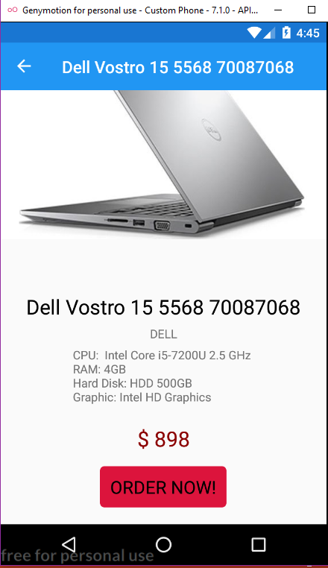
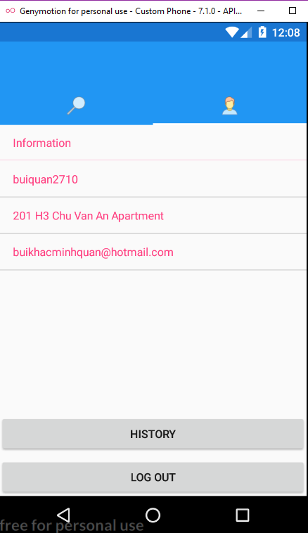
Why you choose tekVan?
tekVan is a minimalism selling app.
tekVan brings your dream laptop to your front door without making you move any step.
We includes tons of promotion in every laptop in every month, every year.
All you have to do, is logging in, looking for your “baby” and pressing that “Order” button, we will carry everything from there for you.

Slide 4
Main Functions
Show Products
Login
Sign Up
Product Details
Order Products
Show History

Slide 5
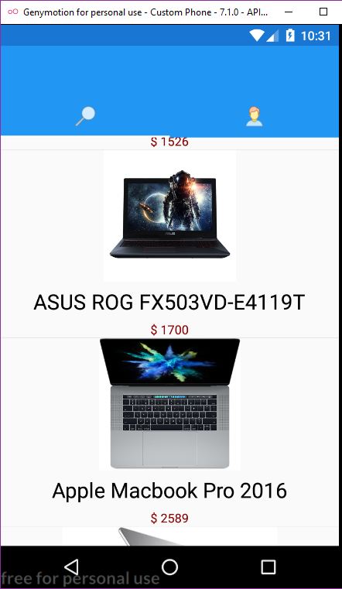
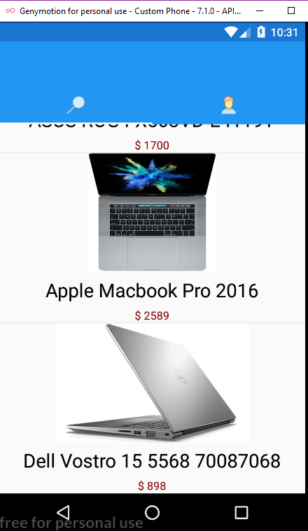
Show Products (ShowRoom.xaml)
Using hard code to insert these products
Pictures are from websites

Slide 6
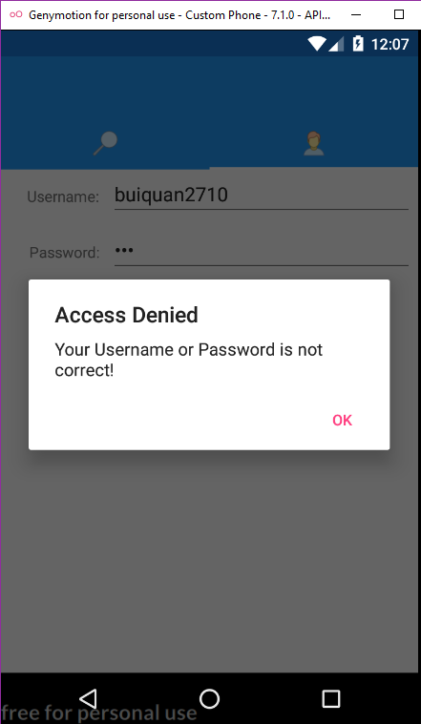
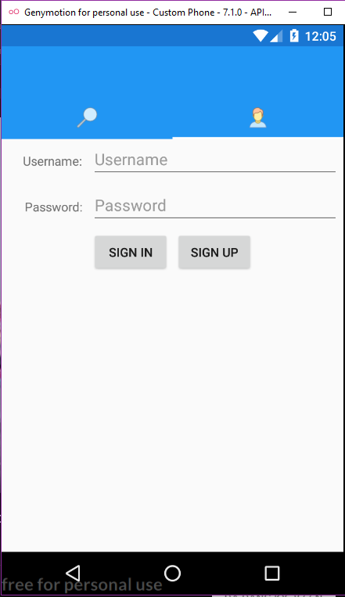
Login & Profile (Profile.xaml)
Login to your account to order or check your information
Sign Up to register new account

Slide 7
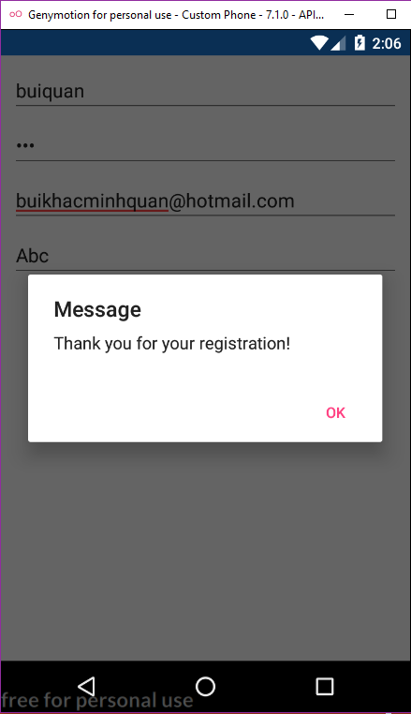
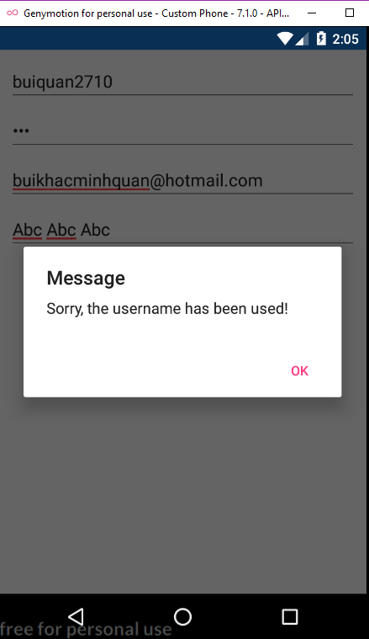
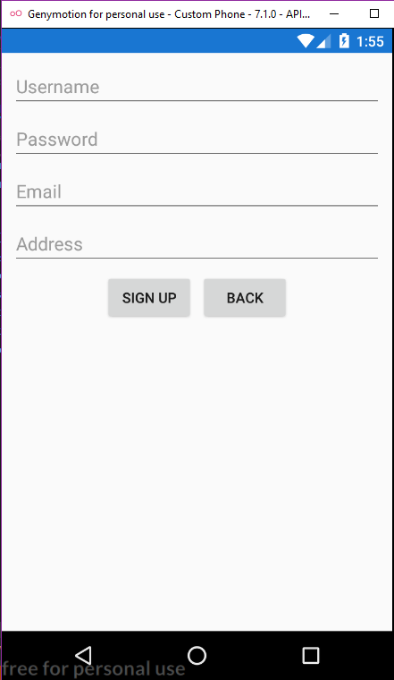
SignUp.xaml
Entry Username, Password, Email, Address for new account.
Check Validation Username

Slide 8
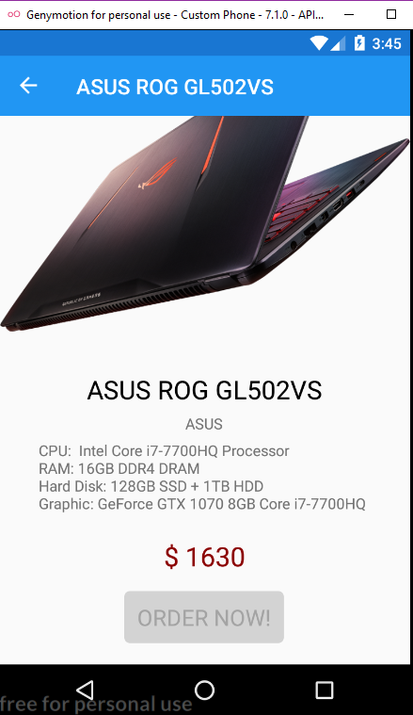
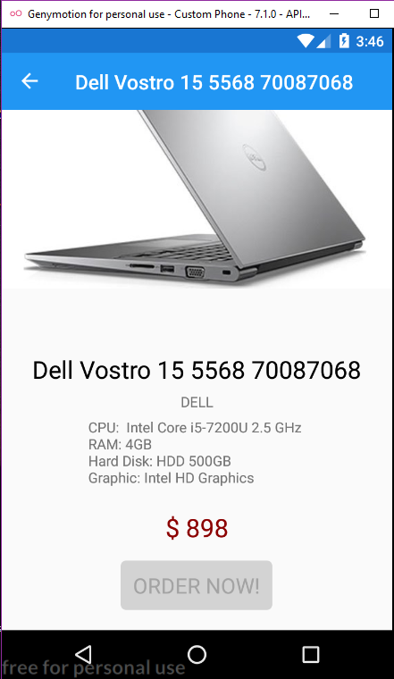
Product Details (Detail.xaml)
Look for the Price, RAM, CPU, Graphic Card inside a laptop
Make an order

Slide 9
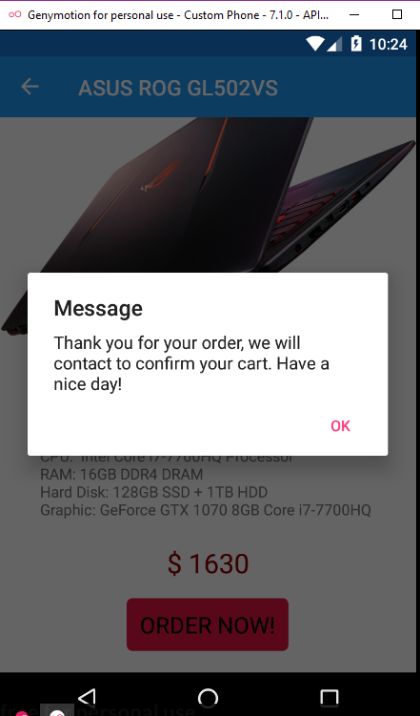
Order Product
After user click that “Order Now” button, order will be made, ready to deliver.

Slide 10
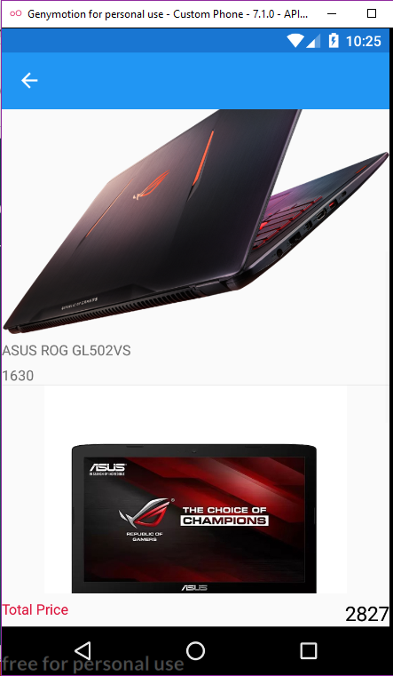
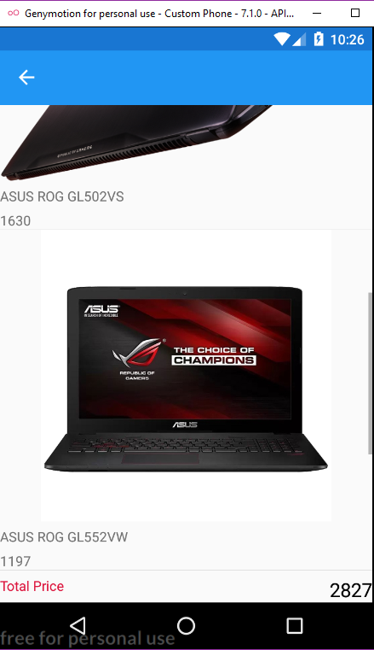
Show History
Check your cart and money you will have to pay

Slide 11
Who made this?
Me, of course lol.
This is my idea according to a buying-new-laptop trip for Jun.

Slide 12

Thank you for having patient with my presentation without falling into sleep. Really appreciate that!!!.

