Slide 1




Data Engineering Assessment Solution Proposal
By: Rajata Utensute (Pian)
Date: 3rd of May 2024

Slide 2



General Overview
Goal
Tools
Solution Workflow
The Pipelines

Slide 3
Assessment Goals
In a low code manner:
Combine the files using Azure Data Factory (ADF)
Create a usable dataset using ADF
Perform ad-hoc analyses using SQL querying

Slide 4
Tools
Microsoft Azure: Azure Data Factory
Azure Data Studio
No Python

Slide 5
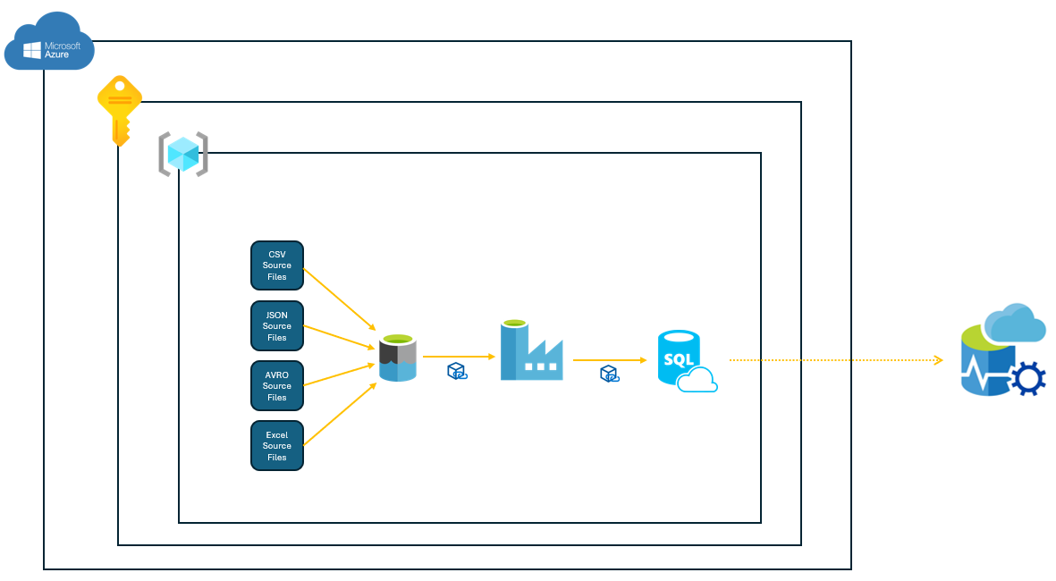
Solution Workflow

Slide 6
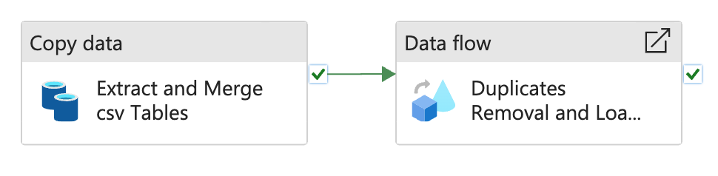
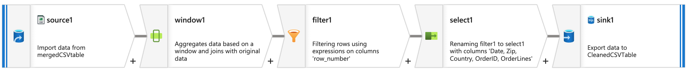
The Pipelines In ADF

Slide 7

Check - Out

