Slide 1
Data Engineering Assessment Solution
By: Pian

Slide 2
Table of Contents
Goal
Tools
Solution Workflow
Remarks when creating the resources

Slide 3
Goal
In a low code manner:
Combine the files using Azure Data Factory (ADF)
Create a usable dataset using ADF
Perform analyses using SQL querying

Slide 4
Tools
Azure Data Factory
Azure Data Studio

Slide 5
Solution Workflow

Slide 6






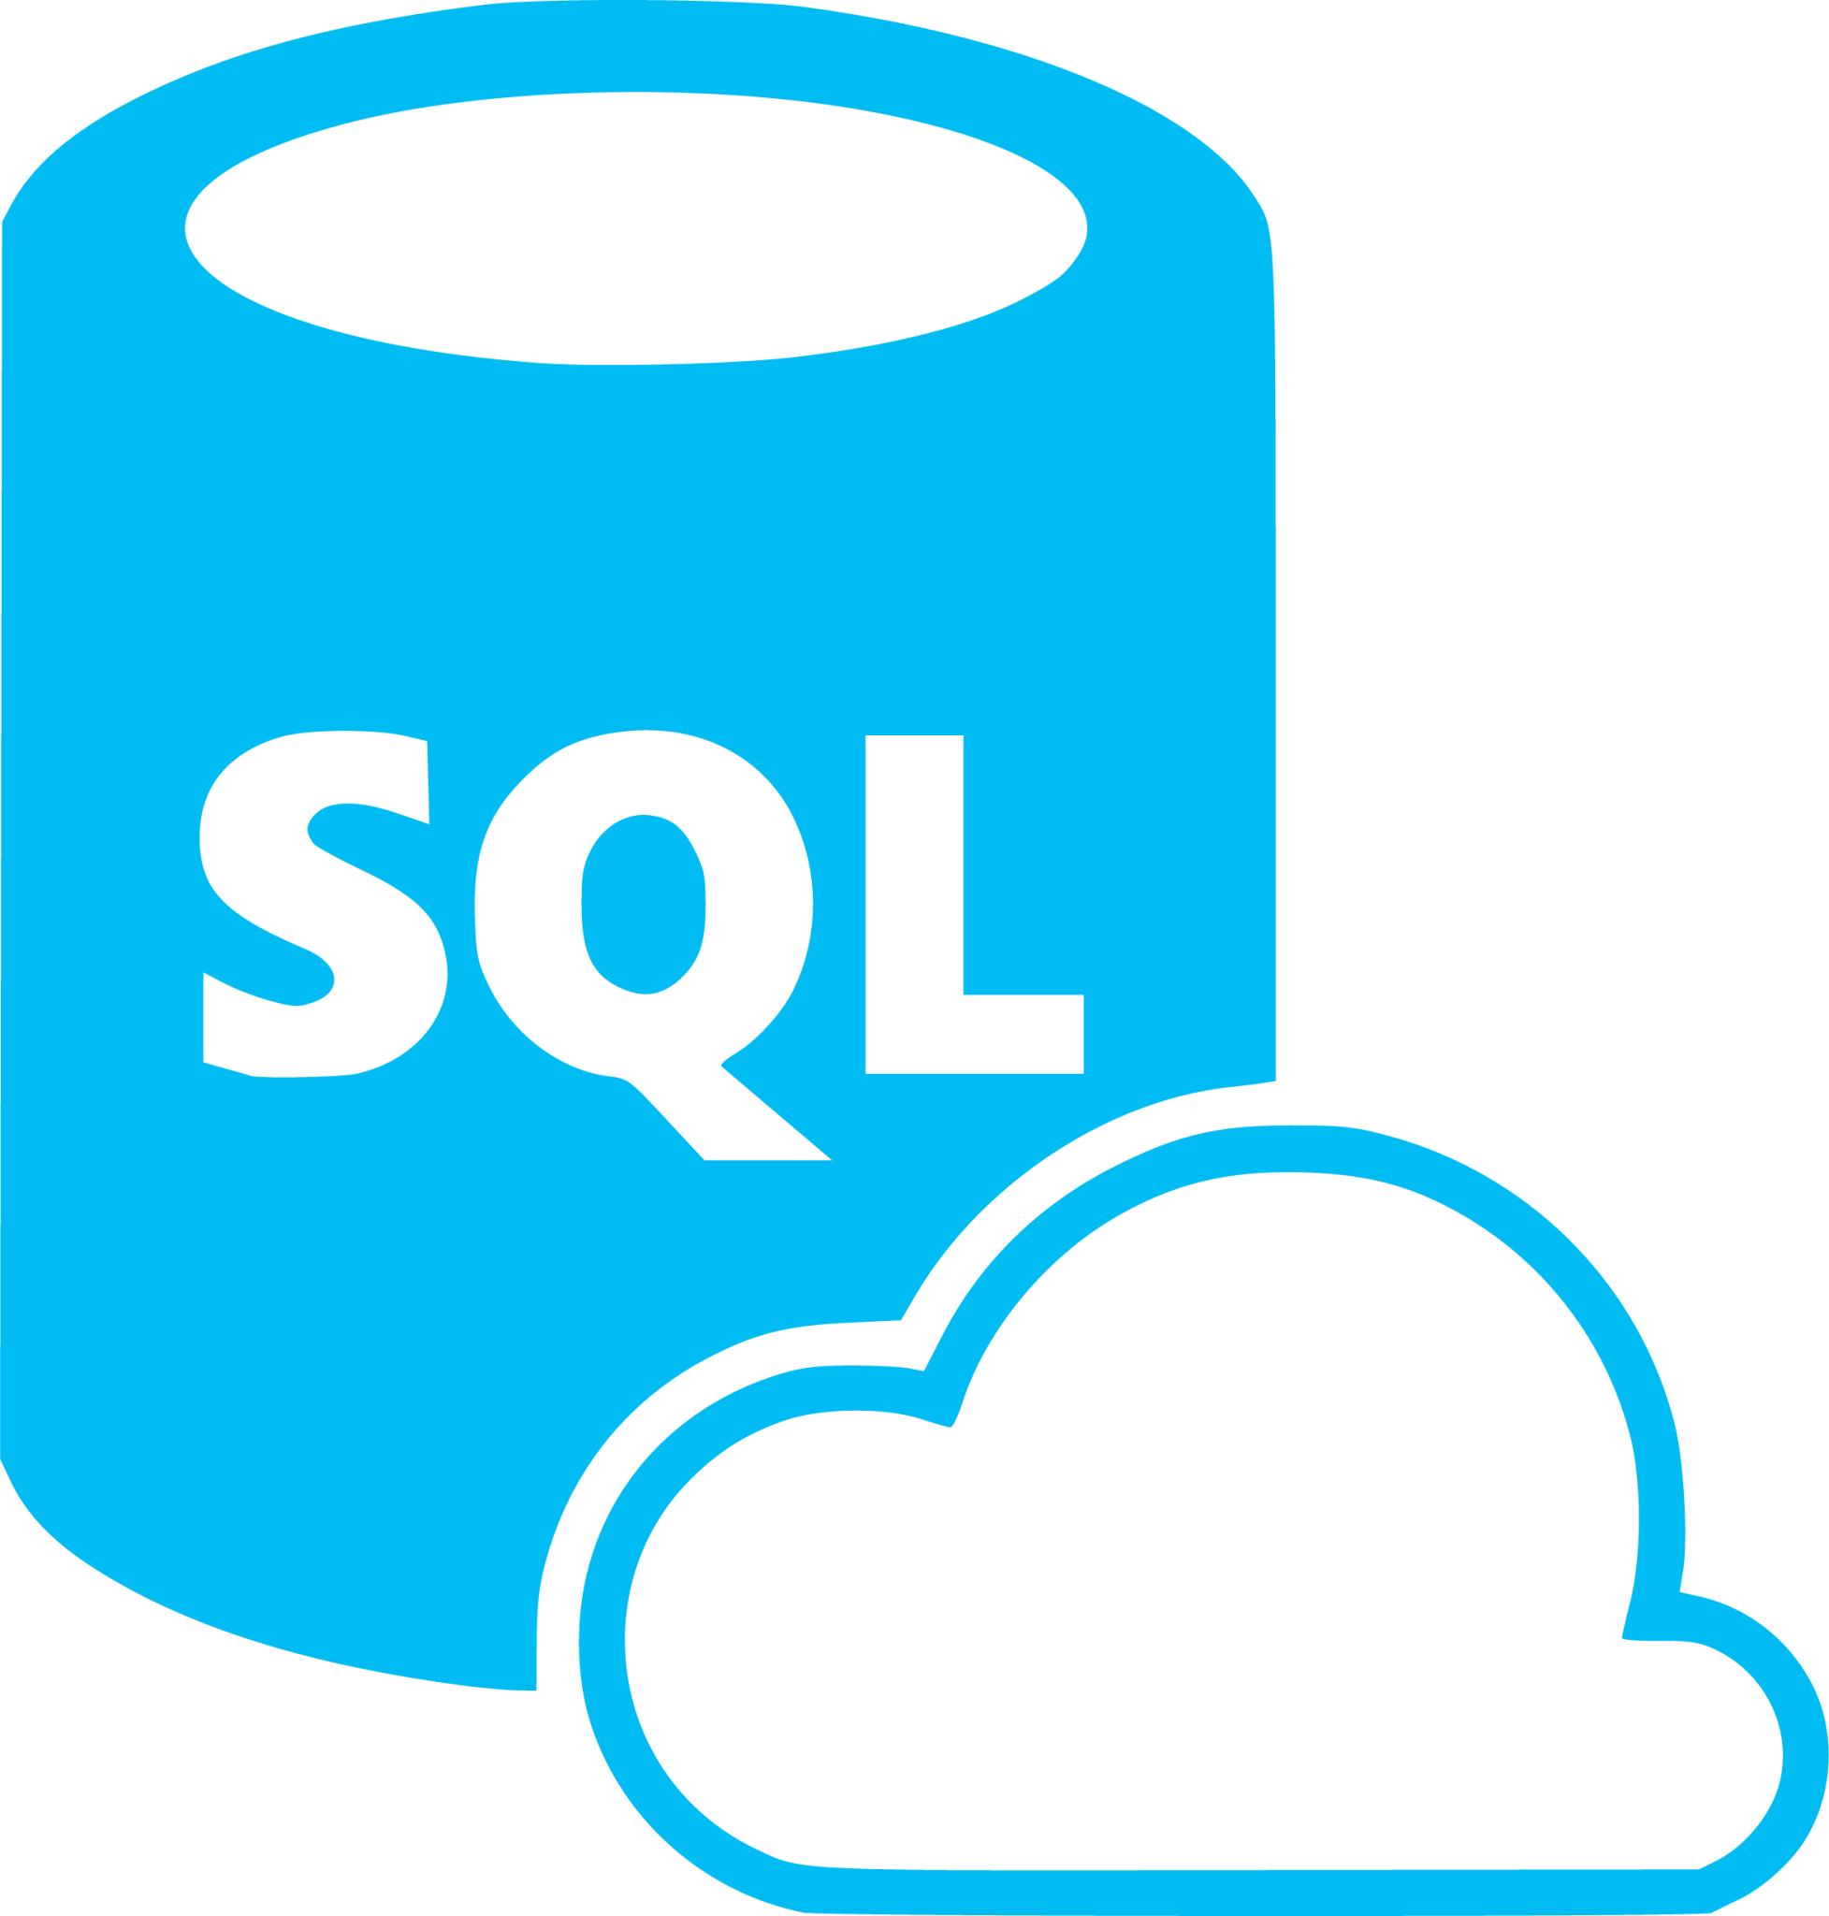

CSV
Source Files
JSON
Source Files
AVRO
Source Files
Excel
Source Files
Notes:
The hierarchy:
Azure portal
Azure subscription
Resource group
Services within the resource group

Slide 7
Create the resource group
An organizational container for storing all the relevant resources.
Create necessary Azure resources
Storage Account: to store raw data files
SQL Database: host the final transformed data combined dataset for further analyses
Azure Data Factory: for managing data flows from ingestion through transformation to loading data into the SQL Database
Upload the data files
Upload the relevant files within the Azure Storage Account.
Setup Azure Data Factory
Create Linked Services: establish connections to Azure Storage Account and Azure SQL Database.
Create Datasets: define the structure of my data sources and destinations.
Create Pipelines:
build data flows to ingest, cleanse, transform, and merge datasets.
move the final dataset into the SQL Database.
Querying the data
Connect SSMS to the Azure SQL Database using the database connection string from the Azure SQL Database.
Execute SQL queries to analyze the data accordingly.

Slide 8
Issues when creating the resources

Slide 9
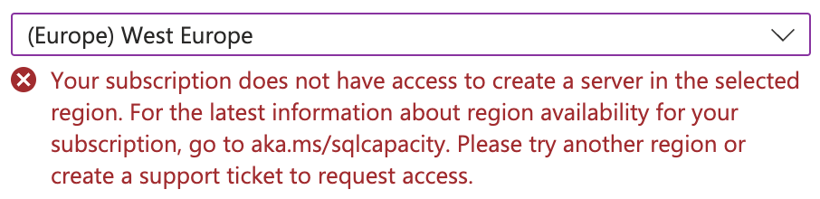
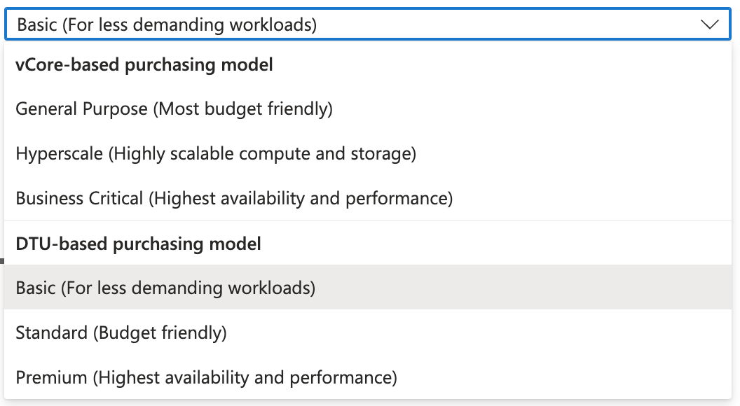
Notes:
Region issues:
Boy mentioned that we usually use West Europe as the region, therefore I set the resources to west region to europe when I can.
However, with the student subscription that I am using, I am not able to select west europe as the region when creating the SQL server, as a result, North Europe is selected instead, so as the SQL database.
Compute configuration:
I have opted for the cheapest compute configuration when creating the SQL Database.
Other notes

