Slide 1
Data Engineering Assessment Solution
By: Pian

Slide 2
Table of Contents
Goal
Tools
Solution Workflow
Remarks when creating the resources
Region
SQL Database compute configuration
Blob storage vs. Data lake
Data ingestion to ADF

Slide 3
Goal
In a low code manner:
Combine the files using Azure Data Factory (ADF)
Create a usable dataset using ADF
Perform analyses using SQL querying

Slide 4
Tools
Azure Data Factory
Azure Data Studio
Notes:
I opted for Azure Data Factory because this tool is primarily focused on data integration and processing, which is ideal for ETL/ELT workflows.
ETL = Extract Transform Load,
ELT = Extract Load Transform

Slide 5
Solution Workflow

Slide 6





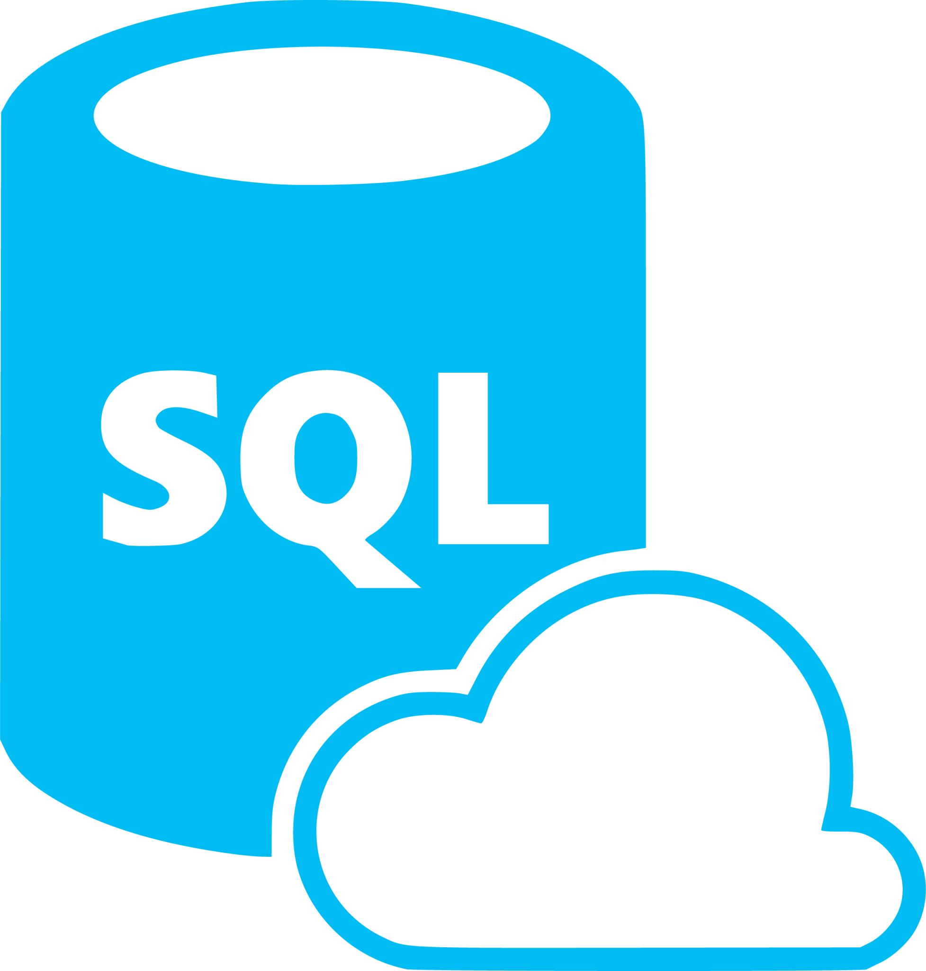


CSV
Source Files
JSON
Source Files
AVRO
Source Files
Excel
Source Files
Notes:
The hierarchy:
Azure portal
Azure subscription
Resource group
Services within the resource group
Storage account (data lake) within the resource group
Linked service to define the connection information needed for ADF to connect to the data lake
ADF
Linked service to define the connection information needed for ADF to connect to the SQL Database/SQL Server
Azure Data Studio/SQL Server Management Studio for further data analyses through SQL querying

Slide 7
Create the resource group
An organizational container for storing all the relevant resources.
Create necessary Azure resources
Storage Account: to store raw data files
SQL Database: host the final transformed data combined dataset for further analyses
Azure Data Factory: for managing data flows from ingestion through transformation to loading data into the SQL Database
Upload the data files
Upload the relevant files within the Azure Storage Account.
Setup Azure Data Factory
Create Linked Services: establish connections to Azure Storage Account and Azure SQL Database.
Create Datasets: define the structure of my data sources and destinations.
Create Pipelines:
build data flows to ingest, cleanse, transform, and merge datasets.
move the final dataset into the SQL Database.
Querying the data
Connect SSMS to the Azure SQL Database using the database connection string from the Azure SQL Database.
Execute SQL queries to analyze the data accordingly.

Slide 8
Remarks when creating the resources

Slide 9
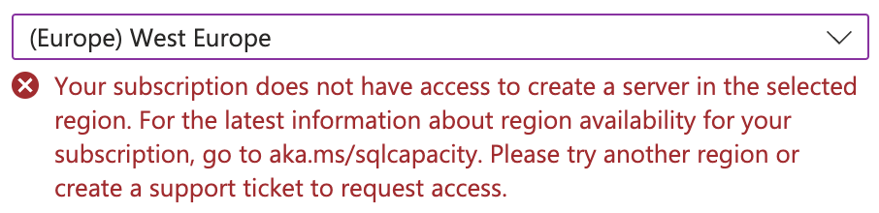
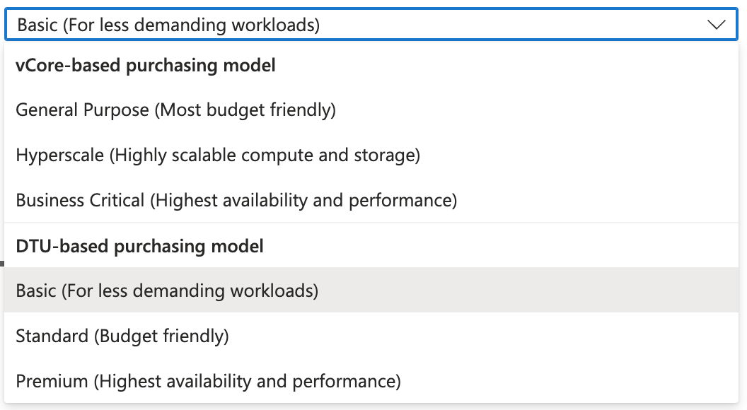
Notes:
Region issues:
Boy mentioned that we usually use West Europe as the region, therefore I set the resources to west region to europe when I can.
However, with the student subscription that I am using, I am not able to select west europe as the region when creating the SQL server, as a result, North Europe is selected instead, so as the SQL database.
Compute configuration:
I have opted for the cheapest compute configuration when creating the SQL Database.
Other notes

Slide 10
Blob Storage vs. Data Lake

Slide 11
Data Ingestion into ADF

Slide 12
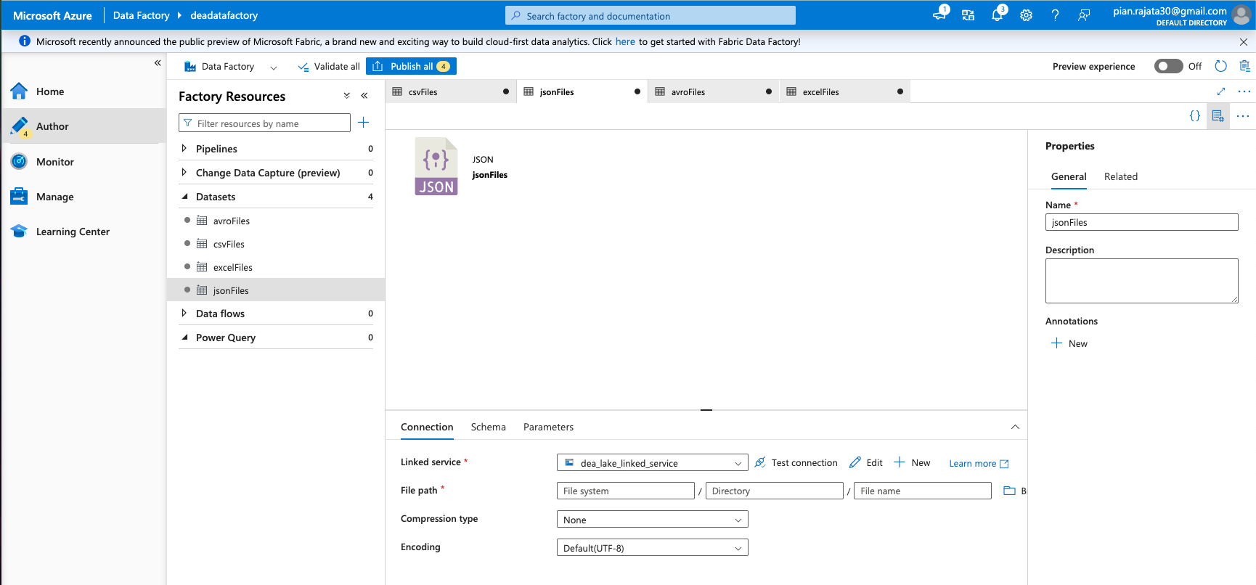
Notes:
For each dataset, I add parameters to make them flexible. For example, parameteres can be used to dynamically change file paths, file names, or file types based on runtime inputs.

Slide 13
Notes:
Without cleaning just yet:
1. Create a dataset called “csvFiles” that has a connection to the container stored in the data lake with the appropriate linked service
2. Create a new pipeline where the first step would be a “Copy data” activity named “Extract and Merge csv Tables” that would extract all the relevant csv files that was loaded into the csvFiles data set, merge them, and sink it to a table in SQL Database. This means that I have to create a new empty table first in SQL Database that will store the results of the transformed csv table, json table, and avro table.
Why use copy data activities?
It is designed for data movement between different data stores, making it suitable for ingesting data files from a dataset and store it in a target data set.

Slide 14
The Pipelines

Slide 15
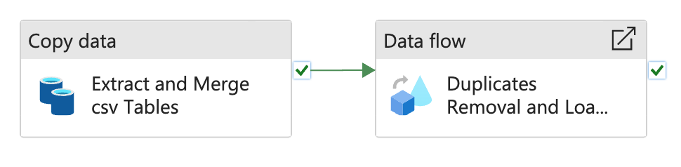
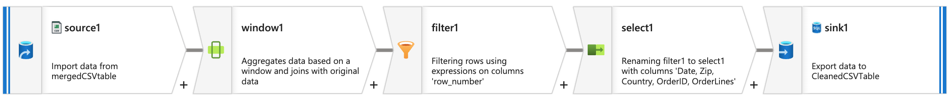
Notes:
For all of the merged files, I create the following ETL pipeline
1. Copy data activity (for extracting all the files of the same type, merge them together into one single table)
2. Data flow activity (extract the merged table of one file format, perform the transformation, and load the transformed data table onto a specific table in the relevant SQL database)

Slide 16
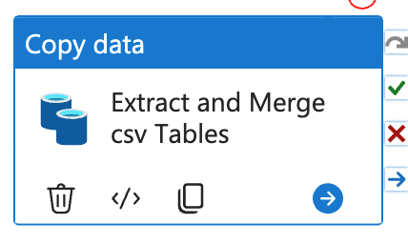
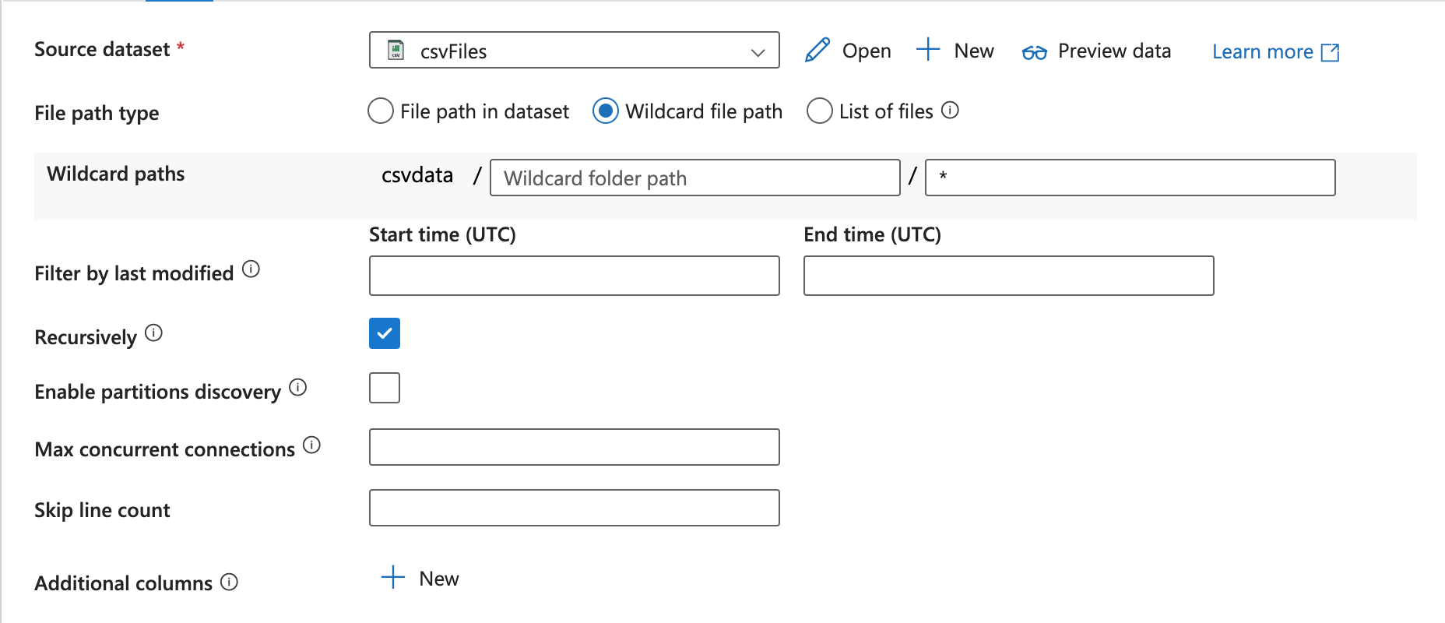
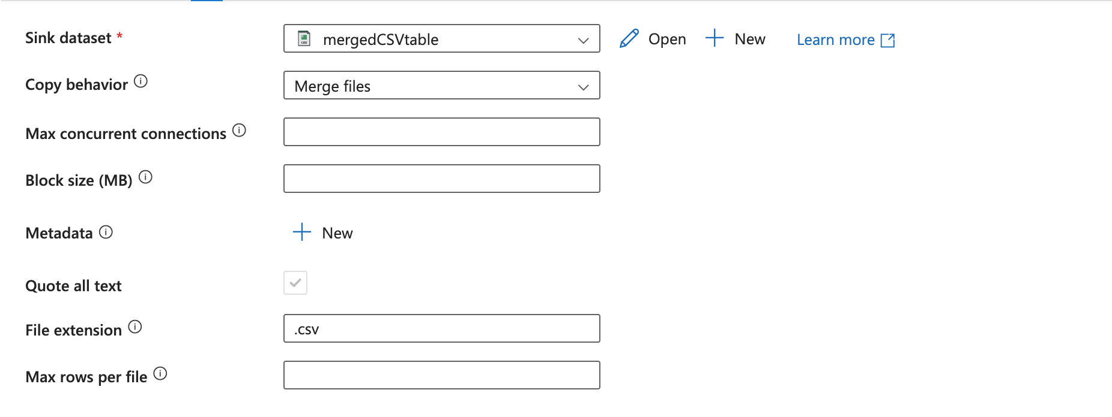
1
2
Notes:
Within the copy data activity, I make sure that the source dataset is the one that stores all the relevant files to merge and set the file path type to ’Wildcard file path’, to extract ALL of the files with the same format stored in that dataset.
Then, I also ensure that the copy behaviour is set to ’Merge files’ because I want to merge all the extracted files together into one single data set, where I also set the sink dataset to be the right dataset which would store the merged table.
Notably, this is the same for all file types.

Slide 17
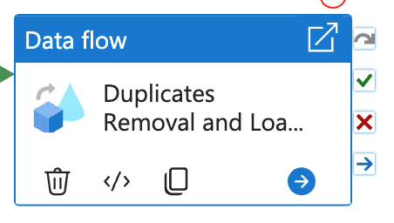
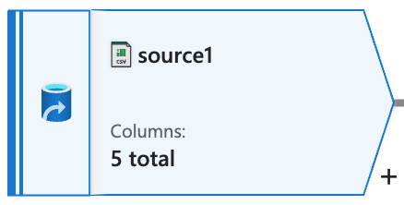
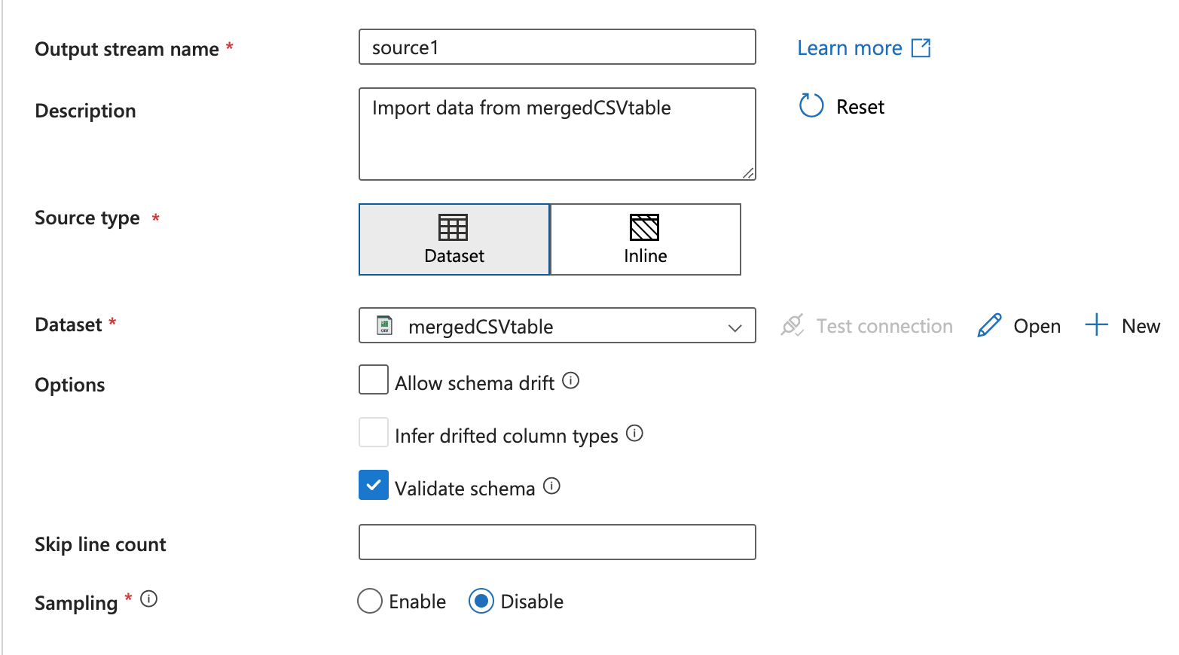
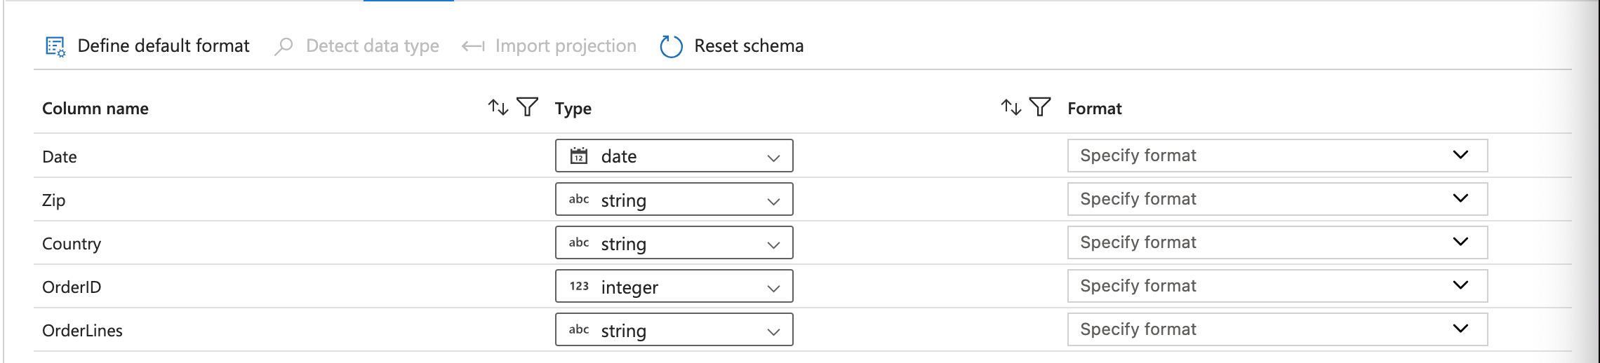
Notes:
1. Within the data flow activity, the duplicates removal process is performed.
2. There are 5 steps in this data flow activity: 1. Source, 2. Window, 3. Filter, 4. Select, 5. Sink
3. In the first activity, is the source activity. In this activity, the source dataset is defined and extracted, selecting the relevant dataset that stores the mergedCSVtable after the copy data activity in the main pipeline.
4. Notably, I also check the Validate schema tick box to ensure that the data flow will fail if the column defined in the projection does not match with the discovered schema of the source dataset. This will ensure that the incoming data matches a predefined schema before processing it further.
5. So, the projection of the csv table should like the image above.

Slide 18
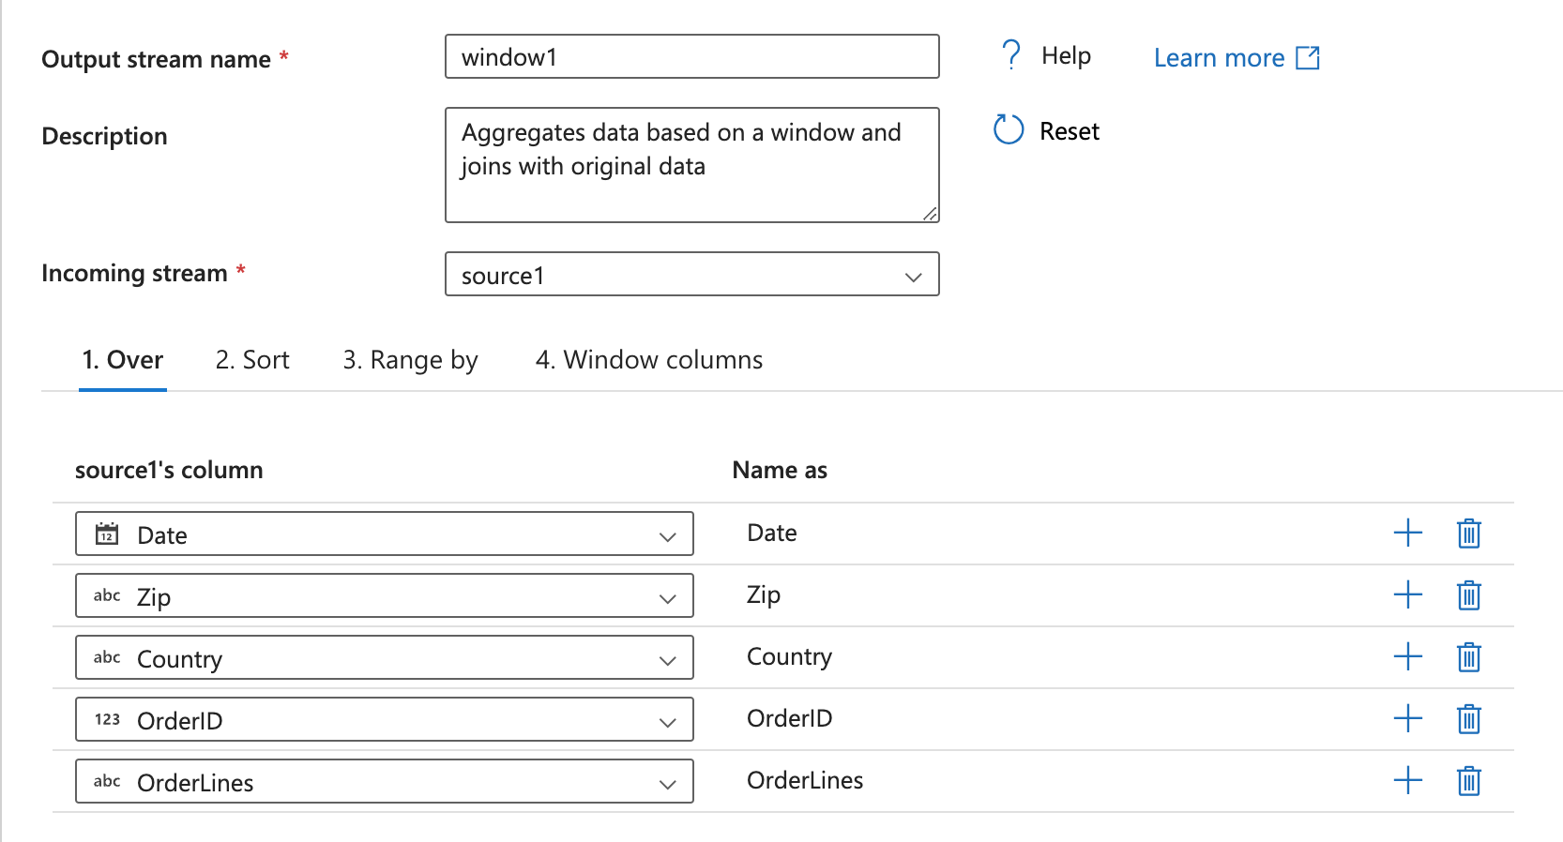
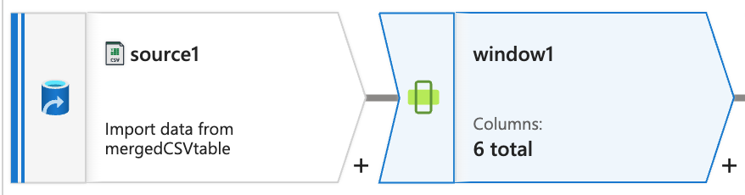
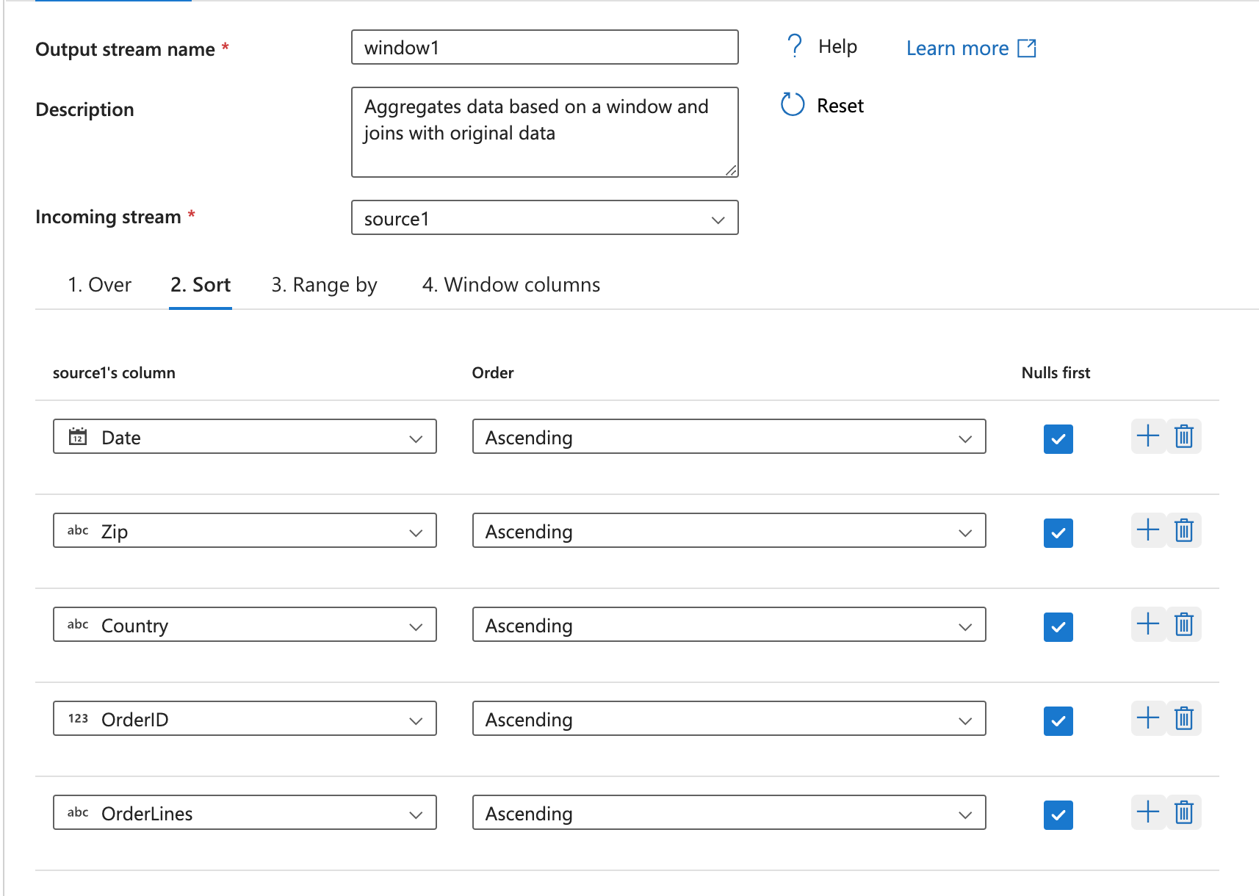
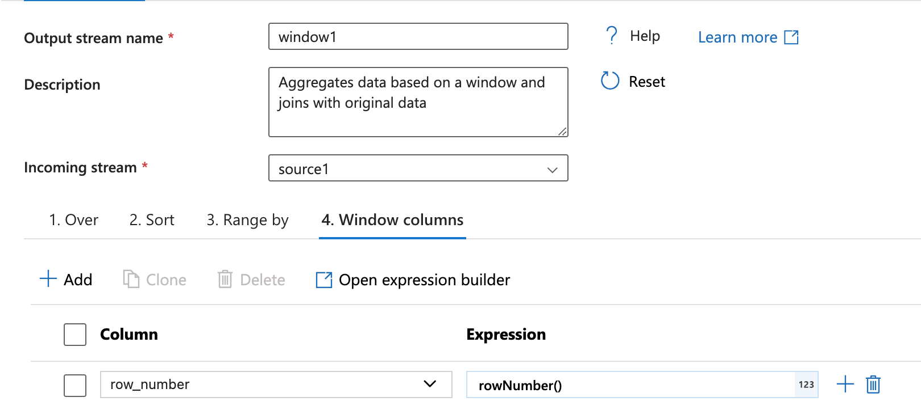
1
2
3
Notes:
1. Then, I use the window function activity in the data flow that would take in the data from source1,
2. Select the relevant columns, sort based on all of the columns accordingly,
3. Then create a new column in the dataset that utilize the rowNumber() expression.
4. Where the rowNumber() function would specify for each distinct row, the row number. So if there are duplicates, the first occurrence of that row would have row_number of 1, but the second occurrence would have row_number of 2.

Slide 19
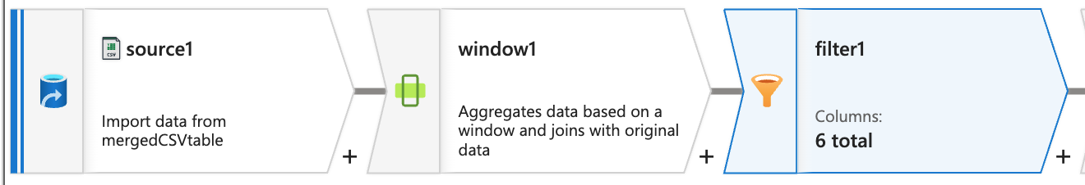
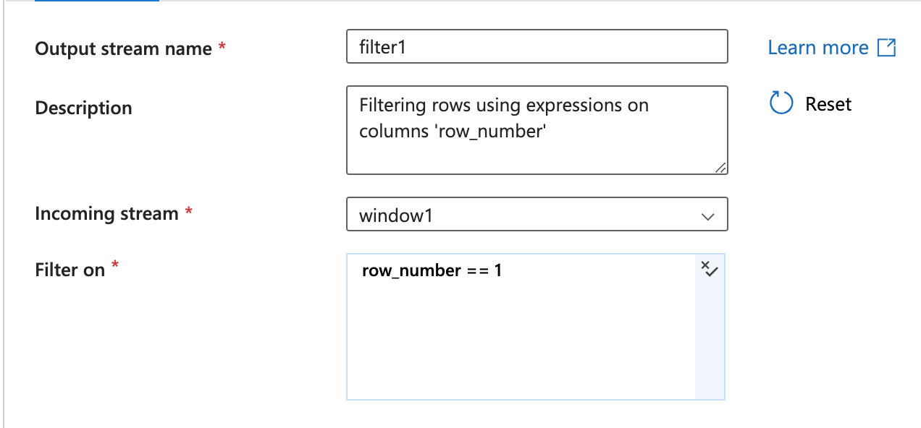
Notes:
Then, I filter out the duplicate rows by keeping only those observations in which row_number == 1 so that the first occurrence of each row are kept only.

Slide 20
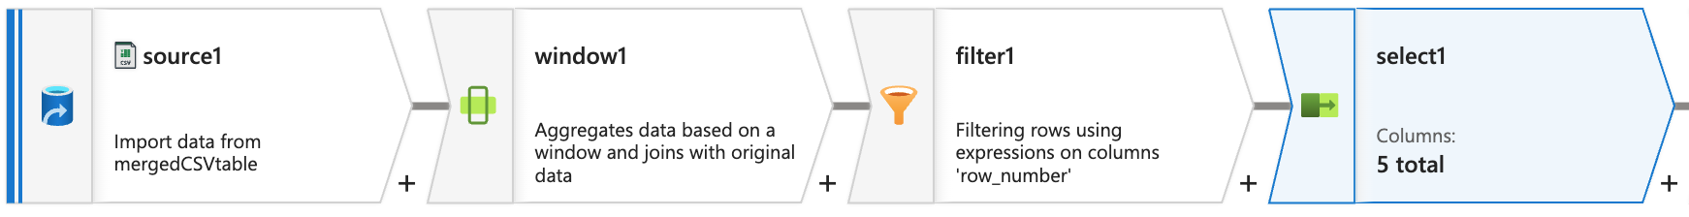
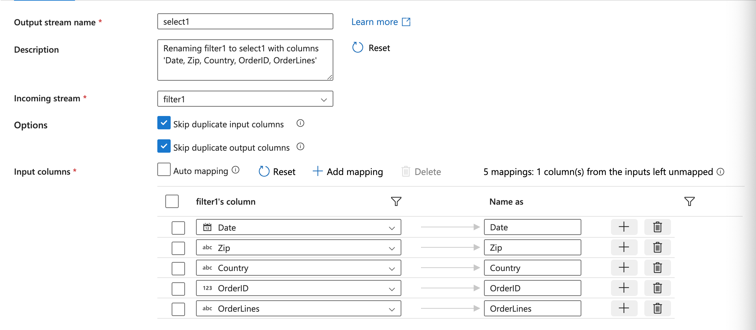
Notes:
Subsequently, because we are not interested in the row_number column, I use the select activity to select the relevant columns from the filtered dataframe, excluding the row_number column, by clicking on the bin icon.

Slide 21
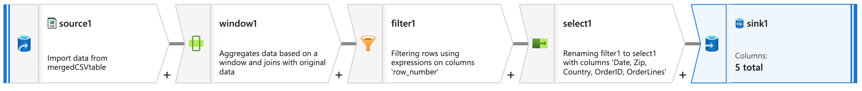
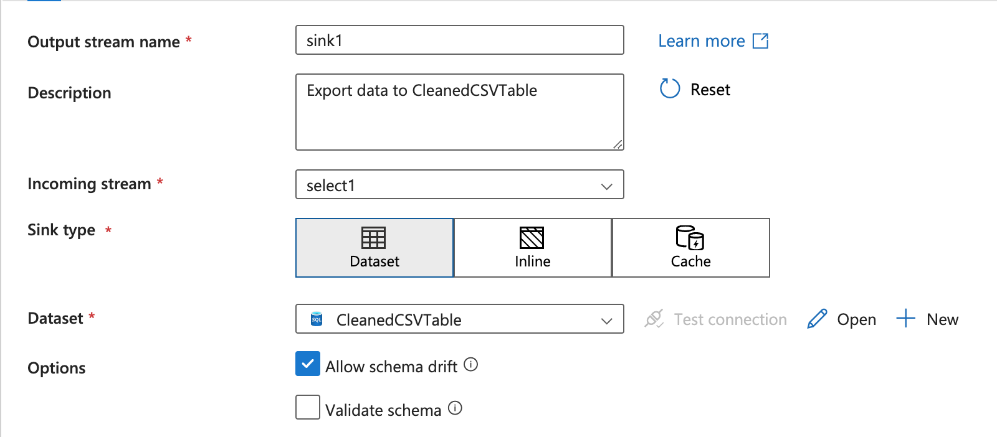
Notes:
1. Ultimately, I complete the whole data flow activity by sinking/loading the transformed dataset onto the appropriate table in the SQL database using the relevant SQL server that is connected to the correct linked servce.

