Slide 1
Data Engineering Assessment Solution
By: Pian

Slide 2
Table of Contents
Goal
Tools
Solution Workflow
Remarks when creating the resources
Region
SQL Database compute configuration
Blob storage vs. Data lake
Data ingestion to ADF

Slide 3
Goal
In a low code manner:
Combine the files using Azure Data Factory (ADF)
Create a usable dataset using ADF
Perform analyses using SQL querying

Slide 4
Tools
Azure Data Factory
Azure Data Studio
Notes:
I opted for Azure Data Factory because this tool is primarily focused on data integration and processing, which is ideal for ETL/ELT workflows.
ETL = Extract Transform Load,
ELT = Extract Load Transform

Slide 5
Solution Workflow

Slide 6
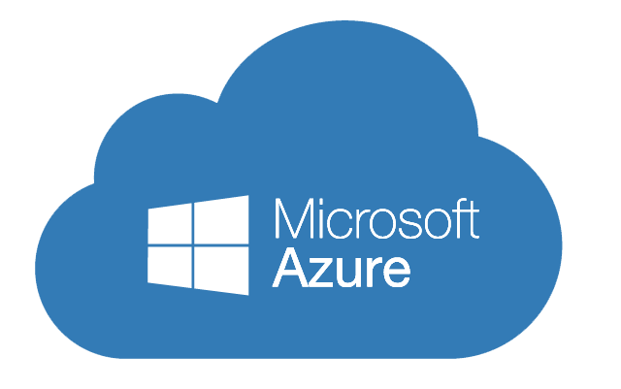


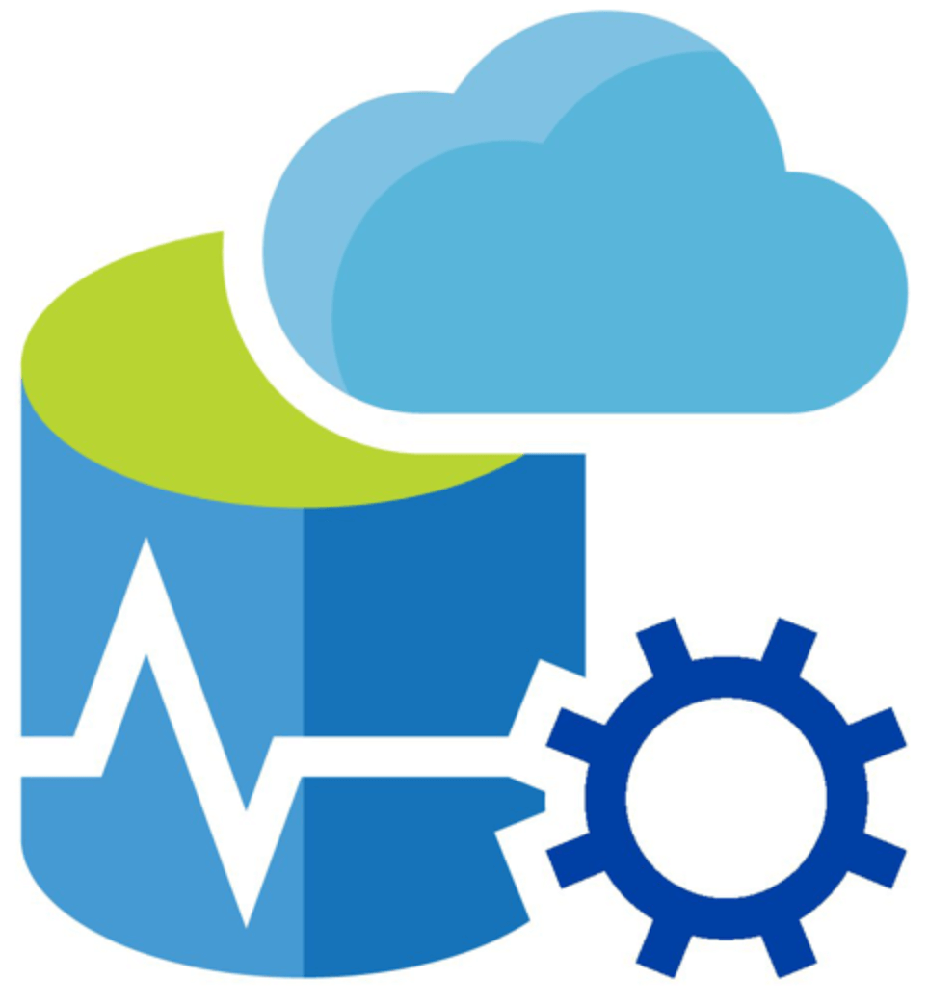

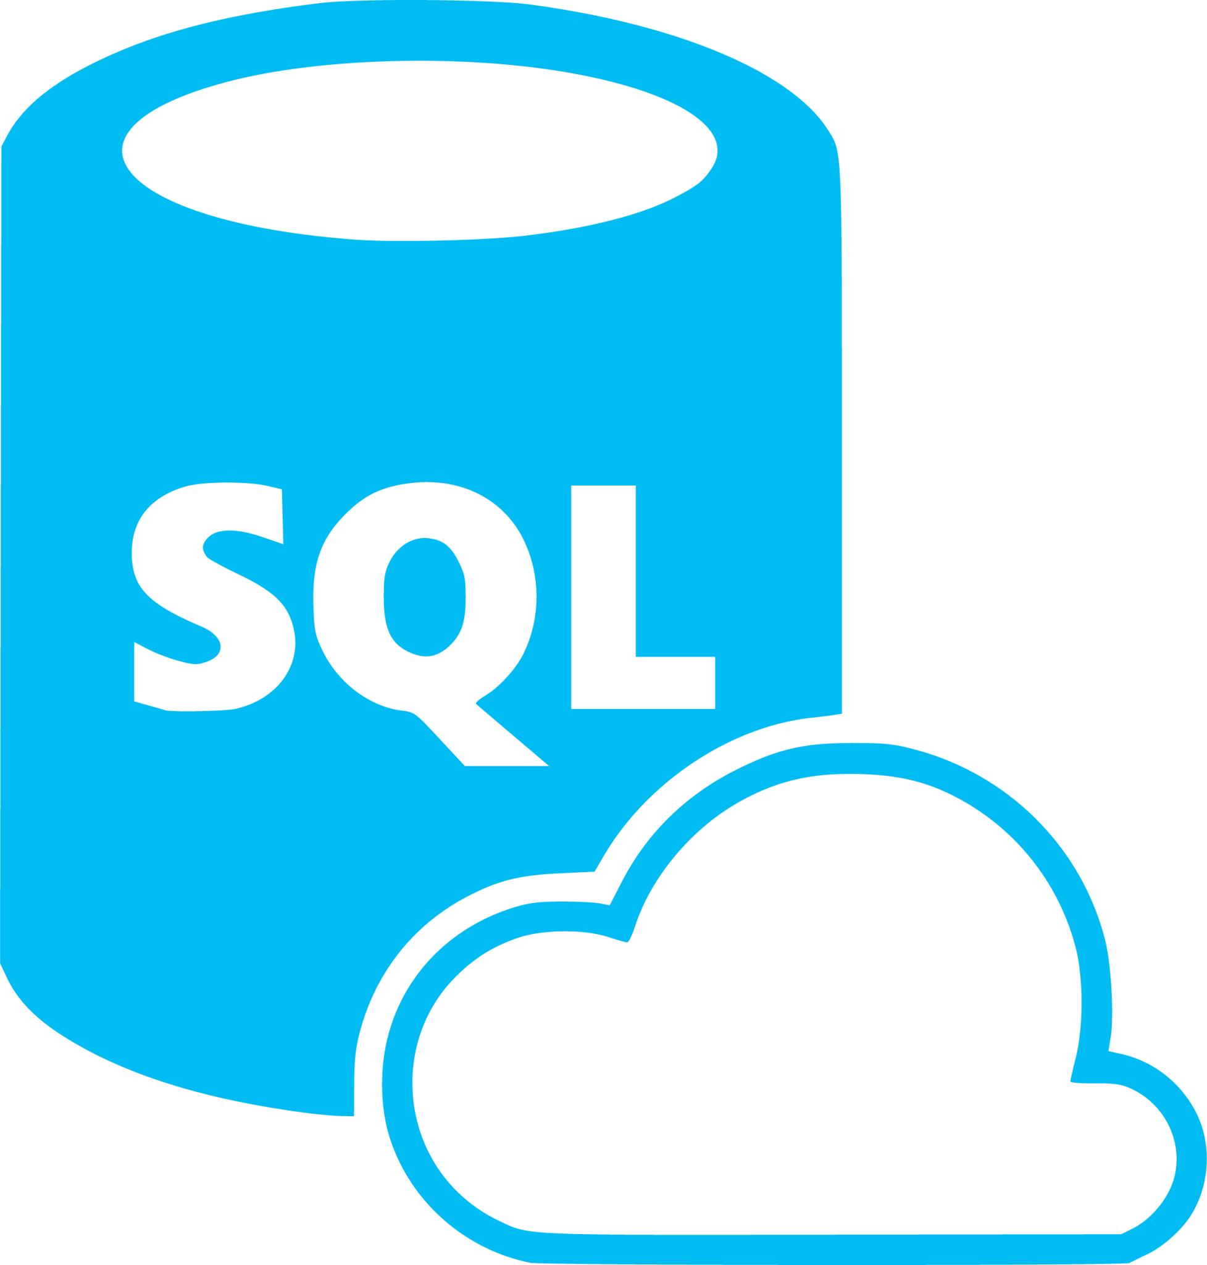

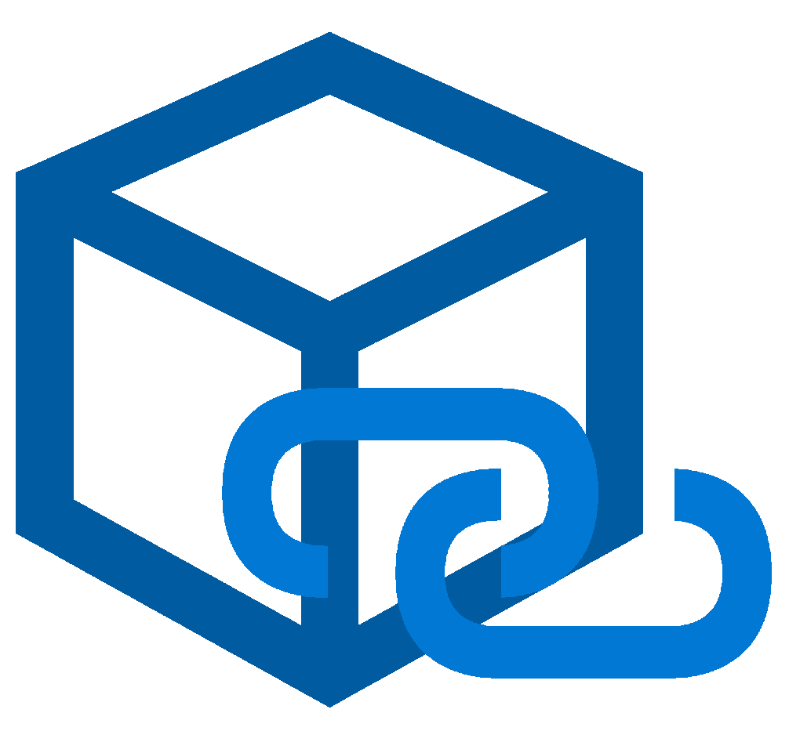
CSV
Source Files
JSON
Source Files
AVRO
Source Files
Excel
Source Files
Notes:
The hierarchy:
Azure portal
Azure subscription
Resource group
Services within the resource group
Storage account (data lake) within the resource group
Linked service to define the connection information needed for ADF to connect to the data lake
ADF
Linked service to define the connection information needed for ADF to connect to the SQL Database/SQL Server
Azure Data Studio/SQL Server Management Studio for further data analyses through SQL querying

Slide 7
Create the resource group
An organizational container for storing all the relevant resources.
Create necessary Azure resources
Storage Account: to store raw data files
SQL Database: host the final transformed data combined dataset for further analyses
Azure Data Factory: for managing data flows from ingestion through transformation to loading data into the SQL Database
Upload the data files
Upload the relevant files within the Azure Storage Account.
Setup Azure Data Factory
Create Linked Services: establish connections to Azure Storage Account and Azure SQL Database.
Create Datasets: define the structure of my data sources and destinations.
Create Pipelines:
build data flows to ingest, cleanse, transform, and merge datasets.
move the final dataset into the SQL Database.
Querying the data
Connect SSMS to the Azure SQL Database using the database connection string from the Azure SQL Database.
Execute SQL queries to analyze the data accordingly.

Slide 8
Remarks when creating the resources

Slide 9
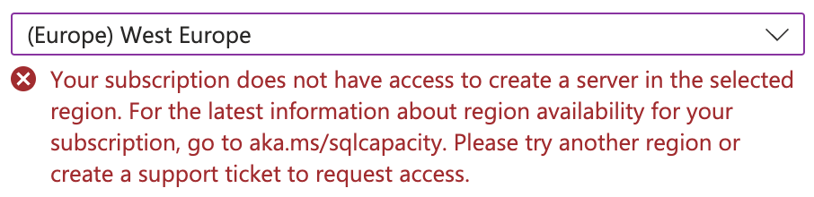
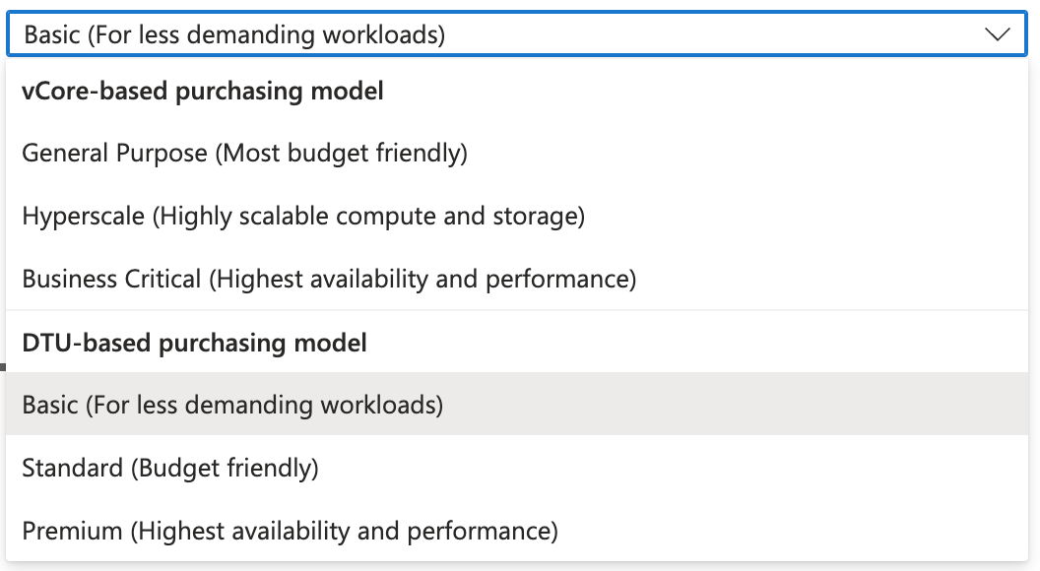
Notes:
Region issues:
Boy mentioned that we usually use West Europe as the region, therefore I set the resources to west region to europe when I can.
However, with the student subscription that I am using, I am not able to select west europe as the region when creating the SQL server, as a result, North Europe is selected instead, so as the SQL database.
Compute configuration:
I have opted for the cheapest compute configuration when creating the SQL Database.
Other notes

Slide 10
Blob Storage vs. Data Lake

Slide 11
Data Ingestion into ADF

Slide 12
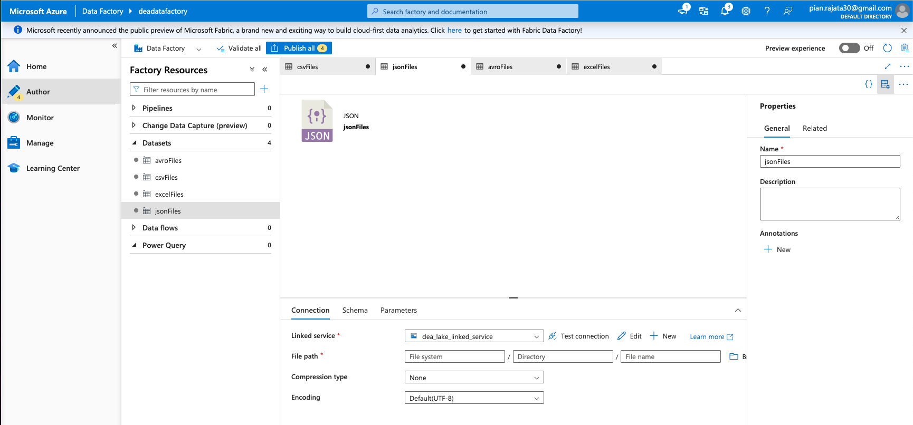
Notes:
For each dataset, I add parameters to make them flexible. For example, parameteres can be used to dynamically change file paths, file names, or file types based on runtime inputs.

Slide 13
Bulk copy with Lookup and ForEach
Lookup:
Retrieve dataset action (content of file or table)
Used to dynamically determine list of objects
Supports most data factory data sources
The Loopup returns list or first row of data
Maximum of 2MB of data
Maximum of 5000 rows of data
ForEach:
Execute set of activities for each object in the list
ForEach iterates over list of objects from previous steps
Can’t nest Foreach, use pipelines instead
To merge csv files, json files, and avro files to one another, we can use copy activity because they have same columns in ADF
But I will need to use data flows to merge tables together that have different column names
With the Wildcard file path I can select all the files in a particular container

Slide 14
Copy data
Extract and Merge Tables
Data flow
Data cleaning by removing duplicates
Copy data
Load the transformed data into a table in SQL Database
Notes:
Without cleaning just yet:
1. Create a dataset called “csvFiles” that has a connection to the container stored in the data lake with the appropriate linked service
2. Create a new pipeline where the first step would be a “Copy data” activity named “Extract and Merge csv Tables” that would extract all the relevant csv files that was loaded into the csvFiles data set, merge them, and sink it to a table in SQL Database. This means that I have to create a new empty table first in SQL Database that will store the results of the transformed csv table, json table, and avro table.
Why use copy data activities?
It is designed for data movement between different data stores, making it suitable for ingesting data files from a dataset and store it in a target data set.

