Slide 1
RANS: Evidence for Multiple Solutions
Malte Wegener*, Prahladh Iyer†, Boris Diskin†, Dimitry Kamenetsky‡, Mike Park‖, Mohamed Sereez#
* German Aerospace Center, Institute of Aerodynamics and Flow Technology
† NASA, Langley Research Center
^{‡ The Boeing Company}
^{‖ FlexCompute}
^{# De Montfort University}

Slide 2
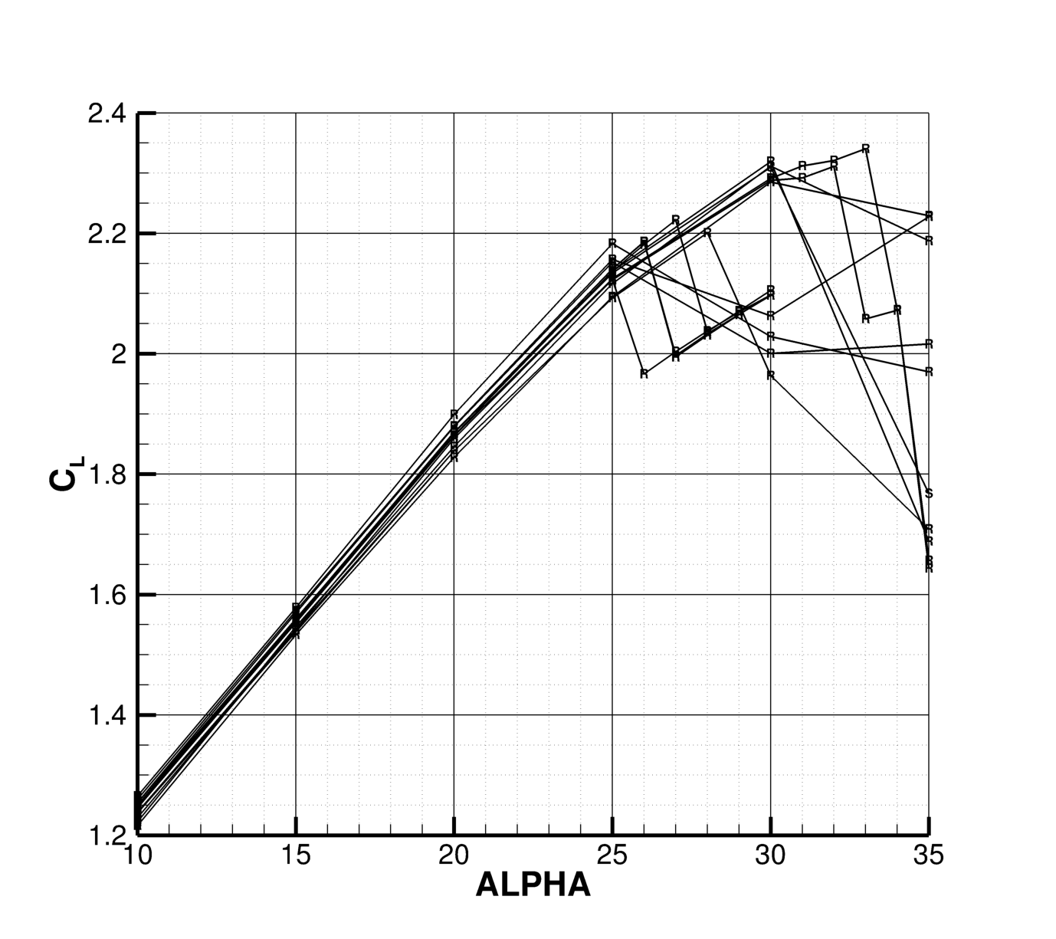
Differences in Stall
In the linear region most results compare quite well
At the near stall region there is a large spread between different solvers

Slide 3
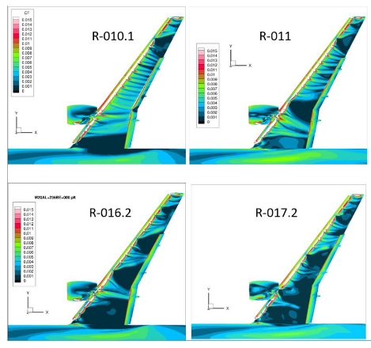
Differences in stall
This was also observed for previous Workshops
Multiple different solutions for the same test case between different solvers
Is the spread between solvers a sign of the non-uniqueness of the RANS equations?
HLPW5 Summary slides

Slide 4
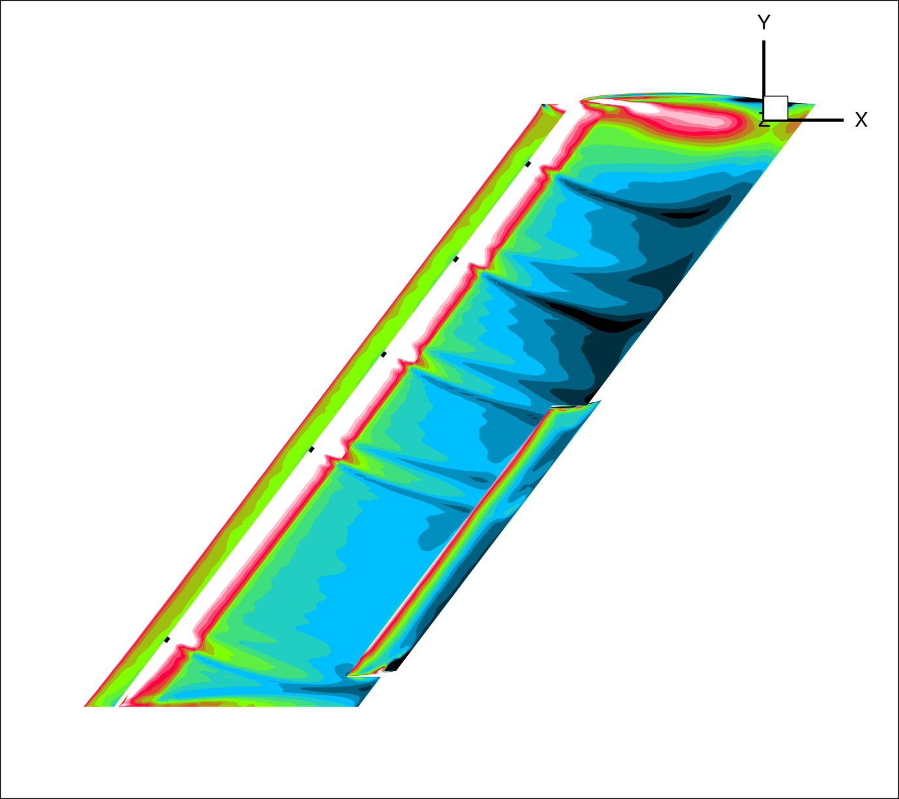
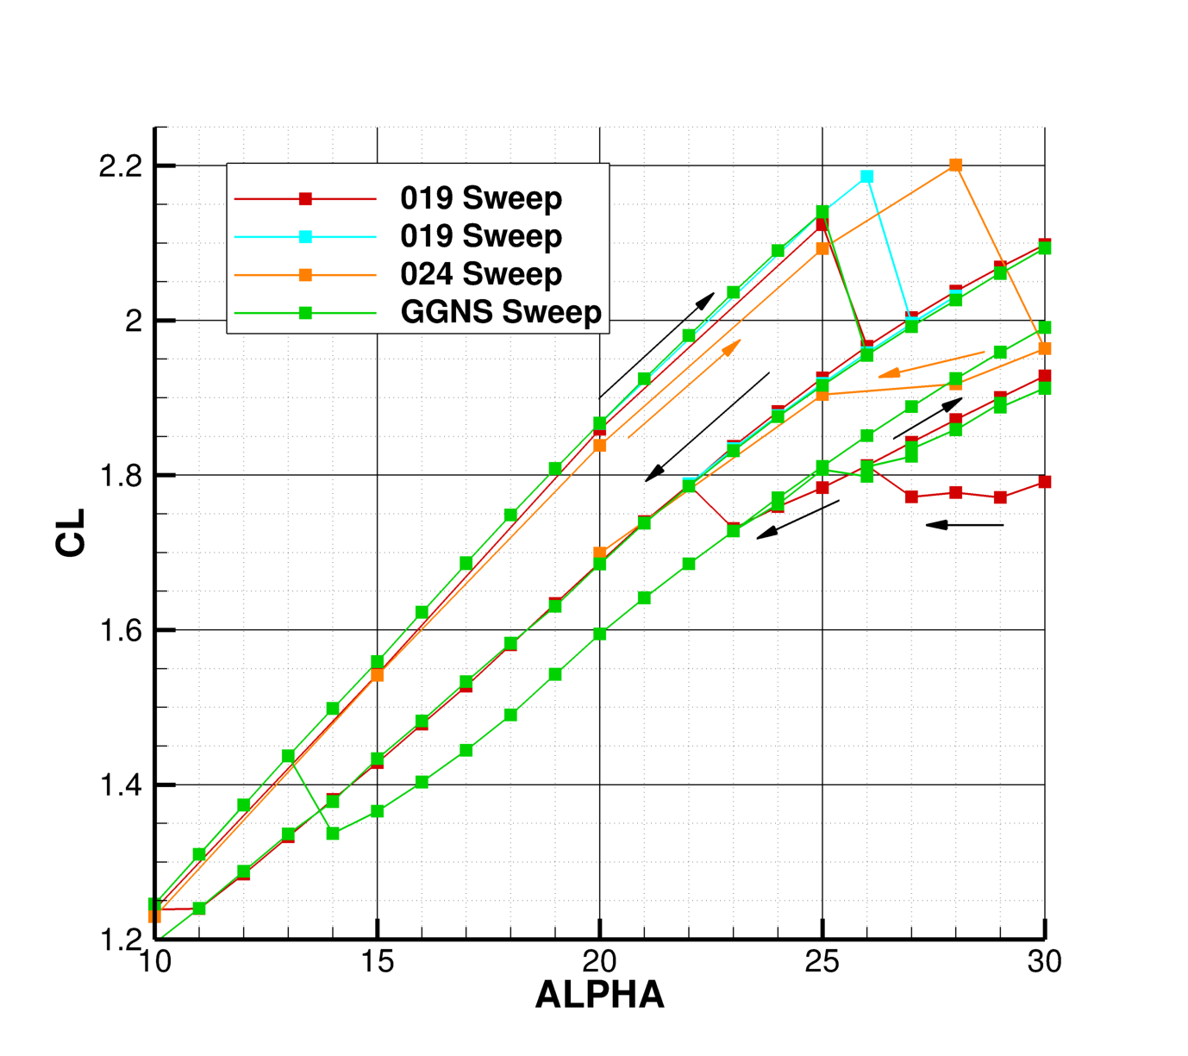
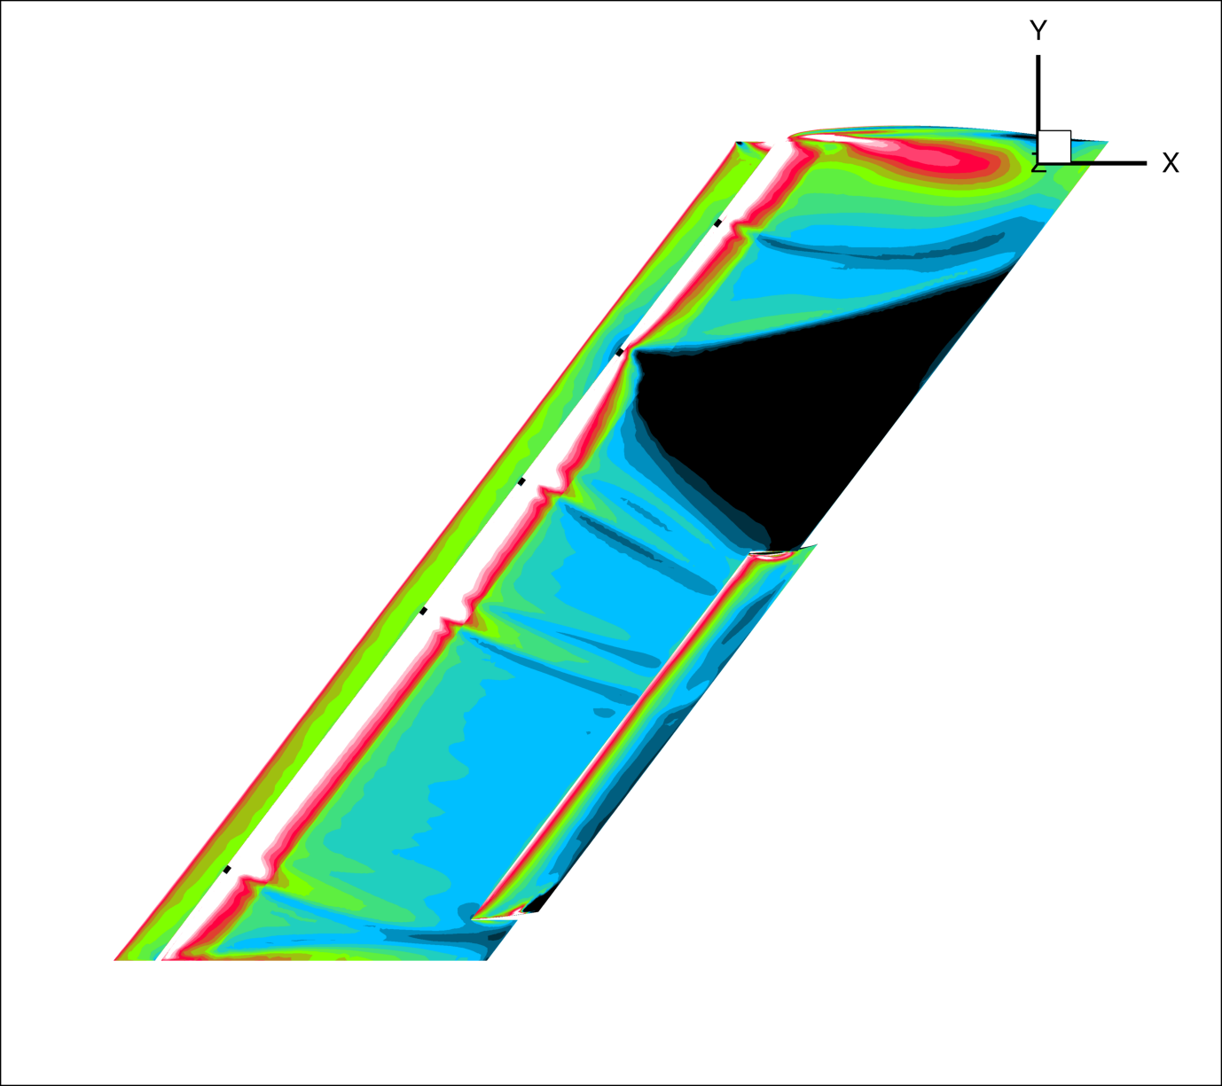
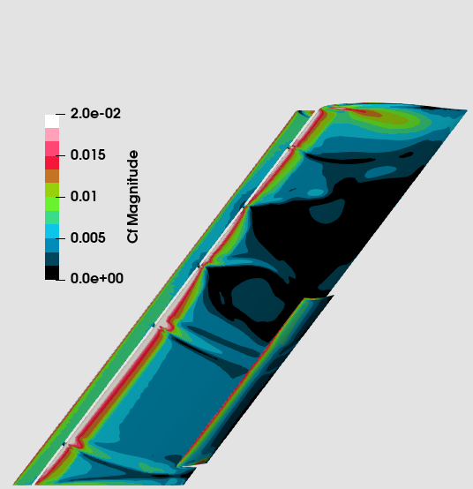
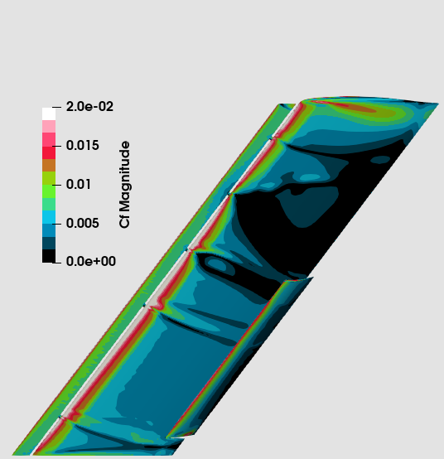
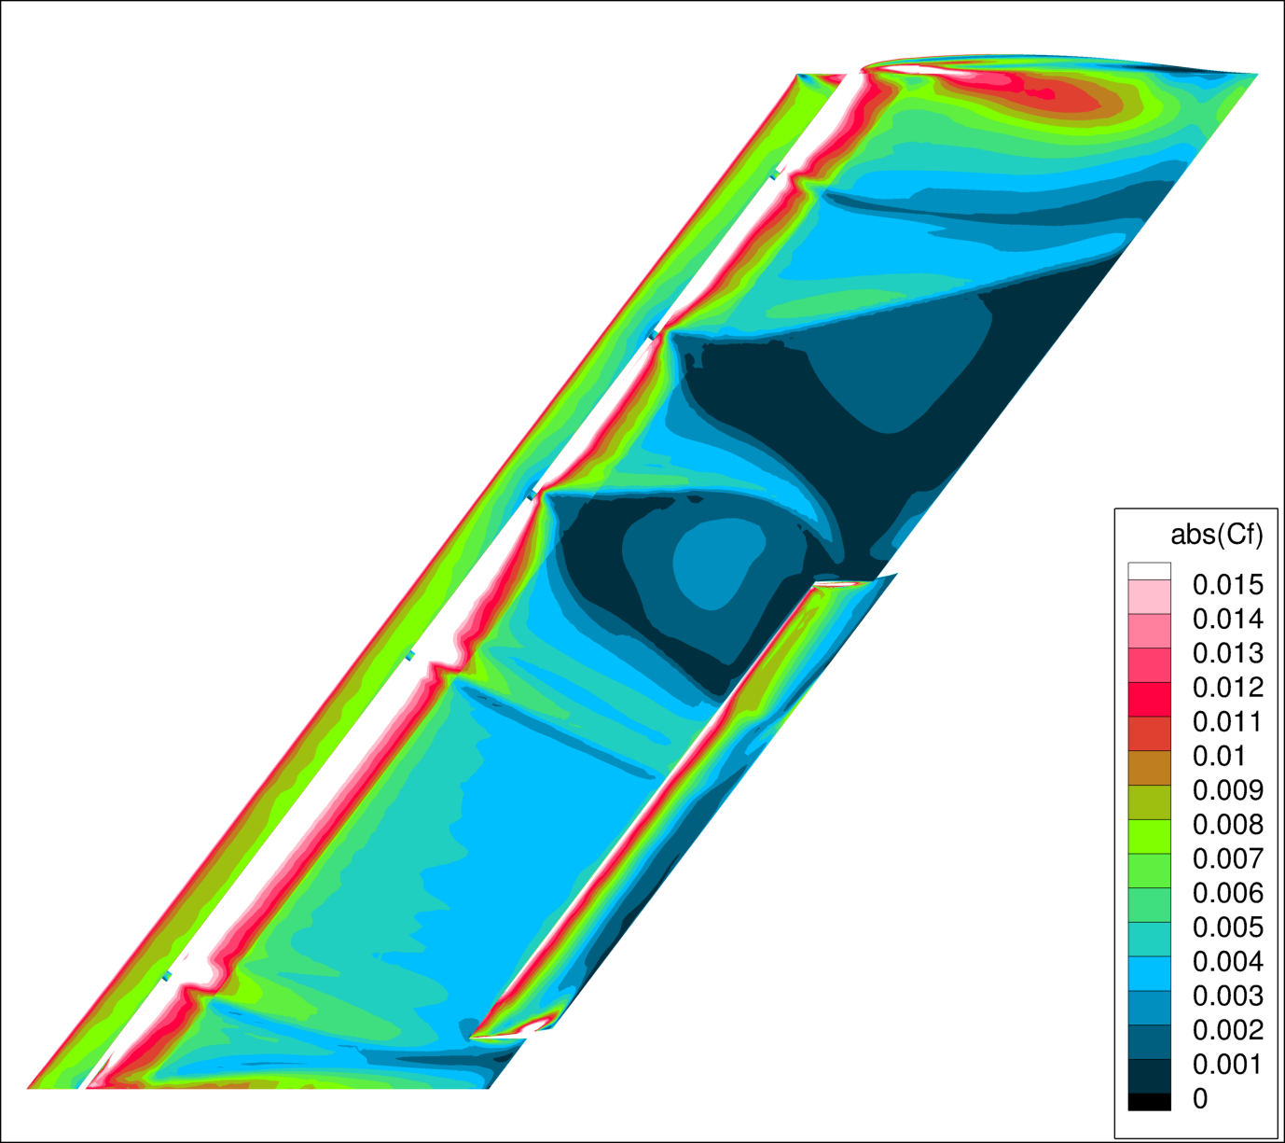
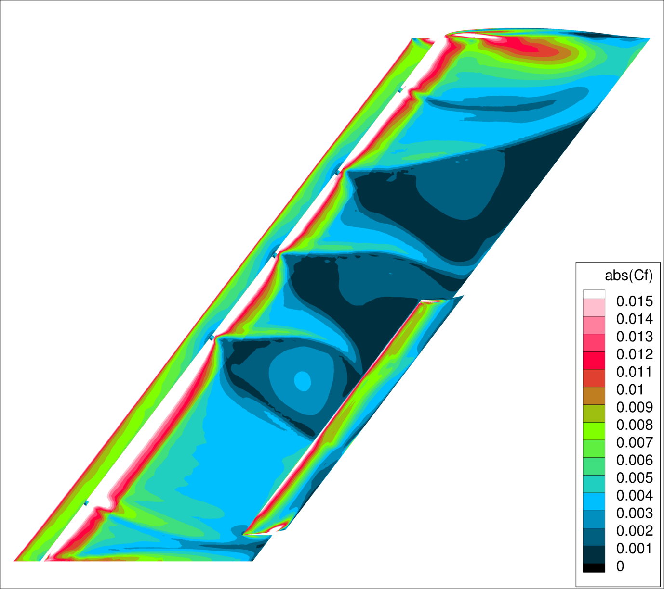
Alpha-continuation from perturbed solutions
Multiple solutions can be found by perturbing the solver
These solutions can be continued by alpha-continuation
Switching between branches occurs suddenly and irregularly

Slide 5
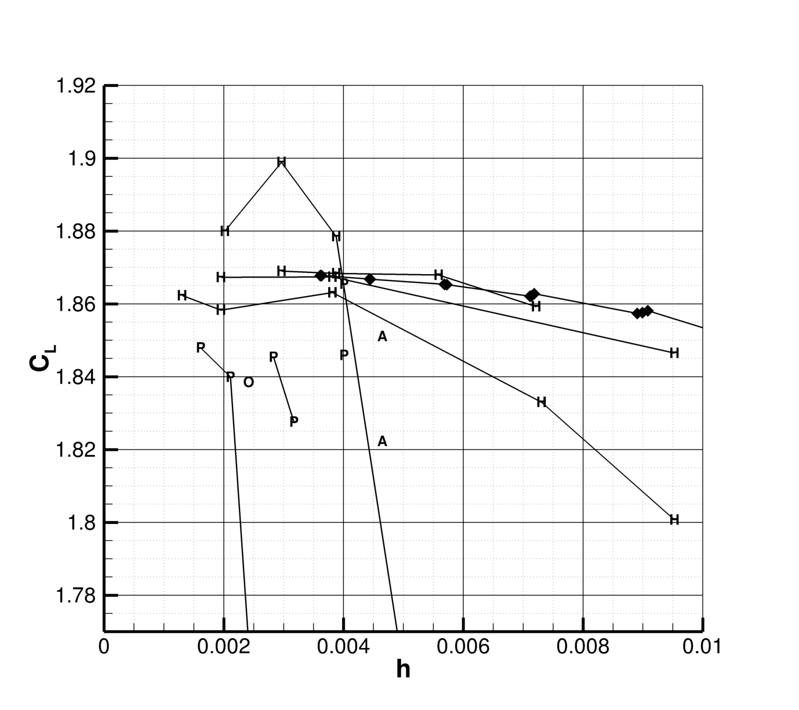
Spatial convergence at 20 degrees
Agreement between different codes and different Mesh families is quite good for the high-lift solution

Slide 6
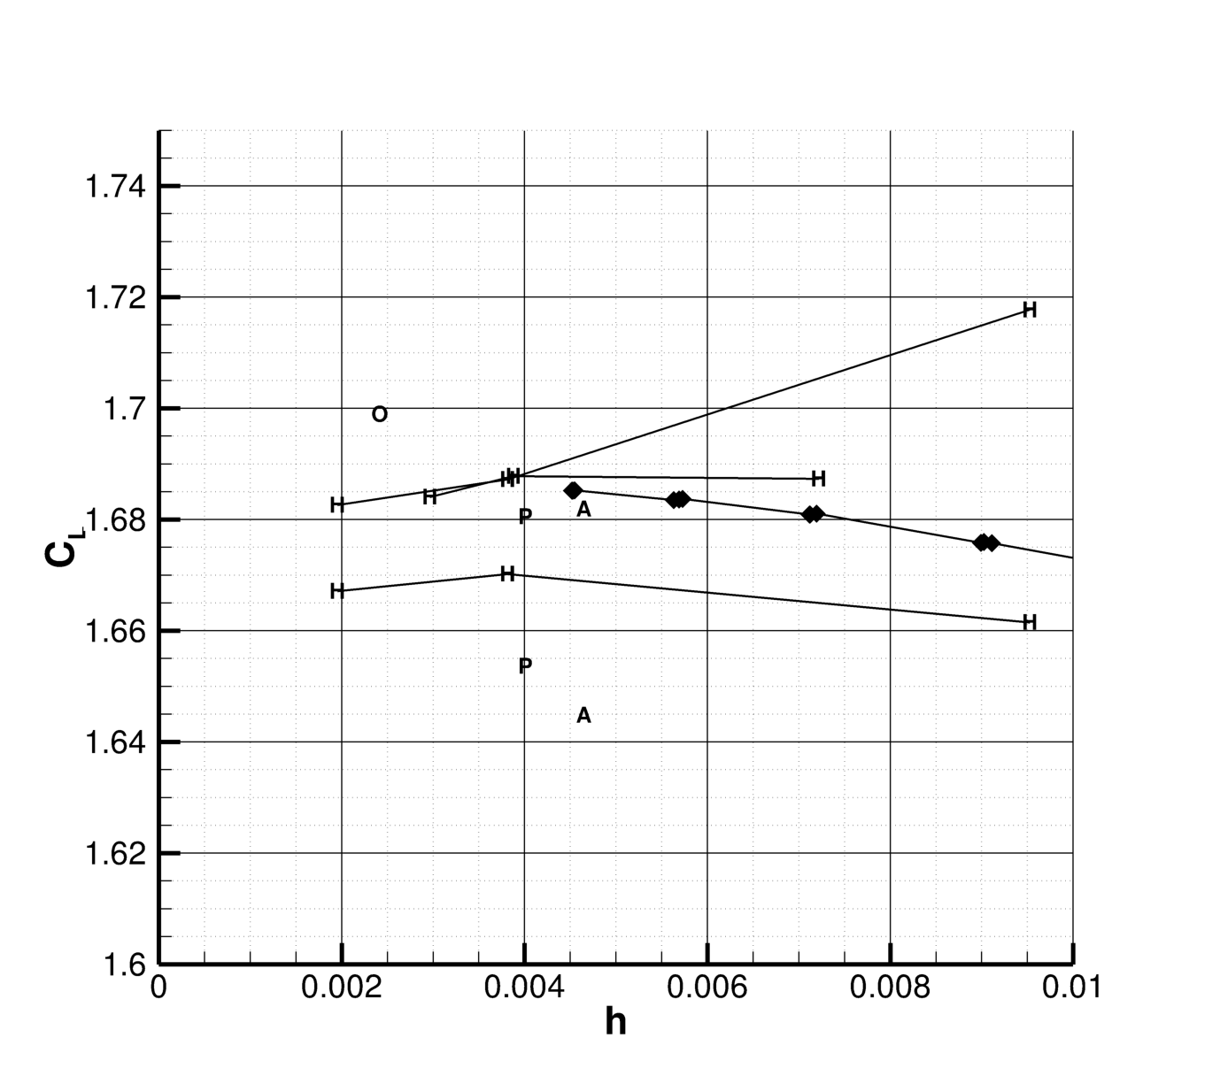
Spatial convergence at 20 degrees
Spatial convergence looks indistinguishable from the high-lift solution
The low-lift solution can be found by 6 different spatial discretizations on 5 different mesh families

Slide 7
Main Take-aways
The multiple solutions obtained for the TC-1 configuration are consistent between different solvers over different grid families and from examining their grid convergence behavior none of the solutions can be identified as the “correct” solution.
Switching between solution branches happens randomly and participants report different sensitivities
Numerical dissipation
Turbulence model
Geometric variation
Mesh variation
Multiple solutions can be found through a combination of these perturbations of the solver and alpha-continuation

Slide 8
A Vision for dealing with multiple solutions
Physical
Numerical
Robust RANS Models should allow for multiple solutions to capture Hysteresis effectrs
Is there a physical condition these pizza slice solutions violate?
Can this condition be incorporated into the solution process as a constraint
Similar to how the entropy-fix in the Roe scheme prevents unphysical expansion shocks
Can the N strongest attractors of the multiple solutions be found systematically?
Can a regularization of the path that is taken through state-space be made such that the initial condition remains the strongest attractor?
Can regions be identified which need to be sufficiently fine such that the initial condition is remains the strongest attractor
There is no way to label any of the solutions as the best solution and we want to find all solutions and not exclude all but one
This is a highly cross-topic problem that can only be solved cross topic collaboration

