Slide 1
HLPW6: How to upload results to GitHub
Daniel Heathcote
Heathcote.Daniel@aurora.aero
Rev A, 1st April 2026

Slide 2
Overview
For HLPW6, a new method of collecting results is being used: via GitHub
This method has been successfully used by DPW
This document outlines a method by which submission files can be uploaded
It is assumed that the submitter already has a GitHub account
If not, sign up is free via www.github.com
It is also assumed that all operations are completed in-browser, alternate workflows may be available via command line or desktop application

Slide 3
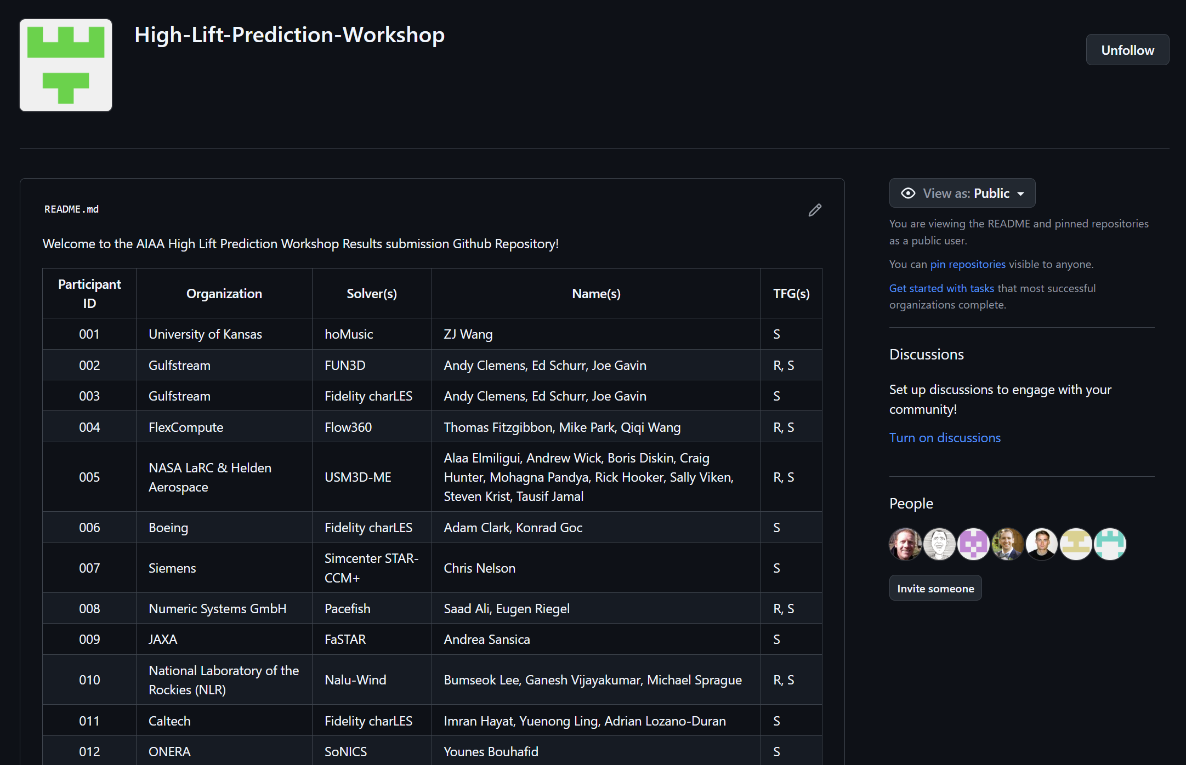
Accessing the organization
HLPW6 GitHub:
High-Lift-Prediction-Workshop
Welcome page should display participant information & IDs
If your name isn’t present and you wish to submit results, please reach out to TFG leads for an ID

Slide 4
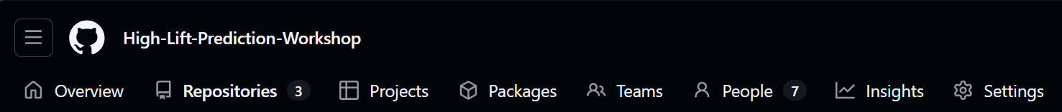
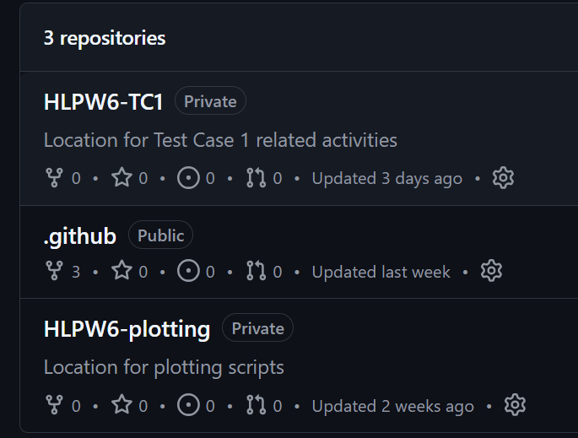
Repository Structure
The organization currently contains three repositories:
HLPW6-TC1: Repo for test case 1 submissions
.github: do not open/modify, relates to participant table
HLPW6-plotting: Associated tecplot macros, layout files and scripts for plotting and comparing results
Navigate to HLPW6-TC1:
High-Lift-Prediction-Workshop/HLPW6-TC1: Location for Test Case 1 related activities

Slide 5
Repo/ Submission Folder Structure
HLPW6 – TC1 Repo
000-Template-Submission: Replace 000 with your participant ID
000_TC1_Y_SS: Corresponds to a specific submission to a specific TFG. Template files are located here
FlowViz: location for flow visualization images. Utilize standard Tecplot layout file containing requisite views as defined by TFG leads and RANS visualization subcommittee
E00-Experimental Data: placeholder for experimental data

Slide 6
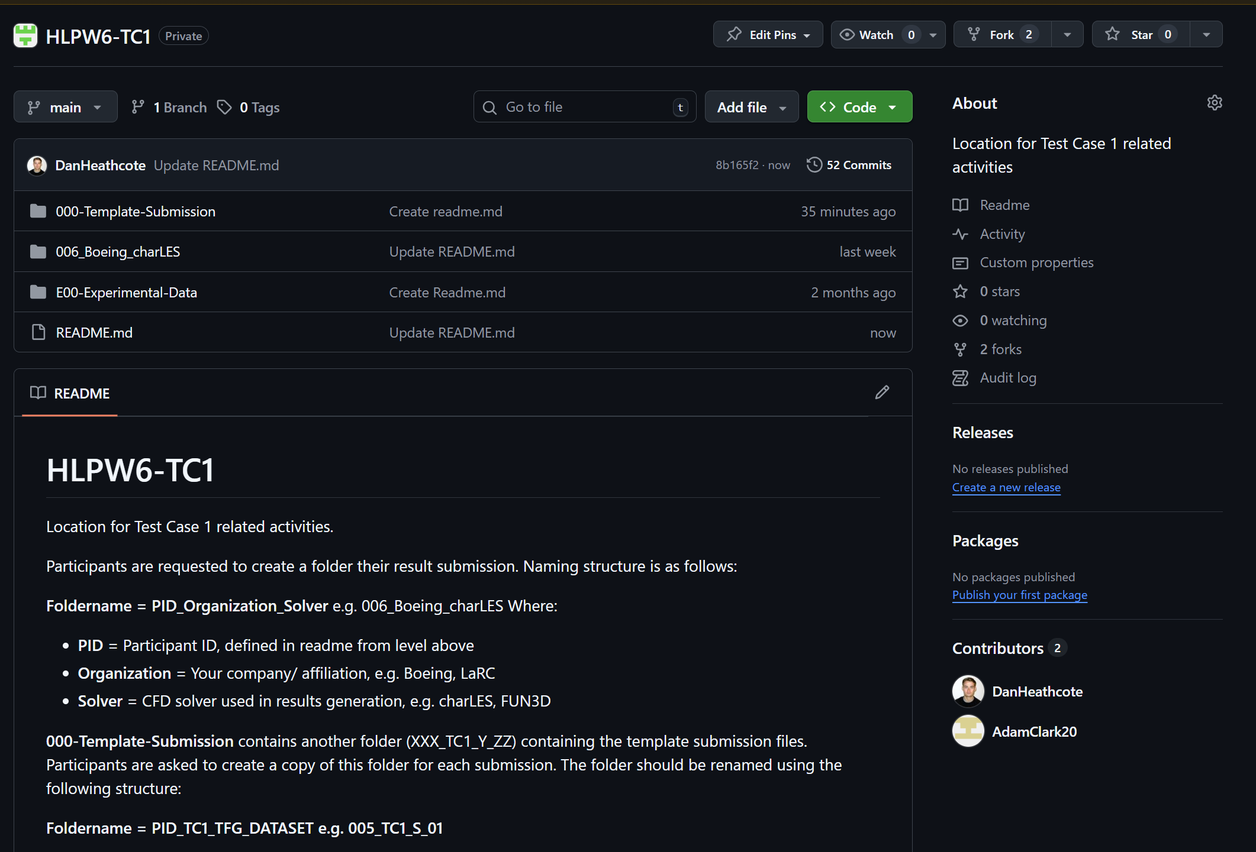
Creating your HLPW6-TC1 fork (1/2)
Creating a fork of the repo keeps any changes you make to the repo isolated until they are “pushed” to the main branch.
This is done via forking (red highlight)
You will use this branch to upload and submit your data
Please read the contents of the README.md file carefully, as these provide the guidelines for naming submission folders

Slide 7
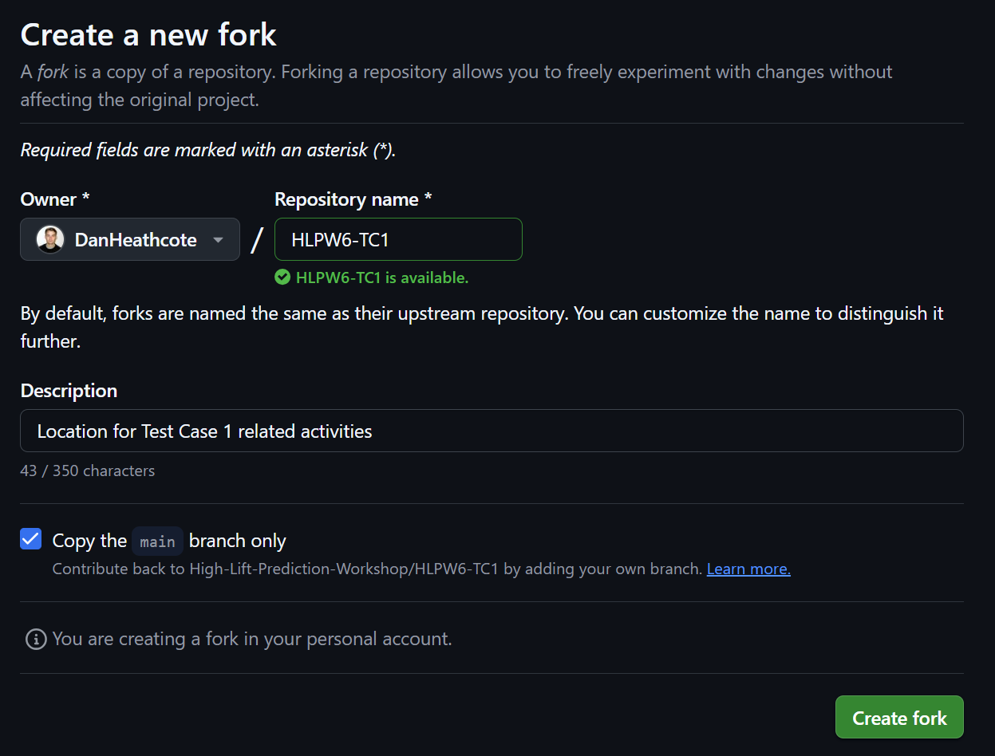
Creating your HLPW6-TC1 fork (2/2)
Creating a fork places a copy of the “main” branch in your GitHub
Please create your own fork by clicking the highlighted button.
The fork’s name can be anything you fancy, although keeping it the same as the master is recommended

Slide 8
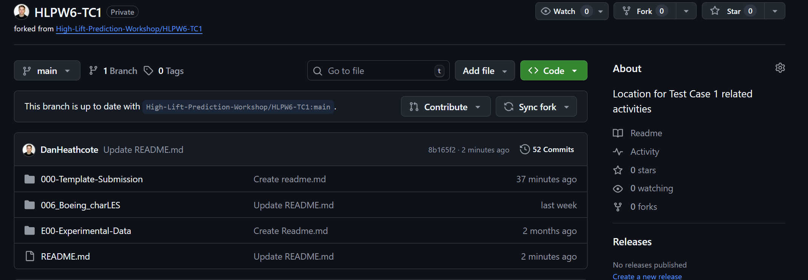
Using your HLPW6-TC1 fork
After creating the fork, you’ll be brought to a landing page for your new fork of the repository.
Some key features here are:
Contribute – This is how you will push (submit) your data up to the main repository
Sync fork – Clicking this will bring updates from the main repository into your local fork

Slide 9
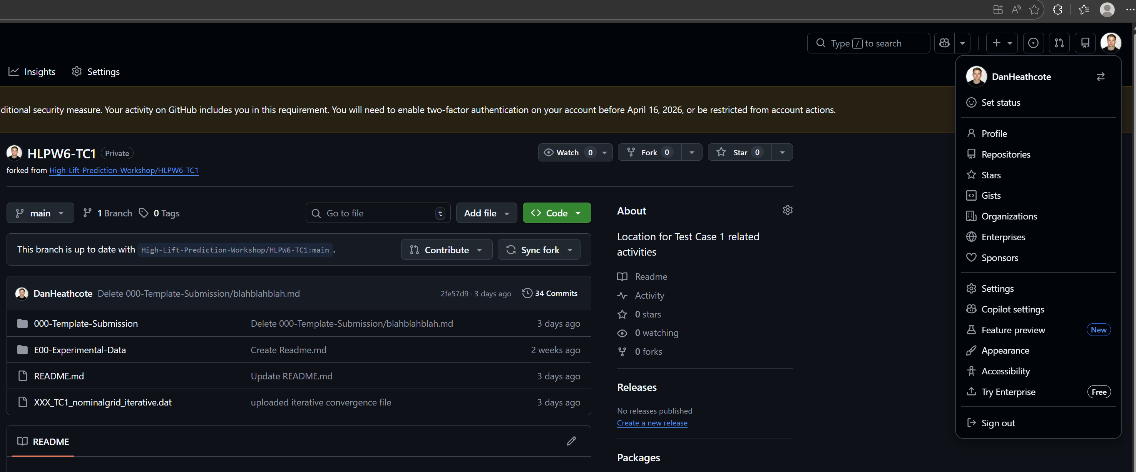
Using your HLPW6-TC1 fork
Ensure you are working within your fork:
Navigate to your profile by clicking on your profile image -> profile
Select you fork of HLPW6-TC1
The view should match the right hand image (note “forked from” text)
000-Template-Submission contains the files which need to be modified for submission

Slide 10
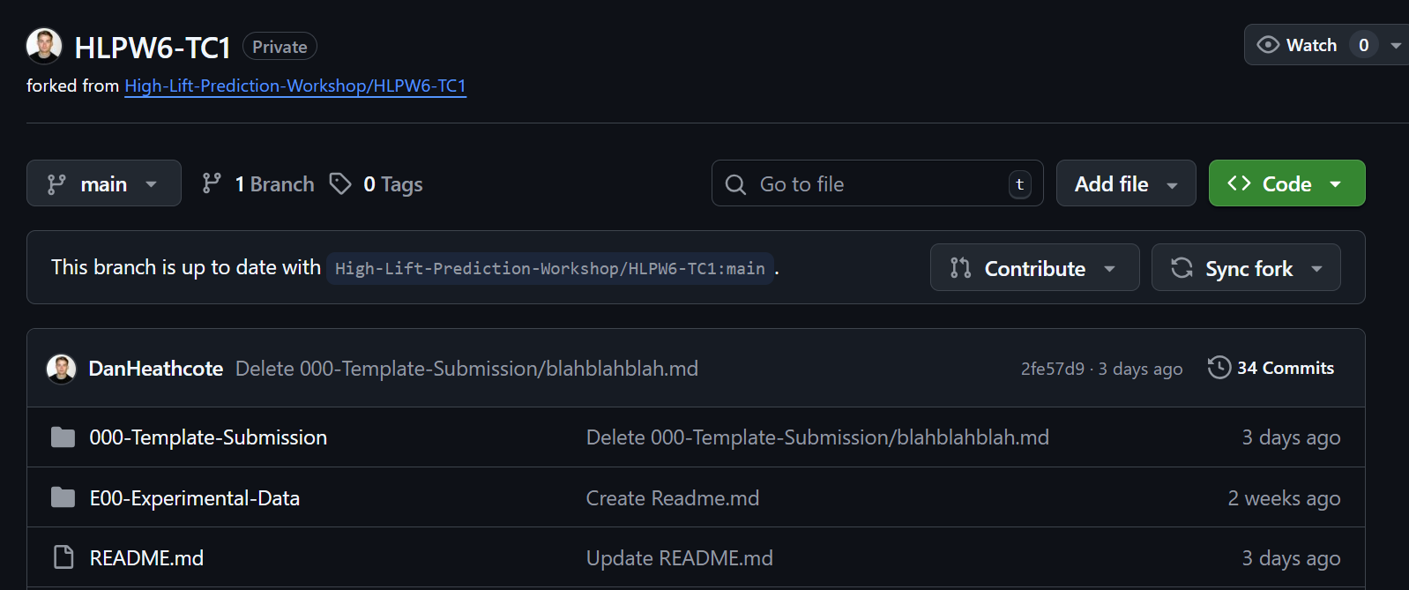
Creating a submission folder (1)
Github does not natively allow browser based “copy” operations. The following provides a methodology to get around this. Alternate workflows via command line operations may be available
Essentially, we need to copy the files from the template directory, modify them with our results, and add them to a folder corresponding to our participant ID, TFG and submission number
Create a new folder by clicking “add file”

Slide 11
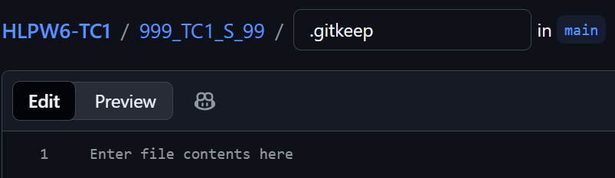
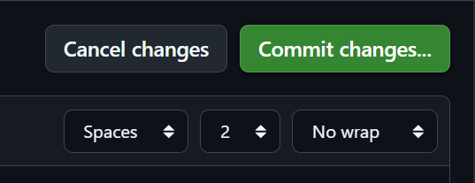
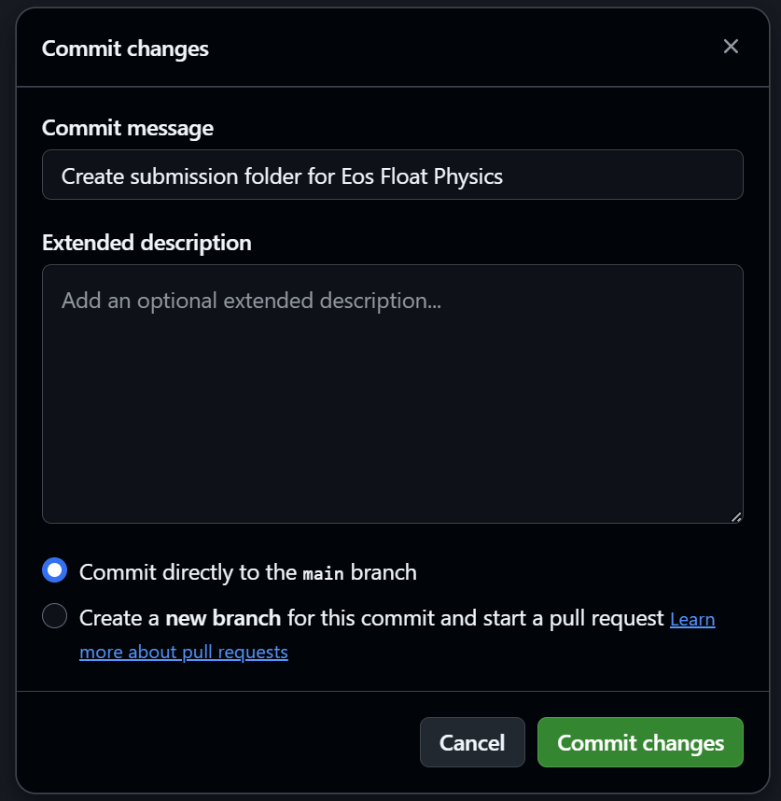
Creating a submission folder (2)
Folder naming convention should follow HLPW6-TC1/readme.md
Input name in flied after HLPW6-TC1 following convention adding “/.gitkeep” to the end
As git tracks files and not folders, an empty file is required until the results files are uploaded
Click “Commit” button on far right
In pop up window, please provide a descriptive message for the commit
Committing to main branch on your fork is appropriate
Create
Commit
Confirm

Slide 12
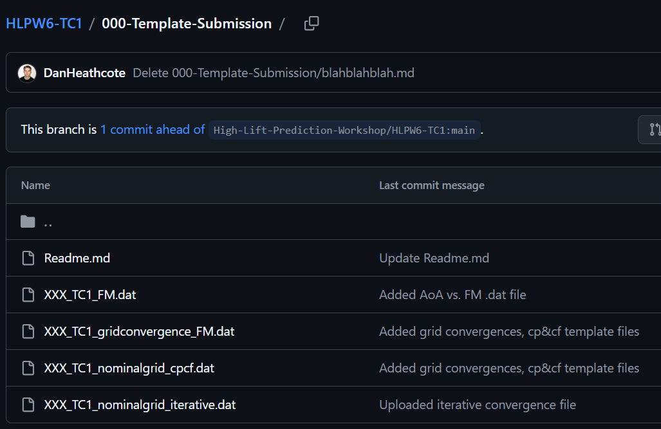
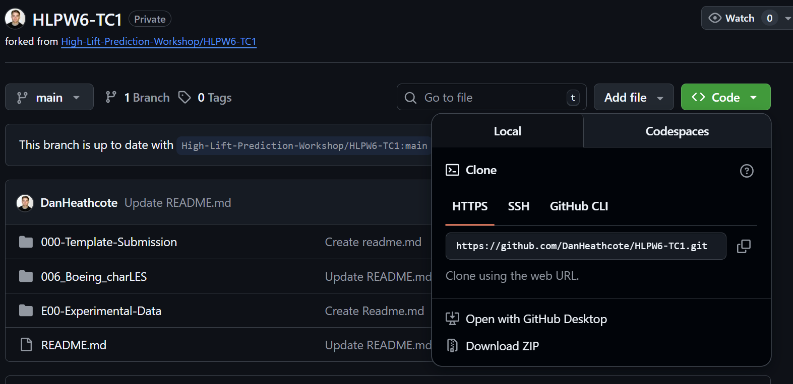
Creating submission files
Five files are provided in the template submission folder:
Readme.md = contains supplemental information for the submission
FM.dat = Converged or time-averaged Force and Moment data vs. angle of attack, multiple grid levels may be included
gridconvergence_FM.dat = Converged or time-averaged Force and Moment data vs. grid level, multiple angles of attack may be included (this is a transpose of #2)
nominalgrid_cpcf.dat = Surface pressure and skin friction distributions at locations corresponding to experimental pressure belts. These are defined here:
nominalgrid_iterative.dat = Solver iterative convergence with respect to iteration, or if time-dependent, with respect to convective time
It’s recommended to modify these by downloading a copy of the repo via a zip file (left)
Alternatively, a local clone of the repo can be conducted

Slide 13
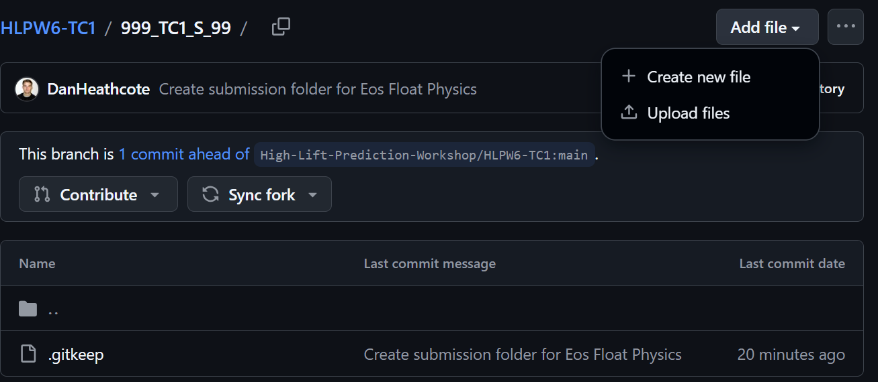
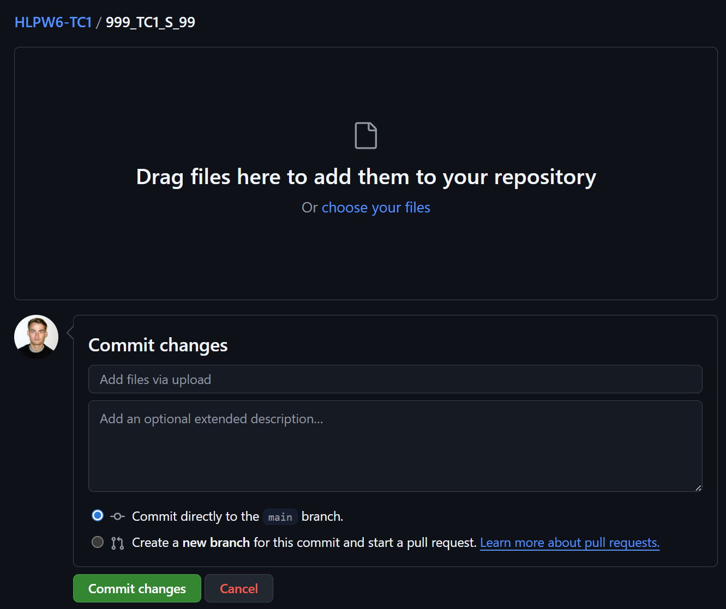
Uploading Submission files (1/3)
Navigate back to your submission folder
Click “Add file”, then “Upload files”
Either drag & drop or navigate to submission file location
Provide description to commit, and commit your changes

Slide 14
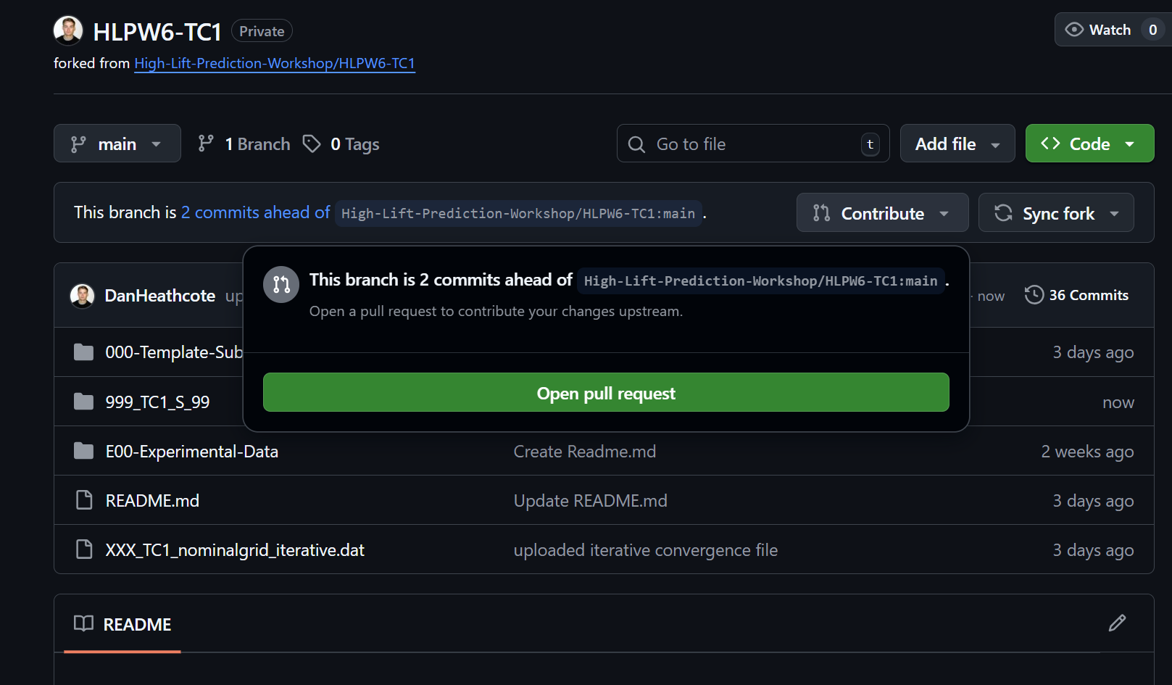
Uploading Submission files (2/3)
Your files are now uploaded to your fork of the repository.
You can add more submissions by repeating the process of creating a submission folder and adding additional files.
Once all of the files are uploaded to your fork, navigate to the front page of your repo, and click “Contribute” and “Open pull request”

Slide 15
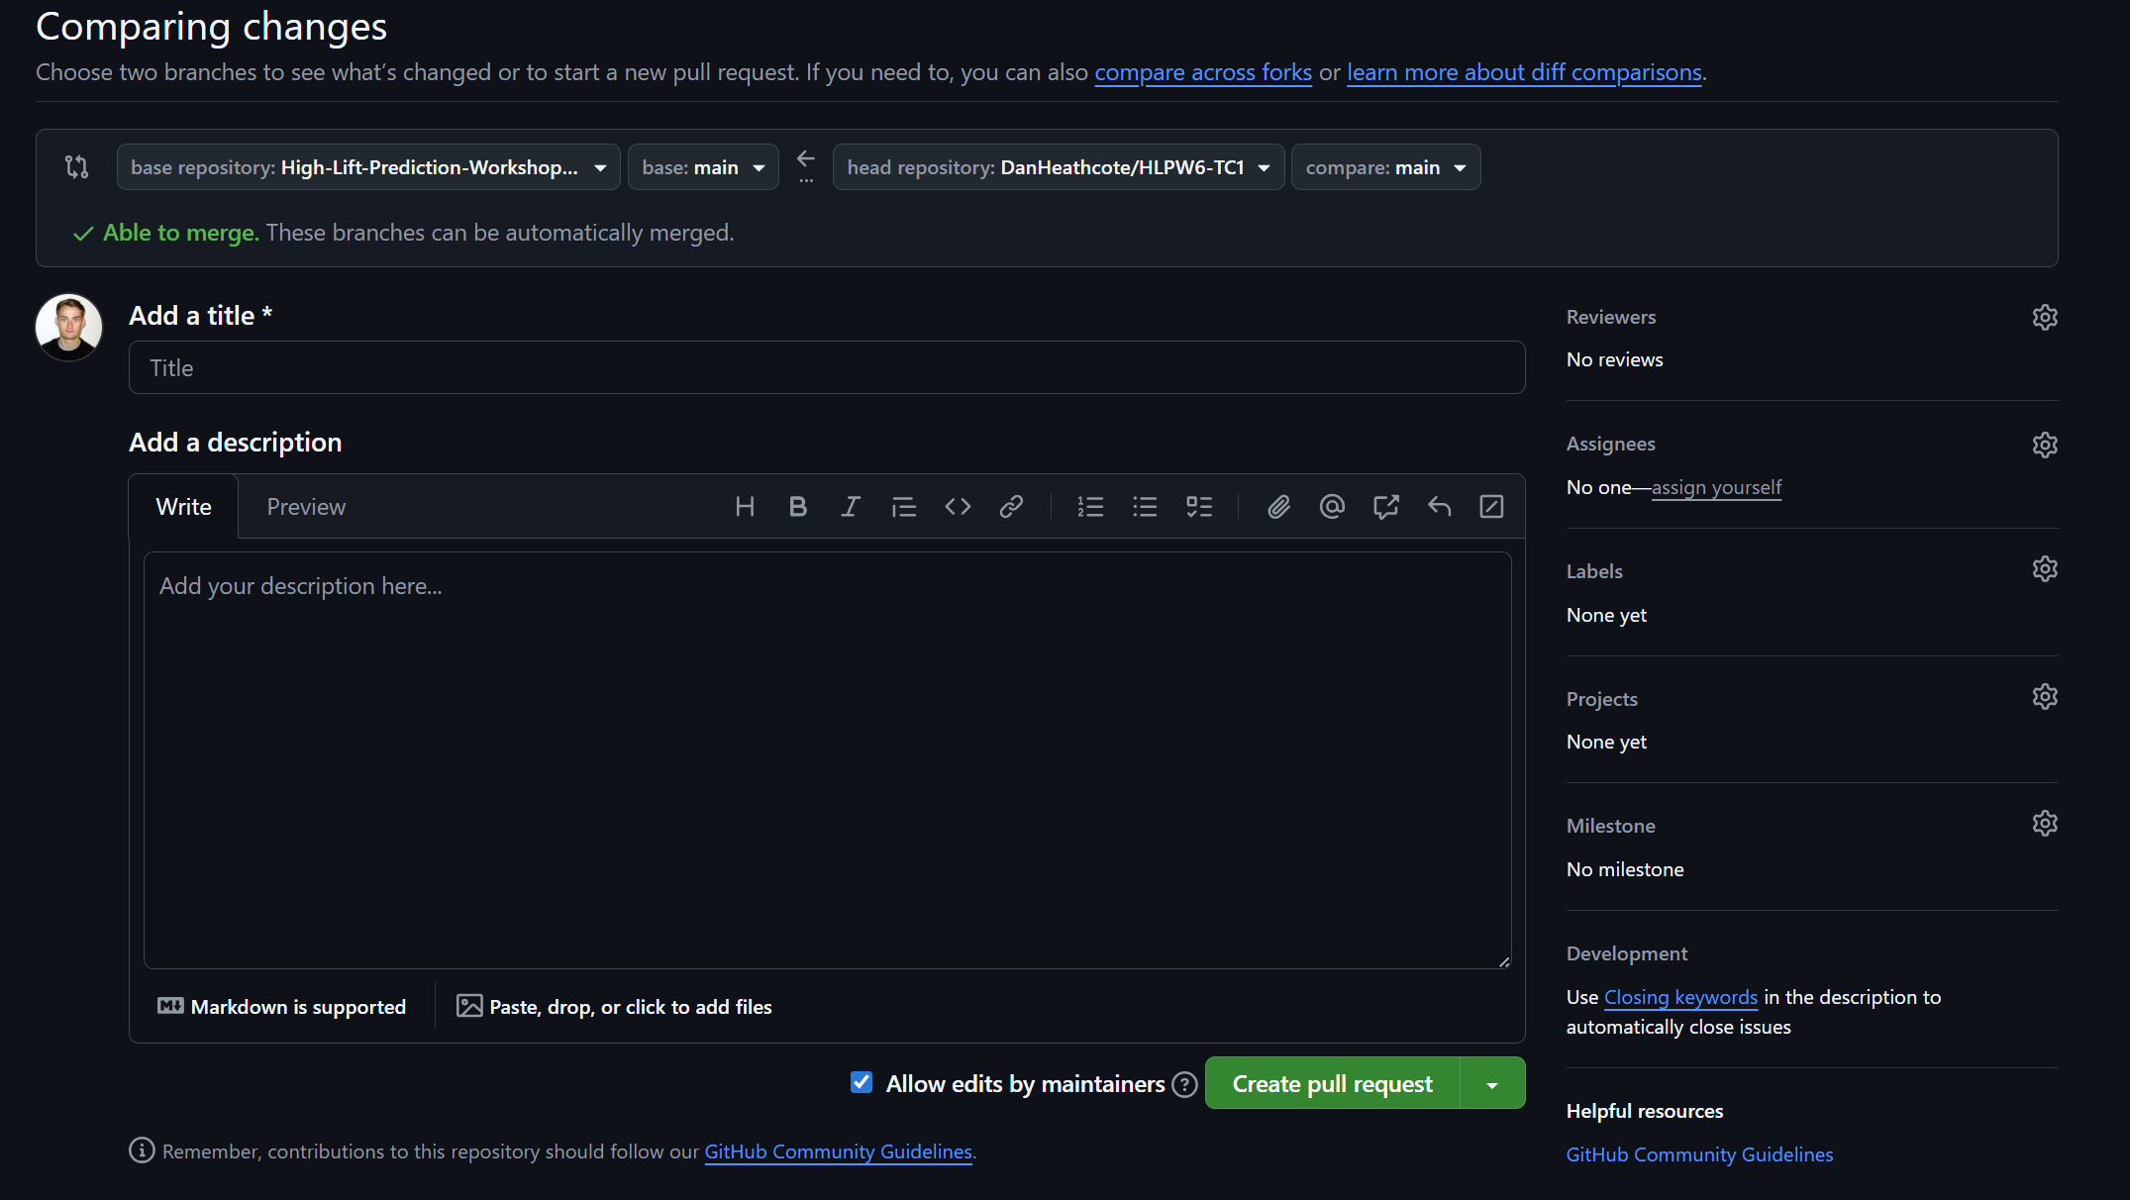
Uploading Submission files (3/3)
From here, you’ll have to add a title for your pull request, fill in some description, as necessary, and then click “Create pull request”
This will inform the group leads that your data files are awaiting review
Thank you for your contribution to HLPW6!
The same fork can be used to create subsequent submittals by creating a new folder and completing the same “pull request/ push process”

Slide 16
Final thoughts (from DPW)
This method only relied on the web interface for GitHub. If you’re familiar with their command line interface or GitHub application, you absolutely can use those as well.
Undoubtedly people will run into issues along the way, so please feel free to reach out to the group leads with any questions.
Also, there is a wealth of information on the Fork and Pull method of contributing to a repository. Here’s one tutorial that is slightly more advanced and uses the command line interface: https://gist.github.com/Chaser324/ce0505fbed06b947d962

