Slide 1



Introduction to Bootstrap
Bootstrap is a powerful framework that simplifies web development. It provides a collection of pre-designed components and utilities that make it easy to create visually appealing and responsive websites.
by Meet Mehta

Slide 2


Opacity in Bootstrap
1
Controlling Visibility
2
Adding Depth
Opacity is a property that controls the transparency of an element. It allows you to create subtle effects or gradually fade elements.
Using opacity can add a sense of depth and hierarchy to your designs by making certain elements appear closer or farther away.
3
Creating Visual Interest
4
Background Overlays
Opacity can be used to create visually interesting effects such as fading in or out elements or creating subtle transitions.
Opacity is often used to create overlays on top of images or backgrounds, allowing you to add text or other content without obscuring the underlying visuals.

Slide 3
Overflow in Bootstrap
Visible Content
Hidden Content
Scrollbars
The overflow property determines how content that exceeds the boundaries of its container is handled.
With hidden overflow, content that extends beyond the container's dimensions is clipped and not displayed.
When overflow is set to scroll, scrollbars are added to the container, allowing users to view content that extends beyond the visible area.
Visible overflow is the default behavior, where content that extends beyond the container's dimensions is displayed outside the container.

Slide 4

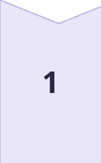
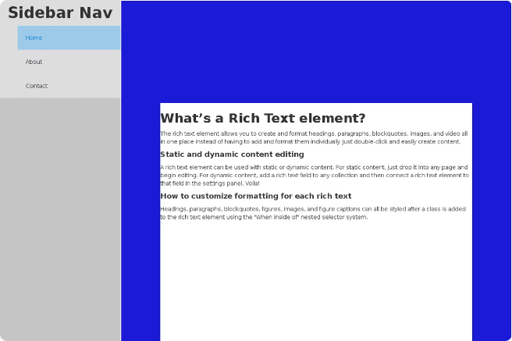
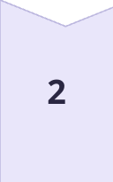
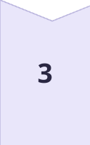

Positioning in Bootstrap
Static Positioning
Elements with static positioning are positioned according to the normal document flow.
Relative Positioning
Elements with relative positioning are positioned relative to their normal position in the document flow.
Absolute Positioning
Elements with absolute positioning are positioned relative to the nearest ancestor that has a position other than static.
Fixed Positioning
Elements with fixed positioning are positioned relative to the viewport, and they remain fixed in their position even when the user scrolls.

Slide 5

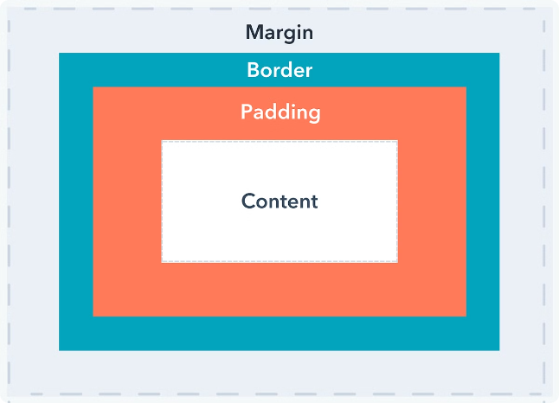
Spacing in Bootstrap
Class
Property
Value
m-0
margin
0
m-1
margin
0.25rem
m-2
margin
0.5rem
m-3
margin
1rem
p-0
padding
0
p-1
padding
0.25rem
p-2
padding
0.5rem
p-3
padding
1rem

Slide 6

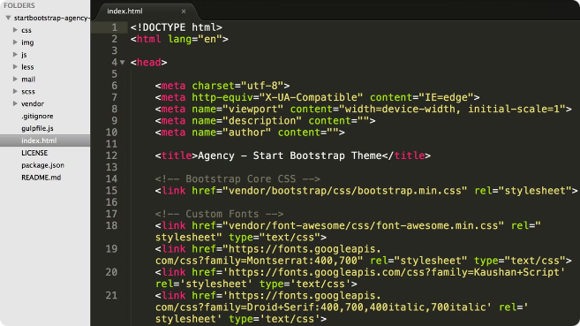
Implementing the Concepts
1
Understanding the Basics
Start by understanding the fundamental concepts of Bootstrap and how to include it in your project.
2
Exploring the Utilities
Learn about the various utility classes that Bootstrap provides, including those for opacity, overflow, positioning, and spacing.
3
Building Simple Components
Begin by creating basic components using Bootstrap's utility classes to practice applying these concepts.
4
Creating Complex Layouts
Once you've mastered the basics, start creating more complex layouts and components using Bootstrap's grid system and other features.

Slide 7
Conclusion and Key Takeaways
Foundation for Success
Efficiency and Consistency
Community Support
Bootstrap provides a strong foundation for building modern and responsive websites.
Bootstrap saves time and effort by offering pre-designed components and utilities that help you create consistent designs.
Bootstrap has a large and active community, which means that you can find plenty of resources and support to help you along the way.

