Slide 1
SupeRR Selector Season 2 — Round 1
Identifying the most reliable players under pressure
Context-aware Pressure Index · hierarchical empirical-Bayes ratings · match bootstrap · 18-spec robustness ensemble
837 IPL & T20I matches · 193,988 deliveries · 2022–2026 · prepared for Rajasthan Royals, 11 Nov 2026
Notes:
Title. The whole study is computed from the supplied data; external facts are used only in the RR strategy section.

Slide 2
The final top 10s under pressure
Batters | Score | Conf.
1. Tim David | 96.5 | High
2. Heinrich Klaasen | 90.1 | High
3. Suryakumar Yadav | 87.6 | High
4. Shashank Singh | 83.9 | Medium
5. Abhishek Sharma | 81.9 | Low
6. Andre Russell | 81.9 | High
7. Dinesh Karthik | 81.0 | Medium
8. Nicholas Pooran | 76.7 | Medium
9. Shreyas Iyer | 72.8 | Medium
10. Naman Dhir | 72.1 | Low
Bowlers | Score | Conf.
1. Sunil Narine | 99.8 | High
2. Mohsin Khan | 91.1 | Medium
3. Matheesha Pathirana | 88.6 | High
4. Jasprit Bumrah | 86.5 | High
5. Josh Hazlewood | 79.7 | Medium
6. Kuldeep Yadav | 77.6 | Medium
7. Varun Chakravarthy | 75.2 | Medium
8. Rashid Khan | 72.3 | Medium
9. Bhuvneshwar Kumar | 69.4 | Medium
10. Mustafizur Rahman | 66.4 | Low
Score = mean 0–100 Pressure Performance Score across 18 model specifications. Confidence combines bootstrap P(top 10), spec robustness and sample size.
Notes:
Answer first. 7 High, 10 Medium, 3 Low confidence finalists. Russell and Karthik are retired from IPL: ranking findings, not auction options.

Slide 3
Clean data first: every field validated, nothing imputed
837
16
75%
30
IPL (367) + T20I (470) matches analysed
missing matches — all abandoned, no data lost
rebuilt totals within ±3 runs of official margins
non-IPL T20 matches excluded from the core
extras1_runs is a category code (6 = none, 2 = wide, 3 = leg-bye …): never summed as runs
"runs" = off the bat only; bowler conceded = bat runs + 1 per wide/no-ball; byes & leg-byes excluded
Legal balls counted from flags (over_ball_num reaches 13); super overs (38 rows) excluded
Bowler wickets = caught, bowled, LBW, stumped, hit-wicket; run-outs and retirements never credited
All joins on player_id; 7 duplicate display names flagged (e.g. Rashid Khan 4722 vs 20172)
Notes:
Extra-run amounts (e.g. 4 byes) are not recorded, so chase targets carry about ±3 runs of noise; player batting runs are exact.

Slide 4
Pressure Index: pre-ball state only, 0–100
Component | 2nd inns | 1st inns
Chase difficulty σ(4·ln D), D = need / E_rem(balls, wkts) | 0.25 | —
Required rate vs competition par | 0.10 | —
Closeness 4·WP·(1−WP) (win-prob model, AUC 0.90) | 0.20 | —
Projected-total shortfall vs par | — | 0.30
Wickets above expected for the stage | — | 0.15
Wickets lost | 0.15 | 0.10
Stage (final five overs boosted) | 0.15 | 0.20
Recent collapse (wkts, last 18 balls) | 0.10 | 0.15
Scoring squeeze (dots, last 12 balls) | 0.05 | 0.10
From score to index
PI = percentile rank of the weighted composite within competition × innings
Low < 50 · Medium 50–75 · High 75–90 · Extreme ≥ 90
Primary pressure set: PI ≥ 75. Tested at 65 and 85.
Dead chases (WP < 10% or > 90%) are down-weighted by a contest-alive factor.
Equal-weight alternative index: Spearman 0.85 with the main index.
Notes:
E_rem is a monotone gradient-boosted resource curve (DLS-style) learned from full first innings by competition and season.

Slide 5
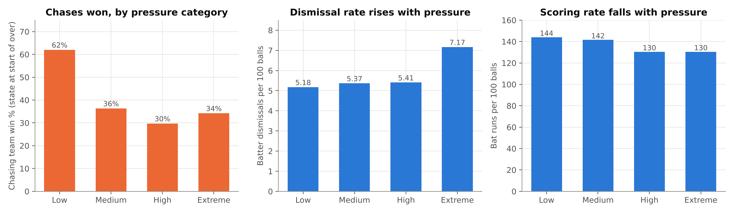
The index finds genuine danger
+38%
62% → 30%
144 → 130
dismissal rate: Extreme vs Low pressure (7.2 vs 5.2 per 100 balls)
chase win rate: Low vs High pressure states
bat runs per 100 balls, despite pressure clustering at the death

Slide 6
Four steps from ball to rating
1 Expect
2 Value
3 Shrink
4 Combine
Cross-fitted gradient boosting predicts runs, dismissal, dot, boundary for an average player in the same context: competition, season, over, wickets, batting position, pace/spin, opposition, pressure
RAA = (runs − E[runs]) − λ·(out − P(out)); bowlers mirror it as RSAA. λ = run value of a wicket in that state (11.7 powerplay → 3.5 death)
θ = r·x_pressure + (1 − r)·(a + b·x_normal), r = n/(n+k). Shrinks toward the player's OWN baseline; k ≈ 390 (bat) / 460 (bowl) IPL balls
Weighted z-score composite + 10th-pct lower bound + pressure-vs-normal delta (+ death-over value for bowlers); IPL:T20I 70:30; averaged over 18 specs
Eligibility (fixed before ranking): batters ≥ 100 pressure balls, bowlers ≥ 120; ≥ 10 matches; ≥ 30 IPL pressure balls; ≥ 200 normal balls → 72 batters, 90 bowlers.

Slide 7
Raw "clutch" numbers are mostly noise, so shrink smartly
≈ 0
split-half reliability of raw pressure batting value
0.47
correlation of normal vs pressure batting scoring
0.34
split-half reliability of pressure bowling value
Honest caveat: for batting, the normal baseline alone predicts slightly better (47.9). Batting ranks describe evidence, not strong forecasts.

Slide 8
Top 10 batters: score, sample and confidence
Player | IPL/T20I balls | Press. RAA | Normal | Δ | SR (exp.) | P(top10) | Conf.
Tim David | 341/205 | 23.5 | 14.0 | +9.5 | 168 (136) | 92% | High
Heinrich Klaasen | 361/67 | 18.3 | 12.7 | +5.6 | 156 (135) | 86% | High
Suryakumar Yadav | 476/143 | 20.1 | 18.1 | +2.0 | 154 (141) | 74% | High
Shashank Singh | 237/0 | 18.6 | 6.7 | +11.8 | 160 (137) | 75% | Medium
Abhishek Sharma | 86/66 | 11.8 | 21.6 | -9.8 | 159 (149) | 26% | Low
Andre Russell | 307/40 | 19.8 | 9.3 | +10.6 | 165 (130) | 76% | High
Dinesh Karthik | 225/81 | 15.2 | 9.6 | +5.7 | 149 (139) | 52% | Medium
Nicholas Pooran | 419/203 | 17.0 | 8.2 | +8.8 | 153 (139) | 60% | Medium
Shreyas Iyer | 235/120 | 13.4 | 10.5 | +2.9 | 150 (142) | 39% | Medium
Naman Dhir | 127/39 | 9.7 | 6.6 | +3.1 | 178 (141) | 30% | Low
Press. RAA = runs added above context expectation per 100 pressure balls (shrunk). Δ = pressure − own normal. P(top10) from 300 match bootstraps.

Slide 9
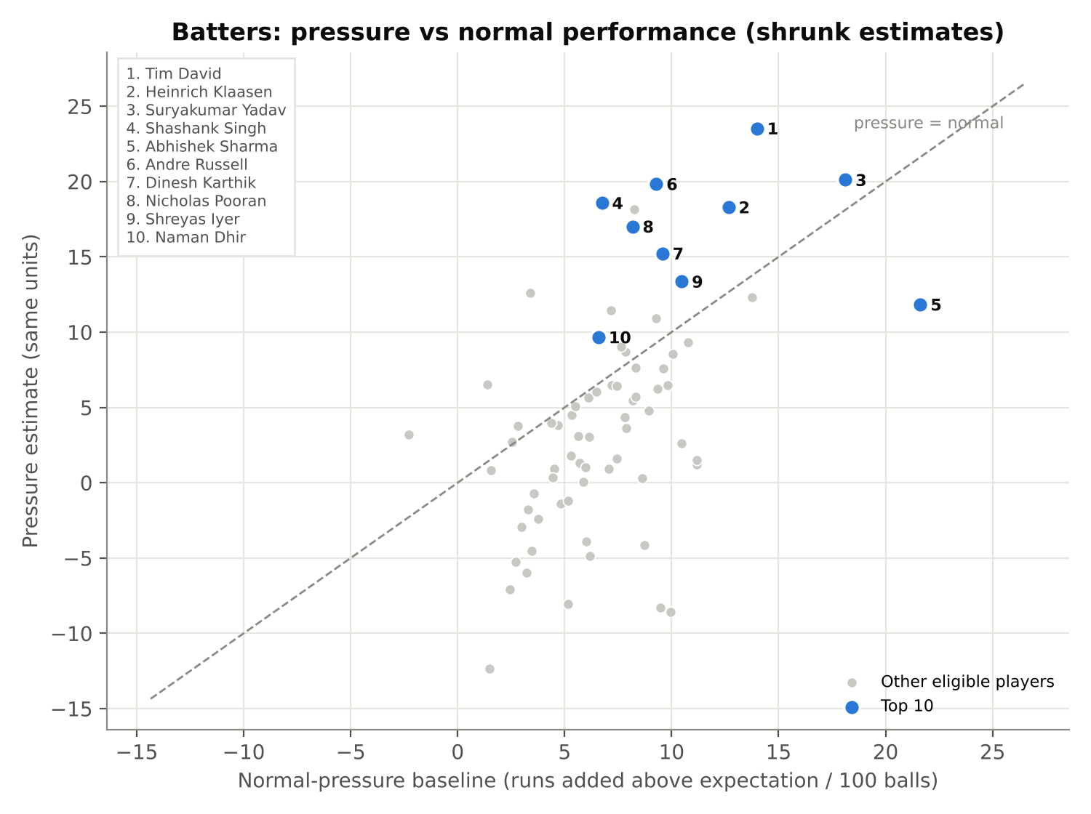
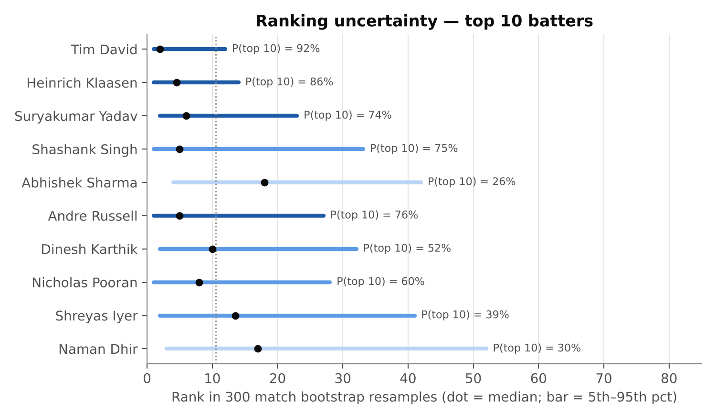
Batters: own baseline and uncertainty
Tim David, Klaasen, Suryakumar: High confidence, top 10 in all 18 specs
Shashank Singh: biggest lift over his own baseline (+11.8)
Abhishek Sharma & Naman Dhir: Low confidence; small pressure samples

Slide 10
Top 10 bowlers: score, sample and confidence
Player | IPL/T20I balls | Press. RSAA | Normal | Δ | Econ (exp.) | P(top10) | Conf.
Sunil Narine | 486/0 | 22.1 | 3.2 | +18.8 | 5.31 (7.28) | 99% | High
Mohsin Khan | 169/0 | 22.4 | 2.7 | +19.7 | 6.53 (9.41) | 82% | Medium
Matheesha Pathirana | 284/162 | 17.7 | 4.2 | +13.5 | 7.64 (9.99) | 93% | High
Jasprit Bumrah | 358/150 | 20.5 | 7.5 | +13.0 | 7.12 (8.58) | 94% | High
Josh Hazlewood | 243/148 | 15.3 | 6.1 | +9.2 | 8.16 (8.51) | 48% | Medium
Kuldeep Yadav | 472/180 | 13.3 | 3.1 | +10.2 | 6.64 (7.81) | 50% | Medium
Varun Chakravarthy | 466/253 | 12.8 | 7.0 | +5.8 | 6.94 (7.44) | 50% | Medium
Rashid Khan | 507/365 | 12.9 | 4.8 | +8.1 | 6.61 (7.48) | 55% | Medium
Bhuvneshwar Kumar | 381/94 | 14.6 | 4.3 | +10.2 | 8.59 (9.52) | 64% | Medium
Mustafizur Rahman | 132/382 | 10.2 | 4.3 | +5.9 | 7.09 (8.49) | 32% | Low
Press. RSAA = runs saved above context expectation per 100 pressure balls (shrunk). Δ = pressure − own normal. P(top10) from 300 match bootstraps.

Slide 11
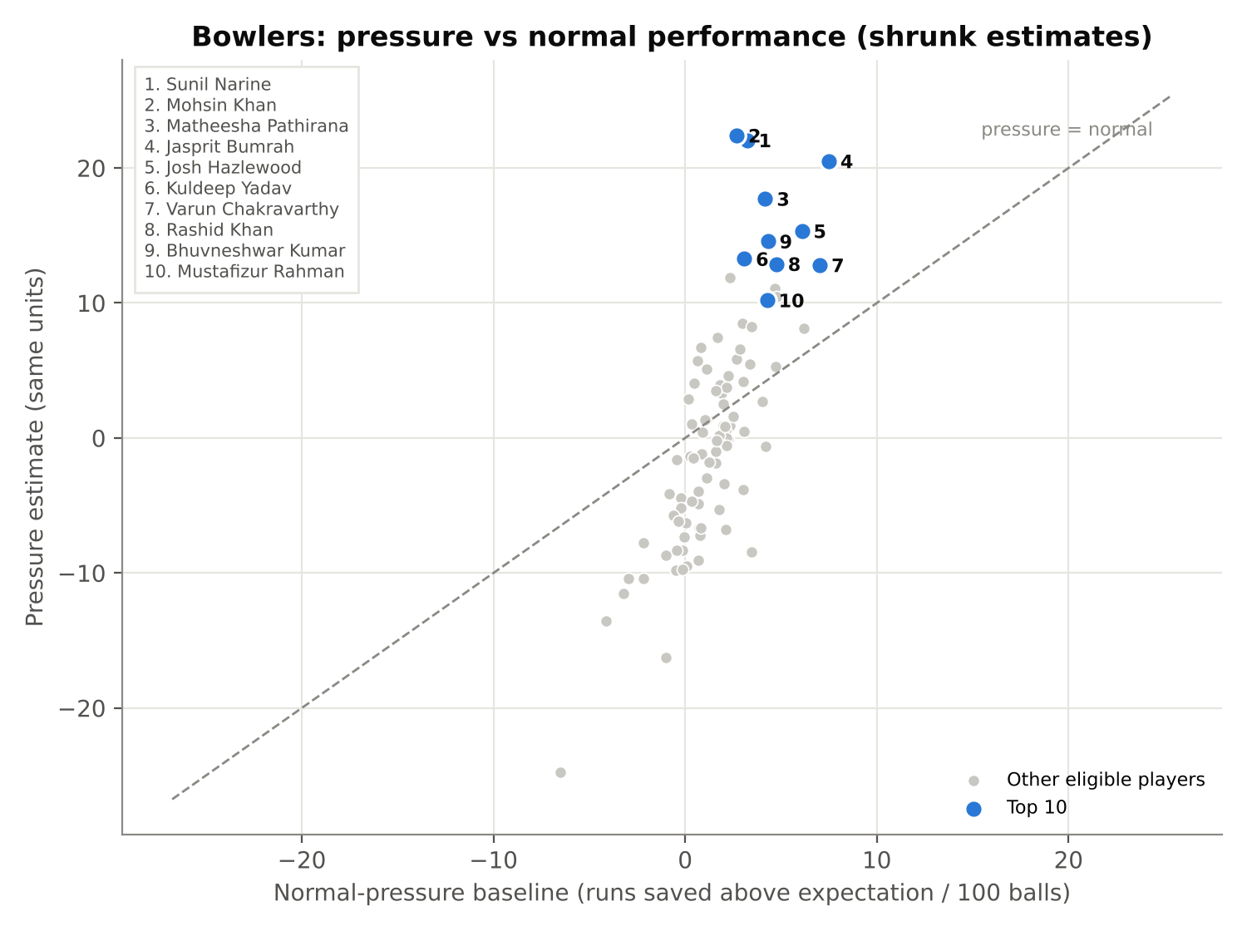
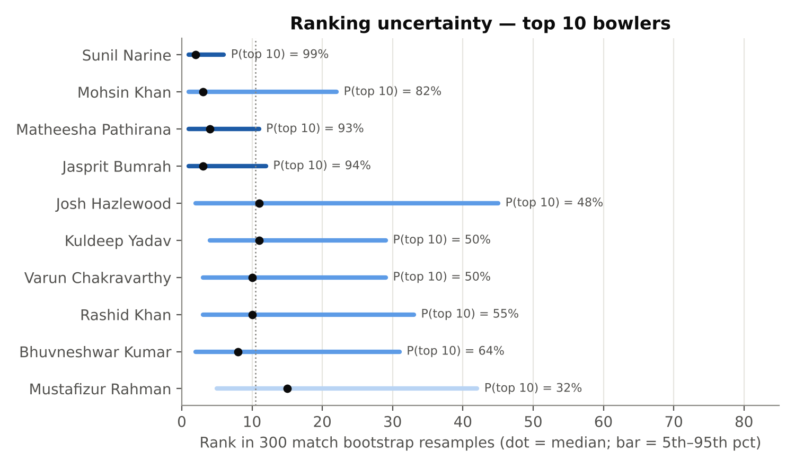
Bowlers: own baseline and uncertainty
Narine: rank 1 in 15 of 18 specs, P(top 10) = 99%
Bumrah & Pathirana: High-confidence death specialists
Mustafizur: Low confidence (P(top 10) = 32%)

Slide 12
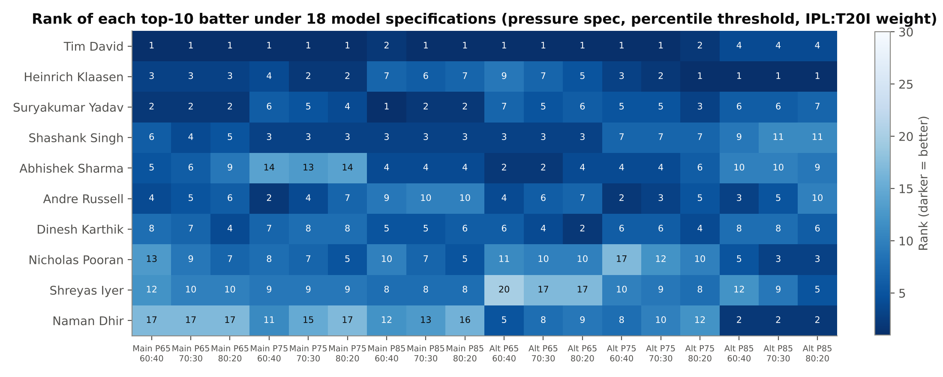
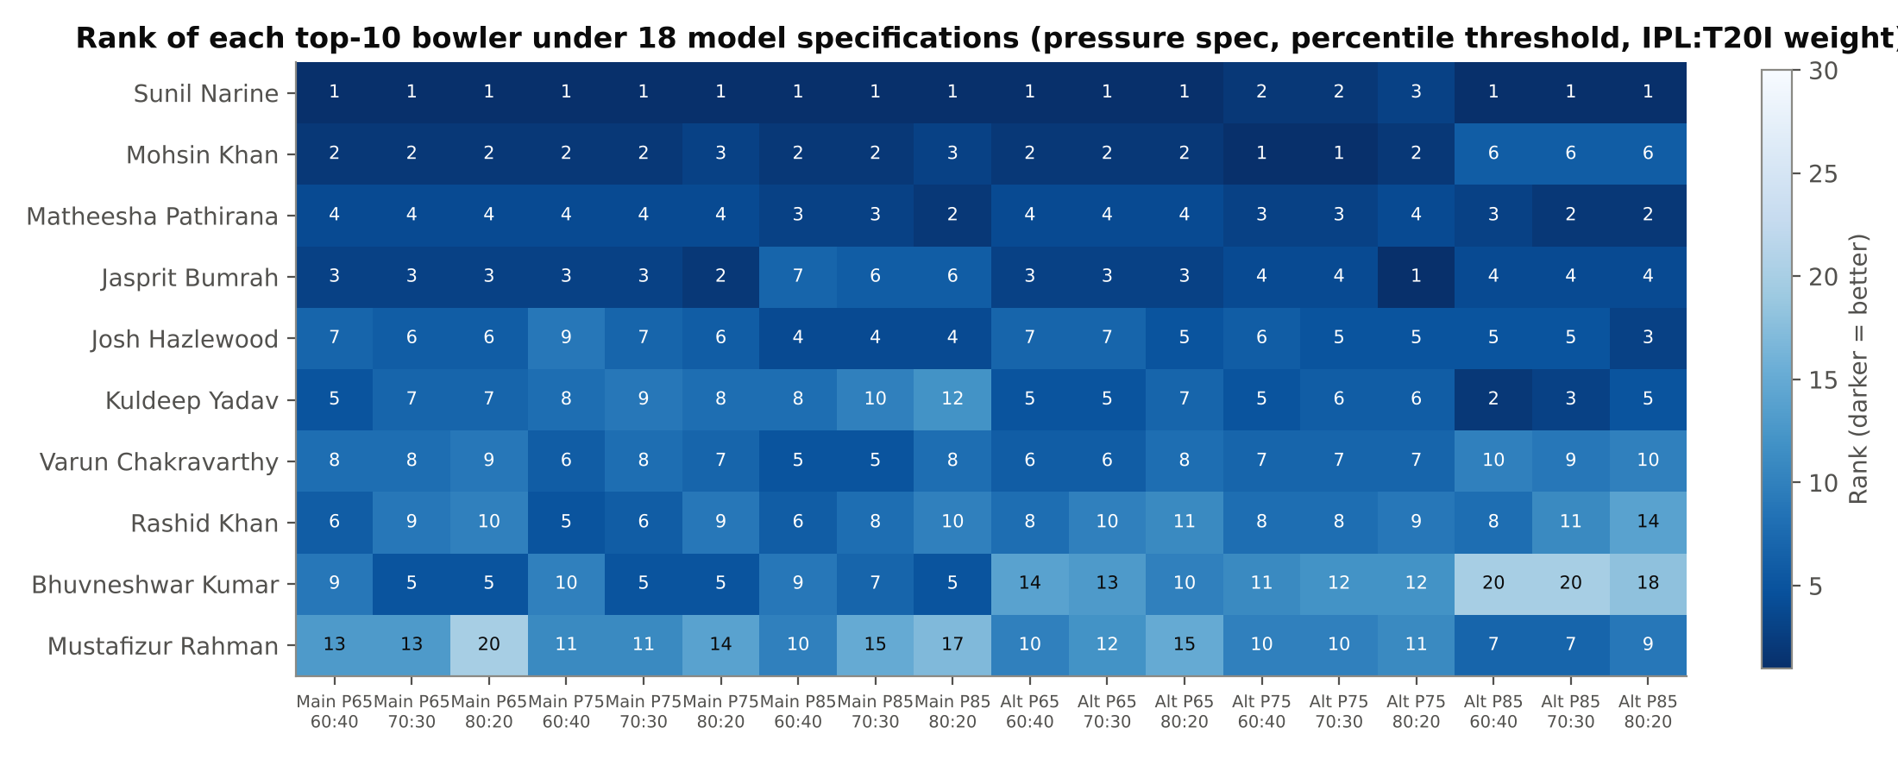
Ranks hold across 18 model specifications
Notes:
Specs: pressure definition (main / equal-weight) x threshold (65/75/85th pct) x IPL:T20I (60:40/70:30/80:20). Overlap with final top 10: batting 7-9, bowling 8-10.

Slide 13
For RR: buy pressure death bowling first, then a finisher
Data finding
No IPL 2026 RR player reaches either top 20
Best RR pressure bowler: Archer, 24th of 90; Deshpande 62nd, Bishnoi 80th, Curran 84th, Sandeep Sharma 85th
Best RR pressure batters: Jurel 26th, Parag 27th of 72
Jaiswal & Sooryavanshi: openers, too few pressure balls to judge
Opinion (role fit)
Death: Pathirana, Bumrah (High); Indian-slot options Mohsin Khan, Bhuvneshwar
Middle-overs spin: Narine; Indian-slot Kuldeep, Varun Chakravarthy
Finisher No. 5–7: Tim David, Klaasen; Indian-slot Shashank Singh
Russell & Karthik retired: next eligible are Tilak Varma, Rajat Patidar, Tristan Stubbs
IPL 2027 retentions not yet official (11 Nov 2026): no availability assumed
Notes:
Squad source: rajasthanroyals.com (15-16 Dec 2025) cross-checked with the IPL 2026 mapping in the data.

Slide 14
Limits we report, not hide
Multi-run extras not recorded: chase targets carry ±3 runs of noise
Batting pressure skill has weak out-of-sample signal; bowling is stronger
Index weights are judgement-based: mitigated by an equal-weight alternative and the 18-spec ensemble
Full methodology, code and the all-player ranking dataset accompany this deck

