Slide 1
CoAtNet:
Marrying Convolution and Attention for All Data Sizes
DAI, Zihang, et al.
Advances in Neural Information Processing Systems, 2021, 34: 3965-3977.
2023-06-01
Garam Kim

Slide 2
Abstract
Intention
Effectively combine the strengths from both architectures. (CNN, self-attention)
Depth-wise convolution and self-attention can be naturally unified via simple relative attention.
Improve generalization, capacity and efficiency.
CoAtNet achieve SOTA performance without extra dataset.

Slide 3
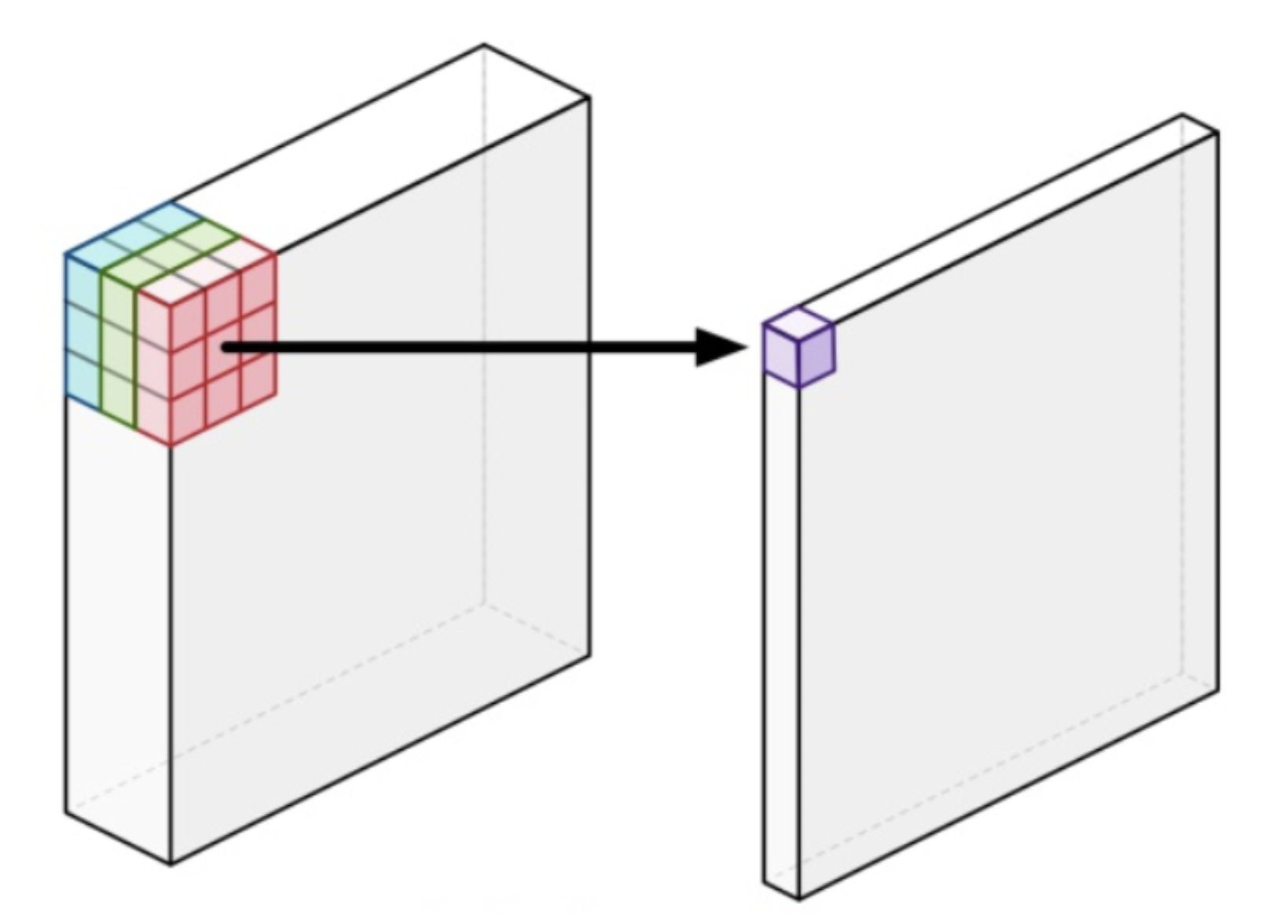
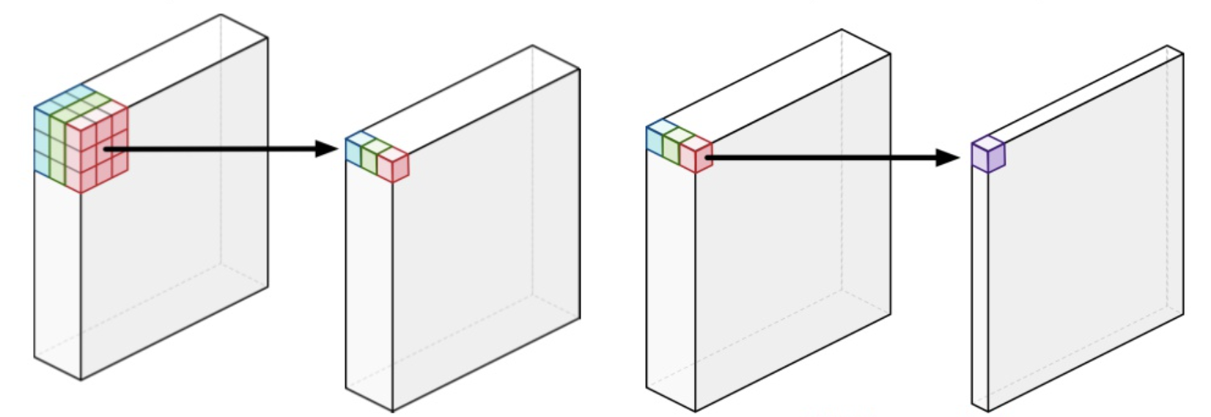
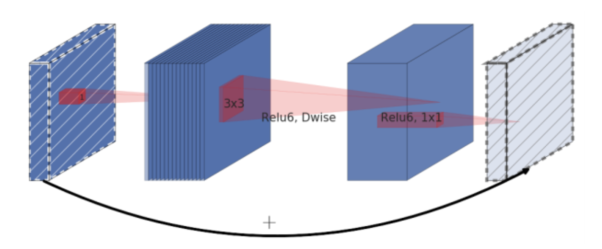
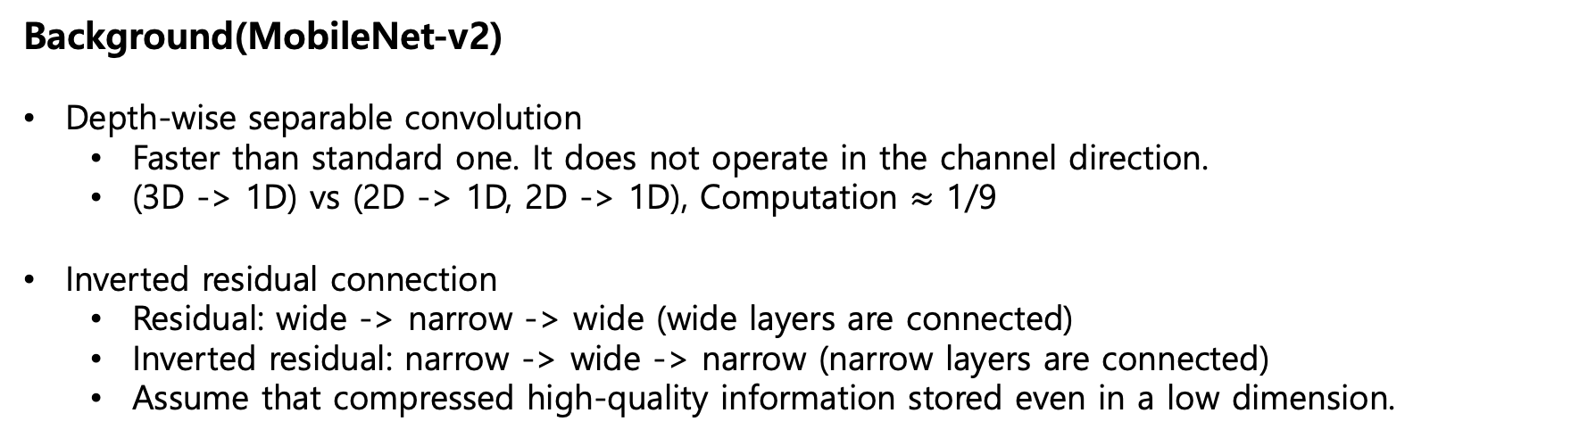
Abstract
Background(MobileNet-v2)
Depth-wise separable convolution
Faster than standard one. It does not operate in the channel direction.
(3D -> 1D) vs (2D -> 1D, 2D -> 1D), Computation $≈$ 1/9
Inverted residual connection
Residual: wide -> narrow -> wide (wide layers are connected)
Inverted residual: narrow -> wide -> narrow (narrow layers are connected)
Assume that compressed high-quality information stored even in a low dimension.
[Standard Conv]
[Depth-wise separable Conv]
[Inverted residual]
(Depth-wise Conv + Point-wise Conv)
Notes:
Wide의 의미는 채널이 많은 것. 차원이 큰 것.

Slide 4
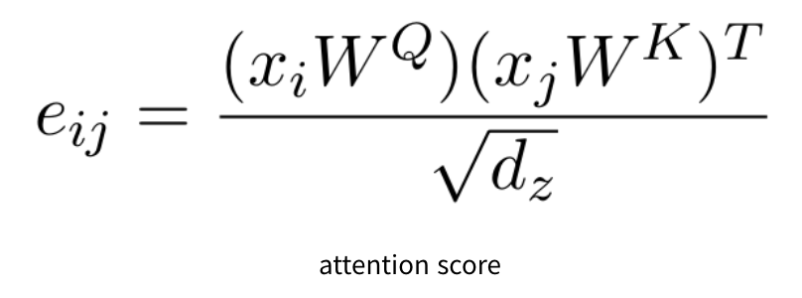
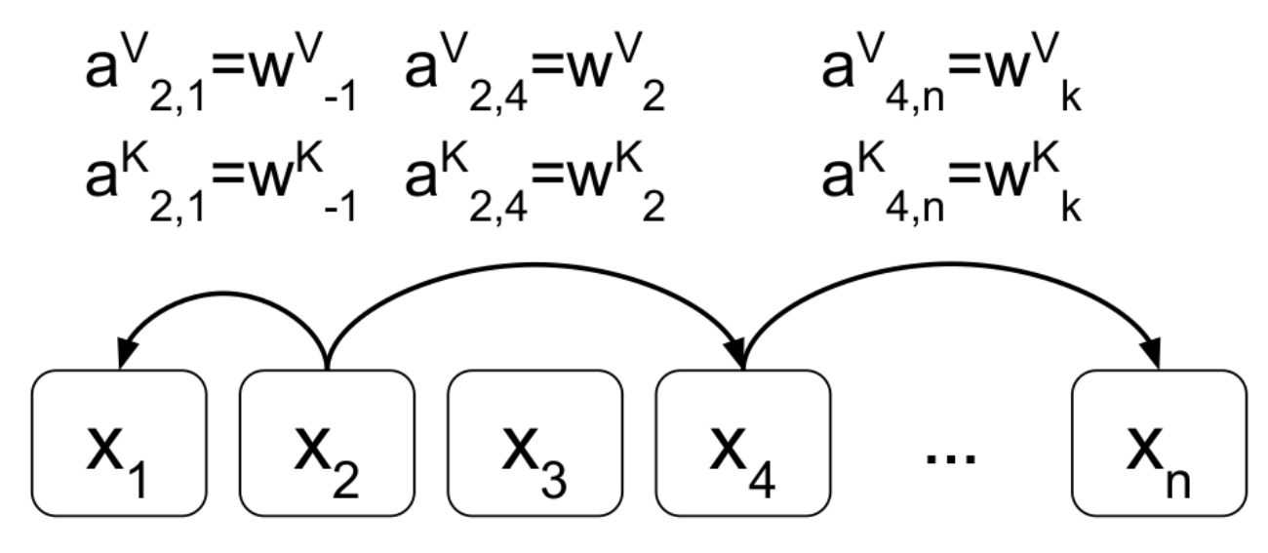
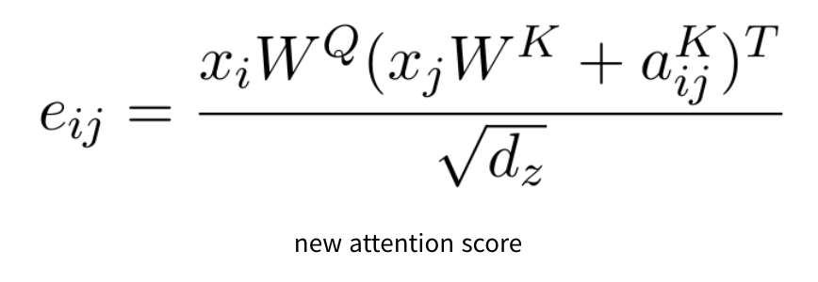
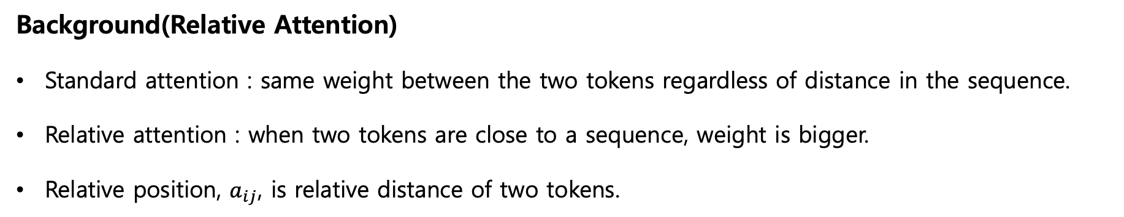
Abstract
Background(Relative Attention)
Standard attention : same weight between the two tokens regardless of distance in the sequence.
Relative attention : when two tokens are close to a sequence, weight is bigger.
Relative position, $a_{ij}$, is relative distance of two tokens.

Slide 5
Introduction
Existing Problems
ViT’s performance still falls behind ConvNets in the low data regime.
Vanilla ViTs layers may lack certain desirable inductive biases.
Key Ideas
Convolution layers tend to have better generalization with faster converging speed.
Attention layers have higher model capacity that can benefit from larger datasets.

Slide 6
Model
Merging Convolution and Self-Attention
We mainly focus on the MBConv block. (Depth-wise Conv block)
Because Transformer and MBConv employ the design of inverted bottleneck.
First, let’s analyze the desirable properties of the two layers.
Input-adaptive weighting
Self-attention can capture complicated relation between different position.
Input-adaptive weighting is a property that we desire most when processing high-level concept.
Translation equivariance
Conv weight only cares about the relative shift between given any position pair(i, j).
Translation equivariance improve generalization under datasets is not large.
Global receptive field
Self-attention have the global size of the receptive field.
Global receptive field provides more contextual information, which could lead to higher capacity.

Slide 7
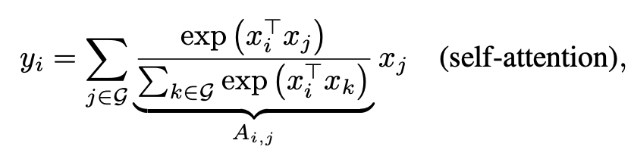
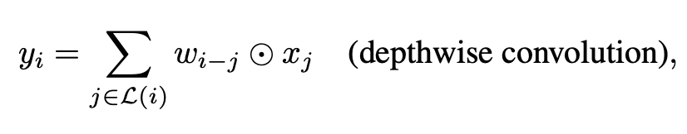
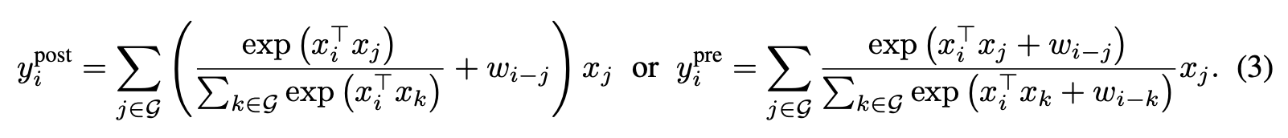
Model
Merging Convolution and Self-Attention
An ideal model should be able to combine the 3 desirable properties.
Depth-wise Conv & Self-attention has similarity.
Merging kernel weight of Conv and attention matrix of self-attention.

Slide 8
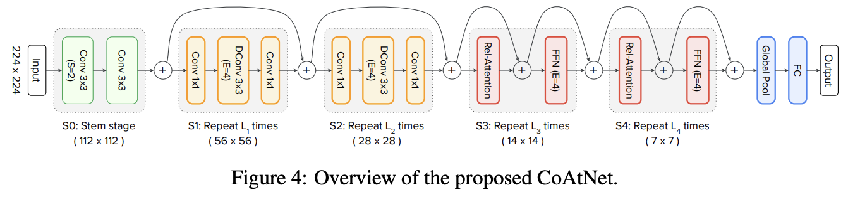
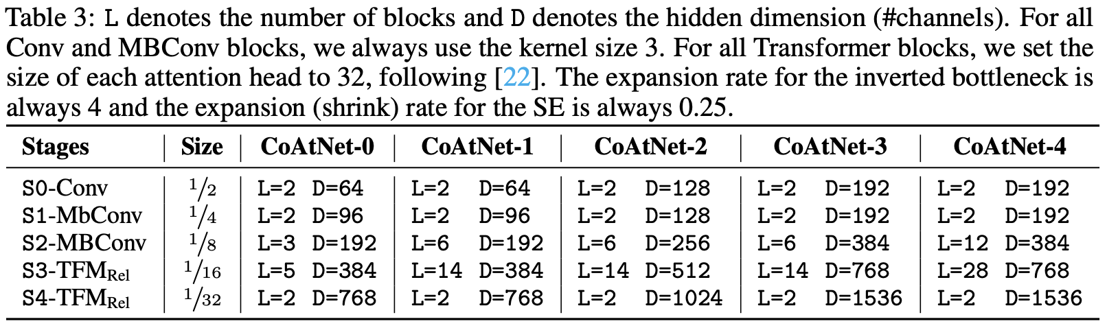
Model
Model Details

Slide 9
Model
Model Details
Down-sampling to reduce the spatial size and employ the global relative attention.
S0 : Stem stage, reduce the spatial size to half by using the (3x3) kernel (stride=2).
S1 : Always MBConv block, Conv block has good performance in the early stage.
S2~S4 : MBConv block or relative attention block.
4 variants model (CCCC, CCCT, CCTT, CTTT)

Slide 10
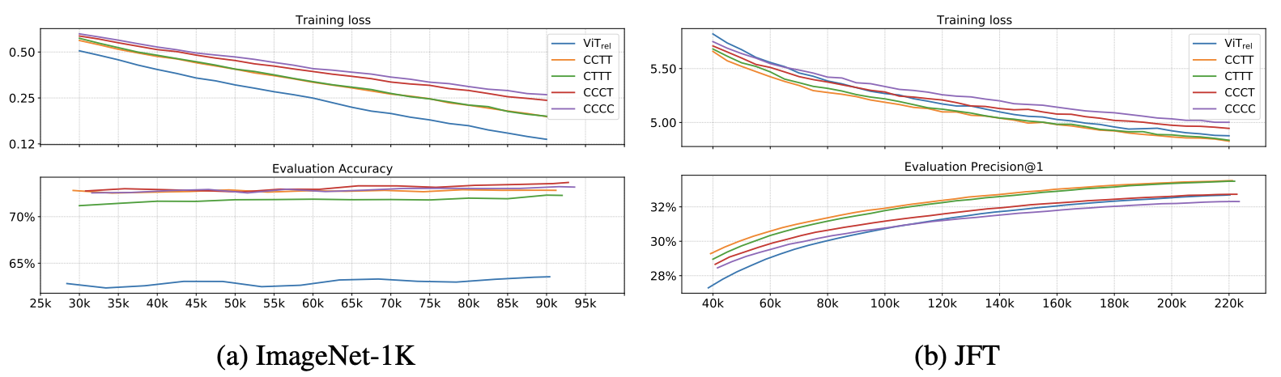
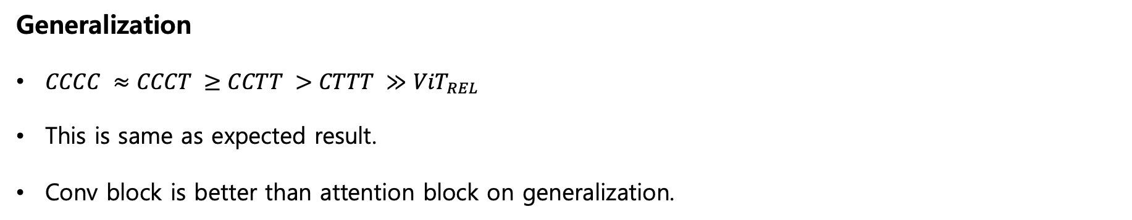
Model
Generalization
$CCCC ≈CCCT ≥CCTT >CTTT ≫{ViT}_{REL}$
This is same as expected result.
Conv block is better than attention block on generalization.

Slide 11
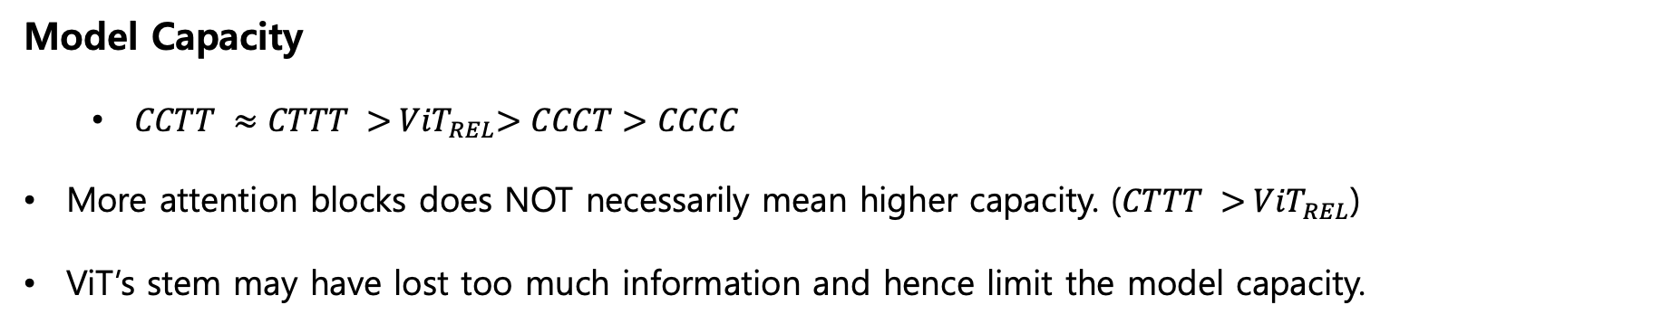
Model
Model Capacity
$CCTT ≈CTTT >{ ViT}_{REL}>CCCT>CCCC$
More attention blocks does NOT necessarily mean higher capacity. ($CTTT >{ ViT}_{REL}$)
ViT’s stem may have lost too much information and hence limit the model capacity.

Slide 12
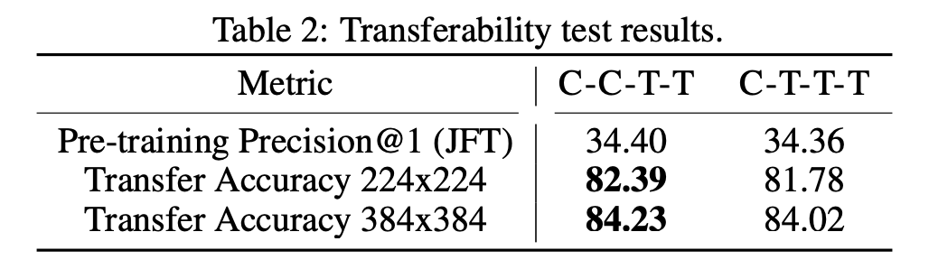
Model
Transferability Test (CCTT vs CTTT)
Pre-training on JFT and fine-tuning on ImageNet-1K (30 epochs)
CCTT’s 30 shots transfer accuracy is better than CTTT’s.
Finally, CoAtNet architecture is determined by CCTT.

Slide 13
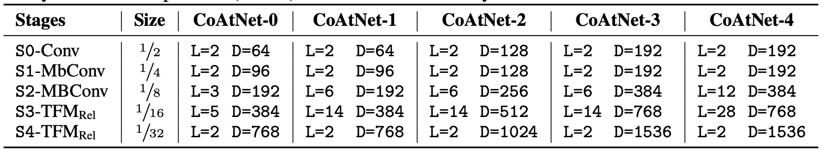
Experiments
CoAtNet Model Family

Slide 14
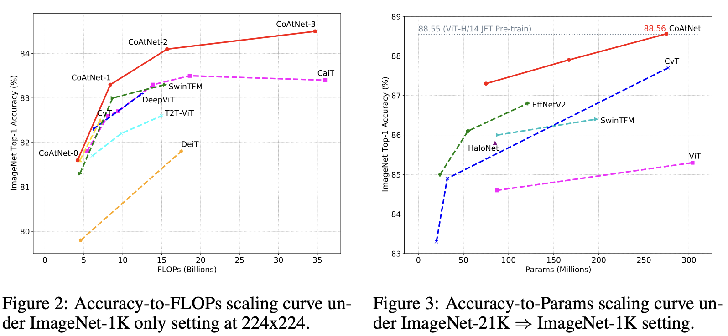
Experiments
Main Results

Slide 15
Conclusion
Meaning
We systematically study the properties of convolutions and transformers.
Combine them into a new family of models named CoAtNet.
Show that CoAtNet enjoys both good generalization like conv and capacity like transformers.
As of June 2023, it is ranked 6th to ImageNet Challenge. (Next CNN model, RevCol-H, is 17th)

