Slide 1
MLP-Mixer: An all-MLP Architecture for Vision
TOLSTIKHIN, Ilya O., et al.
Advances in neural information processing systems, 2021, 34: 24261-24272.
2023-07-21
Garam Kim

Slide 2
Abstract
Intention
Show that convolution layers and attention layers are not necessary.
Present MLP-Mixer, an architecture based exclusively on MLPs.

Slide 3
Introduction
Existing Problems
Architecture of CNNs and ViTs are too complex.
Key Ideas
Does not use convolutions or self-attention. Only based entirely on MLPs.
MLP repeatedly applied across either spatial locations or feature channels.

Slide 4
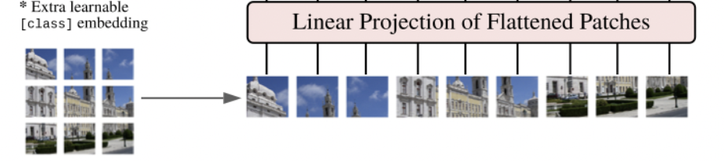
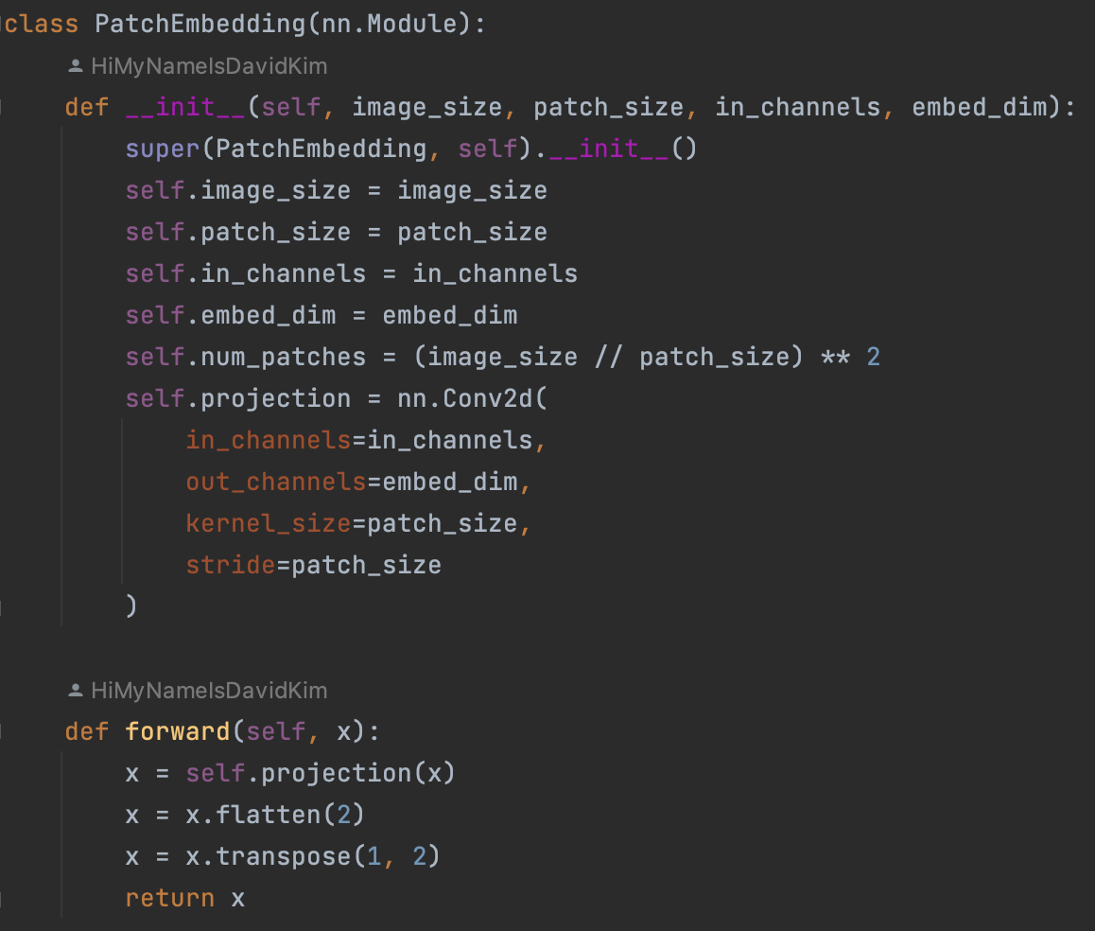
Patch
image_size: Size of a big image (384) patch_size: Divided patches size (16) in_channels: Channel of a big image (3)
embed_dim: Dimension of patch embed (768) (=16 * 16 * 3)
num_patches = (384/16)^2 = 576
768 (pixel)
576
(patch)

Slide 5
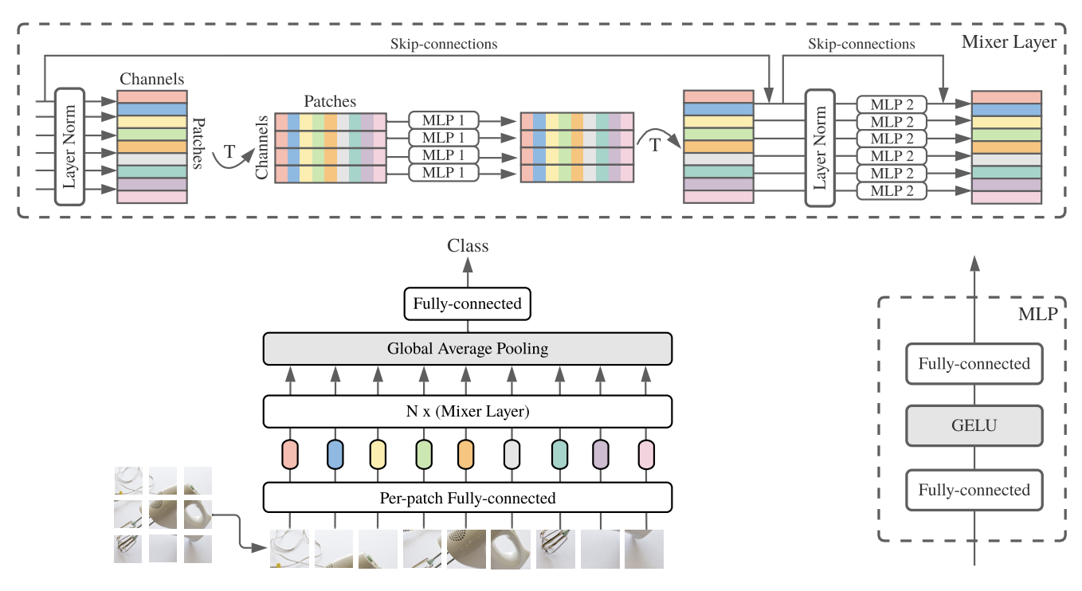
Overview
image_size: Size of a big image (384) patch_size: Divided patches size (16) in_channels: Channel of a big image (3)
embed_dim: Dimension of patch embed (768)
(=16 * 16 * 3)
num_patches = (384/16)^2 = 576
768 (pixel)
576
(patch)

Slide 6
Mixing MLPs
Channel-mixing MLPs
Allow communication between different channels. (per-location)
Each token independently.
Can be seen as 1x1 convolutions.
Token-mixing MLPs
Allow communication between different tokens. (cross-location)
Each channel independently.
Can be seen single-channel depth-wise convolutions.
768 (pixel)
576
(patch)
768 (channel)
576
(token)

Slide 7
Architecture
Features at a given spatial location (i)
CNN : 1x1 convolution layers, large size kernel convolution layers
ViT : MLP blocks, self-attention layers
Mixer : channel-mixing MLPs
Features between different spatial locations (ii)
CNN : Large size kernel convolution layers
ViT : self-attention layers
Mixer : token-mixing MLPs
Mixer architecture is to clearly separate both features.

Slide 8
Experiments
Pre-training
Resolution = 224, batch size = 4096, epochs = 300
AdamW, learning rate = 0.001, warmup of 10k steps and linear decay
Dataset = JFT-300M or ImageNet-21k
Fine-tuning
Resolution = 224, Batch size = 512, steps = 7k,
SGD, learning rate = 0.001, cosine learning rate schedule with a linear warmup
Dataset = ImageNet

Slide 9
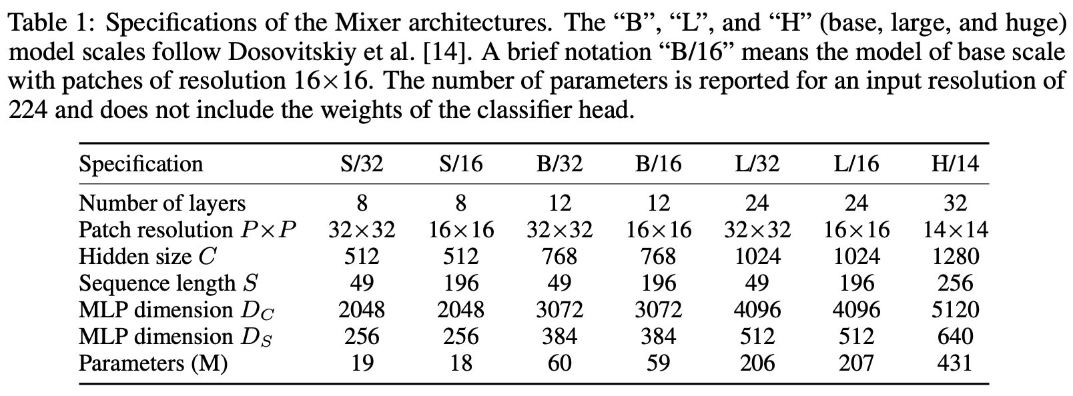
Experiments
Main Result
Specifications of the Mixer architectures.
L/16 is the best model that pre-trained on ImageNet-21k.

Slide 10
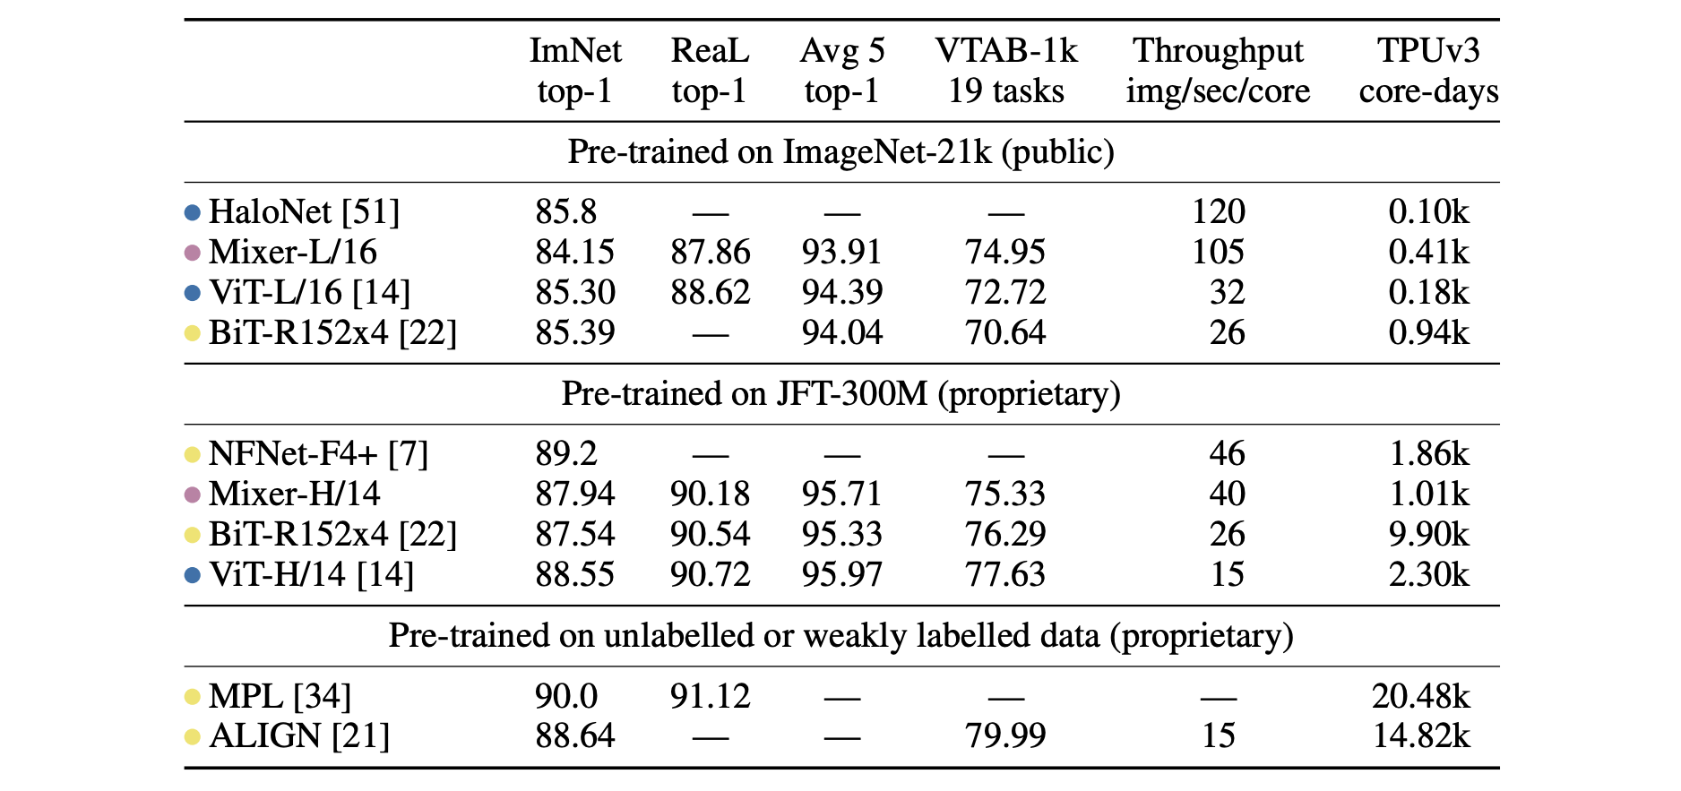
Experiments
Main Result
Pink = Mixers, Yellow = CNN-based models, Blue = Attention-based models
Big size of upstream dataset improve performance.
It's not the best, but it's fast and accurate.

Slide 11
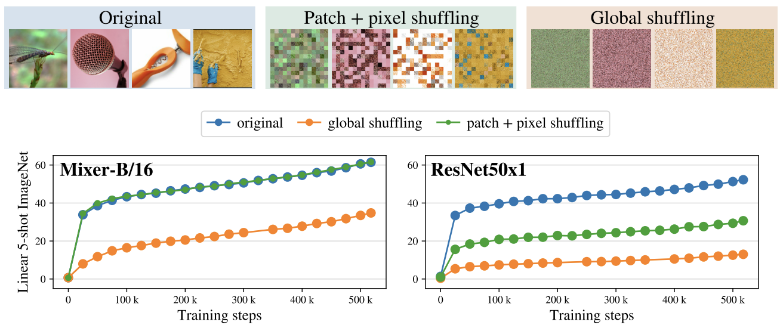
Experiments
Invariance to input permutations
Study difference between inductive biases of Mixer and CNN architectures.
We train Mixer and ResNet on JFT-300M(pre-training) and ImageNet(5 shots).
Dataset : original, patch shuffling + pixel shuffling within each patch, pixel shuffling
Mixer is invariant to patch+pixel shuffling. ResNet’s strong inductive bias relies on order of pixels.

Slide 12
Conclusions
Discussion
We describe a very simple architecture for vision.
We believe these results open many questions.
We hope that our results spark further research, beyond the convolution and self-attention.

