Slide 1
Masked Autoencoders Are Scalable Vision Learners
HE, Kaiming, et al.
In: Proceedings of the IEEE/CVF conference on computer vision and pattern recognition. 2022. p. 16000-16009.
2023-08-11
Garam Kim

Slide 2
Abstract
Intention
Masked autoencoders(MAE) are scalable self-supervised learners for CV.
Train large models efficiently and effectively.
An approach to learning high-capacity models that generalize well.

Slide 3
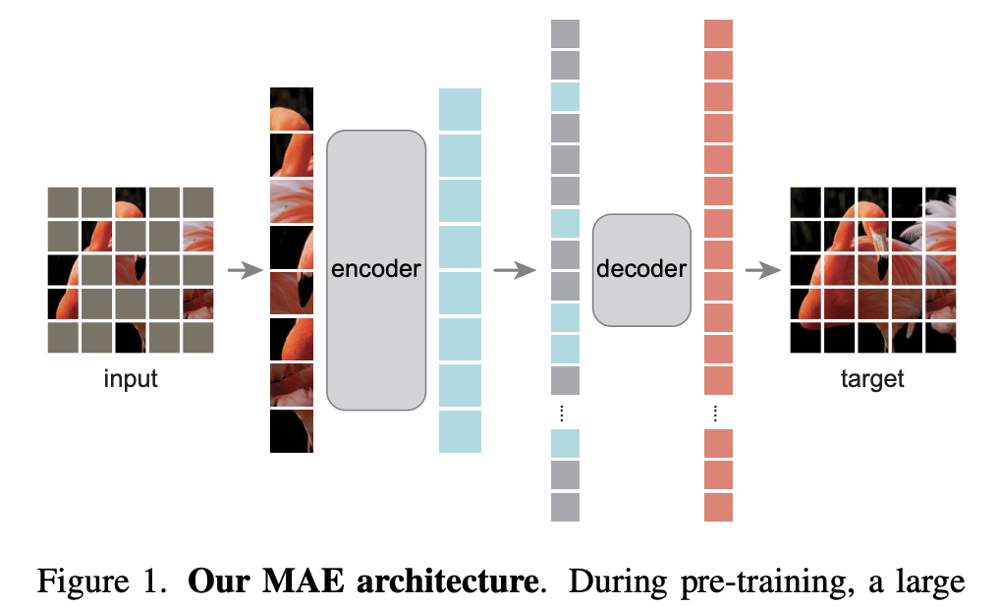
Introduction
Existing Problems
The idea of masked autoencoders, methods of BERT NLP models, is applicable in CV as well.
But, autoencoding methods in CV lags behind NLP.
We ask: what makes MAE different between CV and NLP?
(i) Architectures (CNN) -> This gap has been addressed with the ViT.
(ii) Information density
(iii) The autoencoder’s decoder
Key Ideas
Masking a very high portion.
Masking random patches.

Slide 4
Key Ideas
Masking a high portion
Languages are human-generated signals and images are natural signals.
Languages’ information density is higher than images.
NLP models predict only few missing words. And CV model need to mask a high portion.
This strategy reduces redundancy and this task requires holistic understanding.
Masking random patches
In CV, the decoder reconstructs pixels that is a lower sematic level than recognition task.
In NLP, the decoder reconstructs missing words that contain rich semantic information.
Reconstructs missing patches with mask tokens(=position) can solve this problem.

Slide 5
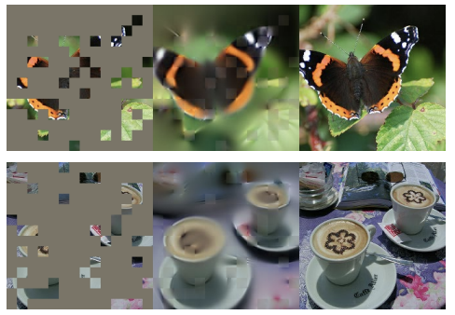
Approach
Masking
Following ViT, we divide an image into patches.
Random sampling with a high masking ratio can reduce redundancy.
Task cannot be easily solved by extrapolation from neighboring patches.
Masked image / MAE reconstruction / Ground-truth

Slide 6
Approach
MAE encoder
Our encoder is a ViT but applied only on unmasked patches. Masked patches are removed.
Input the small subset(=25% of full set) and output the small subset.
This allows us to train very large encoders with only a fraction of compute and memory.
Masked image / MAE reconstruction / Ground-truth

Slide 7
Approach
MAE decoder
Input the full set of unmasked patches and mask tokens.
We add positional embeddings to all tokens in this full set.
MAE decoder is only used during pre-training to perform the reconstruction task.
We experiment with smaller, narrower and shallower than the encoder. (lightweight decoder)
Masked image / MAE reconstruction / Ground-truth

Slide 8
Approach
Reconstruction target
Predicting the pixel values for each masked patch.
The decoder’s output is reshaped to form a image.
Our loss function computes the MSE in the pixel space. (Compute only on masked patches)
Masked image / MAE reconstruction / Ground-truth

Slide 9

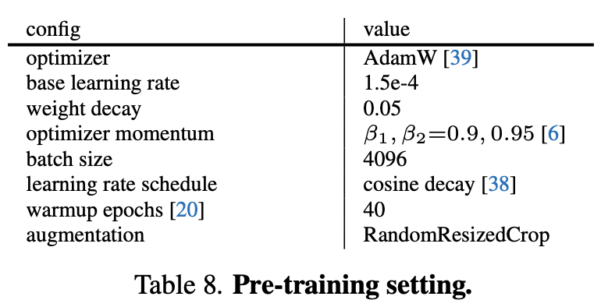
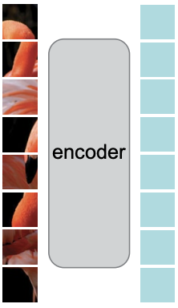
ImageNet Experiments
Baseline: ViT-L/16
ViT-L/16 is very big and tends to overfit.
ViT-L/16 can train better than original with a good strong regularization recipe.
MAE fine-tuning is only for 50 epochs (vs 200 from scratch).
linear probing
fine-tuning
MLP
Head
Max
Output
Confidence

Slide 10
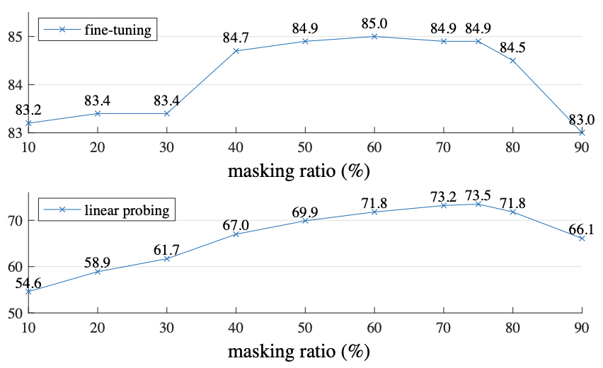
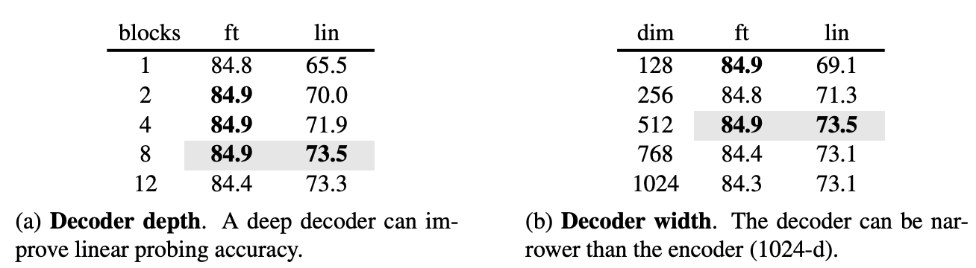
ImageNet Experiments
Main properties – masking ratio, decoder design
The ratio of 75% is good for both linear probing and fine-tuning. (BERT’s typical ratio is 15%)
Linear probing and fine-tuning results follow different trends.
Decoder’s depth and width is not important to fine-tuning.
When decoder’s depth is shallower, encoder are more specialized for reconstruction(not recognition).

Slide 11
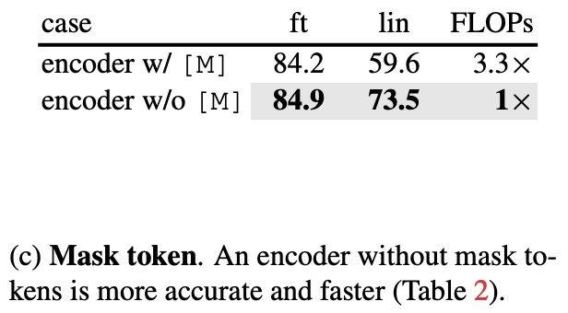
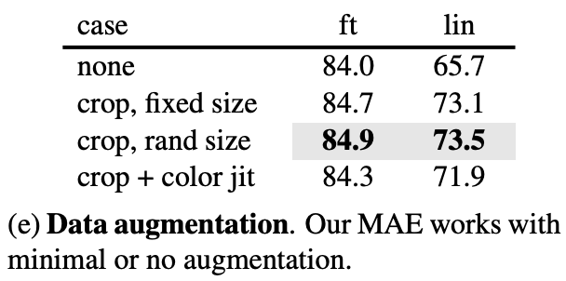
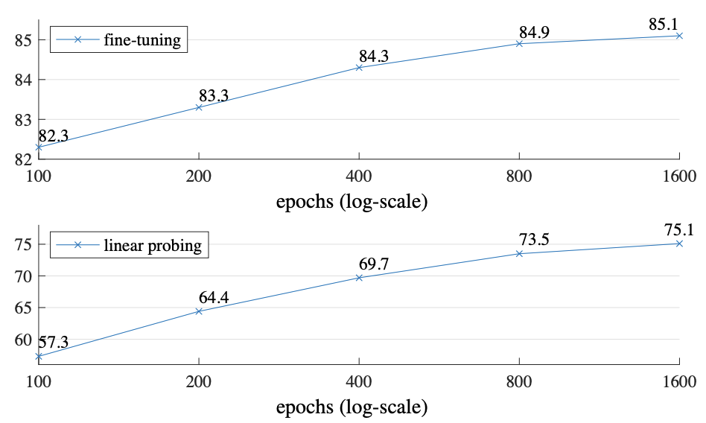
ImageNet Experiments
Main properties – mask token, augmentation, schedule
Skip the mask token [M] in the encoder and apply it later in the decoder.
MAE works well using cropping or random-size even if using no data augmentation.
Our ablations thus far are based on 800-epoch pre-training but there is no saturation at 1600-epoch.

Slide 12
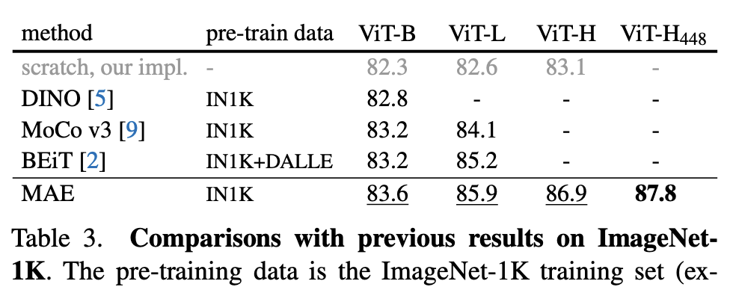
ImageNet Experiments
Comparisons with previous results
We compare the fine-tuning results of self-supervised ViT models.
By fine-tuning with a 448 size, we achieve 87.8% accuracy, using only 1N1K data.
Our result is based on vanilla ViT, and we expect advanced networks will perform better.

Slide 13
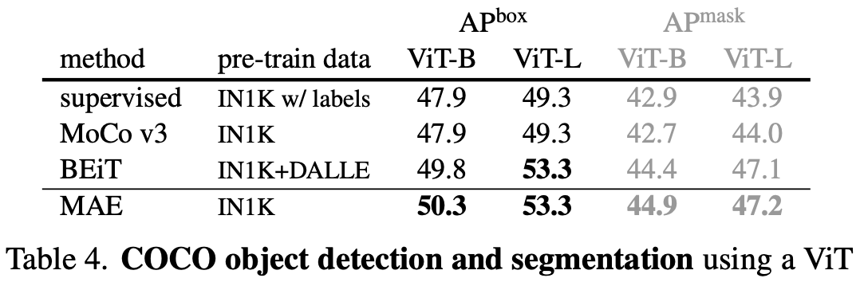
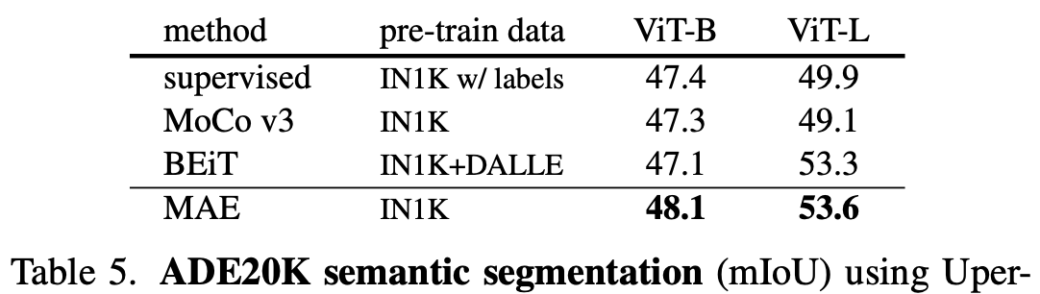
Transfer Learning Experiments
Object detection and segmentation
We fine-tune Mask R-CNN end-to-end on COCO.
We report box AP for object detection and mask AP for instance segmentation.
Semantic segmentation
We experiment on ADE20K using UperNet.
AP : Average Precision

Slide 14
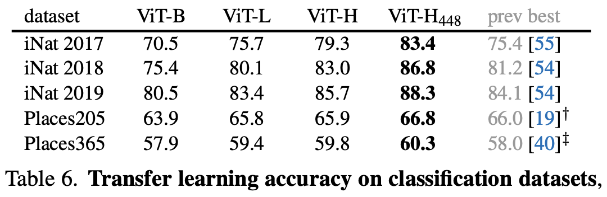
Transfer Learning Experiments
Classification task
Transfer learning on the iNaturalists and Places datasets.
On iNat, our method shows strong scaling behavior. (accuracy improves with bigger models)
On Places, our MAE is higher performance than previous best results.

Slide 15
Discussion and Conclusion
Conclusion
Masked autoencoder is a simple self-supervised method similar to techniques in NLP.
Self-supervised learning in CV may now be embarking on a similar trajectory as in NLP.
We note that images and languages are signals of a different nature.
We observe that our MAE infers complex, holistic reconstructions.
Thoughts
Take insight to train holistic features.
(Pixel is not same as word. Even patch is also not same.)
We can apply Mask token later and independently. -> How to use this for train holistic features.

