Slide 1
Diamond price prediction
Done by:
Hiba Alnimer
Marah Alfaraj

Slide 2
Introduction:
Firstly, we need to understand data so our observe:
1- The dataset has 53,940 tuples of diamonds and contains 10 fields includes the target one.
2-main features (columns)
carat (weight of the diamond)
cut (quality of the cut)
color (diamond color)
clarity (how clear the diamond is)
x (length in mm)
y (width in mm)
z (depth in mm)
depth (total depth percentage = z / mean(x, y))
table (width of top of diamond relative to widest point)

Slide 3
Slide Title
We have two data (train and test) firstly, we need to read it and save it in variables.
then to study and understand the data we apply some functions on data like: train/test.shape , info (to know datatype of each feature),sum (to count how many missing data we have), describe(show the summary statistics of the numeric variables)

Slide 4
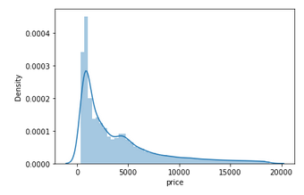
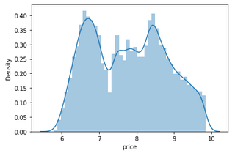
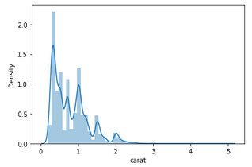
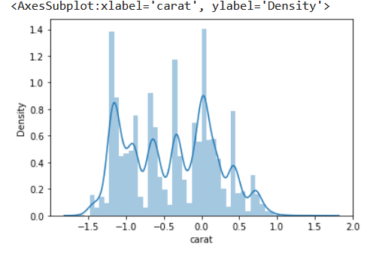
Data Visualization
Some plots we use :
The distribution shows that price and carat is skewed to the right since mean > median
Then we use log to it to normalize it:
train["price"]=np.log(train["price"])
train["carat"]=np.log(train["carat"])

Slide 5
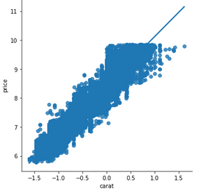
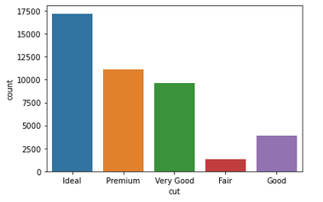
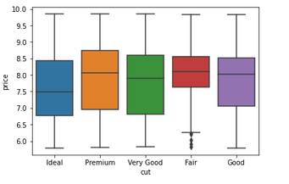
Some conclusion:
1-The graph shows that there is strong relationship between carat and price
2-There is no relationship between cut and price, and median price is around 8.5
3-The graph shows that G color has maximum count values, and J color has the lowest count

Slide 6
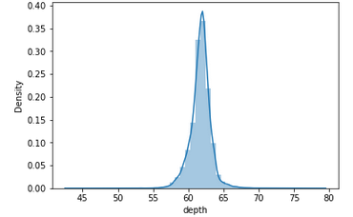
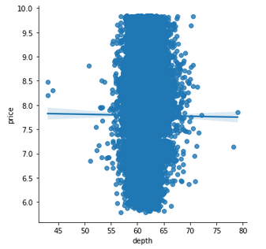
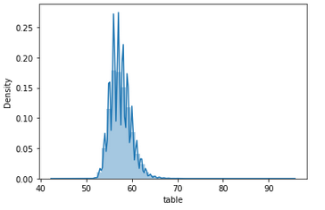
Some conclusion:
1- The graph shows depth is normally distribution with mean of 61.8, and also it
2- There is no relationship between depth and price
3- The graph shows table is normally distribution with mean of 57.5, and also it shows an outliers

Slide 7
Cont.
Missing values or outliers: The dataset doesn’t include any missing values but diamonds with z ,y and x have outliers.
#Dropping the outliers.
train = train[(train["depth"]<75)&(train["depth"]>45)]
train = train[(train["table"]<80)&(train["table"]>40)]
train = train[(train["x"]<30)]
train = train[(train["y"]<30)]
train = train[(train["z"]<30)&(train["z"]>2)]

Slide 8
Encode the object data:
feature Engineering :
The dataset includes 3 categorical variables (cut, color, and clarity). I chose to create dummy variables for those categorical variables using a “replace” function.
Con, we use replace function to solve this one of them:
train.clarity.replace({'SI2':1, 'SI1':2, 'VS1':3, 'VS2':4, 'VVS2':5, 'VVS1':6, 'I1':7, 'IF':8},inplace=True)

Slide 9
we created a new feature “vol” (for volume) which is a multiplication of x, y, and z and then we replaced x, y, and z with this vol to deal with these 3 columns as one column .
train['vol'] = train['x'] * train['y'] * train['z']
train.drop(['x','y','z'], axis=1, inplace=True)

Slide 10
99.11
Model Building
Train and Build a Linear Regression Model
Train and Build a Decision Tree Model
Train and Build a AdaBoostRegressor Model
Train and Build a Gradient Boost Model
Train and Build a xgboost Model
Train and Build a KNeighbors Model
Train and Build a RandomForestRegressor Model
Train and Build aExtraTrees Model

Slide 11
Finally, exporting The Model
we collect all algorithms together under ensemble method, and apply voting technique and end up with R2= , and mse
voting = VotingRegressor([('lr', lr), ('dt', dt),("AdaBoost",AdaBoost) ,('Gradient_Boost',Gradient_Boost), ('xgboost',xgboost),("Random_Forest",Random_Forest),("KNN",KNN),("ExtraTrees",ExtraTrees)],weights=[5,5,1,1,1,1,1,1])

