Slide 1

CROWDSOURCED TRAVEL GUIDE
HIBA NASRIN
MES24MCA2021
Department of Computer Applications
MES College of Engineering, Kuttippuram
20-08-2025

Slide 2
PRODUCT OWNER VASUDEVAN T V ASSISTANT PROFESSOR DEPARTMENT OF COMPUTER APPLICATIONS MES COLLEGE OF ENGINEERING, KUTTIPPURAM

Slide 3
TABLE OF CONTENTS
Introduction
Objective
Existing System
Proposed System
Motivation
Functionalities
Module Description
Developing Environment
Sprint Backlog
Product Backlog
User Story
Project Plans
Data Flow Diagrams
ER Diagram

Slide 4
CROWDSOURCED TRAVEL GUIDE
Community-driven web platform for sharing real-time travel experiences.
Focus on authentic reviews, tips, photos, and itineraries.
Themed destination categorization (culture, adventure, food, etc.).
Personalized planning via filters and interactive maps.
Promotes sustainable tourism.
Secure, user-friendly, and scalable for all travelers.

Slide 5
OBJECTIVES
Enable sharing of authentic, real-time travel experiences.
Provide personalized recommendations with filters and maps.
Promote sustainable tourism.
Foster community interaction and collaboration.
Ensure secure, user-friendly, and scalable access.

Slide 6
EXISTING SYSTEM
Relies on traditional travel websites and blogs with static content.
Most platforms focus on popular destinations, ignoring lesser-known spots.
Information is often outdated, commercialized, or sponsored.
Limited personalization options for travelers’ preferences.
Lack of real-time updates from actual travelers.
Minimal community interaction or collaborative planning features.

Slide 7
PROPOSED SYSTEM
A community-driven web platform for real-time travel sharing.
Travelers can post reviews, tips, photos, and hidden gems.
Advanced filters for location, budget, theme, and season.
Interactive map for easy destination exploration.
Promotes lesser-known destinations
Provides authentic, experience-based content over commercial data.
Designed for secure, user-friendly, and scalable travel planning.

Slide 8
MOTIVATIONS
Finding real, trustworthy travel info online is still hard.
Most travel sites focus on ads and popular spots, not genuine experiences.
Travelers want tips from people who’ve actually been there.
Lesser-known places deserve more attention.
Creating a friendly space where travelers help each other.

Slide 9
FUNCTIONALITIES
User Registration & Login – Secure access for travelers and contributors.
Add Travel Content – Share reviews, tips, and photos of destinations.
Search & Filter – Quickly find places based on budget, theme, or location.
Interactive Map View – Explore destinations visually on a map..
Community Interaction –comment and engage with other travelers.
Admin Control Panel – Manage users and moderate shared content and add new hidden locations and current location.

Slide 10
MODULE DESCRIPTION
Admin Module: Handles overall system control. Admin manages users, monitors posts, Add new locations, update locations and ensures security.
User Module: Covers normal user activities. Users can create accounts, update profiles, share posts, and engage in community interactions.
Traveler Module: Extension of user module for travel needs. Travelers manage travel profiles, plan trips, store preferences, and share experiences.

Slide 11
DEVELOPING ENVIRONMENT
Operating System : windows 10/11
Frontend : HTML,CSS3,JavaScript
Backend : Python with Django Framework
IDE : Visual Studio Code
Database : MySQL
API : Google Maps API

Slide 12
SPRINT BACKLOG
Backlog tem | Completion Date | Original Estimation in Hours | Day 1 Hrs | Day 2 hrs | Day 3 hrs | Day 4 hrs | Day 5 hrs | Day 6 hrs | Day 7 hrs | Day 8 hrs | Day 9 hrs | Day 10 hrs
SPRINT1
User Registration module | 19/8/2025 | 3 | 1 | 1 | 0 | 0 | 0 | 0 | 0 | 0 | 0 | 0
Login & Authentication | 24/8/2025 | 3 | 1 | 1 | 1 | 0 | 0 | 0 | 0 | 0 | 0 | 0
Profile Management | 30/8/2025 | 5 | 1 | 1 | 1 | 1 | 1 | 0 | 0 | 0 | 0 | 0

Slide 13
SPRINT BACKLOG
Backlog tem | Completion Date | Original Estimation in Hours | Day 1 hrs | Day 2 hrs | Day 3 hrs | Day 4 hrs | Day 5 hrs | Day 6 hrs | Day 7 hrs | Day 8 hrs | Day 9 hrs | Day 10 hrs
SPRINT2
Post Creation | 3/10/2025 | 7 | 1 | 1 | 1 | 1 | 1 | 1 | 1 | 0 | 0 | 0
Feedback & Complaint System | 10/10/2025 | 7 | 1 | 1 | 1 | 1 | 1 | 1 | 1 | 0 | 0 | 0
Content Moderation | 13/10/2025 | 7 | 1 | 1 | 1 | 1 | 1 | 1 | 1 | 0 | 0 | 0

Slide 14
SPRINT BACKLOG
Backlog tem | Completion Date | Original Estimation in Hours | Day 1 hrs | Day 2 hrs | Day 3 hrs | Day 4 hrs | Day 5 hrs | Day 6 hrs | Day 7 hrs | Day 8 hrs | Day 9 hrs | Day 10 hrs
SPRINT3
Location Management | 3/10/2025 | 9 | 1 | 1 | 1 | 1 | 1 | 1 | 1 | 1 | 1 | 0
Search & filter | 10/10/2025 | 9 | 1 | 1 | 1 | 1 | 1 | 1 | 1 | 1 | 1 | 0
Interactive Map Integration | 13/10/2025 | 10 | 1 | 1 | 1 | 1 | 1 | 1 | 1 | 1 | 1 | 1
Total |  | 60 | 9 | 9 | 8 | 7 | 7 | 6 | 6 | 3 | 3 | 1

Slide 15
PRODUCT BACKLOG
ID | NAME | PRIORITY <high/medium/low> | ESTIMATE (Hours) | STATUS <Planned/In progress/Completed>
1 | User Registration | High | 6 | Completed
2 | Login & Authentication | High | 6 | In Progress
3 | Profile Management | High | 10 | Planned
4 | Post Creation | High | 15 | Planned
5 | Experience Sharing | Hight | 12 | Planned
6 | Feedback & Complaint System | Medium | 8 | Planned

Slide 16
PRODUCT BACKLOG
ID | NAME | PRIORITY <high/medium/low> | ESTIMATE (Hours) | STATUS <Planned/In progress/Completed>
7 | Content Moderation | High | 14 | Completed
8 | Location Management | High | 10 | In Progress
9 | Interactive Map integration | Medium | 18 | Planned
10 | Search & Filter | High | 15 | Planned
11 | Sustainable Tourism Features | Medium | 12 | Planned
12 | Security & Scalability | High | 20 | Planned

Slide 17
USER STORY
User Story ID | As type of User | I Want to | So that I Can
1 | Admin | Login | Access and manage the system securely
2 | Admin | Manage Users | Control user accounts, roles, and permissions
3 | Admin | Manage Content | Ensure only valid and relevant content is published
4 | Admin | Post Control | Approve, edit, or remove inappropriate posts
5 | Admin | Location Add | Provide new destinations for users and travelers
6 | Admin | Update locations | Keep travel location details accurate and up to date
7 | User | Login | Access my personal account and use platform features

Slide 18
USER STORY
User Story ID | As type of User | I Want to | So that I Can
8 | User | Share Post | Contribute my travel stories and information
9 | User | Update Details | Keep my profile and travel info accurate
10 | User | Post Complaint/ Feedback | Report issues or share opinions to improve the platform
11 | Travelers | Login | Access travel content and participate in the community
12 | Traveler | Share Experience | Help others by providing authentic travel insights
13 | Traveler | Share Post | Contribute photos, tips, and recommendations
14 | Traveler | View | Explore posts, experiences, and travel information from others

Slide 19
PROJECT PLAN
User StoryID | Task Name | Start Date | End Date | Days | Status
1 | SPRINT 1 | 20/08/2025 | 22/08/2025 | 3 | Completed
2 |  | 23/08/2025 | 24/08/2025 | 3 | Planned
3 |  | 25/08/2025 | 27/08/2025 | 4 | Planned
7 |  | 28/8/2025 | 30/08/2025 | 3 | Planned
11 |  | 31/08/2025 | 02/09/2025 | 3 | Planned

Slide 20
PROJECT PLAN
User StoryID | Task Name | Start Date | End Date | Days | Status
4 | SPRINT 2 | 03/09/2025 | 05/09/205 | 2 | Planned
8 |  | 04/09/2025 | 07/09/2025 | 4 | Planned
9 |  | 07/09/2022 | 10/09/2025 | 4 | Planned
10 |  | 11/09/2025 | 13/09/2025 | 3 | Planned
12 |  | 14/09/2025 | 16/09/2025 | 3 | Planned
13 |  | 17/09/2025 | 21/09/2025 | 5 | Planned
14 |  | 22/09/2025 | 25/09/2025 | 3 | Planned

Slide 21
PROJECT PLAN
User StoryID | Task Name | Start Date | End Date | Days | Status
5 | SPRINT 3 | 26/09/2025 | 06/10/2025 | 10 | Planned
6 |  | 06/10/2022 | 16/10/2025 | 10 | Planned

Slide 22
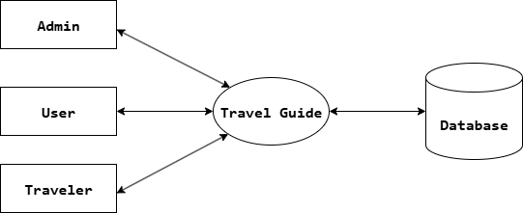
DATA FLOW DIAGRAM
LEVEL 0

Slide 23
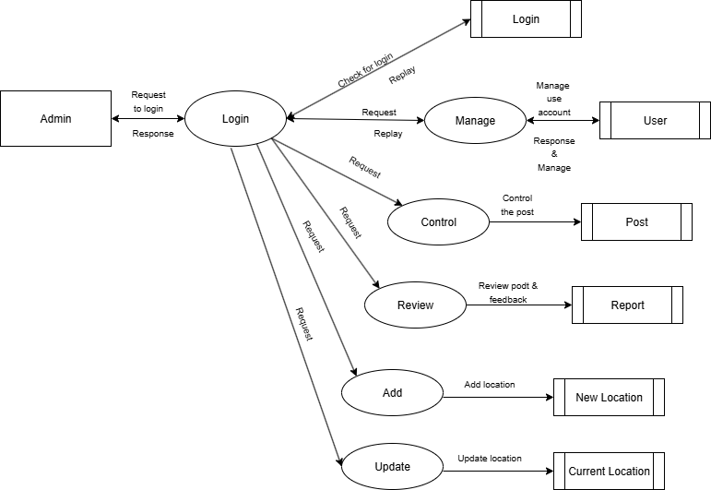
DATA FLOW DIAGRAM
Level 1

Slide 24
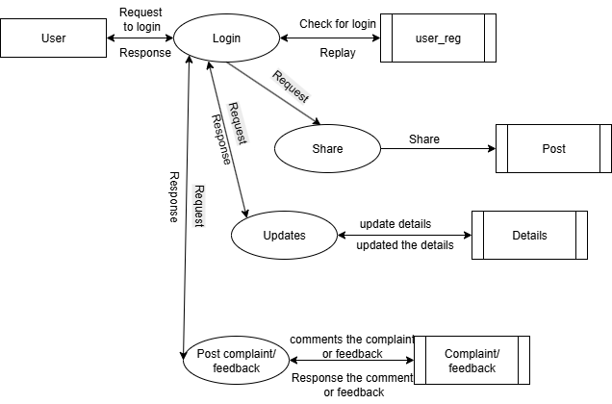
DATA FLOW DIAGRAM
Level 2

Slide 25
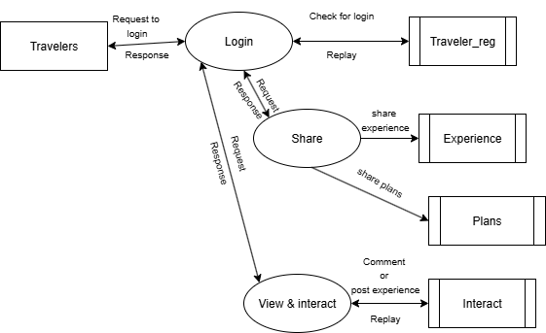
DATA FLOW DIAGRAM
Level 3

Slide 26
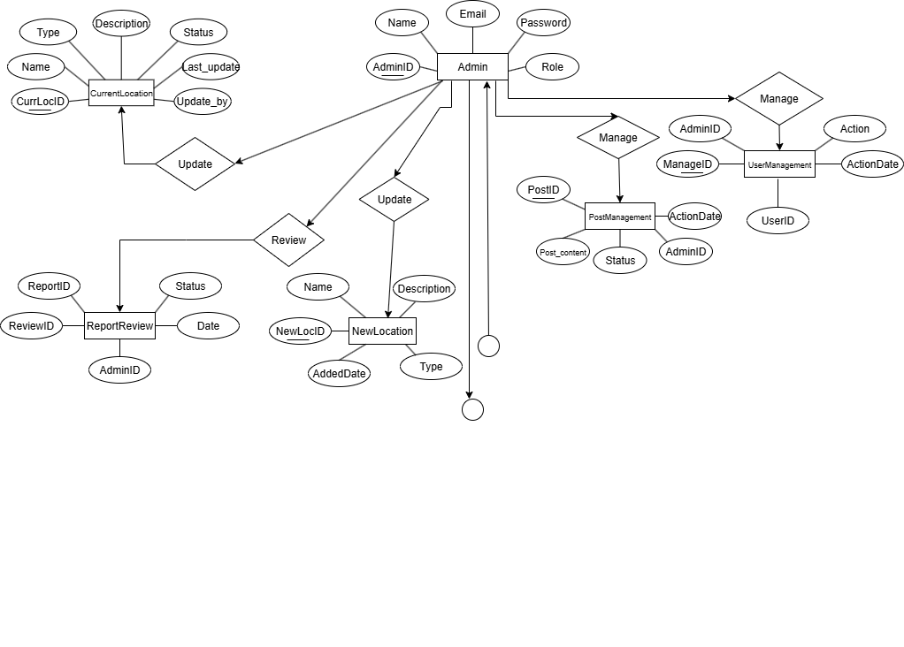
ER DIAGRAM

Slide 27
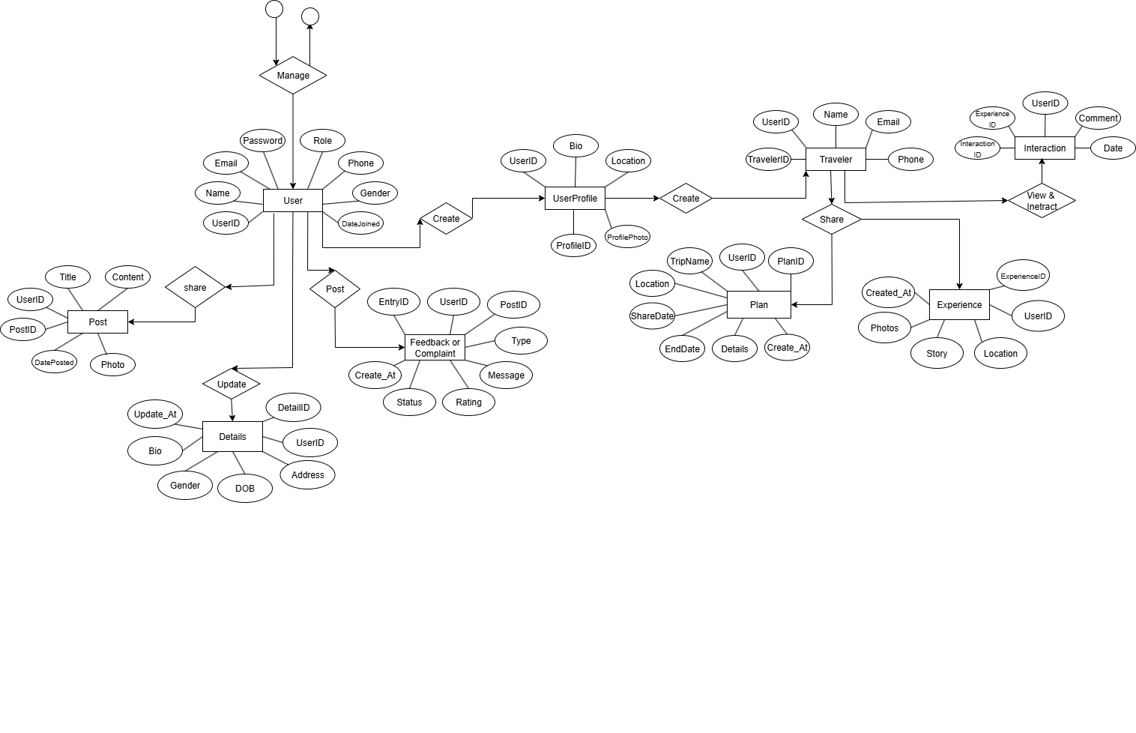
ER DIAGRAM

Slide 28
THANK YOU

