Slide 1


An Introduction to ESG Investing
Mike Seagrove & Calum Butt

Slide 2


Introduction to ESG Investing
The World Needs to Change
Being part of the solution
Sustainability
What is ESG Investing?
Environmental
Social
Governance
INTRODUCTION
Types of ESG Investment?
Impact Portfolio
Thematic Portfolio
Systematic Portfolio
AG Approach to ESG Investment
Systematic ESG Portfolio
Overweight ‘Best in Class’
Performance
The destination is worth it

Slide 3

The World Needs to Change
The world is facing many real challenges, important and in some cases urgent.

Slide 4
The World Needs to Change
4
Energy Supply
Housing
Sourcing greener energy
Solar panels
Smart meters
Better insulation
Appliance ratings
Recycling
Being Part
of the
Solution
Travel
Consumer Purchasing
Carbon off-set for flights
E-cars and fuel efficiency
Methods of travel
Avoid companies with poor reputations
Favour good companies
Animal testing choices
Food & Agriculture
Sustainable Investing
Better animal welfare
Food miles
Avoiding deforestation (palm oil).
Favour good companies
Avoid worse companies
Underweight ‘less good’ companies

Slide 5

The World Needs to Change
Sustainability – Balancing the claims of the present, against the claims of the future.
Making the world a better place
Defining a more balanced use of natural resources
Tackling climate change and caring for the environment
Building a fairer society
Driving better corporate governance
ESG Investing can assist with all of these factors
Source: United Nations

Slide 6
What is ESG Investing?
Environmental
Biodiversity loss
Greenhouse gas emissions
Energy efficiency
Renewable energy
Resource depletion
Ocean acidification
Ozone depletion
Social
Mass migration
Wealth distribution
Access to healthcare
Workplace health and safety
Diversity
Employment rights, child labour and slavery
Controversial weapons such as cluster bombs
Governance
Executive compensation
Bribery and corruption
Independent directors
Ethics in business
Transparent disclosure of ESG criteria
Whistle-blowing policies
Implications of business strategy on social and sustainability issues

Slide 7
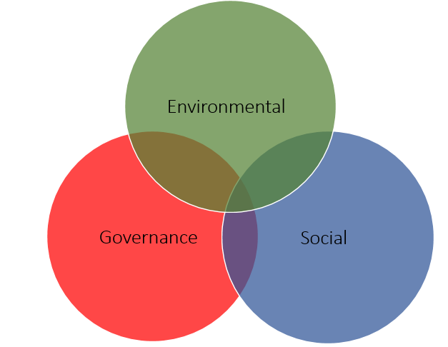
What is ESG Investing?
ESG investing can be broadly defined as ‘integrating Environmental, Social and Governance factors of companies into the fundamental investment process’
How is this Integrated?
Core portfolio analysis to include ESG credentials
ESG ratings form part of decision
Ratings Agencies (e.g. MSCI & Sustainaltics)
Evaluation of ESG can be difficult – lack of data

Slide 8
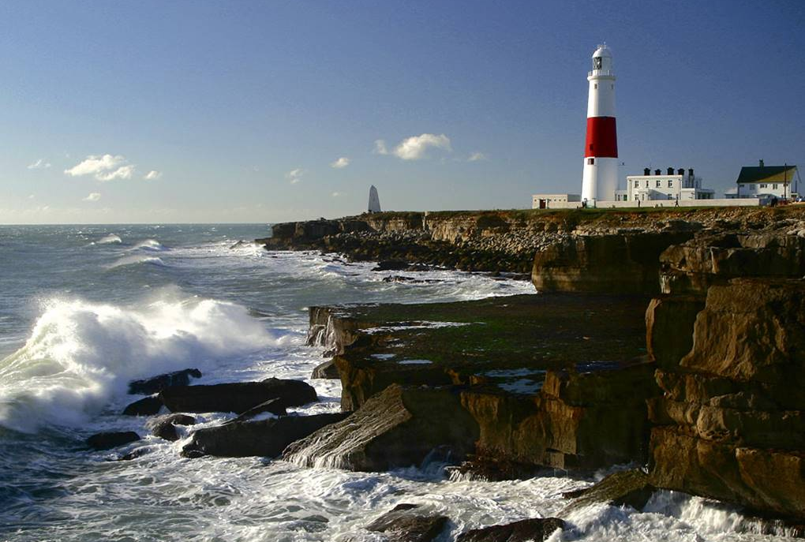
Types of ESG Investment
Impact Portfolio
Thematic Portfolio
Systematic Portfolio
Often private markets
Direct involvement
Return of capital +
Concentration risks
Liquidity and exit risk
Impact closely measured
Seeking capital market returns
Public and private markets
Themes e.g. renewable energy farms
Company size tends to be smaller
More highly concentrated
Impact implied in theme choice
Seeking broad capital market returns
From public markets
Risk and return similar to traditional portfolio
Remain broadly diversified
Tilt toward better ESG credentials
Impact harder to quantify

Slide 9
Our Preferred Approach to ESG Investment
Capture broad market returns
Low cost – Passive options available
Retain Sector Weightings
Systematic
ESG
Portfolio
Well diversified portfolios to reduce risk
Steps in the right direction
Suitable for large proportion of investors

Slide 10
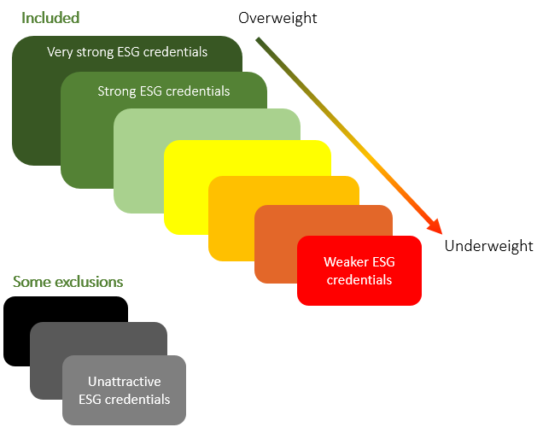
Our Preferred Approach to ESG Investment
Systematic ESG Portfolios in practice – Improving the ESG Credentials of a portfolio.
Key Notes
Moves from market cap to ESG Rating
Oil & Gas – Not excluded - Why?
Production of ‘Cluster Munitions’ excluded
Building a fairer society
Strong ESG Credentials – Better long term prospects

Slide 11
Our Preferred Approach to ESG Investment
60%
AG ESG Balanced Portfolio
40%
80%
AG ESG Moderately Adventurous Portfolio
AG ESG Moderately Cautious Portfolio
The AG ESG Model Portfolio range
AG ESG Cautious Portfolio
20%
100%
AG ESG Adventurous Portfolio

Slide 12
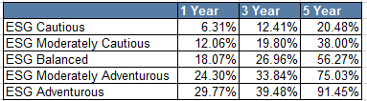
Our Preferred Approach to ESG Investment
The Albert Goodman ESG Model Portfolio Performance
Long term returns in line with broad global market
Higher ESG credentials – better longer term prospects
Positive impact on the world
1 Year returns – post pandemic recovery
*Returns are net of fund costs
**Historic returns from 31/03/2021
Past performance is not indicative of future results and no representation is made that the stated results will be replicated.

Slide 13

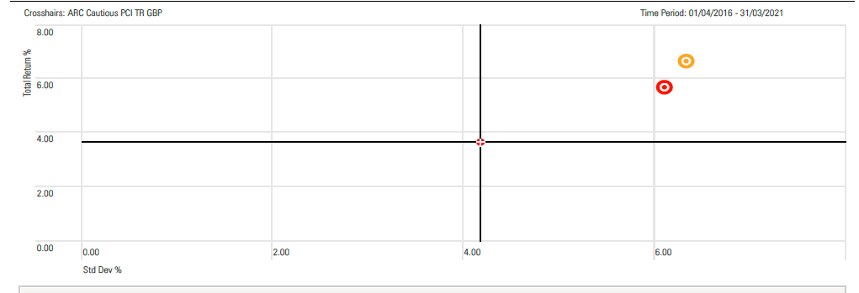
Our Preferred Approach to ESG Investment
Comparison against non ESG investment
Returns Comparison
Risk Comparison
*Returns are net of fund costs
**Historic returns from 31/03/2021
Past performance is not indicative of future results and no representation is made that the stated results will be replicated.

Slide 14

Our Preferred Approach to ESG Investment
The destination is worth it………….
1
2
Use a sensible ESG approach where available
Maintain portfolio risk
Better, more robust ESG Metrics
A more consistent approach
Great impact understanding
3
Wider product choices
Better index construction
Full asset class coverage
4
A better World

Slide 15
Important Notes
This is a purely educational document to discuss some general investment related issues. It does not in any way constitute investment advice or arranging investments. It is for information purposes only; any information contained within them is the opinion of the authors, which can change without notice. All information is based on sources that the firm believes to be reliable. No responsibility can be accepted for actions taken as a result of reading this document.
Past performance is not indicative of future results and no representation is made that the stated results will be replicated.
Errors and omissions excepted.

Slide 16


Thank
You
Mike Seagrove
Chartered Financial Planner
michael.seagrove@albertgoodman.co.uk
Calum Butt
Consultant
calum.butt@albertgoodman.co.uk

