Slide 1

Al-Usra Hajj and Umrah Company Management System
Database Project Presentation
Prepared by: Mohammed Jaber & Hiba Bani Meneh

Slide 2
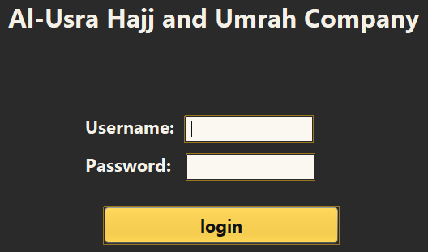
Project Overview
The Al-Usra Hajj and Umrah Company Management System is a desktop application designed to manage the main operations of a Hajj and Umrah company.
The system organizes data related to users, employees, Hajj applicants, campaigns, packages, bookings, hotels, transportation, tasks, and messages.
It uses Java Swing for the graphical user interface and MySQL for database management.

Slide 3
Problem Statement
Hajj and Umrah companies manage many types of data such as customers, employees, bookings, hotels, transportation, packages, tasks, and messages.
Managing this data manually can cause several problems:
- Data duplication
- Missing or incorrect records
- Slow searching and updating
- Difficulty tracking customer services
- Lack of access control between users

Slide 4



Project Objectives
The main objectives of this project are:
- To design a database system for a Hajj and Umrah company
- To organize company data in a structured MySQL database
- To create user-friendly Java Swing interfaces
- To provide role-based access for Manager, Employee, and Customer
- To support CRUD operations: Add, View, Update, and Delete
- To connect the Java application with the MySQL database using JDBC
Database icon
Link/Server icon
To organize company data in MySQL
JDBC connection
Java icon
Table/CRUD icon
To create Java Swing interfaces
Add, View, Update, Delete
Users icon
Role-based access
Login icon
Code icon
Security icon

Slide 5



Tools and Technologies Used
The project was developed using the following tools:
- NetBeans: used to build the Java application and design the GUI
- Java Swing: used to create forms, buttons, tables, and panels
- MySQL: used to store and organize the database
- MySQL Workbench: used to create tables, relationships, and test SQL queries
- JDBC: used to connect the Java application with the MySQL database
Database
Java
NetBeans
MySQL
Workbench

Slide 6
System Users and Roles
The system supports three main user roles:
Manager:
- Manages campaigns, Hajj applicants, employees, hotels, and transport companies
- Has full access to the main management screens
Employee:
- Views and updates profile information
- Checks assigned tasks
- Reads and replies to messages
Customer:
- Views personal Hajj information
- Checks booking, hotel, and transport details
- Can edit limited information such as phone number and password
Manager
Employee
Customer

Slide 7
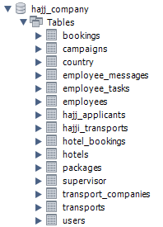
Database Design
The system uses a MySQL relational database to store and organize all project data.
The database is divided into several related tables, such as:
- users
- employees
- hajj_applicants
- campaigns
- packages
- bookings
- hotels
- hotel_bookings
- transport_companies
- transports
- employee_tasks
- employee_messages
Each table represents a specific part of the system and is connected to other tables using primary keys and foreign keys.

Slide 8
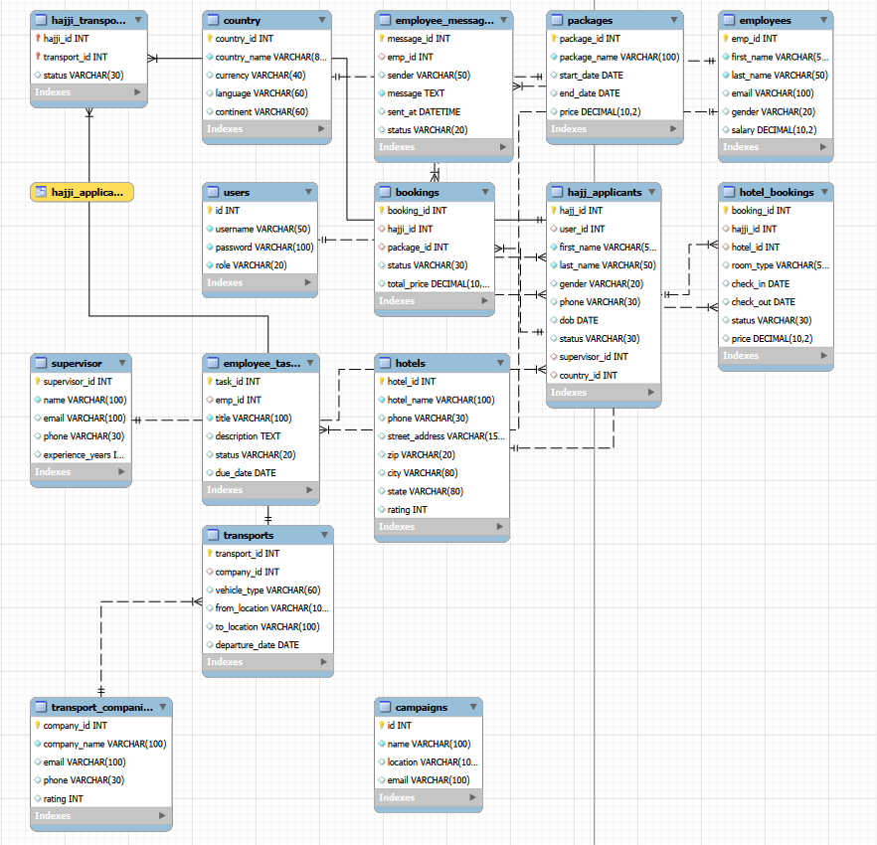
Database Relationships
The database tables are connected using Primary Keys and Foreign Keys.
Main relationship examples:
- Employees are connected with their tasks and messages.
- Hajj applicants are connected with bookings, hotels, and transport.
- Bookings are connected with Hajj packages.
- Hotels and transports are connected with customer services.
These relationships help reduce data duplication and keep the database organized.

Slide 9

CRUD Operations
The system supports the four main database operations:
Create:
- Add new records such as employees, campaigns, hotels, and transport companies.
Read:
- Display database records inside tables in the GUI.
Update:
- Modify existing records such as employee data or applicant status.
Delete:
- Remove records when needed from management screens.

Slide 10
Java and Database Connection
The Java application is connected to the MySQL database using JDBC.
The connection is handled in DBConnection.java.
The system uses:
- Connection: to connect Java with MySQL
- PreparedStatement: to execute SQL queries safely
- ResultSet: to retrieve data from SELECT queries
- JTable: to display database records in the GUI
General flow:
Button Click → SQL Query → MySQL Database → GUI Display
Java GUI → JDBC → MySQL Database

Slide 11


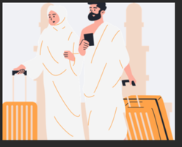
Main System Interfaces
The system contains different interfaces based on the user role.
Manager Dashboard:
- Manage campaigns, Hajj applicants, employees, hotels, and transport companies.
Employee Dashboard:
- View profile information, assigned tasks, and messages.
Customer Dashboard:
- View profile, booking, hotel, and transport information.

Slide 12
Testing and Sample Data
The system was tested using sample data stored in the MySQL database.
Examples of tested data:
- Users for login roles
- Employees and assigned tasks
- Hajj applicants and their application status
- Bookings connected with packages
- Hotel and transport records
- Internal messages between manager and employees
Testing confirmed that the GUI is connected correctly with the database.

Slide 13
Project Resources
The project files can be accessed using the following links:
Source Code:
https://github.com/HibaMeneh/HajiiCompanySystem
Database SQL File:
https://drive.google.com/drive/folders/1SfC1LHnourozUQZdVeOvd1eFaKZ-j73z?hl=ar
Project Report:
https://drive.google.com/drive/folders/18duxPOWe-xY3yPafysyipHD4weGxBhdY?hl=ar
ERD and Normalization Document:
https://drive.google.com/drive/folders/1ctKbE_jBrty-wuRPUunhvnDcrDKsRlEY?hl=ar

