Slide 1

Database Systems
Chapter 21
Mr. Faizad Ullah
Lecturer Computer Science

Slide 2
CHAPTER 21
Concurrency Control Techniques

Slide 3
Introduction
Concurrency control protocols
Set of rules to guarantee serializability
Two-phase locking protocols
Lock data items to prevent concurrent access
Timestamp
Unique identifier for each transaction

Slide 4
Two-Phase Locking Techniques for Concurrency Control
Lock
Variable associated with a data item describing status for operations that can be applied
One lock for each item in the database
Binary locks
Two states (values)
Locked (1)
Item cannot be accessed
Unlocked (0)
Item can be accessed when requested

Slide 5
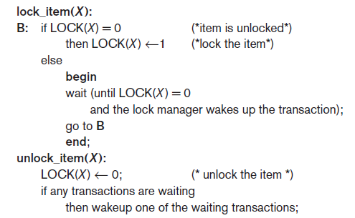
Two-Phase Locking Techniques for Concurrency Control (cont’d.)
Transaction requests access by issuing a lock_item(X) operation

Slide 6
Two-Phase Locking Techniques for Concurrency Control (cont’d.)
Lock table specifies items that have locks
Lock manager subsystem
Keeps track of and controls access to locks
Rules enforced by lock manager module
At most one transaction can hold the lock on an item at a given time

Slide 7
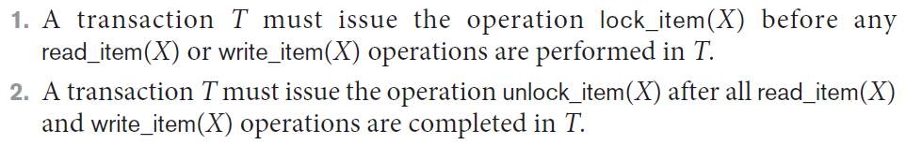
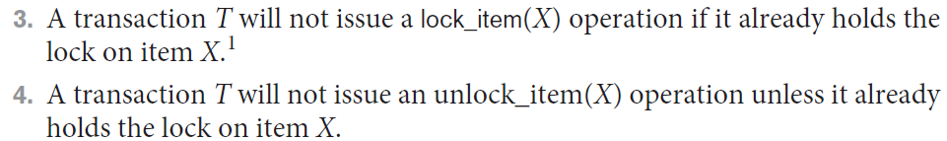
Two-Phase Locking Techniques for Concurrency Control (cont’d.)
If the simple binary locking scheme described is used, then every transaction must obey the following rules:

Slide 8
Binary locking too restrictive for database items

Slide 9
Two-Phase Locking Techniques for Concurrency Control (cont’d.)
Shared/exclusive or read/write locks or multi-mode locks
Read operations on the same item are not conflicting
Must have exclusive lock to write
Three locking operations
read_lock(X) (shared-locked)
write_lock(X) (exclusive-locked)
unlock(X)

Slide 10
Each record in the lock table will have four fields: <Data_item_name, LOCK, No_of_reads, Locking_transaction(s)>.

Slide 11
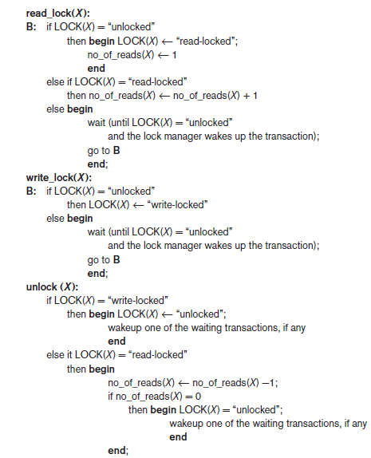
Figure 21.2 Locking and unlocking operations for two-mode (read/write, or shared/exclusive) locks

Slide 12
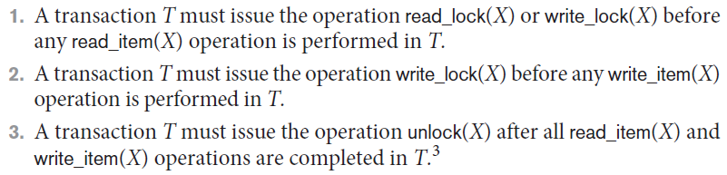
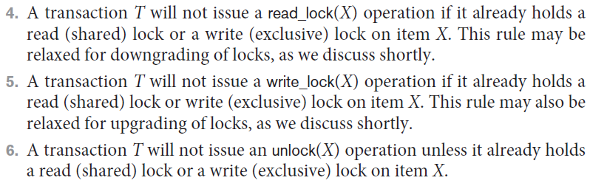
Two-Phase Locking Techniques for Concurrency Control (cont’d.)
When we use the shared/exclusive locking scheme, the system must enforce the following rules:

Slide 13
Two-Phase Locking Techniques for Concurrency Control (cont’d.)
Lock conversion
Transaction that already holds a lock allowed to convert the lock from one state to another
Upgrading
Issue a read_lock operation then a write_lock operation
Downgrading
Issue a read_lock operation after a write_lock operation

Slide 14
Guaranteeing Serializability by Two-Phase Locking (2PL)
Two-phase locking protocol
Phases
Expanding (growing) phase
New locks can be acquired but none can be released
Lock conversion upgrades (from read-locked to write-locked) must be done during this phase
Shrinking phase
Existing locks can be released but none can be acquired
Downgrades (from write-locked to read-locked) must be done during this phase

Slide 15
A given non-serial schedule of ‘n’ Transactions is said to be serializable if there exists some kind of equivalent serial schedule to the same ‘n’ transactions.
Serializability in DBMS decides if an interleaved non-serial schedule is serializable or not.

Slide 16
To guarantee serializablity, we must follow some additional protocol concerning the positioning of locking and unlocking operations in every transaction.

Slide 17
Guaranteeing Serializability by Two-Phase Locking (2PL)
If every transaction in a schedule follows the two-phase locking protocol, schedule guaranteed to be serializable
Two-phase locking may limit the amount of concurrency that can occur in a schedule

Slide 18
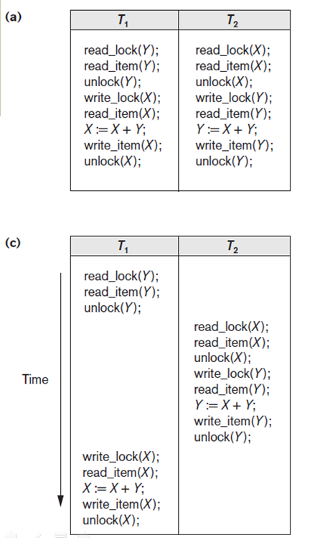
X=20
Y=30

Slide 19
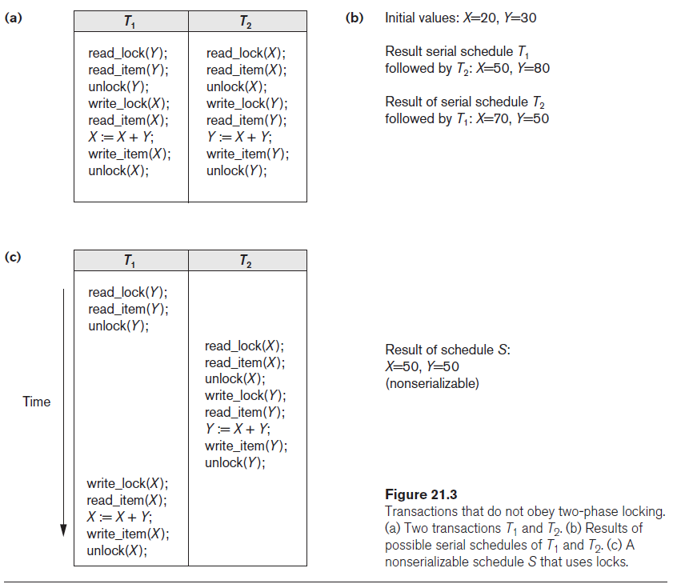

Slide 20
Variations of Two-Phase Locking (2PL)
Basic 2PL
Technique described previously
Strict 2PL
Transaction does not release exclusive locks (write locks) until after it commits or aborts. It is not deadlock-free.

Slide 21
Variations of Two-Phase Locking (cont’d.)
Rigorous 2PL
Transaction does not release any locks (exclusive or shared) until after it commits or aborts
Conservative (static) 2PL
Requires a transaction to lock all the items it accesses before the transaction begins
Predeclare read-set and write-set
Difficult to use in practice because of the need to predeclare the read-set and write-set, which is not possible in some situations.

Slide 22
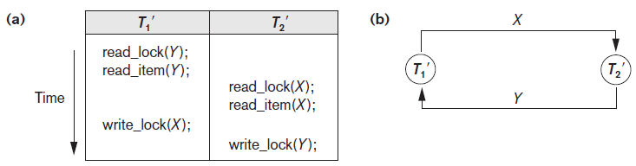
Dealing with Deadlock and Starvation
Deadlock
Occurs when each transaction T in a set is waiting for some item locked by some other transaction T’
Both transactions stuck in a waiting queue
Figure 21.5 Illustrating the deadlock problem (a) A partial schedule of T1′ and T2′ that is
in a state of deadlock (b) A wait-for graph (WFG) for the partial schedule in (a)

Slide 23
Dealing with Deadlock and Starvation (cont’d.)
Deadlock prevention protocols
Every transaction locks all items it needs in advance
Ordering all items in the database
Transaction that needs several items will lock them in that order
Both approaches impractical

Slide 24
Dealing with Deadlock and Starvation (cont’d.)
A number of other deadlock prevention schemes have been proposed that make a decision about what to do with a transaction involved in a possible deadlock situation:
These techniques use the concept of transaction timestamp TS(T′), which is a unique identifier assigned to each transaction.
If transaction T₁ starts before transaction T₂,
then TS(T₁) < TS(T₂).
NOTE: older transaction (which starts first) has the smaller timestamp value

Slide 25
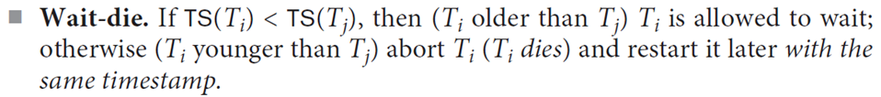
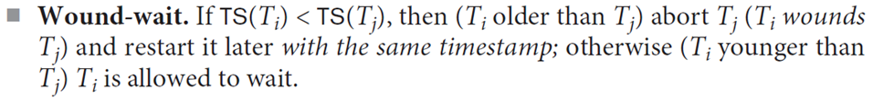
Dealing with Deadlock and Starvation (cont’d.)
2 Protocols based on a timestamp
Suppose that transaction T_{i} tries to lock an item X but is not able to because X is locked by some other transaction T_{j}
since in wait-die, transactions only wait for younger transactions so no cycle is created.
In wound-wait, transactions only wait for older transactions so no cycle is created.

Slide 26
Dealing with Deadlock and Starvation (cont’d.)
wait-die: When an older transaction tries to lock a DB element that has been locked by a younger transaction, it waits. When a younger transaction tries to lock a DB element that has been locked by an older transaction, it dies.
wound-wait: When an older transaction tries to lock a DB element that has been locked by a younger transaction, it wounds the younger transaction. When a younger transaction tries to lock a DB element that has been locked by an older transaction, it waits.

Slide 27
Dealing with Deadlock and Starvation (cont’d.)
No waiting algorithm
If transaction unable to obtain a lock, immediately aborted and restarted later
Cautious waiting algorithm
If T_{i} tries to lock an item X but is not able to do because X is locked by some T_{j}. In such a conflict, if T_{j} is not waiting for some other locked item, then T_{i} is allowed to wait, otherwise abort T_{i}.

Slide 28
Deadlock detection
System checks to see if a state of deadlock exists
Wait-for graph (a state of deadlock if and only if the wait-for graph has a cycle)

Slide 29
Concurrency Control Based on Timestamp Ordering
Timestamp
Unique identifier assigned by the DBMS to identify a transaction
Assigned in the order submitted
Transaction start time
Concurrency control techniques based on timestamps do not use locks, so
Deadlocks cannot occur

Slide 30
Concurrency Control Based on Timestamp Ordering (cont’d.)
Generating timestamps
Counter incremented each time its value is assigned to a transaction
Current date/time value of the system clock
Ensure no two timestamps are generated during the same tick of the clock

Slide 31
Concurrency Control Based on Timestamp Ordering (cont’d.)
Timestamp ordering (TO)
Allows interleaving of transaction operations
Must ensure timestamp order is followed for each pair of conflicting operations

Slide 32
Concurrency Control Based on Timestamp Ordering (cont’d.)
Each database item assigned two timestamp values
1) read_TS(X)
2) write_TS(X)
read_TS(X) is the largest timestamp of any transaction that executed read(X) successfully.
write_TS(X) is the largest timestamp of any transaction that executed write(X) successfully.

Slide 33
Basic TO algorithm
The timestamp ordering protocol ensures that any conflicting read and write operations are executed in timestamp order.
Whenever some Transaction T tries to issue a R_item(X) or a W_item(X), the Basic TO algorithm compares the timestamp of T with R_TS(X) & W_TS(X) to ensure that the Timestamp order is not violated.

Slide 34
Concurrency Control Based on Timestamp Ordering (cont’d.)
Strict TO algorithm
Transaction T issues a write_item(X) operation:
If TS(T) > write_TS(X), then delay T until the transaction T’ that wrote X has terminated (committed or aborted).
Transaction T issues a read_item(X) operation:
If TS(T) > write_TS(X), then delay T until the transaction T’ that wrote X has terminated (committed or aborted).

Slide 35
Concurrency Control Based on Timestamp Ordering (cont’d.)
Thomas’s write rule
Modify the checks for the write_item(X) operation:
If read_TS(X) > TS(T) then abort and roll-back T and reject the operation.
If write_TS(X) > TS(T), then just ignore the write operation and continue execution.
If the conditions given in 1 and 2 above do not occur, then execute write_item(X) of T and set write_TS(X) to TS(T).

Slide 36
Multiversion Concurrency Control Techniques
These protocols for concurrency control keep copies of the old values of a data item when the item is updated (written).
They are known as multiversion concurrency control because several versions (values) of an item are kept by the system.

Slide 37
Drawbacks
More storage is needed to maintain multiple versions of the database items.

Slide 38
Multiversion Technique Based on Timestamp Ordering
To ensure serializability, the two rules are used:
Rule1:
If transaction T issues write_item (X) and version i of X has the highest write_TS(Xi) of all versions of X that is also less than or equal to TS(T), and read _TS(Xi ) > TS(T), then abort and roll-back T; otherwise create a new version Xi and read_TS(X) = write_TS(Xj ) = TS(T).

Slide 39
Rule2:
If transaction T issues read_item (X), find the version i of X that has the highest write_TS(Xi ) of all versions of X that is also less than or equal to TS(T), then return the value of Xi to T, and set the value of read _TS(Xi ) to the largest of TS(T) and the current read_TS(Xi ).
Rule 2 guarantees that a read will never be rejected.

Slide 40
Multiversion Two-Phase Locking Using Certify Locks
In this multiple-mode locking scheme, there are three locking modes for an item— read, write, and certify
The state of LOCK(X) for an item X can be one of
read-locked,
write-locked,
certify-locked,
unlocked.

Slide 41
Multiversion Two-Phase Locking Using Certify Locks
Allow a transaction T’ to read a data item X while it is write locked by a conflicting transaction T.
This is accomplished by maintaining two versions of each data item X
One version must always have been written by some committed transaction. This means a write operation always creates a new version of X.
The second version created when a transaction acquires a write lock an the item.

Slide 42
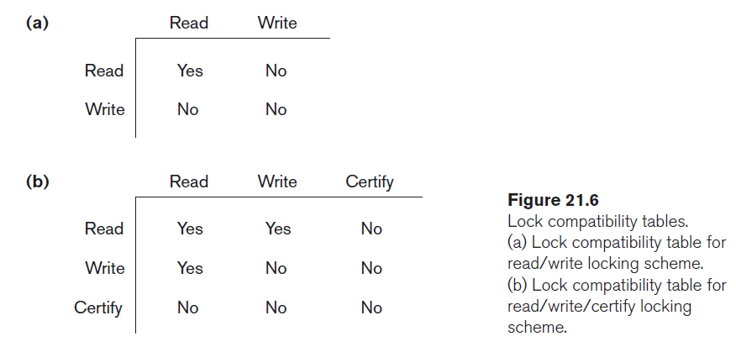
Multiversion Two-Phase Locking Using Certify Locks

