Slide 1

Database Systems
Chapter 22
Mr. Faizad Ullah
Lecturer Computer Science

Slide 2
CHAPTER 22
Database Recovery Techniques

Slide 3
Recovery Concepts
Recovery process restores database to most recent consistent state before time of failure
Information kept in system log
Typical recovery strategies
Restore backed-up copy of database
Best in cases of extensive damage (disk crash)
Identify any changes that may cause inconsistency
Best in cases of noncatastrophic failure

Slide 4
Recovery Concepts (cont’d.)
Deferred update techniques
Do not physically update the database until after transaction commits
Undo is not needed; Redo needed
Also known as NO-UNDO/REDO algorithm
Immediate update techniques
Database may be updated by some operations of a transaction before it reaches commit point
Operations recorded in log, recovery still possible
Also known as UNDO/REDO algorithm

Slide 5
Recovery Concepts (cont’d.)
Undo and redo operations required to be idempotent
Executing operations multiple times equivalent to executing just once
Entire recovery process should be idempotent
Caching (buffering) of disk blocks
DBMS cache: a collection of in-memory buffers
Cache directory keeps track of which database items are in the buffers

Slide 6
Recovery Concepts (cont’d.)
Cache buffers replaced (flushed) to make space for new items
Dirty bit (0 or 1)
Pin-unpin bit
Dirty bit associated with each buffer in the cache
Indicates whether the buffer has been modified

Slide 7
Recovery Concepts (cont’d.)
Main strategies
In-place updating
Writes the buffer to the same original disk location
Overwrites old values of any changed data items
Shadowing
Writes an updated buffer at a different disk location, to maintain multiple versions of data items
Not typically used in practice
Before-image (BFIM): old value of data item
After-image (AFIM): new value of data item

Slide 8
Recovery Concepts (cont’d.)
Write-ahead logging
Ensure that the BFIM is recorded
Ensure that appropriate BFIM is overwritten with AFIM
Necessary for UNDO operation if needed
Two types of log entries
UNDO-type log entries (old values / BFIM)
REDO-type log entries (new values / AFIM)

Slide 9
Recovery Concepts (cont’d.)
Steal/no-steal and force/no-force
Specify rules that govern when a page from the database cache can be written to disk
No-steal approach
Cache buffer page updated by a transaction cannot be written to disk before the transaction commits
Steal approach
Recovery protocol allows writing an updated buffer before the transaction commits

Slide 10
Recovery Concepts (cont’d.)
Force approach
All pages updated by a transaction are immediately written to disk before the transaction commits
Otherwise, no-force
Typical database systems employ a steal/no-force strategy
Avoids need for very large buffer space

Slide 11
Checkpoints
Taking a checkpoint consist of following actions
Suspend execution of all transactions temporarily
Force-write all main memory buffers that have been modified to disk
Write a checkpoint record to the log, and force-write the log to the disk
Resume executing transactions
DBMS recovery manager decides on checkpoint interval

Slide 12
Checkpoints in the System Log and Fuzzy Checkpointing (cont’d.)
Fuzzy checkpointing
System can resume transaction processing after a begin_checkpoint record is written to the log
Previous checkpoint record maintained until end_checkpoint record is written

Slide 13
Transaction Rollback
Transaction failure after update but before commit
Necessary to roll back the transaction
Old data values restored using undo-type log entries
Cascading rollback
If transaction T is rolled back, any transaction S that has read value of item written by T must also be rolled back

Slide 14
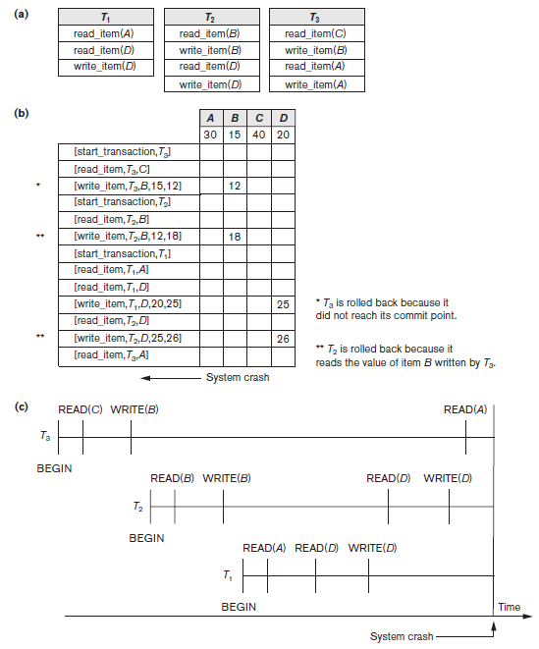
Figure 22.1 Illustrating cascading rollback. (a) The read and write operations of three transactions (b) System log at point of crash (c) Operations before the crash

Slide 15
Transactions that Do Not Affect the Database
Generating and printing messages and reports
Reports should be generated only after transaction reaches commit point

Slide 16
NO-UNDO/REDO Recovery Based on Deferred Update
Do not physically update the database until after transaction commits
Undo is not needed; Redo needed
Also known as NO-UNDO/REDO algorithm
REDO-type log entries needed (AFIM)
UNDO-type log entries not needed

Slide 17
NO-UNDO/REDO Recovery Based on Deferred Update
We can state a typical deferred update protocol as follows:
A transaction cannot change the database on disk until it reaches its commit point; hence all buffers that have been changed by the transaction must be pinned until the transaction commits.
A transaction does not reach its commit point until all its REDO-type log entries are recorded in the log.

Slide 18
Procedure RDU_M (NO-UNDO/REDO with checkpoints).
Procedure RDU_M (NO-UNDO/REDO with checkpoints).
Use two lists of transactions
The committed transactions T
The active transactions T′ (active list).
REDO all the WRITE operations of
The committed transactions from the log,
The transactions that are active and did not commit are effectively canceled and must be resubmitted.

Slide 19
Procedure REDO (WRITE_OP)
Procedure REDO (WRITE_OP)
WRITE_OP consists of its log entry
[write_item, T, X, new_value]
Setting the value of item X in the database to new_value, which is the after image (AFIM).

Slide 20
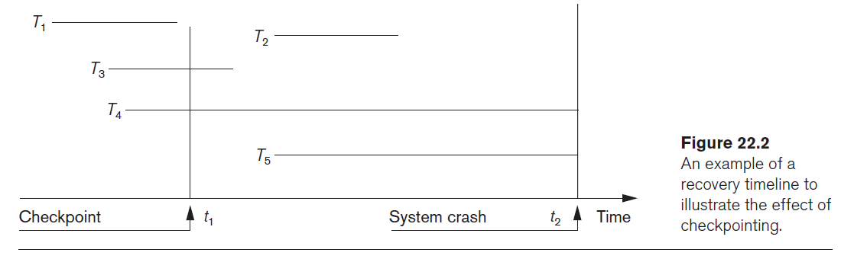
Recovery timeline and effect of checkpointing

Slide 21
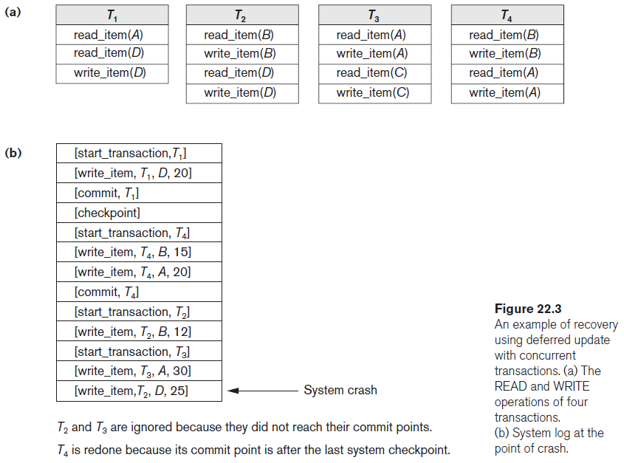

Slide 22
Recovery Techniques Based on Immediate Update
Database may be updated by some operations of a transaction before it reaches commit point
Operations recorded in log, recovery still possible
Also known as UNDO/REDO algorithm

Slide 23
Two main categories of immediate update algorithms
If the recovery technique ensures that all updates of a transaction are recorded in the database on disk before the transaction commits, there is never a need to REDO any operations of committed transactions.
This is called the UNDO/NO-REDO recovery algorithm.

Slide 24
Two main categories of immediate update algorithms
If the transaction is allowed to commit before all its changes are written to the database, we have the most general case, known as the UNDO/REDO recovery algorithm.

