Slide 1
Asymptotic Notations
Algorithms perform f(n) basic operations to accomplish task
Identify that function
Identify size of problem (n)
Count number of operations in terms of n

Slide 2
Execution time
Time computer takes to execute f(n) operations is cf(n)
where c
depends on speed of computer and
varies from computer to computer

Slide 3
Development of Notation
Not concerned with small values of n
Concerned with VERY LARGE values of n
Asymptotic – refers to study of function f as n approaches infinity
Example: f(n) = n²+4n + 20
n² is the dominant term and the term 4n + 20 becomes insignificant as n grows larger

Slide 4
Development of Notation
Drop insignificant terms and constants
Say function is of O(n²) called Big-O of n²
Common Big-O functions in algorithm analysis
g(n) = 1 (growth is constant)
g(n) = log ₂ n (growth is logarithmic)
g(n) = n (growth is linear)
g(n) = n log ₂ n (growth is faster than linear)
g(n) = n² (growth is quadratic)
g(n) = 2^{n} (growth is exponential)

Slide 5
n | log2n | nlog2n | n^2 | 2^n
1 | 0 | 0 | 1 | 2
2 | 1 | 2 | 4 | 4
4 | 2 | 8 | 16 | 16
8 | 3 | 24 | 64 | 256
16 | 4 | 64 | 256 | 65536
32 | 5 | 160 | 1024 | 4294967296

Slide 6
Common Growth Functions (How f(n) grows as n grows)

Slide 7
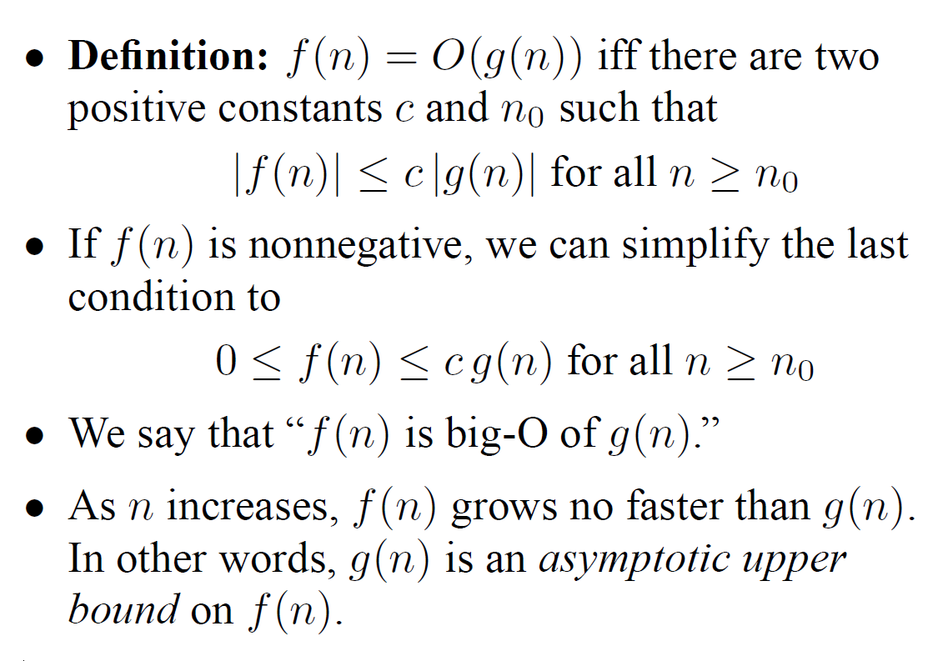
Big Oh

Slide 8
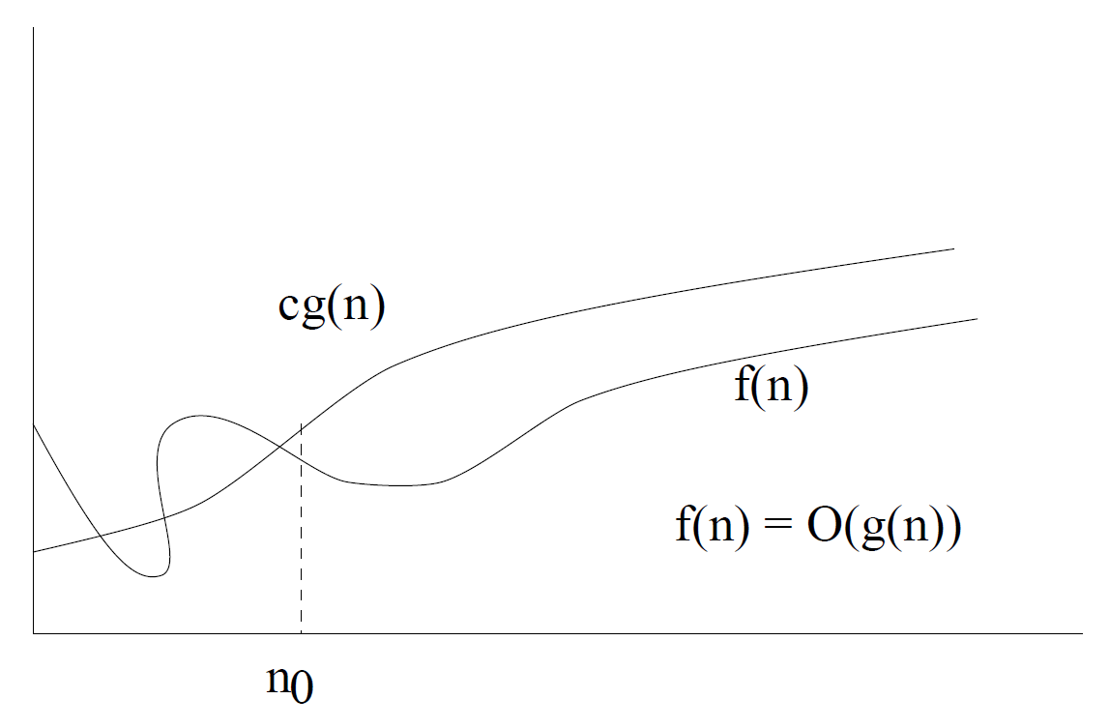
Big Oh

Slide 9
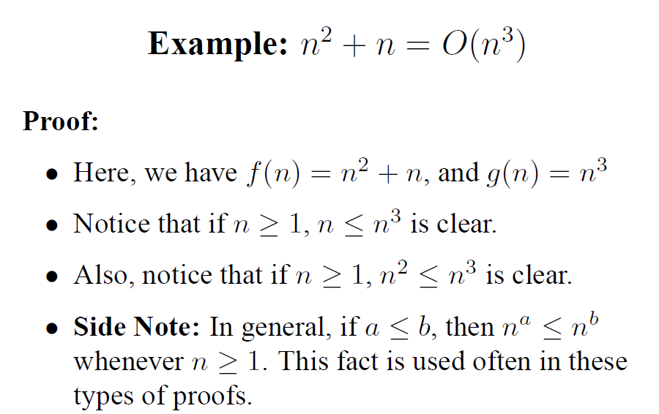

Slide 10
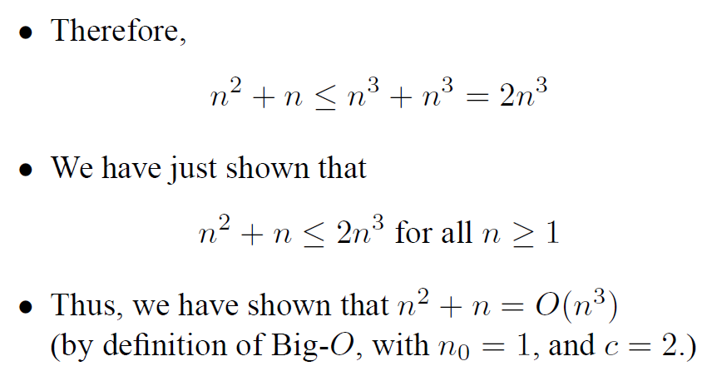

Slide 11
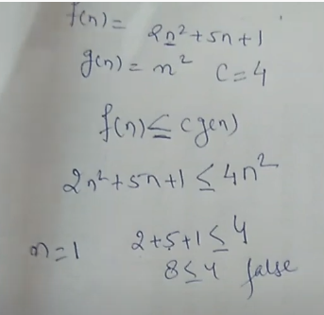
Cg(n)=4n^2
n>=3
18+15+1
34<=36

Slide 12
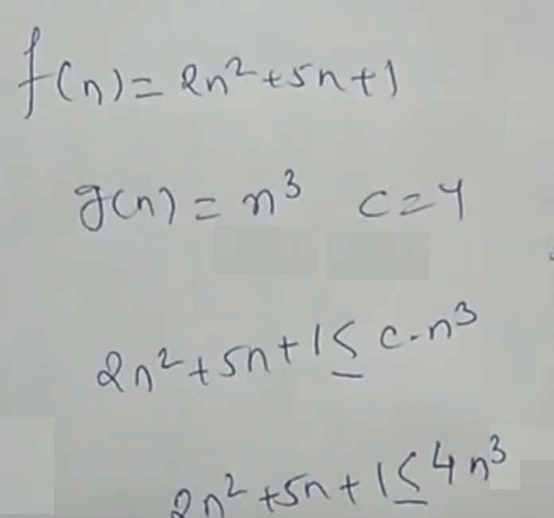
4n^3
n>=2
2n^2+5n^2+n^2=8n^2
O(n^2)
Cg(n)=8n^2

Slide 13
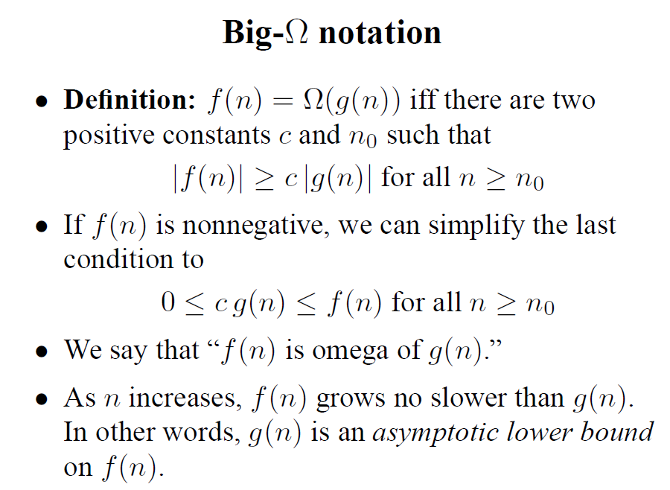

Slide 14
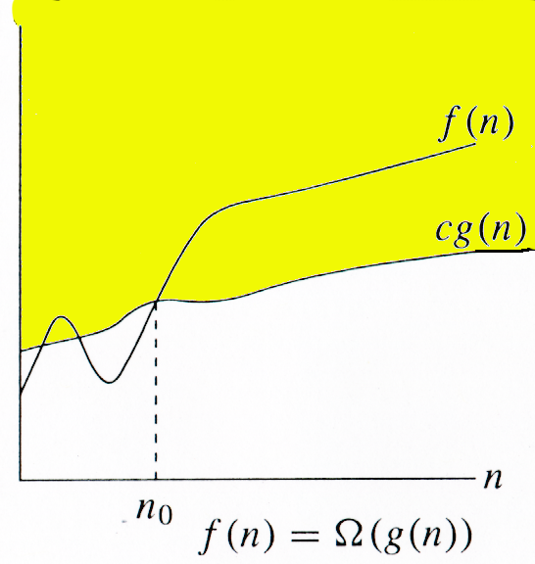

Slide 15
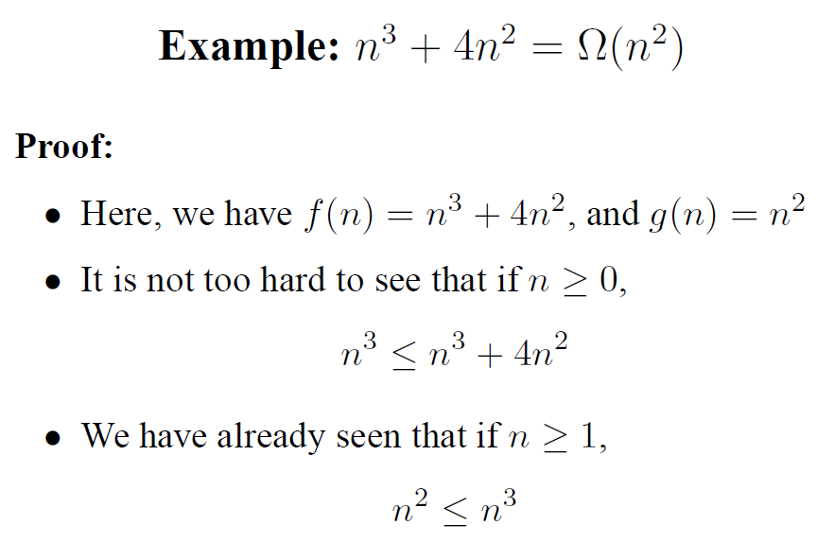

Slide 16
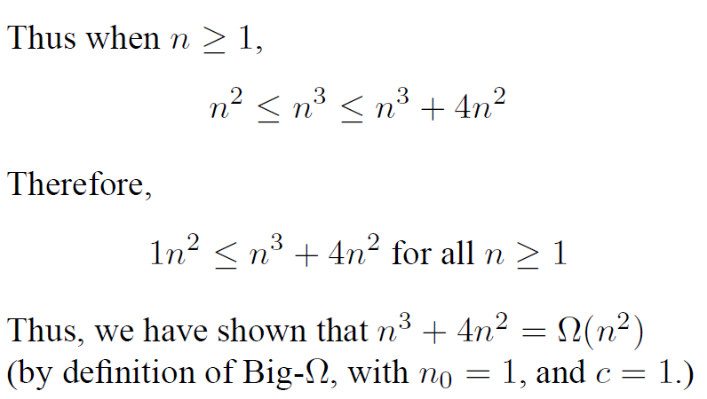

Slide 18
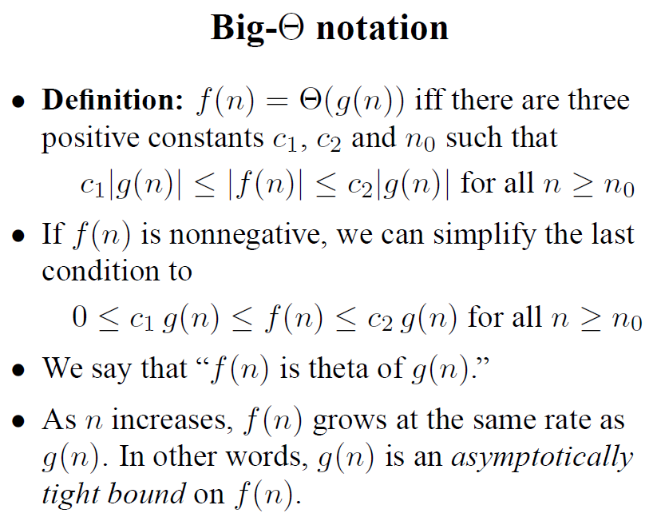

Slide 20
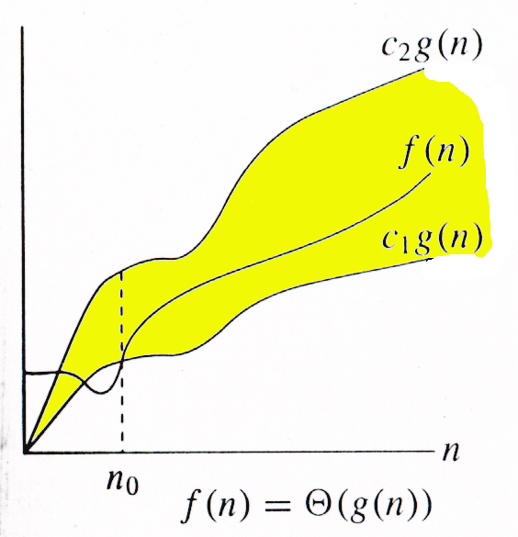

Slide 21
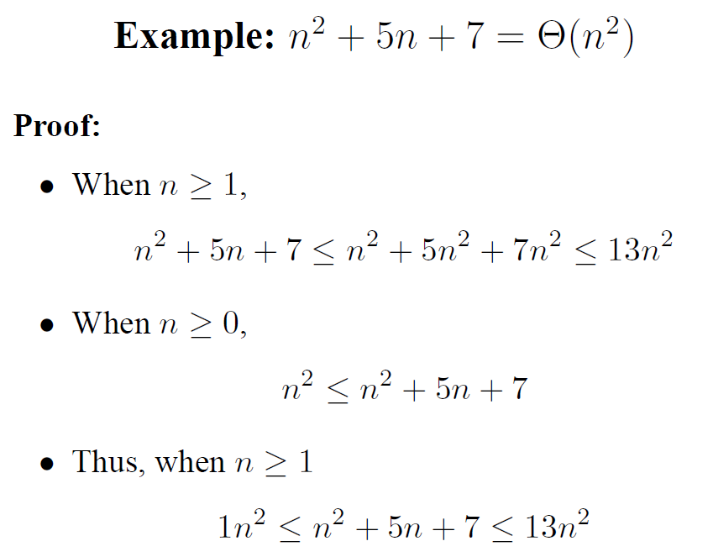
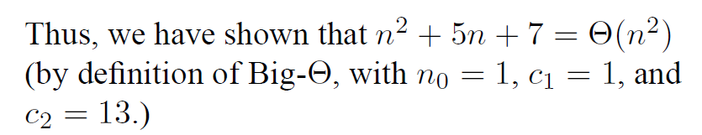

Slide 23
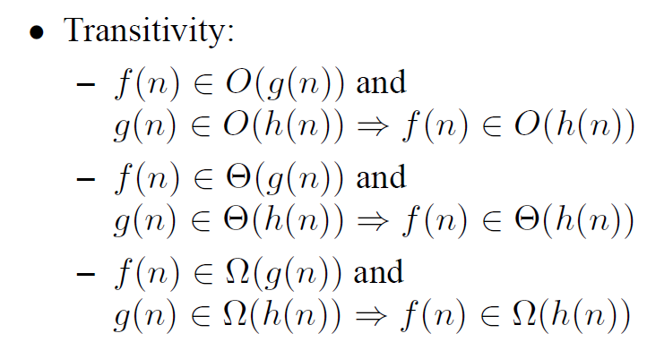

Slide 24
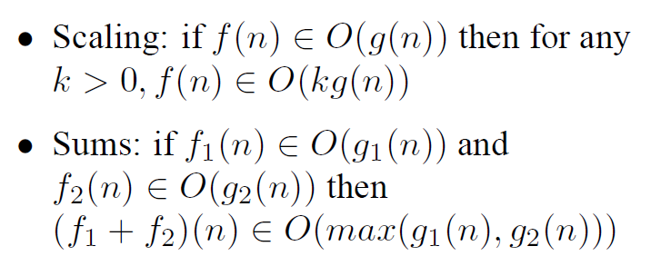

Slide 25

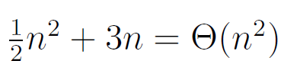

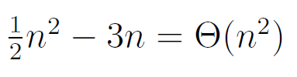
Prove that

Slide 26
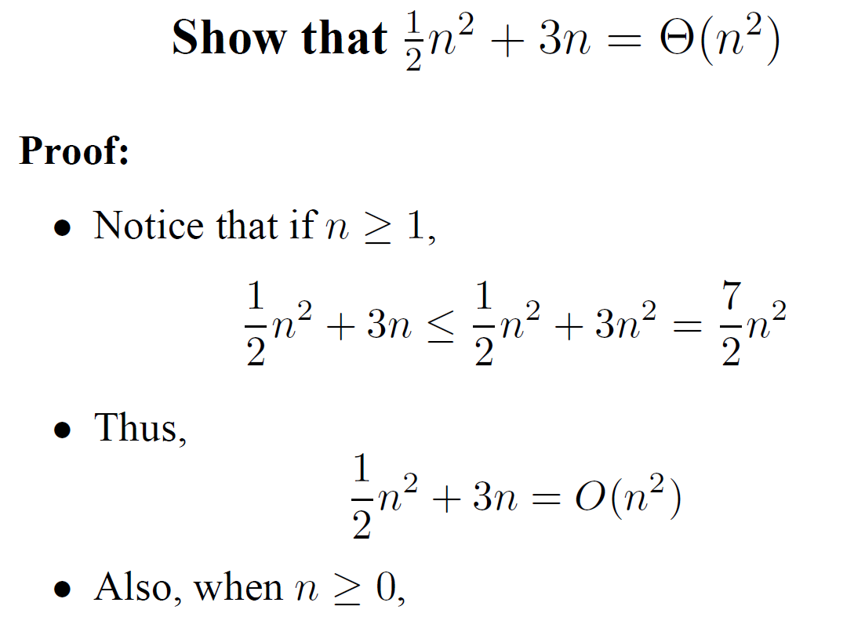

Slide 27
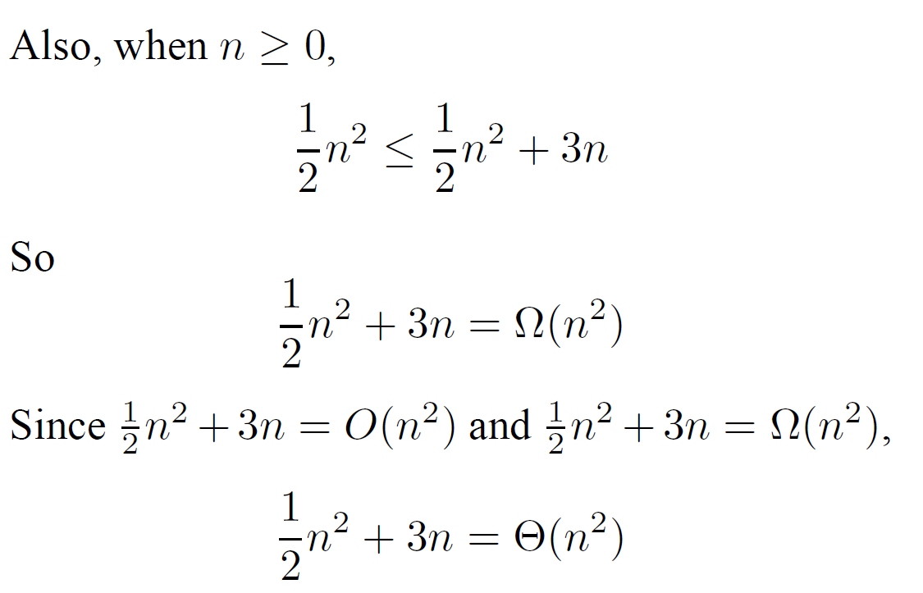

Slide 28
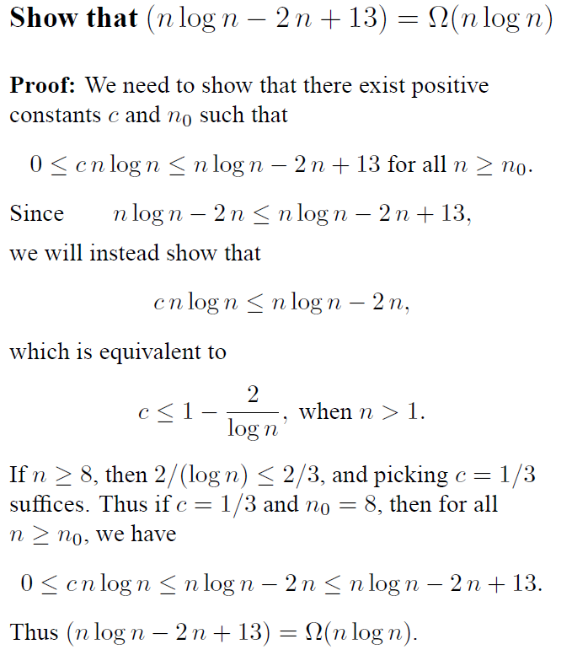

Slide 29
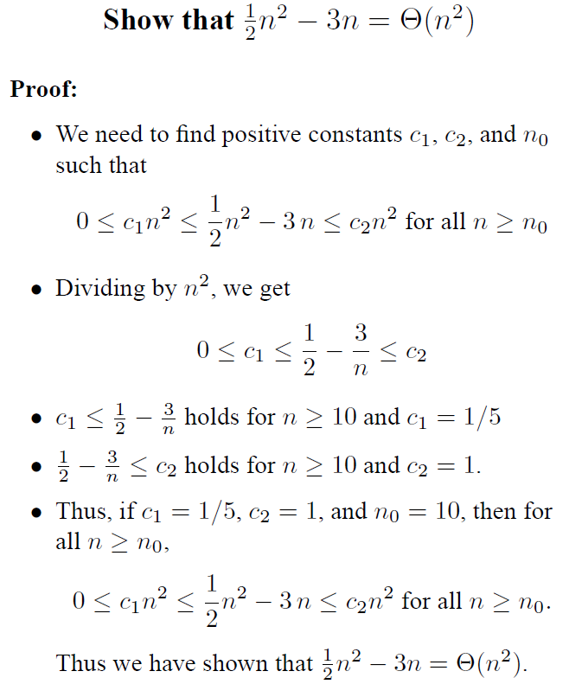

Slide 30
o-notation
For a given function g(n), the set little-o:
o(g(n)) = {f(n): ∀ c > 0, ∃ n0 > 0 such that ∀ n ≥ n0, we have 0 ≤ f(n) < cg(n)}.
f(n) becomes insignificant relative to g(n) as n approaches infinity:
lim [f(n) / g(n)] = 0
^{n→∞}
g(n) is an upper bound for f(n) that is not asymptotically tight.
Observe the difference in this definition from previous ones. Why?

Slide 31
ω -notation
For a given function g(n), the set little-omega:
w(g(n)) = {f(n): ∀ c > 0, ∃ n0 > 0 such that ∀ n ≥ n0, we have 0 ≤ cg(n) < f(n)}.
f(n) becomes arbitrarily large relative to g(n) as n approaches infinity:
lim [f(n) / g(n)] = ∞.
^{n→∞}
g(n) is a lower bound for f(n) that is not asymptotically tight.

Slide 32
Comparison of Functions
f ↔ g ≈ a ↔ b
f (n) = O(g(n)) ≈ a ≤ b
f (n) = Ω(g(n)) ≈ a ≥ b
f (n) = Θ(g(n)) ≈ a = b
f (n) = o(g(n)) ≈ a < b
f (n) = ω (g(n)) ≈ a > b

Slide 33
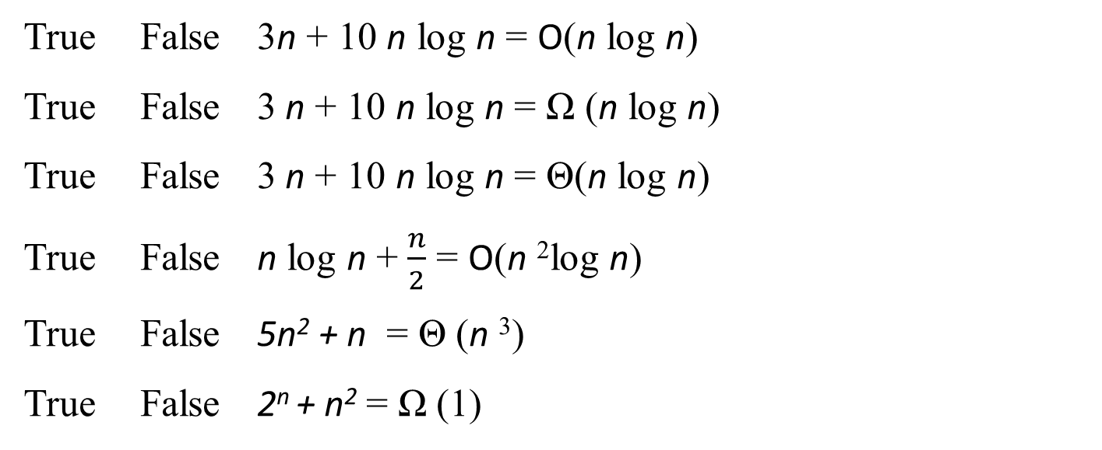
Notes:
Only 5th one is FALSE

