Slide 1

Revenue Leakage Analysis and
Recovery Strategy

Slide 2
Understanding Revenue
Leakage
Revenue leakage is the loss of money a business should earn but fails to collect because of avoidable mistakes. It happens through incorrect pricing, wrong billing, tax or discount errors, unnecessary refunds, process delays, and weak controls. These small losses add up over time and reduce profitability. Finding and fixing these issues is essential to keep revenue accurate and protect financial performance. Strong monitoring helps prevent repeated errors and ensures the business captures its full revenue.

Slide 3
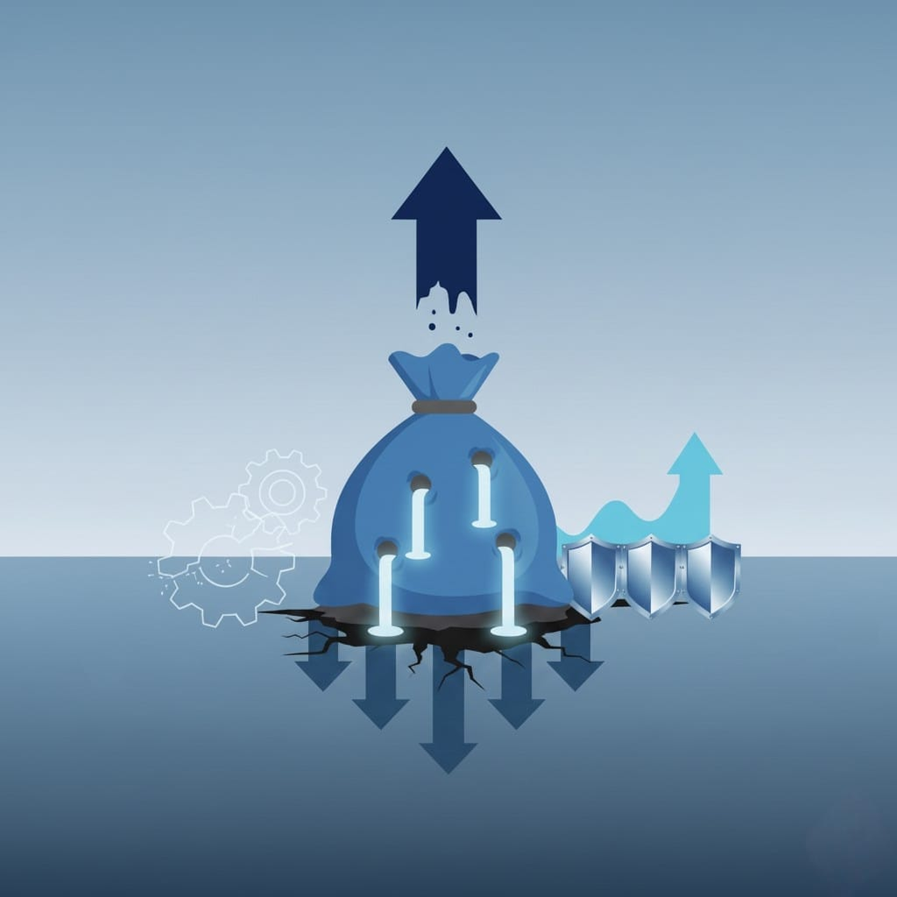
Project Abstract
This project analyses the issue of revenue leakage in an organisation, focusing on how unnoticed financial losses reduce overall profitability. It identifies the key points where leakage occurs, evaluates the effectiveness of existing processes, and measures their impact on financial accuracy. The study also proposes clear recovery methods and preventive strategies to strengthen financial control and improve long-term performance.

Slide 4






Scope of the Study
Covers detailed assessment of all major revenue leakage points, including billing errors, pricing inconsistencies, discounts, tax mismatches, and refund irregularities.
Provides practical, actionable strategies to reduce leakage and strengthen revenue accuracy, based purely on analytical findings.
Evaluates leakage trends across regions, product categories, and transaction types to pinpoint high-risk areas.
Focuses on internal operational data only, ensuring accurate, organisation-specific insights.
Measures the financial impact of leakage and recovery, quantifying how much is lost versus how much is regained.
Examines the effectiveness of current control and recovery mechanisms, identifying bottlenecks and process failures.

Slide 5
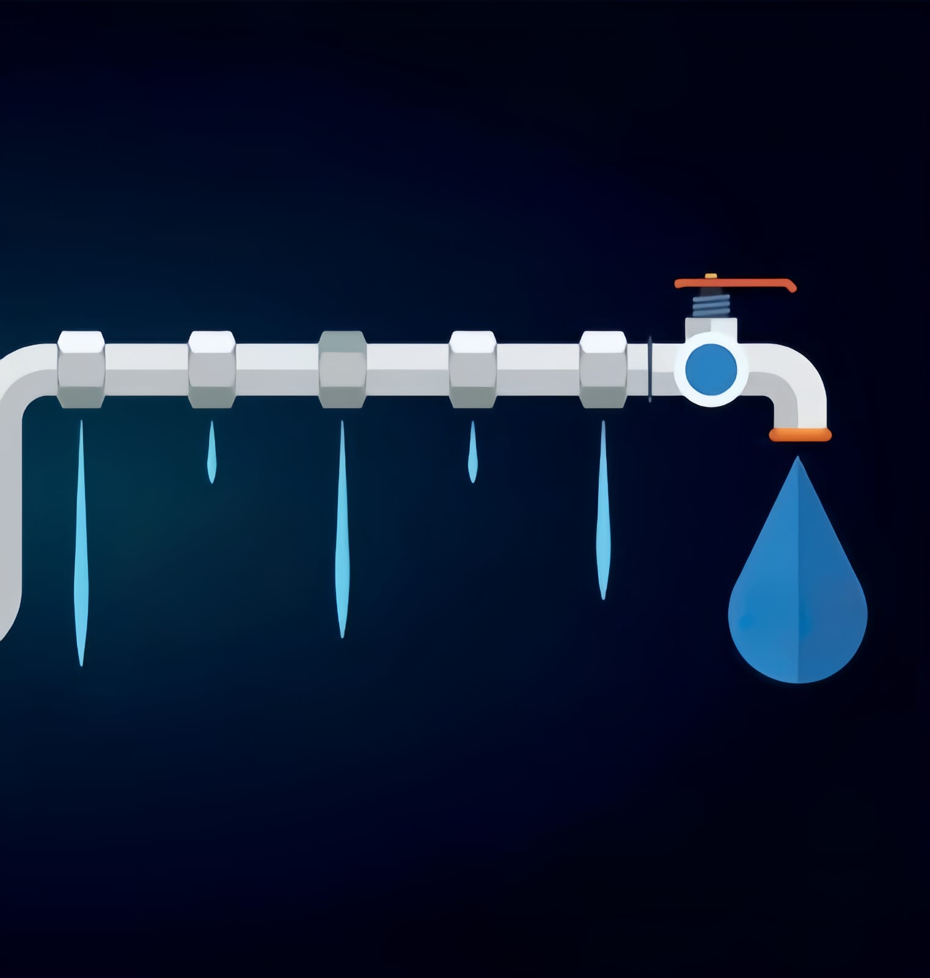
Objectives
To recommend strategies to reduce future revenue leakage and improve revenue accuracy.
To assess the effectiveness of current recovery processes and identify areas needing improvement.
To analyze monthly trends in leakage, recovery, and refunds to detect operational inconsistencies.
To identify major leakage sources across regions, product categories, and error types.
To quantify the total revenue leakage and determine how much is recovered versus unrecovered.

Slide 6
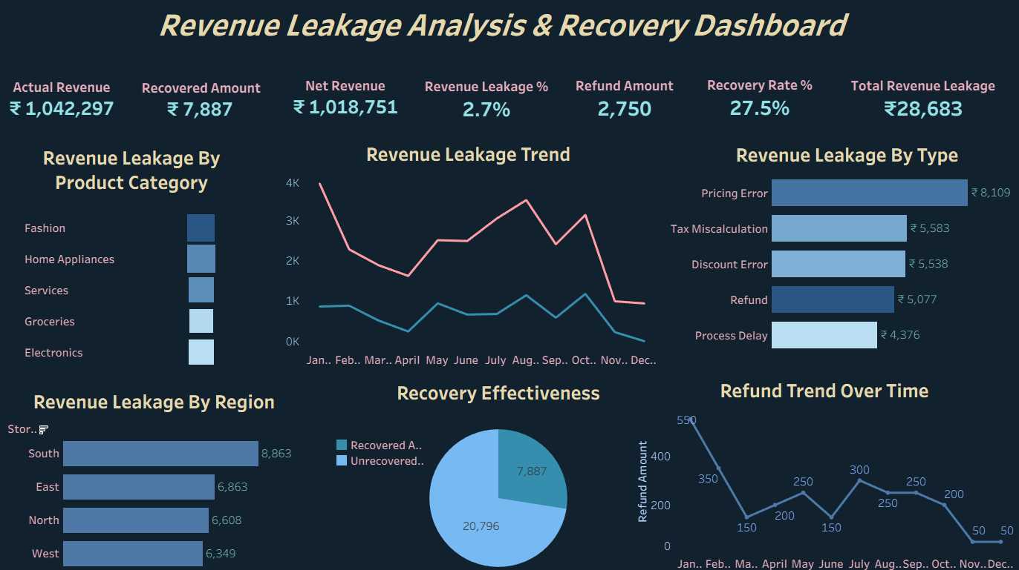
Dashboard

Slide 7
FINDINGS
STRATEGIC RECOMMENDATIONS
Leakage is concentrated in specific regions and product categories.
Billing errors, discount issues, and refund mismatches are the primary leakage sources.
A considerable share of identified leakage remains unrecovered.
Monthly leakage patterns show irregular spikes.
Refund-related leakage is higher than acceptable.
Recovery efficiency differs across regions and categories.
Internal control mechanisms are inconsistent across operations.
Apply targeted controls, audits, and monitoring in high-leakage regions and categories.
Automate billing checks, enforce fixed discount rules, and tighten refund approval processes.
Implement a structured follow-up system to track, close, and verify all unrecovered cases.
Set automated alerts for abnormal monthly variations and review operational deviations promptly.
Introduce mandatory justification and multi-level verification for all high-value or frequent refunds.
Provide focused training and improve process controls in low-performing areas.
Strengthen system reconciliation and conduct periodic revenue assurance reviews to improve accuracy.

Slide 8

CONCLUSION
The study clearly identifies the key points where revenue leakage occurs and the factors driving these losses. By highlighting low-performing segments, pricing inconsistencies, and process inefficiencies, the analysis provides a focused understanding of how and where revenue is slipping. These insights form a solid base for corrective actions that can reduce leakage, strengthen operational control, and improve overall revenue performance.

Slide 9

Presented by
Hiba

