Slide 1

SUPPLY CHAIN MANAGEMENT
SUPPLY CHAIN MANAGEMENT

Slide 2

WHAT IS SUPPLY CHAIN MANAGEMENT
Supply Chain Management (SCM) involves the strategic coordination of goods, information, and financial flows among suppliers, manufacturers, distributors, and customers. Its main objective is to improve efficiency, reduce costs, and ensure timely delivery while enhancing customer satisfaction. In today’s competitive global market, SCM plays a crucial role in driving business growth, operational excellence, and long-term sustainability. Moreover, effective SCM enables businesses to adapt quickly to market changes and disruptions, ensuring resilience and continuous value creation.

Slide 3
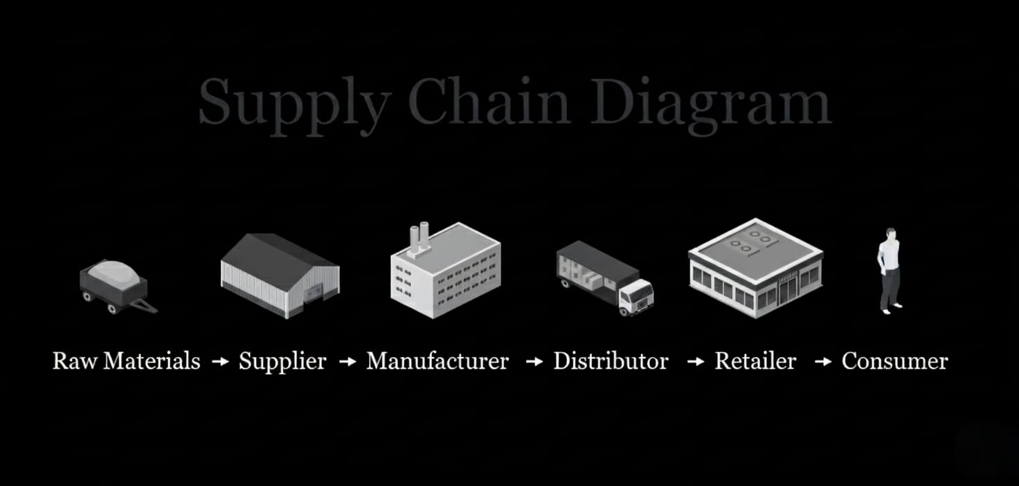
SUPPLY CHAIN DIAGRAM

Slide 4
EXECUTIVE SUMMARY
This project develops a performance dashboard to assess and enhance supply chain operations. The dashboard provides insights into logistics distribution, revenue contribution by product categories, cost efficiency, manufacturing performance, and defect rates. By leveraging visual analytics, the study highlights operational strengths and weaknesses, enabling data-driven decisions and supporting strategies for improved efficiency and customer satisfaction. Additionally, the dashboard facilitates proactive monitoring and quick response to potential supply chain disruptions, promoting greater reliability and resilience in operations.

Slide 5
SCOPE 0F THE RESEARCH
To evaluate overall supply chain performance through data visualization.
To analyze logistics and transportation patterns influencing cost and efficiency.
To assess product categories based on order volumes, revenue, and quality indicators.
To identify areas of improvement and provide actionable recommendations.

Slide 6
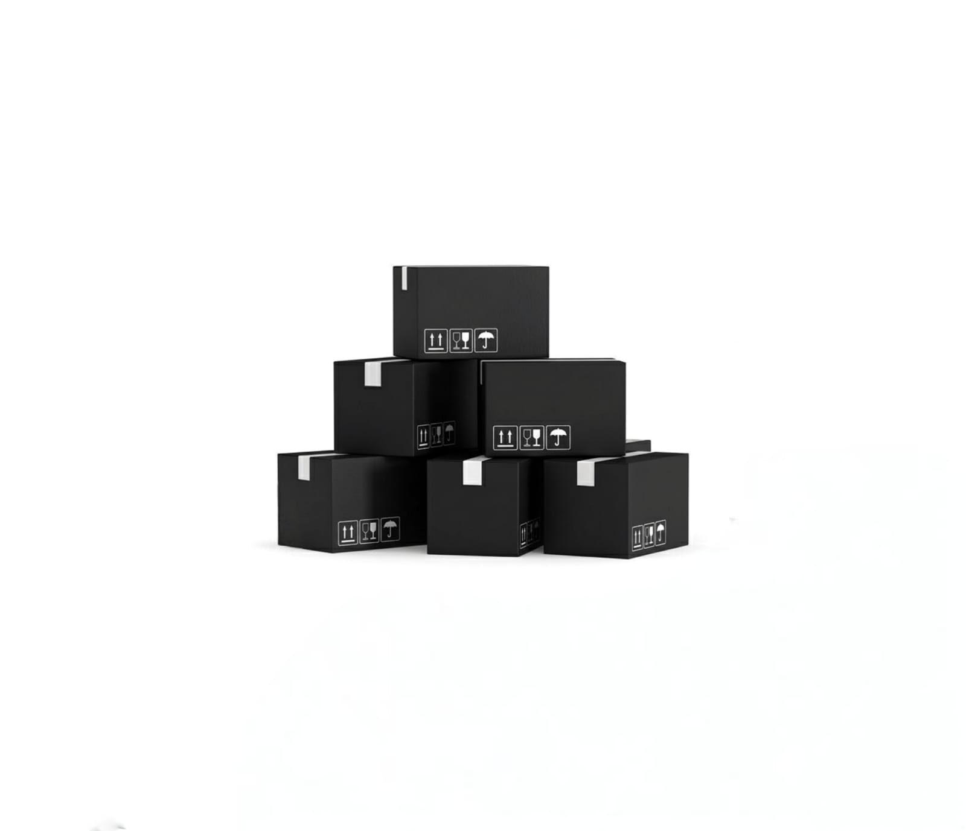
OBJECTIVES
Maintain the right balance of stock to minimize shortages and reduce excess costs.
OPTIMIZE INVENTORY MANAGEMENT

Slide 7

Cut unnecessary expenses in logistics and storage while sustaining service quality.
REDUCE OPERATIONAL COSTS

Slide 8

Deliver quality products on time to strengthen trust and loyalty.
ENHANCE CUSTOMER SATISFACTION

Slide 9

Streamline processes across procurement, production, and distribution for faster operations.
IMPROVE
EFFICIENCY

Slide 10
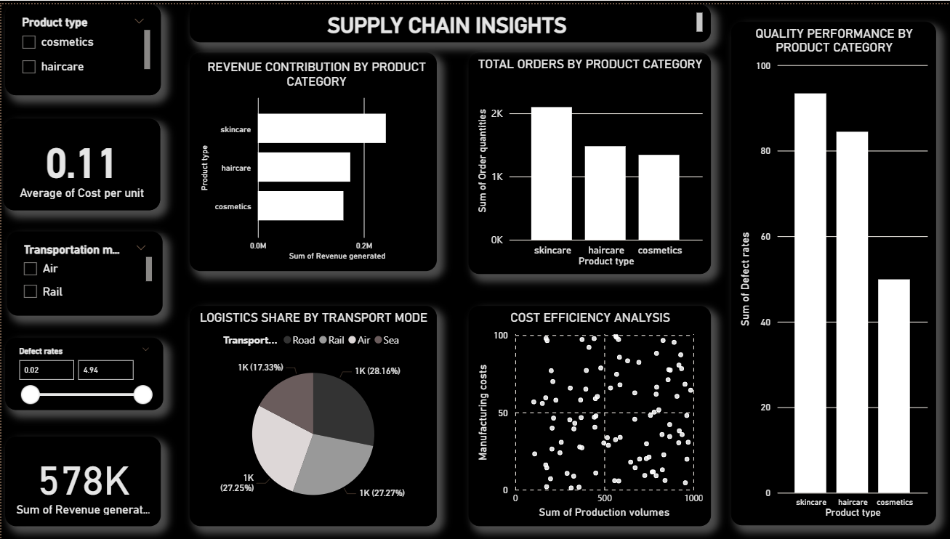

Slide 11

KEY FINDINGS
STRATEGIC RECOMMENTATIONS
Transportation and logistics decisions significantly impact efficiency and cost.
Skincare, haircare, and cosmetics categories show varying levels of contribution to revenue and orders.
Defect rates reveal areas where stronger quality control is required.
Transportation delays increase overall delivery time and raise costs.

Slide 12
KEY FINDINGS
STRATEGIC RECOMMENTATIONS
Prioritize cost-effective logistics and transportation modes.
Strengthen quality assurance processes to reduce defect rates.
Focus investment on high-performing product categories while addressing weaker ones.
Implement real-time monitoring through dashboards to enable faster, data-driven decision-making.

Slide 13


THANKYOU
PRESENTED BY HIBA

