Slide 1
Synthetic IMTS benchmark
• 3 variates per sample: v1, v2 ~ sin(2πf·t + φ) · v3 = w·v1 + (1−w)·v2, w ~ U(0.2, 0.8)
• Cross-variate info is load-bearing — single-variate models pay for ignoring it
• 120 obs / variate · history = 8.0 · forecast = [8, 10]
• 4 irregularity regimes via frac_regular ∈ {1.0, 0.8, 0.3, 0.0} → Regular / Low / Med / High
• Phase 2 — sync timestamps (same ts across variates)
• Phase 3 — async timestamps (per-variate independent)
• Phase 4-2 — Phase 3 + random-variate long gap per sample

Slide 2
Models
• Mamba-MV (ours) — multivariate SSM: per-variate SSM + variable-axis attention + fusion Mamba on shared grid
• d_model = 256 · d_state = 16 · 3 per-variate + 3 fusion layers · 7.79 M params
• dt_modes: learned (vanilla Mamba Δ) / replace (Δ = Δtrue)
• S5 (Smith+ ICLR '23) — per-variate diagonal SSM, paper-native config
• d_model = 128 · state_dim = 256 · 6 layers · 1.40 M params
• RoMAE — Rotary-PE masked autoencoder (2D positions: timestamp + variate-id)
• encoder d=288, 6-head, 7 layers · decoder d=180, 3-head, 2 layers · 7.80 M params
• mTAN — dropped (training collapse across 5 configs)
• Shared recipe: AdamW (lr=5e-4 default; S5 overrides to paper-native lr=1e-3) · cosine 100→1600 steps · patience=50 · n=5 seeds

Slide 3
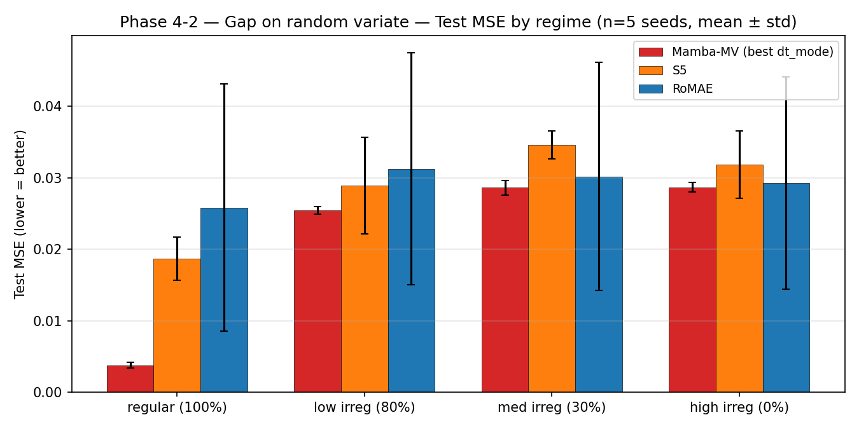
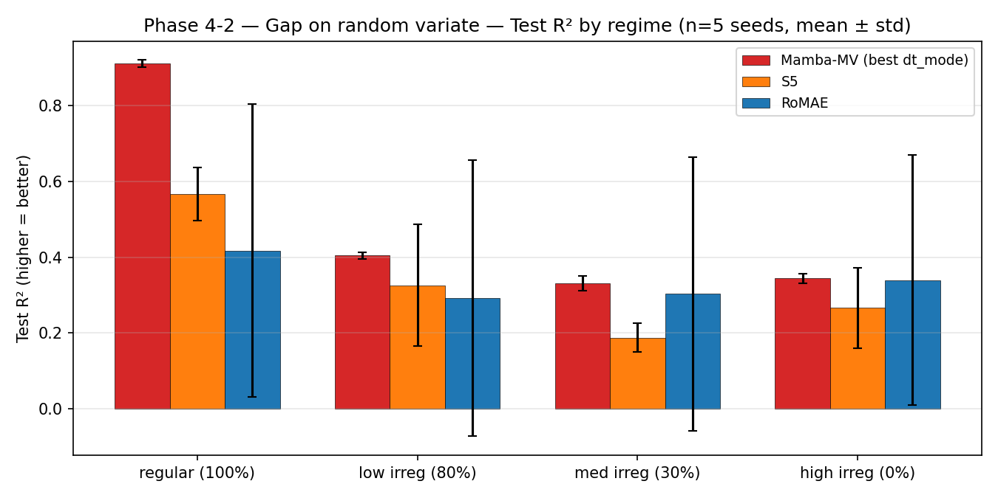
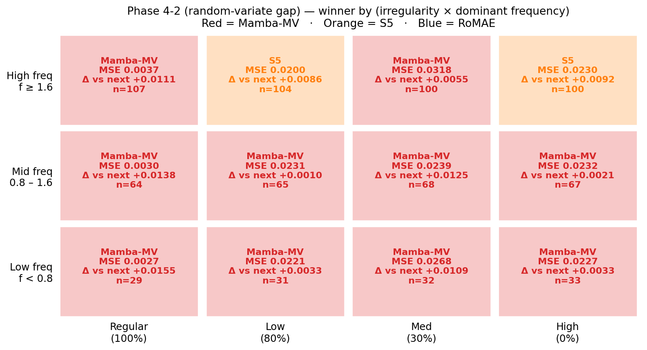
Phase 4-2 — async + random-variate long gap
• Mamba-MV wins 10/12 (regime × freq) cells — multivariate SSM fills the gapped variate from the other two
• S5 (per-variate) can’t recover the gapped variate — loses across almost all cells
• Mamba dt_mode: learned > replace here (Δtrue spikes near gaps amplified by replace)

Slide 4
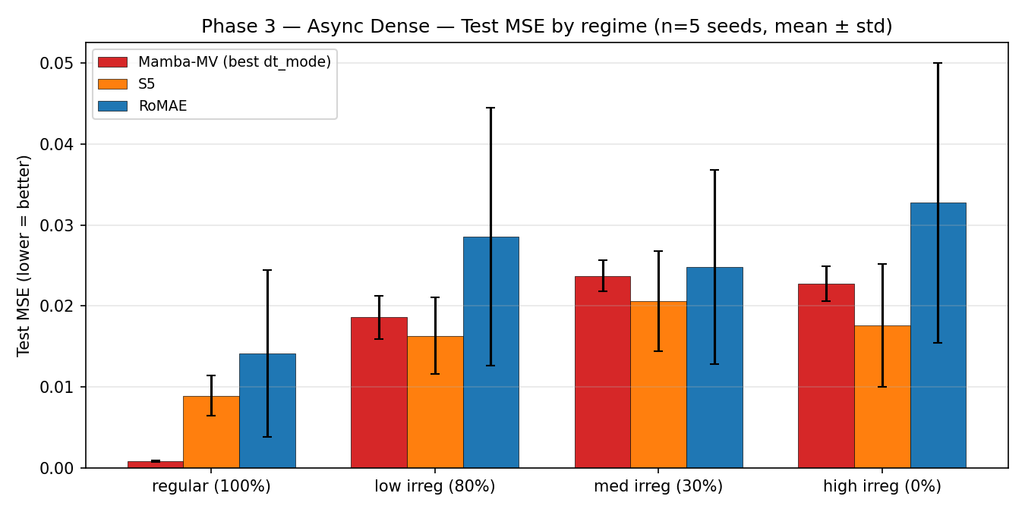
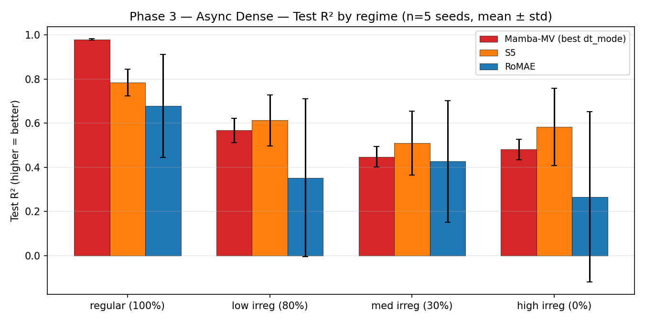
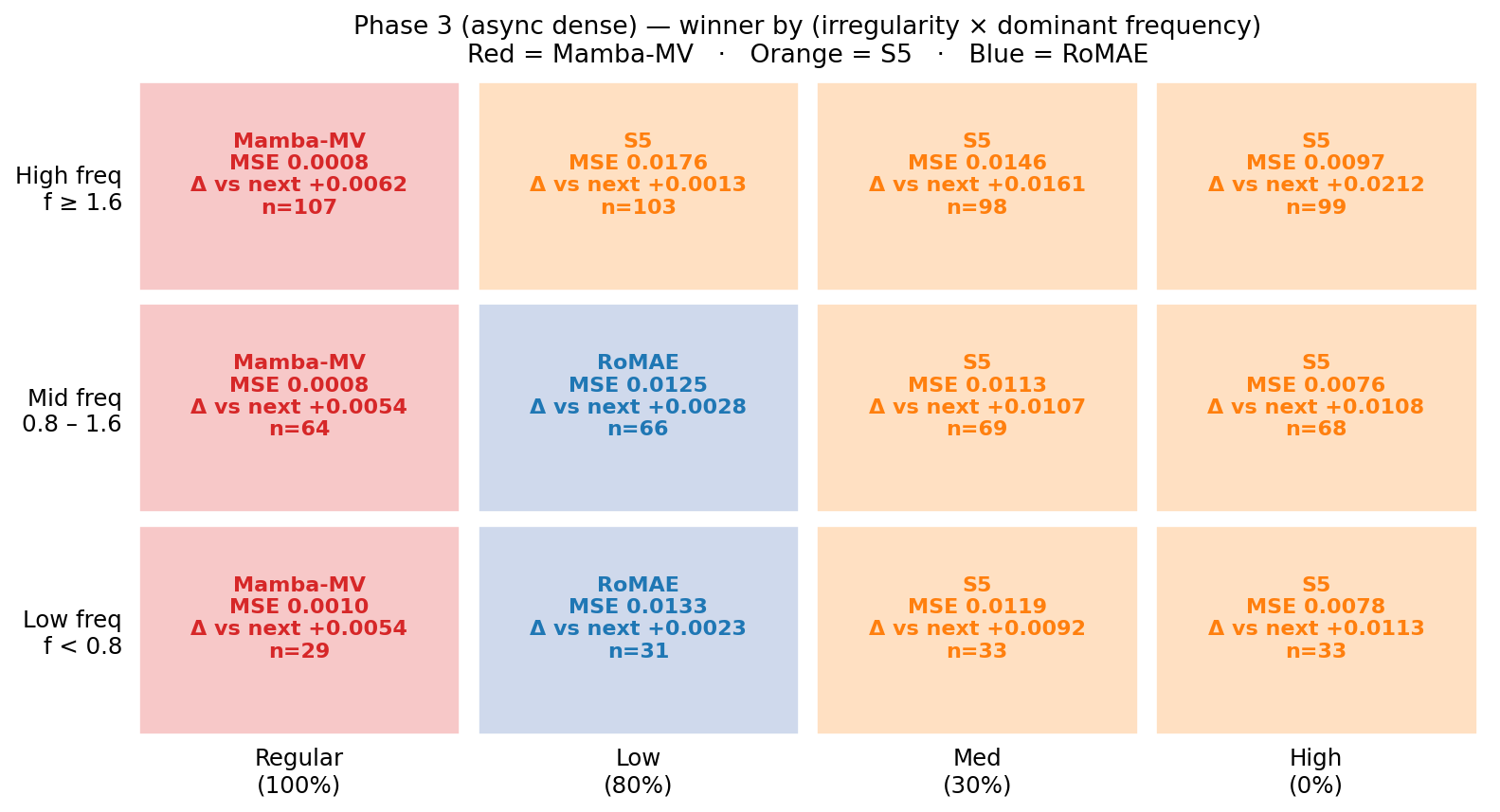
Phase 3 — async dense (per-variate timestamps)
• S5 wins 7/12 cells (all Med/High irreg × all freqs) — HPO gate triggered (Mamba replace loses 3/3 on irregular regimes)
• Mamba-MV wins only the sync-like Regular column (all 3 freqs) and loses under async irregularity
• Training time — Mamba ~3.5 min · RoMAE ~3.6 min · S5 ~11 min (Mamba cheapest by ~3×)

Slide 5
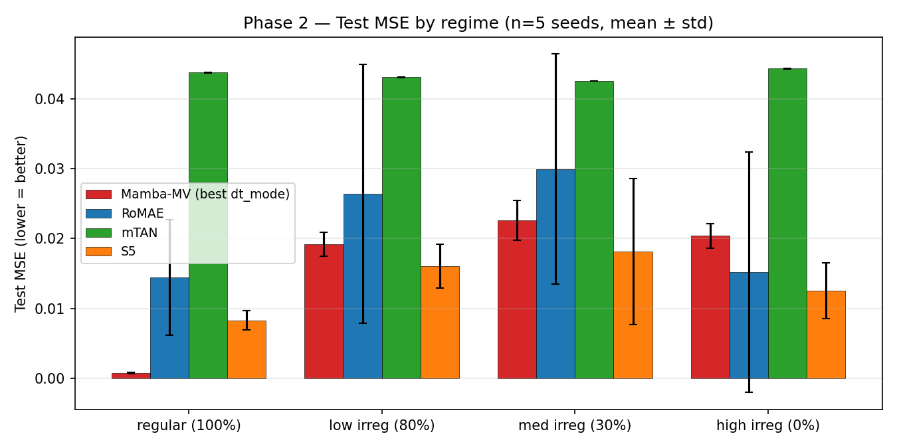
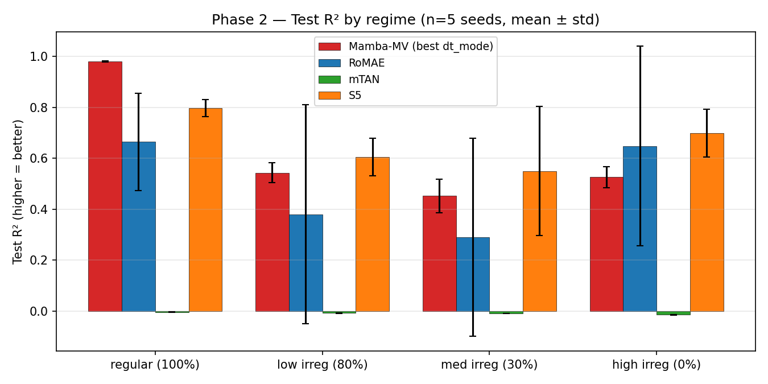
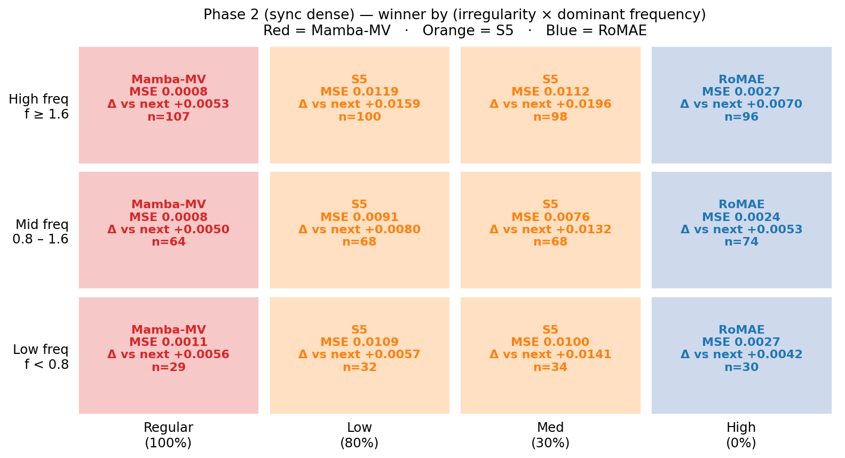
Phase 2 — sync dense (baseline check)
• Mamba-MV wins the Regular column (all freqs); S5 wins Low+Med; RoMAE wins High
• Fair-comparison baseline — paper-native S5 + paper-native RoMAE at matched recipe

Slide 6
Summary — who wins where
• Mamba-MV wins Regular (all phases) AND almost everywhere under gaps (Phase 4-2)
• → multivariate-SSM + cross-variate fusion pays off when variates must be combined
• S5 wins async-no-gap irregularity (Phase 3 Med/High columns, any freq)
• → single-variate SSM with paper-native state=256 is a strong forecasting baseline
• RoMAE wins narrow niches (Phase 2 High, Phase 3 Low irreg at low/mid freq)
• Next question: can HPO close the gap on Phase 3 Med/High (where Mamba replace loses 3/3)?

Slide 7
Next steps
• Mamba-MV HPO — sweep d_model, d_state, depth, LR (per HPO_PLAN.md, gated on Phase 3 result)
• Re-evaluate post-HPO on Phase 2 / 3 / 4-2
• Apply winning config to real IMTS data (astronomy / clinical)

